Slide 1


Feedback-Aware Social Event-Participant Arrangement
Jieying She¹, Yongxin Tong ², Lei Chen ¹, Tianshu Song ² ¹ The Hong Kong University of Science and Technology ² Beihang University

Slide 2
Outline
Background and Motivation
Problem Definition
Our Solutions
Experiments
Conclusion
Notes:
This is the outline

Slide 3

Event-Based Social Networks
A platform for users to organize and attend events
A Snapshot of Meetup
Notes:
Event-based social network is a platform for online users to organize and attend offline events. Here is a snapshot of Meetup, one of the most famous EBSNs. On meetup, some users can organize social groups with different interests, and other users can join the social groups and attend the events organized by the groups. Here, we can see 9 social groups. Let’s take the first basketball group as an example.

Slide 4

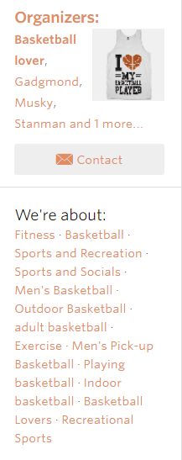
Event-Based Social Networks
Notes:
We can see much information about the basketball group. On the left, we can see the interests or major topics of this group. On the right, we can see two events organized by the group. And each event contains information of date and time and location. We can also see that the events have limited quota, or capacity. For example, the first event can only have 20 attendees.

Slide 5

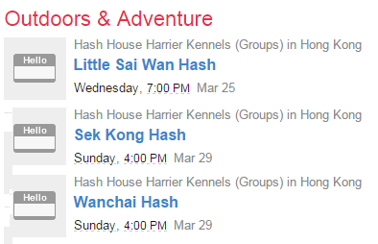


Event-Based Social Networks
Event-participant arrangement is an important problem!
Notes:
EBSNs often recommend events to users based on their interests. Here is a snapshot of the recommendation email. Among the many recommended events, some may be conflicting with each other. For example, these three events are conflicting in time, and thus users often have to make a choice.

Slide 6

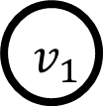



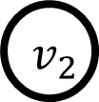


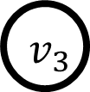

Existing Research
Arrange one event to some users
Find a global arrangement strategy among the events and users to satisfy most parties’ interests
Users
7
Events
5
3
11
9
7
1
Satisfaction score of an arrangement such as α₁×distance+α₂×price+…
6
2
On Social Event Organization, KDD’14
Real-Time Multi-Criteria Social Graph Partitioning: A Game Theoretic Approach, SIGMOD’15
Conflict-Aware Event-Participant Arrangement, ICDE’15
Notes:
Existing research on Event-participant arrangement focus on the arrangement of one event to some users or a global assignment among the events and users
Bipartite graph is a model to describe the arrangement. In this bipartite graph, the nodes on the left represent the events and the nodes on the right represent the users. The weight of the edge is the satisfaction score and can be calculated like this formula, which is a linear combination of a few factors such as distance or price, whose weights (namely α₁ and α₂) are predefined and fixed.

Slide 7
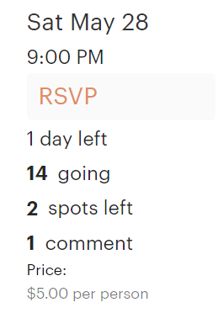
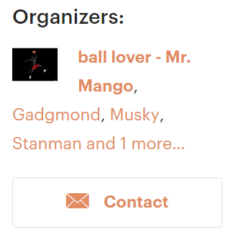
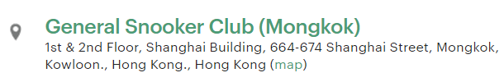
Motivation
Existing works assume
The satisfaction score is a linear combination of few factors
The weights of factors are predefined and fixed
?
Challenge 1: The weights of factors may not be observed easily!
Notes:
As mentioned above, the existing works all assume that the satisfaction score of an arrangement, whether maxsum, total utility or other terms, is a linear combination of a few factors. And the weights of the factors are predefined and fixed
However, in the real world, the satisfaction score can be affected by many factors. For example, interests of users, locations, time and prices of events, or even the reputation of the event organizers. And it is often hard to determine how much each factor contribute to the satisfaction score. In other words, the weights of different factors are hard to know. This is the first challenge.

Slide 8


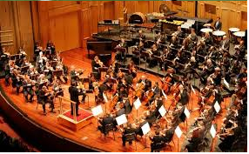

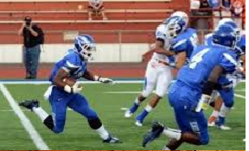
Motivation
Current research assumes that users always accept the arrangement
In reality users may reject the assigned event
Challenge 2: Feedbacks should be considered to provide better services!
Notes:
Besides, current research assumes that users always accept the arrangement. But in fact users may reject the assigned event. In this example, Alex is assigned to an event of a classical concert. He does not like it. Next time, an event of American football is arranged and he is satisfied with it.
Thus, Feedbacks should be considered to provide better services.

Slide 9
Motivation
For each new-coming user (online scenario)
Values of factors are observed (interests, locations, etc.)
Arrange a set of events
User chooses to accept the arranged events or not
Learn users’ satisfaction based on the feedbacks
Notes:
This motivates us to study a new problem, which is an online scenario. Specifically, when a new-coming user arrives, we observe the values of certain factors, such as interests, home locations, travel budgets, etc. We then arrange a set of events to the user and the users chooses to accept the arranged events or not.

Slide 10
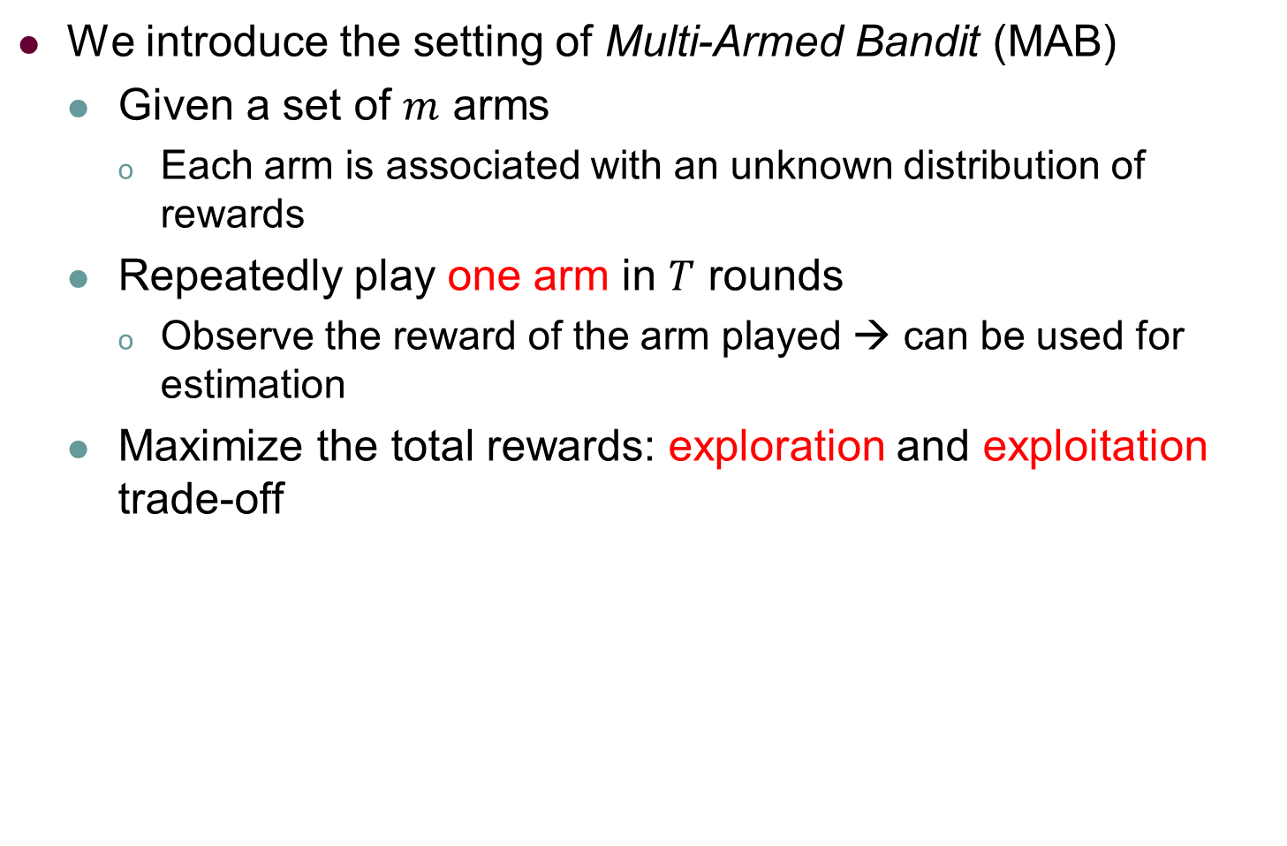
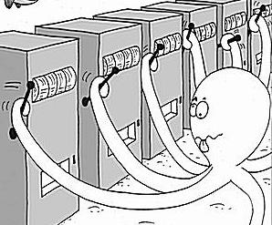
Background of MAB
Notes:
Such requirements fit well with a problem called multi-armed bandit, which has been studied long.
Specifically, in the mab problem, we are given a set of arms. Each arm has an unknown distribution of rewards. And we repeatedly play one arm in multiple rounds. After playing an arm, we can observe the reward only for the arm that is played. This observation can be used to estimate the reward distribution of the arm. The goal of the mab problem is to maximize the total rewards gained in multiple rounds.

Slide 11
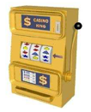

MAB
The unknown expectation of
each machine
0.40
0.45
0.50
0.55
0.60
Round 1
0.35
Round 2
0.56
Round 3
0.58
Round 4
0.44
Round 5
0.52
MAB Problem: What strategy should we take to maximize the total reward？
Notes:
This is an example. There are five machines/arms. In each round, we play an arm and observe the reward. In this example, we play all the arms sequentially in the first five rounds. The expected value of the reward of each arm is shown by the red number, which is unknown by the player. The goal is to maximize the total reward

Slide 12
MAB
The unknown expectation of
each machine
0.40
0.45
0.50
0.55
0.60
Round 1
0.35
Round 2
0.56
Round 3
0.58
Round 4
0.44
Round 5
0.52
Many classical solutions for this problem using exploration and exploitation trade-off!
Notes:
Actually there are Many classical solutions for this problem using exploration and exploitation trade-off

Slide 13
Background of MAB
We introduce the setting of Multi-Armed Bandit (MAB)
A variant of MAB: contextual combinatorial bandit
Combinatorial: play a subset of arms in each round
Notes:
One related variant of Mab is called the contextual combinatorial bandit problem. Combinatorial means that a subset of arms can be played in each round instead of one single arm.

Slide 14
Combinatorial MAB
The unknown expectation of
each machine
0.40
0.45
0.50
0.55
0.60
Round 1
0.52
0.43
Round 2
0.23
0.43
play a subset of arms in each round
Round 3
0.32
0.35
Round 4
0.36
0.43
Round 5
0.40
0.45
The reward of each round could be a function of all the feedbacks such as sum, max or other more sophisticated nonlinear functions
Notes:
This this example, in each round ,two arms are played and each arm gives a reward. The reward of each round could be a function of all the feedbacks such as sum, max or other more sophisticated nonlinear functions

Slide 15
Background of MAB
We introduce the setting of Multi-Armed Bandit (MAB)
A variant of MAB: contextual combinatorial bandit
Combinatorial: play a subset of arms in each round
Contextual: before playing, a context (feature vector) of each arm is observed in each round
The reward of an arm depends on the context
Linear payoff: mean of reward is a linear combination of the features with unknown weights
Notes:
Contextual means that before playing arms in each round, a context, which can be a feature vector, of each arm is observed. The reward of an arm depends on the context. One particular reward function that captures the relation between the reward and the context of an arm is the linear payoff. It means that the mean of the reward is a linear combination of the features, but the weights are unknown.

Slide 16
Contextual MAB
The unknown weights
(0.42,0.78)
Round 1
See
(0.33,0.48)
(0.51,0.40)
(0.58,0.32)
(0.54,0.36)
(0.53,0.41)
Feature vectors
0.51
≈0.42×0.33+0.78×0.48
Notes:
This is an example, different from MAB and combinatorial MAB, in the contextual setting, we first observe an feature vector for each arm, and when we play an arm, the reward is observed. Besides, there is a unknown vector of the weights, and the reward is calculated by the weights and the feature vector.

Slide 17
Background
Contextual combinatorial bandit → event-participant arrangement
Each round (for each new-coming user)
Values of factors are observed → contexts are observed
Arrange a set of events → play a subset of arms
User chooses to accept the arranged events or not → observe rewards
Notes:
In particular, corresponding to our event-participant problem, making an arrangement for a new-coming user corresponds to play a subset of arms in a round. The related factors of the user correspond to the contexts. And the acceptance of an arranged event by the user denotes the reward observed.

Slide 18
Outline
Background and Motivation
Problem Definition
Our Solutions
Experiments
Conclusion
Notes:
We next formally formulate our problem.

Slide 19
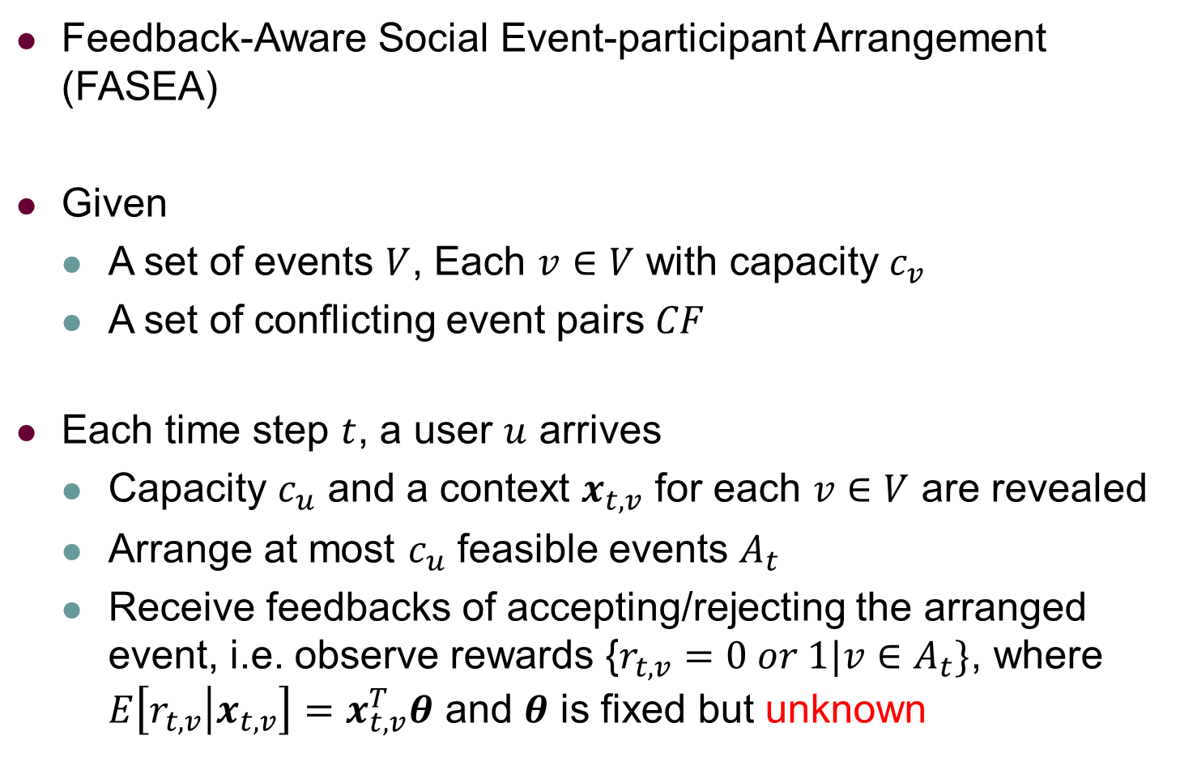
Problem Definition
Notes:
Our problem is called the feedback-aware social event-participant arrangement problem.
We are given a set of events and a set of conflicting event pairs.
Then at each time step, when a user arrives, its capacity and a context for each event are revealed. Some events are then arranged to the user and we receive the user’s feedbacks on whether accepting each of the arranged event or not. Particularly, following contextual bandit with linear payoff, the expected reward, i.e. the feedback, of an arranged event is a linear combination of its context, where the weight vector is theta, which is fixed but unknown.

Slide 20
Problem Definition
Feedback-Aware Social Event-participant Arrangement (FASEA)
Maximize the total number of accepted events in multiple rounds
Capacities and conflict constraints
Online constraint: decision is immediate and cannot be revoked
Making arrangement each time step: NP-hard
Notes:
Then our goal is to maximize the total number of accepted events in multiple rounds such that the capacities, conflict and online constraints are satisfied. Note that making an arrangement at each time step is NP-hard.

Slide 21
Outline
Background and Motivation
Problem Definition
Our Solutions
Experiments
Conclusion
Notes:
We next introduce two multi-arm bandit based solutions.

Slide 22
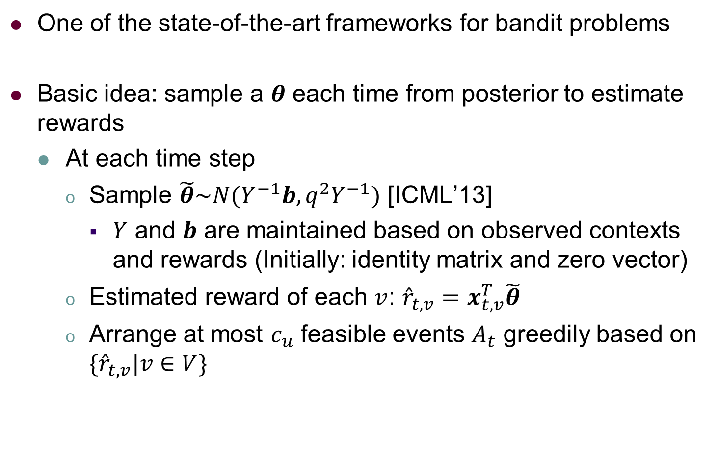
Thompson Sampling (TS)
Thompson Sampling for Contextual Bandits with Linear Payoffs, ICML’13
Notes:
The first algorithm we introduce is based on Thompson Sampling, one of the state-of-the-art frameworks for bandit problems.
The basic idea is that a theta (𝜽 ̃) is sampled at each time step from its posterior distribution, which is updated through observations of contexts and feedbacks
Then contexts of different events are observed, and the sampled theta is used to estimate the expected rewards of events by the dot product with the observed contexts.
Based on the estimated expected rewards, we arrange events greedily to the user.

Slide 23
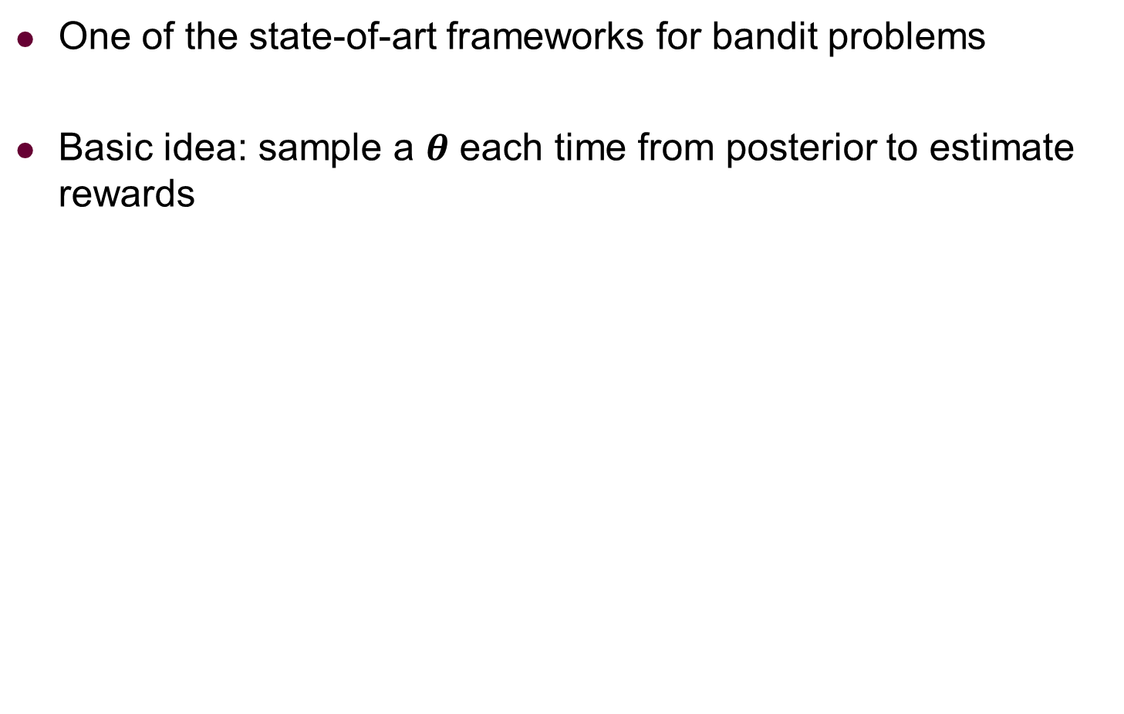

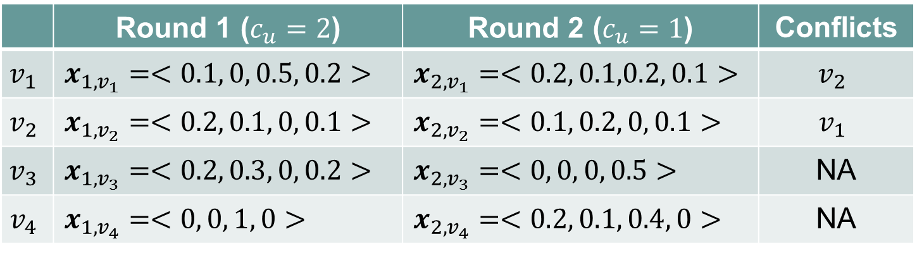
Thompson Sampling (TS)
 |  |  | Conflicts
 |  |  | NA
 |  |  | NA
Notes:
Here is our running example. Suppose there are four events (v_1 to v_4) and v_1 is conflicting with v_2. Then in the first round, a user arrives.

Slide 24





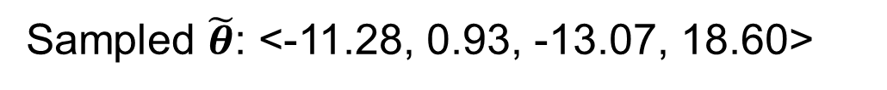


Thompson Sampling (TS)
 |  |  | Conflicts
 |  |  | NA
 |  |  | NA
✗
✗
…
Notes:
And c_u, which means the capacity of the user and a context for each of the four events are revealed. For example, the context for the event v_1 at this round (namely Round 1) is 𝒙_(1, 𝑣_1 )=<0.1, 0, 0.5, 0.2>.
We then sample a theta as follows (namely Sampled 𝜽 ̃: <-11.28, 0.93, -13.07, 18.60>), and use the sampled theta to calculate its dot product with each context x(namely, 𝑟 ̂_(𝑡,𝑣)=𝒙_(𝑡,𝑣)^𝑇 𝜽 ̃, where 𝑟 ̂_(𝑡,𝑣) is the estimated expected reward, 𝒙_(𝑡,𝑣)^𝑇 is the content of an event and 𝜽 ̃ is the sampled theta), which results in the estimated expected reward of each event. As c_u is 2, we arrange two non-conflicting events v_2 and v_3, but they are both rejected by the user. Then when the next user arrives, we process in a similar way.

Slide 25
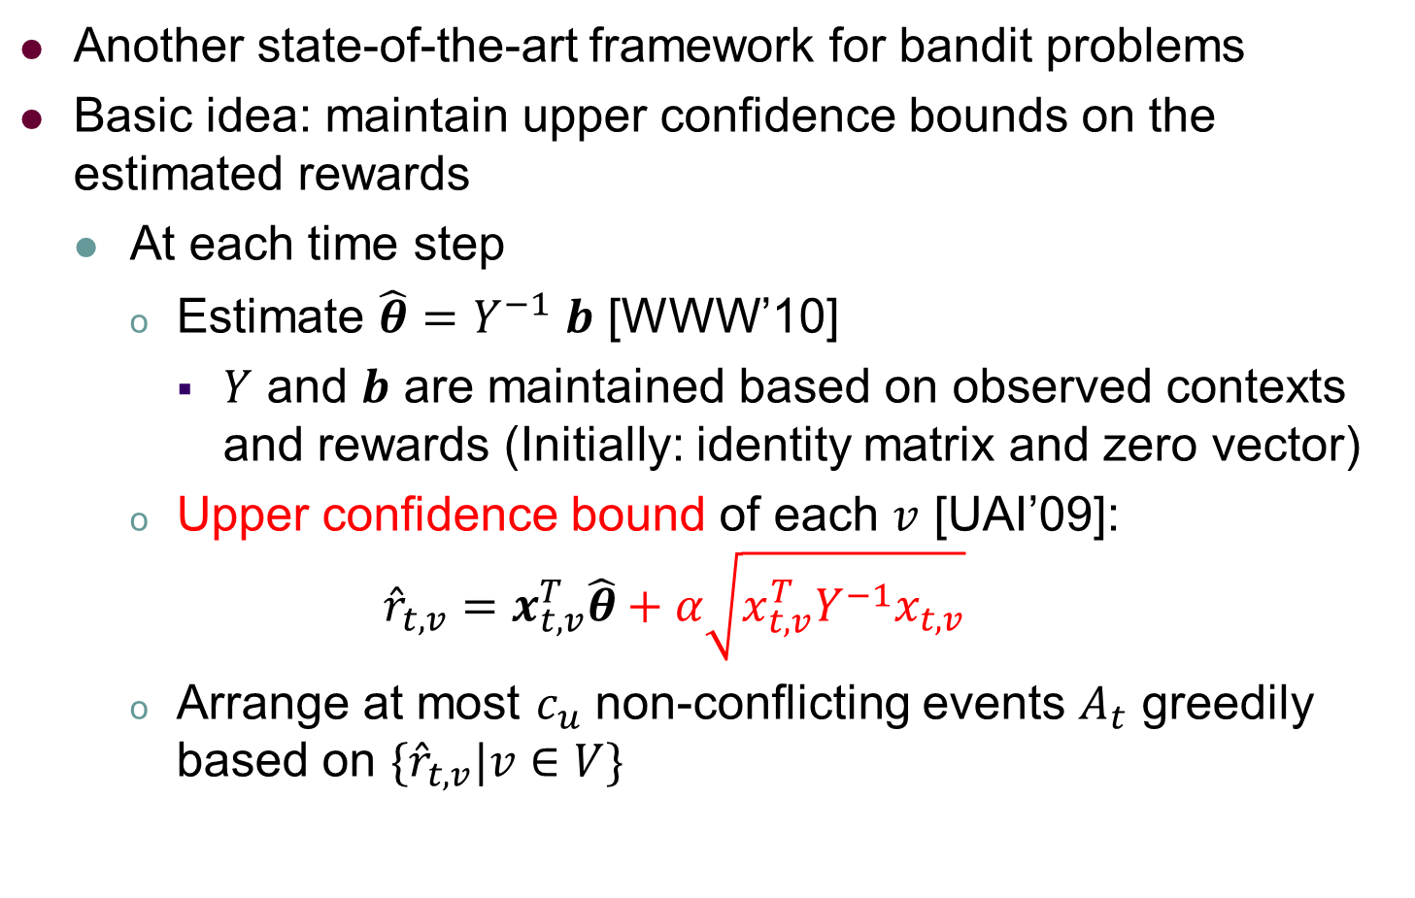
Upper Confidence Bound (UCB)
A Contextual-Bandit Approach to Personalized News Article Recommendation, WWW’10
Exploring Compact Reinforcement-Learning Representations with Linear Regression, UAI’09
Notes:
The second algorithm we introduce is based on another state-of-the-art framework, Upper Confidence Bound.
The basic idea of UCB is to maintain upper confidence bounds on the estimated reward of each event based on some concentration inequalities.
Unlike TS that incorporates uncertainty into the sampling process, UCB considers uncertainty by the upper confidence bounds. The under-explored (指未经充分探索的，或者说尝试次数少的)arms or the arms that actually have large expected rewards will have larger upper confidence bounds. Thus, by selecting the arms with the largest upper confidence bounds each time, we trade-off between exploitation and exploration.

Slide 26




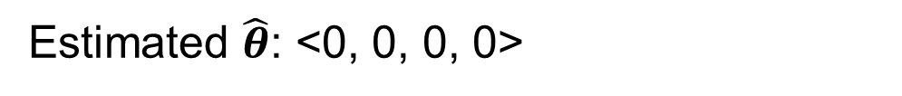
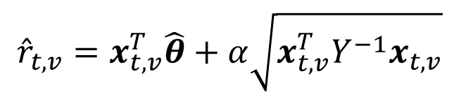
Upper Confidence Bound (UCB)
Another state-of-art frameworks for bandit problems
Basic idea: maintain upper confidence bounds on the estimated rewards
 |  |  | Conflicts
 |  |  | NA
 |  |  | NA
✓
✓
Notes:
Here is our running example.
Similarly, when the first user arrives at Round 1, the contexts and c_u are revealed.
As initially, the estimated theta is a zero vector (namely <0, 0, 0, 0>), the estimated rewards of the events are simply their upper confidence bounds. For example, the estimated rewards of the event v_1 is 𝒓 ̂_(𝟏, 𝐯_𝟏 )=𝟏.𝟏𝟎.
Then we select v_1 and v_4 that have larger estimated rewards, which are both accepted.

Slide 27




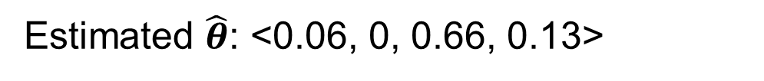
Upper Confidence Bound (UCB)
Another state-of-art frameworks for bandit problems
Basic idea: maintain upper confidence bounds on the estimated rewards
 |  |  | Conflicts
 |  |  | NA
 |  |  | NA
✓
…
Notes:
Then when the next user whose capacity is 1 arrives at Round 2, we adjust the estimated theta based on our observations of contexts and feedbacks received in Round 1, and the estimated theta is adjusted to <0.06, 0, 0.66, 0.13>.
Then based on the estimated theta, the upper confidence bounds of the events are calculated, and v_3 is arranged and accepted.

Slide 28
Outline
Background and Motivation
Problem Definition
Our Solutions
Experiments
Conclusion
Notes:
This is the outline

Slide 29
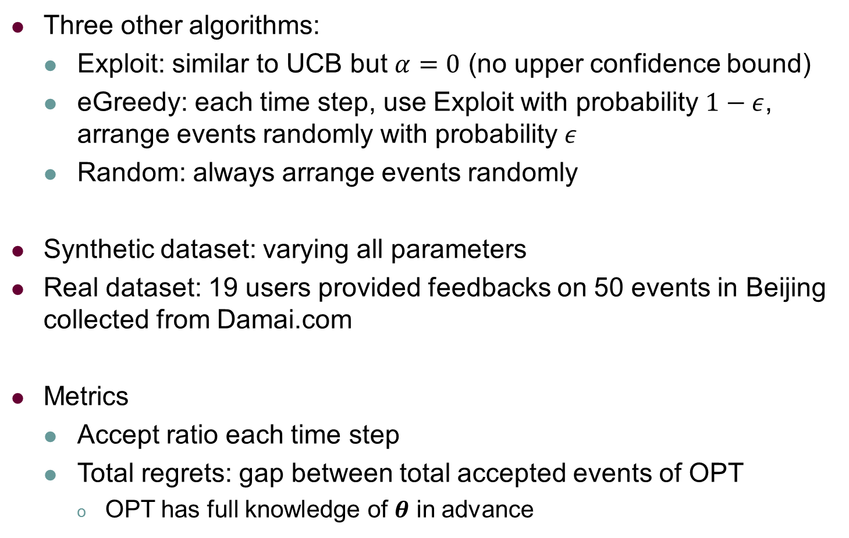
Experiments
Notes:
In the experiments, we compare with three other algorithms. Exploit is similar to UCB but we let alpha to be 0, that is we do not calculate the upper confidence bounds of events but only arrange events based on their simple estimated expected rewards based on the estimated theta. eGreedy introduces randomness to Exploit by arranging events randomly with probability \epsilon. Random is a pure random strategy.
We test on both synthetic and real datasets. For real datasets, we ask 19 users to provide feedbacks on 50 events in Beijing collected from Damai.com
We next present the results of accept ratio in each round and the total regrets of the algorithms, which is the gap between the total accepted events of OPT and that of an algorithm. OPT is the algorithm that knows theta in advance and thus it always knows the accurate expected rewards of the events.

Slide 30
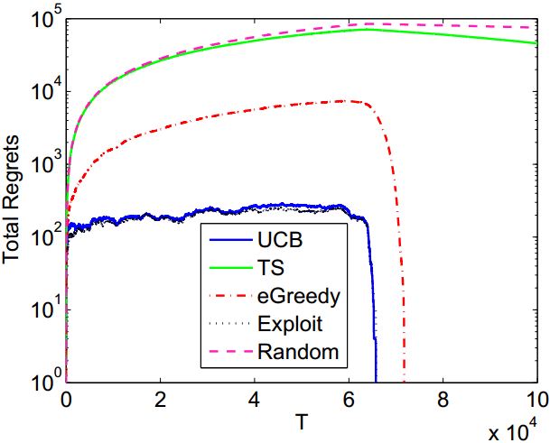
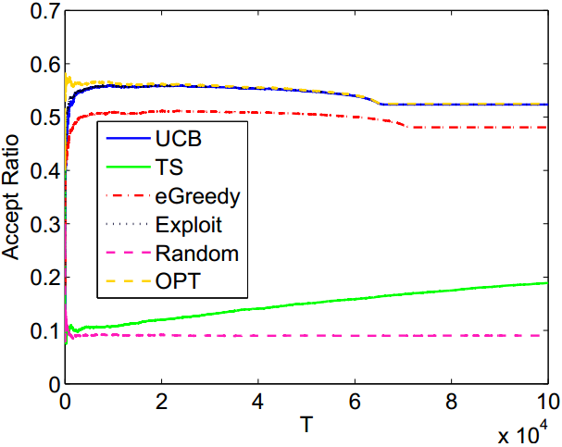
Default Setting: |V|=500, T=100000
Synthetic Dataset
Total Regrets
Accept Ratio
Notes:
Here are the results under the default setting on synthetic dataset. We can observe that TS, the green line is only better than Random. And UCB and Exploit, the blue and the black lines, perform the best.

Slide 31
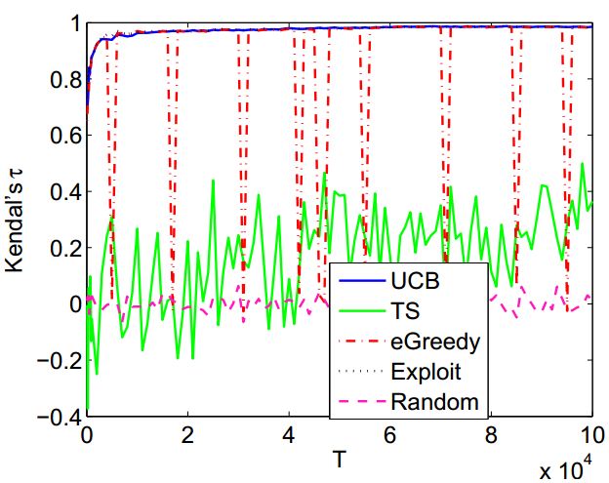
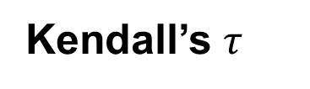
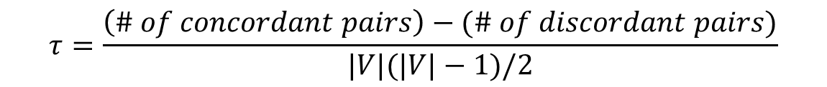
Rank Correlation with OPT
Synthetic Dataset
Notes:
We further investigate whether the algorithms can estimate the expected rewards of the events accurately. Specifically, we rank the events based on their estimated expected rewards, and investigate their rank correlation with OPT, which can rank the events accurately. Here is the result of the Kendall’s tau. We can observe that UCB and Exploit is highly correlated with OPT, while TS is quite noisy.

Slide 32
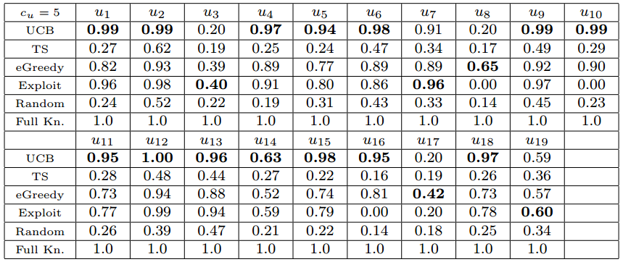
Real Dataset
Accept ratio after 1000 rounds
UCB generally performs the best
Notes:
Here are the results on real datasets. We can see that UCB is generally the best. Note that Exploit has accept ratio of 0 for u_8, u_19 and u_16. The reason is that the events arranged by Exploit are all rejected by the user in the first round, and thus Exploit cannot use the feedbacks to update its estimation on theta. As the same set of events are revealed to the user in each round in the real dataset, Exploit will always arrange those events that the user will reject.

Slide 33
Experiments
Existing studies: TS is better than UCB under basic bandit
Our new finding: UCB is better under contextual bandit
Our analysis of better performance of UCB than TS:
Arms are independent under basic bandit but correlated under contextual bandit
Playing one arm may help estimate all the other arms
Intuitive idea then: always greedily playing the best arm is enough
Sampling a 𝑑-dimensional 𝜽 enlarges noise/variance
Notes:
Note that according to our results, TS is worse than UCB, but existing studies claim that TS is better than UCB under basic bandit setting. Our analysis of the worse performance of TS is as follows.
First, the arms are independent under basic bandit but they are correlated under contextual bandit. Therefore, under contextual bandit, playing one arm may help estimate all the others. Therefore, the greedy strategy of UCB and Exploit based on the estimated rewards is good enough for contextual bandit.
Second, the sampling process of TS under contextual bandit may introduce much more noise as a d-dimensional theta is sampled each time, as our results also indicate.
Then, it indicates that the sampling strategy of TS may not work for contextual bandit, at least for contextual bandit with linear payoff.

Slide 34
Outline
Background and Motivation
Problem Definition
Our Solutions
Experiments
Conclusion
Notes:
This is the outline

Slide 35
Conclusion
Study a new event-participant arrangement strategy called FASEA problem
Model the problem as a contextual combinatorial bandit setting
Use a Thompson Sampling-based solution and a UCB-based solution to solve the problem. Further present two heuristics based on UCB
Find that TS does not perform well under FASEA while UCB is the best in overall by extensive experiments on both real and synthetic datasets
Notes:
We formally define novel dynamic task assignment problem for crowdsourcing.
We design two threshold-based algorithms with theoretical guarantees.
And we run extensive experiments on both real and synthetic datasets to verify our proposed solutions.

Slide 36

Thank You
Q & A

