Slide 1




Dynamic Pricing in Spatial Crowdsourcing: A Matching-Based Approach
Yongxin Tong¹, Libin Wang¹, Zimu Zhou², Lei Chen³, Bowen Du¹, Jieping Ye⁴ ¹ Beihang University ² ETH Zurich ³ The Hong Kong University of Science and Technology ⁴ DiDi Chuxing Inc.

Slide 2
Outline
Background and Motivation
Problem Statement
Our Solutions
Experiments
Conclusion
Notes:
Here is the outline

Slide 3
Outline
Background and Motivation
Problem Statement
Our Solutions
Experiments
Conclusion
Notes:
Let’s start with the background and motivation.

Slide 4





Spatial Crowdsourcing
A new way of organizing the crowd (mobile Internet workers) to do spatial tasks
Representatives
Y. Tong, L. Chen, and C. Shahabi. Spatial Crowdsourcing: Challenges, Techniques, and Applications. (tutorial) VLDB 2017.
Notes:
With the development of Mobile Internet, spatial crowdsourcing becomes ubiquitous.
It can be seen as a new way of organizing the crowd to do spatial tasks
Representatives include Didi, Uber and gigwalk

Slide 5

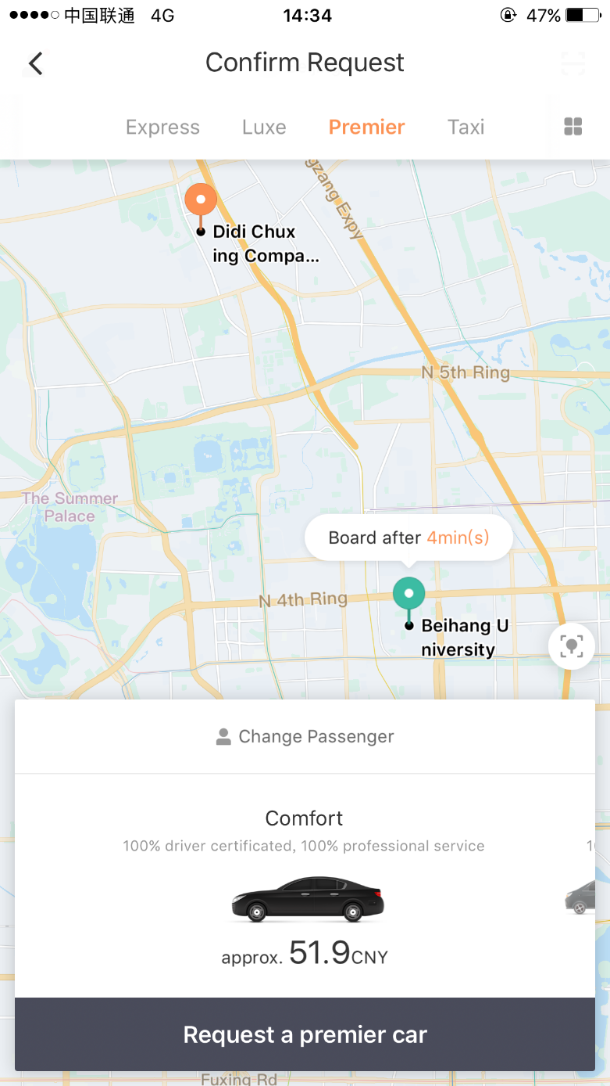


Spatial Crowdsourcing: Workflow
Requester
(1) Request
(3) Decision
It serves as an important step
Platform
(2) Pricing
(4) Assignment
Worker
Notes:
There are mainly four steps in the workflow.
First, some requester submits the request. He chooses the origin and the destination of his trip.
And then the platform offers him a price.
When the requester sees the price, he will decide if it exceeds his valuation for the trip. If it doesn’t, he will accept it and the platform will assign an available worker to him and gain a revenue.
Among the steps, pricing serves as an important step, because it directly affects the users’ experience and the platform’s revenue.

Slide 6
Outline
Background and Motivation
Problem Statement
Our Solutions
Experiments
Conclusion
Notes:
Next we show some basic concepts and then formally define the problem.

Slide 7





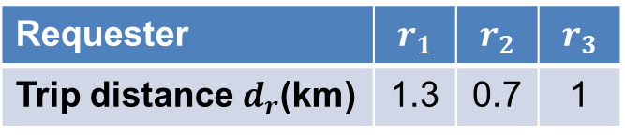
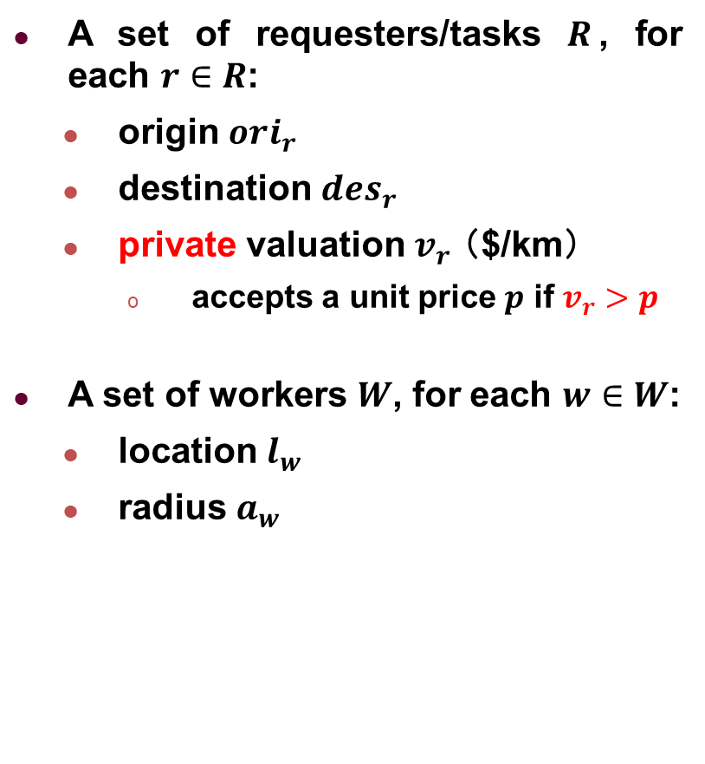

Basic Concepts
Requester | $$r_{1}$$ | $$r_{2}$$ | $$r_{3}$$
Trip distance $d_{r}$(km) | 1.3 | 0.7 | 1
A set of requesters/tasks $R$, for each $r∈R$:
origin ${ori}_{r}$
destination ${des}_{r}$
private valuation $v_{r}$ （$/km）
accepts a unit price $p$ if $v_{r}>p$
A set of workers $W$, for each $w∈W$:
location $l_{w}$
radius $a_{w}$
$$r_{2}(2,6)$$
$$r_{3}(5,5)$$
$$r_{1}(1,5)$$
$$w_{1}(3,5)$$
$$w_{2}(7,5)$$
$$w_{3}(5,3)$$
Notes:
In each time period, we are given as input a set of requesters or tasks.
For each r in R, it specifies its origin and destination.
Its trip distance dr can be easily calculated. We directly show them in the table.
In addition, we assume it also has a private valuation about the price per unit distance vr. The word private means we do not know its value but it exists.
For each worker w, it has a location and a radius.
The radius determines the range of worker.

Slide 8
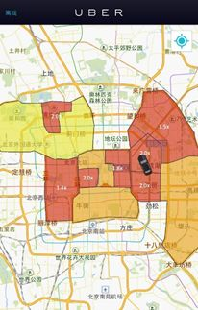















Basic Concepts
Requester | $$r_{1}$$ | $$r_{2}$$ | $$r_{3}$$
Trip distance $d_{r}$(km) | 1.3 | 0.7 | 1
Goal: platforms set prices to maximize the total revenue!
The revenue of request $r$ is $d_{r}p$
Platform sets the same (unit) price $p$ for requesters in the same grid $g$
$$13$$
14
$1$5
$1$6
$$r_{2}(2,6)$$
$$r_{3}(5,5)$$
$$r_{1}(1,5)$$
$$w_{1}(3,5)$$
$$w_{2}(7,5)$$
$$9$$
10
$$11$$
$$12$$
$$w_{3}(5,3)$$
$$5$$
$$6$$
$$7$$
$$8$$
$$1$$
$$2$$
$$3$$
$$4$$
Notes:
As for the platforms, they set prices to maximize the total revenue. If we offer some requester a unit price p, the revenue is dr times p.
And the platform will set the same price for requesters in the same grid.

Slide 9








Basic Concepts
Requester | $$r_{1}$$ | $$r_{2}$$ | $$r_{3}$$
Trip distance $d_{r}$(km) | 1.3 | 0.7 | 1
Goal: platforms set prices to maximize the total revenue!
Platform
$$r_{1}$$
$$w_{1}$$
$3/km
$$r_{2}$$
$$w_{2}$$
$$r_{2}(2,6)$$
$$r_{3}(5,5)$$
$$r_{1}(1,5)$$
$$w_{1}(3,5)$$
$$w_{2}(7,5)$$
$$r_{3}$$
$$w_{3}$$
$$w_{3}(5,3)$$
Notes:
The bipartite graph is used to represent the relationship between requests and workers.
Here we set a price of 3 dollars for grid 9. It is then offered to r1 and r2,

Slide 10
Basic Concepts
Requester | $$r_{1}$$ | $$r_{2}$$ | $$r_{3}$$
Trip distance $d_{r}$(km) | 1.3 | 0.7 | 1
Goal: platforms set prices to maximize the total revenue!
Platform
$$r_{1}$$
$$w_{1}$$
$3/km
$$r_{2}$$
$$w_{2}$$
$$r_{2}(2,6)$$
$$r_{3}(5,5)$$
$$r_{1}(1,5)$$
$$w_{1}(3,5)$$
$$w_{2}(7,5)$$
$2/km
$$r_{3}$$
$$w_{3}$$
$$w_{3}(5,3)$$
Notes:
and 2 dollars to r3.

Slide 11





Basic Concepts
Requester | $$r_{1}$$ | $$r_{2}$$ | $$r_{3}$$
Trip distance $d_{r}$(km) | 1.3 | 0.7 | 1
Goal: platforms set prices to maximize the total revenue!
$$v_{r_{1}}>3$$
$$r_{1}$$
$$w_{1}$$
$3/km
$$v_{r_{2}}<3$$
$$r_{2}$$
$$w_{2}$$
$$r_{2}(2,6)$$
$$r_{3}(5,5)$$
$$v_{r_{3}}>2$$
$$r_{1}(1,5)$$
$$w_{1}(3,5)$$
$$w_{2}(7,5)$$
$2/km
$$r_{3}$$
$$w_{3}$$
$$w_{3}(5,3)$$
Decision
Notes:
After the decision, R2 refuses the price, since its valuation is lower than 3.

Slide 12






Basic Concepts
Requester | $$r_{1}$$ | $$r_{2}$$ | $$r_{3}$$
Trip distance $d_{r}$(km) | 1.3 | 0.7 | 1
Goal: platforms set prices to maximize the total revenue!
$$v_{r_{1}}>3$$
$$r_{1}$$
$$w_{1}$$
$3/km
$$v_{r_{2}}<3$$
$$r_{2}$$
$$w_{2}$$
$$r_{2}(2,6)$$
$$r_{3}(5,5)$$
$$v_{r_{3}}>2$$
$$r_{1}(1,5)$$
$$w_{1}(3,5)$$
$$w_{2}(7,5)$$
$2/km
$$r_{3}$$
$$w_{3}$$
$$w_{3}(5,3)$$
Decision
$3/km*1.3km= $3.9
$$r_{1}$$
$$w_{1}$$
$$w_{2}$$
$$r_{3}$$
$$w_{3}$$
$2/km*1km= $2
Notes:
And finally we do the assignment, which by default finds the matching with the maximum total revenue.

Slide 13
Basic Concepts
Requester | $$r_{1}$$ | $$r_{2}$$ | $$r_{3}$$
Trip distance $d_{r}$(km) | 1.3 | 0.7 | 1
Goal: platforms set prices to maximize the total revenue!
$$v_{r_{1}}>3$$
$$r_{1}$$
$$w_{1}$$
$3/km
$$v_{r_{2}}<3$$
$$r_{2}$$
$$w_{2}$$
$$r_{2}(2,6)$$
$$r_{3}(5,5)$$
$$v_{r_{3}}>2$$
$$r_{1}(1,5)$$
$$w_{1}(3,5)$$
$$w_{2}(7,5)$$
$2/km
$$r_{3}$$
$$w_{3}$$
$$w_{3}(5,3)$$
Decision
$3/km*1.3km= $3.9
$$r_{1}$$
$$w_{1}$$
Total Revenue is 5.9
$$w_{2}$$
$$r_{3}$$
$$w_{3}$$
$2/km*1km= $2
Notes:
Here it is 5.9.

Slide 14










Basic Concepts
Requester | $$r_{1}$$ | $$r_{2}$$ | $$r_{3}$$
Trip distance $d_{r}$(km) | 1.3 | 0.7 | 1
Goal: platforms set prices to maximize the total revenue!
$$v_{r_{1}}$$
$$r_{1}$$
$$w_{1}$$
$$v_{r_{2}}$$
$$r_{2}$$
$$w_{2}$$
$$v_{r_{3}}$$
$$r_{3}$$
$$w_{3}$$
Notes:
However if the valuations are arbitrary, the problem is hard.

Slide 15
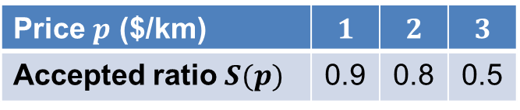

Basic Concepts
Requester | $$r_{1}$$ | $$r_{2}$$ | $$r_{3}$$
Trip distance $d_{r}$(km) | 1.3 | 0.7 | 1
Goal: platforms set prices to maximize the total revenue!
Price $p$ ($/km) | $$1$$ | $$2$$ | $$3$$
Accepted ratio $S(p)$ | 0.9 | 0.8 | 0.5
$v_{r}$ w.r.t. grid $g$ are i.i.d. samples from an unknown distribution
$F^{g}\left(p\right)=Pr[v_{r}≤p]$
Accepted ratio/probability:
$S^{g}\left(p\right)=Pr\left[v_{r}>p\right]=1−F^{g}\left(p\right)$
$$v_{r_{1}}$$
$$r_{1}$$
$$w_{1}$$
$$v_{r_{2}}$$
$$r_{2}$$
$$w_{2}$$
$$v_{r_{3}}$$
$$r_{3}$$
$$w_{3}$$
Y. Singer, M. Mittal. Pricing Mechanisms for Crowdsourcing Markets. WWW 2013.
M. Babaioff, S. Dughmi, R. D. Kleinberg, and A. Slivkins. Dynamic Pricing with Limited Supply. In ACM TEAC 2011.
Notes:
Learning previous works, we assume vr in grid g are iid samples from an unknown distribution.
If the CDF is denoted by Fgp, the accepted ratios are defined as sgp.
An example is shown in the table

Slide 16
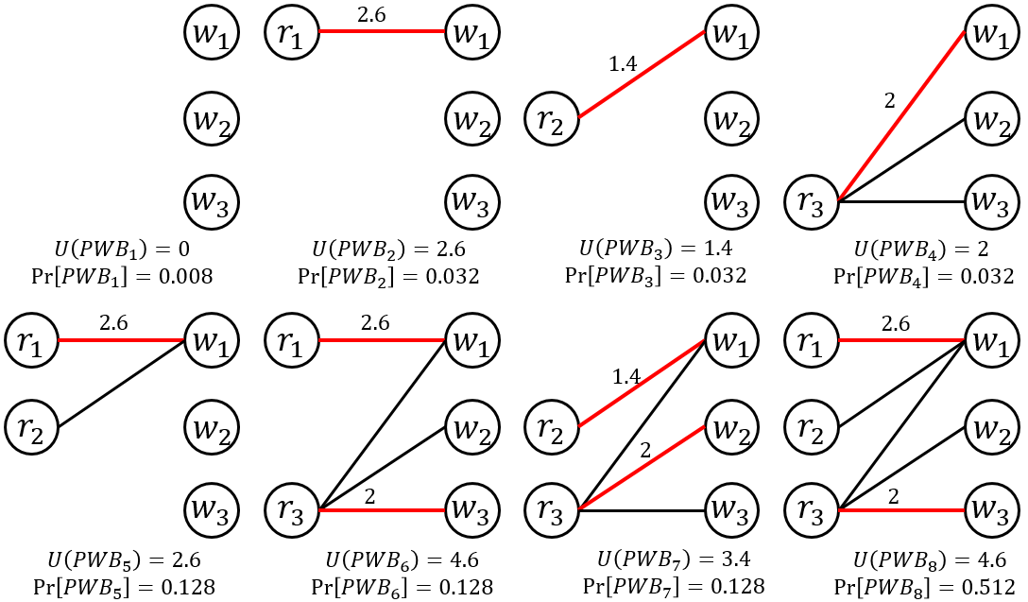



Basic Concepts
Requester | $$r_{1}$$ | $$r_{2}$$ | $$r_{3}$$
Trip distance $d_{r}$(km) | 1.3 | 0.7 | 1
Goal: platforms set prices to maximize the expected total revenue!
Price $p$ ($/km) | $$1$$ | $$2$$ | $$3$$
Accepted ratio $S(p)$ | 0.9 | 0.8 | 0.5
Expected Total Revenue is 3.9
$$S\left(2\right)=0.8$$
$$r_{1}$$
$$w_{1}$$
$$S\left(2\right)=0.8$$
$2/km
$$r_{2}$$
$$w_{2}$$
$$S\left(2\right)=0.8$$
$$r_{3}$$
$$w_{3}$$
Notes:
Now we maximize the expected total revenue. if we offer them 2 dollars per km, each node has a probability of 0.8. The expected total revenue is 3.9

Slide 17
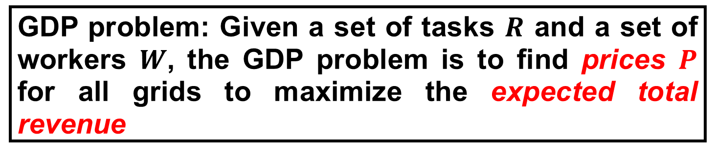
Global Dynamic Pricing (GDP) Problem
GDP problem: Given a set of tasks $R$ and a set of workers $W$, the GDP problem is to find prices $P$ for all grids to maximize the expected total revenue
Hardness: Even if we know the accepted ratios, GDP problem is NP-hard
Notes:
Now we propose Global Dynamic Pricing problem GDP. Given a set of tasks and a set of workers, the GDP problem is to find prices P for all grids to maximize the expected total revenue.
Even if we know the accepted ratios, it’s np-hard.

Slide 18
Outline
Background and Motivation
Problem Statement
Our Solutions
Experiments
Conclusion
Notes:
We next present our solutions.

Slide 19
Framework
Dependent supply: Complex Bipartite Graph
Multiple Grids with Limited and Dependent Supply
One Grid with Sufficient Supply
One Grid with Limited Supply
Unknown demand: accepted ratios
Limited supply:
worker shortage
Notes:
Our framework is as follows. We start with special cases and extend them to the multiple grids.

Slide 20
Framework
One Grid with Sufficient Supply
Unknown demand: accepted ratios
Notes:
We first consider one grid with sufficient supply.

Slide 21























One Grid with Sufficient Supply
Expected total revenue: $\sum_{r}{d_{r}pS(p)}$
Find the base price: $\underset{p}{argmax}{pS(p)}$
Use discretized prices
$$S\left(p\right)$$
$$w_{1}$$
$$r_{2}$$
$$d_{r_{1}}p$$
$$r_{1}$$
$$w_{1}$$
$$r_{1}$$
$$p$$
$$S\left(p\right)$$
$$w_{2}$$
$$w_{3}$$
$$…$$
$$w_{n}$$
$$d_{r_{2}}p$$
$$r_{2}$$
$$w_{2}$$
$$…$$
$$w_{4}$$
$$w_{n}$$
Revenue
$$pS(p)$$
$$p_{m}^{}$$
$$p$$
Notes:
We offer a single price p.
The expected total revenue can be expressed in a concise way.
Since the sum of d_r is fixed, actually we only need to find the maximizer of pS(p), also called the base price.
As S(p) is a continuous function, we use discretized prices to approximate it.

Slide 22

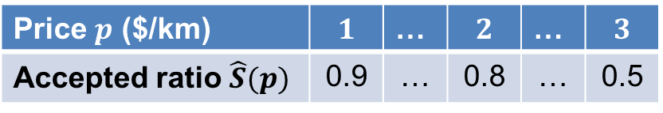




One Grid with Sufficient Supply
Order ID | Price(CNY/km) | Decision
1 | 2 | Accept
2 | 3 | Reject
3 | 2 | Accept
4 | 2 | Reject
5 | 2 | Accept
6 | 1 | Accept
7 | 2 | Accept
… | … | …
$$w_{1}$$
$$r_{2}$$
$$r_{1}$$
$$w_{3}$$
$$…$$
$$w_{n}$$
$$w_{2}$$
$$w_{4}$$
Revenue
Price $p$ ($/km) | $$1$$ | … | $$2$$ | … | $$3$$
Accepted ratio $\hat{S}(p)$ | 0.9 | … | 0.8 | … | 0.5
$$p\hat{S}(p)$$
Sample size: $O(\left(2p^{2}/ε^{2}\right)\ln{(2k/δ}))$
Base pricing strategy: $eG$ approximation
$$p_{m}^{}$$
$$p$$
Notes:
Under a certain price p, the number of requesters who accept p follows the binomial distribution.
So we can calculate the sample mean from historical records and obtain a table like this.
Finally, we choose the maximizer as the base price and in this case a price of 2 dollars will be it.
The sample size showed here gives an epsilon error.
It is worth noting that always sticking to the base price gives an eG approximation.

Slide 23
Framework
One Grid with Sufficient Supply
One Grid with Limited Supply
Unknown demand: accepted ratios
Limited supply:
worker shortage
Notes:
But if the supply is limited, there is no such concise expression.

Slide 24
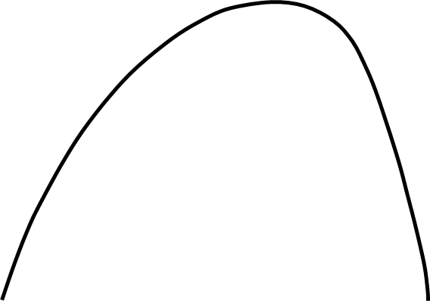

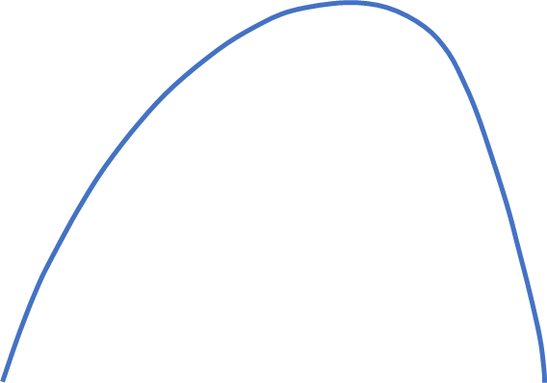
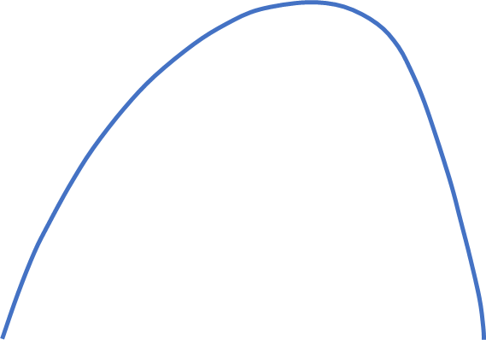










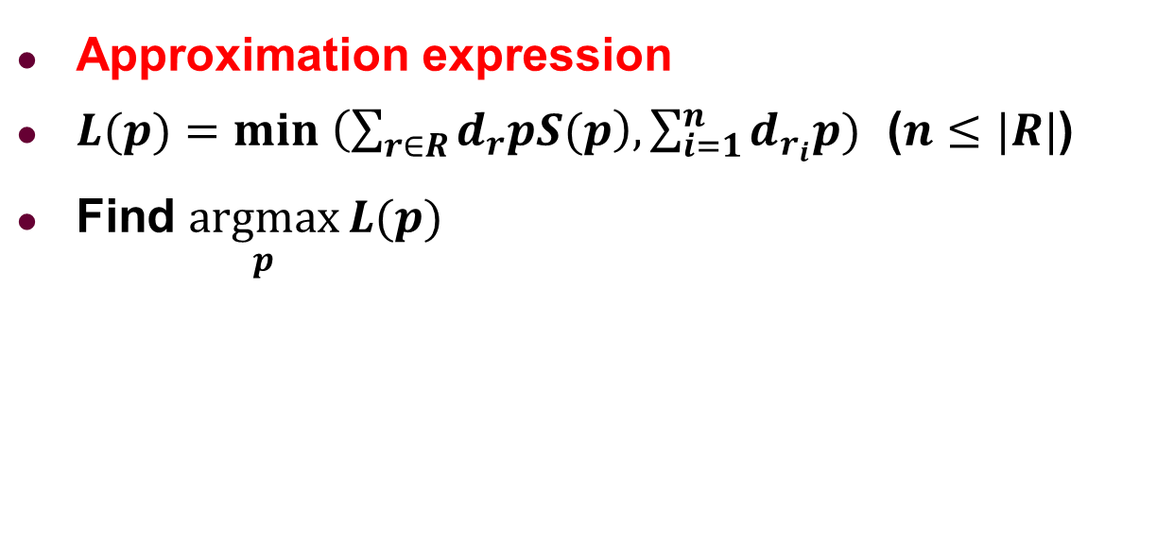


One Grid with Limited Supply
$$r_{1}$$
$$w_{1}$$
$$r_{2}$$
$$n=1$$
$$r_{2}$$
Curve: the expected revenue of $|R|$requesters
Line: the revenue $n$ workers can achieve at most
$$r_{1}$$
$$w_{1}$$
Approximation expression
$L(p)=min \left(\sum_{r∈R}{d_{r}pS(p}\right),\sum_{i=1}^{n}{d_{r_{i}}p})$ ($n≤|R|$)
Find $\underset{p}{argmax}{L(p)}$
Revenue
Revenue
Revenue
$$p$$
$$p$$
$$p$$
Sufficient Supply
Sufficient Supply
Limited Supply
$$n=\left|R\right|$$
$$n<\left|R\right|$$
Notes:
We use an approximation expression.
The first term inside the min represents the expected revenue of |R| requesters.
The second term represents the revenue n workers can achieve at most.
There are three cases for different numbers of workers. Only the third one shows a limited supply and the maximizer moves to the intersection, which means a higher price is more suitable.
As long as the number of workers is clear, we can always find the maximizer.

Slide 25
Framework
Dependent supply: Complex Bipartite Graph
Multiple Grids with Limited and Dependent Supply
One Grid with Sufficient Supply
One Grid with Limited Supply
Unknown demand: accepted ratios
Limited supply:
worker shortage
Notes:
When there are multiple grids, we extend previous cases.

Slide 26









Multiple Grids with Limited and Dependent Supply
Extension: $\sum_{g}{L^{g}(n^{g},p^{g})}=\sum_{g}{min (\sum_{r∈R}{d_{r}p^{g}S(p^{g}}),\sum_{i=1}^{n^{g}}{d_{r_{i}}p^{g}}) }$
$$r_{1}$$
$$w_{1}$$
$$13$$
14
$1$5
$1$6
$$grid 9$$
$$r_{2}(2,6)$$
$$r_{3}(5,5)$$
$$r_{2}$$
$$w_{2}$$
$$r_{1}(1,5)$$
$$w_{1}(3,5)$$
$$w_{2}(7,5)$$
$$9$$
10
$$11$$
$$12$$
$$w_{3}(5,3)$$
$$grid 11$$
$$r_{3}$$
$$w_{3}$$
$$5$$
$$6$$
$$7$$
$$8$$
$n^{9}∈\left\{0,1\right\},$ $n^{11}∈\left\{0,1,2,3\right\}$
$$1$$
$$2$$
$$3$$
$$4$$
Notes:
We only add the sum and ng.

Slide 27
Multiple Grids with Limited and Dependent Supply
Extension: $\sum_{g}{L^{g}(n^{g},p^{g})}=\sum_{g}{min (\sum_{r∈R}{d_{r}p^{g}S(p^{g}}),\sum_{i=1}^{n^{g}}{d_{r_{i}}p^{g}}) }$
$$r_{1}$$
$$w_{1}$$
$$13$$
14
$1$5
$1$6
$$grid 9$$
$$r_{2}(2,6)$$
$$r_{3}(5,5)$$
$$r_{2}$$
$$w_{2}$$
$$r_{1}(1,5)$$
$$w_{1}(3,5)$$
$$w_{2}(7,5)$$
$$9$$
10
$$11$$
$$12$$
$$w_{3}(5,3)$$
$$grid 11$$
$$r_{3}$$
$$w_{3}$$
$$5$$
$$6$$
$$7$$
$$8$$
$n^{9}∈\left\{0,1\right\},$ $n^{11}∈\left\{0,1,2,3\right\}$
$$1$$
$$2$$
$$3$$
$$4$$
Notes:
But the amount of supply for each grid ng is actually unclear, since workers can move to neighbor grids.
We will use a matching-based approach to find better ng.
Once they are specified, the maximizer pg can be obtained and we maximize the expression overall.

Slide 28

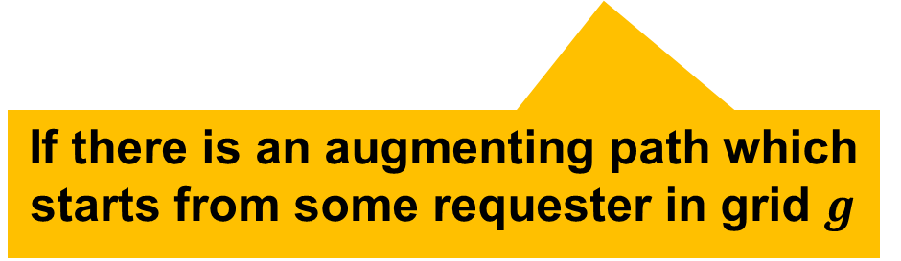
MAtching-based Pricing Strategy (MAPS)
Basic idea
Initialize all $n^{g}$ at 0
In each iteration, find the maximum increase for $\sum_{g}{L^{g}(n^{g},p^{g})}$ among those grids whose $n^{g}$ can be increased by 1
If there is an augmenting path which starts from some requester in grid $g$
Notes:
The basic idea of MAPS is as follows.
Initialize all ng at 0.
In each iteration,
Find the maximum increase for the expression among all grids.
Here if there is an augmenting path which starts from some requester in grid, there can be a worker assigned to that grid and ng can be increased by 1.

Slide 29


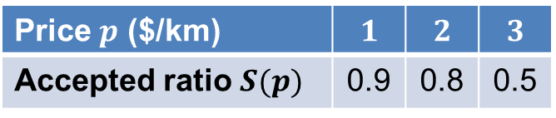

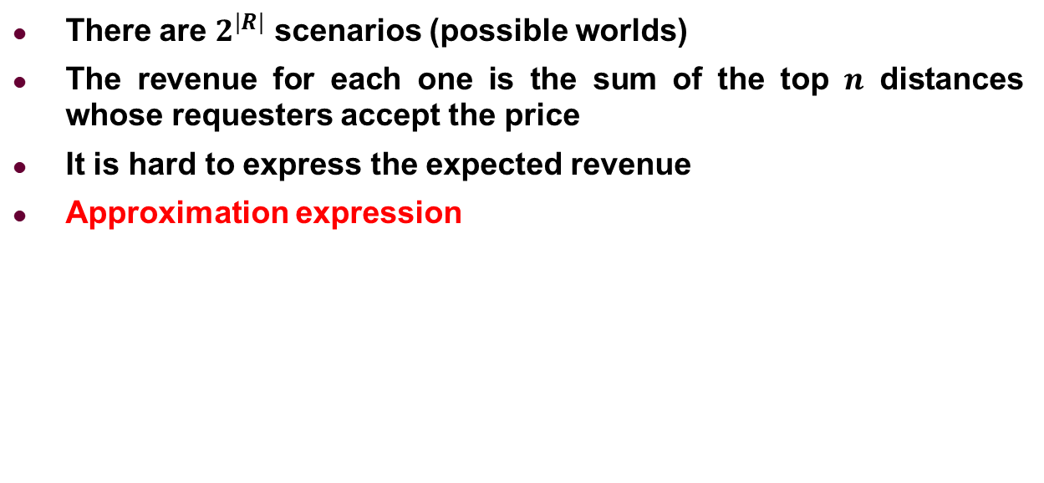








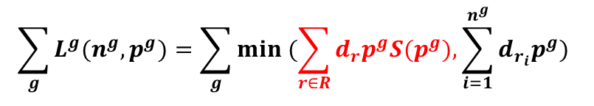








Multiple Grids with Limited and Dependent Supply
Price $p$ ($/km) | $$1$$ | $$2$$ | $$3$$
Accepted ratio $S(p)$ | 0.9 | 0.8 | 0.5
$$r_{1}$$
$$w_{1}$$
$$grid 9$$
$$r_{2}$$
$$w_{2}$$
$$grid 11$$
$$r_{3}$$
$$w_{3}$$
$$\sum_{g}{L^{g}(n^{g},p^{g})}=\sum_{g}{min (\sum_{r∈R}{d_{r}p^{g}S(p^{g}}),\sum_{i=1}^{n^{g}}{d_{r_{i}}p^{g}}) }$$
$$r_{2}(2,6)$$
$$r_{3}(5,5)$$
$$r_{1}(1,5)$$
$$w_{1}(3,5)$$
$$w_{2}(7,5)$$
Revenue
Revenue
$n^{9}=0$, $p^{9}=0$
$n^{11}=0$, $p^{11}=0$
$$w_{3}(5,3)$$
$$3.2$$
$$1.8$$
$$1.6$$
$$1.5$$
$$0.9$$
$$1$$
$$2$$
$$3$$
$$p$$
$$1$$
$$2$$
$$3$$
$$p$$
Notes:
We still use the previous example.
At first, n9 and n11 are both 0, so there are only discretized curves, represented by the crosses.

Slide 30




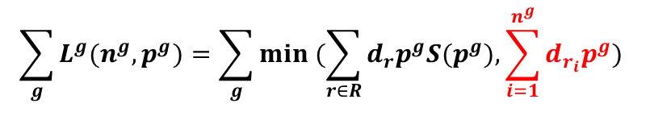




Multiple Grids with Limited and Dependent Supply
Price $p$ ($/km) | $$1$$ | $$2$$ | $$3$$
Accepted ratio $S(p)$ | 0.9 | 0.8 | 0.5
$$r_{1}$$
$$w_{1}$$
$$grid 9$$
$$r_{2}$$
$$w_{2}$$
$$grid 11$$
$$r_{3}$$
$$w_{3}$$
$$\sum_{g}{L^{g}(n^{g},p^{g})}=\sum_{g}{min (\sum_{r∈R}{d_{r}p^{g}S(p^{g}}),\sum_{i=1}^{n^{g}}{d_{r_{i}}p^{g}}) }$$
$$r_{2}(2,6)$$
$$r_{3}(5,5)$$
$$r_{1}(1,5)$$
$$w_{1}(3,5)$$
$$w_{2}(7,5)$$
Revenue
Revenue
$n^{9}=0$, $p^{9}=0$
$n^{11}=0$, $p^{11}=0$
$$w_{3}(5,3)$$
$$3.2$$
$$1.8$$
$$1.6$$
$$1.5$$
$$0.9$$
$$1$$
$$2$$
$$3$$
$$p$$
$$1$$
$$2$$
$$3$$
$$p$$
Notes:
If some ng can be increased by 1, there will be a dashed line.

Slide 31
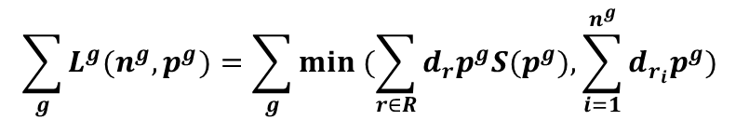
Multiple Grids with Limited and Dependent Supply
Price $p$ ($/km) | $$1$$ | $$2$$ | $$3$$
Accepted ratio $S(p)$ | 0.9 | 0.8 | 0.5
$$r_{1}$$
$$w_{1}$$
$$grid 9$$
$$r_{2}$$
$$w_{2}$$
$$grid 11$$
$$r_{3}$$
$$w_{3}$$
$$\sum_{g}{L^{g}(n^{g},p^{g})}=\sum_{g}{min (\sum_{r∈R}{d_{r}p^{g}S(p^{g}}),\sum_{i=1}^{n^{g}}{d_{r_{i}}p^{g}}) }$$
$$r_{2}(2,6)$$
$$r_{3}(5,5)$$
$$r_{1}(1,5)$$
$$w_{1}(3,5)$$
$$w_{2}(7,5)$$
Revenue
Revenue
$n^{9}=0$, $p^{9}=0$
$n^{11}=0$, $p^{11}=0$
$$w_{3}(5,3)$$
$$3.2$$
$$1.8$$
$$1.6$$
$$1.5$$
$$0.9$$
$$1$$
$$2$$
$$3$$
$$p$$
$$1$$
$$2$$
$$3$$
$$p$$
Notes:
Now we try to compare the increases between grids.
We find grid 9 has the larger increase.

Slide 32

Multiple Grids with Limited and Dependent Supply
Price $p$ ($/km) | $$1$$ | $$2$$ | $$3$$
Accepted ratio $S(p)$ | 0.9 | 0.8 | 0.5
$$r_{1}$$
$$w_{1}$$
$3/km
$$grid 9$$
$$r_{2}$$
$$w_{2}$$
$$grid 11$$
$$r_{3}$$
$$w_{3}$$
$$\sum_{g}{L^{g}(n^{g},p^{g})}=\sum_{g}{min (\sum_{r∈R}{d_{r}p^{g}S(p^{g}}),\sum_{i=1}^{n^{g}}{d_{r_{i}}p^{g}}) }$$
$$r_{2}(2,6)$$
$$r_{3}(5,5)$$
$$r_{1}(1,5)$$
$$w_{1}(3,5)$$
$$w_{2}(7,5)$$
Revenue
Revenue
$n^{9}=1$, $p^{9}=3$
$n^{11}=0$, $p^{11}=0$
$$w_{3}(5,3)$$
$$3.2$$
$$1.8$$
$$1.6$$
$$1.5$$
$$0.9$$
$$1$$
$$2$$
$$3$$
$$p$$
$$1$$
$$2$$
$$3$$
$$p$$
Notes:
We admit this increase by modifying n9 as 1 and marking a request worker pair in the matching.

Slide 33
Multiple Grids with Limited and Dependent Supply
Price $p$ ($/km) | $$1$$ | $$2$$ | $$3$$
Accepted ratio $S(p)$ | 0.9 | 0.8 | 0.5
$$r_{1}$$
$$w_{1}$$
$3/km
$$grid 9$$
$$r_{2}$$
$$w_{2}$$
$$grid 11$$
$$r_{3}$$
$$w_{3}$$
$$\sum_{g}{L^{g}(n^{g},p^{g})}=\sum_{g}{min (\sum_{r∈R}{d_{r}p^{g}S(p^{g}}),\sum_{i=1}^{n^{g}}{d_{r_{i}}p^{g}}) }$$
$$r_{2}(2,6)$$
$$r_{3}(5,5)$$
$$r_{1}(1,5)$$
$$w_{1}(3,5)$$
$$w_{2}(7,5)$$
Revenue
$n^{11}=0$, $p^{11}=0$
$$w_{3}(5,3)$$
$$1.6$$
$$1.5$$
$$0.9$$
$$1$$
$$2$$
$$3$$
$$p$$
Notes:
Since there is no worker who can be the supply of grid 9, there is only grid 11 left.

Slide 34

Multiple Grids with Limited and Dependent Supply
Price $p$ ($/km) | $$1$$ | $$2$$ | $$3$$
Accepted ratio $S(p)$ | 0.9 | 0.8 | 0.5
$$r_{1}$$
$$w_{1}$$
$3/km
$$grid 9$$
$$r_{2}$$
$$w_{2}$$
$2/km
$$grid 11$$
$$r_{3}$$
$$w_{3}$$
$$\sum_{g}{L^{g}(n^{g},p^{g})}=\sum_{g}{min (\sum_{r∈R}{d_{r}p^{g}S(p^{g}}),\sum_{i=1}^{n^{g}}{d_{r_{i}}p^{g}}) }$$
$$r_{2}(2,6)$$
$$r_{3}(5,5)$$
$$r_{1}(1,5)$$
$$w_{1}(3,5)$$
$$w_{2}(7,5)$$
Revenue
$n^{11}=1$, $p^{11}=2$
$$w_{3}(5,3)$$
$$1.6$$
$$1.5$$
$$0.9$$
$$1$$
$$2$$
$$3$$
$$p$$
Notes:
We admit the increase and the pricing is done. The expected total revenue is 4.1, which is larger than the case where we stick to the base price.

Slide 35
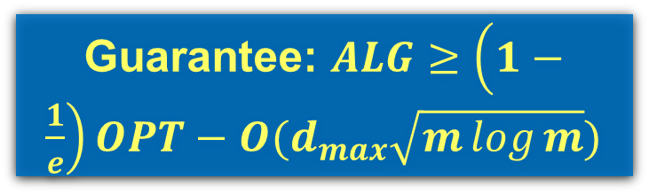
Multiple Grids with Limited and Dependent Supply
Price $p$ ($/km) | $$1$$ | $$2$$ | $$3$$
Accepted ratio $S(p)$ | 0.9 | 0.8 | 0.5
$$r_{1}$$
$$w_{1}$$
$3/km
$$grid 9$$
$$r_{2}$$
$$w_{2}$$
$2/km
$$grid 11$$
$$r_{3}$$
$$w_{3}$$
$$\sum_{g}{L^{g}(n^{g},p^{g})}=\sum_{g}{min (\sum_{r∈R}{d_{r}p^{g}S(p^{g}}),\sum_{i=1}^{n^{g}}{d_{r_{i}}p^{g}}) }$$
$$r_{2}(2,6)$$
$$r_{3}(5,5)$$
$$r_{1}(1,5)$$
$$w_{1}(3,5)$$
$$w_{2}(7,5)$$
Expected Total Revenue is 4.1
$$w_{3}(5,3)$$
Guarantee: $ALG≥\left(1−\frac{1}{e}\right)OPT−O(d_{max}\sqrt{m\log{m}})$
Notes:
We admit the increase and the pricing is done. The expected total revenue is 4.1, which is larger than the case where we stick to the base price.

Slide 36
Outline
Background and Motivation
Problem Statement
Our Solutions
Experiments
Conclusion
Notes:
We briefly present the evaluation results.

Slide 37
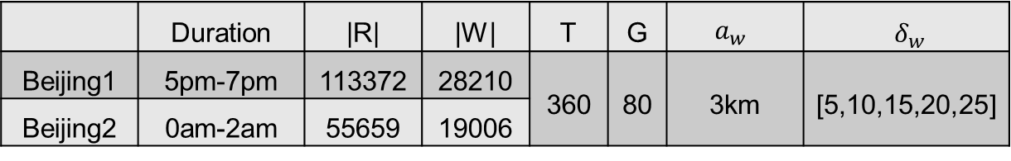
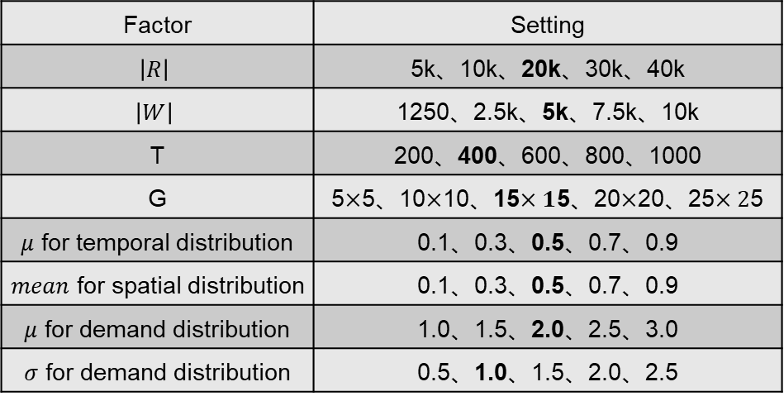
Experimental Setting
Real Datasets
An online taxi-calling platform in China
Synthetic Datasets
Compared Algorithms
SDE (Exponent), SDR (Ratio), BaseP, CappedUCB [TEAC11]
 | Duration | |R| | |W| | T | G | $$a_{w}$$ | $δ_{w}$
Beijing1 | 5pm-7pm | 113372 | 28210 | 360 | 80 | 3km | [5,10,15,20,25]
Beijing2 | 0am-2am | 55659 | 19006
Factor | Setting
$$\left|R\right|$$ | 5k、10k、20k、30k、40k
$$\left|W\right|$$ | 1250、2.5k、5k、7.5k、10k
T | 200、400、600、800、1000
G | 5$×$5、10$×$10、15$×1$5、20$×$20、25$×2$5
$μ$ for temporal distribution | 0.1、0.3、0.5、0.7、0.9
$mean$ for spatial distribution | 0.1、0.3、0.5、0.7、0.9
$μ$ for demand distribution | 1.0、1.5、2.0、2.5、3.0
$σ$ for demand distribution | 0.5、1.0、1.5、2.0、2.5
Notes:
We use real and synthetic datasets with settings shown in the table.
We compare five algorithms: SDE uses the supply and demand in an exponent. SDR uses the ratio of supply and demand. BaseP is the strategy where we always stick to the base price. And CappedUCB is designed for one grid with limited supply.

Slide 38
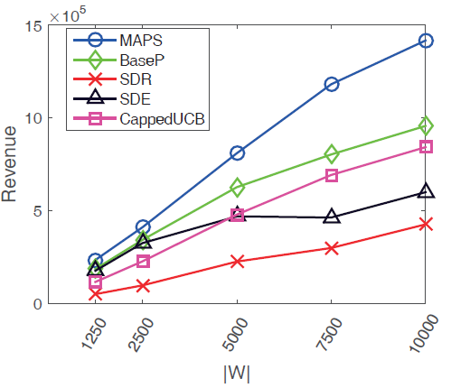
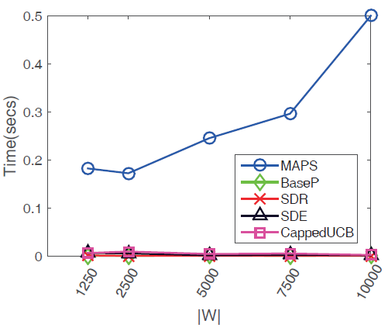
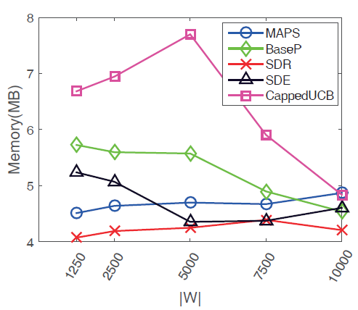
Experiments: Synthetic Data
MAPS is the most effective
MAPS is efficient
Notes:
MAPS achieves the largest revenue. Since the other four strategies can be implemented in one line, their running times can be negligible. As for MAPS, the time shows here is actually the accumulated time of all pricing periods, so the time per period is still in an acceptable range.

Slide 39
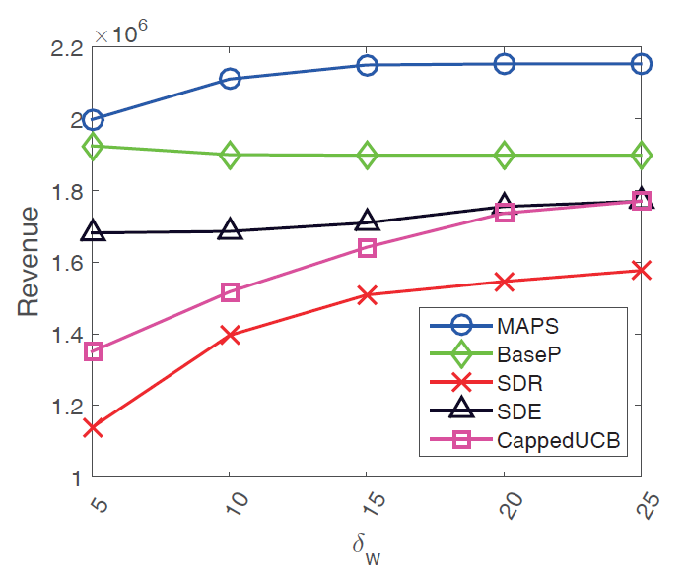
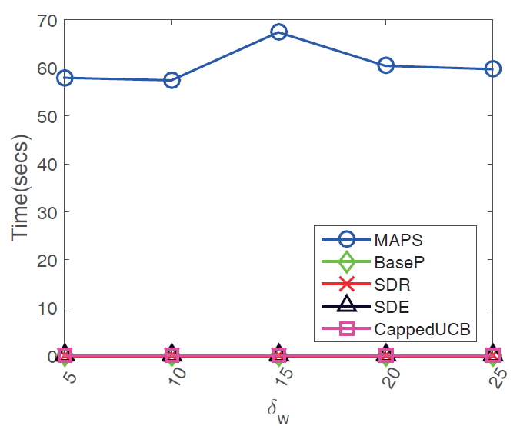
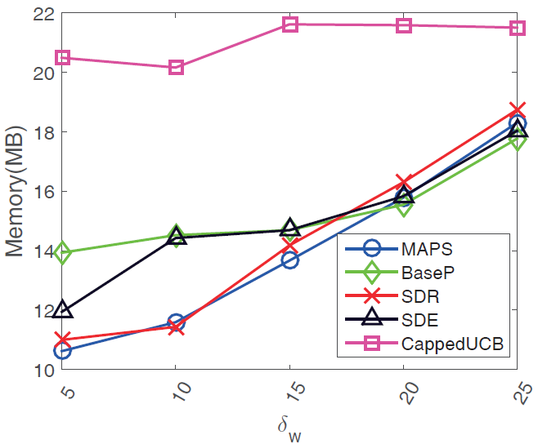
Experiments: Real Data
MAPS still performs best on real datasets
Notes:
Here are the results on real datasets.
MAPS still performs best.

Slide 40
Outline
Background and Motivation
Problem Statement
Our Solutions
Experiments
Conclusion
Notes:
And finally the conclusion.

Slide 41
Conclusion
Propose a new problem of pricing in spatial crowdsourcing, called Global Dynamic Pricing (GDP)
Design several techniques with theoretical guarantees to tackle the problem
A sampling-based approach
A base pricing strategy
A matching-based pricing strategy (MAPS)
Conduct extensive experiments on both real and synthetic datasets
Notes:
Here it is.

Slide 42

Thank You
Q & A

