Slide 1



Online Minimum Matching in Real-Time Spatial Data: Experiments and Analysis
Yongxin Tong ¹, Jieying She ², Bolin Ding ³, Lei Chen ², Tianyu Wo ¹, Ke Xu ¹ ¹ Beihang University ² The Hong Kong University of Science and Technology ³ Microsoft Research
Notes:
Good morning everyone. I am Yongxin Tong from Beihang University. Today I’ll present our work online minimum matching in real-time spatial data: Experiments and Analysis. This is a collaborative work with Jieying and Lei from HKUST, Bolin from Microsoft research, and Tianyu and Ke from Beihang University.

Slide 2
Outline
Background and Motivation
Problem Statement
Representative Algorithms
The Greedy Algorithm Revisited
Experiments
Conclusion
Notes:
This is the outline of this work.

Slide 3
Outline
Background and Motivation
Problem Statement
Representative Algorithms
The Greedy Algorithm Revisited
Experiments
Conclusion
Notes:
First, I will introduce the background and motivation.

Slide 4
Minimum Bipartite Matching (MBM)
The problem of minimum bipartite matching (MBM) in spatial data is a fundamental issue
Notes:
The problem of minimum bipartite matching (MBM) in spatial data is a fundamental issue

Slide 5



Minimum Bipartite Matching (MBM)
The problem of minimum bipartite matching (MBM) in spatial data is a fundamental issue
Given a set of service providers and a set of users in a 2D space.
Y
w₄（5，5）
5
w₃（3，4）
t₃（5，5）
4
w₂（2，3）
3
t₂（2，3）
t₄（5，3）
2
t₁（1，2）
1
w₁（3，0）
1
2
3
4
5
X
Notes:
For the MBM problem, given a set of service providers and a set of users in a 2D space. For example,

Slide 6








Minimum Bipartite Matching (MBM)
The problem of minimum bipartite matching (MBM) in spatial data is a fundamental issue
Given a set of service providers and a set of users in a 2D space.
The MBM problem is to find a maximum-cardinality matching with minimum total distance between the matched pairs.
Y
$$w_{1}$$
$$t_{1}$$
w₄（5，5）
5
w₃（3，4）
t₃（5，5）
$$w_{2}$$
$$t_{2}$$
4
w₂（2，3）
$$w_{3}$$
$$t_{3}$$
3
t₂（2，3）
t₄（5，3）
2
$$w_{4}$$
$$t_{4}$$
t₁（1，2）
1
w₁（3，0）
Optimal Matching
1
2
3
4
5
X
Notes:
The MBM problem is to find a maximum-cardinality matching with minimum total distance between the matched pairs. In our example, the optimal minimum matching is shown on the left.

Slide 7



Online Minimum Bipartite Matching (OMBM)
Recently, most applications of the MBM issue need to be addressed in real-time, which is called the online MBM (OMBM) problem
Notes:
With the development of mobile Internet and smartphone techniques in recent years, many applications of the MBM problem on real-time spatial data become popular, such as the real-time taxi dispatching platforms, Uber, Chinese Uber, Didi and Shenzhou Taxi.

Slide 8




Online Minimum Bipartite Matching (OMBM)
Recently, most applications of the MBM issue need to be addressed in real-time, which is called the online MBM (OMBM) problem
Notes:
And all kinds of real-time spatial crowdsourcing platforms, e.g. gigwalk, taskrabiit, grubhub and Waze.

Slide 9
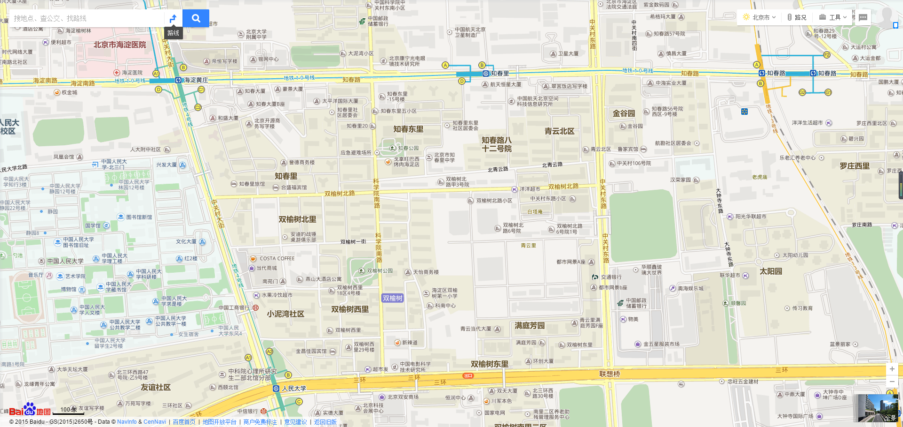

Challenges of the OMBM Problem
Real-time taxi-calling services usually adopt ‘nearest neighbor (NN)’ strategy to address the OMBM issues.
Once a task appears, it should be assigned immediately.
The cost of the NN strategy
Notes:
Let’s see an example to explain the challenges of the OMBM problem. Most of real-time taxi-calling platforms, such as Ubers and Didi, usually use a simple greedy approach, called NN, to assign a taxi to each requestor and get the minimum total waiting time or distances. In other words, this is an OMBM problem. However, whether such greedy-based matching method is good?
Particularly, in real application platform, once a task appears, it should be assigned immediately. For example, for the red user, based on the nearest neighbor rule, this taxi will be assigned to him. Unfortunately, after the assignment is performed, the green user appears in the same location. The platform has to assign that taxi according to the nearest neighbor strategy. Similarly, after the second assignment, the user in white emerges in the place of second assigned taxi. Thus, the total distance is like this.

Slide 10
Challenges of the OMBM Problem
Real-time taxi-calling services usually adopt ‘nearest neighbor (NN)’ strategy to address task assignment issues.
Once a task appears, it should be assigned immediately.
If we know everything in advance, the offline OPT is shown.
The offline cost
Notes:
If we know the location and emerging time of all users in advance, the offline optimal assignment for the platform should be like this. Hence, the greedy strategy for the OMBM problem seems to be bad. Is that right? If the strategy is bad, why most industrial platforms adopt it?

Slide 11
Contributions of Our Work
Inspired by many observations in applications and a comprehensive experimental study of the OMBM problem, our contributions are
 | Motivations | Contributions
1 | Is Greedy really the worst? | Greedy has good performance.
2 | Is the worst-case analysis appropriate for the OMBM problem in practice? | Worst-case vs. Average-case analysis.
3 | Are implementations and experimental evaluations uniform? | Uniform implementations and evaluations are provided.
Open question: the average-case approximation ratio (a.k.a competitive ratio) of the simple greedy algorithm for the OMBM problem should be constant!
Notes:
Inspired by many observations in the applications of the OMBM problem, we conduct a comprehensive experimental study and our contributions are shown as follows.
Particularly, we propose a new hypothesis: the average-case approximation ratio (a.k.a competitive ratio) of the simple greedy algorithm for the OMBM problem should be constant!

Slide 12
Outline
Background and Motivation
Problem Statement
Representative Algorithms
The Greedy Algorithm Revisited
Experiments
Conclusion
Notes:
We then formally define the OMBM problem.

Slide 13
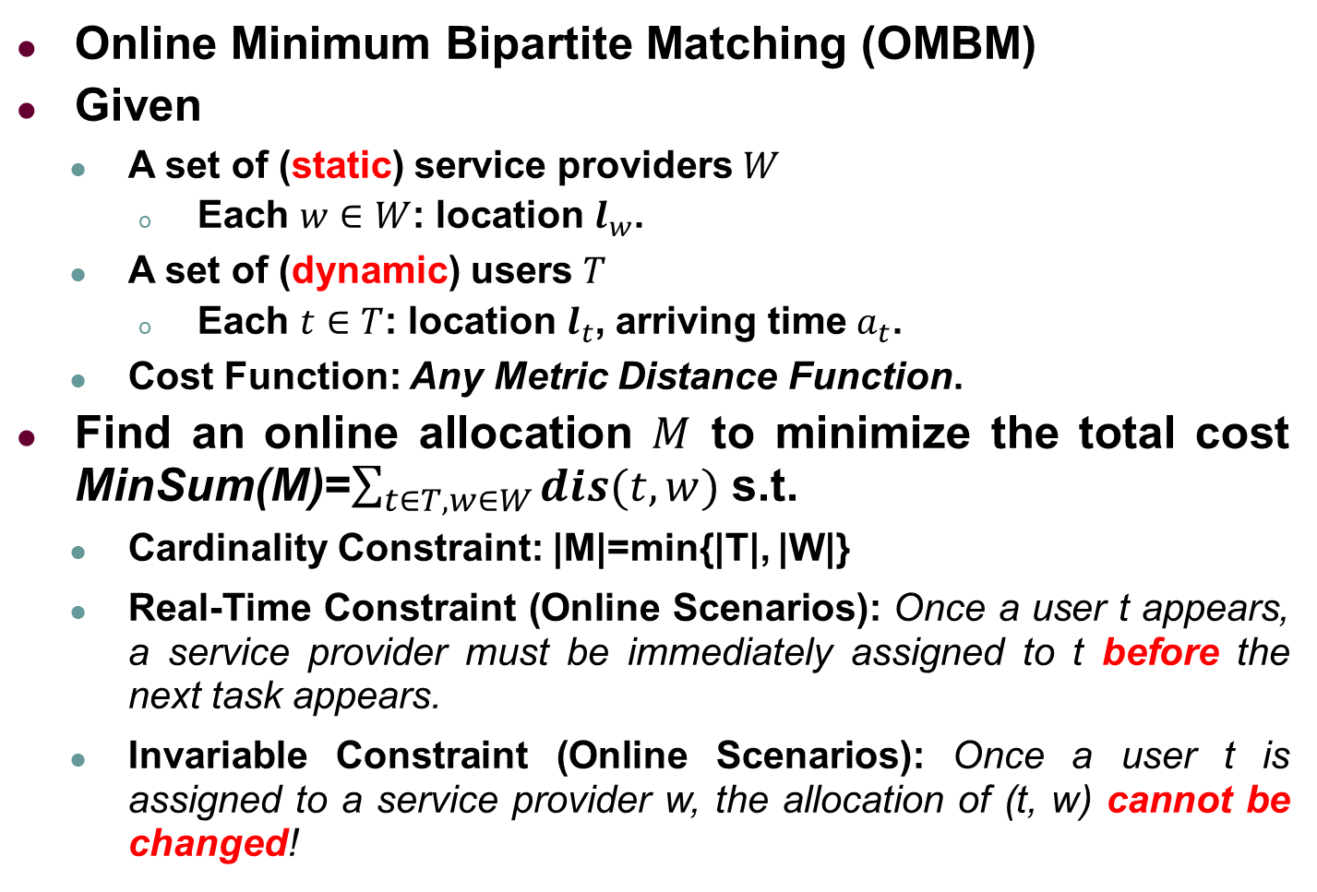
Problem Statement
Online Minimum Bipartite Matching (OMBM)
Given
A set of (static) service providers $W$
Each $w∈W$: location $l_{w}$.
A set of (dynamic) users $T$
Each $t∈T$: location $l_{t}$, arriving time $a_{t}$.
Cost Function: Any Metric Distance Function.
Find an online allocation $M$ to minimize the total cost MinSum(M)=$\sum_{t∈T, w∈W}{dis(t,w)}$ s.t.
Cardinality Constraint: |M|=min{|T|, |W|}
Real-Time Constraint (Online Scenarios): Once a user t appears, a service provider must be immediately assigned to t before the next task appears.
Invariable Constraint (Online Scenarios): Once a user t is assigned to a service provider w, the allocation of (t, w) cannot be changed!
Notes:
Particularly, we study the problem of online minimum bipartite matching in spatial data
We are given a set of static service provider, each with a location l_w
We are also given a set of dynamic users, each with a location l_w and an arriving time a_t
Our goal is to find an allocation to minimize the total cost MinSum(M) and needs to satisfy the following three constraints.
The first constraint is used to guarantee the cardinality of the matching is maximum.
Particularly, both real-time constraint and invariable constraint are only for online scenarios. For the real-time constraint, Once a task t appears, a worker must be immediately assigned to t before the next task appears. For the invariable constraint means that the allocation between a task and a worker cannot be revoked once it is made.

Slide 14
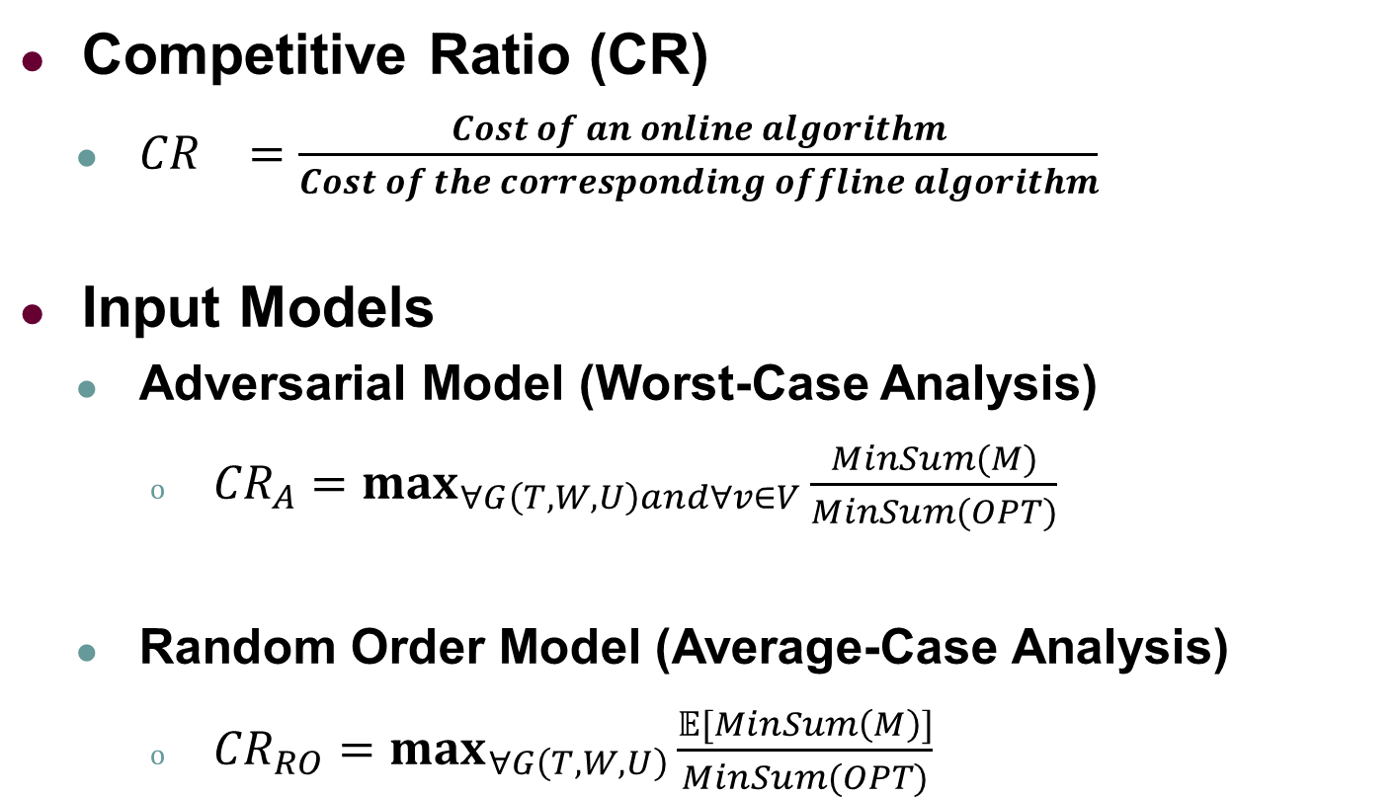
Evaluation for Online Algorithms
Competitive Ratio (CR)
${CR}_{}=\frac{Cost of an online algorithm}{Cost of the corresponding offline algorithm}$
Input Models
Adversarial Model (Worst-Case Analysis)
${CR}_{A}=\max_{∀G\left(T,W,U\right)and∀v∈V}\frac{MinSum(M)}{MinSum(OPT)}$
Random Order Model (Average-Case Analysis)
${CR}_{RO}=\max_{∀G\left(T,W,U\right)}\frac{𝔼[MinSum\left(M\right)]}{MinSum(OPT)}$
The worst bipartite graph
The worst arrival order
The expectation of the total cost of all possible arrival orders
The worst bipartite graph
Notes:
For online algorithms, competitive ratio is used to evaluate their performance.
And there are two input models for competitive analysis. The first is the adversarial model, which is used to analyze worst case. Particularly, the ratio means the online result over the offline one on the worst bipartite graph with the worst arrival order.
Another is the random order model, which is used to analyze average case. Specifically, the ratio is the expected online result over the offline result on the worst bipartite graph. Note that the expected online result is taken over all possible arrival orders on a specific bipartite graph.
Therefore, the total cost for an online algorithm depends on different arrival orders!

Slide 15
Outline
Background and Motivation
Problem Statement
Representative Algorithms
The Greedy Algorithm Revisited
Experiments
Conclusion
Notes:
We then review four representative algorithms for the OMBM problem.

Slide 16
Four Representative Algorithms
Deterministic Algorithms
Greedy [SODA 1991]
Permutation [SODA 1991]
Randomized Algorithms
HST-Greedy [SODA 2006]
HST-Reassignment [ESA 2007]

Slide 17
Four Representative Algorithms
Deterministic Algorithms
Greedy [SODA 1991]
Permutation [SODA 1991]
Randomized Algorithms
HST-Greedy [SODA 2006]
HST-Reassignment [ESA 2007]

Slide 18
Greedy
Basic idea
Match the nearest neighbor of the new task.

Slide 19





Greedy
Basic idea
Match the nearest neighbor of the new task.
Y
w₄（5，5）
$$w_{1}$$
$$t_{1}$$
5
w₃（3，4）
4
$$w_{2}$$
w₂（2，3）
3
$$w_{3}$$
2
t₁（1，2）
$$w_{4}$$
1
w₁（3，0）
1
2
3
4
5
X

Slide 20

Greedy
Basic idea
Match the nearest neighbor of the new task.
Y
w₄（5，5）
$$w_{1}$$
$$t_{1}$$
5
w₃（3，4）
4
$$w_{2}$$
$$t_{2}$$
w₂（2，3）
3
$$w_{3}$$
t₂（2，3）
2
t₁（1，2）
$$w_{4}$$
1
w₁（3，0）
1
2
3
4
5
X

Slide 21

Greedy
Basic idea
Match the nearest neighbor of the new task.
Y
w₄（5，5）
$$w_{1}$$
$$t_{1}$$
5
w₃（3，4）
t₃（5，5）
4
$$w_{2}$$
$$t_{2}$$
w₂（2，3）
3
$$w_{3}$$
$$t_{3}$$
t₂（2，3）
2
t₁（1，2）
$$w_{4}$$
1
w₁（3，0）
1
2
3
4
5
X

Slide 22

Greedy
Basic idea
Match the nearest neighbor of the new task.
Cost=6.43
Y
w₄（5，5）
$$w_{1}$$
$$t_{1}$$
5
w₃（3，4）
t₃（5，5）
4
$$w_{2}$$
$$t_{2}$$
w₂（2，3）
3
$$w_{3}$$
$$t_{3}$$
t₂（2，3）
t₄（5，3）
2
t₁（1，2）
$$w_{4}$$
$$t_{4}$$
1
w₁（3，0）
1
2
3
4
5
X

Slide 23
Permutation
Basic idea
When a new task appears, compute the offline minimum matching M_{i} on the revealed part of the graph.
If the service provider matched to the new task in M_{i} is unmatched, match the pair.
Otherwise, it is guaranteed that there existed exactly one service provider that does not appear in M_{i-1} and match the pair.

Slide 24










Permutation
Basic idea
When a new task appears, compute the offline minimum matching M_{i} on the revealed part of the graph.
If the service provider matched to the new task in M_{i} is unmatched, match the pair.
$$w_{1}$$
$$t_{1}$$
$$w_{1}$$
$$t_{1}$$
Y
w₄（5，5）
5
$$w_{2}$$
$$w_{2}$$
w₃（3，4）
4
$$w_{3}$$
$$w_{3}$$
w₂（2，3）
3
$$w_{4}$$
$$w_{4}$$
2
t₁（1，2）
1
w₁（3，0）
1
2
3
4
5
X

Slide 25



Permutation
Basic idea
Otherwise, it is guaranteed that there existed exactly one service provider that does not appear in M_{i-1} and match the pair.
$$w_{1}$$
$$t_{1}$$
$$w_{1}$$
$$t_{1}$$
Y
w₄（5，5）
5
$$w_{2}$$
$$t_{2}$$
$$w_{2}$$
$$t_{2}$$
w₃（3，4）
4
$$w_{3}$$
$$t_{3}$$
$$w_{3}$$
w₂（2，3）
3
t₂（2，3）
$$w_{4}$$
$$t_{4}$$
$$w_{4}$$
2
t₁（1，2）
1
w₁（3，0）
1
2
3
4
5
X

Slide 26

Permutation
Basic idea
When a new task appears, compute the offline minimum matching M_{i} on the revealed part of the graph.
If the service provider matched to the new task in M_{i} is unmatched, match the pair.
$$w_{1}$$
$$t_{1}$$
$$w_{1}$$
$$t_{1}$$
Y
w₄（5，5）
5
$$w_{2}$$
$$t_{2}$$
$$w_{2}$$
$$t_{2}$$
w₃（3，4）
t₃（5，5）
4
$$w_{3}$$
$$t_{3}$$
$$w_{3}$$
$$t_{3}$$
w₂（2，3）
3
t₂（2，3）
$$w_{4}$$
$$w_{4}$$
2
t₁（1，2）
1
w₁（3，0）
1
2
3
4
5
X

Slide 27


Permutation
Basic idea
When a new task appears, compute the offline minimum matching M_{i} on the revealed part of the graph.
If the service provider matched to the new task in M_{i} is unmatched, match the pair.
Cost=6.81
$$w_{1}$$
$$t_{1}$$
$$w_{1}$$
$$t_{1}$$
Y
w₄（5，5）
5
$$w_{2}$$
$$t_{2}$$
$$w_{2}$$
$$t_{2}$$
w₃（3，4）
t₃（5，5）
4
$$w_{3}$$
$$t_{3}$$
$$w_{3}$$
$$t_{3}$$
w₂（2，3）
3
t₂（2，3）
t₄（5，3）
$$w_{4}$$
$$t_{4}$$
$$w_{4}$$
$$t_{4}$$
2
t₁（1，2）
1
w₁（3，0）
1
2
3
4
5
X

Slide 28
Four Representative Algorithms
Deterministic Algorithms
Greedy [SODA 1991]
Permutation [SODA 1991]
Randomized Algorithms
HST-Greedy [SODA 2006]
HST-Reassignment [ESA 2007]

Slide 29
HST Construction
Basic idea
Randomly generate a global permutation of all the given objects as an order.
Perform a hierarchical decomposition following the generated order level by level.

Slide 30
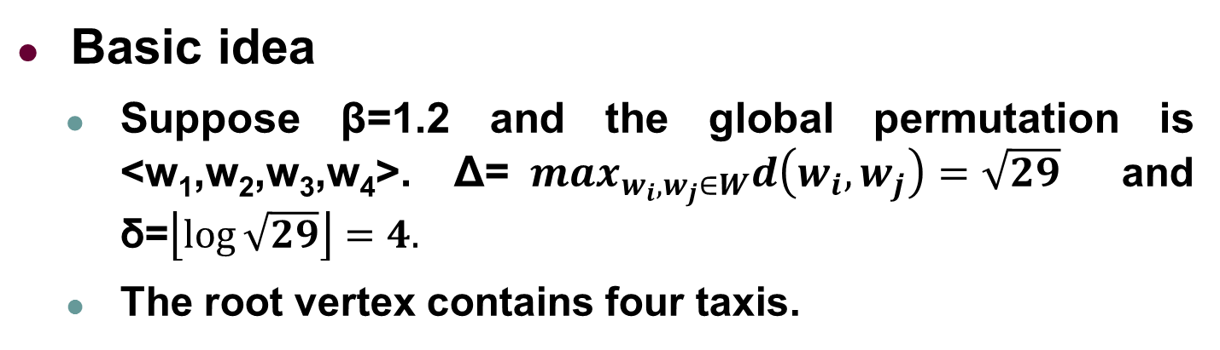

HST Construction
Basic idea
Suppose β=1.2 and the global permutation is <w₁,w₂,w₃,w₄>. Δ=$\max_{w_{i},w_{j}∈W}d\left(w_{i},w_{j}\right)=\sqrt{29}$ and δ=$\left\lfloor \log{\sqrt{29}}\right\rfloor =4.$
The root vertex contains four taxis.
$$w_{1},w_{2},w_{3},w_{4}$$
Y
w₄（5，5）
5
w₃（3，4）
4
w₂（2，3）
3
2
1
w₁（3，0）
1
2
3
4
5
X

Slide 31
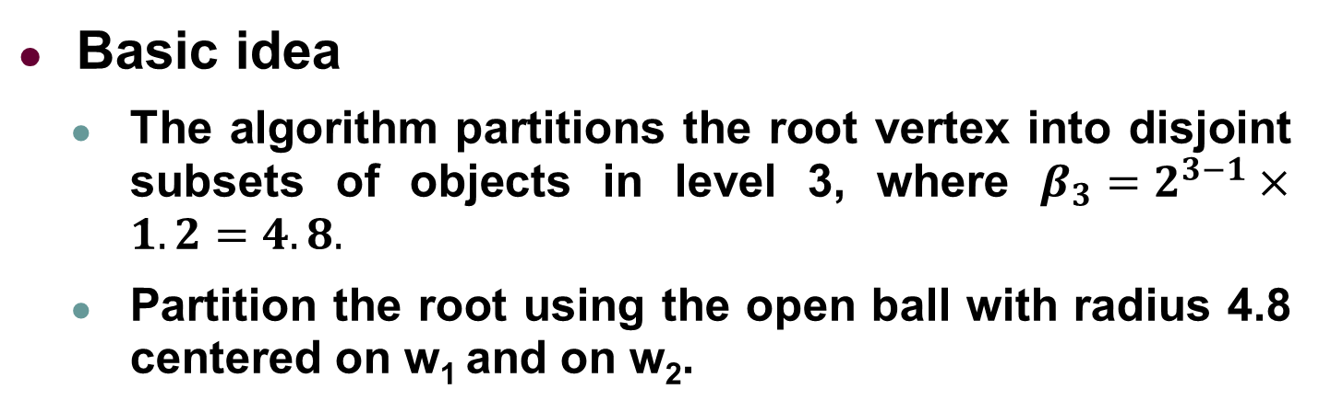


HST Construction
Basic idea
The algorithm partitions the root vertex into disjoint subsets of objects in level 3, where $β_{3}=2^{3−1}×1.2=4.8.$
Partition the root using the open ball with radius 4.8 centered on w₁ and on w₂.
$$w_{1},w_{2},w_{3},w_{4}$$
Y
w₄（5，5）
16
5
w₃（3，4）
$$w_{1},w_{2},w_{3}$$
$$w_{4}$$
4
w₂（2，3）
3
2
1
w₁（3，0）
1
2
3
4
5
X

Slide 32



HST Construction
Basic idea
Partition the vertex {w₁,w₂,w₃} using the open ball with radius 2.4 centered on w₁ and on w₂.
There is no need to partition vertex {w₄}.
$$w_{1},w_{2},w_{3},w_{4}$$
Y
w₄（5，5）
16
5
w₃（3，4）
$$w_{1},w_{2},w_{3}$$
$$w_{4}$$
4
8
w₂（2，3）
3
$$w_{1}$$
$$w_{2}{,w}_{3}$$
$$w_{4}$$
2
1
w₁（3，0）
1
2
3
4
5
X

Slide 33








HST Construction
Basic idea
In the 1st level, there are four open balls, each of which is singleton.
Since there is no need to partition singletons, the algorithm terminates in level 0.
$$w_{1},w_{2},w_{3},w_{4}$$
Y
w₄（5，5）
16
5
w₃（3，4）
$$w_{1},w_{2},w_{3}$$
$$w_{4}$$
4
8
w₂（2，3）
3
$$w_{1}$$
$$w_{2}{,w}_{3}$$
$$w_{4}$$
2
4
$$w_{1}$$
$$w_{2}$$
$$w_{3}$$
$$w_{4}$$
1
w₁（3，0）
2
$$w_{1}$$
$$w_{2}$$
$$w_{3}$$
$$w_{4}$$
1
2
3
4
5
X

Slide 34
HST-Greedy Algorithm
Basic idea
Generate HST to approximate the original metric.
When a new task appears, use the location of the nearest service provider as the task’s location on the tree.
Greedily select an unmatched service provider on the tree.

Slide 35













HST-Greedy Algorithm
Basic idea
Generate HST to approximate the original metric.
t₁’s location on the tree is w₂, since the nearest neighbor is w₂.
The unmatched nearest neighbor of t₁ is w₂ on the tree, thus match the pair (t₁,w₂).
Y
$$w_{1}$$
$$t_{1}$$
$$w_{1},w_{2},w_{3},w_{4}$$
w₄（5，5）
16
5
$$w_{2}$$
w₃（3，4）
$$w_{1},w_{2},w_{3}$$
$$w_{4}$$
4
8
w₂（2，3）
$$w_{3}$$
$$w_{1}$$
$$w_{2}{,w}_{3}$$
$$w_{4}$$
3
4
2
$$w_{4}$$
$$w_{1}$$
$$w_{2}$$
$$w_{3}$$
$$w_{4}$$
t₁（1，2）
2
1
$$w_{1}$$
$$w_{2}$$
$$w_{3}$$
$$w_{4}$$
w₁（3，0）
1
2
3
4
5
X
$$t_{1}$$

Slide 36





HST-Greedy Algorithm
t₂’s location on the tree is w₂, since the nearest neighbor is w₂.
The unmatched nearest neighbor of t₂ is w₃ on the tree, thus match the pair (t₂,w₃).
Y
$$w_{1}$$
$$t_{1}$$
$$w_{1},w_{2},w_{3},w_{4}$$
w₄（5，5）
16
5
$$w_{2}$$
$$t_{2}$$
w₃（3，4）
$$w_{1},w_{2},w_{3}$$
$$w_{4}$$
4
8
w₂（2，3）
$$w_{3}$$
$$w_{1}$$
$$w_{2}{,w}_{3}$$
$$w_{4}$$
3
4
t₂（2，3）
2
$$w_{4}$$
$$w_{1}$$
$$w_{2}$$
$$w_{3}$$
$$w_{4}$$
t₁（1，2）
2
1
$$w_{1}$$
$$w_{2}$$
$$w_{3}$$
$$w_{4}$$
w₁（3，0）
1
2
3
4
5
X
$$t_{2}$$

Slide 37
HST-Greedy Algorithm
t₃’s location on the tree is w₄, since the nearest neighbor is w₄.
The unmatched nearest neighbor of t₃ is w₄ on the tree, thus match the pair (t₃,w₄).
Y
$$w_{1}$$
$$t_{1}$$
$$w_{1},w_{2},w_{3},w_{4}$$
w₄（5，5）
16
5
$$w_{2}$$
$$t_{2}$$
w₃（3，4）
t₃（5，5）
$$w_{1},w_{2},w_{3}$$
$$w_{4}$$
4
8
w₂（2，3）
$$w_{3}$$
$$t_{3}$$
$$w_{1}$$
$$w_{2}{,w}_{3}$$
$$w_{4}$$
3
4
t₂（2，3）
2
$$w_{4}$$
$$w_{1}$$
$$w_{2}$$
$$w_{3}$$
$$w_{4}$$
t₁（1，2）
2
1
$$w_{1}$$
$$w_{2}$$
$$w_{3}$$
$$w_{4}$$
w₁（3，0）
1
2
3
4
5
X
$$t_{3}$$

Slide 38
HST-Greedy Algorithm
t₄’s location on the tree is w₃, since the nearest neighbor is w₁.
The unmatched nearest neighbor of t₂ is w₃ on the tree, thus match the pair (t₄,w₁).
Cost=6.43
Y
$$w_{1}$$
$$t_{1}$$
$$w_{1},w_{2},w_{3},w_{4}$$
w₄（5，5）
16
5
$$w_{2}$$
$$t_{2}$$
w₃（3，4）
t₃（5，5）
$$w_{1},w_{2},w_{3}$$
$$w_{4}$$
4
8
w₂（2，3）
$$w_{3}$$
$$t_{3}$$
$$w_{1}$$
$$w_{2}{,w}_{3}$$
$$w_{4}$$
3
4
t₂（2，3）
t₄（5，3）
2
$$w_{4}$$
$$t_{4}$$
$$w_{1}$$
$$w_{2}$$
$$w_{3}$$
$$w_{4}$$
t₁（1，2）
2
1
$$w_{1}$$
$$w_{2}$$
$$w_{3}$$
$$w_{4}$$
w₁（3，0）
1
2
3
4
5
X
$$t_{4}$$

Slide 39
HST-Reassignment Algorithm
Basic idea
When a new task appears, HST-Reassignment also choose the nearest neighbor as its location on the tree.
Different from HST-Greedy, the algorithm iteratively changes the pair until the optimal matching in offline scenario is formed. It is designed to avoid trapping in the local optimum.

Slide 40
Existing Representative Algorithms for the OMBM Problem
Algorithms | Time Complexity per Each Arrival Vertex | Randomization | Data Structure | Competitive Ratio (Worst-Case Analysis)
Greedy [SODA’1991] | O(k) | Deterministic | No | O(2^{k})
Permutation [SODA’1991] | O(k³) | Deterministic | No | O(2k-1)
HST-Greedy [SODA 2006] | O(k) | Randomized | HST | O(log³k)
HST-Reassignment [ESA 2007] | O(k²) | Randomized | HST | O(log²k)
Hierarchically Separated Tree
Is the greedy algorithm really the worst?
Notes:
We summarize the theoretical results under the worst-case analysis for online minimum matching .
Both two recent works utilize a specific data structure, called HST, to avoid the worst matching case.
Here, we ask a question Is the greedy algorithm really the worst?

Slide 41
Outline
Background and Motivation
Problem Statement
Representative Algorithms
The Greedy Algorithm Revisited
Experiments
Conclusion
Notes:
We then revisit the greedy algorithm.

Slide 42
Greedy Revisited
(a)Locations
Notes:
Here is the worst case of greedy approach.
w_2 and t_2 locate in the same place, w3 and t3, w4 and t4 are same. The distance between w1 and t1 is 1+\epsilon, the distance between t1 and w2 is 1, the distance between w2 and W3 is 2, the distance between w3 and w4 is 4. Also, t2 and w2 locate the same place. Similarly, w3 and t3, w4 and t4 are also at the same place.

Slide 43
Greedy Revisited
(a)Locations
(b)Matching of Offline OPT
Notes:
In the offline scenario, the optimal matching is shown in the red curves. The total cost is 1+\epsilon.

Slide 44
Greedy Revisited
(a)Locations
(b)Matching of Offline OPT
(c)Matching of Worst-Case Greedy
When t₁ appears, w₂ will be assigned to t₁ by Greedy.
Notes:
In the online scenario, the worst arrival order is t1,t2,t3,t4. Let’s see the process, when t1 appears, it will be assigned to w2 since the distance of t1 and w1 is larger than that of t1 and w2.

Slide 45
Greedy Revisited
(a)Locations
(b)Matching of Offline OPT
(c)Matching of Worst-Case Greedy
When t₂ appears, w₃ will be assigned to t₂ by Greedy.
Notes:
Similarly, when t2 appears, it will be assigned to w3 since the distance of t2 and w1 is larger than that of t2 and w3.

Slide 46
Greedy Revisited
(a)Locations
(b)Matching of Offline OPT
(c)Matching of Worst-Case Greedy
When t₃ appears, w₄ will be assigned to t₃ by Greedy.
Notes:
Similarly, when t3 appears, it will be assigned to w4 since the distance of t3 and w1 is larger than that of t3 and w4.

Slide 47
Greedy Revisited
Competitive Ratio CR_{RO}=3.195
(a)Locations
(b)Matching of Offline OPT
(c)Matching of Worst-Case Greedy
When t₄ appears, w₁ has to be assigned to t₄ by Greedy.
Open question: the average-case competitive ratio under the random order model of Greedy for the OMBM problem should be constant!
Notes:
Finally, when t4 appears, it is only assigned to w1. Thus, the total cost of the worst case is exponential.
However, for this case , we prove that the competitive ratio under average-case analysis is 3.195, and the probability that the worst-case happens is only 1 over the factorial of k, which is the number of users. The more details of our proof can be found in our paper.
Hence, we propose an open question, the average-case competitive ratio under the random order model of Greedy for the OMBM problem should be constant!

Slide 48
Outline
Background and Motivation
Problem Statement
Representative Algorithms
The Greedy Algorithm Revisited
Experiments
Conclusion
Notes:
We then show our experimental study.

Slide 49
Experimental Setting
Real Datasets (Shenzhou Taxi “神州专车”)
15082 Shenzhou Taxis at Beijing in May 2015)
Average 115364 calling-taxi requests per day
Synthetic Dataset
|T| (The number of spatial tasks)=5000
|W|(The number of crowd workers)=5000
The locations of tasks randomly follows Normal distribution, Uniform distribution, Power-law distribution and Exponential distribution.
Notes:
We use two real datasets and four larger synthetic datasets to compare Greedy algorithm and the other three algorithms. The four synthetic datasets follow normal distribution, uniform distribution, power-law distribution, exponential distribution, respectively.

Slide 50
Experiments: Task (Normal)
Notes:
Due to the limited time, here only show the results when varying the location of workers following Normal distribution. We compare the total distance of the three online algorithms.
We can see that Greedy, which is the red curve, is the most effective. In other words, the total distance of Greedy is closer to the offline optimal results than that of other two algorithms.
Also, Greedy is the fastest one and spends the lowest memory.

Slide 51
Experiments: Real Datasets
For the total distance, Greedy is almost 2 times better than the other two online algorithms!
Notes:
Here are the results on real datasets.
With varying time of one day, we can again observe that Greedy is both the most efficient and effective. Moreover, for the total distance, Greedy is almost 2 times better than the other two online algorithms.

Slide 52
Outline
Background and Motivation
Problem Statement
Representative Algorithms
The Greedy Algorithm Revisited
Experiments
Conclusion
Notes:
We finally conclude our work.

Slide 53
Conclusion
Our most important experimental finding is that both the efficiency and the effectiveness of Greedy significantly outperforms the other algorithms in almost all practical cases.
We clarify the 25-year misunderstanding towards Greedy for the OMBM problem through the experimental study!
According to extensive random experiments, we propose an open question: the average-case competitive ratio of Greedy for the OMBM problem should be constant.

Slide 54

Thank You
Q & A
The datasets can be downloaded by the following link: https://www.cse.ust.hk/jshe/OMBM.zip

