Slide 1






Flexible Online Task Assignment in Real-Time Spatial Data
Yongxin Tong ¹, Libin Wang¹, Zimu Zhou², Bolin Ding³, Lei Chen⁴, Jieping Ye⁵, Ke Xu¹ ¹ Beihang University ² ETH Zurich ³ Microsoft Research ⁴ The Hong Kong University of Science and Technology ⁵ DiDi Research

Slide 2
Outline
Background and Motivation
Problem Statement
Our Solutions
Experiments
Conclusion

Slide 3
Outline
Background and Motivation
Problem Statement
Our Solutions
Experiments
Conclusion

Slide 4




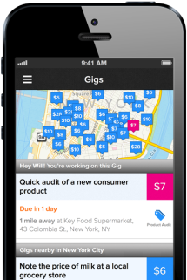


Real-Time Spatial Data
Mobile Internet applications make real-time spatial data ubiquitous
  Intelligent transportation platforms
  Food delivery platforms
  Spatial crowdsourcing platforms

Slide 5
Why Real-Time Task Assignment
Task assignment is an important issue in many real-time Online-to-Offline (O2O) platforms
Type | Application | Issue
Intelligent transportation platforms |  | Assign proper drivers (workers) to pick up passengers (tasks)
Food delivery platforms |  | Assign proper deliverers (workers) to send food to users (tasks)
Spatial crowdsourcing platforms |  | Assign micro tasks to proper workers

Slide 6
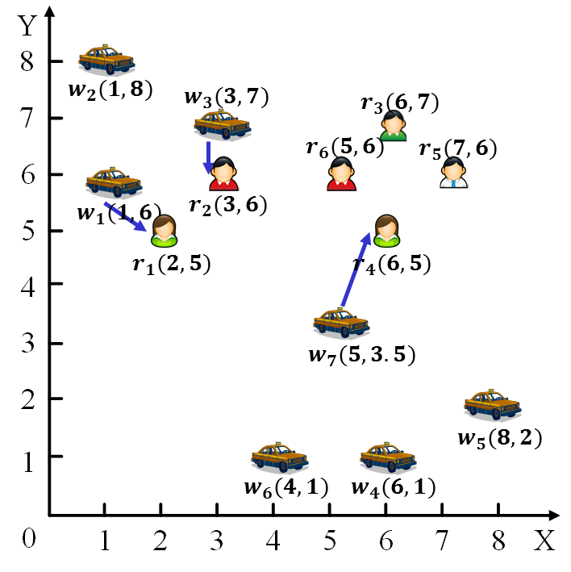
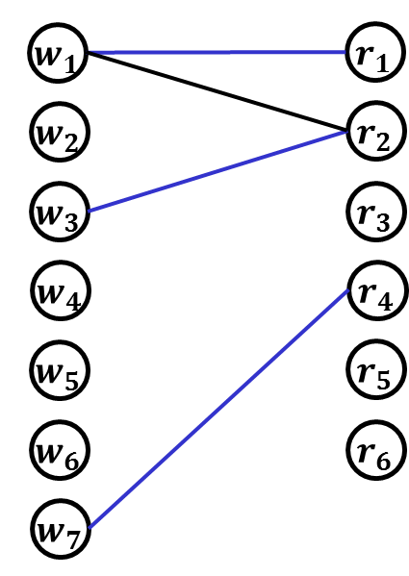
Existing Research
Early research directly models the task assignment problem through the classical “offline bipartite matching” problem, which tries to maximize the total number of the assignment
Worker
Task
Edge: a worker can arrive at the location of a task before the deadline of the task.
L. Kazemi et al. Geocrowd: enabling query answering with spatial crowdsourcing. In GIS 2012.
H. To et al. A server-assigned spatial crowdsourcing framework. In TASA 2015.

Slide 7
Existing Research
Early research directly models the task assignment problem through the classical “offline bipartite matching” problem, which tries to maximize the total number of the assignment
Worker
Task
Cannot handle real-time scenarios where workers and tasks will dynamically appear !
Edge: a worker can arrive at the location of a task before the deadline of the task.
L. Kazemi et al. Geocrowd: enabling query answering with spatial crowdsourcing. In GIS 2012.
H. To et al. A server-assigned spatial crowdsourcing framework. In TASA 2015.

Slide 8
Existing Research
Recent research uses “online bipartite matching” to model the real-time task assignment problem
When a task/worker appears, the task assignment is performed immediately and irrevocably
A rigorous assumption: once a worker appears on the platform, the worker can only wait in place tlil a task is assigned to him/her
Y. Tong et al. Online Mobile Micro-Task Allocation in Spatial Crowdsourcing. In ICDE2016.

Slide 9


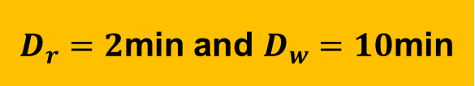
Existing Research: An Example
$${ w}_{1}$$
$$w_{1}(1,6)$$
Each taxi can move one unit distance per minute
$D_{r}=2$min and $D_{w}=10$min

Slide 10


Existing Research: An Example
$${ w}_{1}$$
$${ r}_{1}$$
Deadline constraint: If a taxi is in the dotted circle, it can arrive at the position of the passenger before her/his deadline
$$w_{1}(1,6)$$
$$r_{1}(2,5)$$
$D_{r}=2$min and $D_{w}=10$min

Slide 11




Existing Research: An Example
$${ w}_{1}$$
$${ r}_{1}$$
$$w_{2}(1,8)$$
$$w_{3}(3,7)$$
$${ w}_{2}$$
$${ w}_{3}$$
$D_{r}=2$min and $D_{w}=10$min

Slide 12


Existing Research: An Example
$${ w}_{1}$$
$${ r}_{1}$$
$$w_{2}(1,8)$$
$$w_{3}(3,7)$$
$${ w}_{2}$$
$${ r}_{2}$$
$${ w}_{3}$$
$$r_{2}(3,6)$$
$D_{r}=2$min and $D_{w}=10$min

Slide 13








Existing Research: An Example
$${ w}_{1}$$
$${ r}_{1}$$
$$w_{2}(1,8)$$
$${ w}_{2}$$
$${ r}_{2}$$
$${ w}_{3}$$
$${ w}_{4}$$
$${ w}_{5}$$
$$w_{7}(5,3.5)$$
$${ w}_{6}$$
$$w_{5}(8,2)$$
$${ w}_{7}$$
$$w_{6}(4,1)$$
$$w_{4}(6,1)$$
$D_{r}=2$min and $D_{w}=10$min

Slide 14


Existing Research: An Example
$${ w}_{1}$$
$${ r}_{1}$$
$$w_{2}(1,8)$$
$$r_{3}(6,7)$$
$${ w}_{2}$$
$${ r}_{2}$$
No taxi can pick him up before his deadline
$${ w}_{3}$$
$${ r}_{3}$$
$${ w}_{4}$$
$${ w}_{5}$$
$$w_{7}(5,3.5)$$
$${ w}_{6}$$
$$w_{5}(8,2)$$
$${ w}_{7}$$
$$w_{6}(4,1)$$
$$w_{4}(6,1)$$
$D_{r}=2$min and $D_{w}=10$min

Slide 15






Existing Research: An Example
Matching size is 3
$${ w}_{1}$$
$${ r}_{1}$$
$$w_{2}(1,8)$$
$$w_{3}(3,7)$$
$$r_{3}(6,7)$$
$${ w}_{2}$$
$${ r}_{2}$$
$$r_{6}(5,6)$$
$$r_{5}(7,6)$$
$${ w}_{3}$$
$${ r}_{3}$$
$$w_{1}(1,6)$$
$$r_{2}(3,6)$$
$${ w}_{4}$$
$${ r}_{4}$$
$$r_{1}(2,5)$$
$$r_{4}(6,5)$$
$${ w}_{5}$$
$${ r}_{5}$$
$$w_{7}(5,3.5)$$
$${ w}_{6}$$
$${ r}_{6}$$
$$w_{5}(8,2)$$
$${ w}_{7}$$
$$w_{6}(4,1)$$
$$w_{4}(6,1)$$
$D_{r}=2$min and $D_{w}=10$min

Slide 16
Existing Research: An Example
Matching size is 3
$${ w}_{1}$$
$${ r}_{1}$$
$$w_{2}(1,8)$$
$$w_{3}(3,7)$$
$$r_{3}(6,7)$$
$${ w}_{2}$$
$${ r}_{2}$$
$$r_{6}(5,6)$$
$$r_{5}(7,6)$$
$${ w}_{3}$$
$${ r}_{3}$$
$$w_{1}(1,6)$$
$$r_{2}(3,6)$$
$${ w}_{4}$$
$${ r}_{4}$$
$$r_{1}(2,5)$$
$$r_{4}(6,5)$$
$${ w}_{5}$$
$${ r}_{5}$$
$$w_{7}(5,3.5)$$
The inflexible assumption that workers can only wait in place may lose some potential matches.
$${ w}_{6}$$
$${ r}_{6}$$
$$w_{5}(8,2)$$
$${ w}_{7}$$
$$w_{6}(4,1)$$
$$w_{4}(6,1)$$
$D_{r}=2$min and $D_{w}=10$min

Slide 17
Motivation
Motivation: flexible task assignment
If a worker has no task to perform during that time, s/he tends to move for potential tasks
A flexible model should allow workers to move when no task is assigned to them!

Slide 18
Motivation: An Example
$${ w}_{1}$$
$${ r}_{1}$$
$$w_{2}(1,8)$$
$${ w}_{2}$$
I think there might be tasks in this direction
$D_{r}=2$min and $D_{w}=10$min

Slide 19
Motivation: An Example
$${ w}_{1}$$
$${ r}_{1}$$
$$w_{2}(1,8)$$
$$w_{3}(3,7)$$
$${ w}_{2}$$
$${ w}_{3}$$
$D_{r}=2$min and $D_{w}=10$min

Slide 20
Motivation: An Example
$${ w}_{1}$$
$${ r}_{1}$$
$$r_{3}(6,7)$$
$${ w}_{2}$$
$${ r}_{2}$$
$$w_{2}(1,8)$$
$${ w}_{3}$$
$${ r}_{3}$$
$${ w}_{4}$$
$$w_{5}(8,2)$$
$${ w}_{5}$$
$$w_{4}(6,1)$$
$$w_{7}(5,3.5)$$
$${ w}_{6}$$
$${ w}_{7}$$
$$w_{6}(4,1)$$
$D_{r}=2$min and $D_{w}=10$min

Slide 21
Motivation: An Example
$${ w}_{1}$$
$${ r}_{1}$$
$${ w}_{2}$$
$${ r}_{2}$$
$${ w}_{3}$$
$${ r}_{3}$$
$${ w}_{4}$$
$${ r}_{4}$$
$$r_{4}(6,5)$$
$$w_{5}(8,2)$$
$${ w}_{5}$$
$$w_{4}(6,1)$$
$$w_{7}(5,3.5)$$
$${ w}_{6}$$
$${ w}_{7}$$
$$w_{6}(4,1)$$
$D_{r}=2$min and $D_{w}=10$min

Slide 22
Motivation: An Example
$${ w}_{1}$$
$${ r}_{1}$$
$${ w}_{2}$$
$${ r}_{2}$$
$$r_{5}(7,6)$$
$${ w}_{3}$$
$${ r}_{3}$$
$$w_{5}(8,2)$$
$${ w}_{4}$$
$${ r}_{4}$$
$$w_{7}(5,3.5)$$
$${ w}_{5}$$
$${ r}_{5}$$
$${ w}_{6}$$
$${ w}_{7}$$
$$w_{6}(4,1)$$
$D_{r}=2$min and $D_{w}=10$min

Slide 23
Motivation: An Example
$${ w}_{1}$$
$${ r}_{1}$$
$${ w}_{2}$$
$${ r}_{2}$$
$$r_{6}(5,6)$$
$${ w}_{3}$$
$${ r}_{3}$$
$$w_{7}(5,3.5)$$
$${ w}_{4}$$
$${ r}_{4}$$
$${ w}_{5}$$
$${ r}_{5}$$
$${ w}_{6}$$
$${ r}_{6}$$
$${ w}_{7}$$
$$w_{6}(4,1)$$
$D_{r}=2$min and $D_{w}=10$min

Slide 24
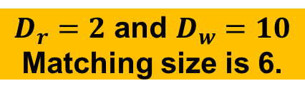
Motivation: An Example
Matching size is 6
$${ w}_{1}$$
$${ r}_{1}$$
$$w_{2}(1,8)$$
$$w_{3}(3,7)$$
$$r_{3}(6,7)$$
$${ w}_{2}$$
$${ r}_{2}$$
$$r_{6}(5,6)$$
$$r_{5}(7,6)$$
$${ w}_{3}$$
$${ r}_{3}$$
$$w_{1}(1,6)$$
$$r_{2}(3,6)$$
$${ w}_{4}$$
$${ r}_{4}$$
$$r_{1}(2,5)$$
$$r_{4}(6,5)$$
$${ w}_{5}$$
$${ r}_{5}$$
$$w_{7}(5,3.5)$$
$${ w}_{6}$$
$${ r}_{6}$$
$$w_{5}(8,2)$$
$${ w}_{7}$$
$$w_{6}(4,1)$$
$$w_{4}(6,1)$$
$D_{r}=2$min and $D_{w}=10$min

Slide 25
Motivation: An Example
Matching size is 6
$${ w}_{1}$$
$${ r}_{1}$$
$$w_{2}(1,8)$$
$$w_{3}(3,7)$$
$$r_{3}(6,7)$$
$${ w}_{2}$$
$${ r}_{2}$$
$$r_{6}(5,6)$$
$$r_{5}(7,6)$$
$${ w}_{3}$$
$${ r}_{3}$$
$$w_{1}(1,6)$$
$$r_{2}(3,6)$$
$${ w}_{4}$$
$${ r}_{4}$$
$$r_{1}(2,5)$$
$$r_{4}(6,5)$$
$${ w}_{5}$$
$${ r}_{5}$$
$$w_{7}(5,3.5)$$
$${ w}_{6}$$
$${ r}_{6}$$
The better matching size thanks to the flexible strategy that workers properly moved in advance
$$w_{5}(8,2)$$
$${ w}_{7}$$
$$w_{6}(4,1)$$
$$w_{4}(6,1)$$
$D_{r}=2$min and $D_{w}=10$min

Slide 26


























Motivation
Motivation: flexible task assignment
If a worker has no tasks to perform temporarily, s/he tends to move for potential tasks
$${ w}_{1}$$
$${ r}_{1}$$
$${ w}_{1}$$
$${ r}_{1}$$
$${ w}_{2}$$
$${ r}_{2}$$
$${ w}_{2}$$
$${ r}_{2}$$
$${ w}_{3}$$
$${ r}_{3}$$
$${ w}_{3}$$
$${ r}_{3}$$
$${ w}_{4}$$
$${ r}_{4}$$
$${ w}_{4}$$
$${ r}_{4}$$
$${ w}_{5}$$
$${ r}_{5}$$
$${ w}_{5}$$
$${ r}_{5}$$
$${ w}_{6}$$
$${ r}_{6}$$
$${ w}_{6}$$
$${ r}_{6}$$
$${ w}_{7}$$
$${ w}_{7}$$
Online task assignment
Flexible online task assignment

Slide 27


























Motivation
Motivation: flexible task assignment
If a worker has no tasks to perform temporarily, s/he tends to move for potential tasks
More practical, more potential assignment!
$${ r}_{1}$$
$${ r}_{1}$$
$${ r}_{1}$$
$${ w}_{1}$$
$${ r}_{1}$$
$${ w}_{1}$$
$${ w}_{1}$$
$${ w}_{1}$$
$${ r}_{2}$$
$${ r}_{2}$$
$${ r}_{2}$$
$${ w}_{2}$$
$${ r}_{2}$$
$${ w}_{2}$$
$${ w}_{2}$$
$${ w}_{2}$$
$${ r}_{3}$$
$${ r}_{3}$$
$${ r}_{3}$$
$${ w}_{3}$$
$${ r}_{3}$$
$${ w}_{3}$$
$${ w}_{3}$$
$${ w}_{3}$$
How to solve the flexible online task assignment problem?
$${ r}_{4}$$
$${ r}_{4}$$
$${ r}_{4}$$
$${ w}_{4}$$
$${ r}_{4}$$
$${ w}_{4}$$
$${ w}_{4}$$
$${ w}_{4}$$
$${ r}_{5}$$
$${ r}_{5}$$
$${ r}_{5}$$
$${ w}_{5}$$
$${ r}_{5}$$
$${ w}_{5}$$
$${ w}_{5}$$
$${ w}_{5}$$
$${ r}_{6}$$
$${ r}_{6}$$
$${ r}_{6}$$
$${ w}_{6}$$
$${ r}_{6}$$
$${ w}_{6}$$
$${ w}_{6}$$
$${ w}_{6}$$
Key idea: prediction + online matching
$${ w}_{7}$$
$${ w}_{7}$$
$${ w}_{7}$$
$${ w}_{7}$$
Online task assignment
Online task assignment
Flexible online task assignment
Flexible task assignment

Slide 28
Outline
Background and Motivation
Problem Statement
Our Solutions
Experiments
Conclusion

Slide 29
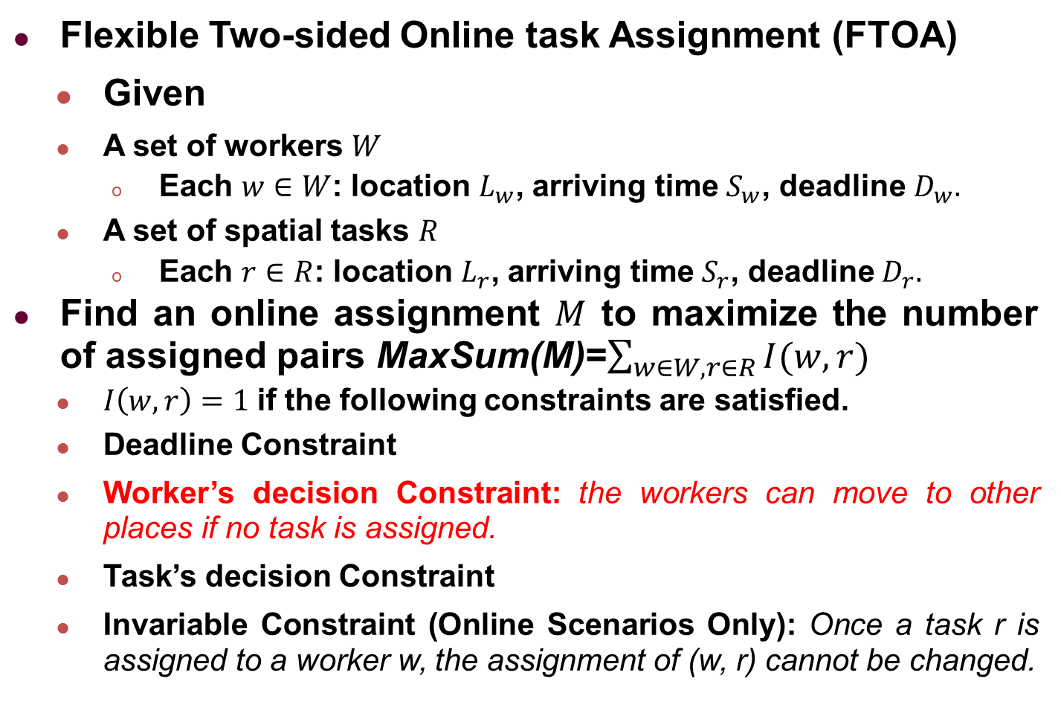
Problem Statement
Flexible Two-sided Online task Assignment (FTOA)
  Given
  A set of workers $W$
    Each $w∈W$: location $L_{w}$, arriving time $S_{w}$, deadline $D_{w}.$
  A set of spatial tasks $R$
    Each $r∈R$: location $L_{r}$, arriving time $S_{r}$, deadline$D_{r}.$
Find an online assignment $M$ to maximize the number of assigned pairs MaxSum(M)=$\sum_{w∈W,r∈R}{I(w,r)}$
  $I\left(w,r\right)=1$if the following constraints are satisfied.
  Deadline Constraint
  Worker’s decision Constraint: the workers can move to other places if no task is assigned.
  Task’s decision Constraint
  Invariable Constraint (Online Scenarios Only): Once a task r is assigned to a worker w, the assignment of (w, r) cannot be changed.

Slide 30
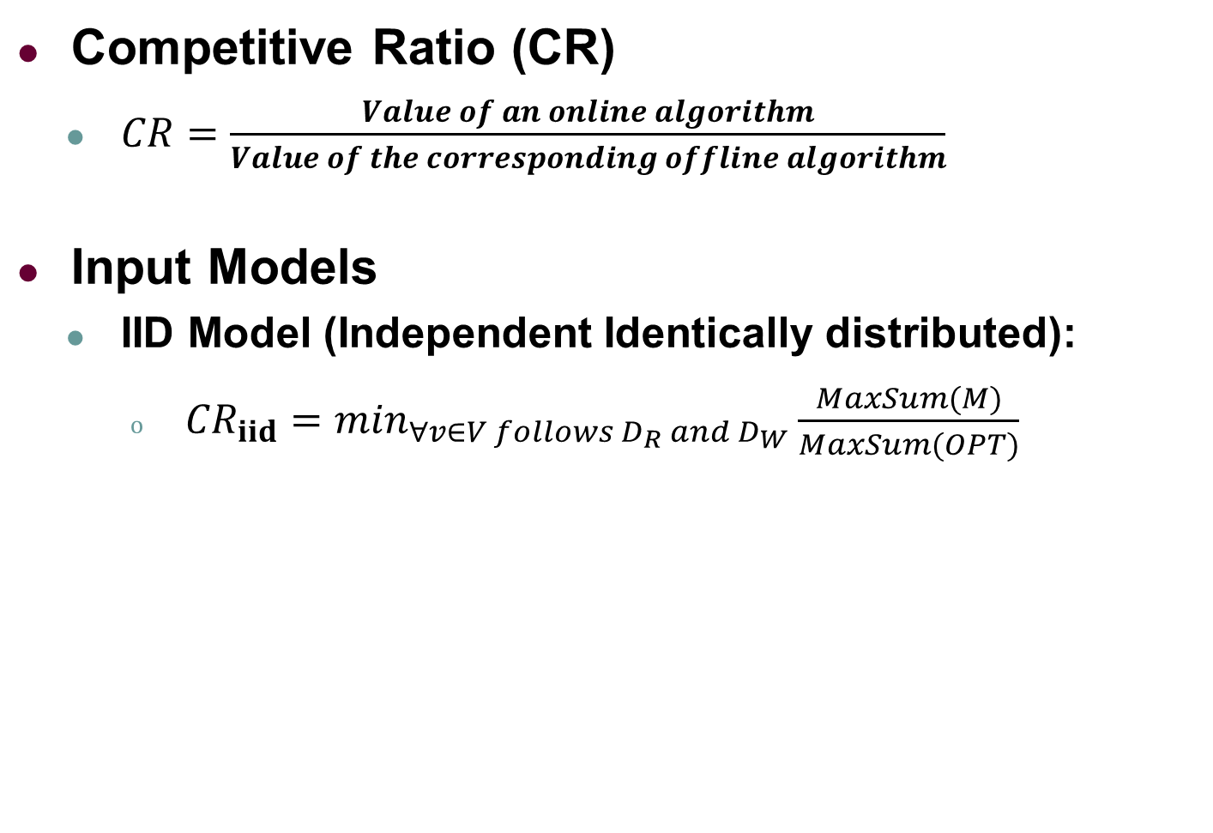
Evaluation for Online Algorithms
Competitive Ratio (CR)
  $CR=\frac{Value of an online algorithm}{Value of the corresponding offline algorithm}$
Input Models
  IID Model (Independent Identically distributed):
    ${CR}_{iid}=\min_{∀v∈V follows D_{R} and{ D}_{W}}\frac{MaxSum(M)}{MaxSum(OPT)}$
The stochastic bipartite graph
The probability distribution over tasks and workers
We assume that each worker/task is independently and identically distributed from a known distribution.

Slide 31
Outline
Background and Motivation
Problem Statement
Our Solutions
Experiments
Conclusion

Slide 32
Overall Framework
POLAR
POLAR-OP
Online task assignment
Construct bipartite graph
Generate offline guide
Offline Guide Generation
Space and time partition
Predict the number of tasks/workers
Offline Prediction

Slide 33
Offline Prediction
Basic idea
  Partition the spatial and temporal dimensions
  Use the state-of-the-art methods to predict the number of tasks/workers for each time slot and area
Y
8
Area0
Area1
7
Slot0(9:00
-
9:05)
Slot0(9:00
-
9:05)
6
Dividing the time into multiple 5-minute slots
Slot1(9:05
-
Slot1(9:05
9:10)
-
5
9:10)
4
Area2
Area3
Dividing the space into 4 grid areas
3
Slot0(9:00
-
Slot0(9:00
9:05)
-
9:05)
2
Slot1(9:05
-
Slot1(9:05
9:10)
-
9:10)
1
0
1
2
3
4
5
6
7
8
X
The granularity of the spatiotemporal partition is application-specific.

Slide 34
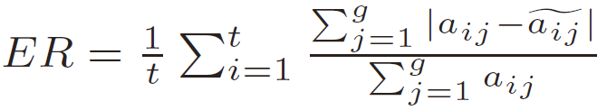
Offline Prediction
Our offline prediction component is a general framework and is independent with a specific prediction algorithm!
Compared algorithms
  Historical Average
  Linear Regression
  Neural Network
  Auto-Regressive Integrated Moving Average (ARIMA)
  Gradient Boosted Regression Tree (GBRT)
  Predictive Aggregation Queries (ICDE 2004)
  HP-MSI (GIS 2015)
Evaluation metric
Root Mean Squared Logarithmic Error (RMLSE)
Error Rate (ER)

Slide 35
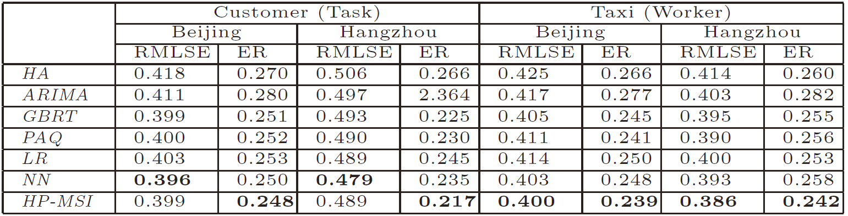
Offline Prediction: Experiments
Experimental Results
HP-MSI performs the best among all compared algorithms

Slide 36
Offline Prediction
Prediction Results
  For each area and time slot, there are two predicted numbers for workers and tasks
Two workers will appear in slot 0(9:00-9:05) and area 0 in expectation
One task will appear in slot 0(9:00-9:05) and area 0 in expectation

Slide 37
Overall Framework
POLAR
POLAR-OP
Online task assignment
Construct bipartite graph
Generate offline guide
Offline Guide Generation
Space and time partition
Predict the number of tasks/workers
Offline Prediction

Slide 38
Offline Guide Generation
Basic idea
  Construct a bipartite graph based on prediction results
  Run max-flow algorithms to get the offline maximum matching, called the “offline guide”

Slide 39















Offline Guide Generation
Basic idea
  Construct a bipartite graph based on prediction result
𝑫_𝒓−(𝑺_𝒘−𝑺_𝒓 )−𝒅(𝑳_𝒘,𝑳_𝒓 )≥𝟎 𝐚𝐧𝐝 𝑺_𝒓≤𝑺_𝒘+𝑫_𝒘
a₀₀ is instantiated
$${\hat{W}}^{001}$$
$${\hat{R}}^{001}$$
$$b_{00}$$
$$a_{00}$$
$${\hat{W}}^{002}$$
$${\hat{R}}^{111}$$
$${\hat{W}}^{031}$$
$${\hat{R}}^{112}$$
$$b_{11}$$
$$a_{03}$$
$${\hat{W}}^{032}$$
$${\hat{R}}^{113}$$
$${\hat{W}}^{033}$$
$${\hat{R}}^{121}$$
$$b_{12}$$

Slide 40























Offline Guide Generation
Basic idea
  Run max-flow algorithms to get the offline maximum matching, called the “offline guide”
$${\hat{W}}^{001}$$
$${\hat{R}}^{001}$$
$$b_{00}$$
$${\hat{W}}^{001}$$
$${\hat{R}}^{001}$$
$$a_{00}$$
cap=
1
flow=1
$${\hat{W}}^{002}$$
$${\hat{R}}^{111}$$
$${\hat{W}}^{002}$$
$${\hat{R}}^{111}$$
$$s$$
$$t$$
$${\hat{W}}^{031}$$
$${\hat{R}}^{112}$$
$$b_{11}$$
$${\hat{W}}^{031}$$
$${\hat{R}}^{112}$$
$$a_{03}$$
$${\hat{W}}^{032}$$
$${\hat{R}}^{113}$$
$${\hat{W}}^{032}$$
$${\hat{R}}^{113}$$
$${\hat{W}}^{033}$$
$${\hat{R}}^{121}$$
$${\hat{W}}^{033}$$
$${\hat{R}}^{121}$$
$$b_{12}$$
Offline Guide

Slide 41
Overall Framework
POLAR
POLAR-OP
Online task assignment
Construct bipartite graph
Generate offline guide
Offline Guide Generation
Space and time partition
Predict the number of tasks/workers
Offline Prediction

Slide 42
POLAR Algorithm
Basic idea
  When a new task/worker arrives, it tris to occupy a corresponding node in the offline guide
  If success, it finds the matched node in the offline guide
  It strictly performs the match according to the offline guide

Slide 43

















POLAR Algorithm
Timeline
$${\hat{W}}^{001}$$
$${\hat{R}}^{001}$$
$$b_{00}$$
9
：
00
$${\hat{W}}^{001}$$
(
)
$$w_{1}$$
[Stays in area0]
$$a_{00}$$
9
：
0
0
$${\hat{W}}^{002}$$
$${\hat{R}}^{111}$$
9
：
0
1
$$b_{11}$$
$${\hat{W}}^{031}$$
$${\hat{R}}^{112}$$
9
：
0
1
A node in offline guide can be regarded as a “box” that can contain a worker/task that actually appears on the platform
$$a_{03}$$
9
：
0
2
$${\hat{W}}^{032}$$
$${\hat{R}}^{113}$$
9
：
0
3
$${\hat{W}}^{033}$$
$${\hat{R}}^{121}$$
$$b_{12}$$
9
：
0
3
9
：
0
3
9
：
0
4
9
：
0
5
Area0
Area1
Area2
Area3
9
：
0
6
9
：
0
7
9
：
0
8

Slide 44


POLAR Algorithm
Timeline
$${\hat{W}}^{001}$$
$${\hat{R}}^{001}$$
$$b_{00}$$
9
：
00
$${\hat{W}}^{001}$$
(
)
$$w_{1}$$
[Stays in area0]
$$a_{00}$$
$${\hat{R}}^{001}$$
(
$$r_{1}$$
)
$${\hat{W}}^{002}$$
$${\hat{R}}^{111}$$
9
：
0
0
[Matches w₁
]
9
：
0
1
$$b_{11}$$
$${\hat{W}}^{031}$$
$${\hat{R}}^{112}$$
9
：
0
1
$$a_{03}$$
$${\hat{W}}^{032}$$
$${\hat{R}}^{113}$$
9
：
0
2
9
：
0
3
$${\hat{W}}^{033}$$
$${\hat{R}}^{121}$$
$$b_{12}$$
9
：
0
3
9
：
0
3
9
：
0
4
9
：
0
5
Area0
Area1
Area2
Area3
9
：
0
6
9
：
0
7
9
：
0
8

Slide 45


POLAR Algorithm
Timeline
$${\hat{W}}^{001}$$
$${\hat{R}}^{001}$$
$$b_{00}$$
9
：
00
$${\hat{W}}^{001}$$
(
)
$$w_{1}$$
[Stays in area0]
$$a_{00}$$
$${\hat{R}}^{001}$$
(
$$r_{1}$$
)
$${\hat{W}}^{002}$$
$${\hat{R}}^{111}$$
9
：
0
0
[Matches w₁
]
(
)
9
：
0
1
$${\hat{W}}^{002}$$
$$w_{2}$$
[Goes to area1]
$${\hat{W}}^{031}$$
$${\hat{R}}^{112}$$
$$b_{11}$$
9
：
0
1
$$a_{03}$$
$${\hat{W}}^{032}$$
$${\hat{R}}^{113}$$
9
：
0
2
9
：
0
3
$${\hat{W}}^{033}$$
$${\hat{R}}^{121}$$
$$b_{12}$$
9
：
0
3
9
：
0
3
9
：
0
4
9
：
0
5
Area0
Area1
Area2
Area3
9
：
0
6
9
：
0
7
9
：
0
8

Slide 46

POLAR Algorithm
Timeline
$${\hat{W}}^{001}$$
$${\hat{R}}^{001}$$
$$b_{00}$$
9
：
00
$${\hat{W}}^{001}$$
(
)
$$w_{1}$$
[Stays in area0]
$$a_{00}$$
$${\hat{R}}^{001}$$
(
$$r_{1}$$
)
$${\hat{W}}^{002}$$
$${\hat{R}}^{111}$$
9
：
0
0
[Matches w₁
]
(
)
9
：
0
1
$${\hat{W}}^{002}$$
$$w_{2}$$
[Goes to area1]
$${\hat{W}}^{031}$$
$${\hat{R}}^{112}$$
$$b_{11}$$
9
：
0
1
$$w_{3}$$
[Fails to occupy]
$$a_{03}$$
$${\hat{W}}^{032}$$
$${\hat{R}}^{113}$$
9
：
0
2
Since the two nodes of a00 have been occupied in the offline guide, w3 is simply ignored.
9
：
0
3
$${\hat{W}}^{033}$$
$${\hat{R}}^{121}$$
$$b_{12}$$
9
：
0
3
9
：
0
3
9
：
0
4
9
：
0
5
Area0
Area1
Area2
Area3
9
：
0
6
9
：
0
7
9
：
0
8

Slide 47

POLAR Algorithm
Timeline
$${\hat{W}}^{001}$$
$${\hat{R}}^{001}$$
$$b_{00}$$
9
：
00
$${\hat{W}}^{001}$$
(
)
$$w_{1}$$
[Stays in area0]
$$a_{00}$$
$${\hat{R}}^{001}$$
(
$$r_{1}$$
)
$${\hat{W}}^{002}$$
$${\hat{R}}^{111}$$
9
：
0
0
[Matches w₁
]
(
)
9
：
0
1
$${\hat{W}}^{002}$$
$$w_{2}$$
[Goes to area1]
$${\hat{W}}^{031}$$
$${\hat{R}}^{112}$$
$$b_{11}$$
9
：
0
1
$$w_{3}$$
[Fails to occupy]
$$r_{2}$$
$$a_{03}$$
$${\hat{W}}^{032}$$
$${\hat{R}}^{113}$$
9
：
0
2
[Fails to occupy]
9
：
0
3
$${\hat{W}}^{033}$$
$${\hat{R}}^{121}$$
$$b_{12}$$
9
：
0
3
9
：
0
3
9
：
0
4
9
：
0
5
Area0
Area1
Area2
Area3
9
：
0
6
9
：
0
7
9
：
0
8

Slide 48


POLAR Algorithm
Timeline
$${\hat{W}}^{001}$$
$${\hat{R}}^{001}$$
$$b_{00}$$
9
：
00
$${\hat{W}}^{001}$$
(
)
$$w_{1}$$
[Stays in area0]
$$a_{00}$$
$${\hat{R}}^{001}$$
(
$$r_{1}$$
)
$${\hat{W}}^{002}$$
$${\hat{R}}^{111}$$
9
：
0
0
[Matches w₁
]
(
)
9
：
0
1
$${\hat{W}}^{002}$$
$$w_{2}$$
[Goes to area1]
$${\hat{W}}^{031}$$
$${\hat{R}}^{112}$$
$$b_{11}$$
9
：
0
1
$$w_{3}$$
[Fails to occupy]
$$r_{2}$$
$$a_{03}$$
$${\hat{W}}^{032}$$
$${\hat{R}}^{113}$$
9
：
0
2
[Fails to occupy]
(
)
9
：
0
3
$${\hat{W}}^{031}$$
$$w_{4}$$
[Goes to area 1]
$$b_{12}$$
$${\hat{W}}^{033}$$
$${\hat{R}}^{121}$$
9
：
0
3
9
：
0
3
9
：
0
4
9
：
0
5
Area0
Area1
Area2
Area3
9
：
0
6
9
：
0
7
9
：
0
8

Slide 49


POLAR Algorithm
Timeline
$${\hat{W}}^{001}$$
$${\hat{R}}^{001}$$
$$b_{00}$$
9
：
00
$${\hat{W}}^{001}$$
(
)
$$w_{1}$$
[Stays in area0]
$$a_{00}$$
$${\hat{R}}^{001}$$
(
$$r_{1}$$
)
$${\hat{W}}^{002}$$
$${\hat{R}}^{111}$$
9
：
0
0
[Matches w₁
]
(
)
9
：
0
1
$${\hat{W}}^{002}$$
$$w_{2}$$
[Goes to area1]
$${\hat{W}}^{031}$$
$${\hat{R}}^{112}$$
$$b_{11}$$
9
：
0
1
$$w_{3}$$
[Fails to occupy]
$$r_{2}$$
$$a_{03}$$
$${\hat{W}}^{032}$$
$${\hat{R}}^{113}$$
9
：
0
2
[Fails to occupy]
(
)
9
：
0
3
$${\hat{W}}^{031}$$
$$w_{4}$$
[Goes to area 1]
$$b_{12}$$
$${\hat{W}}^{033}$$
$${\hat{R}}^{121}$$
(
)
9
：
0
3
$${\hat{W}}^{032}$$
$$w_{5}$$
[Goes to area 1]
9
：
0
3
9
：
0
4
9
：
0
5
Area0
Area1
Area2
Area3
9
：
0
6
9
：
0
7
9
：
0
8

Slide 50


POLAR Algorithm
Timeline
$${\hat{W}}^{001}$$
$${\hat{R}}^{001}$$
$$b_{00}$$
9
：
00
$${\hat{W}}^{001}$$
(
)
$$w_{1}$$
[Stays in area0]
$$a_{00}$$
$${\hat{R}}^{001}$$
(
$$r_{1}$$
)
$${\hat{W}}^{002}$$
$${\hat{R}}^{111}$$
9
：
0
0
[Matches w₁
]
(
)
9
：
0
1
$${\hat{W}}^{002}$$
$$w_{2}$$
[Goes to area1]
$${\hat{W}}^{031}$$
$${\hat{R}}^{112}$$
$$b_{11}$$
9
：
0
1
$$w_{3}$$
[Fails to occupy]
$$r_{2}$$
$$a_{03}$$
$${\hat{W}}^{032}$$
$${\hat{R}}^{113}$$
9
：
0
2
[Fails to occupy]
(
)
9
：
0
3
$${\hat{W}}^{031}$$
$$w_{4}$$
[Goes to area 1]
$$b_{12}$$
$${\hat{W}}^{033}$$
$${\hat{R}}^{121}$$
(
)
9
：
0
3
$${\hat{W}}^{032}$$
$$w_{5}$$
[Goes to area 1]
(
)
9
：
0
3
$${\hat{W}}^{033}$$
$$w_{6}$$
[Goes to area 2]
9
：
0
4
9
：
0
5
Area0
Area1
Area2
Area3
9
：
0
6
9
：
0
7
9
：
0
8

Slide 51



POLAR Algorithm
Timeline
$${\hat{W}}^{001}$$
$${\hat{R}}^{001}$$
$$b_{00}$$
9
：
00
$${\hat{W}}^{001}$$
(
)
$$w_{1}$$
[Stays in area0]
$$a_{00}$$
$${\hat{R}}^{001}$$
(
$$r_{1}$$
)
$${\hat{W}}^{002}$$
$${\hat{R}}^{111}$$
9
：
0
0
[Matches w₁
]
(
)
9
：
0
1
$${\hat{W}}^{002}$$
$$w_{2}$$
[Goes to area1]
$${\hat{W}}^{031}$$
$${\hat{R}}^{112}$$
$$b_{11}$$
9
：
0
1
$$w_{3}$$
[Fails to occupy]
$$r_{2}$$
$$a_{03}$$
$${\hat{W}}^{032}$$
$${\hat{R}}^{113}$$
9
：
0
2
[Fails to occupy]
(
)
9
：
0
3
$${\hat{W}}^{031}$$
$$w_{4}$$
[Goes to area 1]
$$b_{12}$$
$${\hat{W}}^{033}$$
$${\hat{R}}^{121}$$
(
)
9
：
0
3
$${\hat{W}}^{032}$$
$$w_{5}$$
[Goes to area 1]
(
)
9
：
0
3
$${\hat{W}}^{033}$$
$$w_{6}$$
[Goes to area 2]
9
：
0
4
$$w_{7}$$
[Fails to occupy]
$${\hat{R}}^{111}$$
(
$$r_{3}$$
)
9
：
0
5
[Matches w₂
]
Area0
Area1
Area2
Area3
9
：
0
6
9
：
0
7
9
：
0
8

Slide 52














POLAR Algorithm
Matching size = 4
CR = 0.4
Timeline
$${\hat{W}}^{001}$$
$${\hat{R}}^{001}$$
$$b_{00}$$
9
：
00
$${\hat{W}}^{001}$$
(
)
$$w_{1}$$
[Stays in area0]
$$a_{00}$$
$${\hat{R}}^{001}$$
(
$$r_{1}$$
)
$${\hat{W}}^{002}$$
$${\hat{R}}^{111}$$
9
：
0
0
[Matches w₁
]
(
)
9
：
0
1
$${\hat{W}}^{002}$$
$$w_{2}$$
[Goes to area1]
$${\hat{W}}^{031}$$
$${\hat{R}}^{112}$$
$$b_{11}$$
9
：
0
1
$$w_{3}$$
[Fails to occupy]
$$r_{2}$$
$$a_{03}$$
$${\hat{W}}^{032}$$
$${\hat{R}}^{113}$$
9
：
0
2
[Fails to occupy]
(
)
9
：
0
3
$${\hat{W}}^{031}$$
$$w_{4}$$
[Goes to area 1]
$$b_{12}$$
$${\hat{W}}^{033}$$
$${\hat{R}}^{121}$$
(
)
9
：
0
3
$${\hat{W}}^{032}$$
$$w_{5}$$
[Goes to area 1]
(
)
9
：
0
3
$${\hat{W}}^{033}$$
$$w_{6}$$
[Goes to area 2]
9
：
0
4
$$w_{7}$$
[Fails to occupy]
$${\hat{R}}^{111}$$
(
$$r_{3}$$
)
9
：
0
5
[Matches w₂
]
Area0
Area1
(
$$r_{4}$$
)
Area2
Area3
9
：
0
6
$${\hat{R}}^{112}$$
[Matches w₄
]
The tasks/workers, who fail to occupy the nodes in the offline guide, are ignored
(
$$r_{5}$$
)
9
：
0
7
$${\hat{R}}^{113}$$
[Matches w₅
]
9
：
0
8
$$r_{6}$$
[Fails to occupy]

Slide 53
POLAR-OP Algorithm
Basic idea
  When a new task/worker arrives, it tris to associate a corresponding node in the offline guide
  If success, it finds the matched node in the offline guide
  It performs the match according to the offline guide
  Note that each node in the offline guide can be associated multiple times

Slide 54





POLAR-OP Algorithm
Timeline
$${\hat{W}}^{001}$$
$${\hat{R}}^{001}$$
$$b_{00}$$
9
(
$$w_{1}$$
)
：
00
$${\hat{W}}^{001}$$
[Stays in area 0]
$$a_{00}$$
9
(
)
$${\hat{W}}^{002}$$
$${\hat{R}}^{111}$$
：
0
0
$${\hat{R}}^{001}$$
$$r_{1}$$
[Matches w₁
]
$${\hat{W}}^{002}$$
(
)
9
$$w_{2}$$
：
0
1
[Goes to area 1]
$$b_{11}$$
$${\hat{W}}^{031}$$
$${\hat{R}}^{112}$$
9
(
)
：
0
1
$${\hat{W}}^{001}$$
$$w_{3}$$
[Stays in area 0]
$$a_{03}$$
$${\hat{W}}^{032}$$
$${\hat{R}}^{113}$$
9
：
0
2
The worker w3 will be associated with the node W⁰⁰¹, and will also be matched to a task that is associated with R⁰⁰¹
9
：
0
3
$${\hat{W}}^{033}$$
$${\hat{R}}^{121}$$
$$b_{12}$$
9
：
0
3
9
：
0
3
9
：
0
4
9
Area0
Area1
：
0
5
Area2
Area3
9
：
0
6
9
：
0
7
9
：
0
8

Slide 55


POLAR-OP Algorithm
Timeline
$${\hat{W}}^{001}$$
$${\hat{R}}^{001}$$
$$b_{00}$$
9
(
$$w_{1}$$
)
：
00
$${\hat{W}}^{001}$$
[Stays in area 0]
$$a_{00}$$
9
(
)
$${\hat{W}}^{002}$$
$${\hat{R}}^{111}$$
：
0
0
$${\hat{R}}^{001}$$
$$r_{1}$$
[Matches w₁
]
$${\hat{W}}^{002}$$
(
)
9
$$w_{2}$$
：
0
1
[Goes to area 1]
$$b_{11}$$
$${\hat{W}}^{031}$$
$${\hat{R}}^{112}$$
9
(
)
：
0
1
$${\hat{W}}^{001}$$
$$w_{3}$$
[Stays in area 0]
(
)
$$a_{03}$$
$${\hat{W}}^{032}$$
$${\hat{R}}^{113}$$
9
$${\hat{R}}^{001}$$
$$r_{2}$$
：
0
2
[
Matches
w₃
]
9
：
0
3
$${\hat{W}}^{033}$$
$${\hat{R}}^{121}$$
$$b_{12}$$
9
：
0
3
9
：
0
3
9
：
0
4
9
Area0
Area1
：
0
5
Area2
Area3
9
：
0
6
9
：
0
7
9
：
0
8

Slide 56












POLAR-OP Algorithm
Matching size = 6
CR = 0.47
Timeline
$${\hat{W}}^{001}$$
$${\hat{R}}^{001}$$
$$b_{00}$$
9
(
$$w_{1}$$
)
：
00
$${\hat{W}}^{001}$$
[Stays in area 0]
$$a_{00}$$
9
(
)
$${\hat{W}}^{002}$$
$${\hat{R}}^{111}$$
：
0
0
$${\hat{R}}^{001}$$
$$r_{1}$$
[Matches w₁
]
$${\hat{W}}^{002}$$
(
)
9
$$w_{2}$$
：
0
1
[Goes to area 1]
$$b_{11}$$
$${\hat{W}}^{031}$$
$${\hat{R}}^{112}$$
(
)
OPLAR strictly follows the offline guide, so it ignores these unexpected workers/tasks
9
：
0
1
$${\hat{W}}^{001}$$
$$w_{3}$$
[Stays in area 0]
(
)
$$a_{03}$$
$${\hat{W}}^{032}$$
$${\hat{R}}^{113}$$
9
$${\hat{R}}^{001}$$
$$r_{2}$$
：
0
2
[
Matches
w₃
]
(
)
9
$${\hat{W}}^{031}$$
$$w_{4}$$
：
0
3
[Goes to area 1]
$${\hat{W}}^{033}$$
$${\hat{R}}^{121}$$
$$b_{12}$$
(
)
9
$${\hat{W}}^{032}$$
$$w_{5}$$
：
0
3
[Goes to area 1]
(
)
9
$$w_{6}$$
：
0
3
$${\hat{W}}^{033}$$
[Goes to area 2]
OPLAR-OP handles the unexpected workers/tasks by reusing the “boxes” (nodes) in the offline guide
(
$$w_{7}$$
)
[
9
$${\hat{W}}^{031}$$
Goes to
area
1
]
：
0
4
(
$$r_{3}$$
)
9
$${\hat{R}}^{111}$$
[Matches w₂
]
Area0
Area1
：
0
5
(
)
Area2
Area3
9
$${\hat{R}}^{112}$$
$$r_{4}$$
[Matches w₄
]
：
0
6
(
$$r_{5}$$
)
9
$${\hat{R}}^{113}$$
[Matches w₅
]
：
0
7
(
)
9
$${\hat{R}}^{112}$$
$$r_{6}$$
[Matches w₇
]
：
0
8

Slide 57
Outline
Background and Motivation
Problem Statement
Our Solutions
Experiments
Conclusion

Slide 58
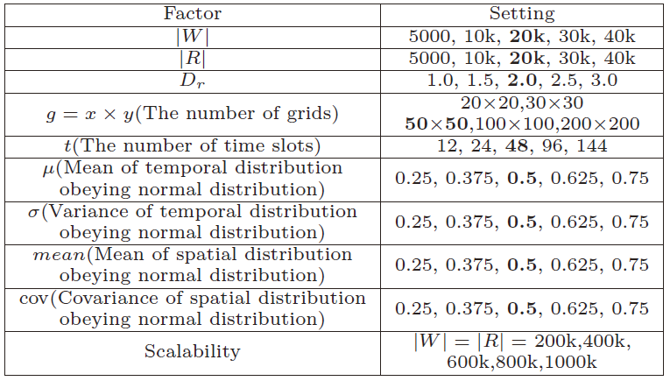
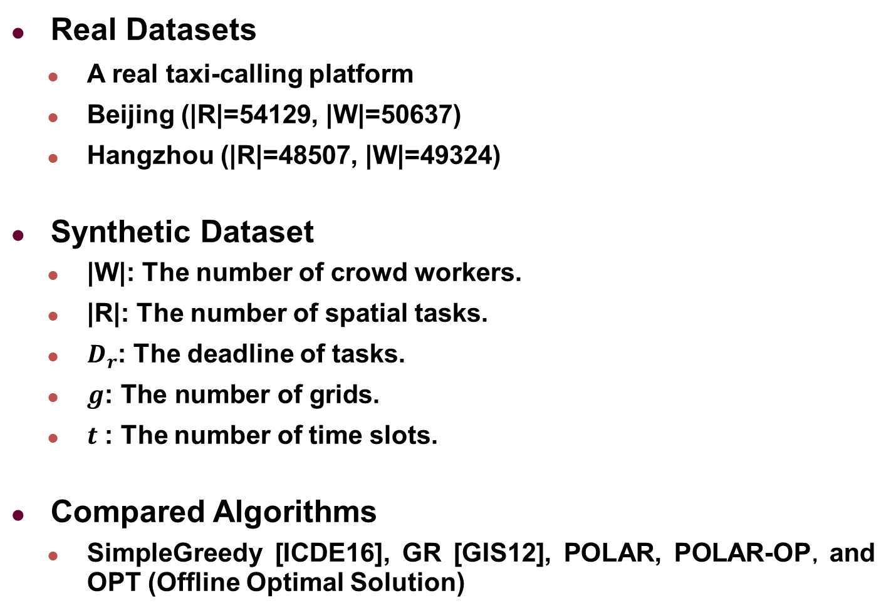
Experimental Setting
Real Datasets
  A real taxi-calling platform
  Beijing (|R|=54129, |W|=50637)
  Hangzhou (|R|=48507, |W|=49324)
Synthetic Dataset
  |W|: The number of crowd workers.
  |R|: The number of spatial tasks.
  $D_{r}$: The deadline of tasks.
  $g\text{: }\text{The} \text{number} \text{of} \text{grids}$.
  $t$ : The number of time slots.
Compared Algorithms
  SimpleGreedy [ICDE16], GR [GIS12], POLAR, POLAR-OP，and OPT (Offline Optimal Solution)

Slide 59
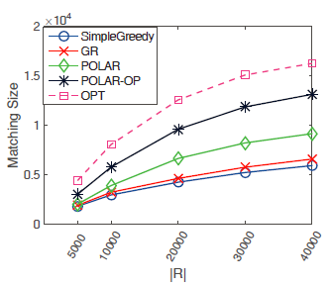
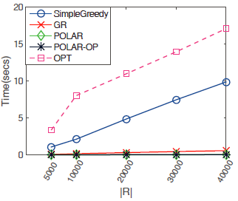
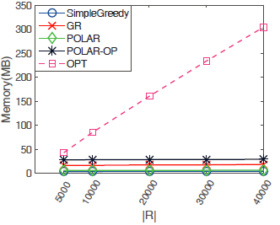
Experiments: Vary |R|
POLAR-OP is the most effective
POLAR-OP is the most efficient
Comparing the matching size of the online algorithms against the offline OPT

Slide 60
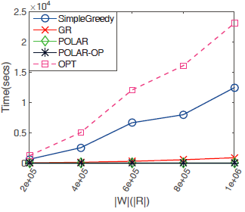
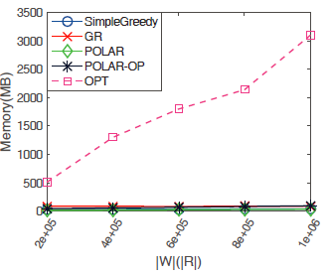
Experiments: Scalability
POLAR-OP is quite scalable, even for a dataset with one million workers and tasks

Slide 61
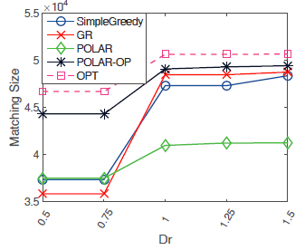
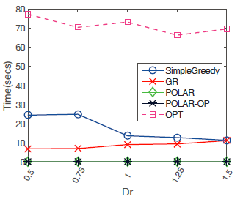
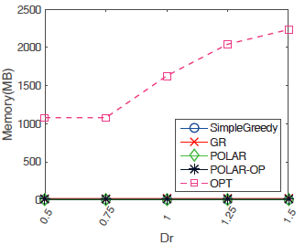
Experiments: Real Data
With increasing the length of tasks’ deadline, POLAR-OP still performs best on real datasets

Slide 62
Outline
Background and Motivation
Problem Statement
Our Solutions
Experiments
Conclusion

Slide 63
Conclusion
Identify a new problem of online task assignment, called Flexible Two-sided Online task Assignment (FTOA), in real-time spatial data
Design a novel two-step framework, which integrates offline prediction with online task assignment
Propose two competitive online algorithms, called POLAR and POLAR-OP, with constant competitive ratio
Extensive experiments on both real and synthetic datasets verify our solutions

Slide 64

Thank You
Q & A

