Slide 1
Purple Team Analytic Development
81 Cyber protection team

Slide 2
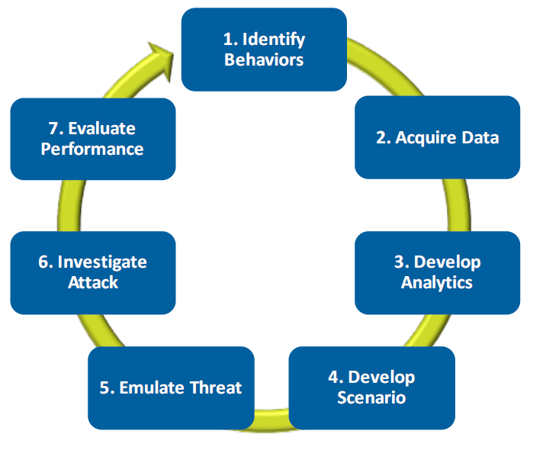
ATT&CK based Analytic Development
The ATT&CK model can be utilized as a framework for purple team analytic development
Key principles:
Post-Compromise Focus
Behavioral Focus
Iterative approach by design
Develop and test in realistic environment
Minimize false negatives by accepting false positives
Notes:
Reference: Finding Cyber Threats with ATT&CK™-Based Analytics, Mitre

Slide 3
Analytic Development Workflow
Phase 4: Continuous Improvement
Identify and Collect Data
Uncover Patterns of Behavior
Develop Analytics
Emulate Technique
Evaluate Performance
Research Technique
Develop Scenario & Environment
Community Review
Evaluate and Refine
Phase 1: Preparation
Phase 3: Analytic Refinement
Phase 2: Active Emulation and Detection

Slide 4
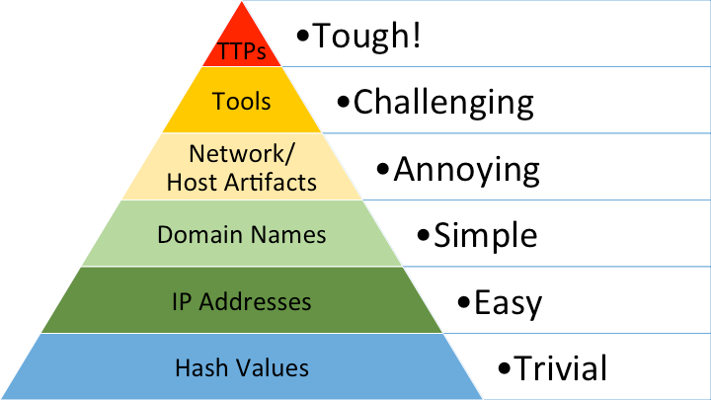
Mature Analytic Development
Reliable detection cannot be accomplished by analyzing a single event
Uncover patterns of behavior
Focus on the inevitable result of execution, not the execution itself
Moves detection capabilities further up the pyramid of pain
Don’t confuse a Splunk Query for an analytic

Slide 5

Mature Analytic Development
Low Maturity
Static/Easily Changeable Indicators
Medium Maturity
Moves away from easily changeable indicators
Low False Negative
High Maturity
Focused on unavoidable result of executing a technique
Positive identification regardless of technique execution
Easily avoidable, short shelf life
High False Negative
Zero False Negative
Manageable False Positive
Only able to detect specific execution techniques
Effectively an ‘IOC’
Low False Positive
High fidelity detection in various environments
May not perform well in different environments
May incorporate multiple data sources and methods of execution
High False Positive

Slide 6
Key Takeaways
Avoid the trap of thinking ‘full coverage’ is the goal
Full coverage is neither necessary nor practical
Don’t assume all techniques are equal
Some techniques are not worth developing analytics for
Don’t assume all data sources are equal
Data sources vary greatly in fidelity and completeness
Avoid binary coverage maps (covered/not covered)
Think of coverage as a spectrum of strength weighed by multiple factors
Focus on post-incident detection
Look for the ‘ripple’ not the ‘rock’

Slide 7
T1088 UAC Bypass
By: Christopher Schmid and Garrick Macas
Notes:
Good (morning, afternoon) gentlemen (and ladies) this is a presentation on UAC Bypass also known as T1088 on the MITRE AT&TACK framework.

Slide 8
Analytic Development Workflow
Phase 4: Continuous Improvement
Identify and Collect Data
Uncover Patterns of Behavior
Develop Analytics
Emulate Technique
Evaluate Performance
Research Technique
Develop Scenario & Environment
Community Review
Evaluate and Refine
Phase 1: Preparation
Phase 3: Analytic Refinement
Phase 2: Active Emulation and Detection
Notes:
Reference: Finding Cyber Threats with ATT&CK™-Based Analytics
References to get started: https://github.com/hunters-forge/ThreatHunter-Playbook

Slide 9
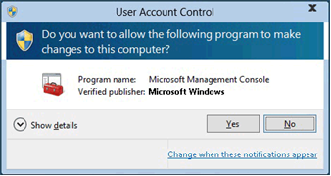
What is User Account Control (UAC)?
Known for the consent/credential prompt when administrative privileges are requested
Access tokens
Standard – administrative privileges and security identifiers removed
Standard/Administrator Accounts
Administrator
Administrator Accounts only
NOT a Security Boundary
Notes:
UAC or User Account Control is commonly known for the consent prompt window or the credential prompt window that appears when a user needs to perform a task on a Microsoft Windows system that requires administrative privileges. The prompt windows are also known as an elevation prompt. When a standard user logs on to a system a standard user access token is created by the system. The user’s access token contains access information which includes the user’s security identifier and Windows privileges. The standard access token is checked prior to performing tasks and executing prompt if applicable. For an administrator two tokens are created by the system which are the standard user access token and an administrative access token. An administrator’s standard users access token has the same access information as a standard user, however the Windows privileges and security identifiers are removed. As an administrator the standard users token is used to display explorer.exe which is the desktop and explorer.exe becomes the parent process to all child processes that are started by the administrator. All child processes inherit the access token of the parent process to include any tasks started by the administrator.
Reference: https://docs.microsoft.com/en-us/windows/security/identity-protection/user-account-control/how-user-account-control-works

Slide 10
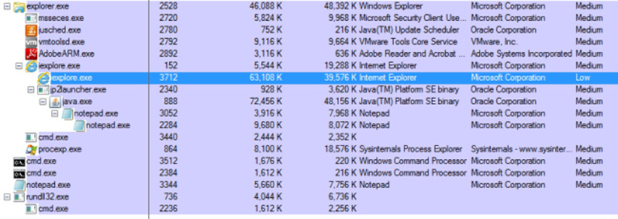
What is Integrity Context?
Integrity levels
System: reserved for the system
High: modifies the system
Medium: task with current user’s privileges
Low: heavily restricted process
Process could potentially cause damage to the operating system, so it is given the tightest restrictions
Notes:
Applications run in one of four integrity levels which are System, high, medium, and low. High integrity can be translated as a high level of trust and involves tasks that modify system data. Medium integrity runs any task with current user’s privileges. Low integrity involves tasks that could potentially compromise the operating system and are heavily restricted. By default, Window’s UAC settings are set to “Notify me only when a programs try to make changes to my computer” which will not prompt the user for certain built-in Windows programs that require administrative privileges

Slide 11
Early Implementation
First introduced in Windows Vista
Continuously Requested to Elevate
Scaled back drastically in Windows 7
Impeded some offensive operations
UAC Now
Certain Microsoft applications are able to “AutoElevate”
Many Microsoft and all non-Microsoft applications request the “Consent Banner”

Slide 12
AIS Boolean Summary
The Application Information Service initiates a Boolean to determine if an Executable can spawn a child process in a higher integrity context without requesting consent
Executable on Whitelist -- OR -- “AutoElevate Set to “True”
-- AND --
Executable signed by Microsoft
-- AND --
Executable run out of a trusted system Directory

Slide 13
AIS Boolean Step 1
AIS will read the desired Executable’s manifest looking for the "AutoElevate" key being set to "True“
If the key is set to “False” and is not on the executable is not on a whitelist, consent.exe will be run and the user will be prompted to approve the program to run

Slide 14
AIS Boolean Step 2
If "True" or "False" (or nonexistent) but on the executable whitelist‘ The program will do a signature check using wintrust!WTGetSignatureInfo (verify signature)
If neither of those wickets are hit, consent.exe will be run and the user will be prompted to approve the program to run.

Slide 15
AIS Boolean Step 3
If "True” The program will be checked to see if it is running from a trusted directory by passing the given path to GetLongPathNameW API (to force full path usage as opposed to relative path). The string is then compared to the list of trusted directories using RtlPrefixUnicodeString API(such as C:\windows\system32).
If the directory is not trusted, consent.exe will be run and the user will be prompted to approve the program to run.
If True the program will run with no user consent needed.

Slide 16
Laws of Process Integrity
A process can not change it’s own integrity level
Once a process is running, its integrity level cannot be changed
A process may only create other processes with its current integrity level or lower.
Processes cannot modify/write processes/files with a higher integrity level.

Slide 17
Laws of Process Integrity: Exceptions
A high integrity process granted SE_DEBUG_NAME can modify processes of a higher integrity level.
A medium integrity process that is signed by Microsoft can elevate certain COM objects from medium to high integrity
A process can request elevation from medium to high integrity, but only upon execution

Slide 18
Normal AutoElevate Operation
Cmd.exe launches Sysprep.exe in a Medium Integrity Context
Sysprep.exe passes all the Booleans and requests integrity elevation
Sysprep.exe process requests a higher integrity context via an Elevated Com Object to parent process
Parent process uses the Elevated Com Object to spawn a new higher integrity Sysprep process
The original, medium integrity, Sysprep process is killed

Slide 19
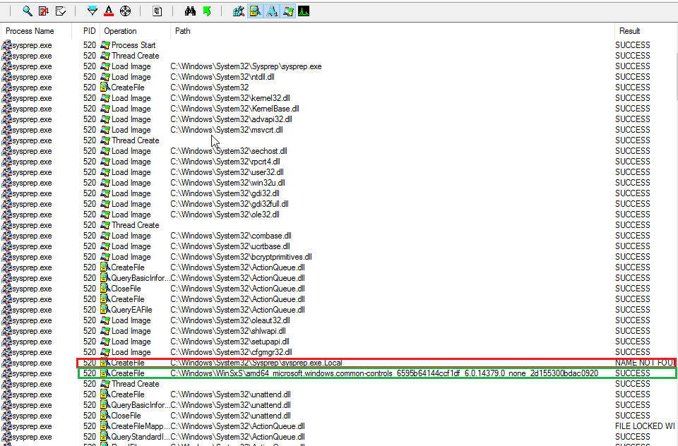
DLL Hijack Vulnerability
C:\windows\system32\sysprep\sysprep.exe.local\amd64_microsoft.windows.common-controls_6595b64144ccf1df_6.0.14379.0_none_2d155300bdac0920\comctl32.dll
Notes:
Application component.

Slide 20
UAC Bypass in the Wild
Tools
Organizations
Autolt backdoor
BlackEnergy
Bronze Butler
Cobalt Strike
Downdelph
Empire
Pupy
APT28
APT29
APT37
Cobalt Group
**Everyone Else

Slide 21
Public Exploits
57 known UAC vulnerabilities exist as of September 23rd 2019.
Theses are annotated on the UACME GitHub project
Methods include:
Dll Hijack, Appcompat, Elevated Com Interface, Shell API, Race Condition, Whitelisted Component, Token Manipulation, and even a GUI Hack
https://github.com/hfiref0x/UACME

Slide 22
Analytic Development Workflow
Phase 4: Continuous Improvement
Identify and Collect Data
Uncover Patterns of Behavior
Develop Analytics
Emulate Technique
Evaluate Performance
Research Technique
Develop Scenario & Environment
Community Review
Evaluate and Refine
Phase 1: Preparation
Phase 3: Analytic Refinement
Phase 2: Active Emulation and Detection

Slide 23
Emulation & Detection Environment
Victim Machines
Windows 7 (x86/x64)
Windows 10 (x86/x64)
Red Team Machines
Kali Linux
Analysis Tools
Splunk
Process Monitor
Sysmon
sysmon-modular configuration file

Slide 24
Analytic Development Workflow
Phase 4: Continuous Improvement
Identify and Collect Data
Uncover Patterns of Behavior
Develop Analytics
Emulate Technique
Evaluate Performance
Research Technique
Develop Scenario & Environment
Community Review
Evaluate and Refine
Phase 1: Preparation
Phase 3: Analytic Refinement
Phase 2: Active Emulation and Detection

Slide 25
UACME Emulation
Akagi.exe | OS | Method | SubMethod
22 | 10x64 | Dll Hijack | COM Interface
23 | 10x64 | Dll Hijack | COM Interface
24 | 10x64 | Shell API | EVE
1 | 7x86 | Dll Hijack | COM Interface
2 | 7x86 | Dll Hijack | COM Interface
3 | 7x86 | Dll Hijack | COM Interface
4 | 7x64 | AppCompat | Shim
5 | 7x64 | Reg Key | COM Interface
6 | 7x86 | Dll Hijack | WUSA
7 | 7X86 | Dll Hijack | WUSA
9 | 10X64 | Dll Hijack | WUSA
11 | 7X86 | AppCompat | Shim
52 | 8.1X64,7X86 | Whitelist | AIP
36 | 7X86 | Dll Hijack | Race

Slide 26
Analytic Development Workflow
Phase 4: Continuous Improvement
Identify and Collect Data
Uncover Patterns of Behavior
Develop Analytics
Emulate Technique
Evaluate Performance
Research Technique
Develop Scenario & Environment
Community Review
Evaluate and Refine
Phase 1: Preparation
Phase 3: Analytic Refinement
Phase 2: Active Emulation and Detection

Slide 27
Sysmon Events Identified
27
Sysmon | Windows ID(s) | Event Type | Sysmon | Windows ID(s) | Event Type
1 | Security: 4688 | Process Creation | 12 | Security: 4657 | Registry Create and Delete
2 | Security: 4657 | Process Changed a file creation time | 13 | Security: 4657 | Registry Value Set
3 | Security: 5156 | Network Connection | 14 | Security: 4657 | Registry Key and Value Rename
4 | n/a | Sysmon Service State Change | 15 | n/a | File Create Stream Hash
5 | Security: 4689 | Process Terminated | 16 | n/a | Sysmon Config Change
6 | System: 6, 219, 7026 | Driver Loaded | 17 | n/a | Pipe Event Created
7 | n/a | Image Loaded | 18 | n/a | Pipe Event Connected
8 | n/a | Create Remote Thread | 19 | Security: 5861, 5858, 5859 | WMI EventFilter activity
9 | n/a | Raw File Access Read | 20 | Security: 5861, 5858, 5859 | WMI EventConsumer activity
10 | n/a | Process Access | 21 | Security: 5861, 5858, 5859 | WMI EventConsumerToFilter activity
11 | Security: 4663 | File Create | 22 | Security: 1016, 3008, 3010, 3020 | DNS Query
Notes:
This is a slide of eventID’s for sysmon. You will notice that each Sysmon EventID correlates with an Event Type and most EventID’s correlate with Windows ID’s. I am going to show you two queries in order to detect two different UAC bypass techniques, but you must understand that EventID 1 has an EventType is “Process Creation” and EventID 13 is “Registry Value Set”. I highly encourage getting familiar with these eventID’s on your own time in order to construct effective Splunk and Elasticsearch queries.

Slide 28
Analytic Development Workflow
Phase 4: Continuous Improvement
Identify and Collect Data
Uncover Patterns of Behavior
Develop Analytics
Emulate Technique
Evaluate Performance
Research Technique
Develop Scenario & Environment
Community Review
Evaluate and Refine
Phase 1: Preparation
Phase 3: Analytic Refinement
Phase 2: Active Emulation and Detection

Slide 29
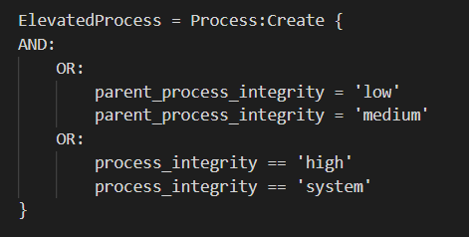
Patterns of Behavior: Process Spawns a Child with Higher Integrity
All emulated UAC bypass behavior follows a specific pattern
Exploitation Method Executed
DLL Hijack, Environment Variable Expansion, Registry Search Order Hijack, etc..
Process spawns a child process with higher integrity

Slide 30
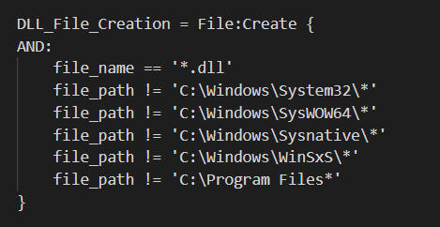
Patterns of Behavior: DLL Hijack
Behavior pattern:
DLL file is created in a user writable Directory
An Elevated COM object is used to write the DLL to a trusted directory
A related process spawns a child process with higher integrity

Slide 31
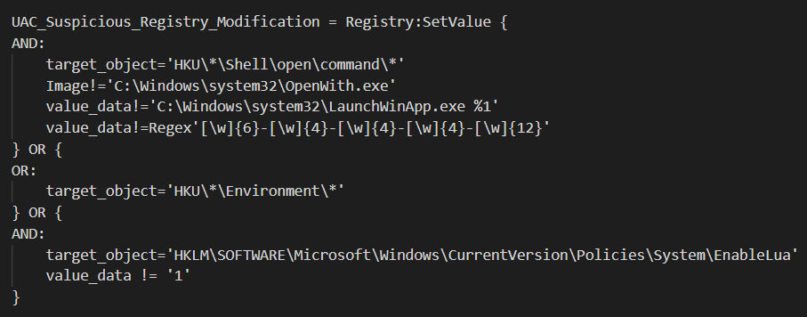
Patterns of Behavior: Registry Manipulation
Behavior pattern:
Suspicious Registry Keys are modified
A related process spawns a child process with higher integrity

Slide 32
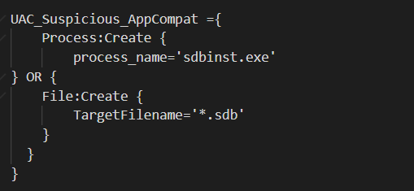
Patterns of Behavior: Application Compatibility Manipulation
Behavior pattern:
sdbinst.exe is called OR a new Shim Database file is created (*.sdb)
A related process spawns a child process with higher integrity

Slide 33
Works In Progress…
Application WhiteList
Race Condition
Token Manipulation
GUI Hack

Slide 34
Analytic Development Workflow
Phase 4: Continuous Improvement
Identify and Collect Data
Uncover Patterns of Behavior
Develop Analytics
Emulate Technique
Evaluate Performance
Research Technique
Develop Scenario & Environment
Community Review
Evaluate and Refine
Phase 1: Preparation
Phase 3: Analytic Refinement
Phase 2: Active Emulation and Detection

Slide 35
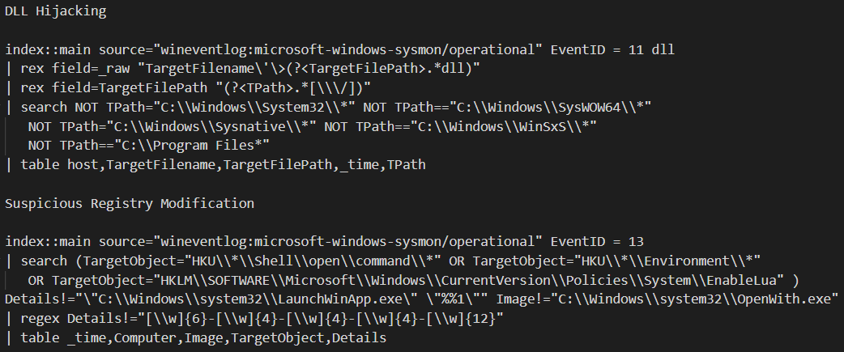
Splunk Query Examples

Slide 36
Analytic Development Workflow
Phase 4: Continuous Improvement
Identify and Collect Data
Uncover Patterns of Behavior
Develop Analytics
Emulate Technique
Evaluate Performance
Research Technique
Develop Scenario & Environment
Community Review
Evaluate and Refine
Phase 1: Preparation
Phase 3: Analytic Refinement
Phase 2: Active Emulation and Detection

Slide 37
UAC Bypass Lessons Learned
Applied Sysmon Configuration File was not capturing key events
Environment Variable Settings
Sysmon Configuration File was opened up to log all events of interest
Some desired data was either not written directly to a log file or impractical at scale
Use of Elevated COM Objects
Image Load Events
Detections efforts were designed to work without these data sources

Slide 38
References
https://0x00-0x00.github.io/research/2018/10/31/How-to-bypass-UAC-in-newer-Windows-versions.html
https://blog.cobaltstrike.com/2014/03/20/user-account-control-what-penetration-testers-should-know/
https://docs.microsoft.com/en-us/previous-versions/technet-magazine/dd822916(v=msdn.10)?redirectedfrom=MSDN
https://docs.microsoft.com/en-us/windows/security/identity-protection/user-account-control/how-user-account-control-works
https://enigma0x3.net/2016/08/15/fileless-uac-bypass-using-eventvwr-exe-and-registry-hijacking/
https://enigma0x3.net/2017/03/14/bypassing-uac-using-app-paths/
https://enigma0x3.net/2017/03/17/fileless-uac-bypass-using-sdclt-exe/
https://github.com/hfiref0x/UACME
https://medium.com/@z3roTrust/bypassing-windows-user-account-control-back-for-more-dd5672c48600
https://static1.squarespace.com/static/552092d5e4b0661088167e5c/t/5d5588b51fd81f0001471db4/1565886646582/Windows+Sysmon+Logging+Cheat+Sheet_Aug_2019.pdf
https://uncoder.io
https://www.fuzzysecurity.com/tutorials/27.html
Notes:
These are our reference, thank you for your time gentlemen.

