Slide 1

Name: Parmar Kuldeepkumar
Pravinbhai
Enrollment no: 230610107026
Stream: Computer Engineering
Hello!
Everyone
College: Government Engineering
College, Palanpur

Slide 2

Leveraging AI and Green Skilling for Global Sustainability
A Data-Driven Approach
to Advancing UN SDG 17

Slide 3
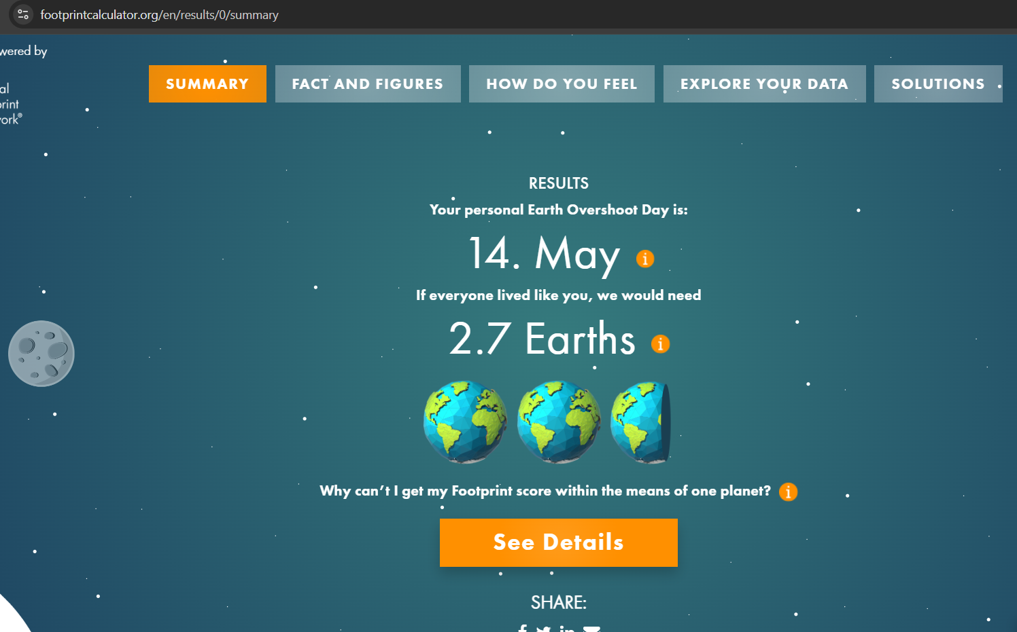
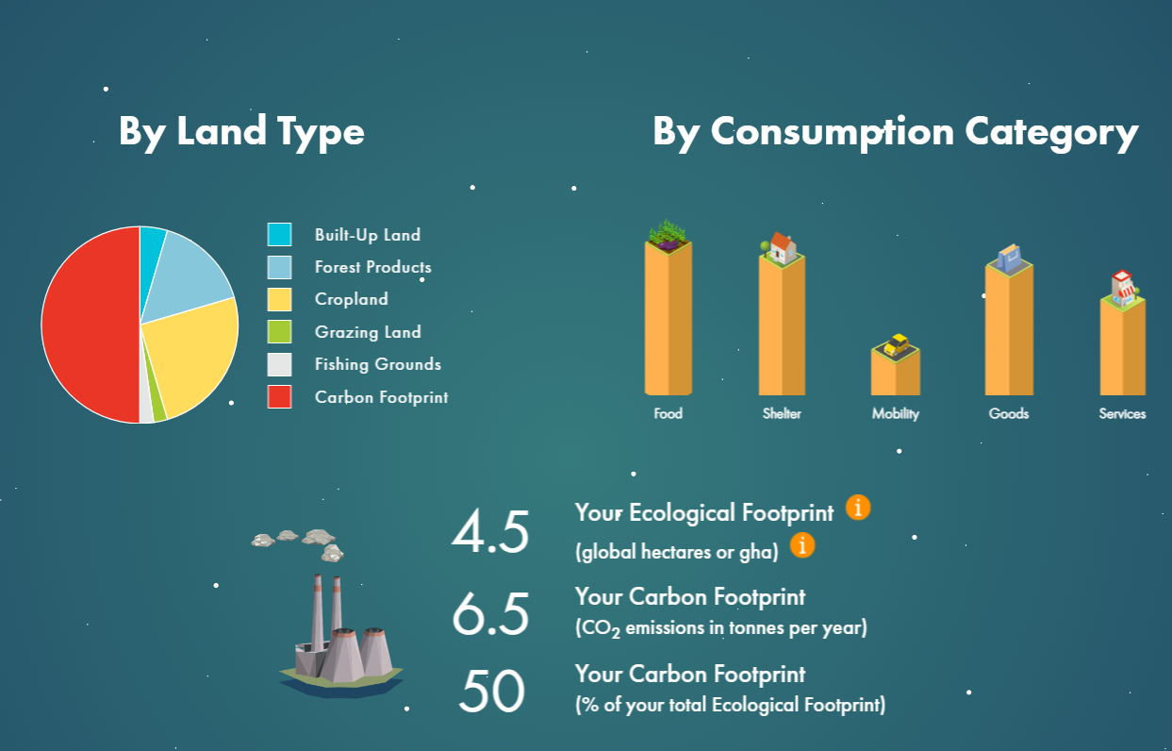
Activities that I have done:
1. I calculated my ecological footprint using
“https://www.footprintcalculator.org/home/en”
From here I have learned that
2. I calculated carbon emission produced by my two-wheeler vehicle and should i replace it by E-Vehicle using
“https://e-amrit.niti.gov.in/co2-calculator”

Slide 4
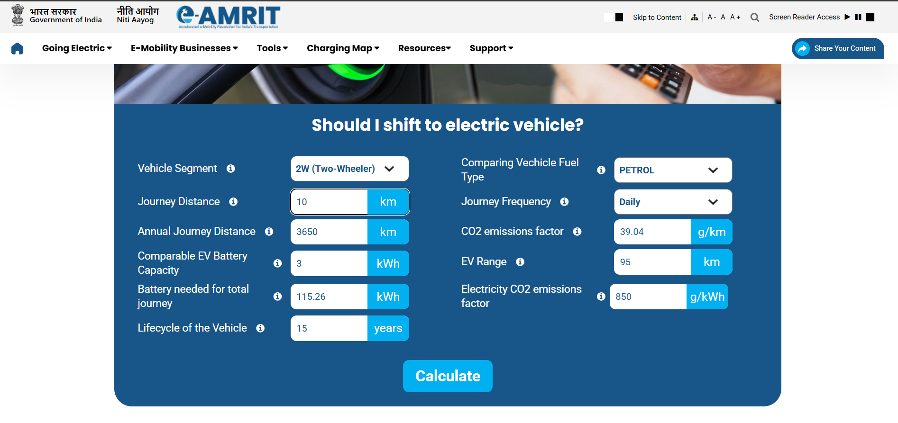
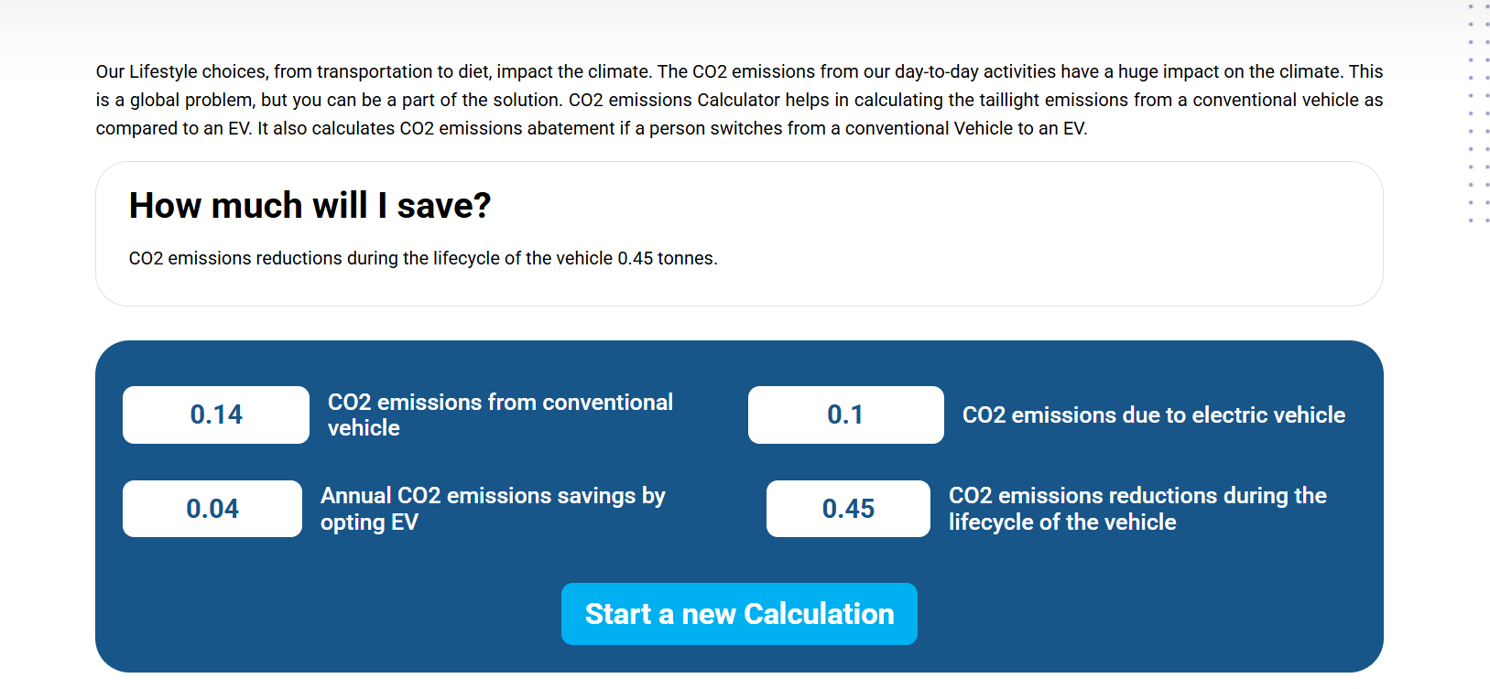

Slide 5
Key Insights from Calculator Activities
Lessons from the Footprint Calculator: The results showed that my lifestyle uses more resources than the Earth can naturally replace. My Earth Overshoot Day is May 14, meaning we would need 2.7 Earths if everyone lived like me. This shows that my lifestyle is not sustainable.
Lessons from the Carbon Emission Calculator: By comparing different vehicles, I learned how much carbon emissions change depending on the type of transport we use. It proved that small individual switches—like choosing a 45 g/km petrol scooter over a 103 g/km car—drastically reduces daily carbon emissions.
Why SDG 17 (Partnerships) is My Core Focus: The calculator activities highlight that isolated data is useless. SDG 17 is the most important goal because it connects global data knowledge, enables green technology transfers, and provides open-source digital calculators to help humanity use natural resources more responsibly.
The Data Center Dilemma: While online footprint calculators are essential for global awareness, the massive cloud data centers running these complex simulations demand extreme energy and cooling water, making carbon optimization a primary tech challenge.

Slide 6
The En-ROADS Solution: En-ROADS is a climate simulation tool developed by MIT that helps people understand how different climate policies can affect global warming.
Sustainability: Meeting our present economic, industrial, and social needs without destroying, polluting, or compromising the core resource budget required by future generations.
Green Skilling: Training and equipping the workforce with the specific technical knowledge, capabilities, and industrial competencies needed to operate a sustainable, low-carbon economy.

Slide 7
SCGJ: Skill Council for Green Jobs (SCGJ) is a Government of India initiative that develops training programs and certifications to prepare people for jobs in clean energy and sustainable industries.
The SCGJ National Standard: Moving beyond simple energy generation to actively train a workforce specialized in capturing, treating, and minimizing chemical pollutants directly at the industrial source
Core Training Domains:
Air quality monitoring
Wastewater treatment
Safe industrial waste management
Renewable energy (Solar & Wind)

Slide 8
Pros & Cons of AI
Pros
Cons
Helps predict solar and wind energy production.
Improves electricity distribution and reduces energy waste.
Monitors pollution using real-time sensor data.
Detects pollution early so action can be taken quickly.
Training AI models requires a lot of electricity.
AI data centers increase energy consumption.
AI depends on powerful computer chips
Frequent hardware upgrades can increase electronic waste.

Slide 9
Capstone Project Ideas:
EcoSort – AI Computer Vision Waste Classifier
What it does: A lightweight image recognition application that uses a webcam to scan discarded trash items. The AI instantly identifies the material (e.g., plastic, paper, or electronic parts) and instructs the user on how to sort it into correct recycling or SCGJ e-waste categories.
2. Smart-Filter AI
What it does: A lightweight Python script that monitors simulated factory emission data. It automatically detects toxic chemical spikes and instantly triggers digital commands to activate secondary filtration systems before industrial pollution leaks occur.

Slide 10


Thank You

