Slide 1

SAMSUNG PRISM
Generative AI
Hackathon
3rd Edition 2026 – 27
Theme ID - 04
Team Name - Apex
College Name – Vellore Institute Of Technology (Vellore)
Member Name & Email 1- Naveenbabu H & naveenbabu.h2023@vitstudent.ac.in
Member Name & Email 2- Aishwaraya A & aishwaraya.a2023@vitstudent.ac.in
Submission Github link - GITHUB_REPO
Notes:
Opening slide for the 3rd edition of the PRISM Generative AI Hackathon. Replace the SAMSUNG PRISM pill with the official PRISM logo image if you have the asset. Confirm the academic year label (2026-27) before circulating.

Slide 2

Theme 04 — Streaming Live RAG
Problem
Conventional RAG waits for the user's complete query before retrieval begins.In live speech/conference scenarios:
  Retrieval starts only after the speaker finishes.
  Every transcript fragment cannot be treated as a new query.
  Repeated/refined questions can cause redundant retrieval.
  Multi-part questions can create evidence imbalance.
  Streaming queries can produce stale asynchronous results.
  Fast retrieval alone does not guarantee grounded answers.
Objective
  Reduce the waiting time before useful evidence is available while maintaining retrieval control, evidence quality and grounded generation.
Our Core Idea
  Retrieve while the user is speaking — but only when retrieval is justified.

Slide 3

Existing Solutions & Gaps
Conventional RAG waits for the full query, while streaming RAG can act earlier — but only with control over retrieval timing, reuse, and evidence quality.
Approach | Flow | Gap
Existing RAG | Query → Retrieve → Rerank → Generate | Retrieval begins only after the complete query.
Streaming / Incremental RAG | Partial Query → Retrieve repeatedly | Naively retrieving every partial transcript creates unnecessary retrieval noise and computation.
Conventional Query Reuse | Previous Query → Reuse | Does not distinguish between meaningful query extensions, replacements and presentation-only changes.
Standard Multi-Document Retrieval | Compound Query → One Evidence Pool | One intent can dominate the evidence budget and starve another intent.
Our Approach | Streaming Controller + Reuse/Delta Retrieval + Multi-Intent Isolation + Evidence Gating | This allows the system to decide when to retrieve, what to reuse, what to retrieve newly, and what evidence is allowed into generation.

Slide 4
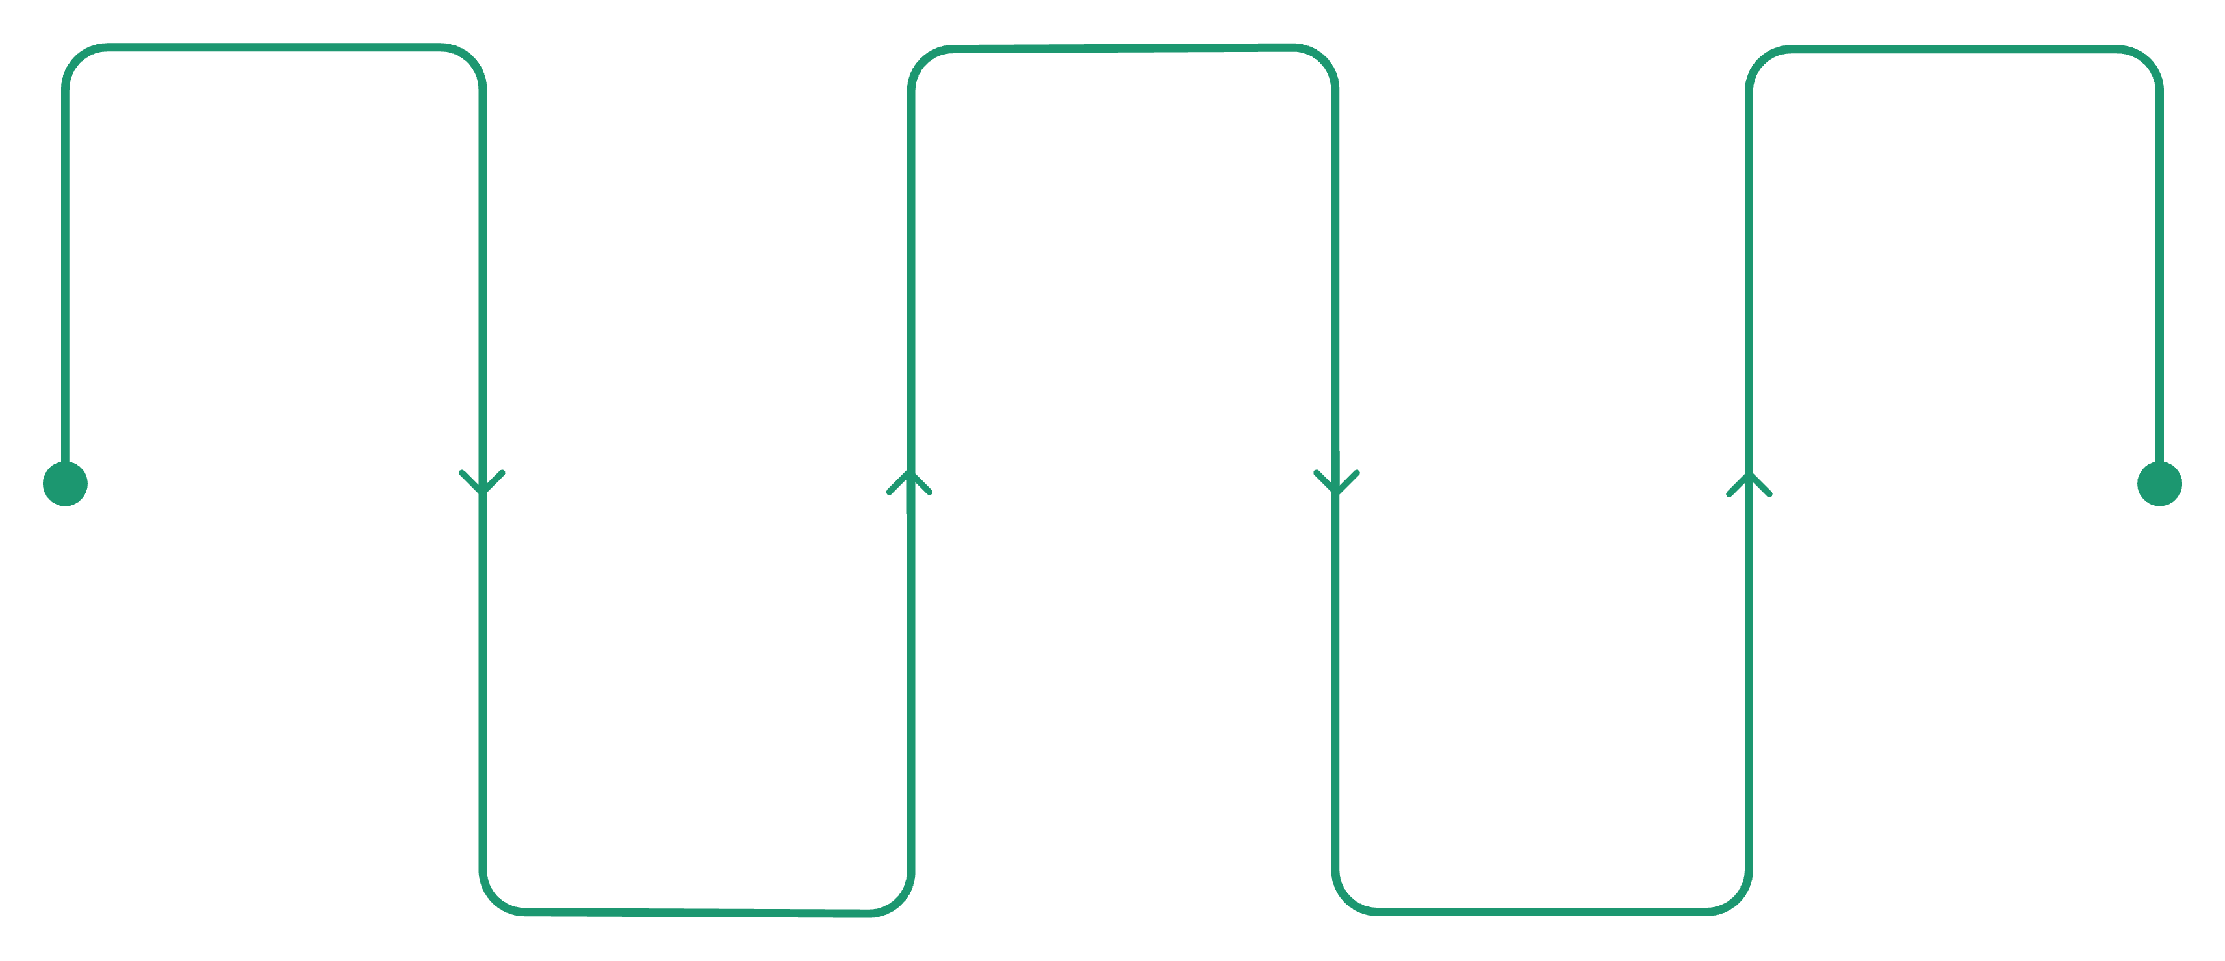
Our Solutions & Architecture Diagram
Streaming-Live-RAG Architecture
Live Transcript
Query Refinement
Retrieval Types
Partial transcript triggers preparation
New / Additive / Replacement / Presentation
Early / Reused / Delta retrieval paths
Retrieval Controller
Multi-Intent Decomposition
Wait / Suppress / Retrieve decisions
Split into focused intents
Input to Output Flow:
Input Stream
Control & Refinement
Output
Live transcript enters the system incrementally.
The controller decides when to wait, suppress, or retrieve, then refines the query.
Compound requests are split into focused intents and matched to the right retrieval path.
Only grounded evidence is passed forward to generate the final answer.
Intent Isolation

Slide 5


Demo & Product Walkthrough
Judge Mode
Shows the internal RAG pipeline:
  Live transcript evolution
  Controller decision
  Early retrieval
  Retrieval reuse
  Query refinement
  Evidence selection
  Grounded answer
  Citation validation
Conference Mode
Designed for natural live interaction:
  Push-to-talk microphone
  Partial transcript while speaking
  Retrieval begins before speech ends
  Continue speaking/refine the query
  Release microphone → automatic query commit
  Grounded answer generated from validated evidence
  Reset clears the active session
Demo Flow
Speak → Early Retrieval → Refine → Release → Commit → Reuse/Delta Retrieval → Grounded Answer → Validated Citation

Slide 6
Tools and tech stack used
Retrieval
Generation
Backend
BM25
Sentence Transformers
FAISS
Reciprocal Rank Fusion
CrossEncoder
Ollama
llama3.2:3b
Grounded Generation
Python
FastAPI
WebSocket
Session State Management
Frontend
Engineering
HTML
CSS
JavaScript
WebSocket
Push-to-Talk Voice Layer
Git / GitHub
Docker-ready environment
Automated evaluation scripts
Deterministic test fixtures

Slide 7
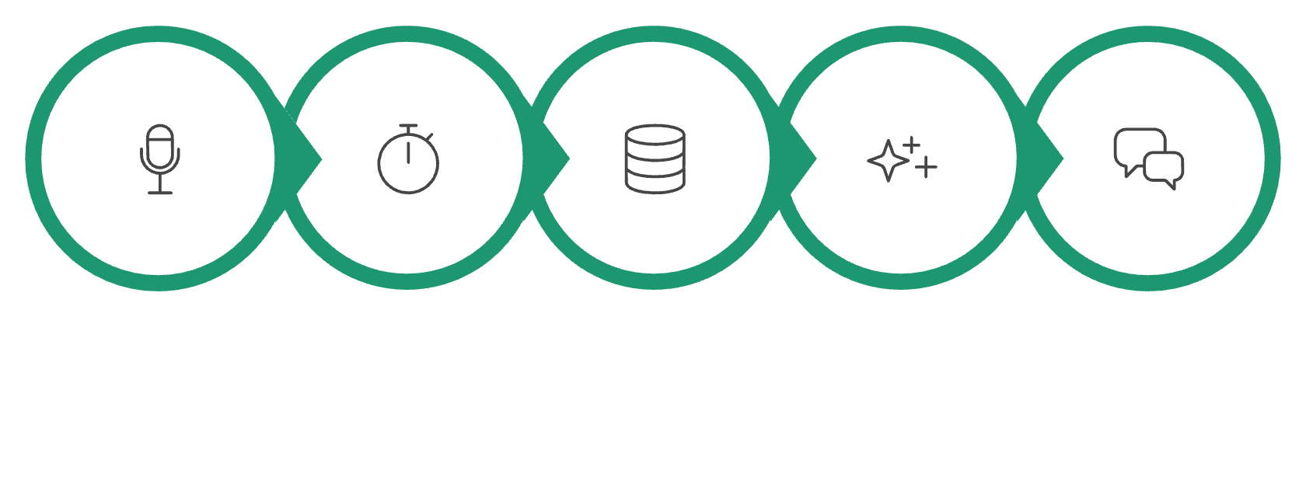
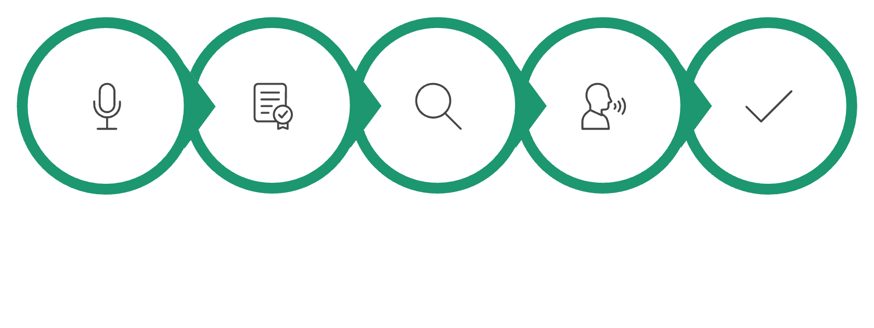
Impact & Use case
Target Use Case: Live Conference / Voice Knowledge Assistant
A user can ask questions naturally while speaking instead of waiting for transcription to finish.
With Streaming-Live-RAG
Before
Speak
Partial Transcript
Early Retrieval
Continue Speaking
Commit
Speak
Finish
Retrieve
Generate
Answer
Speak → Finish → Retrieve → Generate → Answer
Speak → Partial Transcript → Early Retrieval → Continue Speaking → Commit → Answer
Impact
Potential Applications
Reduces the delay before useful evidence is available.
Avoids unnecessary retrieval from unstable transcript fragments.
Reuses previously retrieved evidence when applicable.
Handles refined and compound questions.
Maintains evidence grounding during streaming interaction.
Supports local/private inference using Ollama.
Conference assistants
Meeting knowledge assistants
Enterprise policy assistants
Live customer-support systems
Voice-based knowledge retrieval

Slide 8
Innovation highlights, results and limitations
Early Retrieval
Deterministic Streaming Control
Retrieval Reuse + Delta Retrieval
Multi-Intent Evidence Isolation
Evidence Gate + Citation Validation
Stale-Generation Protection
Retrieval preparation starts before the query is complete.
Avoids repeating retrieval work for compatible query refinements.
WAIT / SUPPRESS / RETRIEVE controls when retrieval happens.
Each intent receives independent retrieval and evidence selection.
Unsupported evidence and invalid citations are blocked.
Older asynchronous results cannot overwrite newer query state.
Results — Production Benchmark (18 queries)
Limitations
Groundedness: 26/29 = 0.897
Invalid citations: 0
Validator rejections: 0
Whole-query refusals: 0
Intent-level abstention: 1 query
Mean pipeline TTFT: 7.50 s
Median pipeline TTFT: 5.70 s
Local LLM generation remains the main latency component.
Offline retrieval dataset reaches saturated retrieval scores.
Current system is CPU-friendly rather than optimized for large-scale GPU serving.
Voice quality depends on browser/ASR behaviour.

Slide 9
What’s next
Future Improvements
Faster Local Generation
Smarter Retrieval Scheduling
Optimize model loading, inference and token streaming.
Improve controller decisions using learned signals while preserving deterministic safeguards.
Adaptive Evidence Budgets
Better Voice Interaction
Dynamically allocate evidence based on query complexity and number of intents.
Improve ASR robustness, interruption handling and conversational turn-taking.
Production Scaling
Larger Evaluation
Move from local single-machine execution toward scalable distributed retrieval and inference.
Evaluate across larger corpora, longer conversations and more complex multi-intent queries.

Slide 10
Brownie points slide( differentiation)
Why Streaming-Live-RAG is Different
Conventional RAG | Streaming-Live-RAG
Waits for complete query | Retrieves during speech
Retrieves after commit | Early retrieval preparation
Repeats retrieval | Reuses compatible evidence
One query → one retrieval | NEW / ADDITIVE / REPLACEMENT handling
One evidence pool | Per-intent evidence isolation
Static pipeline | Streaming-aware controller
Generation can race with updates | Generation IDs prevent stale results
Citation checking after generation | Evidence gate + citation validation
Core Differentiator
We are not simply making RAG faster.
We are making RAG aware of how a live query evolves over time.

Slide 11
Checklist- Updated on Public GitHub
Working prototype code —Public GitHub (YES ✓)
README with reproducible setup instructions (YES ✓)
Demo video, max 5 minutes (https://www.youtube.com/watch?v=Twsv_37PmaQ)
Presentation file (PPT) (YES ✓)

Slide 12
Thank you
Streaming-Live-RAG
APEX
VIT Vellore
Theme 04 — Generative AI Hackathon
Team Members
Naveenbabu H.
Aishwaraya A.
GitHub: GITHUB_REPO
Organised by the Language AI Team and the PRISM Team, Samsung R&D Institute India
Notes:
Closing slide. Add the Google Form URL and a contact email before sharing. Edition 2 organising team for reference: Language AI - Sourabh Tiwari, Gaurav, Sanjeeth Pothireddy, Gorang Maniar; PRISM - Binny Lakra, Prakhar Chandrakar, Vishu Kumar; Kick-off and mentors - Giridhar Jakki, Deepraj Prabhakar Patkar (Language AI), Srimanu Prasad Nagaraju, Ashish Kumar (Tech Strategy).

