Slide 1

Customer Shopping Behavior Analysis
3,900 transactions · 18 features · Python · SQL · Power BI

Slide 2
Dataset at a Glance
3,900
18
Purchases
Features
Across all categories
Demographics, behavior, spend
37
2
Missing Values
Genders
Review Rating column only
Male (68%) vs Female

Slide 3


Data Preparation in Python
Clean & Standardize
Snake_case columns, median imputation for Review Rating
Feature Engineering
age_group bins, purchase_frequency_days
Database Load
Cleaned DataFrame pushed to PostgreSQL

Slide 4
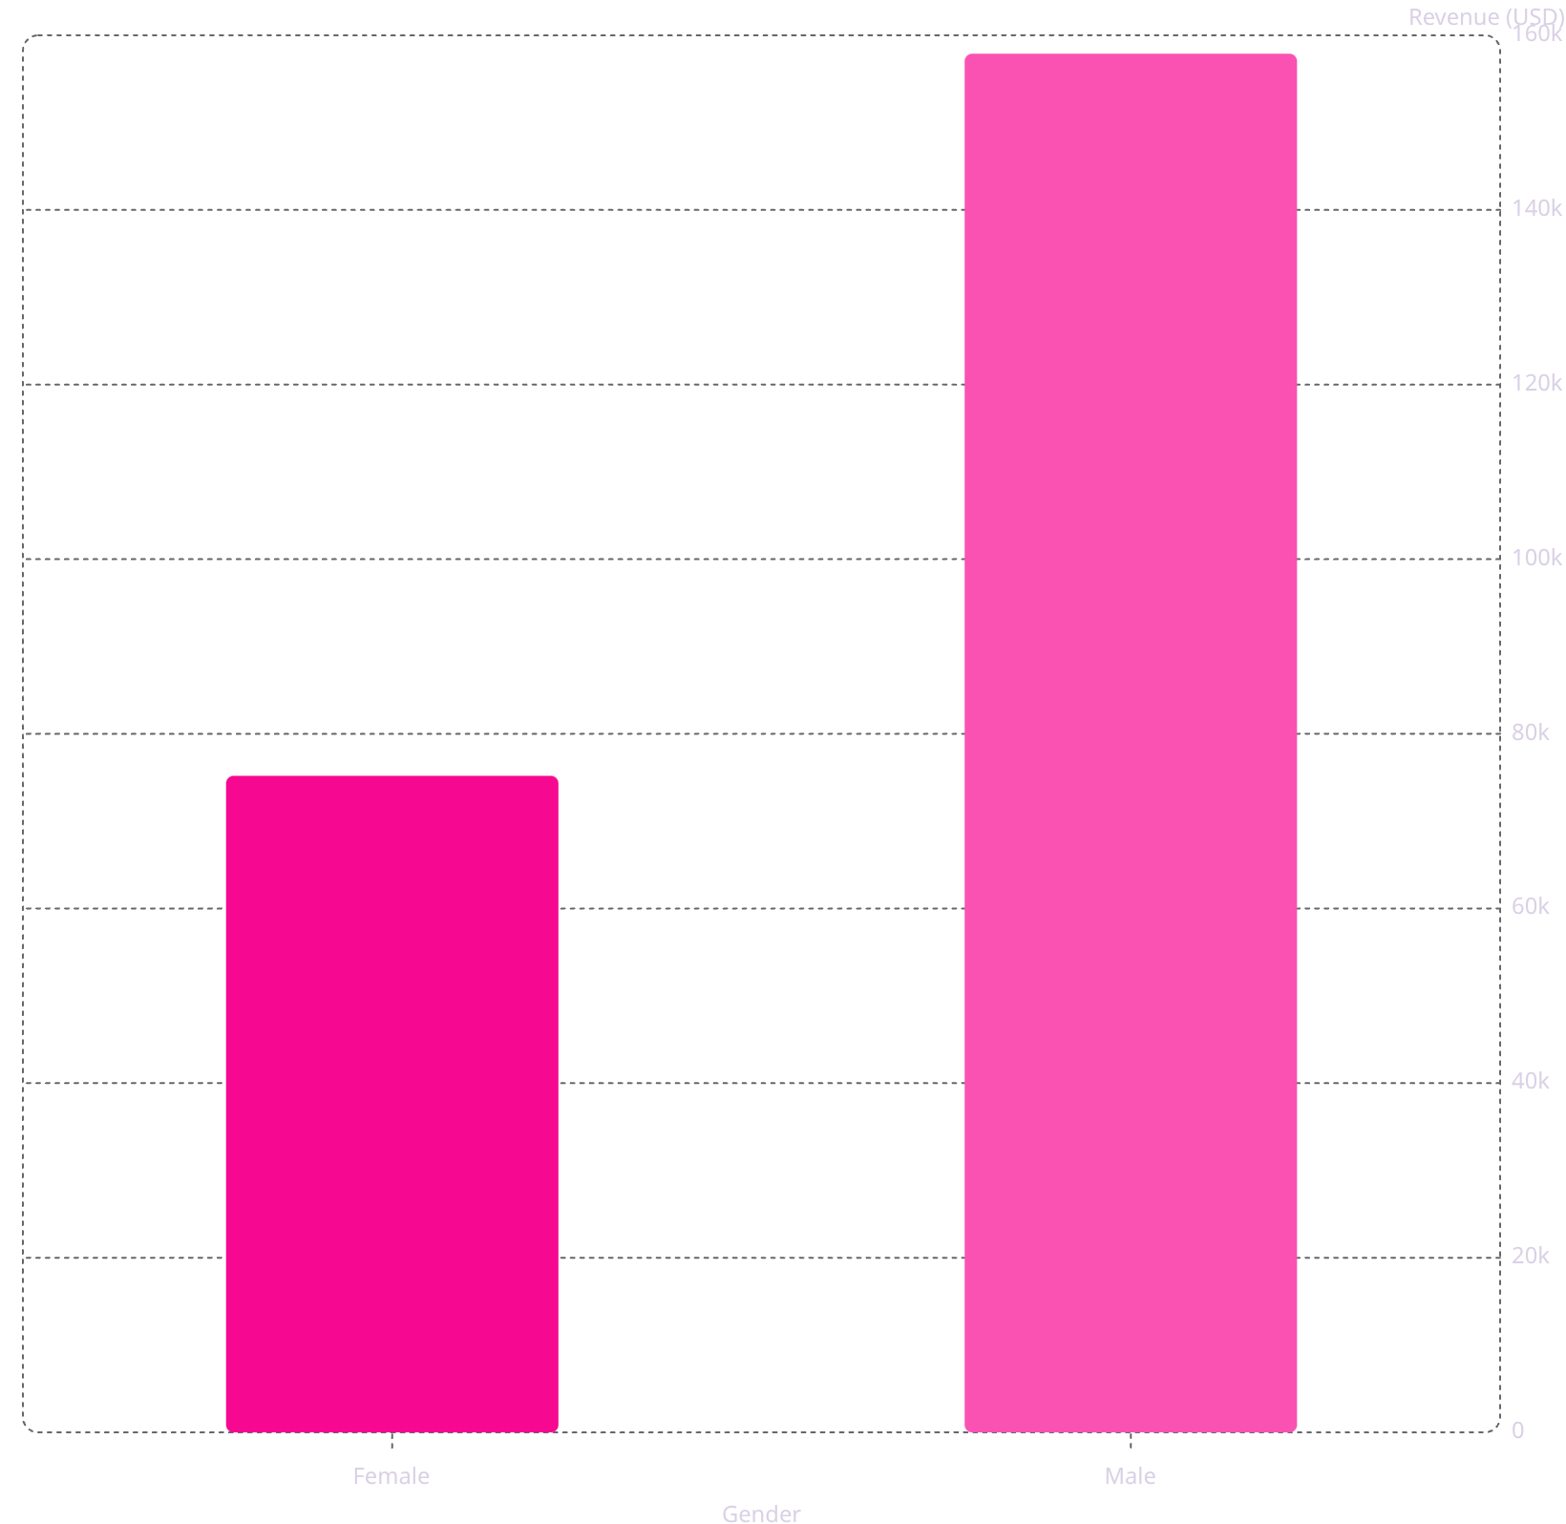
Revenue by Gender
Key Insight
Male customers generated 2.1× more revenue than female customers — a critical segment to understand and target.
Male
Female
$157,890
$75,191

Slide 5
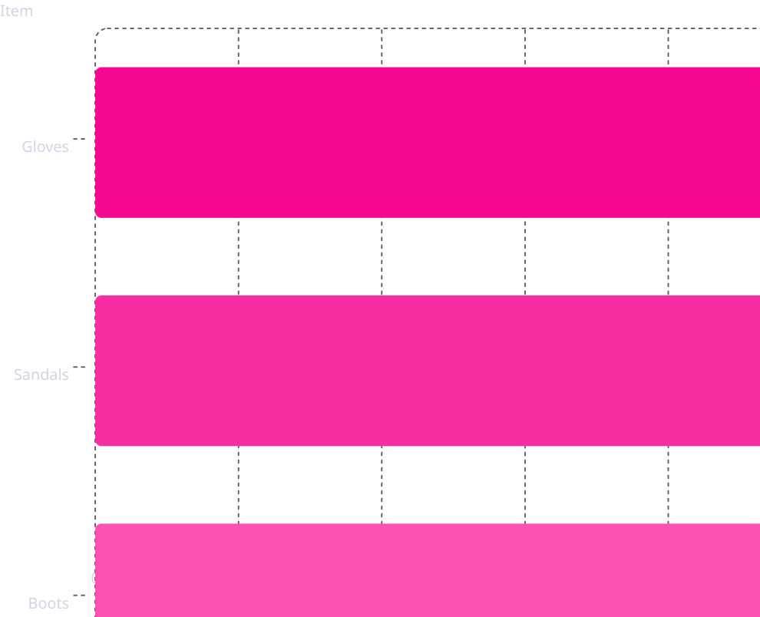
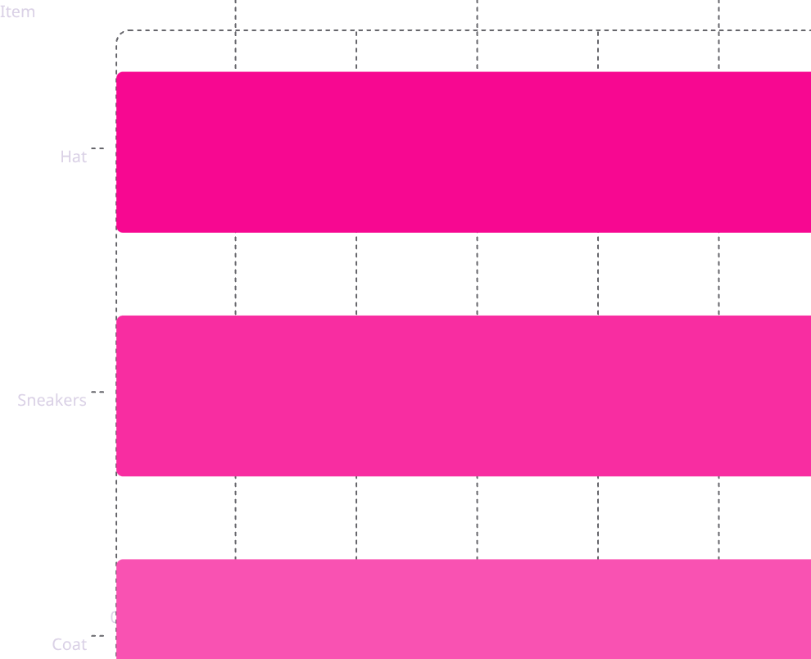
Top Products & Discounts
Top 5 by Rating
Most Discounted Products

Slide 6
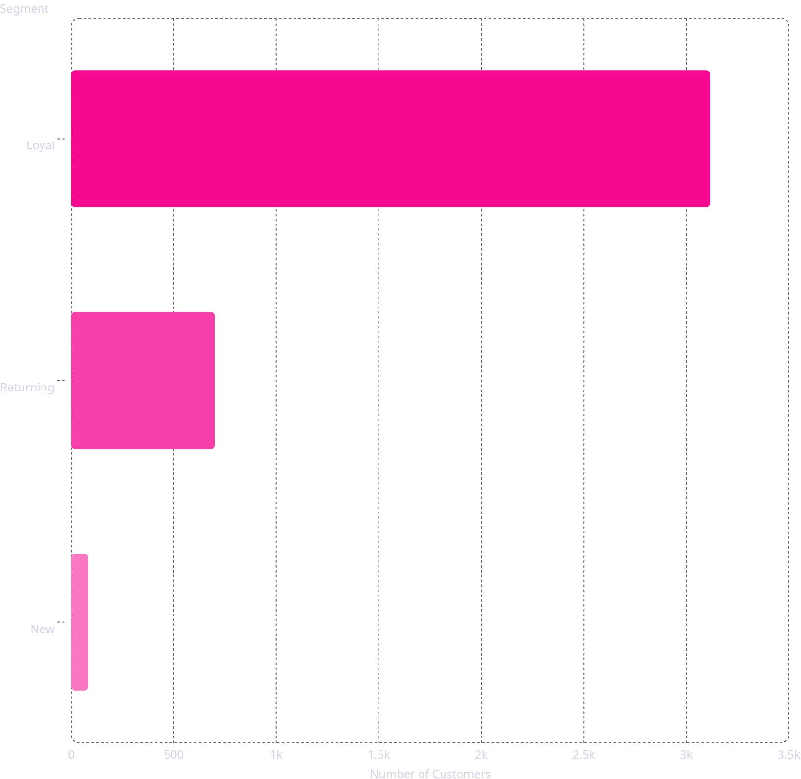
Customer Segmentation
Segment Breakdown
Loyal — 80%
3,116 customers
Returning — 18%
701 customers
New — 2%
83 customers

Slide 7
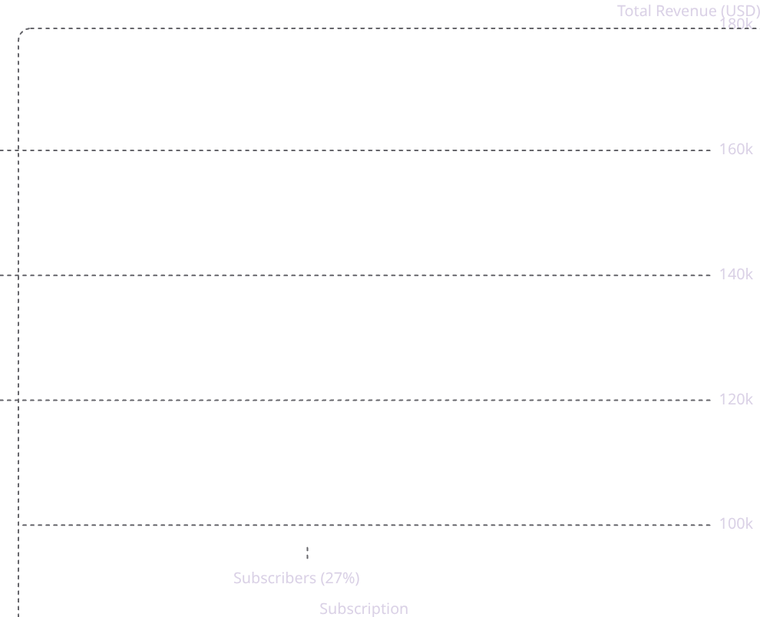
Subscribers vs. Non-Subscribers
Average Spend is Nearly Equal
Subscribers: $59.49 · Non-subscribers: $59.87
Non-subscribers drive 73% of total revenue — conversion opportunity.

Slide 8
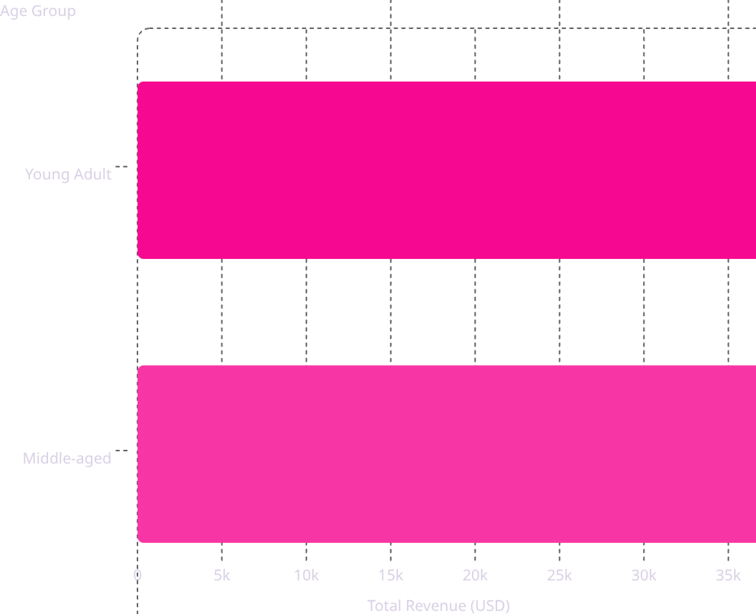
Revenue by Age Group
Young Adults Lead
Young Adult group generates the highest total revenue at $62,143.
Revenue is relatively balanced across all four age groups.

Slide 9

Power BI Dashboard
3.9K Customers
$59.76 Avg Order
Total purchase count
Average purchase amount
3.75 Avg Rating
Customer review score
Interactive filters: Subscription, Gender, Category, Shipping Type

Slide 10

Business Recommendations
Boost Subscriptions
Promote exclusive subscriber benefits
Loyalty Programs
Reward repeat buyers → Loyal segment
Review Discount Policy
Balance sales lift with margins
Targeted Marketing
Focus on high-revenue age groups & express shippers

