Slide 1
ecFlow
John Hodkinson Axel Bonet
Meteorological Applications Section
ECMWF

Slide 2
Topics to be covered in theory sessions
Aims
Overview
ecFlow Components
Writing operational suites and scripts
ecFlow Usage
Important Concepts
Comparison with SMS
Python API
Migration to ecFlow
ecflowview

Slide 3
Course Aims
Introduce ecFlow, its API and ecflowview
Show how to design an “operational” suite
Summarise our use of ecFlow and plans
Cover aspects of ecFlow, its API, ecflowview and suite/task design in theory and practical sessions
Aim for students to be able to write and implement suites of a reasonable complexity by the end of the course

Slide 4
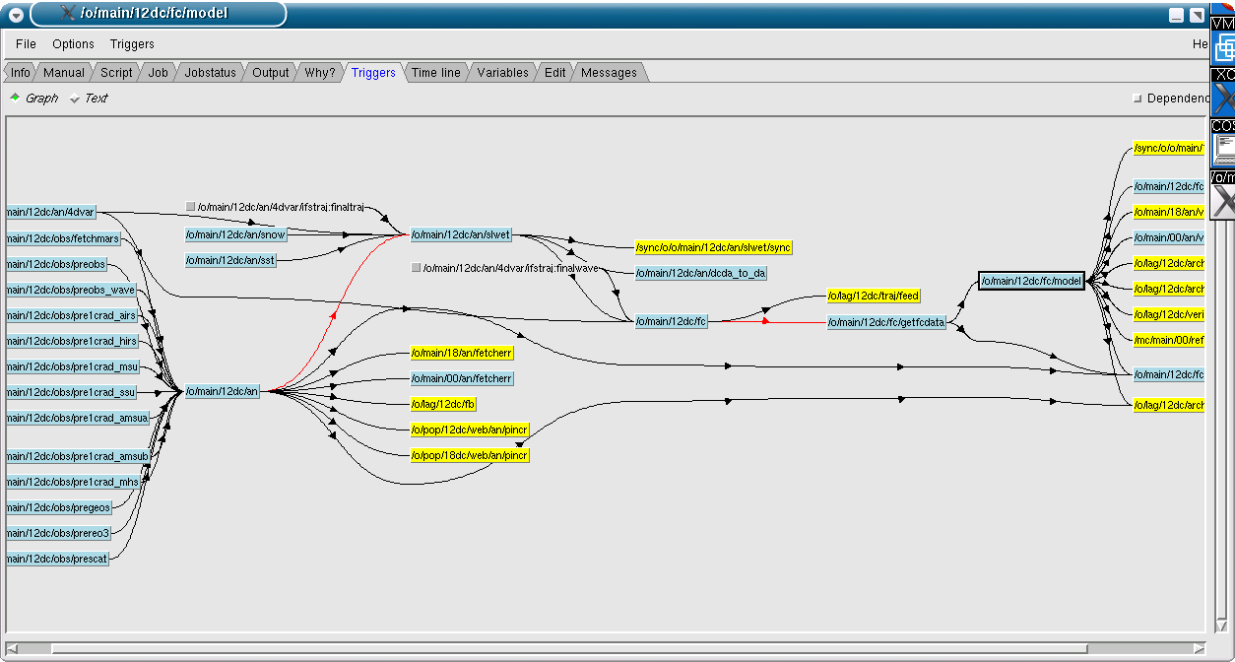
Overview: ecFlow
The ECMWF workflow manager
A general purpose application designed to schedule a large number of computer processes in a heterogeneous environment

Slide 5
Overview: what is ecFlow ?
Client/Server based replacement for SMS
Complete re-write in C++, to improve maintenance and ease of development
Similar scheduling and supervision functionality to ecFlow
Python API can be used to generate definition structure
Client Server API available on the command line and in Python
Allows reuse of existing task wrapper/header files, with some modifications
GUI based on xcdp. Will be rewritten soon
Jira: http://software.ecmwf.int/wiki/display/ECFLOW/Home

Slide 6
Overview: Features?
Flexible inter-dependencies between tasks – triggering
Complex automated scheduling
based on events, times, task status
Multiple users / platforms / queues
Access to monitoring information via GUI and CLI
ecflowview and API
Dynamic and interactive supervision in real time
Good recovery – at task and ecFlow level
But … ecFlow is not a queuing system, it is a scheduler
Notes:
Collection of tasks known as a suite can trigger off of one another Create product, plot product, archive product
With each process able to run on separate hosts.
Suites can trigger off time dependencies / other suites
GUI interface show status of jobs and can show whether they are running late e.t.c.
ecFlow is checkpointed and creates log files
Able to move suites between ecFlow servers, rerun jobs etc
Not able to see the load of target machines. However, course control via limits.
We do submit to queuing systems such as PBS, sge and loadleveller

Slide 7
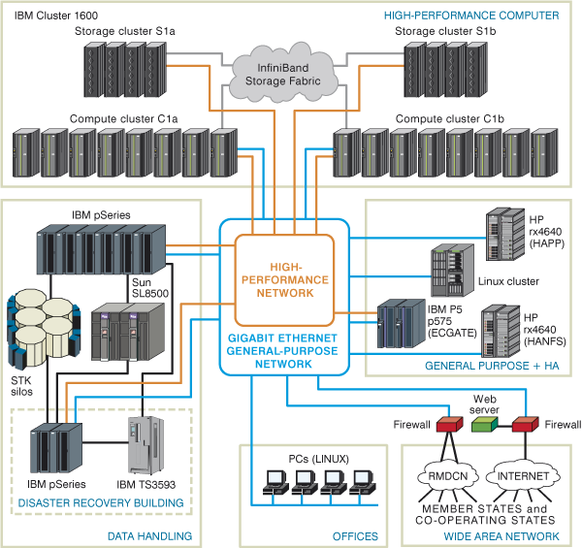
Overview: Schematic of our systems

Slide 8








Simplified view of how we use ecFlow on our systems
ecflowview
c1a
c1b
ecFlow
HP
ecflowview
ecFlow Server(s)
Cluster
ecflowview
ecFlow b
ecflowview
remote
Notes:
Mulitple ecFlows
Multiple Systems
Multiple Users
Multiple tasks

Slide 9
Components of ecFlow
ecflow_server
The scheduler, continuously running daemon process
ecflow_client
Command line interface to ecFlow
Child commands updating status and attributes
Python API
ecflowview
Graphical interface to ecFlow

Slide 10
ecFlow and terminology
ecFlow server the scheduler runs as daemon process
Users talk to ecFlow using ecflowview, ecFlow client commands or the API
Tasks talk to ecFlow using the child-commands
Communication is via TCP/IP
Users define “suites” to run on ecFlow
ecFlow runs in normal user mode (not as root)‏
Any of the components can run on any of the computers
ecFlow servers do not talk directly to each other

Slide 11
Server Functionality
setup environment: use ecflow # /usr/local/apps/ecflow/current/bin
startup:
ecflow_start.sh ecflow_stop.sh ecflow_server --port $((1000 + $(id -u))) nohup ecflow_server > ecf.out 2>&1 &
hosts the suites
checkpoints (backup) suites tree
handles user and job requests
logs activity

Slide 12
Server
configuration:
ECF_HOME # server admin directory ECF_PORT # port number ECF_CHECK # checkpoint file name ECF_CHECKOLD # backup checkpoint file name ECF_LOG # server log file name ECF_CHECKINTERVAL # [120], 600 sec ECF_LISTS # white list file name ECF_DEBUG_SERVER
server log file: ecflow_client --port 3141 --log=new # [new|clear|flush]

Slide 13
ecFlow: checking the server
identify the presence of a server
ecflow_client --ping --port 31415
ecflowview
netstat -lnptu

Slide 14
Text client interface
for remote assistance, batch mode or directly from the shell
for monitoring and interaction:
ecflow_client --get # --group="get; show state" # --get_state ecflow_client --alter change variable NPES 60 /emc
implicit-explicit call:
ECF_PORT, ECF_NODE, (ECF_NAME, ECF_PASS) ecflow_client --port 3141 --host host3 --get
load-replace suites into the server:
ecflow_client --load mc.def ecflow_client --replace=/emc mc.def

Slide 15
Child commands: ecflow_client
self contained manual: ecflow_client --help
status update: --init <PID/QID>, --abort <cause>, --complete
attribute update: --event <name>, --meter <name> <value>, --label <name> <text>
embedded trigger: --wait ="/suite/taskx == complete"
recovery when a job cannot connect (one host name per line):
export ECF_HOSTFILE=$HOME/.ecf_hostfile
going further: ecflow_client --alter add variable FCNPES 60 /emc ecflow_client --alter change variable THREADS 1 /emc

Slide 16
Child commands: ecflow_client
Tasks interact with ecFlow using the ecflow_client
ecflow_client --help child
--init tells ecFlow task is “active”
--complete tells ecFlow task is “complete”
--abort tells ecFlow task has “aborted”
--event sets an event in ecFlow (a part of the job is done)‏
--meter send progress information to ecFlow
--label set label in ecFlow
--msg write a message line into ecFlow logfile
--wait wait for other tasks by polling ecFlow
--status checks task status
Notes:
Axel

Slide 17
Child commands: ecflow_client
Client configuration in jobs:
ECF_NODE # server hostname ECF_PORT # server port ECF_NAME # task with suite path ECF_PASS # pseudorandom unique identifier ECF_TRYNO # job occurrence number ECF_HOSTFILE # alternative host server list (server recovery) ECF_RID # job remote id (queuing id) ECF_TIMEOUT # interval between two attempts ECF_DENIED # to enable job exit with error before 24h NO_ECF # standalone mode (set to use) ECF_DEBUG_CLIENT # debug mode (set to use)

Slide 18
Graphical client interface: ecflowview
Initial version based on Xcdp
for broadband connection, for both monitoring and interaction
access to most client commands, restricted
direct access to information: script, manual, job, output
user can restrict available commands:
Edit->Preferences->User-Operator-Administrator modes
user can configure nodes/statuses/attributes display, vertical-horizontal display (node + ctrl-middle-mouse-button + close,open)
$HOME/.ecflowrc: servers, X.options, ecflowview.menu

Slide 19
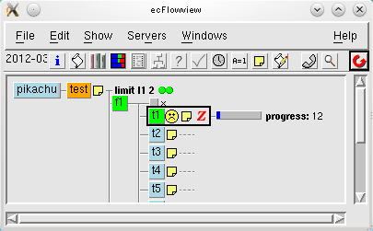
ecflowview‏
Windowed GUI
Allows direct interaction with ecFlow Servers
Can access many ecFlow client commands
Provides easy access to helpful information (script, manual, output, etc.)‏
Contains alarm features, runs even when iconized
User configuration by panels
User can mask information from being displayed
Notes:
Axel

Slide 20
Terminology (1/2)‏
Root The ecFlow server itself
Suite Collection of families, variables, repeat and clock definitions; performing a specific function.
Family Collection of tasks and/or other families
Task A unit of work, a computer job
Alias A task made to run independently
Event A partial completion of a task, set within a task
Meter Like an event, but has a range of values
Label Information updated by the task
Node Generic term for any of the above
Notes:
Axel

Slide 21
Terminology (2/2)‏
def-file Suite definition file, describes a suite
Variable Like in shell, substituted into a tasks, etc
ecf-file Task, edited by ecFlow using variables
job-file
created by ecFlow from the ecf-file
that is sent by ecFlow to be executed
Notes:
Axel

Slide 22
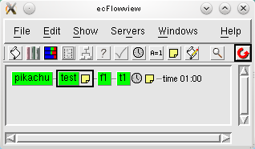
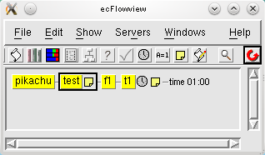
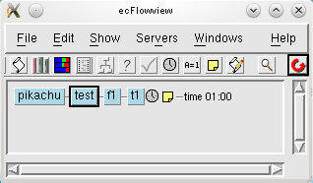
Relationship between .def, .ecf and .job files
load / replace
#definition file
Text
Or
Python
ecFlow client
or API
task t1
ecFlow
Submit
# .ecf
t1.ecf
%include <head.h> …
%include <tail.h>
ECF_FILES ECF_INCLUDE
# t1.job1
# expanded job file

Slide 23
Debugging: an overview
When playing definition file: with Python API correct by construction
When submitting look at ecFlow log (or history via ecflowview) for info
Can you see the script in ecflowview? No – unknown file location ECF_FILES (Python has job checking option)
Can you edit and pre-process the script? No – unknown include file location ECF_INCLUDE, missing variable (check log or history) or misleading use of %
Script stays submitted/active? Submission problem, child process access or header problem. Try submitting job from command line with NOECF=1?
Task aborts? Script problem, check output
No output after task aborts– Mount point not available, ECF_OUT wrong, logserver problem

Slide 24
Migrating cron scripts to ecFlow
Stages:
Run job using ecFlow in its entirety using “cron” or “time” plus header files
Split task into logical units following guidelines for ecFlow scripts (especially re-runnability)
Decide on ecFlow variables vs included variables in header files
Separate into families carrying out related activities
Separate based on criticality

Slide 25
Designing a suite – a simple NWP example
get
Get data
Analysis
Model
Products
Archive data
Plots
an
model
prodgen
archive
plot

Slide 26
Designing an operational suite - considerations
Critical path – minimise dependencies systems/file systems
Documentation – man pages for suites/families/tasks
Rerunnabililty of tasks
Simplicity - KISS
Keep runtimes under control
Keep logfiles for support/optimisation
Make/rebuild within suite plus admin tasks
Allow for simple switching of systems
Clean up

Slide 27
Designing an operational suite – critical path
main
repeat YMD 20120212
get
get_a
get_b
get_c
04:00
an
an_1
an_2
model
model
prodgen
prodgen_1
archive
prodgen_2
plot
15:00
prodgen_3
logs

Slide 28
Designing an operational suite – archiving
lag
repeat YMD 20120212
limit:mars 2
archive
limited by /suite/lag/limit:mars
obs
trigger (/suite/main:YMD>lag:YMD) or (/suite/main:YMD==/suite/lag:YMD and /suite/main/get==complete)‏
analysis
trigger (/suite/main:YMD>lag:YMD) or (/suite/main:YMD==/suite/lag:YMD and /suite/main/an==complete)‏
forecast
trigger (/suite/main:YMD>lag:YMD) or (/suite/main:YMD==/suite/lag:YMD and /suite/main/model==complete)‏
logs
13:15 though not necessary

Slide 29
Designing an operational suite - plotting
repeat YMD 20120212
plot
limit: workstation 2
web
limited by ../limits:workstation
trigger (/suite/main:YMD>/suite/plot:YMD) or (/suite/main:YMD == /suite/plot:YMD and ./suite/main/model == complete)‏
ref
saturday
daily_plots
combined
trigger (/other_suite/main/model == complete and /suite/main/model == complete)‏
weekly_plots
trigger ./ref ==complete
complete not ../ref:Saturday and ../ref==complete
13:15
logs

Slide 30
Writing “operational” scripts – considerations for critical tasks
Re-runnability
Look after critical data – HA systems, backups
Limit number of languages used
Be careful with trapping
All variables should to be set (use default values if necessary)‏
Use a generic user – identify operations
Works on multiple systems
ECF_JOB_CMD
Avoid accessing off-line data in critical path
Avoid NFS mounted files or unsafe file-systems (SCRATCH)‏
Tasks can be serial or parallel, but don’t do serial things in parallel tasks
Use generic directories to simplify cleaning and always clean up!
Check task runtimes
Good to use a CM system and test
Test ecFlow server/suites

Slide 31
Monitoring operational suites
ecflowview– our operators don’t view completed or queued tasks
Colours give clear indication of suite status
Pop up windows
man pages and output
Colours give clear indication of task status (but configurable!)‏
Submitted for too long can indicate resource problems
“Late” warnings are useful: submitted, active or complete
Check tasks also useful – schedule, tasks running, feeds

Slide 32
Implementing suites
A definition file can hold both operational and test versions of suites
Use conditional statements in suite definition to modify behaviour
if SUITE == “oper_suite”: PRODGEN = 1
elif SUITE == “test_suite”: PRODGEN = 0
Use ecFlow variables to distinguish versions and behaviour
if !PRODGEN: task2.add_defstatus(ecflow.Dstate.Complete )
Suite can be played on a test ecFlow server and plugged into an operational server

Slide 33
Suite design: functional aspects
group time dependencies in dedicated families + triggers
easy replacement when schedule changes
defstatus complete in not-real-time-mode
grouping external trigger dependencies in dedicated families (dummy tasks)
easily replaced if reference suite changes
can set defstatus complete in standalone-mode
'umbrella triggers' to prevent evaluating multiple triggers all day long
80-90 triggers for products generation depending on model meter

Slide 34
Similarities to parallel programming (1/2)
ecFlow as a central point:
Sharing information
Reporting status
Retrieving job information
Inter-server cooperation:
Maintaining work during server and network outages
Handling of priorities, systems, tests
Sharing load

Slide 35
Similarities to parallel programming (2/2)
ecFlow allows you to handle:
Deadlocks – broken fluidity
Livelocks – wasting resources
Mutual exclusion (events)
Semaphores (limits)
Allows profiling with timeline
Works in “soft” real-time (ECF_INTERVAL is 60 seconds)

Slide 36
ECMWF Projects: Background
ECMWF code runs on multiple platforms
Software installation should be simultaneous across them all
Need ability to quickly revert changes if problems
Need automated routine maintenance
Need to handle both operational and non-operational tasks
Numerous housekeeping tasks

Slide 37
ECMWF Projects:
Build specific suites to handle different “projects”
Operations still using SMS
We are testing ecFlow
Servers run on standard Linux desktop
Plan to go operational with IFS Cycle 39r1
Features are added to ecFlow to support any new needs:
Improved handling of zombies
Improved error checking
Reason for abort

Slide 38
ECMWF Projects: EMOS
ECMWF’s Meteorological Operational System
ecFlow developed for EMOS as SMS replacement
Time critical
Operationally we will run dozens of suites, tens of thousands of tasks
Access controlled
Operators monitoring
Accesses many computers architectures/queuing systems
Tasks can perform administrative tasks and resource reservation
Using Python to improve modularity of design

Slide 39
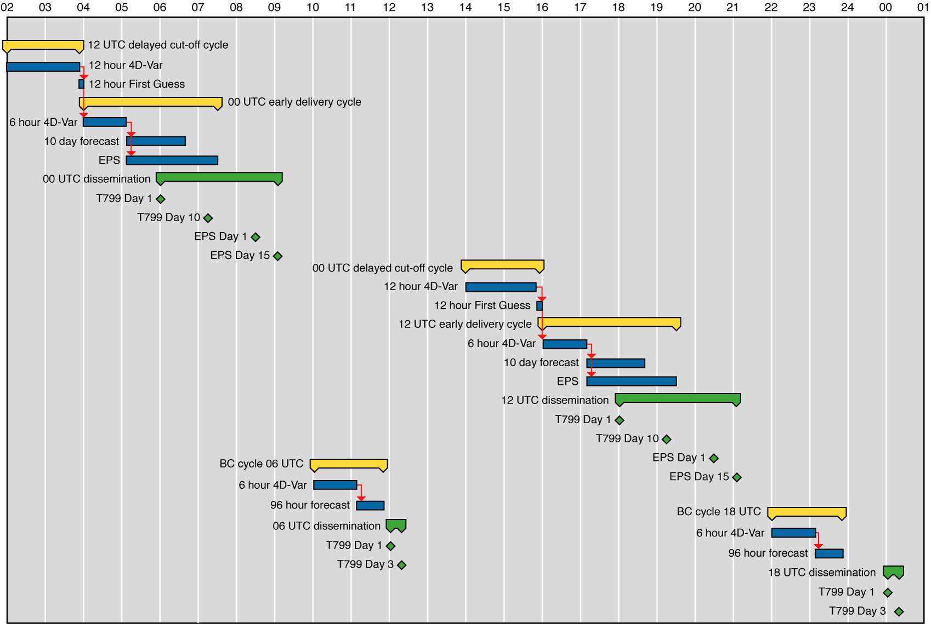
ECMWF Operational Suites

Slide 40
Important Concepts
Status Flow
Dependency
Inheritance
Variables
Task versus job
Notes:
Axel

Slide 41
Important Concepts : Status Flow (1/2)‏
After you play a suite its status is unknown, use begin to start
Re-run, can be automatic if set in definition-file
Repeat, may take nodes back from complete to queued
“time” and “cron” may also make a task queued again
Notes:
Axel

Slide 42
Important Concepts : Status Flow
Unknown
begin
re-run
Complete
Aborted
Queued
Submitted
Active
Complete
Suspended
resume
Aborted
Aborted
Notes:
After you play a suite its status is unknown, use begin to start
Re-run, can be automatic if set in definition-file
Repeat, may take nodes back from complete to queued
time and cron may also make task queued again

Slide 43
Important Concepts: Dependencies
A node may stay queued because:
ecFlow server is halted or shutdown
Its parent has a dependency
It is triggered by a state of another node
It is waiting for time of day, day of a week, date of year
A limit it uses is full
It is suspended
Use “why” button ecflowview to find out why
Notes:
Axel

Slide 44
Important Concepts: Inheritance
There are three different kind of inheritances in ecFlow
Variable inheritance
looks at the task first, then parents until it reaches ecFlow itself
Status inheritance
family status reflects most important status of its tasks
likewise for suites and ultimately for ecFlow
Dependency inheritance
dependencies on any level
for task to run, it must be free to run as all its parents
Zombie handling inheritance
Notes:
Axel

Slide 45
Security
Designed for collaborative working so default access is open
ecFlow server can be protected with white list file
Suites can be locked to specific users
We use a specific accounts for operations and research
Never run as root!
And finally
Do not even think about running as root!

Slide 46
Important Concepts: Task versus Job
Task is the piece of work that you want ecFlow to run for you
You define a task in the suite definition file
You write a ecFlow script describing your task
When ecFlow is ready to run your task it
edits your task and creates a job-file using ecFlow variables
submits the job if it was successfully created
the job runs (e.g. as a NQS or load leveller job)
A task is a parameterised or configurable job
Notes:
Axel

Slide 47
Handling multiple platforms: ECF_JOB_CMD, ECF_KILL_CMD
In course directly set how to submit jobs
Can use a script to modify submission/kill behaviour dependant on system, e.g. ecf_submit.
ECF_JOB_CMD “ecf_submit %USER% %HOST% %JOB% %JOBOUT%”
if (PBS) then qsub …. qdel
if (loadleveler) then llsubmit …. llcancel
Can also use generic queuing commands
#QSUB –q emos
For loadleveler becomes class=emos
For PBS becomes #PBS –q emos

Slide 48
Similarities with SMS
Functionality is very similar
Suites, Family, Task, Variables, Trigger, Time, Date, Late, etc
Child commands: init, complete, event, meter, label, wait, abort
Variable inheritance
Scripts are similar
file name extension: .sms -> .ecf
SMS variables replaced with ECF, ie SMSHOME -> ECF_HOME
GUI: will be changed in the future

Slide 49
Differences with SMS (1)
Maintenance and enhancement of Client/Server easier
Built from the ground up in C++
Design Patterns, Observer, Template, Singleton, etc
Test Driven, large set of regression tests
SMS provided a custom scripting language, ecFlow provides Python integration, that allows:
Building of the suite definition
Client-Server communication
Not restricted to Python, can use shell level interface
Published format, any language for generating the suite definition

Slide 50
Differences with SMS (2)
Improved Error Checking for:
Trigger Expressions
Validation of externs in Trigger expression
Earlier checking for job generation
checks for recursive includes
Simulation with out the need for scripts or server
Customisable handling of zombies
When a task is aborted, a reason can be provided
No explicit login
No autorestore, automigrate

Slide 51
Python definition file
The old SMS definitions start at the beginning and you follow it through to the end
It is not that simple with an object-oriented design
readable code (KISS)

Slide 52
Python
data types consistency:
VERSION = "0001“
if CYCLE == "00": print 'ok'
OOP
inheritance: class derivation
multiple inheritance
Polymorphism
classes, instances, methods

Slide 53
Python
Modules
raise, catch exceptions
dynamically typed: it is then possible to mix types (ecFlow-SMS GUI with PyQt)
embedded, or library extension
portable, open source

Slide 54
Suite design with Python
python modules:
no simple global scope anymore
benefit in accessing the ecflow API through a layer module:
enable/disable 'triggers', 'inlimits', but also 'late'
maintain the ability to load the suite on SMS
intercept variables definitions for translation

Slide 55
Suite design with Python
customize Python API
class Task(ecflow.Task, Node): """ wrapper around task ""“ def __setattr__(self, key, val): if key.isupper(): key, val = translate(key, val) self.add_variable(key, val) tsk = Task("example") tsk.VAR = "value“ tsk.add_variable({ VAR: "value", })
'with great power comes great responsibility'
easy to break the KISS principle

Slide 56
Object oriented design
class StreamDCDA(object):
""" Delayed cut-off stream ""“
def __init__(self):
self.stream = "dc"
self.mxup_traj = MXUP_TRAJ
self.period_4d = PERIOD_4D
self.endanens=0
class StreamED(StreamDCDA):
""" Early delivery ""“
def __init__(self):
super(StreamED, self).__init__()
self.stream = "ed"
self.mxup_traj = ED_MXUP_TRAJ
self.period_4d = PERIOD

Slide 57
Python error handling
It’s good
If your Python is incorrect, the error messages are very helpful for finding where and why it fails
This was NOT the case for SMS
Ecflow has a built-in ‘Job generation checker’ which can be run in advance. It detects, for example, if .ecf job wrappers are missing, or if triggers are invalid.

Slide 58
Python: Code Quality
pylint
Rates code
Enforces syntax
warns about large code: too many members, variables
coverage: identify dead code
documentation: pydoc
iPython: interactive interpreter
beware module dependencies (portability)

Slide 59
Migration from SMS to ecFlow
header files
script wrappers
queuing system directives
# QSUB -o <output file>
associated scripts
ecf_submit, ecf_kill, ecf_status
embedded dependency in applications
ifs, mars

Slide 60
Migration of header files
trap.h, endt.h
smsinit, smsabort, smscomplete replaced with ecflow_client
xinit, xabort, xcomplete?
qsub.h (ECMWF specific generic queuing commands)
queuing system directive replaced before job submission, smssubmit (SMSCMD), ecf_submit (ECF_CMD)
smsmeter, smsevent, smslabel:
replace with ecflow_client commands
xmeter, xevent, xlabel?

Slide 61
Migration: wrapper files
remove occurrences of %SMS variables
%SMSTRYNO%, %SMSJOBOUT%
cdp calls
suite design can remove some embedded CDP
cdp call to force complete
replace with event /complete combination in the definition file
Migrate child commands

Slide 62
Migration: explicit CDP calls
Replace with ecflow_client commands, or
export ECF_PORT=%ECF_PORT:0% case $ECF_PORT in 0) smsvariable BASEDATE $BASEDATE || \ cdp <<EOF set SMS_PROG $SMS_PROG; login -t 60 $SMSNODE $USER 1 if (rc eq 0) then; exit 1; endif alter -V $SMSNAME:BASEDATE $BASEDATE exit 0 EOF ;; *) ecflow_client --alter change variable BASEDATE $BASEDATE $ECF_NAME ;; esac

Slide 63
Migration: examples
admin suite
sync suite
operational or e-suite
member states (option 3) suites

Slide 64
Communicating with ecflowview
Using a 'named pipe' to select and open a window export ECFLOWVIEW_INPUT=/tmp/ecflowview_pipe; if [ ! -p $ECFLOWVIEW_INPUT ]; then rm -f $ECFLOWVIEW_INPUT; mknod $ECFLOWVIEW_INPUT p; fi; ecflowview echo -e 'select lhost /elaw_37r3/main/12/euroshelf/wamobs' > $ECFLOWVIEW_INPUT echo -e '\nwindow -d -f Script\n' > $ECFLOWVIEW_INPUT echo -e '\nwindow -d -f Manual\n' > $ECFLOWVIEW_INPUT
web service unset ECFLOWVIEW_INPUT; ECFLOW_HTTP_PORT=8081 ./bin/gcc-4.5/debug/ecflowview firefox --new-tab http://ibis.ecmwf.int:8081/lhost/ealadin/main/12.json wget http://ibis.ecmwf.int:8081/lhost/ealadin/main

Slide 65
Communicating with ecflowview
ecflowview window position and size can be set at start up, but a window manager can ignore it (window grouping):
ecflowview -geometry=640x480+120+240

Slide 66
Extending ecflowview: Menus
$HOME/.ecflowrc/ecflowview.menu: configuration file for menus created when absent
menu visible/active according to node type and status
ecflow commands start with 'ecflow_client‘
system commands
access to the menubar through the context menu: classes derived from 'panel' have a name. In ecflowview.menu file it can be used to open a window. "grep "name()" `grep -l panel src/*h` | cut -d: -f2 | sort | uniq | cut -d\" -f2“ Check Edit History Info Job Jobstatus Manual Messages Output Script Suites 'Time line' Triggers Users Variables Why? Zombies Options (SERVER, ALL , 'Msg...', WINDOW(Messages))
Collector (node-Ctrl-click1):: (SUITE|SERVER, ALL, 'Collect...', WINDOW(Collector))
scripting.cc: external commands definitions (select, window)

Slide 67
Hints for interface design
nodes: server, suite, family, task, alias
States
attributes
autocancel defstatus edit late
repeat limit event meter label inlimit
trigger complete date time cron today
actions
server: Check History Suites 'Time line' Variables Zombies Options
Nodes
Script Manual Job Output Edit
Info Messages 'Time line' Triggers Variables Why?
Check Jobstatus Execute Requeue Force

Slide 68
Third party libraries
PyQT
http://www.riverbankcomputing.co.uk/software/pyqt/download
python to javascript
http://pyjs.org/
simple web server
http://www.pythonweb.org

Slide 69
Contact Points:
Axel BONET axel.bonet@ecmwf.int
John HODKINSON john.hodkinson@ecmwf.int
Avi BAHRA avi.bahra@ecmwf.int
Blazej KRZEMINSKI blazej.krzeminski@ecmwf.int
ECMWF Software Support software.support@ecmwf.int
Email John or Axel if you want to subscribe to the ecFlow newsgroup

