Slide 1
ecFlow migration course
John Hodkinson Avi Bahra Axel Bonet
Meteorological Applications Section
ECMWF

Slide 2
AIMS
Information
What is ecFlow ?
Development environment
Technology
Similarities with SMS
Differences
Examples
Migration
Schedule

Slide 3
Information
Platforms: Linux, Linux Cluster, IBM, HPUX
Files:
Client
Server
Python Extension
GUI (only available on Linux)
PATHS: /usr/local/apps/ecflow/<version>/bin
User manual: /usr/local/apps/ecflow/<version>/doc
Online Tutorial: http://intra.ecmwf.int/metapps/manuals/ecflow

Slide 4
What is ecFlow ?
Client/Server based replacement for SMS
Complete re-write in C++, to improve maintenance and ease of development
Similar scheduling and supervision functionality to SMS
Python API can be used to generate definition structure
Client Server API available on the command line and in Python
Allows reuse of existing task wrapper/header files, with some modifications
GUI similar to XCdp. To be rewritten in the future

Slide 5
Development environment
Eclipe CDT Indigo: http://www.eclipse.org/indigo
C++ Integrated Development Environment
Syntax highlighting
Customisable formatting
cross reference, navigation
Perforce plug-in
Check-in, Checkout, Get latest revision
Revision history, compare
Python plug-in
Auto-complete
Debug

Slide 6
Technology
Current documentation using Sphinx Pocoo: http://sphinx.pocoo.org
Tutorial, Automated Python API, documentation
Boost: http://boost.org
ASIO
Python
Program options
Spirit
Serialization
Test
Date-Time, File-system
bjam

Slide 7
Similarities with SMS
Functionality is very similar
Suites, Family, Task, Variables, Trigger, Time, Date, Late, etc
Child commands: init, complete, event, meter, label, wait, abort
Variable inheritance
Scripts are similar
file name extension: .sms -> .ecf
SMS variables replaced with ECF, i.e. SMSHOME -> ECF_HOME
Preserve investment
White list file
GUI: is to be changed in the future

Slide 8
Differences with SMS (1)
Maintenance and enhancement of Client/Server easier
Built from the ground up in C++
Design Patterns, Observer, Template, Singleton, etc
Test Driven, huge set of regression tests.
SMS provides a custom scripting language, ecFlow provides Python integration, that allows:
Building of suite definition
Client-Server communication
Not restricted to Python, can use text format and shell level interface
Published text format
Simple format, Any language for generating the suite definition
No interpretation
No loops, conditionals, or functions

Slide 9
Differences with SMS (2)
Improved Error Checking for:
Trigger Expressions
Validation of externs in Trigger expression
Earlier checking for job generation
checks for recursive includes
Simulation with out the need for scripts or server
Customisable handling of zombies
Storage of remote id allows zombies to be killed
When a task is aborted, a reason can be provided
No explicit login
No autorestore, no automigrate
log file

Slide 10
Text Format Example
suite suite
edit ECF_INCLUDE /home/ma/ma0/course # comment line
task foo
label foo ""
date 01.*.*
family familyName
task a
event 1 theEventName
task b
family heir_familyName
task a
meter myMeter 0 100
task c
trigger (a == complete and ../b == complete)
endfamily
endfamily
endsuite

Slide 11
Examples
Correct by Construction
The Python API supports a correct by construction approach.
For example adding nodes of the same name, at the same level, will throw a RuntimeError exception:
import ecflow
defs = ecflow.Defs()
suite = defs.add_suite("s1")
suite.add_task("t1")
suite.add_task("t1") # exception thrown
>>RuntimeError: Add Task failed:
>> A task of name 't1' already exists
>> on node SUITE:/s1

Slide 12
Examples
Correct by Construction
Adding dependencies like dates are also checked:
import ecflow
defs = ecflow.Defs()
suite = defs.add_suite("s1")
task = suite.add_task("t1")
# day, month, year, month is not valid
task.add_date(1, 14, 2007)
>> IndexError: Invalid Date(day,month,year):
the month >= 0 and month <= 12,
where 0 means wild card

Slide 13
Examples
Checking
Some checking has to be deferred until the definition is fully defined:
import ecflow
defs = ecflow.Defs()
suite = defs.add_suite("s1")
suite.add_task("t2")
suite.add_task("t1").add_trigger("t2 == active)")
assert len(defs.check()) != 0, \
"Expected Error: miss-matched brackets in expression."

Slide 14
Examples
Job Checking
Job creation is process of locating a '.ecf' script corresponding to a task and then generating a job file. This can be checked before a definition is loaded into the server:
# Generate jobs for the *ALL* tasks in
# the definition given by variable 'defs' and
# print errors to standard out.
job_ctrl = JobCreationCtrl()
defs.check_job_creation( job_ctrl )
print job_ctrl.get_error_msg()

Slide 15
Examples
Client/Server: load definition into the server:
import ecflow
defs = ecflow.Defs(); # ...
ci = ecflow.Client() # create a client
ci.set_host_port("localhost", "3141")
try:
ci.restart_server() # restart if halted
ci.load(defs) # play
ci.begin_suite("s1") # begin
except RuntimeError, e:
print "failed: " + str(e)

Slide 16
Trigger checking
SMS does not complain when a trigger references a non-existant node
ecFlow provides a command to check triggers with orphan references
Job generation control for ecFlow.
SMS script equivalent is script-Edit-Preprocess-Execute
CDP is tolerant: no complaints, provided math tree can be built.
It may accept unbalanced bracket expression.

Slide 17
Migration
Validation by operations first. Once done and stable, open up to other departments and eventually the member states.
The task scripts and header files can be re-used, with small changes
A completely automated migration from CDP based definition file to ecflow based python scripts is not normally possible.
Python is a fully object oriented language, so to take full advantage, CDP scripts should be completely rewritten.

Slide 18
Timeline
Online tutorial avalable for training
Internal beta is in testing
Full release is expected in 2012

Slide 19
Where we are now...
Do we do a one off transition ?
Or need to load the suite on both systems ?
include/task wrapper files on both systems ?
Best case: only head.h and tail.h have system dependency
embedded children call: IFS, MARS need system scripts (smslabel, smsevent, smsmeter). To intercept the call
identify the scheduler in charge,
call the right child command
administrative tasks demand attention: from cdp to python for batch remote control of the server (e.g. force complete, alter variable)

Slide 20
Components
ecflow_server: a Supervisor, Monitoring, Scheduler, just not SMS
ecflow_client:
command line interface from a terminal
user commands
jobs supervision: child commands, status and attributes update
client, batch mode: ecflow_client, python api
ecflowview: graphical user interface

Slide 21
Server Functionality
setup environment: use ecflow # /usr/local/apps/ecflow/current/bin
startup:
ecflow_start.sh; ecflow_stop.sh
ecflow_server --port $((1500 + $(id -u)))
nohup ecflow_server > ecf.out 2>&1 &
hosts the suites
checkpoints (backup) suites tree
handles user and job requests
logs activity
white list access file, ECF_PASS, to detect-prevent unwanted requests

Slide 22
Server
configuration:
ECF_HOME, # server admin directory
ECF_PORT, # port number $((1000 + $(id =u))) - 1500
ECF_CHECK, # checkpoint file name
ECF_CHECKOLD, # backup checkpoint file name
ECF_LOG, # server log file name
ECF_CHECKINTERVAL, # [120], 600 sec
ECF_LISTS, # white list file name
ECF_DEBUG_SERVER
server log file: ecflow_client --log=new # [new|clear|flush]

Slide 23
Text client interface
for remote assistance or batch mode
for monitoring and interaction:
ecflow_client --get # --group="get; show state"
ecflow_client --get_state
ecflow_client --alter change variable NPES 60 /emc
implicit-explicit call:
ECF_NODE, ECF_PORT (ECF_NAME, ECF_PASS)
ecflow_client --port 3141 --host mordred --get
load-replace suites into the server:
ecflow_client --load mc.def
ecflow_client --replace=/emc mc.def

Slide 24
Child commands: ecflow_client
self contained manual: ecflow_client --help
status update: --init <PID-QID>, --abort <cause>, --complete
attribute update: --event <name>, --meter <name> <value>,
--label <name> <text>
embedded trigger: --wait <expression>
when a job cannot connect (one host name per line):
export ECF_HOSTFILE=$HOME/.ecf_hostfile
going further:
ecflow_client --alter add variable FCNPES 60 /emc
ecflow_client --alter change variable THREADS 1 /emc

Slide 25
Child commands: ecflow_client
configuration:
ECF_NODE, # server hostname
ECF_PORT, # server port
ECF_NAME, # task path
ECF_PASS, # pseurandom string to detect zombies
ECF_TRYNO, # job occurence number
ECF_HOSTFILE, # hostname list for alternative servers
ECF_RID, # job remote id (queuing id)
ECF_TIMEOUT, # interval between two attempts
ECF_DENIED, # to enable job exit with error before 24h
NO_ECF, # standalone mode
ECF_DEBUG_CLIENT

Slide 26
Graphical client interface: ecflowview
Initial version based on Xcdp
for broadband connection, for both monitoring and interaction
most text commands, restricted
direct access to information: script, manual, job, output
user can restrict available commands:
Edit->Preferences->User-Operator-Administrator modes
user can configure nodes/statuses/attributes display, vertical-horizontal display (node + ctrl-middle-mouse-button + close,open)
$HOME/.ecflowrc: servers, X.options, ecflowview.menu

Slide 27
Client-Server environments
CDP: command and display program (SMS)
Korn Shell
Python

Slide 28
Using CDP
rc file environment setting: variables IOIRC, CDPRC, ./.ioirc, ./.cdprc, $HOME/.ioirc, $HOME/.cdprc
variables, variables import, aliases, functions:
set var value
var=1 # math
setenv -i USER HOST
alias ok echo ok
define my_function {
echo ok # $# $* shift return
}
history: !<cmd>, !!, !n
no protected keyword, e.g. "task do" is accepted
# comments
variable rc for latest return code (TRUE=1, FALSE=0)

Slide 29
Using CDP
simple language:
if (<math>) then <cmds>; else <cmds>; endif
while (<math>) do <cmds>; endwhile
for var <math> <math> [step(<math>] do cmds; endfor
loop var (<spaced-list>) do <cmds>; endloop
case var in (<spaced-list>) do <cmds>; endin; in ( ) do <default>; endin; endcase
math expressions may not contain $ for variables
close connection with underlying shell:
$ shell-cmd
% c-shell-cmd
set var `shell-cmd`
include files: CDP> < inc_revervation.def
pipes, redirections: CDP> ls -NR /mc | grep > out
debug: "set debug on", open-source
self contained documentation: man

Slide 30
Using the Korn shell
environment setting: $HOME/.kshrc, $HOME/.profile (once at login)
variables, posix aliases, functions:
var=value
alias ok="echo ok"
function fct {
echo ok # $# $* shift return
}
fct() {
echo ok
}
history: r (?), !cmd, !!, !n
protected keywords, builtin keywords (time, limit), homonyms (date)
# comments
variable $? for latest return code (OK=0, ERR=1)

Slide 31
Using the Korn shell
one-to-one control structure matching:
if (( <math> )) then <cmds>; elif [[ <math> ]]; then <cmds>; else <cmds>; fi
while [[ <math> ]]; do <cmds>; done
while ((<math>)); do <cmds>; var=$((var+step)); done
for var in <spaced-list> do <cmds>; done
case $var in <piped-list>) <cmds>;; *) <default>;; esac
include files: ". inc_common.def"
pipes, redirections: native
debug: set -eux; PS4
documentation: man (MANPATH), bash:help

Slide 32
Using Python
environment setting: $HOME/.pythonrc, PYTHONPATH (modules location)
variables, aliases(?), function (named arguments, default valued argument, documentation)
>>> var=<value>; var="string"; var=True; var=False; var=None
>>> def ok(): print "ok" # alias
>>> def fct(a="def", b=None):
>>> """ documentation example """
>>> if b: print a, b
>>> fct(a="a", b="b"); fct(b=1)
classes http://docs.python.org/tutorial/classes.html
errors handling: try, except, finally, raise, http://docs.python.org/tutorial/errors.html
documentation: http://docs.python.org/library/functions.html

Slide 33
Using Python
control structure matching:
while <math>: <cmds>
while <math>: <cmds>; var=var+step
for var in <list>: <cmds>
for var in xrange(0, n+1): <cmds>
if var in <list>: <cmds>; elif var=="value": <cmds>; else: <cmds>
module import:
>>>from mylib import *
>>>from mylib import a, b, c
>>>import another_lib
>>>import long_name as short
debug: python -m trace -t, pylint, pychecker, coverage
beware indentation

Slide 34
Migration to ecFlow
best case? starting a new project, a new suite
one off translation: task wrappers, task headers, suite definitions
or create a definition file loadable by both SMS and ecFlow
installation: /usr/local/apps/sms/bin, /usr/local/apps/ecflow/current/bin
startup: sms_start, sms -b, sms - ecflow_start.sh, ecflow_server
SMS_PROG - ECF_PORT
child commands: compilation and installation, for all remote platforms
script: rename, copy, link, recode (ecf_submit, ecf_kill, ecf_status)

Slide 35
Migration: task wrappers
default file name extension (.ecf) or part of suite definition (edit ECF_EXTN “.ecf”)
minimum changes requested ? move, copy, link (p4 history)
simple when task is restricted to:
%include <head.h> ... %include <tail.h>
beware smart server interacting tasks, watch dogs, monitoring tasks:
cdp <<EOF
setenv -i USER HOST; login $HOST $USER 1;
alter -V /path:VAR value; force -r /path complete
EOF
ecflow_client --change variable "VAR" "value" /path
ecflow_client --force complete recursive /path

Slide 36
Migration: task headers
translate variables names ? sed -f convert-min.sed <file>
include additional header to work in both mode: %include <ecf.h>
SMS_PROG, ecflow communication port, as discreminator:
if [[ %SMS_PROG:0% != 0 ]]; then echo SMS_NODE
elif [[ %ECF_PORT:0% != 0 ]]; then echo ECF_NODE; fi
convert SMS system variables:
provide default values: %SMSTRYNO:0%
translate: %ECF_TRYNO:0%
use shell variable: $ECF_TRYNO

Slide 37
Migration: expanded suite definition
both SMS and ecFlow can load an "expanded" definition file:
autocancel
clock complete cron date day defstatus
edit endfamily endsuite endtask event extern
family inlimit label late limit meter
repeat suite task time today trigger
removed keywords (CDP> man -s play):
EOF abort action automigrate autorestore owner text

Slide 38
Migration: suite definition
expand suite definition from SMS server:
log="set SMS_PROG $SMS_PROG; login $HOST $USER 1"
cdp -c "$log; get /$SUITE; show /$SUITE > out"
expand suite definition from local file:
cdp -c "play -l $SUITE.def; show /$SUITE > out"
translate, apply sed filter (variables name, filter out):
sed -f sms2ecf-min.sed out > ecf.def
load-reload a suite into ecFlow:
log="--port $ECF_PORT --host $HOST"
ecflow_client $log --load ecf.def
ecflow_client $log --replace /$SUITE ecf.def

Slide 39
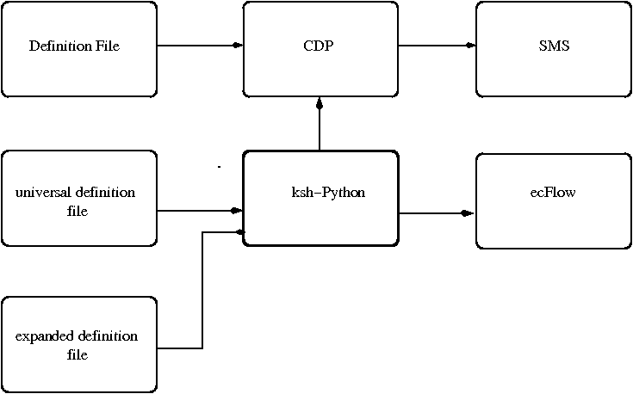
Migration: suite definition

Slide 40
Migration: suite definition - shell
ksh as an environment to generate expanded suite definition
beware: time, limit, date, keywords
dedicated file descriptor:
exec 5>x.def # open
print -u5 "suite x";
print -u5 "family y"; print -u5 "task z"
# exec 5<&- # close
task() {
print -u5 "task $*"
}
family() {
echo "family $*" >&5
}

Slide 41
Migration: CDP-Ksh vs Python
CDP rc files: multilayer configuration files,
standalone environment: quit, restart to reset
Korn shell: global scope for variables, aliases, functions
Python: toward modules
class inheritance: suites template
strong types: if fam == "12" or fam == 12: pass
string manipulation:
PROJECT = "emc"; file_name = "mc.def"
ecf = "ecflow_client --replace"
cmd = "%s /%s %s" % (ecf, PROJECT, file_name)
os.system(cmd)

Slide 42
Migration: debugging
CDP: set debug on, ddd, gdb
Ksh:
ksh -n
set -e stop on first error
set -u no undefined variable
set -x print command before execution
PS4 variable: time stamping, runtime
Python:
Eclipse Pydev: step through the code
python -m trace -t script.py
pylint, pychecker
coverage run mc.py, coverage html mc.py

Slide 43
Migration: suite definition - Python
Python not for job scripting on HPC at ECMWF, so far!
Python api to create a suite tree:
>>> from ecflow import *
>>> s = Suite(emc)
>>> defs = Defs()
print expanded file: >>> f = open("mc.def", "w"); print >> f, defs
played into sms or loaded into ecFlow
class definition, class derivation: main-lag-pop families, logtasks
verbosity can be reduced: multiple arguments at once:
import inc_hostc as ih
def extern(*args):
for path in args:
ih.extern(expand(path))

Slide 44
Migration: suite definition - python
trigger-complete expressions:
from string import Template
dl = { 'root': "/o", 'SELECTION': "/mc" }
trigger("$root/main:YMD gt ${SELECTION}/main:YMD")
root = "/o"; SELECTION = "/mc"
path = "%s/main:YMD gt %s/main:YMD" % (root, SELECTION)
trigger(path)
shell connection: shell variables import, shell command output:
USER = os.getenv("USER")
def shcmd(cmd):
try:
read, err = popen2.popen2(cmd)
out = read.readlines()
return str(' '.join(out).replace('\n', ''))
except:
print "prb with the command ", cmd, err
raise

Slide 45
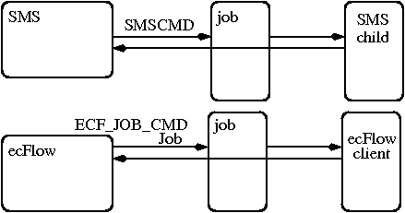
Migration: using child commands
parallel indepent mode:
PATH=/use/local/apps/sms/bin:$PATH
use ecflow
PATH=/use/local/apps/ecflow/current/bin:$PATH

Slide 46
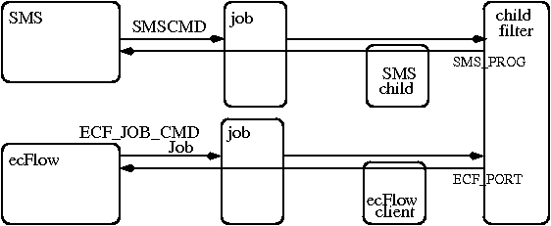
Migration: using child commands
using a filter:
PATH=/use/local/apps/sms/ecflow/bin:$PATH

Slide 47
From CDP Variables
CDP variables can be used for multiple purposes:
within a CDP session (control structures: if, case, loop, while, for)
for one or multiple SMS variables definitions:
set HOST c1a
edit SCHOST $HOST
edit SMSLOGHOST $HOST
imported variables: setenv -i
to simplify trigger-complete expression

Slide 48
Migration: Migrated Variables
SMS | ECF | SMS | ECF
SMSNAME | ECF_NAME | SMSLISTS | ECF_LISTS
SMSNODE | ECF_NODE | SMSPASSWD | ECF_PASSWD
SMSPASS | ECF_PASS | SMSMICRO | ECF_MICRO
SMS_PROG | ECF_PORT | SMSPID | ECF_PID
SMSINCLUDE | ECF_INCLUDE | SMSHOST | ECF_HOST
SMSFILES' | ECF_FILES' | SMSDATE | ECF_DATE
SMSTRYNO' | ECF_TRYNO' | SMSURL | ECF_URL
SMSTRIES' | ECF_TRIES' | SMSURLBASE | ECF_URLBASE
SMSHOME | ECF_HOME | SMSCMD | ECF_JOB_CMD
SMSRID | ECF_RID | SMSKILL | ECF_KILL_CMD
SMSJOB' | ECF_JOB' | SMSSTATUSCMD | ECF_STATUS_CMD
SMSJOBOUT' | ECF_JOBOUT' | SMSURLCMD | ECF_URL_CMD
SMSOUT | ECF_OUT | SMSWEBACCESS | ECF_WEBACCESS
SMSCHECKOLD | ECF_CHECKOLD | SMS_VERS | ECF__VERS
SMSCHECK | ECF_CHECK | SMS_VERSION | ECF__VERSION
SMSLOG | ECF_LOG

Slide 49
Definition File grammar for ecFlow
http://intra.ecmwf.int/metapps/manuals/ecflow/grammar/grammar.html

Slide 50
Definition file examples
operational o suite - ecflow proposal
xdiff ~emos/def/o/o.def ~emos/def/ecflow/o.py
xdiff ~emos/def/o/mc.def ~emos/def/ecflow/mc.py

Slide 51
Migration Part II
step by step example to migrate a suite to ecFlow:
transcoding a definition file
preparing task wrappers
preparing task headers

Slide 52
SMS suite: Play
a template suite to test jobs push on multiple platforms,
the play-expand-translate-load method:
play the suite definition file into sms:
$ l="set SMS_PROG $((900000 +$(id -u))); login $HOST $USER 1"
$ cdp -c "$l; play -r /skull skull.def"
$# MSG:play:/skull replaced.

Slide 53
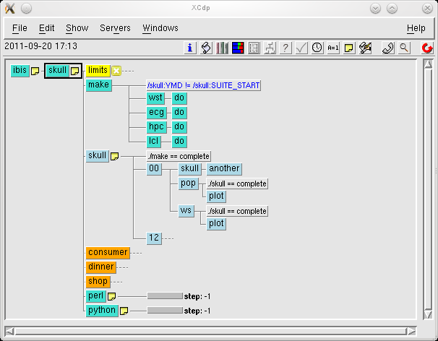
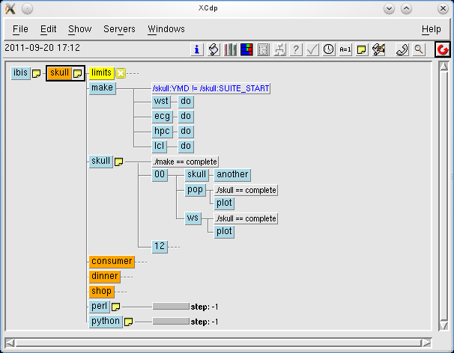
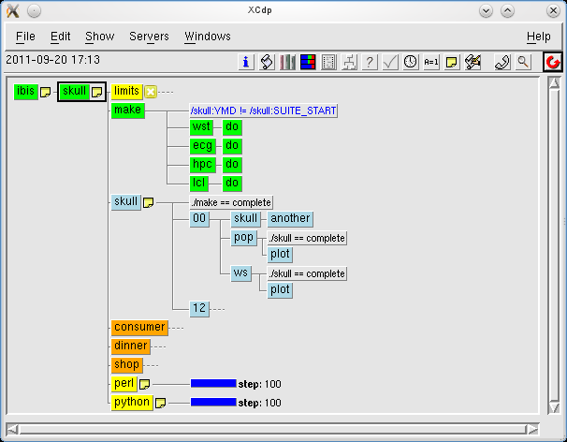
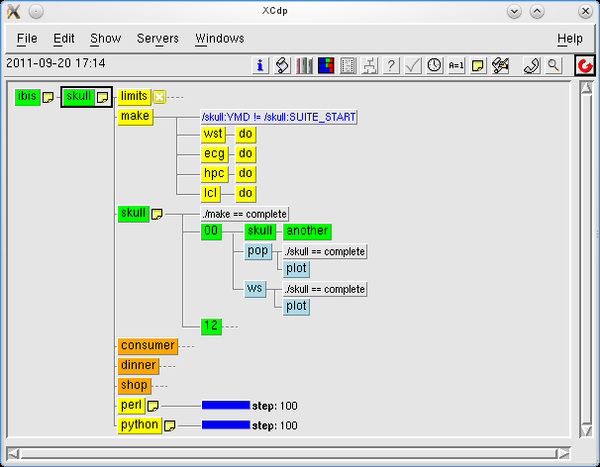
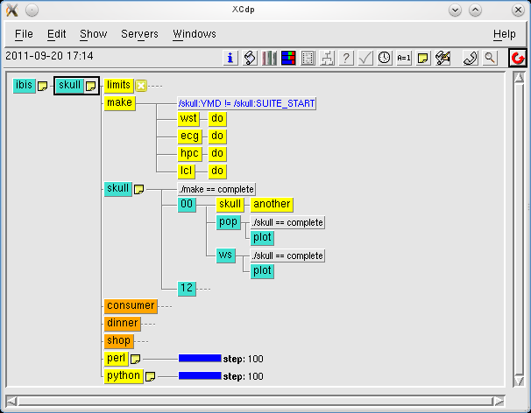
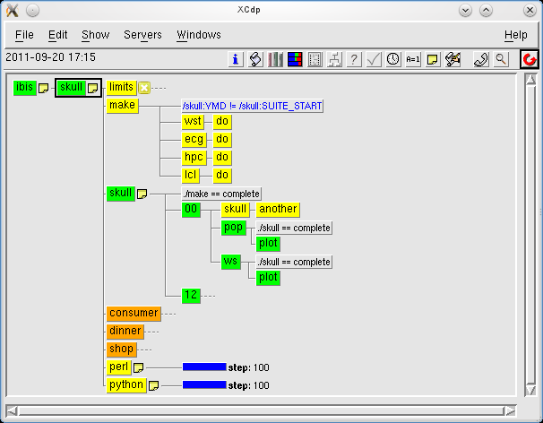
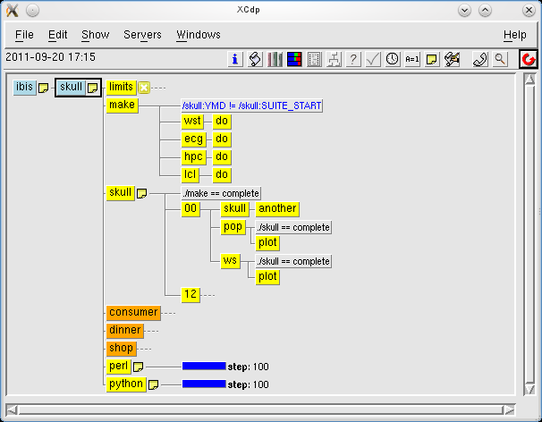
SMS suite: display with XCdp

Slide 54
SMS suite: CDP definition file
#!/usr/bin/env cdp
set PROJECT skull
set SELECTION $PROJECT
# set SELECTION e${PROJECT}
case SELECTION
in (skull) do set FIRST_DAY 0; endin
in (eskull) do set FIRST_DAY 1; endin
endcase
alias def_fam defstatus suspended
setenv -i USER SCRATCH HOME HOST
set GROUP `id -gn`
set SCHOST c1a
set WSHOST `uname -n`
set CLHOST lxa
case USER in (map) do
set WSQUEUE serial
set WS_QUEUE_EPILOG ns
set SCQUEUE ns
set SC_QUEUE_EPILOG ns
set ACCOUNT ecodmdma
endin
in () do
set WSQUEUE serial
set WS_QUEUE_EPILOG ns
set SCQUEUE ns
set SC_QUEUE_EPILOG ns
set ACCOUNT decmsaf
endin
endcase
set WSLOGDIR $SCRATCH/output
$ mkdir -p $WSLOGDIR/$SELECTION # call shell command
set SCLOGDIR /s1a/ms_dir/$GROUP/$USER/smsjoboutput
set WDIR /s1a/ms_dir/$GROUP/$USER/wdir

Slide 55
SMS suite: stepping out
expand the suite:
cdp -c "ode; status; get; show /skull > expanded.sms“
alternatively, it can be played and expanded locally:
cdp –c “play –l skull.def; show /skull > expanded.sms”
apply filter (grep out or change variables):
filter=~map/bin/sms2ecf/sms2ecf-min.sed; name=expanded
sed -f $filter $name.sms > $name.ecf
load into ecFlow server:
ecflow_client --load expanded.ecf
or replace:
ecflow_client --replace=/skull expanded.ecf

Slide 56
ecFlow: first step
the server shall be capable to find tasks wrappers (ECF_HOME)
edit ECF_EXTN .sms
copy, move, link the files ?
the server shall be capable to find header files (ECF_INCLUDE)
%SMS to be replaced with relevant %ECF_ variable
multiple situations:
same location for SMSFILES and ECF_FILES ?
same location for SMSINCLUDE and ECF_INCLUDE ?
different directories
links ? different path names, same location
Script-Edit-Preprocess-Submit ?

Slide 57
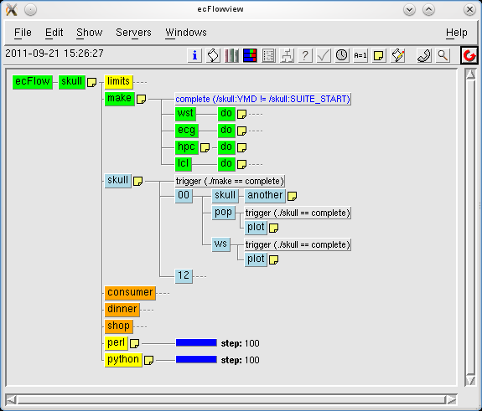
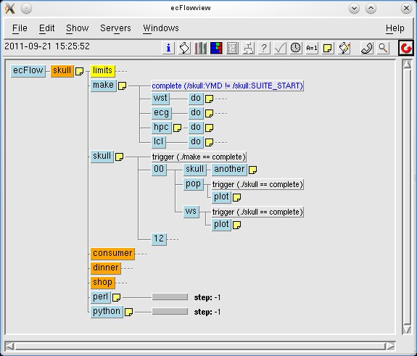
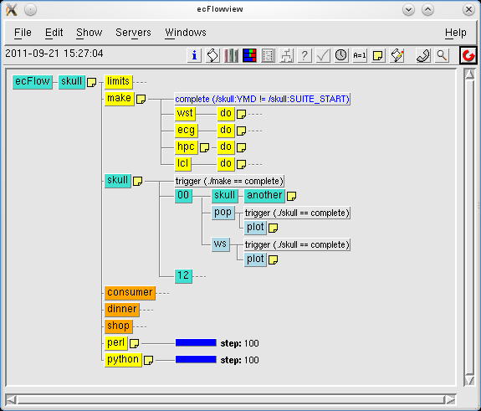
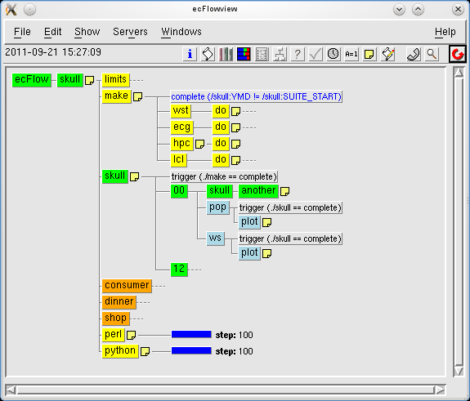

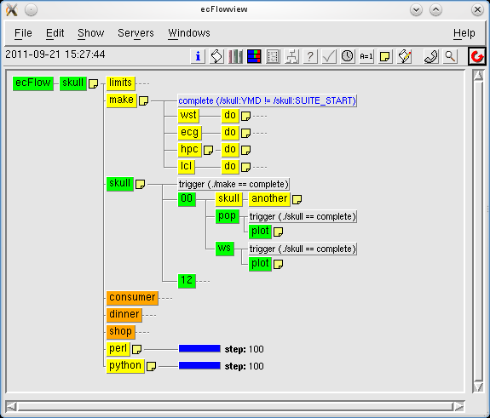
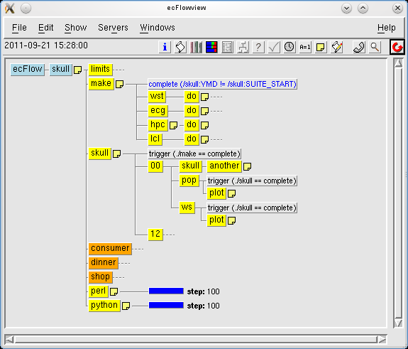
ecFlow suite: display with ecflowview

Slide 58
ecFlow: second step
one-off upgrade ?
updating scripts to gain compatibility with both SMS and ecFlow ?
replace child commands calls with generic name, or use aliases
define a header file to enable the relevant child command to be called

Slide 59
From CDP expanded suite to ecFlow
ecFlow: ready to load
suite skull
defstatus suspended
clock hybrid 0 # 20.09.2011 15:38
edit USER 'map'
edit SCHOST 'c1a'
edit CLHOST 'lxa'
edit WSLOGDIR '/scratch/ma/map/ou
edit SCLOGDIR '/s1a/ms_dir/ma/map
edit DATEMASK '*.*.*'
edit ECF_LOGHOST 'c1a'
edit ECF_LOGPORT '9316'
edit ECF_TRIES '1'
edit ECF_HOME '/scratch/ma/map/ou
edit ECF_FILES '/tmp/map/work/p4/
edit ECF_INCLUDE '/tmp/map/work/p
edit ECF_JOB_CMD '/home/ma/emos/b
edit ECF_KILL_CMD '/home/ma/emos/
edit ACCOUNT 'ecodmdma'
edit VERSION '0040'
edit EPSVERSION '0001'
edit RFVERSION '0001'
edit DELTA_DAY '0'
edit EMOS_BASE '00'
edit USE_YMD 'true'
edit FSFAMILY '/'
edit BINS '/home/ma/map/bin'
edit XBINS '/home/ma/emos/bin'
edit STREAM 'undef'
edit EPSTYPE 'undef'
edit MEMBER '0'
edit FIRST_DAY '0'
edit EMOS_TIME_STEP_H '00'
edit YMD '20110920'
edit SUITE_START '20110920'
edit QUEUE 'serial'
edit QUEUE_EPILOG 'ns'
edit LOGDIR '/scratch/ma/map/outp
edit ECF_OUT '/scratch/ma/map/out
edit WSHOST 'ibis'
edit SLEEP '20'
family limits
defstatus complete
limit lim 3
endfamily
….…………….
………………..
Expanded definition files can be rather large files ...
We expect to find the relevant matching ECF_ variable matching the SMS system variable.

Slide 60
CDP: ready to play
suite skull
defstatus suspended
clock hybrid 0 # 20.09.2011 15:38
edit USER 'map'
edit SCHOST 'c1a'
edit CLHOST 'lxa'
edit WSLOGDIR '/scratch/ma/map/ou
edit SCLOGDIR '/s1a/ms_dir/ma/map
edit DATEMASK '*.*.*'
edit SMSLOGHOST 'c1a'
edit SMSLOGPORT '9316'
edit SMSTRIES '1'
edit SMSHOME '/scratch/ma/map/out
edit SMSFILES '/tmp/map/work/p4/m
edit SMSINCLUDE '/tmp/map/work/p4
edit SMSCMD '/home/ma/emos/bin/sm
edit SMSKILL '/home/ma/emos/bin/s
edit ACCOUNT 'ecodmdma'
edit VERSION '0040'
edit EPSVERSION '0001'
edit RFVERSION '0001'
edit DELTA_DAY '0'
edit EMOS_BASE '00'
edit USE_YMD 'true'
edit FSFAMILY '/'
edit BINS '/home/ma/map/bin'
edit XBINS '/home/ma/emos/bin'
edit STREAM 'undef'
edit EPSTYPE 'undef'
edit MEMBER '0'
edit FIRST_DAY '0'
edit EMOS_TIME_STEP_H '00'
edit YMD '20110920'
edit SUITE_START '20110920'
edit QUEUE 'serial'
edit QUEUE_EPILOG 'ns'
edit LOGDIR '/scratch/ma/map/outp
edit SMSOUT '/scratch/ma/map/outp
edit WSHOST 'ibis'
edit SLEEP '20'
family limits
defstatus complete
limit lim 3
endfamily

Slide 61
Definition file: SMS, ecFlow, or both
#!/usr/bin/env cdp
set USE SMS 1; set USE ECF 1
if (USE_SMS) then
edit SMSLOGHOST ${SCHOST}
edit SMSLOGPORT 9316; edit SMSTRIES 1
edit SMSHOME $SCRATCH/output
edit SMSFILES $HOMEDIR/smsfiles
edit SMSINCLUDE $HOMEDIR/include
edit SMSCMD "/home/ma/emos/bin/smssubmit %USER% %WSHOST% %SMSJOB% %SMSJOBOUT%"
edit SMSKILL "/home/ma/emos/bin/smskill %USER% %WSHOST% %SMSRID% %SMSJOBOUT%"
endif
if (USE_ECF) then
edit ECF_LOGHOST ${SCHOST}
edit ECF_LOGPORT 9316; edit ECF_TRIES 1
edit ECF_HOME $SCRATCH/output
edit ECF_FILES $HOMEDIR/smsfiles
edit ECF_INCLUDE $HOMEDIR/include
edit ECF_JOB_CMD "/home/ma/emos/bin/smssubmit %USER% %WSHOST% %ECF_JOB% %ECF_JOBOUT% "
edit ECF_KILL_CMD "/home/ma/emos/bin/smskill %USER% %WSHOST% %ECF_RID% %ECF_JOBOUT% "
endif
task python; defstatus suspended
if (USE_SMS) then edit SMSMICRO ^; edit SMSCMD "^SMSJOB^ > ^SMSJOBOUT^ 2>&1 &"
endif
if (USE_ECF) then edit ECF_MICRO ^; edit ECF_JOB_CMD "^ECF_JOB^ > ^ECF_JOBOUT^ 2>&1 &"
endif
meter step -1 100

Slide 62
Including one additional header may be enough
export ECF_PORT=%ECF_PORT:0%; ECF_FOLLOW=%ECF_FOLLOW:NO%;
set -a
case $ECF_PORT in
0 ) echo "sms is leading"
if [[ $ECF_FOLLOW = ECF ]] ; then
ECF_NAME=$SMSNAME; ECF_NODE=$SMSNODE; ECF_PASS=$SMSPASS; ECF_PORT=%ECF_PORT:0%
fi
;;
* ) echo "welcome into ecflow world"
PATH=/usr/local/apps/current/bin:$PATH # or call "use ecflow"
ECF_NAME=%ECF_NAME:0%; ECF_NODE=%ECF_NODE:0%; ECF_PASS=%ECF_PASS:0%
ECF_TRYNO=%ECF_TRYNO:0%
ECF_HOSTFILE=$HOME/.ecfhostfile
ECF_JOBOUT=%ECF_JOBOUT:0%
svr=ecflow_client; # svr=/usr/local/apps/ecflow/current/bin/ecflow_client
export SMSNAME=$ECF_NAME # ifs requests SMSNAME to be defined for meter-event posting
if [[ $ECF_FOLLOW != SMS ]] ; then
export NO_SMS=1 NOSMS=1;
else
SMSNODE=$ECF_NODE SMSPASS=ECF_PASS SMS_PROG=314159
fi
# export ECF_DEBUG_CLIENT=1
function smsabort {
$svr --abort $*
}
function smscomplete {
$svr --complete
}
function smsevent {
$svr --event $*
}
function smsinit {
$svr --init $*
}
function smslabel {
$svr --label $*
}
alias smsmail="echo 'not implemented'\; exit 1"
function smsmeter {
$svr --meter $*
}
function smsmsg {
$svr --msg $*
}
function smsping {
$svr --ping $*
}
alias smsrand="echo 'unimplemented'\; exit 1"
alias smsstatus="echo 'unimplemented'\; exit 1"
alias smsvariable="echo 'unimplemented'\; exit 1"
function smswait {
$svr --wait $*
}
;;
esac
set +a

Slide 63
Exotic cases, native python tasks
py_tail.h, task wrapper
call_complete()
# os.system('smscomplete')
# os.system('ecflow_client --complete')
^include <py_head.h>
for step in range(0,101):
print step
call_meter("step", step)
^include <py_tail.h>
#!/usr/local/bin/python
import os, sys, signal
ECF_PORT = ^ECF_PORT:0^
XECF = "ecflow_client "
XECF += "--port %s --host ^ECF_NODE:0^ "%ECF_PORT
XSVR="sms"
if ECF_PORT > 0: XSVR = XECF + "--"
pid = os.getpid()
def call_init(): os.system(XSVR + "init %s"%pid)
def call_abort(): os.system(XSVR + "abort %s"%pid)
def call_complete(): os.system(XSVR + "complete")
def SigHandler(signum, frame):
call_abort(); sys.exit(0)
signal.signal (signal.SIGINT, SigHandler); # ...
if (ECF_PORT > 0):
os.environ['ECF_PORT'] = "^ECF_PORT:0^"
os.environ['ECF_NAME'] = "^ECF_NAME:0^"
os.environ['ECF_NODE'] = "^ECF_NODE:0^"
os.environ['ECF_PASS'] = "^ECF_PASS:0^"
else:
os.environ['SMS_PROG'] = "^SMS_PROG:0^"
os.environ['SMSNAME'] = "^SMSNAME:0^"
os.environ['SMSNODE'] = "^SMSNODE:0^"
os.environ['SMSPASS'] = "^SMSPASS:0^"
def call_meter(name, step):
os.system(XSVR + "meter %s %s"%(name,step))
def call_event(name):
os.system(XSVR + "event %s"%name)
def call_label(name, info):
os.system(XSVR + "label %s %s"%(name,info))
signal.signal (signal.SIGHUP, SigHandler)
signal.signal (signal.SIGQUIT, SigHandler)
signal.signal (signal.SIGILL, SigHandler)
signal.signal (signal.SIGTRAP, SigHandler)
signal.signal (signal.SIGIOT, SigHandler)
signal.signal (signal.SIGBUS, SigHandler)
signal.signal (signal.SIGFPE, SigHandler)
signal.signal (signal.SIGUSR1, SigHandler)
signal.signal (signal.SIGUSR2, SigHandler)
signal.signal (signal.SIGPIPE, SigHandler)
signal.signal (signal.SIGTERM, SigHandler)
signal.signal (signal.SIGXCPU, SigHandler)
signal.signal (signal.SIGPWR, SigHandler)
print 'start'
call_init()

Slide 64
Exotic cases, native perl tasks
perl_tail.h, task wrapper
';
if ($@){
print "caught signal: $@\n";
xabo(); # xabort();
exit;
}
print "the job is now complete\n";
xcom(); # xcomplete();
exit;
#!/usr/bin/perl -w
^include <perl_head.h>
print "Pure perl SMS task";
for (my $step=1; $step <= 100; $step++) {
print "this is the number $step\n";
xmeter("step", $step);
}
^include <perl_tail.h>
#!/usr/bin/env perl
use strict;
my $ECF_PORT=^ECF_PORT:0^;
my ($svr, $xini, $xabo, $xcom, $xmet, $xeve, $xlab);
if ($ECF_PORT > 0) {
$ENV{'ECF_PORT'} = "^ECF_PORT:0^"; # port
$ENV{'ECF_NODE'} = "^ECF_NODE:0^"; # host
$ENV{'ECF_NAME'} = "^ECF_NAME:0^"; # task path
$ENV{'ECF_PASS'} = "^ECF_PASS:0^"; # password
$ENV{'ECF_TRYNO'} = "^ECF_TRYNO:0^"; # job number
($svr, $xini, $xabo, $xcom, $xmet, $xeve, $xlab) =
("ecflow_client", "--init", "--abort", "--complete",
"--meter", "--event", "--label");
} else {
$ENV{'SMS_PROG'} = "^SMS_PROG:0^"; # Program Number
$ENV{'SMSNODE'} = "^SMSNODE:0^" ; # SMS host
$ENV{'SMSNAME'} = "^SMSNAME:0^" ; # task path
$ENV{'SMSPASS'} = "^SMSPASS:0^" ; # password
$ENV{'SMSTRYNO'} = "^SMSTRYNO:0^"; # job number
($svr, $xini, $xabo, $xcom, $xmet, $xeve, $xlab) =
("", "smsinit", "smsabort", "smscomplete",
"smsmeter", "smsevent", "smslabel"); }
sub xini() { system("$svr $xini $$"); }
sub xabo() { system("$svr $xabo $$"); }
sub xcom() { system("$svr $xcom $$"); }
sub xmet() { my ($n,$v)=@_; system("$svr $xmet $n $v"); }
sub xeve($) { my $n=shift; system("$svr $xeve $n"); }
sub xlab() { my ($n, $v)=@_; system("$svr $xlab $n $v"); }
xini();
eval '

Slide 65
Text definition file (Ksh)
#!/bin/ksh
DEBUG_DEF2ECF=0
exec 3> expanded.tmp
. ${TOP:=.}/libgen.sh
PROJECT=skull
SELECTION=$PROJECT
# set SELECTION e${PROJECT}
case $SELECTION in
skull ) FIRST_DAY=0;;
eskull) FIRST_DAY=1;;
esac
function def_fam {
defstatus suspended
}
GROUP=$(id -gn)
SCHOST=c1a
WSHOST=$(uname -n)
CLHOST=lxa
case $USER in
map) WSQUEUE=serial
WS_QUEUE_EPILOG=ns
SCQUEUE=ns
SC_QUEUE_EPILOG=ns
ACCOUNT=ecodmdma;;
*) WSQUEUE=serial
WS_QUEUE_EPILOG=ns
SCQUEUE=ns
SC_QUEUE_EPILOG=ns
ACCOUNT=decmsaf;;
esac
WSLOGDIR=$SCRATCH/output
mkdir -p $WSLOGDIR/$SELECTION # call shell command
SCLOGDIR=/s1a/ms_dir/$GROUP/$USER/smsjoboutput
WDIR=/s1a/ms_dir/$GROUP/$USER/wdir
VERSION=0040
# CONV: set FIRST_DATE `date +%Y%m%d` # date is a keyword for play
FIRST_DATE=$(\date +%Y%m%d)
LAST_DATE=$(newdate -D $FIRST_DATE 1)
QUEUE_EPILOG=ns
onws() {
edit QUEUE $WSQUEUE
edit QUEUE_EPILOG $WS_QUEUE_EPILOG
edit LOGDIR $WSLOGDIR
edit SMSOUT $WSLOGDIR
edit WSHOST $HOST
}
oncl() {
edit QUEUE $WSQUEUE
edit QUEUE_EPILOG $WS_QUEUE_EPILOG
edit LOGDIR $WSLOGDIR
edit SMSOUT $WSLOGDIR
edit WSHOST linux_cluster
edit WSHOST $CLHOST
}
onsc() {
edit QUEUE $SCQUEUE
edit QUEUE_EPILOG $SC_QUEUE_EPILOG
edit LOGDIR $SCLOGDIR
edit SMSOUT $SCLOGDIR
edit WSHOST $SCHOST
}
onecg() {
edit QUEUE normal
edit QUEUE_EPILOG normal
edit LOGDIR $WSLOGDIR
edit SMSOUT $WSLOGDIR
edit WSHOST ecgate
}
Etc etc

Slide 66
Python definition file
#!/usr/bin/env python
import sys, os, ih
from ecflow import *
from inc_hostc import *
PROJECT = "skull"
SELECTION = PROJECT
# SELECTION = "e%s"%PROJECT
if SELECTION == "skull": FIRST_DAY = 0
elif SELECTION == "eskull": FIRST_DAY = 1
USER = os.getenv("USER")
SCRATCH = os.getenv("SCRATCH")
HOME = os.getenv("HOME")
HOST = os.getenv("HOST")
PWD = os.getenv("PWD")
GROUP = ih.shcmd("id -gn")
SCHOST = "c1a"
WSHOST = ih.shcmd("uname -n")
CLHOST = "lxa"
if USER == "map":
WSQUEUE = "serial"
WS_QUEUE_EPILOG = "ns"
SCQUEUE = "ns"
SC_QUEUE_EPILOG = "ns"
ACCOUNT = "ecodmdma"
elif USER == "emos":
WSQUEUE = "serial"
WS_QUEUE_EPILOG = "ns"
SCQUEUE = "ns"
SC_QUEUE_EPILOG = "ns"
ACCOUNT = "oesu"
elif USER[1:2] == "tr":
WSQUEUE = "serial"
WS_QUEUE_EPILOG = "ns"
SCQUEUE = "ns"
SC_QUEUE_EPILOG = "ns"
ACCOUNT = "ectrain"
else:
WSQUEUE = "serial"
WS_QUEUE_EPILOG = "ns"
SCQUEUE = "ns"
SC_QUEUE_EPILOG = "ns"
ACCOUNT = "decmsaf"
def def_fam():
def_suspended()
WSLOGDIR = SCRATCH+"/output"
ih.shcmd("mkdir -p %s/%s" %(WSLOGDIR,SELECTION))
SCLOGDIR = "/s1a/ms_dir/%s/%s/smsjoboutput" % (GROUP, USER)
WDIR = "/s1a/ms_dir/%s/%s/wdir" % (GROUP, USER)
VERSION = 0040
FIRST_DATE = ih.shcmd("\date +%Y%m%d")
LAST_DATE = ih.shcmd("newdate -D %s 1" % (FIRST_DATE))
QUEUE_EPILOG = "ns“
Etc etc

Slide 67
Comparison: CDP vs text
Text
family $PROJECT
def_fam
families="00 12"
edit ENSEMBLES 50
trigger "(./make==complete)"
for fam in $families ; do
family $fam # onsc
if (( $fam == 00 )); then
edit DELTA_DAY 1
else
edit DELTA_DAY 0
fi
edit EMOS_BASE $fam
call_skull
family pop; oncl
trigger "(./${PROJECT}==complete)"
call_pop_skull
endfamily
family ws; onws
trigger "(./${PROJECT}==complete)"
call_pop_skull
endfamily
endfamily #fam
done
CDP
family $PROJECT
def_fam
set families "00 12"
edit ENSEMBLES 50
trigger ./make==complete
loop fam ( $families ) do
family $fam ; # onsc
if (fam eq 00) then
edit DELTA_DAY 1
else
edit DELTA_DAY 0
endif
edit EMOS_BASE $fam
call_skull
family pop; oncl
trigger ./${PROJECT}==complete
call_pop_skull
endfamily
family ws; onws
trigger ./${PROJECT}==complete
call_pop_skull
endfamily
endfamily #fam
endloop #fam = 12, 00
endfamily

Slide 68
Comparison: CDP vs Python
Python
family(PROJECT)
def_fam()
families = '00 12'
var('ENSEMBLES', 50)
trigger("make==complete")
for fam in qw(families):
family(fam)
if fam == "00":
var('DELTA_DAY', 1)
else:
var('DELTA_DAY', 0)
var('EMOS_BASE', fam)
call_skull(PROJECT)
family("pop")
oncl()
trigger("./"+PROJECT+"==complete")
call_pop_skull()
endfamily("pop")
family("ws")
onws()
trigger("./"+PROJECT+"==complete")
call_pop_skull()
endfamily("ws")
endfamily(fam)
endfamily(PROJECT)
CDP
family $PROJECT
def_fam
set families "00 12"
edit ENSEMBLES 50
trigger ./make==complete
loop fam ( $families ) do
family $fam ; # onsc
if (fam eq 00) then
edit DELTA_DAY 1
else
edit DELTA_DAY 0
endif
edit EMOS_BASE $fam
call_skull
family pop; oncl
trigger ./${PROJECT}==complete
call_pop_skull
endfamily
family ws; onws
trigger ./${PROJECT}==complete
call_pop_skull
endfamily
endfamily #fam
endloop #fam = 12, 00
endfamily

Slide 69
Going further
in the interim, compatible definition files can be used
most transition issues are in the suite designer hands
jobs script can be aware what is the server to contact: SMS_PROG, ECF_PORT defined ?
system side:
child binaries can be replaced with homonym shell scripts: intercept-redirect
submission script shall be upgraded to be server independent
# QSUB -o %LOGDIR%%SMSNAME%.%SMSTRYNO%

Slide 70
Questions ?
Online Tutorial: http://intra.ecmwf.int/metapps/manuals/ecflow
Contacts: User Support, or John Hodkinson, Avi Bahra, Axel Bonet

Slide 71
References
http://wedit.ecmwf.int/publications/manuals/ecflow
http://intra.ecmwf.int/metapps/manuals/ecflow/index.html
http://intra.ecmwf.int/metapps/manuals/ecflow/index.html
http://intra.ecmwf.int/metapps/manuals/ecflow/tutorial/tutorial.html
http://oreilly.com/catalog/korn2, learning the Korn Shell, 2nd Edition, O'Reilly, by Arnold Robbins, Bill Rosenblatt, 2002
http://docs.python.org
http://www.ecmwf.int/publications/manuals/sms/course/index.html
http://docutils.sourceforge.net/docs/user/links.html

Slide 72
Tutorial session
Follow the link for the tutorial
http://intra.ecmwf.int/metapps/manuals/ecflow/tutorial/tutorial.html

