Slide 1

NCU-first place
Group-Logitech
Joy—陳皇宇
Jay—李詰琳
Isaac—黃予珩
Charlie—歐陽詮
Notes:
封面

Slide 2


Slide 3
Dancing beyond distance

Slide 4




Teacher & Students interact
Real-time Grading
Alarm & Ranking UI
Bpm control
Functions
Notes:
Need what?

Slide 5




Brand-new learning mode
IR with distance learning
Breakthrough Barrier
Education
Positive learning ENV
Conception
Dancing beyond distance

Slide 6
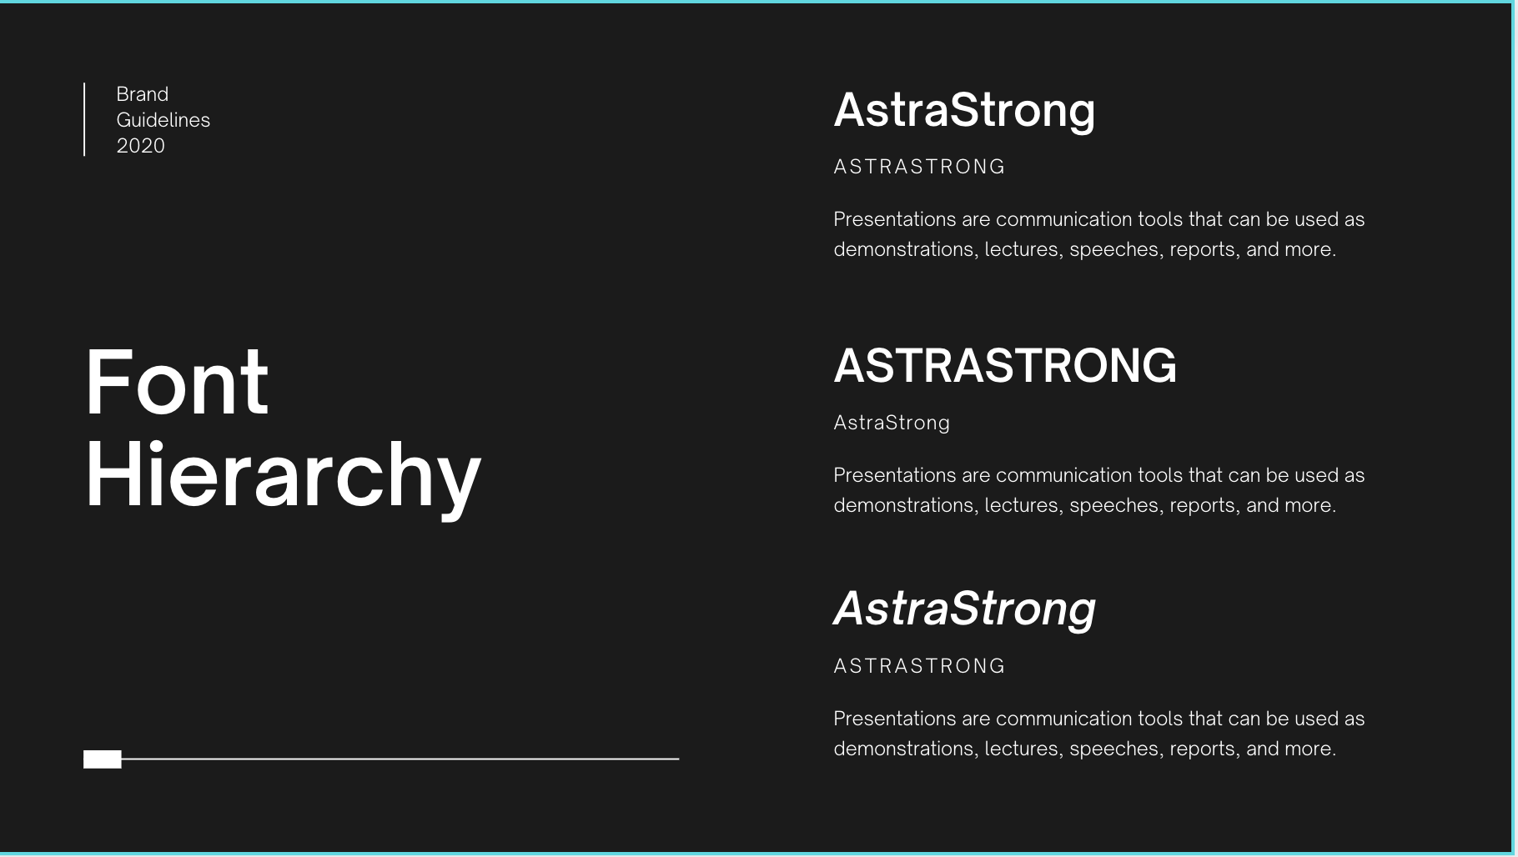



Clients ? Who ?
Distance Learning
Potential?
Specialization
INTEGRAL TO OUR WAY OF LIFE
Elderly Care
Notes:
How’s the potential? 用實作以及市場分析剖析出其前瞻可行性

Slide 7
Dancing beyond distance

