Slide 1
Capstone – Fall Progress Report
Sam Cooney
Fall 2017
Group 68- Investment Performance Mobile App

Slide 2
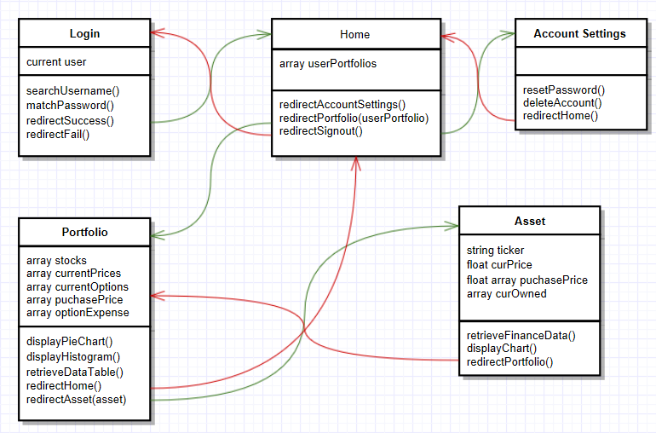
Design and Goals – User Interface
Biggest points of focus for Mobile application
Quick access to all pages
Reliable and Accurate data
Secure account information
Focus of front end – 5 pages
Login
Home View
Portfolio View
Single Asset View
Account Settings

Slide 3
Design and Goals – Log In
Log in page must be quick and easy (pin code)
Account data must be secure from attacks through text boxes
Verification and redirection of correct/incorrect log in information muse be returned within 3 seconds
On correct log in, users are redirected to the home view where they can access all portfolios, create new portfolios, or access account settings

Slide 4
Design and Goals – Home View
Ability to create new portfolios
Redirect to available portfolios with a tap
Portfolios that are shared must display for both users
Redirect to Account settings page with tap
Sign out returns user to log in page

Slide 5
Design and Goals – Portfolio View
Add and remove stocks and stock options
Display all purchased stocks and stock options in both a pie chart and data table
History graph of account value over time
Volatility of portfolio
Sharpe Ratio
Redirect to individual assets with taps on segments in pie chart or on ticker symbols in the data table
Redirect to home page available

Slide 6
Design and Goals – Single Asset View
Display all information that the portfolio has, but for a single asset
Volatility
Sharpe Ratio
Price (both purchase price and market value)
Amount of shares
What shares purchased at what price
Increase amount of owned asset
Delete asset
Redirect back to portfolio view

Slide 7
Design and Goals – Account Settings
More for testing then required for application
Ability to reset password
Ability to delete account and all associated data
Notifications/Requests for shared portfolio

Slide 8
Concerns with Design
Sharing portfolios
Security
Response time
Client and project restructuring
Communication speed
Fall Term Issues

Slide 9
Thanks for a wonderful term! See you in January

