Slide 1
Capstone – Fall Progress Report
Tyler Jones
Fall 2017
Group 68 – Investment Performance Mobile App

Slide 2
Design and Goals
Investment Performance Mobile Application
Commonly, investments are tracked but don’t share relevant performance metrics
Portfolio and individual
Tracking stocks and stock options
One user can have multiple portfolios, and multiple investments within each portfolio

Slide 3
Design and Goals
Front End – Works with API to retrieve financial data
Back End – Stores users’ investment data

Slide 4
Problems
Client uproot
Adhering to/understanding IEEE standards
Financial jargon

Slide 5
Client Uproot
Brice Lemke -> Edison Tsai
Readjusted well
Requirements Rewrite
Ronald Olshausen

Slide 6
IEEE Standards
Understanding IEEE documents
Making sure to follow them exactly

Slide 7
Financial Jargon
In general, it has been hard to ask th e right questions due to lack of prior knowledge of basic and advanced financial terminology

Slide 8
My Pieces
Backend
Relational Database
OSU hosting
MySQL

Slide 9
Capstone – Fall Progress Report
Aviral Sinha
Fall 2017
Group 68- Investment Performance Mobile App

Slide 10
Intro
We have been tasked by HedgeServ with the development of a mobile application for Android and iOS that tracks investment performance.
The project will serve as a learning tool for us to get exposure into the financial technologies industries
Currently most mobile applications focus on one type of investment for the sake of simplicity
Ours will designed with a more professional market in mind rather than targeting consumers the same way Robinhood and Coinbase do.

Slide 11
Design and Goals
Our main goal is to allow the user to look at various investments at both the portfolio level and the individual level, where they can see specific stocks and stock options
The application will be built with both design and functionality at priority, we want the user to easily navigate through various securities while also getting the exact they need to make a financial decision.

Slide 12
Design and Goals
In the portfolio view we show a pie chart showing the diversity. This would also allow for an easy comparison with a benchmark which in the case of our project is the S&P 500.
The user will also be able to see their Sharpe ratio and volatility of the portfolio and individual investments when needed.

Slide 13
Design and Goals
The backend will primarily serve as a place for database storage of user information. We will aim for response time of less than 3 seconds but if a query fails then we don’t report false data.
It will have to accommodate users that have more than one portfolio or account
Allow for joint portfolios between users
Pull data constantly from our external data sets which will be provided by Quandl

Slide 14
Design and Goals
Front end will consist of C# code on a development platform known as Xamarin which allow us to develop both versions of the application at the same time and have native performance.
It will mostly be displaying data that the user wants to track and uses benchmarks that I mentioned above with readily available visualizations.
NOTE: the app won’t be functioning as a brokerage but rather as a tracking tool in addition to the user’s preferred method of trading.

Slide 15
What I will be focusing on
I will be primarily working on the APIs that are implemented into our project
Specifically the implementation of Quandl data sets for our database to properly access
Visualization of pie charts and graphs through the use of Google Charts
The algorithms and calculations that will be implemented to properly display key points like the Sharpe Ratio and volatility of a stock.
Also work on backend and frontend components that Sam and Tyler as all the components are very dependent on each other

Slide 16
Problems
Our biggest problem during this term was in Week 5 when our original client Brice Lemke was replaced with Edison Tsai.
We had about a week and a half of no contact with Brice which was very frustrating considering we had our final requirements document due and it had not been reviewed or approved.
Once HedgeServ contacted us we were greeted warmly by Ronald Olhausen and Edison Tsai who are our new points of contact.
The transition has set us back a few weeks because our scope of the project has been altered with this change.
Originally: Stocks, options, real estate, cryptocurrencies, etc
Now: stocks and options

Slide 17
Problems
Other problems included:
IEEE Standards
Proper communication of what is needed for that aspect
Especially in our design document we were confused about what to follow because our TA said to follow a specific section of the document but when looking at the design documents of other groups we weren’t sure what was going on
Financial knowledge
I personally have a lot of financial knowledge based on personal projects and investments as well as through internship experience in banking
But some of the concepts will be foreign to as a group, but thanks to Ron and Edison we are able to properly understand everything and they have said that the Oregon State Investment Group are interested in looking at our work.

Slide 18
Capstone – Fall Progress Report
Sam Cooney
Fall 2017
Group 68- Investment Performance Mobile App

Slide 19
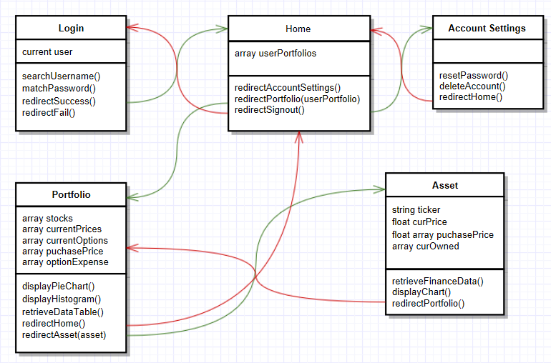
Design and Goals – User Interface
Biggest points of focus for Mobile application
Quick access to all pages
Reliable and Accurate data
Secure account information
Focus of front end – 5 pages
Login
Home View
Portfolio View
Single Asset View
Account Settings

Slide 20
Design and Goals – Log In
Log in page must be quick and easy (pin code)
Account data must be secure from attacks through text boxes
Verification and redirection of correct/incorrect log in information muse be returned within 3 seconds
On correct log in, users are redirected to the home view where they can access all portfolios, create new portfolios, or access account settings

Slide 21
Design and Goals – Home View
Ability to create new portfolios
Redirect to available portfolios with a tap
Portfolios that are shared must display for both users
Redirect to Account settings page with tap
Sign out returns user to log in page

Slide 22
Design and Goals – Portfolio View
Add and remove stocks and stock options
Display all purchased stocks and stock options in both a pie chart and data table
History graph of account value over time
Volatility of portfolio
Sharpe Ratio
Redirect to individual assets with taps on segments in pie chart or on ticker symbols in the data table
Redirect to home page available

Slide 23
Design and Goals – Single Asset View
Display all information that the portfolio has, but for a single asset
Volatility
Sharpe Ratio
Price (both purchase price and market value)
Amount of shares
What shares purchased at what price
Increase amount of owned asset
Delete asset
Redirect back to portfolio view

Slide 24
Design and Goals – Account Settings
More for testing then required for application
Ability to reset password
Ability to delete account and all associated data
Notifications/Requests for shared portfolio

Slide 25
Concerns with Design
Sharing portfolios
Security
Response time
Client and project restructuring
Communication speed
Fall Term Issues

Slide 26
Thanks for a wonderful term! See you in January

