Slide 1
7445 MEMORY USAGE ESTIMATES
Prashant Katre

Slide 2
AGENDA
Memory breakdown by individual features
Example system memory usage
  4K Decode/Display, quad 1080p@30HD transcode
  HD+HD PIP 1080p@60 display,1080p@30 quad HD transcode
  4Kx2K@60 Decode/Display IP Client with two memory controllers
Applibs memory requirements

Slide 3
MEMORY USAGE PER FEATURE
Feature | Memory | Notes
Single 1080p60 decode & HD + SD display | 62 MB (41+ 20) MB | Transport, Decoder and BVN
Single 1080p30 decode & HD + SD display | 66 MB (41+24) MB | Transport, Decoder and BVN
1080p60 10 bit HEVC decode HD+SD Display | 77 MB (52+25) | Transport, Decoder and BVN
1080p30 10 bit HEVC decode HD+SD Display | 82 MB (52+30) | Transport, Decoder and BVN
HEVC 4kx2k(8 bit)@30 decode and display | 177 MB (129+48) | Includes Transport, Decoder and BVN memory
HEVC 4kx2k(10 bit)@30 decode and display | 224 MB (164+60) | Includes Transport, Decoder and BVN memory
HEVC 4kx2k(8 bit)@60 decode and display | 180 MB (132+48) | Includes Transport, Decoder and BVN memory
HEVC 4kx2k(10 bit) @60 decode and display | 227 MB (167+60) | Includes Transport, Decoder and BVN memory
Notes:
Why 1080p@30 memory numbers are higher then 1080p@60?
It’s higher because on the SD path. These needed to be capture as frame and feeding out as field. To not lose content. On the 60hz we can capture as 30 fields.
So for SD path: You would need 480p buffers instead of the 480i buffers.

Slide 4
MEMORY USAGE PER FEATURE - CONTINUED
Feature | Memory | Notes
Graphics-1080p HD+SD Display Dual Buffers | 8.65 MB(8+0.65) 8.65 MB(8+0.65) | HD Front + Front SD + HD Back + SD Back
3D Graphics | 23 MB | Assuming 1280x720 @ 32 bit color - Off-screen surfaces are app specific
1080p24,25,30 Encode | 124 MB (40+21+49+4+10) | Includes decode(all formats), BVN, Encode, FW memory etc.
MOCA | 1.5 MB | Includes 750K FW image
MOCA – Data Path | 524 Kbytes | Packets buffer
GENET | 524 Kbytes | For two other GENETs
WIFI-USB | 3.2 MB | Same for 802.11n and 802.11ac
Linux Kernel | 7 MB | Includes network buffers

Slide 5
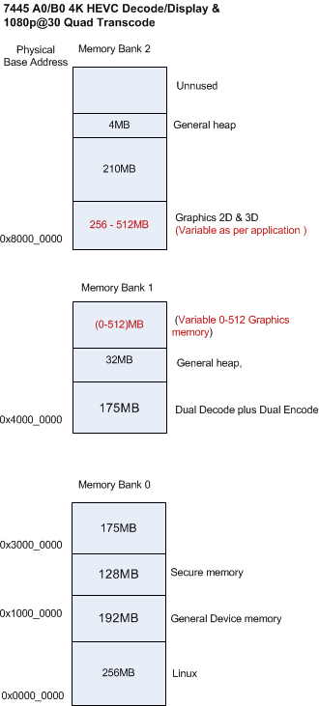
EXAMPLE MEMORY USAGE – 4K DECODE & DISPLAY , QUAD 1080P@P30 TRANSCODE
Linux Memory
  Variable according to application
  7MB including network buffer
  Typical case 256MB for Kernel,
  Includes application dynamic memory
Usage -Single UHD Decode with 4K main display + SD secondary display & Quad 1080p decode transcode
  ~900 MB Device memory
    Memory for full featured Settop box
    Includes Transport, Audio/Video Decode, Display, Record , Playback and Encoder buffers
Various Graphics memory banks, vary according to usage
Notes:
Assumption 8bit 2160p@60
Memc2 picture decoder 104 4K HEVC 8 bit decode + 85MB BVN 4K+HD+SD+HDDVI+656

Slide 6
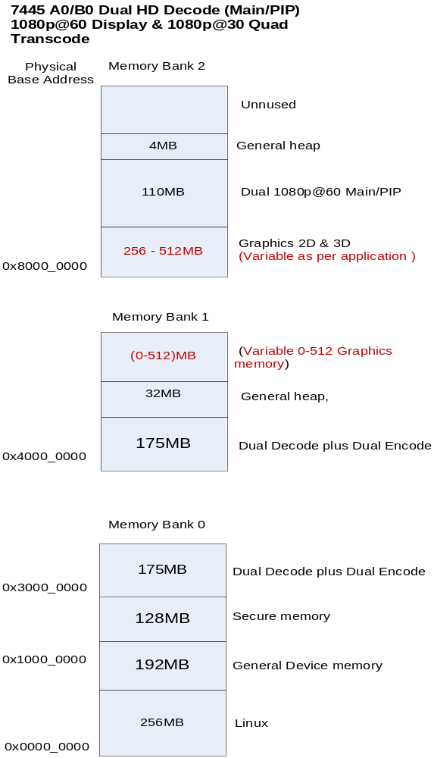
EXAMPLE MEMORY USAGE – HD+HD PIP , QUAD 1080P@30 TRANSCODE
Memory requirements depend on the application usage mode
Linux Memory
  Variable according to application
  Typical case 256MB for Kernel
  7MB for kernel & network buffer
  Includes application dynamic memory
  Includes buffer memory for USB,SATA,MOCA and Ethernet
Usage Dual HD Main/PIP , HD + SD display & Quad Transcode
  816 MB Device memory
    Memory for full featured Settop box application
    Includes Transport, Audio/Video Decode, Encode, Display, Record, playback buffers
Various Graphics memory banks, vary according to usage
Notes:
52+50 MEM2 picture heap

Slide 7
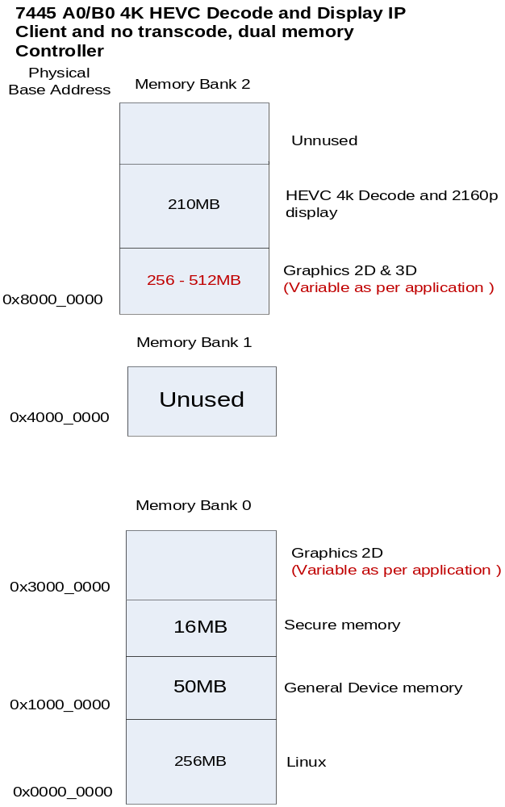
Example Memory Usage – 4Kx2K@60 Decode/Display IP Client, two memory controller
Assumptions
  MOCA or Wireless IP Client
  Only two memory controller available
Linux Memory
  Variable according to application
    Recommend first 256M on memc0
  7MB including network buffer
  Includes application dynamic memory
Usage -Single UHD Decode with 4K main display + SD secondary display. e
  ~280 MB Device memory
    Memory for full featured Settop box
    Includes Transport, Audio/Video Decode and Display
Various Graphics memory banks, vary according to usage
Notes:
XVD
General 11MB
Secure 10
Picture 104
XPT
22
Raaga
18

Slide 8
APPLIBS MEMORY REQUIREMENTS
Component | Memory | Notes
DirectFB | 8MB-13MB | 1 MB for Linux memory, Rest Graphics memory
GStreamer | 35.2 MB | Worst Case with PIP,MP4 playback
WebKit Browser | Recommended memory (See next slide) | Browser is a platform, memory usage depends on which applications running.
Examples Browser memory usage | ESPN – (117+34) MB CNN- (127+36) MB YouTube – (73+42) MB | Resident Set Size Linux Memory + Graphics Memory
Flash Plug-In | 20 MB to 40 MB | Depends upon the website e.g. CNN News use 30 MB

Slide 9
RECOMMENDED BROWSER MEMORY REQUIREMENTS
Component | Memory | Notes
WebKit or WebKitGL | 256 MB | Not recommended
WebKit or WebKitGL | 512MB | Good for predetermined sites & one site at a time
WebKit or WebKitGL | 768MB | Under Trellis mode, two predetermined websites at the same time
WebKit or WebKitGL | 1 GB | Recommended for best browsing performance.

