Slide 1
M-P Neuron & Hebb Learning
CSE301 Biocomputation, Week 1, 2016
Bailing Zhang

Slide 2
Abstract model of a neuron
a₀
+1
an abstract neuron j with n inputs:
Each input i transmits a real value a_{i}
Each connection is assigned with the weight w_{ij}
w_{j0}
a₁
w_{j1}
w_{j2}
x_{j}
a₂
j
w_{j3}
a₃
•
•
•
•
•
w_{jn}
•
a_{n}
The total input S, i.e., the sum of the products of the inputs with the corresponding weights, is compared with the threshold (equal to 0 in this case), and the outcome X_{i} is produced consequently

Slide 3
The McCulloch-Pitts Neuron (1943)
The authors modelled the neuron as
A binary discrete-time element;
With excitatory and inhibitory inputs and an excitation threshold;
The network of such elements was the first model to tie the study of neural networks to the idea of computation in its modern sense.

Slide 4
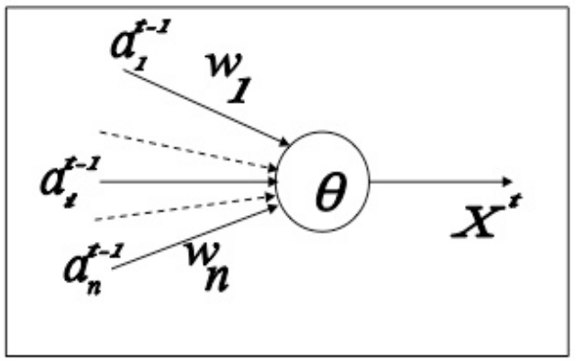
The McCulloch-Pitts Neuron
The input values a_{i}^{t}
from the i-th presynaptic neuron at any instant t may be equal either to 0 or 1 only
The weights of connections w_{i} are
  +1 for excitatory type connection and
  -1 for inhibitory type connection
There is an excitation threshold θ associated with the neuron.

Slide 5
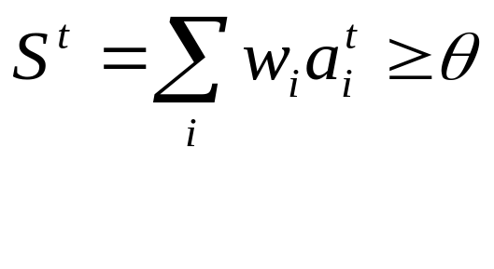
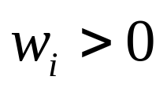

The McCulloch-Pitts Neuron
Output x^{t+1} of the neuron at the following instant t+1 is defined according to the rule
x^{t+1} =1 if and only if
while
In the MP neuron, we shall call the instant total input S^{t} - instant state of the neuron

Slide 6
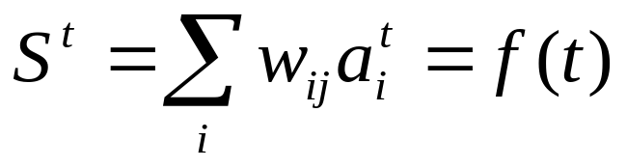
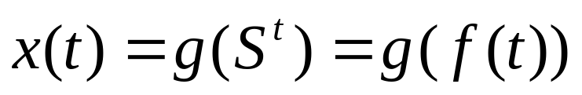
The McCulloch-Pitts Neuron
The state S^{t} of the MP neuron does not depend on the previous state of the neuron itself, but is simply
The neuron output x^{t+1} is function of its state S^{t,} therefore the output also can be written as function of discrete time

Slide 7
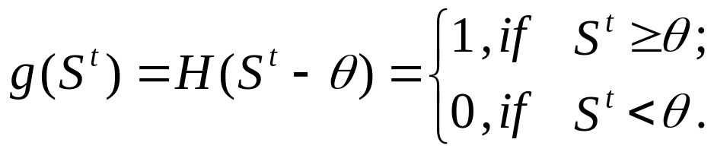
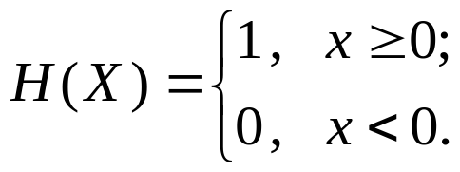
Activation function
The neuron output x^{t+1} can be written as
where g is the threshold activation function
Here H is the Heviside (unit step) function:
H(x)
1
0
x

Slide 8
MP-neuron vs brain function
The McCulloch-Pitts neuron made a base for a machine (network of units) capable of
  Storing information and
  Producing logical and arithmetical operations on it
These correspond to the main functions of the brain as
  To store knowledge, and
  To apply the knowledge stored to solve problems

Slide 9
ANN Learning Rules
McCulloh-Pitts:
  Storing information and
  Producing logical and arithmetical operations on it
The next step must be to realise another important function of the brain, which is
to acquire new knowledge through experience, i.e., learning

Slide 10
ANN learning rules
Learning means
to change in response to experience.
In a network of MP-neurons, binary weights of
connections and thresholds are fixed. The only
change can be the change of pattern of connections,
which is technically expensive.
Some easily changeable free parameters are needed.

Slide 11

ANN Learning Rules
a₀
+1
w_{j0}
a₁
w_{j1}
w_{j2}
x_{j}
a₂
j
w_{j3}
a₃
0 if S_{j}≤0
•
•
X_{j}=
•
w_{jn}
•
1 if S_{j}>0
a_{n}
The ideal free parameters to adjust, and so to resolve learning without changing patterns of connections, are the weights of connections w_{ji}

Slide 12
ANN Learning Rules
Definition:
ANN learning rule: how to adjust the weights of connections to get desirable output.
Much work in artificial neural networks focuses on the learning rules that define
how to change the weights of connections between neurons to better adapt a network to serve some overall function.

Slide 13
ANN Learning Rules
As for the first time the problem was formulated in 1940s,
    When experimental neuroscience was limited, the
    classic definitions of these learning rules came not
    from biology, but from psychological studies of
    Donald Hebb and Frank Rosenblatt
Hebb proposed that
  a particular type of use-dependent modification of the connection strength of synapses might underlie learning in the nervous system

Slide 14
Hebb’s Rule (1949)
axon 轴突
Hebb proposed a neurophysiological postulate:
“ …when an axon of a cell A
  is near enough to excite a cell B and
  repeatedly and persistently takes part in firing it
some growth process or metabolic change takes
place in one or both cells
such that A’s efficiency as one of the cells firing B,
is increased.”

Slide 15
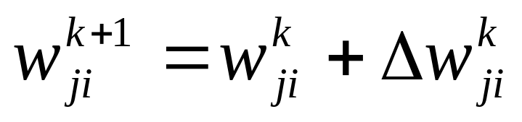
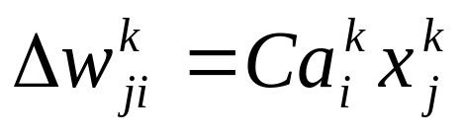
Hebb’s Rule (1949)
The simplest formalisation of Hebb’s rule is
to increase weight of connection
at every next instant in the way:
where

Slide 16
Hebb’s Rule (1949)
here
w_{ji}^{k} is the weight of connection at instant k
w_{ji}^{k+1} is the weight of connection at the following instant k+1
Δw_{ji}^{k} is increment by which the weight of connection is enlarged
C is positive coefficient which determines learning rate
a_{i}^{k} is input value from the presynaptic neuron at instant k
x_{j}^{k} is output of the postsynaptic neuron at the same instant k

Slide 17
Hebb’s Rule (1949)
(2)
Thus
The weight of connection changes at the next instant only if both preceding input via this connection and the resulting output
simultaneously are not equal to 0
Equation (2) emphasizes the correlation
nature of a Hebbian synapse

Slide 18
Hebb’s Rule (1949)
Hebb’s original learning rule (2)
  referred exclusively to excitatory synapses, and
  has the unfortunate property that it can only increase synaptic weights, thus washing out the distinctive performance of different neurons in a network, as the connections drive into saturation …

Slide 19
Hebb’s Rule (1949)
However, when the Hebbian rule is augmented by a formalisation rule, e.g., keep constant the total strength of synapses upon a given neuron, it tends to “sharpen” a neuron’s predisposition “without a teacher”, causing its firing to become better correlated with a cluster of stimulus patterns.
For this reason, Hebb's rule plays an important role in studies of many ANN algorithms, such as unsupervised learning or self-organization, which we will study later.

Slide 20
Hebb’s rule in practice
Input unit
Nº
1
2
3
4
a
1
w
1
a
w
2
2
θ
X
a
w
3
3
w
4
a
4

Slide 21
Hebb’s rule in practice.
Input unit
Nº
1
2
3
4
t=0 C=1
1
w⁰₁ | w⁰₂ | w⁰₃ | w⁰₄
1 | 1 | 1 | 1
1
θ =2
X
1
1

Slide 22
Hebb’s rule in practice.
Input unit
Nº
1
2
3
4
t=0 C=1
1
a⁰₁ | a⁰₂ | a⁰₃ | a⁰₄
1 | 0 | 1 | 0
1
1
0
w⁰₁ | w⁰₂ | w⁰₃ | w⁰₄
1 | 1 | 1 | 1
θ =2
X
1
1
1
0

Slide 23
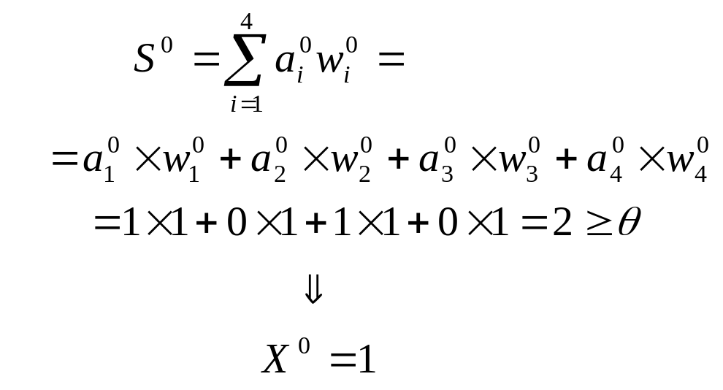
Hebb’s rule in practice.
t=0 C=1
Input unit
Nº
1
2
3
4
a⁰₁ | a⁰₂ | a⁰₃ | a⁰₄
1 | 0 | 1 | 0
1
1
w⁰₁ | w⁰₂ | w⁰₃ | w⁰₄
1 | 1 | 1 | 1
1
0
θ =2
X
1
1
1
0

Slide 24

Hebb’s rule in practice.
Input unit
Nº
1
2
3
4
t=0 C=1
a⁰₁ | a⁰₂ | a⁰₃ | a⁰₄
1 | 0 | 1 | 0
1
1
w⁰₁ | w⁰₂ | w⁰₃ | w⁰₄
1 | 1 | 1 | 1
1
0
θ =2
X
1
1
1
0

Slide 25
Hebb’s rule in practice.
Input unit
Nº
1
2
3
4
t=0 C=1
a⁰₁ | a⁰₂ | a⁰₃ | a⁰₄
1 | 0 | 1 | 0
w⁰₁ | w⁰₂ | w⁰₃ | w⁰₄
1 | 1 | 1 | 1
1
1
1
0
θ =2
1
1
1
1
0

Slide 26
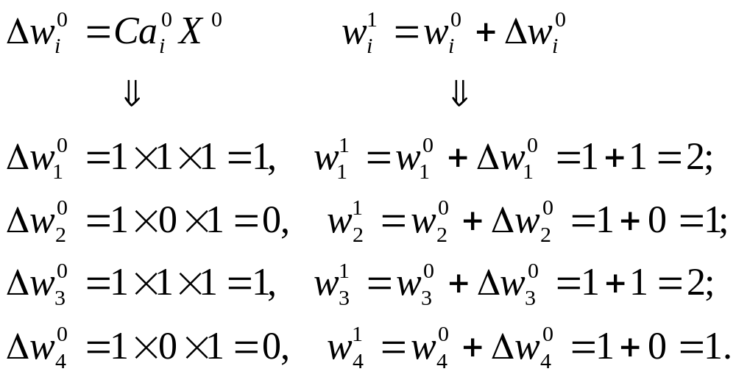
Hebb’s rule in practice.
Input unit
Nº
1
2
3
4
a⁰₁ | a⁰₂ | a⁰₃ | a⁰₄
1 | 0 | 1 | 0
t=0 C=1
1
w⁰₁ | w⁰₂ | w⁰₃ | w⁰₄
1 | 1 | 1 | 1
1
0
1
θ =2
1
1
1
1
0

Slide 27
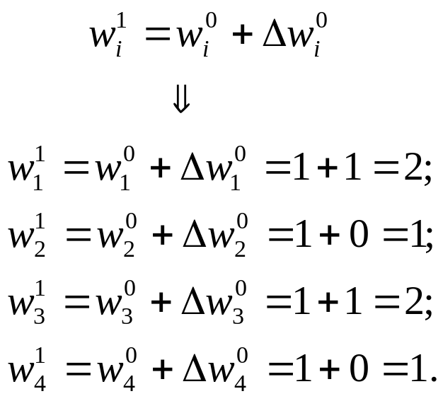
Hebb’s rule in practice.
Input unit
Nº
1
2
3
4
a⁰₁ | a⁰₂ | a⁰₃ | a⁰₄
1 | 0 | 1 | 0
t=1 C=1
w¹₁ | w¹₂ | w¹₃ | w¹₄
2 | 1 | 2 | 1
2
1
θ =2
X
2
1

Slide 28
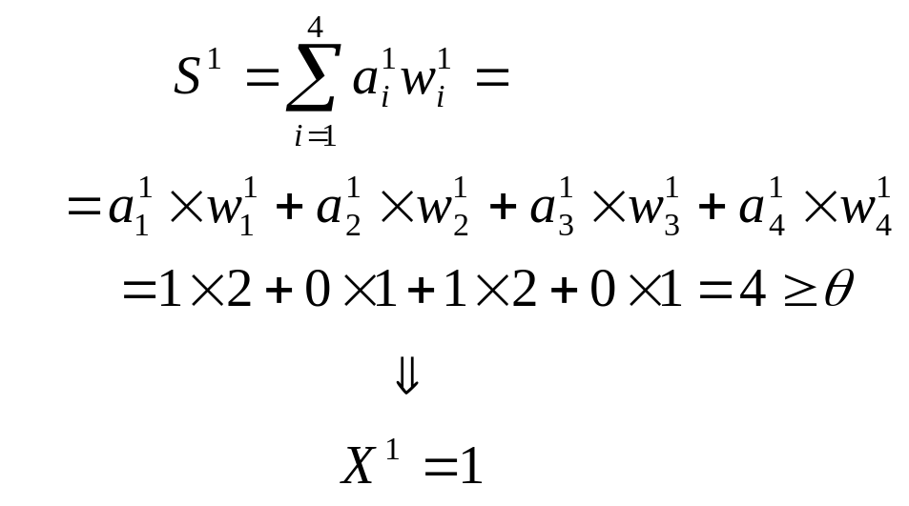
Hebb’s rule in practice.
t=1 C=1
Input unit
Nº
1
2
3
4
a¹₁ | a¹₂ | a¹₃ | a¹₄
1 | 0 | 1 | 0
w¹₁ | w¹₂ | w¹₃ | w¹₄
2 | 1 | 2 | 1
1
2
0
1
θ =2
X
1
2
1
0

Slide 29
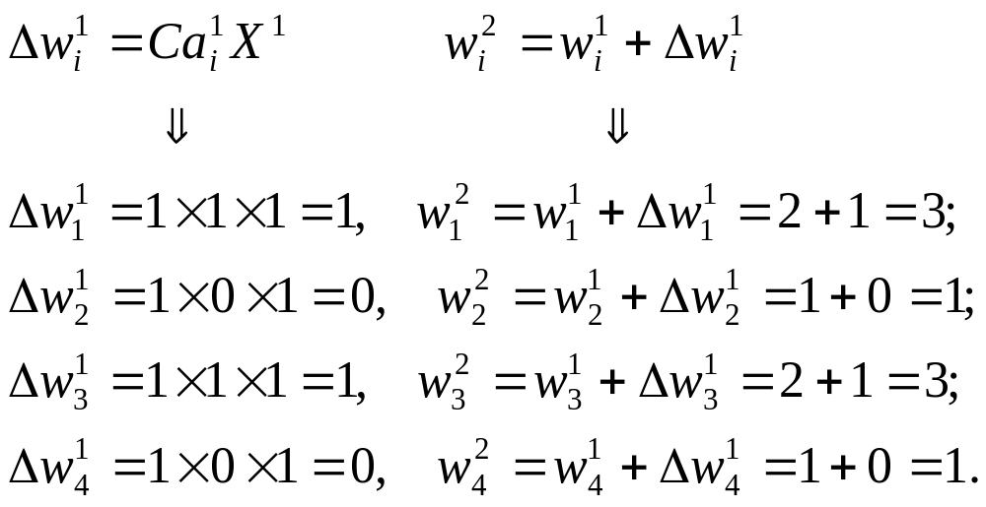
Hebb’s rule in practice.
Input unit
Nº
1
2
3
4
t=1 C=1
a¹₁ | a¹₂ | a¹₃ | a¹₄
1 | 0 | 1 | 0
w¹₁ | w¹₂ | w¹₃ | w¹₄
2 | 1 | 2 | 1
1
2
0
1
θ =2
1
1
2
1
0

Slide 30
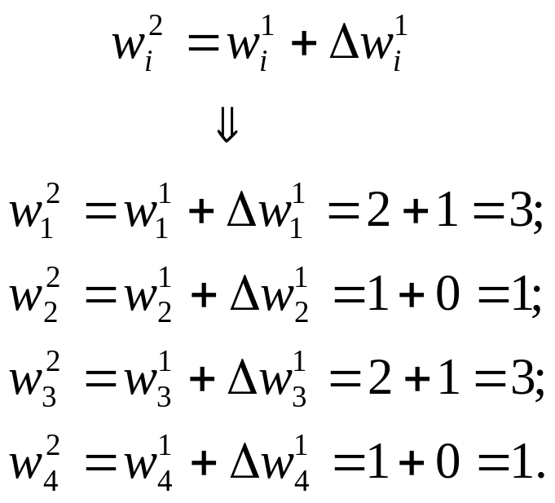
Hebb’s rule in practice.
Input unit
Nº
1
2
3
4
t=2 C=1
a¹₁ | a¹₂ | a¹₃ | a¹₄
1 | 0 | 1 | 0
w²₁ | w²₂ | w²₃ | w²₄
3 | 1 | 3 | 1
3
1
θ =2
X
3
1

Slide 31
Hebb’s rule in practice.
Input unit
Nº
1
2
3
4
t=2 C=1
w²₁ | w²₂ | w²₃ | w²₄
3 | 1 | 3 | 1
3
1
θ =2
X
3
1

Slide 32
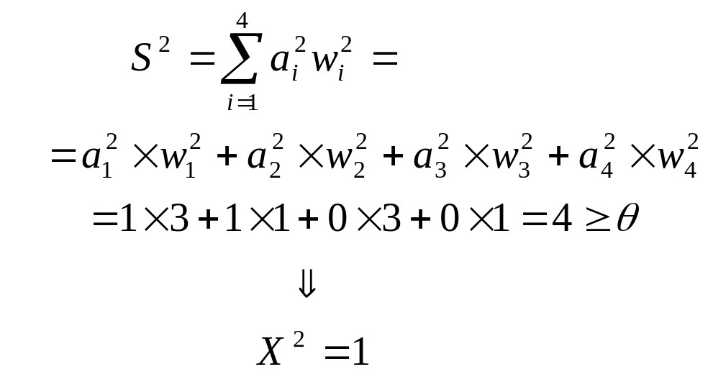
Hebb’s rule in practice.
Input unit
Nº
1
2
3
4
t=2 C=1
1
a²₁ | a²₂ | a²₃ | a²₄
1 | 1 | 0 | 0
w²₁ | w²₂ | w²₃ | w²₄
3 | 1 | 3 | 1
3
1
1
θ =2
X
0
3
1
0

Slide 33
Hebb’s rule in practice.
Input unit
Nº
1
2
3
4
a²₁ | a²₂ | a²₃ | a²₄
1 | 1 | 0 | 0
t=2 C=1
1
w²₁ | w²₂ | w²₃ | w²₄
3 | 1 | 3 | 1
3
1
1
θ =2
1
0
3
1
0

Slide 34
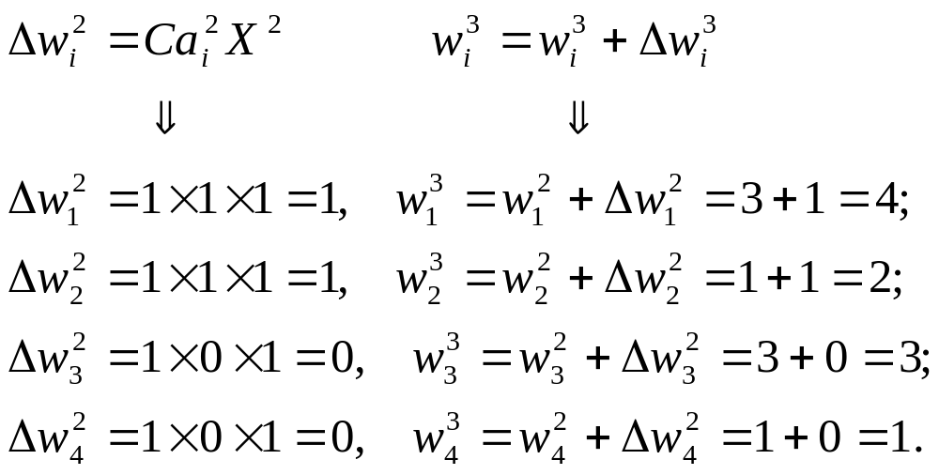
Hebb’s rule in practice.
Input unit
Nº
1
2
3
4
t=2 C=1
a²₁ | a²₂ | a²₃ | a²₄
1 | 1 | 0 | 0
w²₁ | w²₂ | w²₃ | w²₄
3 | 1 | 3 | 1
1
3
1
1
θ =2
1
0
3
1
0

Slide 35
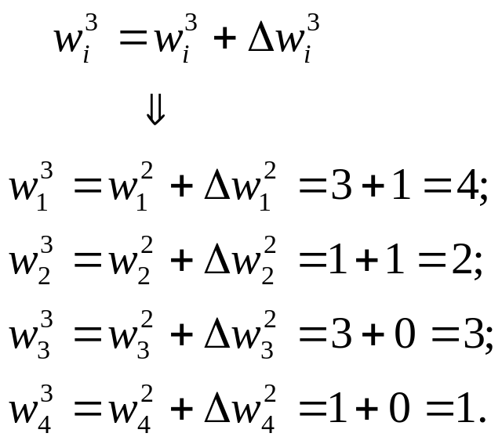
Hebb’s rule in practice.
Input unit
Nº
1
2
3
4
t=3 C=1
a²₁ | a²₂ | a²₃ | a²₄
1 | 1 | 0 | 0
w³₁ | w³₂ | w³₃ | w³₄
4 | 2 | 3 | 1
4
2
θ =2
X
3
1

Slide 36
Hebb’s rule in practice.
Input unit
Nº
1
2
3
4
t=3 C=1
w³₁ | w³₂ | w³₃ | w³₄
4 | 2 | 3 | 1
4
2
θ =2
X
3
1
And so on…

