Slide 1
Self-organizating Feature Map
CSE301 Bio-computation, Weeks 11, 2016
Bailing Zhang

Slide 2
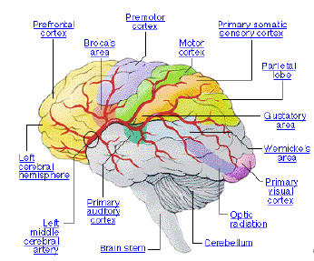
Self-Organizing Map – Biological Motivation
Brain is a self-organizing system that can learn by itself by changing (adding, removing, strengthening) the interconnections between neurons.
The brain processes multidimensional
signals from the external world in a “2”-dimensional internal map.
Neurons with similar functions are grouped together.

Slide 3
Some Historical Notes
Local ordering (von der Malsbyrg, 1973)
(Amari, 1980) a matematical analysis elucidates the dynamic stability of a cortical map
Self-organizing feature map (SOM), (Kohonen 1982)
(Erwin, 1992) a convex neighbourhood function should be used (~ Gaussian)
The relationship between the SOM and principal curves was dicussed (Ritter, 1992 & Cherkassky and Mulier, 1995)
Manifold learning as an important extension of SOM in machine learning after 2000

Slide 4
Some Historical Notes
Vector quantization: Lloyd algorithm 1957 for scalar quantization (= Max quantizer )
The generilized Lloyd algorithm for vector quantization (= k-means algorithm McQueen 1969 = LBG algorithm Linde et al 1980)
The idea of learning vector quantization (LVQ) (Kohonen, 1986)

Slide 5

Christoph von der Malsburg
http://physics.usc.edu/Faculty/vdMalsburg/
http://www.usc.edu/programs/neuroscience/faculty/profile.php?fid=29

Slide 6
Feature Maps
What is the result of the brain’s self-organization?
formation of feature maps in the brain that have a linear or planar topology (that is, they extend in one or two dimensions)
Examples:
tonotopic map - sound frequencies are spatially mapped into regions of the cortex in an orderly progression from low to high frequencies.
retinotopic map - visual field is mapped in the visual cortex (occipital lobe) with higher resolution for the centre of the visual field
somatosensory map - mapping of touch

Slide 7
Topographic maps
Extend the ideas of competitive learning to incorporate the neighborhood around inputs and neurons
We want a nonlinear transformation of input pattern space onto output feature space which preserves neighbourhood relationship between the inputs -- a feature map where nearby neurons respond to similar inputs
E.g. place cells, orientation columns, somatosensory cells etc
Idea is that neurons selectively tune to particular input patterns in such a way that the neurons become ordered with respect to each other so that a meaningful coordinate system for different input features is created

Slide 8
Topographic map: spatial locations are indicative of the intrinsic statistical features of the input patterns: i.e. close in the input close in the output
When the yellow input in the lower layer is active, the yellow neuron in the upper layer is the winner so when the orange input in the lower layer is active, we want the upper orange neuron to be the winner

Slide 9
Activity-based self-organization (von der Malsburg, 1973)
incorporation of competitive and cooperative mechanisms to generate feature maps using unsupervised learning networks
Biologically motivated: how can activity-based learning using highly interconnected circuits lead to orderly mapping of visual stimulus space onto cortical surface?
cortical units
visual space
2 layer network each cortical unit fully connect to visual space via Hebbian units
Interconnections of cortical units described by ‘Mexican-hat’ function (Garbor function): short-range excitation and long-range inhibition

Slide 10
After learning (see original paper for details), a topographic map appears.
However, input dimension is the same as output dimension
Kohonen simplified this model and called it
Kohonen’s self-organizing map (SOM) algorithm
More general as it can perform dimensionality reduction
SOM can be viewed as a vector quantisation type algorithm

Slide 11
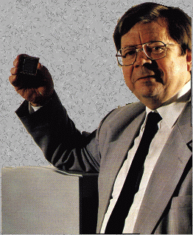
Self-Organizing Feature Maps (SOFMs)
a.k.a. as Kohonen networks, competitive filter associative memories
represents the embodiment of the ideas we have discussed so far
named after Dr. Eng. Teuvo Kohonen, Helsinki Uni of Technology
http://www.cis.hut.fi/research/som-research/teuvo.html

Slide 12
Feature maps are important
Sensory experience is multidimensional
E.g. sound is characterised by pitch, intensity, timbre, noise etc.,
The brain maps the external multidimensional representation of the world (including its spatial relations) into a similar 1 or 2 - dimensional internal representation.
That is, the brain processes the external signals in a topology-preserving way.
So, if we are to have a hope of mimicking the way the brain learns, our system should be able to do the same thing.

Slide 13
The idea in an SOM is to transform on input of arbitrary
dimension into a 1 or 2 dimensional discrete map
Again, 2 layers of neurons with all inputs connecting to each
output. Output neurons are held in a one or (usually) 2D
lattice, where position in the lattice defines the distance
between the neurons
Once weights of net initialised, algorithm comprises 3
processes:
Competition. Given an input pattern, outputs compete to see who is winner based on a discriminant function (e.g. similarity of input vector and weight vector)
Cooperation. Winning neuron determines spatial location of a topological neighborhood within which output neurons excited
Synaptic Adaptation. Excite neurons adapt weights so that value of discriminant function increases i.e. so that presenting a similar input would result in enhanced response from winner

Slide 14
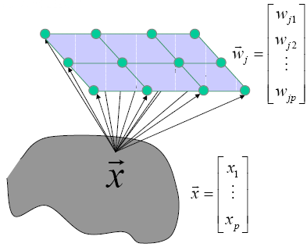
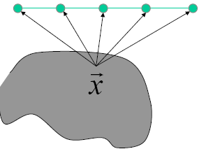
SOM
Transform an input signal pattern of arbitrary dimension into 1 or 2 dimensional discrete map.
Perform this transformation adaptively in a topologically ordered fashion.
Two possible architectures

Slide 15
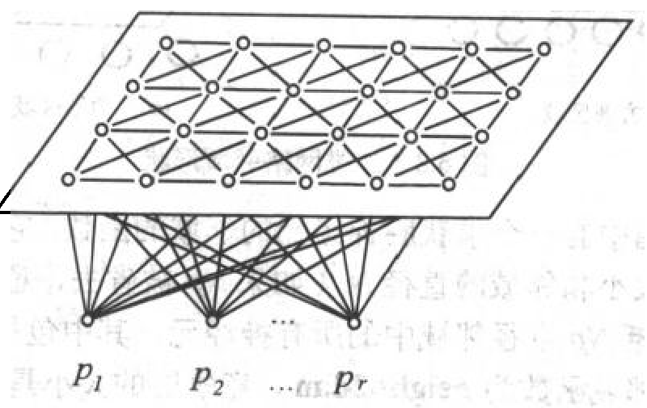
The SOM Training Algorithm
Initialization
Competition
Cooperation
Synaptic Adaptation
Learning Principle
Competitive learning where winning ”spills over” to neighbors

Slide 16
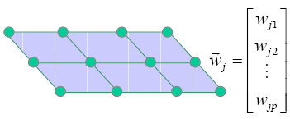
Initialization
Centroid weights:
as other clustering or VQ
algorithms
Assign randomly generated small values
Assign randomly selected samples
… … … …
Grid: size and structure fixed a priori
Most of the times, 2-dimensional grid are used

Slide 17
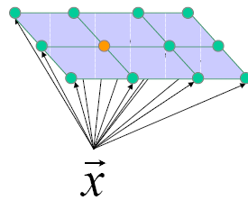
Competitive Process
Winner neuron
x
“A continuous input space of activation patterns is mapped onto a discrete output space of neurons by a process of competition among the neurons in the network.”

Slide 18
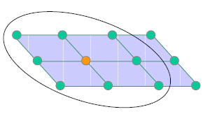
Cooperative Process
“The winning neuron locates the
center of a topological neighborhood
of cooperating neurons”
“… a neuron that is firing tends to
excite the neurons in its immediate
neighborhood more than those
farther away from it …”
The topological neighborhood hj,i
is symmetric around the winning neuron and achieve its maximum value at the winning neuron.

Slide 19
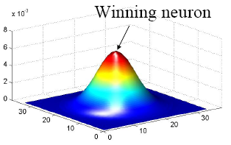
Cooperative Process
The topological neighborhood hj,i
is symmetric around the winning neuron and achieve its maximum value at the winning neuron.
The amplitude decreases monotonically with the increasing lateral distance.

Slide 20
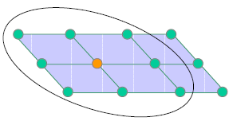
Cooperative Process
The topological neighborhood h_{j,i} shrinks with time
Neighbors of the winning node are also allowed to update, even if they are not even close to winning!

Slide 21
Role of the neighborhood
Large neighborhood
Good global ordering
Bad local fit
Small neighborhood
Bad global ordering
Good local fit
By gradually shrinking the neighborhood we can get the best of both!
Ordering phase (large neighborhood)
Convergence phase (small neighborhood)

Slide 22
Neighborhood in Kohonen Algorithm
m
m
Using a planar array of neurons with rectangular or hexagonal neighborhoods, an input vector x is applied simultaneously to all nodes. A spatial neighborhood Nm is used to specify those neurons that participate in learning/adaptation.

Slide 23
Adaptive Process
Update the weights in relation to the inputs
Learning rate
Neighborhood function

Slide 24
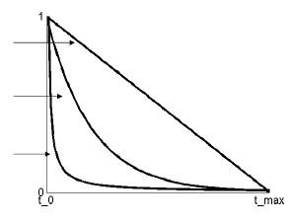
SOM parameters: learning rate
Possible options:

Slide 25
Summary
寻找获胜节点 计算 x 与 w 的点积，j=1,2,…m，从中选出点积最大的获胜节点j*。
initialization
定义优胜邻域N_{j*} (t) 以j*为中心确定t 时刻的权值调整域，一般初始邻域N_{j*} (0)较大，训练过程中N_{j*} (t)随训练时间逐渐收缩。
Draw an input sample x
Winner neuron j*
Update

Slide 26
Selection of Network Size
Q: “How many neurodes do I need in the competitive Layer?”
A: "How much error can you live with?”
generally speaking, more neurodes equals less error.
higher numbers of neurodes will support finer-grained classification of the inputs.
the size of the competitive layer is governed by the number of parameters represented in the input vector
caveat: the more neurodes present, the longer training will take...

Slide 27
The Training Set
Important element of any NN applications
The training set should mirror the probability distribution of inputs in the environment
Within the training set, we should randomize the presentation of input classes
We may need to adjust the elasticity of the learning rate to accommodate large sets

Slide 28
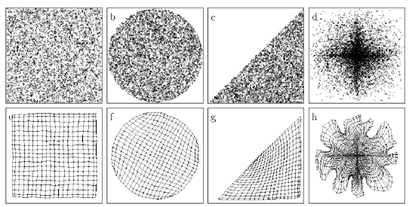
Simple 2-D examples (after convergence)
The grid mimics the initial distribution

Slide 29
Property of the Feature Map
Approximate the input space
Topological ordering
Density matching
Feature selection (features of the underlying distribution)

Slide 30
Example： World Poverty Map
Example from Helsinki University of Technology， Finland
World Bank statistics of countries in 1992
39 features describing various quality-of-life factors, such as state of health, nutrition, educational services
countries that had similar values of the indicators found a place near each other on the map
different clusters on the map were automatically encoded with different bright colors, nevertheless so that colors change smoothly on the map display
As a result of this process, each country was in fact automatically assigned a color describing its poverty type in relation to other countries
The poverty structures of the world can then be visualized in a straightforward manner: each country on the geographic map has been colored according to its poverty type.

Slide 31
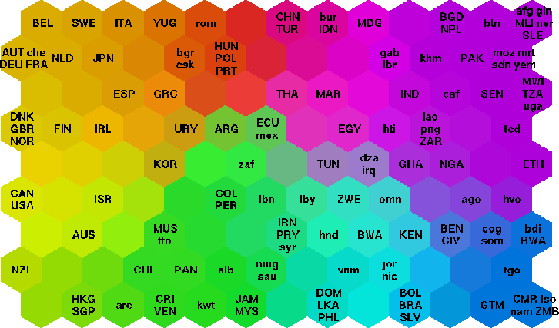
World Poverty Map
Data set has 39 indicators describing various quality-of-life factors, such as state of health, nutrition, educational services, etc,)
PhD research seminar (Qualifying phase) - September 19, 2001- Etien Luc Koua
Notes:
A map of the world where countries have been colored with the color describing their poverty type (the color was obtained with the SOM in the previous figure)
Countries organized based on indicators related to poverty (39 indicators describing various quality-of-life factors, such as state of health, nutrition, educational services, etc,)
The Self-Organizing Map (SOM) can be used to portray complex correlations in statistical data. Here the data consisted of World Bank statistics of countries in 1992.
The complex joint effect of these factors can can be visualized by organizing the countries using SOM
Countries that had similar values of the indicators found a place near each other on the map
The different clusters on the map were automatically encoded with different bright colors, so that colors change smoothly on the map display

Slide 32
An Application Example: Video Surveillance

Slide 33
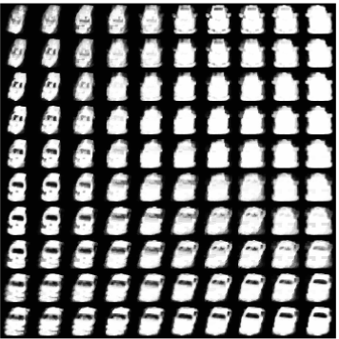
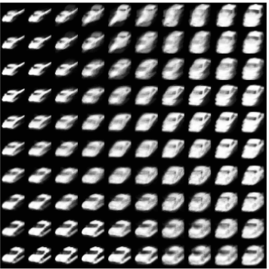
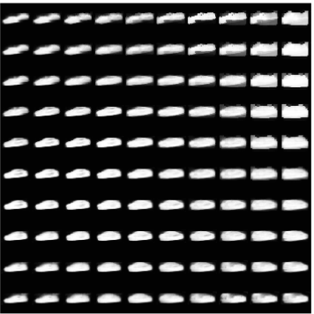
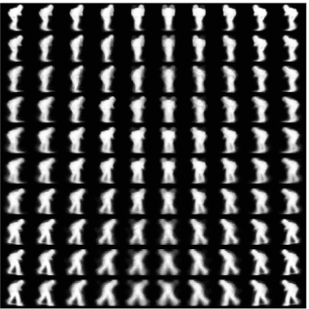
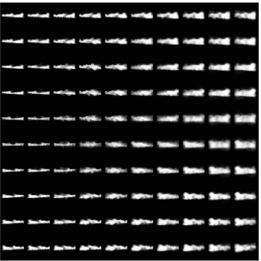
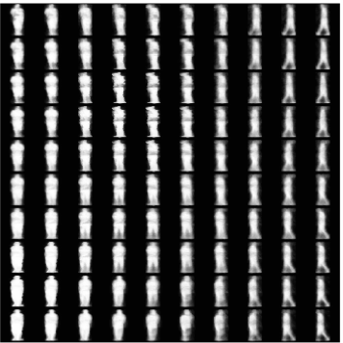

Slide 34
SOM in Matlab NN Toolbox
New version (R2012b)
selforgmap(dimensions,coverSteps,initNeighbor,topologyFcn,distanceFcn)
Example
x = simplecluster_dataset;
net = selforgmap([8 8])
net = train(net,x);
view(net)
y = net(x);
classes = vec2ind(y)
http://www.mathworks.cn/cn/help/nnet/ref/selforgmap.html

