Slide 1
Chapter 26: Applying GoF Design Patterns
Notes:
This module describes recommended software development practices and gives the reasons for these recommendations. It then shows how Rational Unified Process or RUP is designed to help you implement Rational’s Best Practices.

Slide 2
Objective
Introduce and apply some GoF design patterns.
Show GRASP principles as a generalization of other design patterns.
Notes:
This discussion is optional. You may skip this discussion and proceed immediately to the list of Symptoms in the next slide.

Slide 3
26.1. Adapter (GoF)
Problem:
  How to resolve incompatible不相容的 interfaces, or provide a stable interface to similar components with different interfaces?
Solution:
  Convert the original interface of a component into another interface, through an intermediate adapter object.

Slide 4
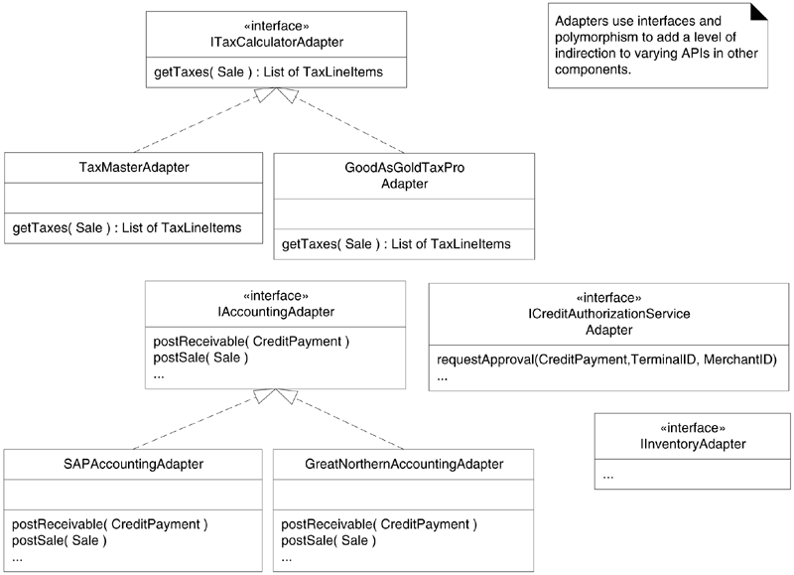
26.1. Adapter (GoF)

Slide 5
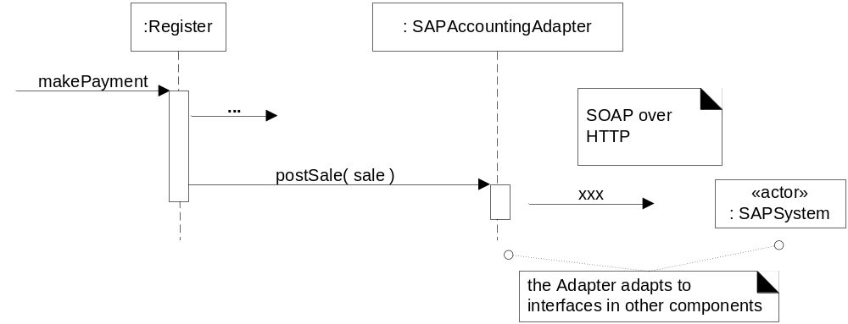
26.1. Adapter (GoF)

Slide 6
26.2. Some GRASP Principles as a Generalization of Other Patterns
What's the Problem? Pattern Overload!
  The Pattern Almanac 2000 lists around 500 design patterns.
A Solution: See the Underlying Principles
  Most design patterns can be seen as specializations of a few basic GRASP principles.

Slide 7
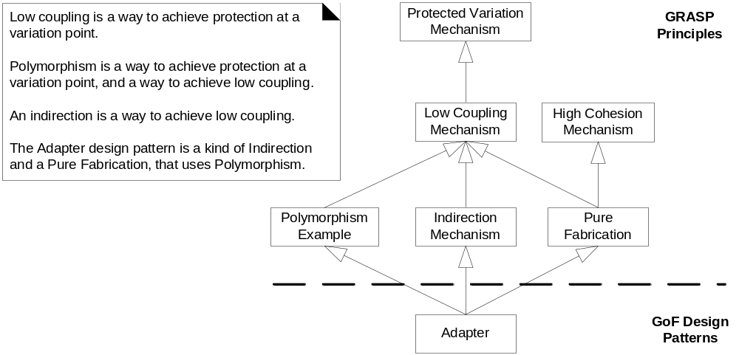
26.2. Some GRASP Principles as a Generalization of Other Patterns
Example: Adapter and GRASP

Slide 8
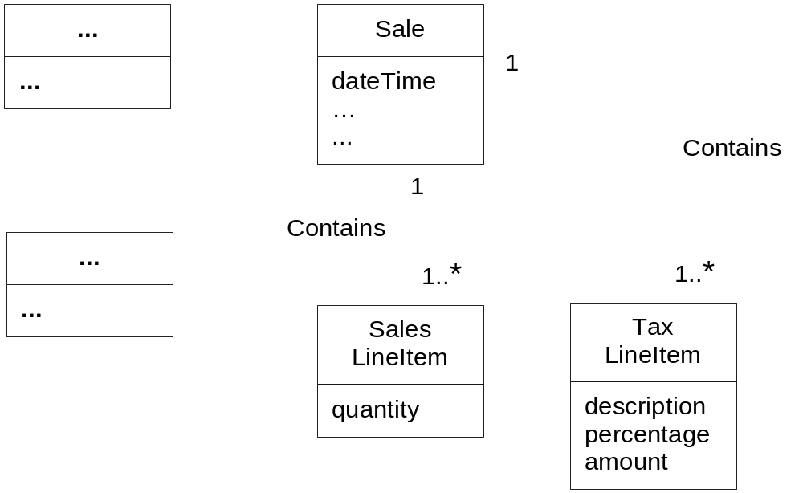
26.3. "Analysis" Discoveries During Design: Domain Model

Slide 9
26.4. Factory
Also called Simple Factory or Concrete Factory
  A simplification of the GoF Abstract Factory pattern
  Problems
    Who creates the adapters in NextGenPos
    Choosing a domain object (such as a Register) to create the adapters
      Does not support the goal of a separation of concerns, and lowers its cohesion.

Slide 10
26.4. Factory
Factory objects have several advantages:
  Separate the responsibility of complex creation into cohesive helper objects.
  Hide potentially complex creation logic.
  Allow introduction of performance-enhancing memory management strategies, such as object caching or recycling.

Slide 11
26.4. Factory
Problem:
  Who should be responsible for creating objects when there are special considerations, such as complex creation logic, a desire to separate the creation responsibilities for better cohesion, and so forth?
Solution:
  Create a Pure Fabrication object called a Factory that handles the creation.

Slide 12
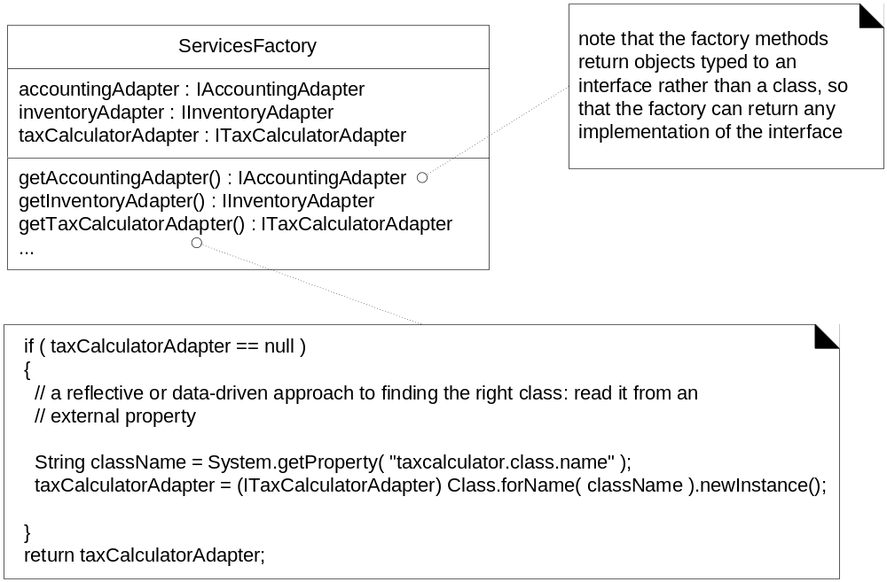
26.4. Factory
Data-driven Design

Slide 13
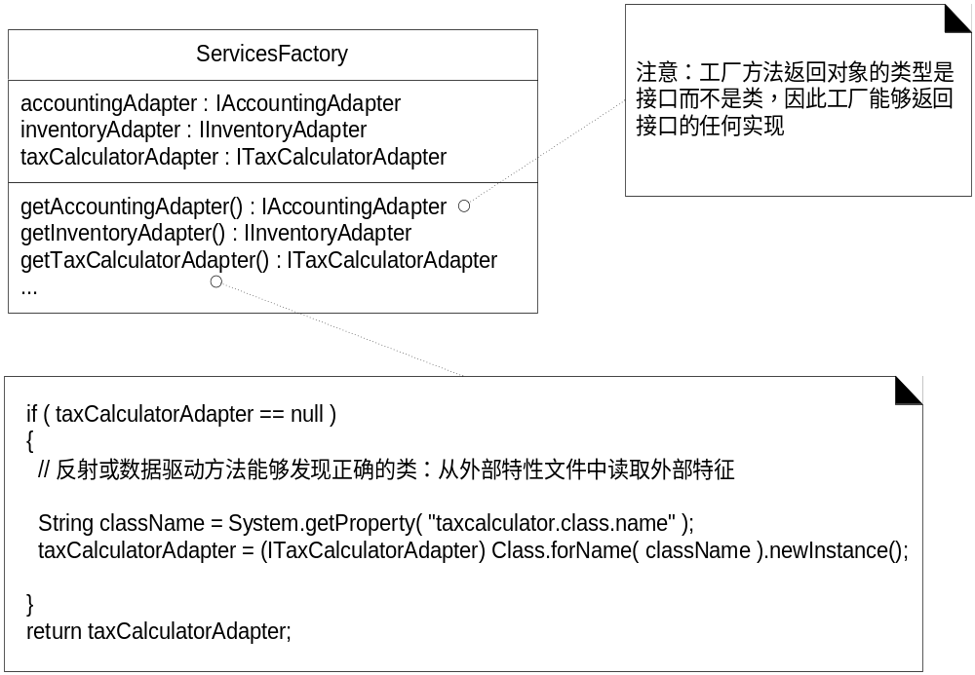
Notes:
在初始化一个类，生成一个实例的时候，newInstance()方法和new关键字的区别
在初始化一个类，生成一个实例的时候，newInstance()方法和new关键字除了一个是方法，一个是关键字外，最主要有什么区别？它们的区别在于创建对象的方式不一样，前者是使用类加载机制，后者是创建一个新类。那么为什么会有两种创建对象方式？这主要考虑到软件的可伸缩、可扩展和可重用等软件设计思想。
Java中工厂模式经常使用newInstance()方法来创建对象，因此从为什么要使用工厂模式上可以找到具体答案。 例如：
class c = Class.forName(“Example”);
factory = (ExampleInterface)c.newInstance();
其中ExampleInterface是Example的接口，可以写成如下形式：
String className = "Example";
class c = Class.forName(className);
factory = (ExampleInterface)c.newInstance();
进一步可以写成如下形式：
String className = readfromXMlConfig;//从xml 配置文件中获得字符串
class c = Class.forName(className);
factory = (ExampleInterface)c.newInstance();
上面代码已经不存在Example的类名称，它的优点是，无论Example类怎么变化，上述代码不变，甚至可以更换Example的兄弟类Example2 , Example3 , Example4……，只要他们继承ExampleInterface就可以。
从JVM的角度看，我们使用关键字new创建一个类的时候，这个类可以没有被加载。但是使用newInstance()方法的时候，就必须保证：1、这个类已经加载；2、这个类已经连接了。而完成上面两个步骤的正是Class的静态方法forName()所完成的，这个静态方法调用了启动类加载器，即加载java API的那个加载器。
现在可以看出，newInstance()实际上是把new这个方式分解为两步，即首先调用Class加载方法加载某个类，然后实例化。 这样分步的好处是显而易见的。我们可以在调用class的静态加载方法forName时获得更好的灵活性，提供给了一种降耦的手段。
最后用最简单的描述来区分new关键字和newInstance()方法的区别：
newInstance: 弱类型。低效率。只能调用无参构造。
new: 强类型。相对高效。能调用任何public构造。
newInstance()是实现IOC、反射、面对接口编程 和 依赖倒置 等技术方法的必然选择，new 只能实现具体类的实例化，不适合于接口编程。
类的加载指的是将类的.class文件中的二进制数据读入到内存中，将其放在运行时数据区的方法区内，然后在堆区创建一个java.lang.Class对象，用来封装类在方法区内的数据结构。

Slide 14
newInstance()方法和new关键字的区别
除了一个是方法，一个是关键字外，最主要有什么区别？它们的区别在于创建对象的方式不一样，前者是使用类加载机制，后者是创建一个新类。那么为什么会有两种创建对象方式？这主要考虑到软件的可伸缩、可扩展和可重用等软件设计思想。
Java中工厂模式经常使用newInstance()方法来创建对象，因此从为什么要使用工厂模式上可以找到具体答案。 例如：
String className = "Example";
class c = Class.forName(className);
factory = (ExampleInterface) c.newInstance();
其中ExampleInterface是Example的接口

Slide 15
newInstance()方法和new关键字的区别
进一步可以写成如下形式：
String className = readfromXMlConfig;//从xml 配置文件中获得字符串
class c = Class.forName(className);
factory = (ExampleInterface)c.newInstance();
上面代码已经不存在Example的类名称，它的优点是，无论Example类怎么变化，上述代码不变，甚至可以更换Example的兄弟类Example2 , Example3 , Example4……，只要他们继承ExampleInterface就可以。

Slide 16
26.5. Singleton (GoF)
Who creates the factory itself, and how is it accessed?
  Only one instance of the factory is needed within the process.
  The methods of this factory may need to be called from various places in the code,
    Different places need access to the adapters for calling on the external services.
  How to get visibility to this single ServicesFactory instance?

Slide 17
26.5. Singleton (GoF)
Problem:
  Exactly one instance of a class is allowed (singleton). Objects need a global and single point of access.
Solution:
  Define a static method of the class that returns the singleton.

Slide 18
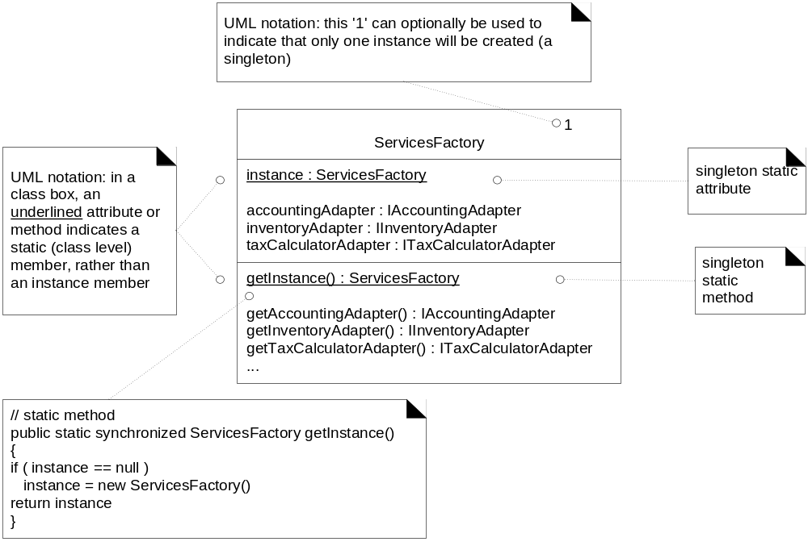
26.5. Singleton (GoF)

Slide 19
26.5. Singleton (GoF)
Implementation and Design Issues
  Lazy initialization 缓式初始化
public static synchronized ServicesFactory getInstance() {
if ( instance == null ) {
// critical section if multithreaded application
instance = new ServicesFactory();
}
return instance;
}

Slide 20
26.5. Singleton (GoF)
public class ServicesFactory {
// eager initialization
private static ServicesFactory instance =
new ServicesFactory();
public static ServicesFactory getInstance() {
return instance;
}
// other methods...
}
  Eager initialization 预先初始化

Slide 21
26.5. Singleton (GoF)
Why not make all the service methods static methods of the class itself
  Instance-side methods permit subclassing and refinement of the singleton class into subclasses;
  Most object-oriented remote communication mechanisms (for example, Java's RMI) only support remote-enabling of instance methods.
  The instance-side solution offers flexibility.
    A class is not always a singleton in all application contexts.
    It is common to start off a design thinking the object will be a singleton, and then discovering a need for multiple instances in the same process.

Slide 22
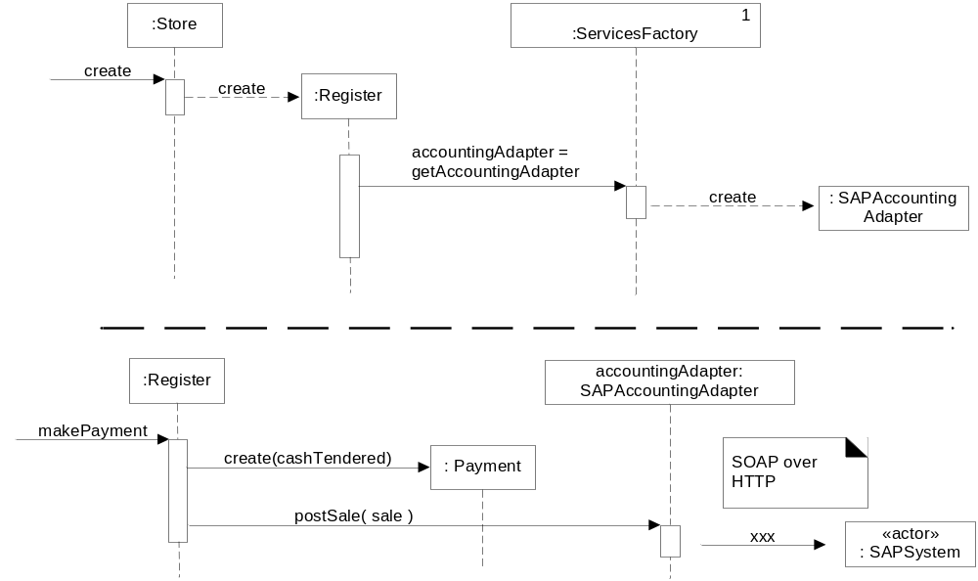
26.6. Conclusion of the External Services with Varying Interfaces Problem
To handle the problem of varying interfaces for external services, let's use Adapters generated from a Singleton Factory.

Slide 23
26.7. Strategy (GoF)
How to provide more complex pricing logic?
  Such as a store-wide discount for the day, senior citizen discounts, and so forth.
The pricing strategy for a sale can vary.
  During one period it may be 10% off all sales, later it may be $10 off if the sale total is greater than $200, and myriad other variations.
  How do we design for these varying pricing algorithms?

Slide 24
26.7. Strategy (GoF)
Problem:
  How to design for varying, but related, algorithms or policies?
  How to design for the ability to change these algorithms or policies?
Solution:
  Define each algorithm/policy/strategy in a separate class, with a common interface

Slide 25
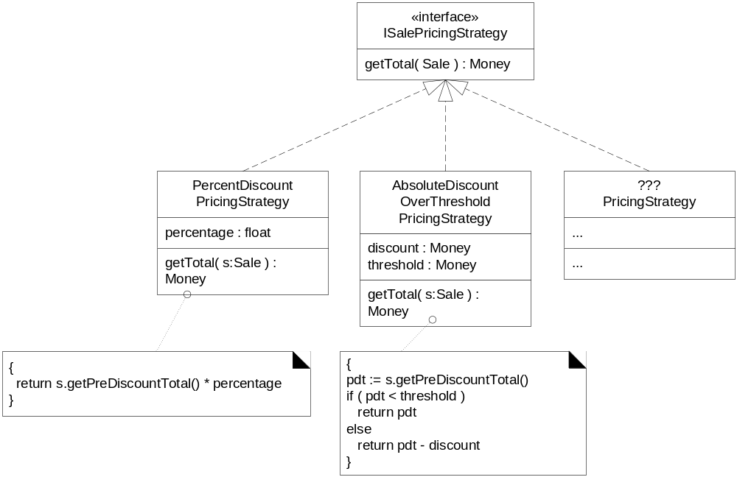
26.7. Strategy (GoF)

Slide 26
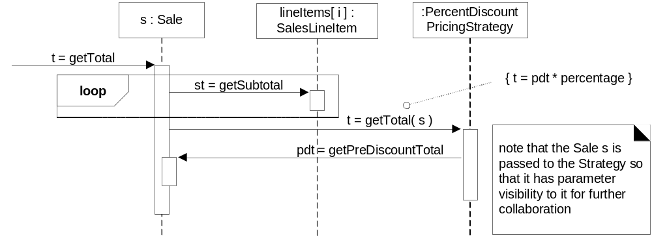
26.7. Strategy (GoF)
A strategy object is attached to a context object.

Slide 27
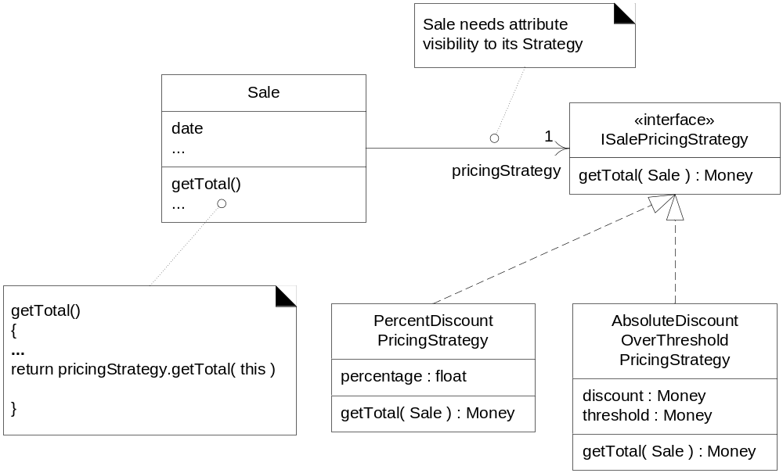
26.7. Strategy (GoF)

Slide 28
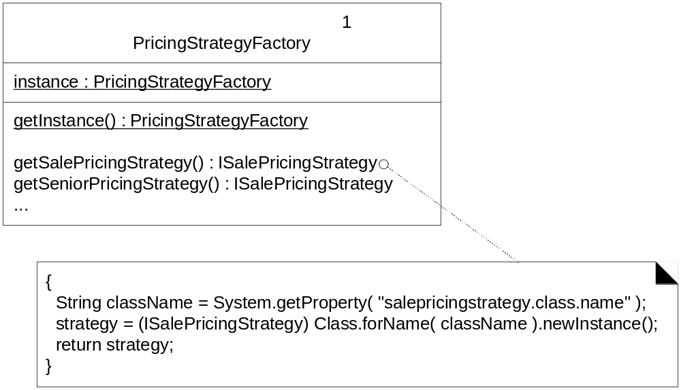
26.7. Strategy (GoF)
Creating a Strategy with a Factory

Slide 29
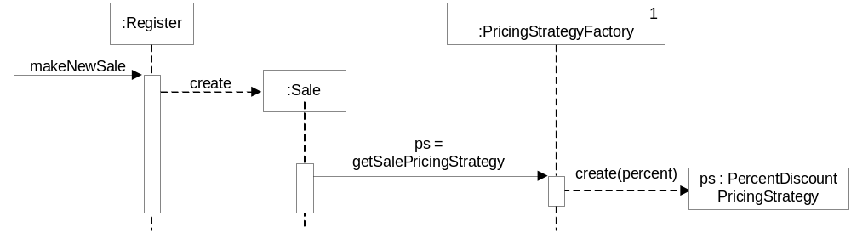
26.7. Strategy (GoF)

Slide 30
26.7. Strategy (GoF)
Reading and Initializing the Percentage Value
  How to find the different numbers for the percentage or absolute discounts.
  These numbers will be stored in some external data store.
  StrategyFactory read them and assign them to the strategy.
Summary
  Protected Variations with respect to dynamically changing pricing policies has been achieved with the Strategy and Factory patterns.
    Strategy builds on Polymorphism and interfaces to allow pluggable algorithms in an object design.

Slide 31
26.8. Composite (GoF) and Other Design Principles
How do we handle the case of multiple, conflicting pricing policies?
  For example, suppose a store has the following policies in effect today (Monday):
    20% senior discount policy
    Preferred customer discount of 15% off sales over $400
    On Monday, there is $50 off purchases over $500
    Buy 1 case of Darjeeling tea, get 15% discount off of everything

Slide 32
26.8. Composite (GoF) and Other Design Principles
Suppose a senior who is also a preferred customer buys
  1 case of Darjeeling tea,
  $600 of veggieburgers.
What pricing policy should be applied?

Slide 33
26.8. Composite (GoF) and Other Design Principles
Pricing strategies by virtue of three factors:
  Time Period (Monday)
  Customer Type (senior)
  a particular line item product (Darjeeling tea)
Three of the four example policies are really just "percentage discount" strategies

Slide 34
26.8. Composite (GoF) and Other Design Principles
How to define the store's conflict resolution strategy
  Usually, a store applies the lowest price conflict resolution strategy
  But the store may have to change to the highest price conflict resolution strategy

Slide 35
26.8. Composite (GoF) and Other Design Principles
Problem:
  How to treat a group or composition structure of objects the same way (polymorphically) as a non-composite (atomic) object?
Solution:
  Define classes for composite and atomic objects so that they implement the same interface.定义组合和原子对象的类,使它们实现相同的接口

Slide 36
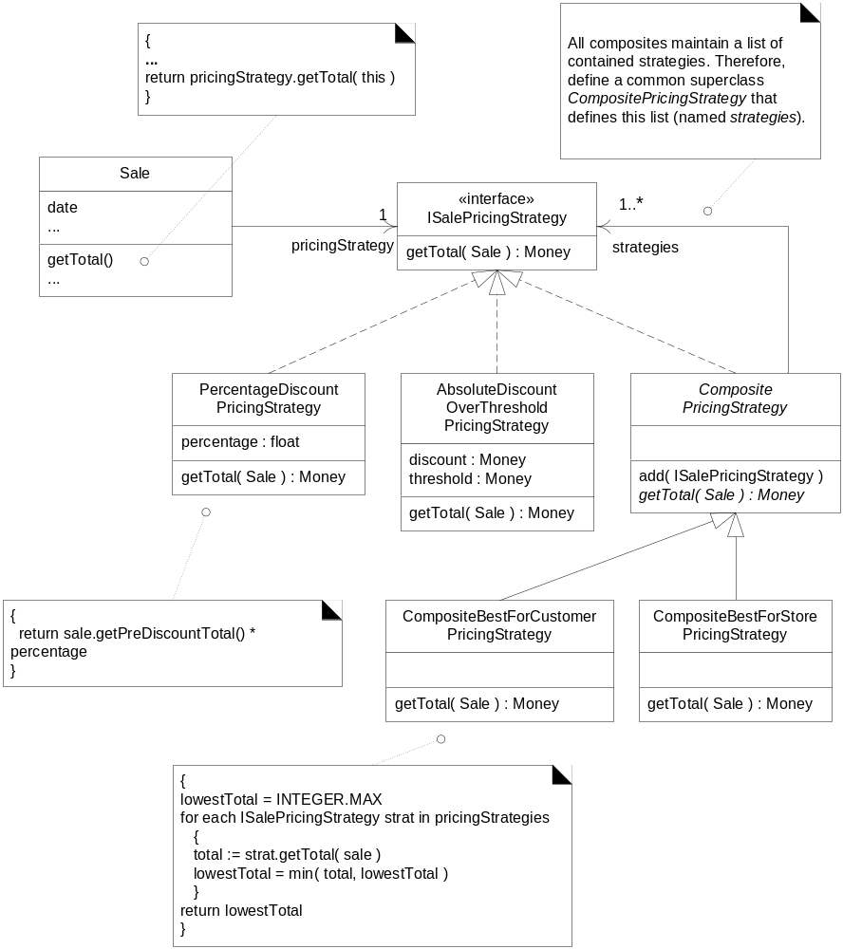

Slide 37
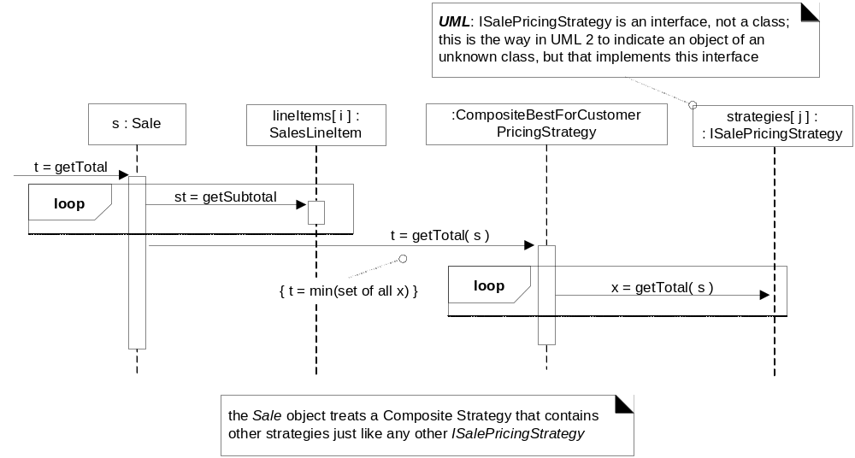
26.8. Composite (GoF) and Other Design Principles

Slide 38
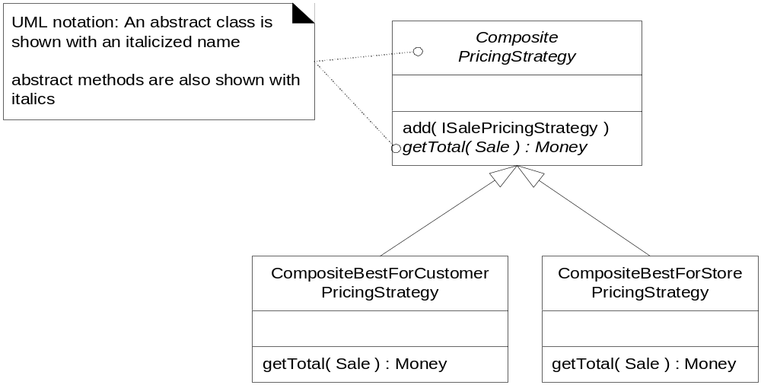
26.8. Composite (GoF) and Other Design Principles

Slide 39
26.8. Composite (GoF) and Other Design Principles
Creating Multiple SalePricingStrategies
  When do we create these strategies?
    Three points in the scenario where pricing strategies may be added to the composite:
      Current store-defined discount, added when the sale is created.
      Customer type discount, added when the customer type is communicated to the POS.
      Product type discount, added when the product is entered to the sale.

Slide 40
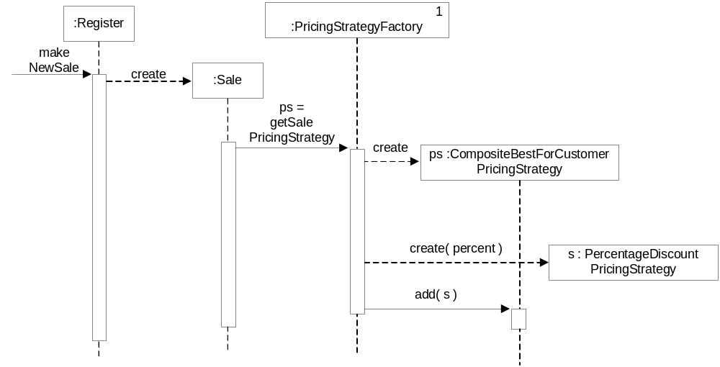
26.8. Composite (GoF) and Other Design Principles
The design of the first case

Slide 41
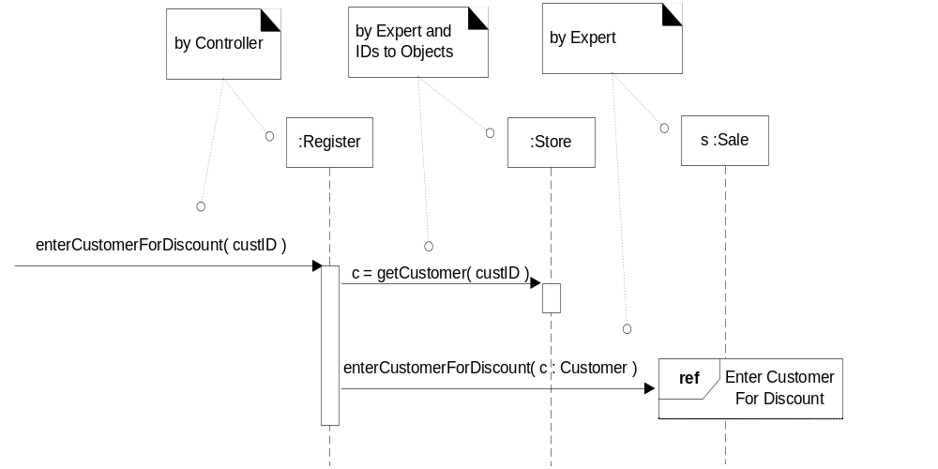
26.8. Composite (GoF) and Other Design Principles
The 2nd case of a customer type discount

Slide 42
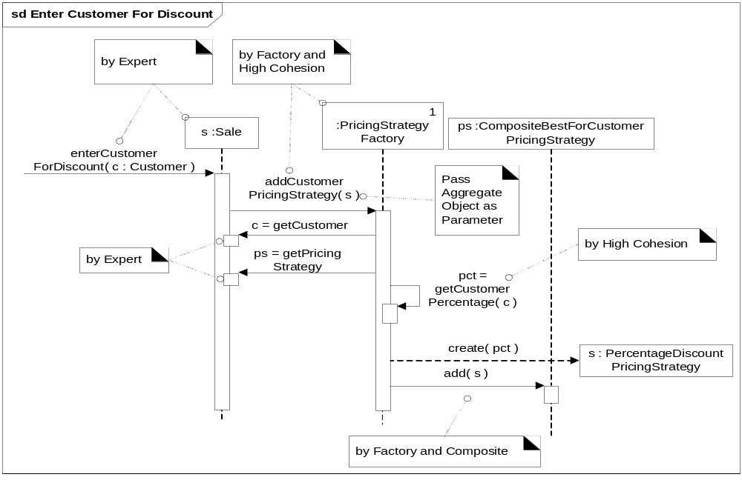
26.8. Composite (GoF) and Other Design Principles

Slide 43
26.8. Composite (GoF) and Other Design Principles
Considering GRASP and Other Principles in the Design
  Why not have the Register send a message to the PricingStrategyFactory,
    to create this new pricing strategy and then pass it to the Sale?
  One reason is to support Low Coupling
    The Sale is already coupled to the factory
  Furthermore, the Sale knows its current pricing strategy;

Slide 44
26.8. Composite (GoF) and Other Design Principles
  Why customerID is transformed into a Customer object via the Register asking the Store for a Customer, given an ID.
    By Information Expert, the Store can know all the Customers.
    Register already has attribute visibility to the Store.
    If the Sale had to ask the Store, the Sale would need a reference to the Store
为什么由Register向store发出getCustomer的请求?

Slide 45
26.8. Composite (GoF) and Other Design Principles
IDs to Objects
  Why transform the customerID into a Customer object?
    Having a true Customer object becomes beneficial and flexible.
Pass Aggregate Object as Parameter
  Why pass a Sale to the factory, not the Customer and PricingStrategy?
    Avoid extracting child objects out of parent or aggregate objects, and then passing around the child objects.

Slide 46
26.9. Facade (GoF)外观对象
To support pluggable business rules.
  at predictable points in the scenarios, different customers would like to customize its behavior slightly
    Suppose when a new sale is created, if it will be paid by a gift certificate. Then, only one item is allowed to be purchased.
    If the sale is paid by a gift certificate, invalidate all payment types of change due back to the customer except for another gift certificate.
    Suppose when a new sale is created, it is possible to identify that it is for a charitable donation. A store may also have a rule to only allow item entries less than $250 each, and also to only add items to the sale if the currently logged in "cashier" is a manager.

Slide 47
26.9. Facade (GoF)
Problem:
  A common, unified interface to a disparate(完全不同) set of implementations or interfaces is required.
  Undesirable coupling to many things in the subsystem.
Solution:
  Define a single point of contact to the subsystem that wraps the subsystem. This facade object presents a single unified interface and is responsible for collaborating with the subsystem components.

Slide 48
26.9. Facade (GoF)
Facade
  A "front-end" object that is the single point of entry for the services of a subsystem.
  Provides Protected Variations from changes in the implementation of a subsystem.

Slide 49
26.9. Facade (GoF)
public class Sale {
public void makeLineItem ( ProductDescription desc,
int quantity ) {
SalesLineItem sli = new SalesLineItem( desc, quantity );
// call to the Facade
if ( POSRuleEngineFacade.getInstance().isInvalid( sli,
this ) )
return;
lineItems.add( sli );
}
// ...
} // end of class

Slide 50
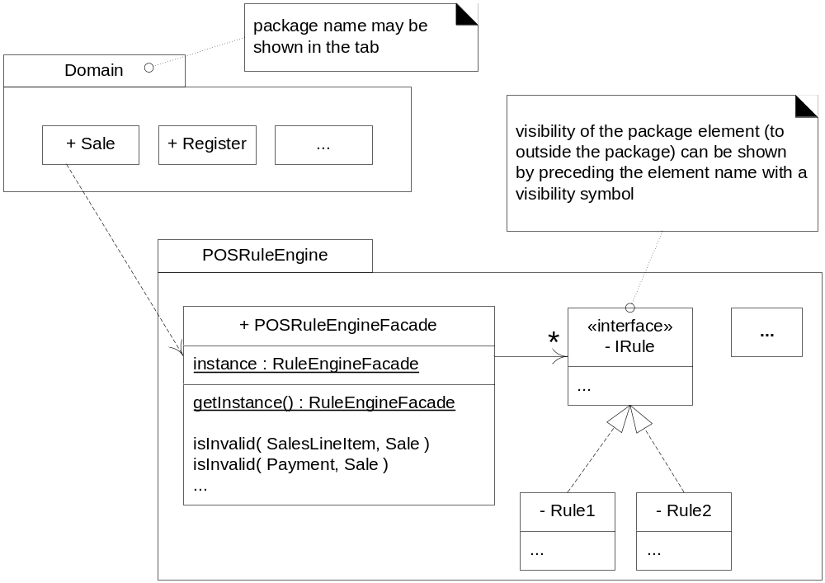
26.9. Facade (GoF)

Slide 51
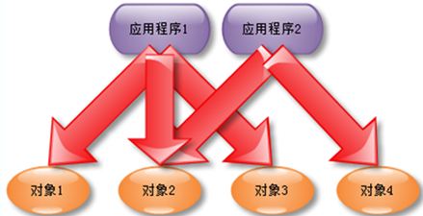
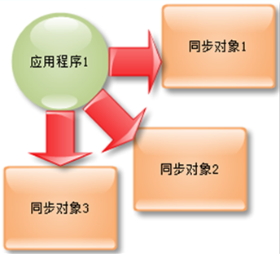
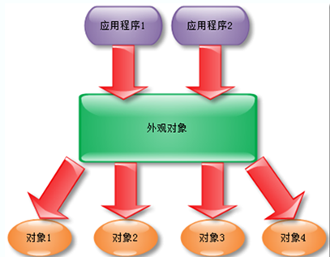
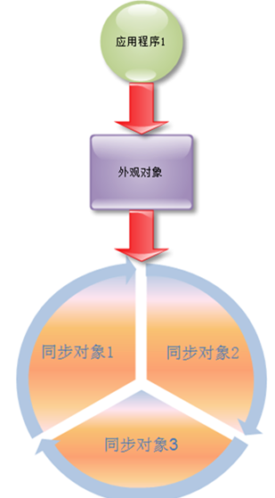
外观使用前
外观使用后

Slide 52
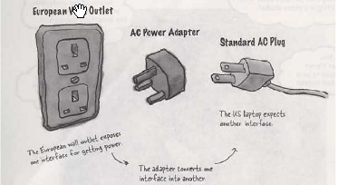
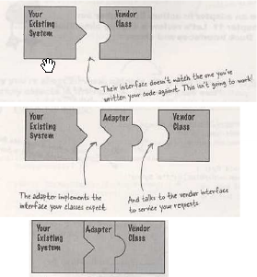

Slide 53
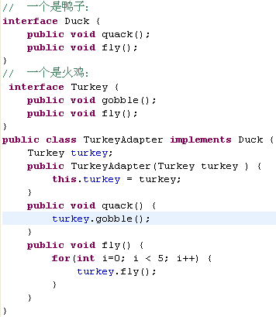
我们举一个火鸡冒充鸭子的适配器例子：
就是要让火鸡有能力去冒充鸭子，那么我们必须把火鸡的一些能力映射到鸭子具备的一些能力中去，于是我们就采用了一个负责处理这样映射的类——适配器类：TurkeyAdapter

Slide 54
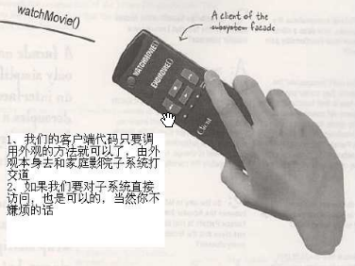
public class HomeTheaterFacade {
Amplifier amp;
Tuner tuner;
DvdPlayer dvd;
CdPlayer cd;
Projector projector;
TheaterLights lights;
Screen screen;
PopcornPopper popper;
//构造函数
HomeTheaterFacade(Amplifier amp,
Tuner tuner,
DvdPlayer dvd,
CdPlayer cd,
Projector projector,
Screen screen,
TheaterLights lights,
PopcornPopper popper) {
this.amp = amp;
this.tuner = tuner;
this.dvd = dvd;
this.cd = cd;
this.projector = projector;
this.screen = screen;
this.lights = lights;
this.popper = popper;
}//将每一个组件的引用传入该对象中

Slide 55
public void watchMovie(String movie) {
System.out.println("Get ready to watch a movie...");
popper.on();
popper.pop();
lights.dim(10);
screen.down();
projector.on();
projector.wideScreenMode();
amp.on();
amp.setDvd(dvd);
amp.setSurroundSound();
amp.setVolume(5);
dvd.on();
dvd.play(movie);
}
public class HomeTheaterTestDrive {
public static void main(String[] args) {
Amplifier amp =
new Amplifier("Top-O-Line Amplifier");
…
HomeTheaterFacade homeTheater = new HomeTheaterFacade(amp, tuner, dvd, cd, projector, screen, lights, popper);
homeTheater.watchMovie("Raiders of the Lost Ark");
homeTheater.endMovie();
}

Slide 56
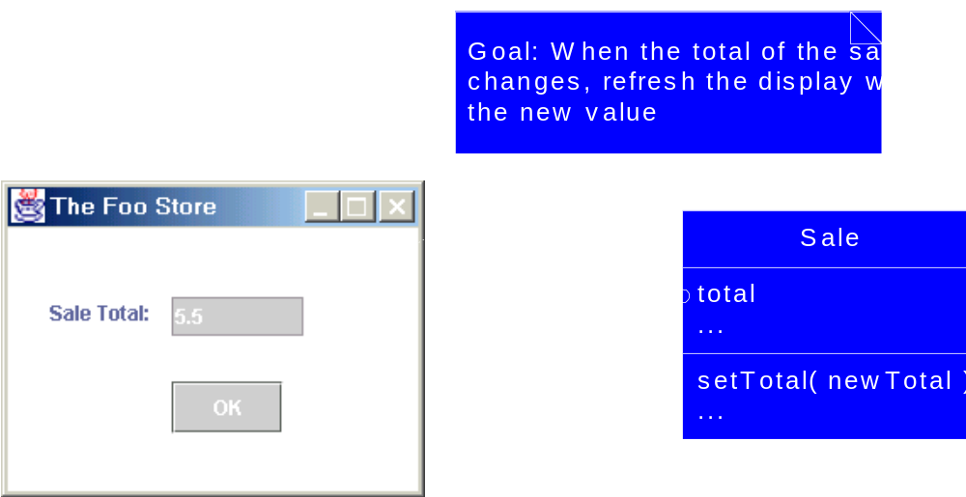
26.10. Observer/Publish-Subscribe/Delegation Event Model (GoF)
How to refresh GUI’s display of the sale total when the total changes

Slide 57
26.10. Observer/Publish-Subscribe/Delegation Event Model (GoF)
Problem:
  Different kinds of subscriber objects are interested in the state changes or events of a publisher object, and want to react in their own unique way when the publisher generates an event.
Solution:
  Define a “subscriber” or “listener” interface. Subscribers implement this interface. The publisher can dynamically register(动态注册) subscribers who are interested in an event and notify them when an event occurs.

Slide 58
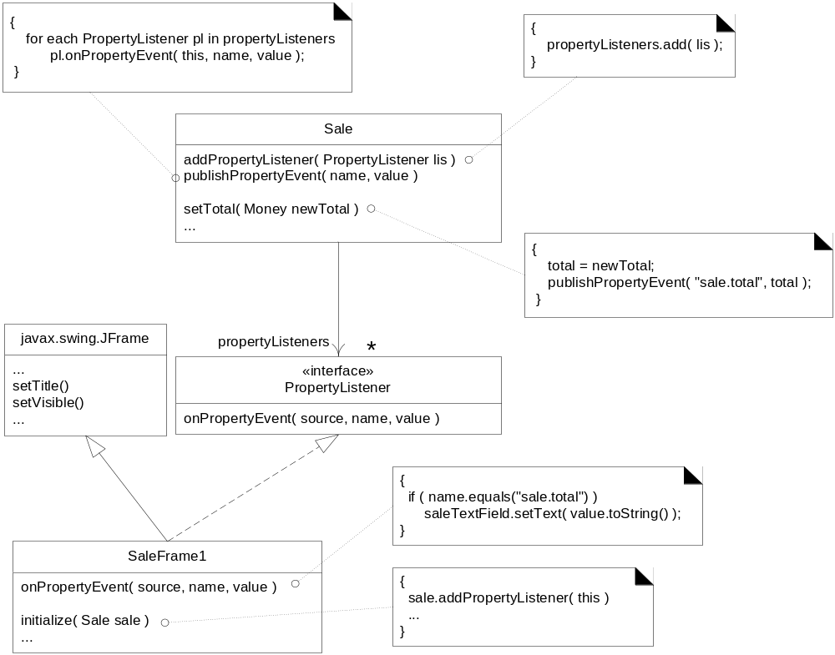
6. Sale为发布者，总额发生变化时，会遍历所有订阅了的PropertyListeners，并通知每一个订阅者
5.Sale知道实现了Property-
Listener接口的对象
1.定义接口
2.定义实现接口的窗口
3.初始化时传递Sale实例以显示总额
4.注册或订阅事件对象

Slide 59
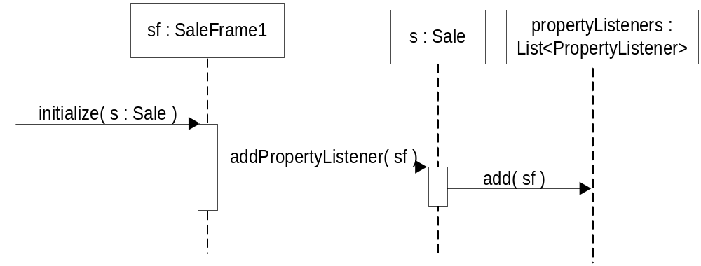
26.10. Observer/Publish-Subscribe/Delegation Event Model (GoF)

Slide 60
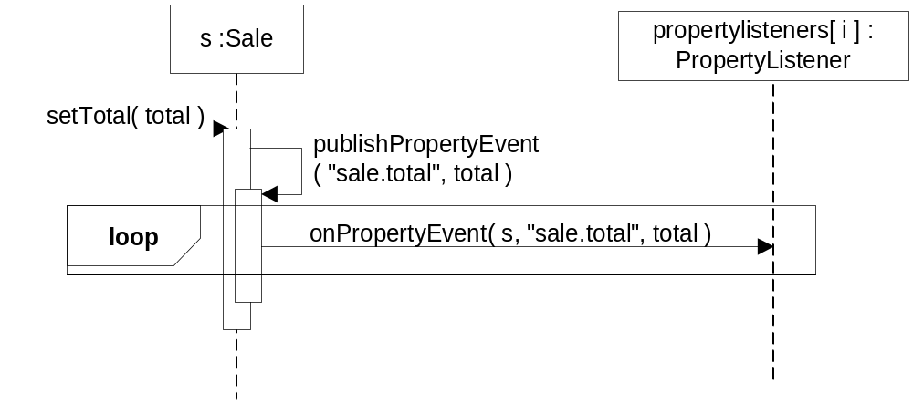
26.10. Observer/Publish-Subscribe/Delegation Event Model (GoF)

Slide 61
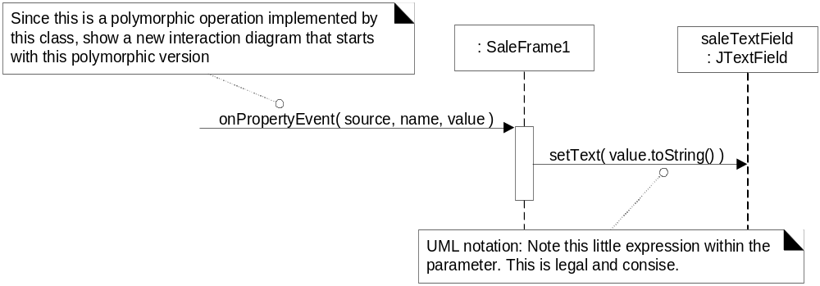
26.10. Observer/Publish-Subscribe/Delegation Event Model (GoF)

Slide 62
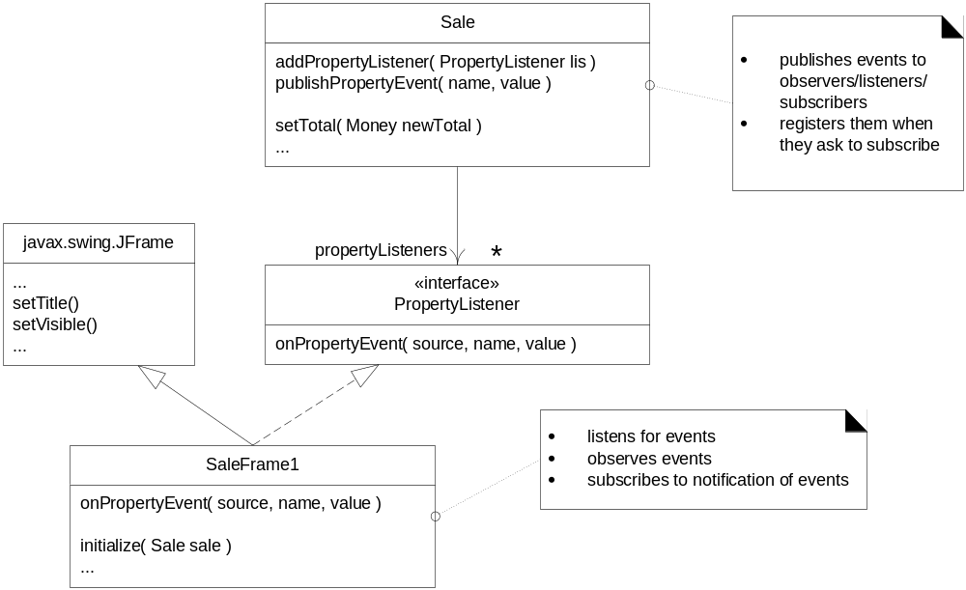
26.10. Observer/Publish-Subscribe/Delegation Event Model (GoF)
Observer, Publish-Subscribe, or Delegation Event Model?

Slide 63
26.10. Observer/Publish-Subscribe/Delegation Event Model (GoF)
Observer Is Not Only for Connecting UIs and Model Objects
  The most prevalent普遍 use of this pattern is for GUI widget窗口小部件 event handling
    JButton publishes an "action event" when it is pressed.
    Another object will register with the button so that when it is pressed
  Another example
    AlarmClock

Slide 64
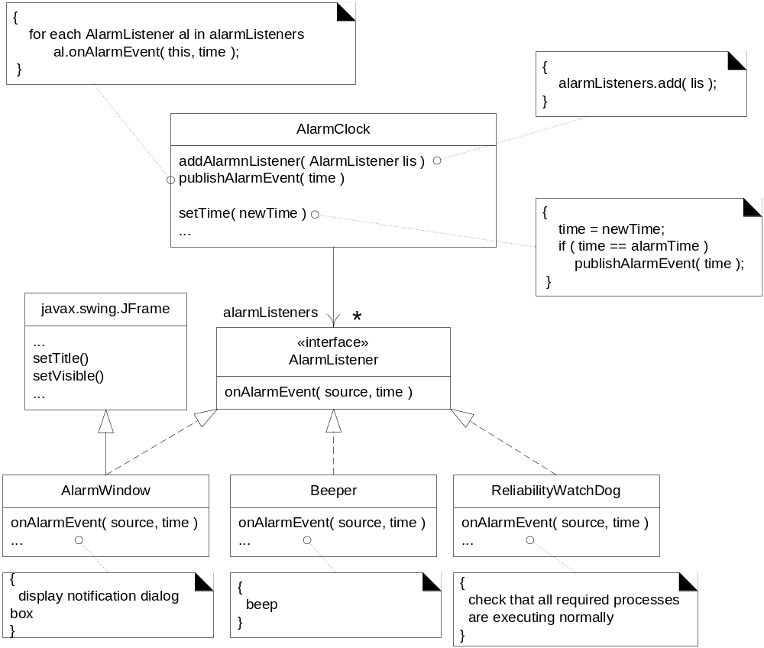

Slide 65
26.10. Observer/Publish-Subscribe/Delegation Event Model (GoF)
Implementation
class PropertyEvent extends Event {
private Object sourceOfEvent;
private String propertyName;
private Object oldValue;
private Object newValue;
//...
}
//...
class Sale {
private void publishPropertyEvent( String name, Object old, Object new ) {
PropertyEvent evt = new PropertyEvent( this,
"sale.total", old, new);
for each AlarmListener al in alarmListeners
al.onPropertyEvent( evt );
}
//...
}

