Slide 1
什么是UML?

Slide 2
1.6 What is the UML?
The Unified Modeling Language is a visual（可视化） language for specifying（描述）, constructing（构造） and documenting（文档化） the artifacts（制品） of systems
Three Ways to Apply UML
  UML as sketch
  UML as blueprint (Reverse Engineering逆向工程/ Code Generation代码生成，前向工程)
  UML as programming language ( MDA )

Slide 3
1.6 What is the UML?
UML and "Silver Bullet" Thinking
What is "Silver Bullet“
  From "No Silver Bullet" by Dr. Frederick Brooks, in his classic book “Mythical Man-Month” (20th anniversary edition).
UML is not a “Silver Bullet”.
  A person without good OO design and programming skills who draws UML is just drawing bad designs

Slide 4
1.6 What is the UML?
Three Perspectives（视点） to Apply UML
Conceptual perspective （概念视点）
  Diagrams are interpreted as describing things in a situation of the real world
Specification (software) perspective （规格说明视点）
  Diagrams describe software abstractions or components with specifications and interfaces ( no implementation)
Implementation (software) perspective （实现视点）
  Diagrams describe software implementations in a particular technology (such as Java, C#).

Slide 5
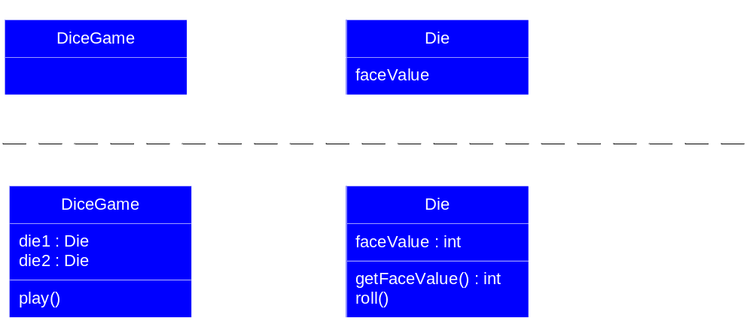
1.6 What is the UML?

Slide 6
1.6 What is the UML?
Meaning of "Class" in Different Perspectives
Conceptual class
  real-world concept or thing in UP domain model
Software class
  specification or implementation perspective of a software component

Slide 7
什么是面向对象的分析与设计?

Slide 8
1.4. What is Object-Oriented Analysis and Design?
Analysis
  Emphasize finding and describing the object( concept ) in problem domain （问题领域）
Design
  Emphasizes defining（定义） software objects and how they collaborate（协作） to fulfill the requirements

Slide 9
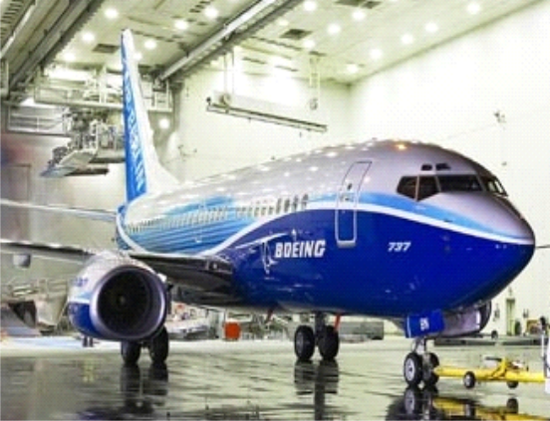
1.4. What is Object-Oriented Analysis and Design?
domain concept
领域概念
Plane
visualization of
tailNumber
domain concept
public class Plane
representation in an
{
private String tailNumber
object
;
-
oriented
programming language
public List getFlightHistory
()
...
}
{
}

Slide 10
什么是UP? RUP?

Slide 11
2.1. What is the UP?
Software Development Process
  describes an approach to building（构造）, deploying（部署）, and possibly maintaining（维护） software

Slide 12
Waterfall Process
Waterfall Process
Requirements
Analysis
Design
Code and Unit Test
Subsystem
Integration
System Test
Heavy documentation
Frustrate designers and programmers
Frequently results in major unplanned iterations
Delays confirmation of critical risk resolution
Delays and aggregates integration and testing

Slide 13
Iterative Development Produces Executables
Requirements
Analysis & Design
Planning
Implementation
Management
Environment
Test
Evaluation
Each iteration results in an executable release.
Deployment

Slide 14
2.1. What is the UP?
Unified Process ( UP )
  a popular iterative software development process for building OO systems
UP encourages including practices from other iterative methods（鼓励引进其他迭代方法中的有用的实践）
  Extreme Programming (XP)（极限编程）
  Scrum
  Test-driven Development
  Refactoring （重构）
  Continuous integration （持续集成）

Slide 15
什么是UP的阶段? 什么是UP科目?

Slide 16
2.10. What are the UP Phases（阶段）
Inception（初始）
  approximate vision
  business case
  scope
  vague estimates. （模糊评估）
Elaboration（细化）
  refined vision
  iterative implementation of the core architecture
  resolution of high risks
  Identification(确定） of most requirements and scope
  more realistic estimates.（更加实际的评估）

Slide 17
2.10. What are the UP Phases
Construction （构造）
  iterative implementation of the remaining lower risk and easier elements
  preparation for deployment.
Transition （移交）
  beta tests
  deployment

Slide 18
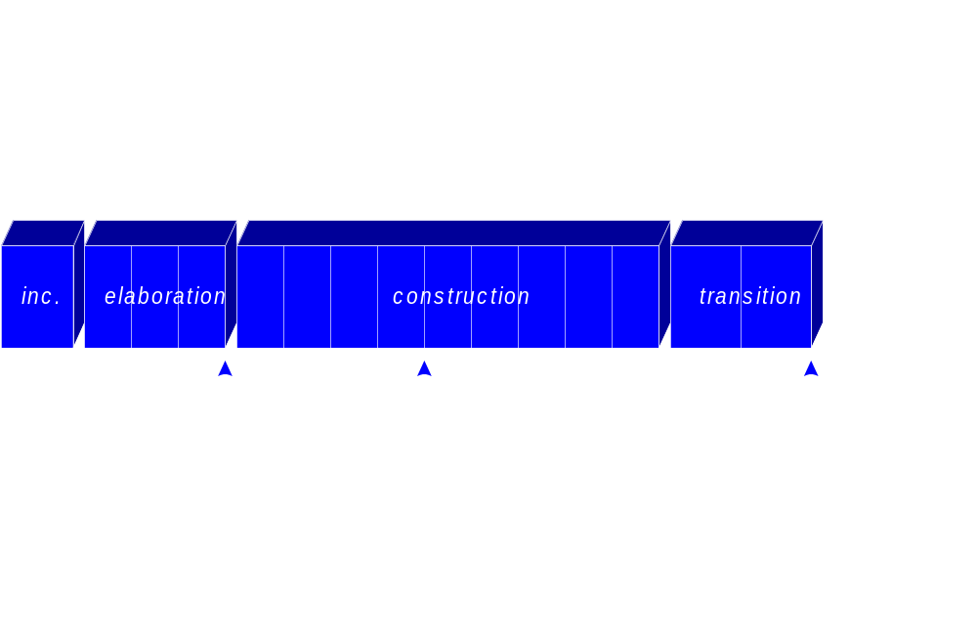
2.10. What are the UP Phases

Slide 19
2.11. What are the UP Disciplines?
Discipline（科目）
  a set of activities (and related artifacts) in one subject area （在一个主题域中的一组活动）
Disciplines in UP
Business Modeling （业务建模）
  The Domain Model artifact
    visualize （可视化）noteworthy（重要的） concepts in the application domain.

Slide 20
2.11. What are the UP Disciplines?
Requirements
  The Use-Case Model and Supplementary Specification artifacts （补充性的规格说明书）
    capture functional and non-functional requirements.
Design
  The Design Model artifact
    design the software objects.

Slide 21
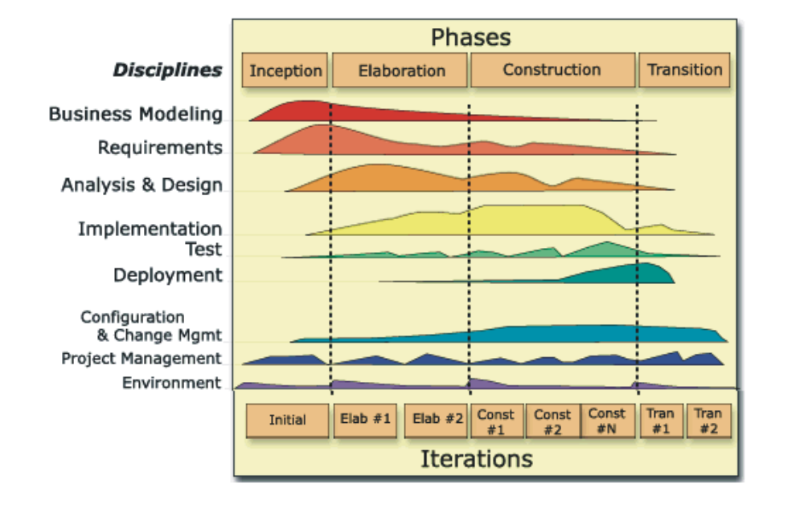
2.11. What are the UP Disciplines?
P35 /26
time
In an iteration, you walk through all disciplines.
content
Disciplines group related activities.

Slide 22
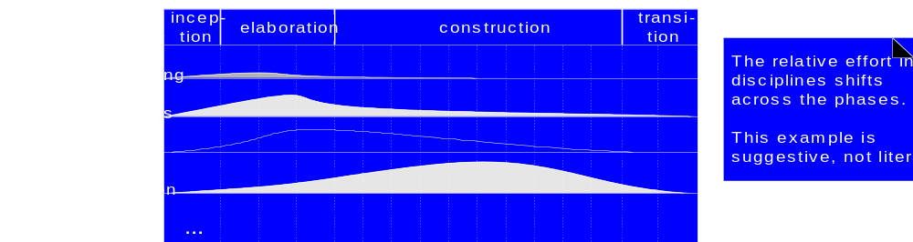
2.11. What are the UP Disciplines?
One iteration work goes on in most or all disciplines.
Relative effort across these disciplines changes over time.

Slide 23
2.11. What are the UP Disciplines?
How is the Book Structure Influenced by UP Phases and Disciplines?
The inception phase chapters
  introduce the basics of requirements analysis
Iteration 1
  introduces fundamental OOA/D and assignment of responsibilities to objects.(为对象分配职责）
Iteration 2
  focuses on object design, especially on introducing some high-use “design patterns.“ 设计模式
Iteration 3
  introduces a variety of subjects（各种主题）, such as architectural analysis （架构分析）and framework design.（框架设计）

Slide 24
为什么说初始阶段不是需求阶段?

Slide 25
4.1. What is Inception?
The initial step of a project
  The vision and business case for this project
  Feasible（可行性）
  Buy and/or build
  Rough unreliable range of cost:
    Is it $10K, 100K or in the millions?
  Proceed or stop?
The purpose of the inception phase is
  not to define all the requirements,
  or generate a believable estimate or project plan.

Slide 26
4.1. What is Inception?
Inception in one sentence:
  Envision（预见） the product scope, vision, and business case.
The main problem solved in one sentence:
  Do the stakeholders（涉众） have basic agreement on the vision of the project, and is it worth investing in serious investigation（认真研究）?

Slide 27
4.1. What is Inception?
An analogy（对比） In the oil business,
  Decide if there is enough evidence or a business case to even justify exploratory drilling（勘测钻探）.
  If so, do measurements and exploratory drilling.
  Provide scope and estimate information.
  Further steps…

Slide 28
什么是参与者?
什么是场景?如何写场景?

Slide 29
6.2. What are Actors, Scenarios, and Use Cases?
Actor
  something with behavior,
    such as a person, computer system, or organization;
      for example, a cashier
Scenario (Use Case Instance )
  a specific sequence of actions and interactions between actors and the system
    one particular story of using a system, or one path through the use case
      for example, the scenario of successfully purchasing items with cash,
      the scenario of failing to purchase items because of a credit payment denial.

Slide 30
6.6. What are Three Kinds of Actors?
Primary actor
  has user goals fulfilled through using services of the SuD ( System under Discussion)
    the cashier.
Supporting actor （协助参与者）
  provides a service to the SuD.
    the automated payment authorization service
Offstage actor （幕后参与者）
  has an interest（利益） in the behavior of the use case, but is not primary or supporting;
    a government tax agency.

Slide 31
什么是用例?

Slide 32
6.2. What are Actors, Scenarios, and Use Cases?
Use Case
  a collection of related success and failure scenarios that describe an actor using a system to support a goal.
RUP
A set of use-case instances, where each instance is a sequence of actions a system performs that yields an observable（可观察的） result of value to a particular actor

Slide 33
什么是用例实现?

Slide 34
18.1. What is a Use Case Realization?
A use-case realization 用例实现
  Describes how a particular use case is realized within the Design Model, in terms of collaborating objects.描述用例基于协作对象如何在设计模型中实现
    the connection between the requirements expressed as use cases and the object design that satisfies the requirements.

Slide 35
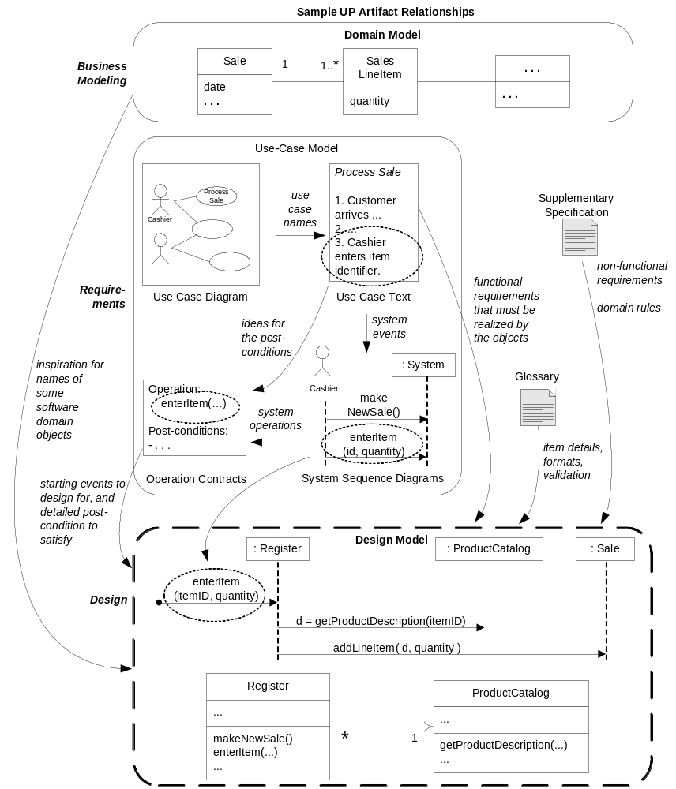

Slide 36
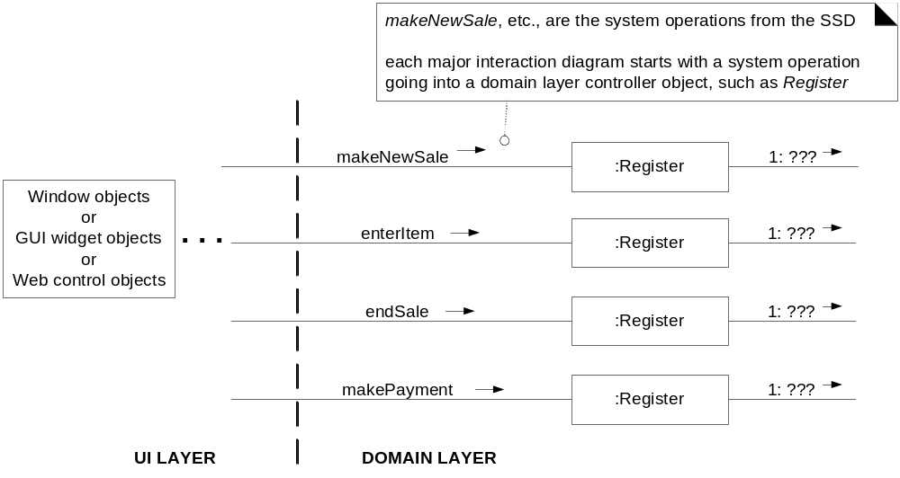
18.1. What is a Use Case Realization?

Slide 37
如何找到概念类?

Slide 38
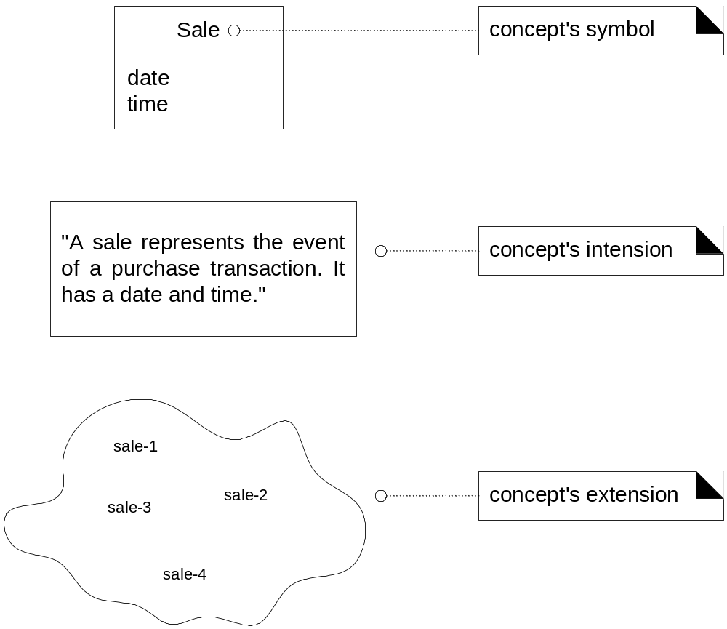
9.2. What is a Domain Model?
What are Conceptual Classes?

Slide 39
9.4.-9.5. Guidelines
How to Create a Domain Model?
  Find the conceptual classes
  Draw them as classes in a UML class diagram.
  Add associations and attributes
How to Find Conceptual Classes?
  Reuse or modify existing models.
  Use a category list (Table 9.1).
  Identify noun phrases.

Slide 40
何时使用描述类建模? 什么是数据类型类? 什么是限定关联?

Slide 41
9.13. When to Model with 'Description' Classes
Description Class （描述类）
  contains information that describes something else.
    a ProductDescription that records the price, picture, and text description of an Item
Why Use 'Description' Classes?
  Assume the following:
    An Item instance represents a physical item in a store;
    it has a description, price, and itemID;
    Everyone working in the store has amnesia健忘症.
    Every time a real physical item is sold, Item object is deleted.

Slide 42
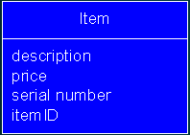
9.13. When to Model with 'Description' Classes
What happens in the following scenario?
  ObjectBurgers are sold out.
    all instances of ObjectBurgers are deleted.
  Who know the cost of ObjectBurgers?
Description, price, and itemID
  duplicated for every instance of the product
    space-inefficient and error-prone

Slide 43
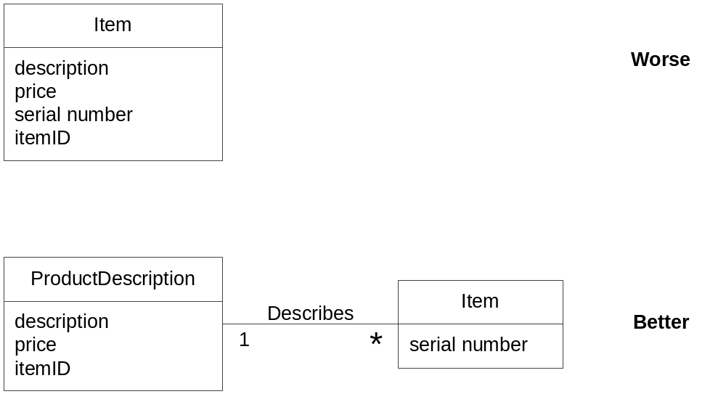
9.13. When to Model with 'Description' Classes

Slide 44
9.13. When to Model with 'Description' Classes
When Are Description Classes Useful?
  Need to be a description about an item,
    independent of the current existence of any examples of those items.
  Deleting instances of things results in a loss of information.
  It reduces redundant or duplicated information.

Slide 45
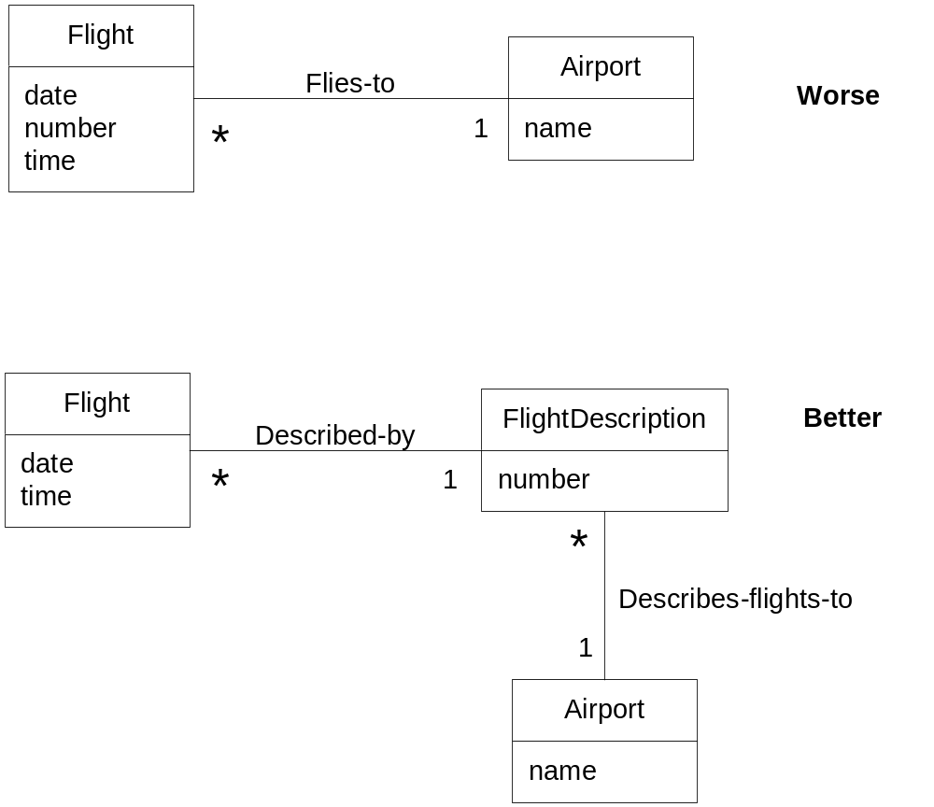
9.13. When to Model with 'Description' Classes
Example: Descriptions in the Airline Domain

Slide 46
9.16. Attributes
When to Define New Data Type Classes(数据类型类）?
  composed of separate sections.
    phone number, name of person
  operations associated with it, such as parsing or validation.
    social security number
  has other attributes.
    promotional price have a start (effective) date & end date
  a quantity with a unit.
    payment amount has a unit of currency
  an abstraction of one or more types with some of these qualities.
    item identifier in the sales domain is a generalization of UPC and EAN

Slide 47
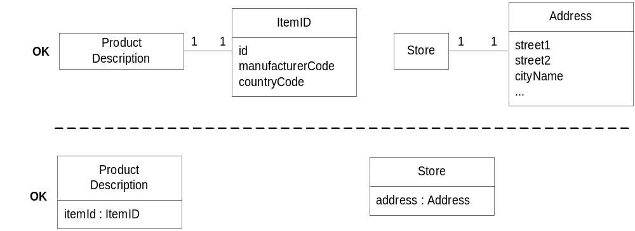
9.16. Attributes
Where to Illustrate These Data Type Classes?

Slide 48
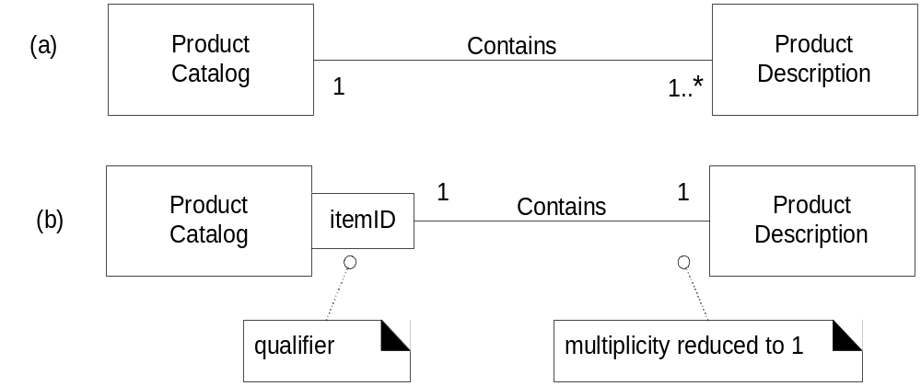
16.15. Qualified Association 限定关联
  used to select an object (or objects) from a larger set of related objects
    based upon the qualifier key暗示基于键对事物进行查找

Slide 49
什么是SSD?

Slide 50
10.2. What are System Sequence Diagrams?
Sequence Diagrams
  Notation that can illustrate actor interactions and the operations initiated by them.
System Sequence Diagram
  A picture that shows the events that external actors generate, their order, and inter-system events.
  准则：应为每个用例的主成功场景，以及频繁发生的或者复杂的替代场景绘制SSD

Slide 51
SSD与用例之间的关系?

Slide 52
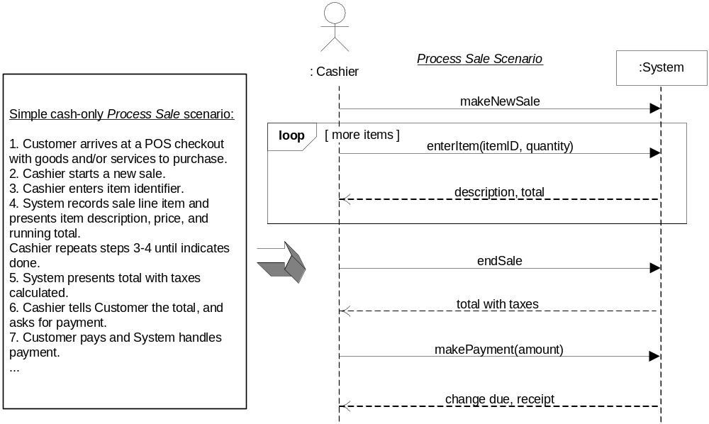
10.5. What is the Relationship Between SSDs and Use Cases?
An SSD shows system events for one scenario of a use case

Slide 53
GRASP 原则有哪些? 请准确理解它们的含义.

Slide 54
17.8. A Short Example of Object Design with GRASP
Nine GRASP patterns
  Creator
  Information Expert
  Low Coupling
  Controller
  High Cohesion

Slide 55
17.8. A Short Example of Object Design with GRASP
Creator
  Problem: Who creates the Square object?
Name:Creator
Problem:Who creates an A?
Solution: Assign class B the responsibility to create an instance of class A if one of these is true (the more the better):
  B "contains" or compositely aggregates A.
  B records A.
  B closely uses A.
  B has the initializing data for A.

Slide 56
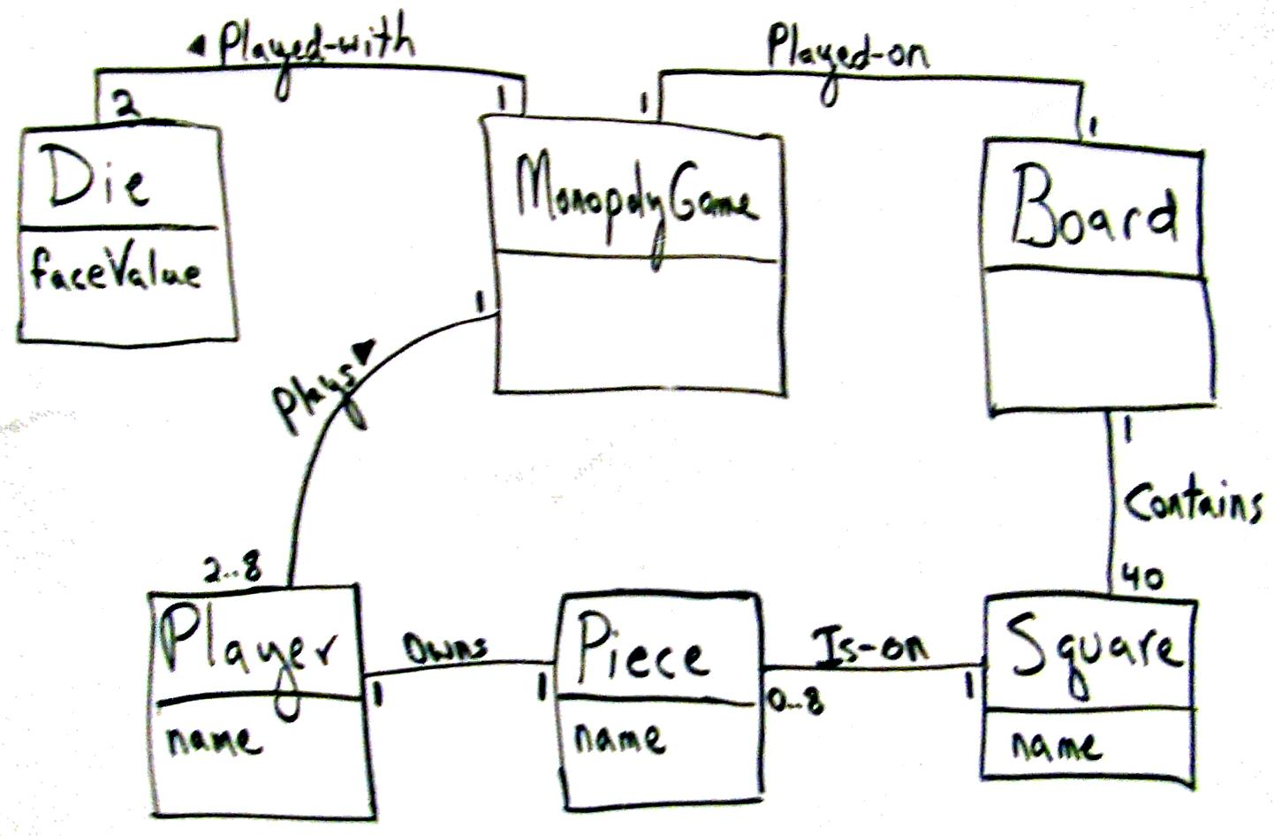
17.8. A Short Example of Object Design with GRASP

Slide 57
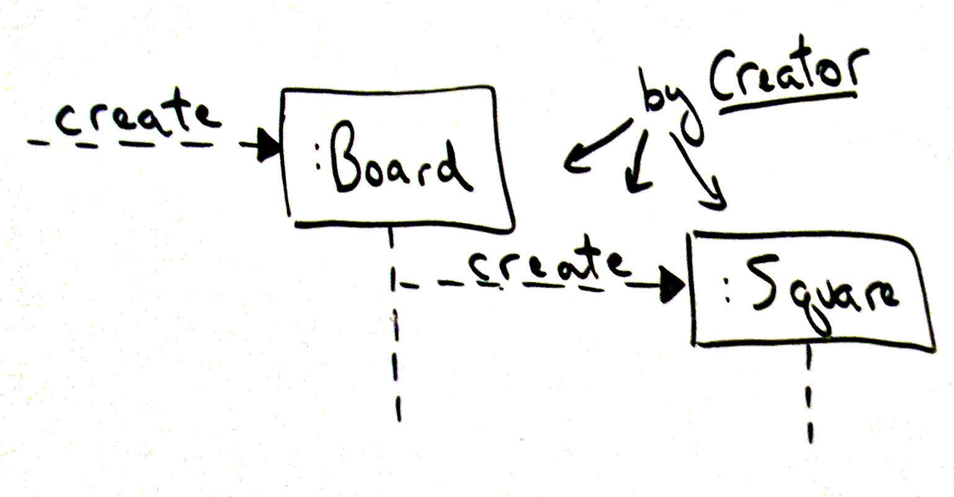
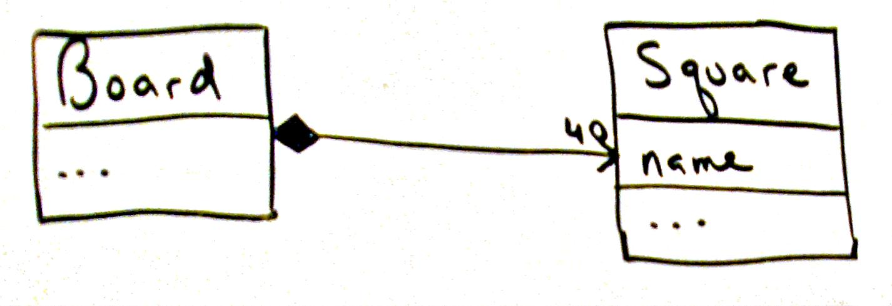
17.8. A Short Example of Object Design with GRASP

Slide 58
17.8. A Short Example of Object Design with GRASP
Information Expert
  Problem: Who knows about a Square object, given a key?如果给定键值，谁知道Square对象的相关信息？
Name: Information Expert
Problem: What is a basic principle by which to assign responsibilities to objects?给对象分配职责的基本原则是什么？
Solution: Assign a responsibility to the class that has the information needed to fulfill it.把职责分配给具有完成该职责所需信息的那个类。

Slide 59
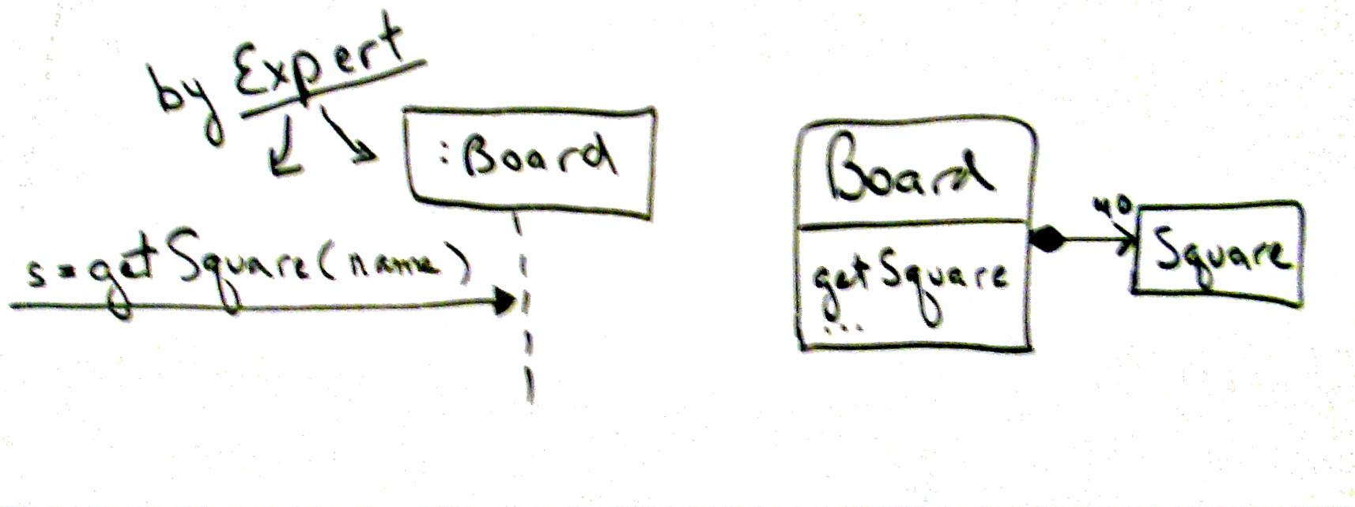
17.8. A Short Example of Object Design with GRASP

Slide 60
17.8. A Short Example of Object Design with GRASP
Low Coupling
  Question: Why Board over Dog?
Name: Low Coupling
Problem: How to reduce the impact of change?如何减少因变化而产生的影响？
Solution: Assign responsibilities so that (unnecessary) coupling remains low. Use this principle to evaluate alternatives.分配职责以使不必要的耦合保持在较低水平。

Slide 61
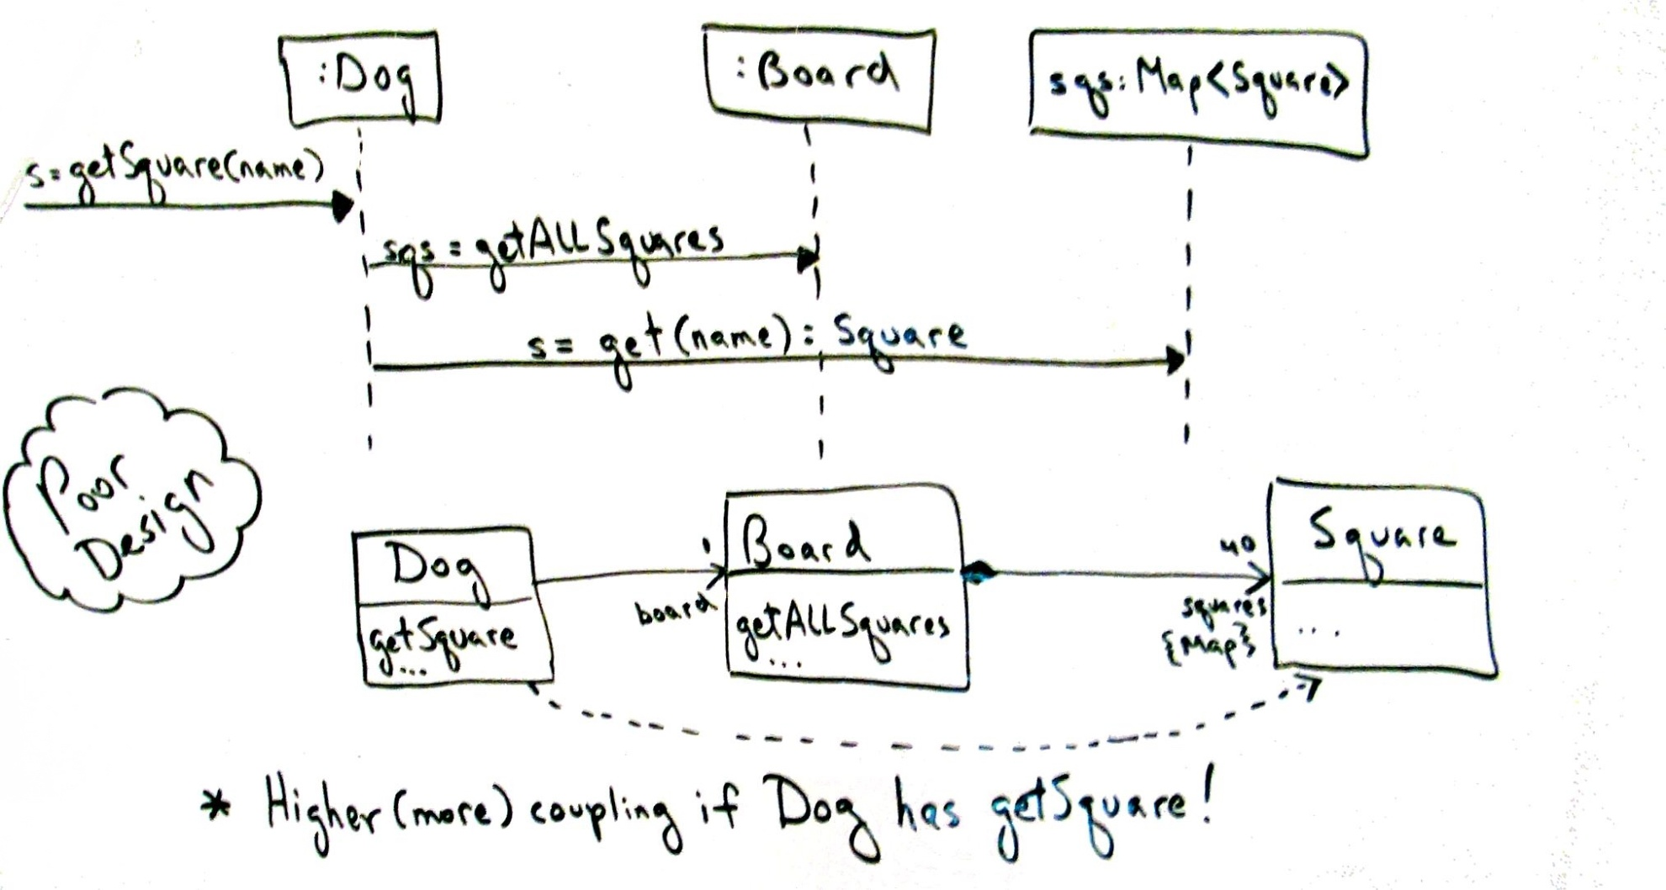
17.8. A Short Example of Object Design with GRASP

Slide 62
17.8. A Short Example of Object Design with GRASP
Controller

Slide 63
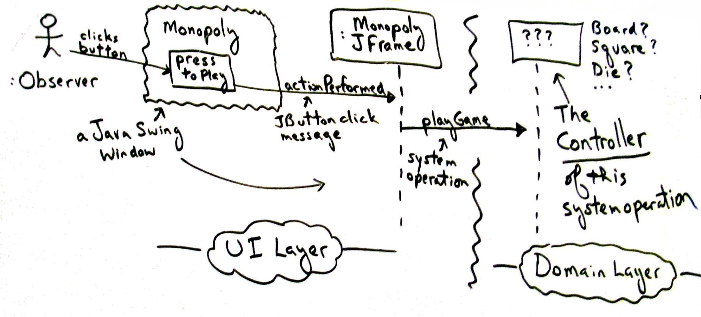
17.8. A Short Example of Object Design with GRASP
Controller

Slide 64
17.8. A Short Example of Object Design with GRASP
Name: Controller
Problem: What first object beyond the UI layer receives and coordinates (“controls”) a system operation?
Solution: Assign the responsibility to an object representing one of these choices:

Slide 65
17.8. A Short Example of Object Design with GRASP
Option 1: Represents the overall "system," or a "root object“代表全部“系统”“根对象”
  such as an object called MonopolyGame.
Option 2: Represents a device that the software is running within;运行软件的设备或主要的子系统。
Option 3: Represents the use case or session.代表发生系统操作的用例场景
  a software class such as PlayMonopolyGameHandler.

Slide 66
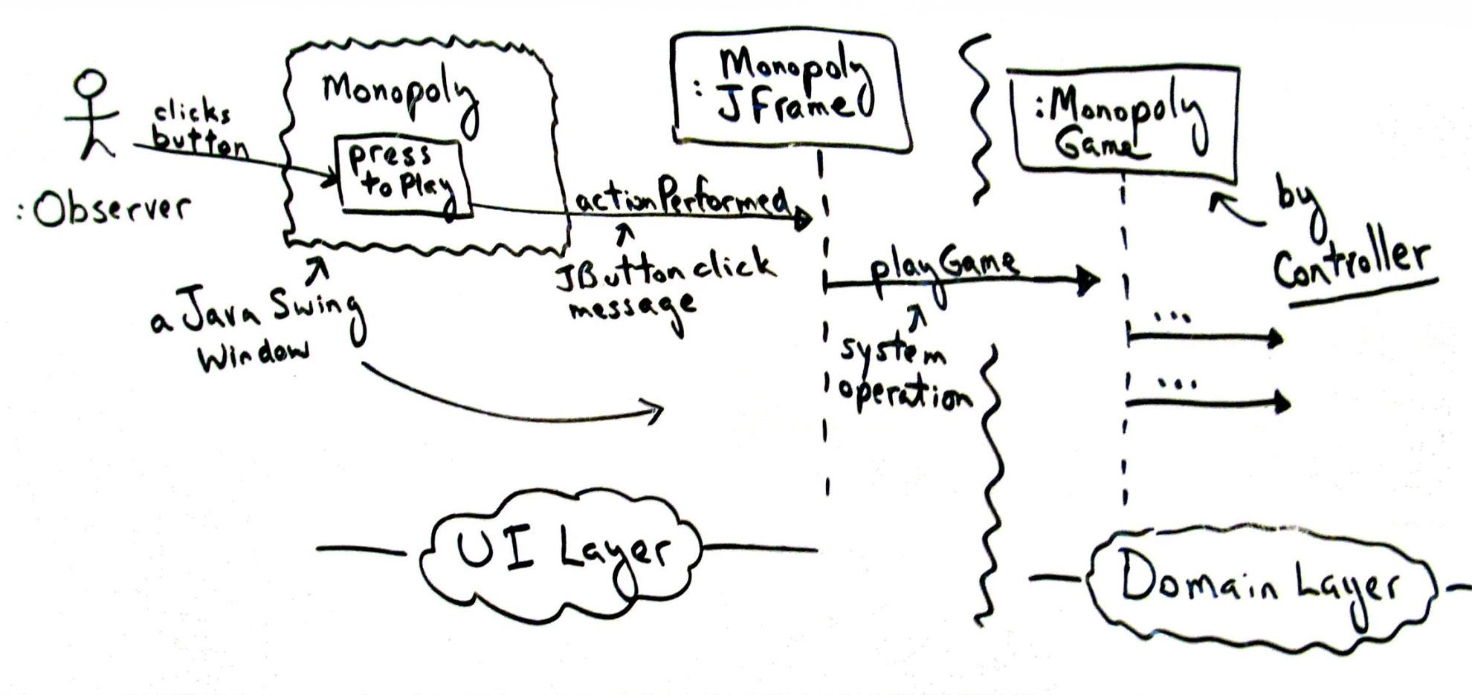
17.8. A Short Example of Object Design with GRASP

Slide 67
17.8. A Short Example of Object Design with GRASP
Name: High Cohesion
Problem: How to keep objects focused, understandable, and manageable, and as a side effect, support Low Coupling?怎样使对象保持有内聚、可理解和可管理，同时具有支持低耦合的附加作用？
Solution: Assign responsibilities so that cohesion remains high. Use this to evaluate alternatives.职责分配应保持高内聚

Slide 68
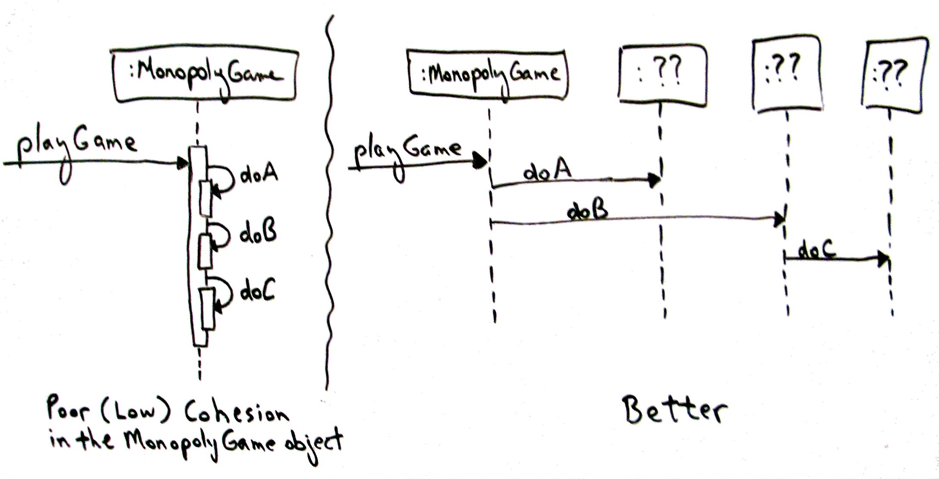
17.8. A Short Example of Object Design with GRASP
High Cohesion

Slide 69
什么是设计模式? 我们共学习了哪些设计模式? 请熟练掌握它们的用法.
26章ppt

Slide 70
什么是持久性对象?

Slide 71
37.1. The Problem: Persistent Objects
Assume that in the NextGen application, ProductDescription data resides in a relational database. It must be brought into local memory during application use.
Persistent objects持久性对象 are those that require persistent storage, such as ProductDescription instances

Slide 72
什么是O/R映射?

Slide 73
37.2. The Solution: A Persistence Service from a Persistence Framework
A persistence framework
  a general-purpose通用的, reusable, and extendable set of types that provides functionality to support persistent objects.
A persistence service
  actually provides the service, and will be created with a persistence framework.
  O-R mapping service. Typically, a persistence service must translate objects into records (or some other form of structured data such as XML) and save them in a database, and translate records into objects when retrieving from a database.

Slide 74
什么是框架?

Slide 75
37.3. Frameworks
Framework
  定义: An extendable set of objects for related functions,功能相关的可扩展对象
  Provides an implementation for the core and unvarying functions,
  Includes a mechanism to allow a developer to plug in the varying functions, or to extend the functions.
  Relies on the Hollywood Principle
“Don‘t call us, we’ll call you.” :用户定义的类将从预定义的框架类接受消息
  Offer a high degree of reuse

Slide 76
37.4. Requirements for the Persistence Service and Framework
Framework PFW (Persistence Framework).
The framework should provide functions such as:
  Store and retrieve objects in a persistent storage mechanism装置
  Commit and rollback transactions
  Be extendable to support different storage mechanisms and formats, such as RDBs, records in flat files普通, or XML in files.

Slide 77
熟练掌握UML标记(关联,聚合,组合,实现,泛化,依赖等)

Slide 78
熟练掌握各种图形的画法.(用例图,类图,顺序图,活动图,状态机图)

