Slide 1


Using Deep Learning to Discover Deontic Logic Statements
Cooper M. Stansbury Winter 2019 CIS 5700

Slide 2
Background:
Donating biospecimen samples or clinical data requires informed consent
Research study
Clinical procedure
Regulatory frameworks that prescribe ‘conditions of use’ for samples and data are complex and conflicting
Different ‘conditions of use’ for samples and data are prescribed by:
Federal laws
State laws
Institutional policies
Local IRB(s)
Individual informed consent forms

Slide 3
Problem Statement:
Records of past consents are stored in paper copies that cannot easily be linked to the data or samples whose use they govern
‘Permissions’ are specified by highly variable and conditional language
Current information systems do not account for an individual’s choices w.r.t donor consent
Managing individual records of permissions is not scalable
Research Question: Is it possible to use machine learning to automate the discovery of statements of permission in informed consent forms?

Slide 4
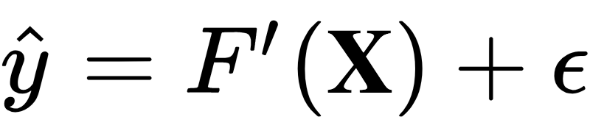
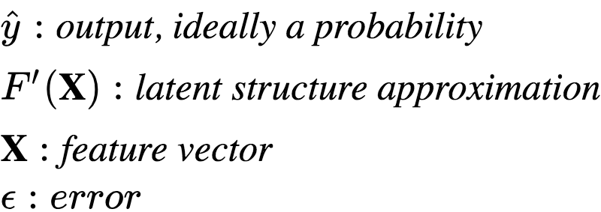
Data and Task:
Data:
752 unsigned, publicly available informed consent forms and informed consent form templates (and growing)
Most available in PDF and were converted to text via OCR processes
NOTE: Medical institutions do not want to share specific informed consent forms due to liability reasons, so these forms are hard to obtain
Goal:
Train a model to predict if an input sentence contains language that permits some action if the form is signed in the affirmative
Supervised classification task:

Slide 5
Motivating Examples:
Simple:
“yes, i will donate a blood sample to be stored at the biorepository for future, undesignated research which may include genetic research.”
“we may continue to use and disclose your information as described above indefinitely.”
Harder:
“i do not wish to take part in the research”
“i understand that there is a risk that my personal information may be accessed by people with no affiliation to the university”

Slide 6
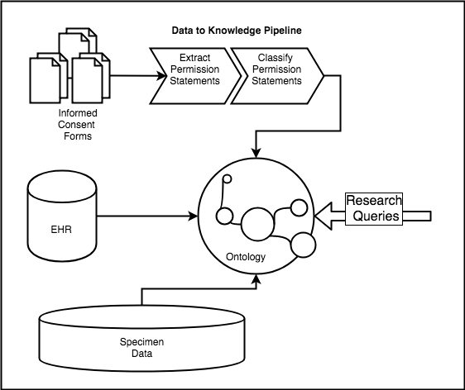
Initial Challenges:
Figure 1:
Proposed data infrastructure to allow for research queries subject to ‘permissions’ constraints.
Data:
High potential for bias in corpus
Raw data is unlabeled
Information loss during OCR conversion
Study:
Unit of analysis (word, document, sentence?) (trade-offs)
Permissions can be semantically ambiguous

Slide 7
Methods (I): Data Collection and Preparation
(1) Identify candidates:
String cleaning (lowercase, force encoding, ect…)
Parse (sentences) documents in parallel
Strip short sentences
Find sentences with any of the defined lexical clues
# Find sentences with any pronoun.
Find sentences above .95 similarity to those containing a lexical clue
Remove duplicates
Identified ~24.7K candidates out of ~71K sentences
(2) Annotation:
Annotated ~3.9K of these with binary labels
(1 = ‘permission’; 0=’not permission’) using DataTurks
Free tier only allows upload of 20,000
(3) Feature extraction:
Simple word counts, density, punctuation counts, ect…
POS counts
GloVe vectors
# Noun chunk counts
# tf-idf features

Slide 8
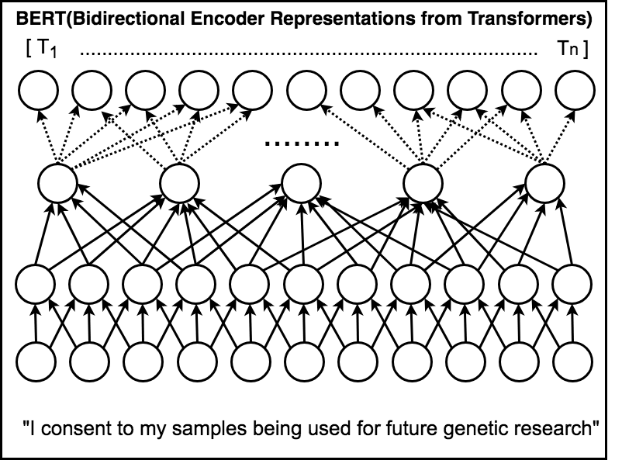
Methods (II): Classification
Permissions only account for ~0.22 of the training data. Used synthetic oversampling (SMOTE) to bring ratio to 1:1
Train classifiers:
Started with baseline classifiers
Moved to more advanced CNN using Keras
Compared against transfer learning model: BERT, Google pre-trained bidirectional DNN
Predict on new sentences

Slide 9
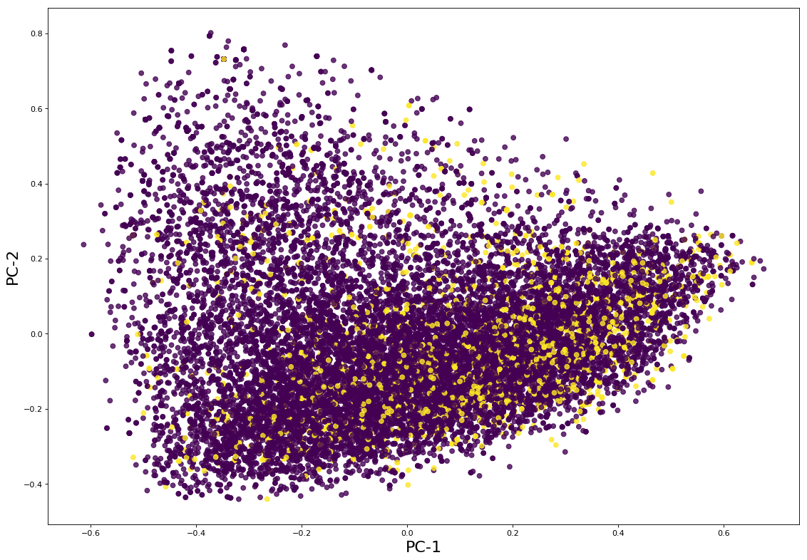
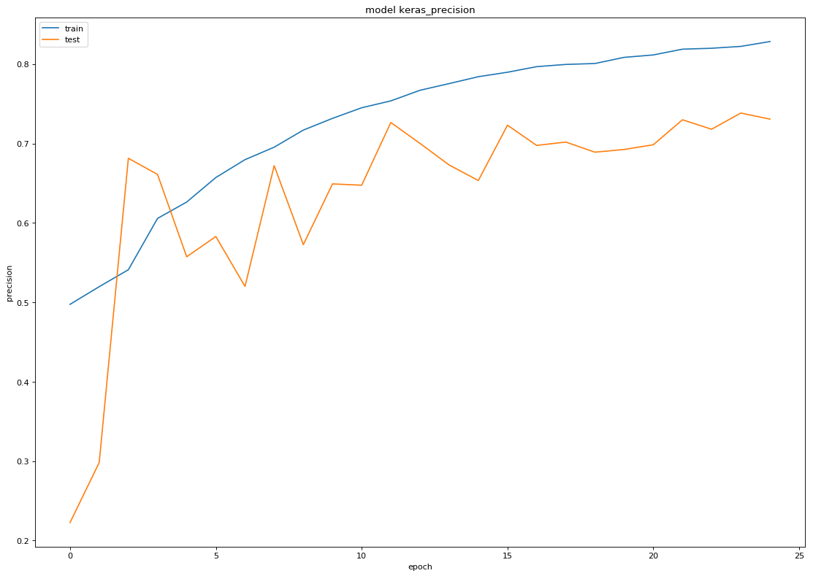
Results:
Figure 1:
PC-1 vs PC-2 from tf-idf for predictions on 20K sentences
Model | Accuracy | Precision | AUCROC
KNN Classifier | 0.480 | 0.261 | 0.569
Logistic Regression | 0.828 | 0.719 | 0.664
Simple Decision Tree | 0.698 | 0.323 | 0.566
Random Forest | 0.843 | 0.635 | 0.789
Random Forest-2 | 0.837 | 0.807 | 0.664
Bagging Classifier | 0.762 | 0.476 | 0.729
Bagging Classifier-2 | 0.779 | 0.750 | 0.505
AdaBoost | 0.842 | 0.639 | 0.780
Gradient Boosted | 0.814 | 0.572 | 0.755
Naive Baseline: (Majority Class) | 0.777 | 0.000 | 0.500
Simple ANN (Keras) | 0.731 | 0.731 | 0.786
CNN (Keras) | 0.851 | 0.851 | 0.972
BERT | 0.859 | 0.745 | 0.859
Figure 2:
Simple ANN learning curve (precision)

Slide 10
Conclusions:
Limitations:
Implications:
Future Work:
Time (as always)
Bias in the data
Too few annotations
Too few annotators
Predictions low quality
Unit of analysis not always appropriate
Possible to use deep learning to learn latent understanding of ‘permissible acts.’
Facilitate greater, more ethical access to data and biospecimen samples
Expand corpus
Recruit more annotators and annotations
Move algorithm execution to big data platforms (Spark, UM hadoop cluster)

Slide 11
Selected References:
Acknowledgements:
Links:
[1] J. Devlin, M.-W. Chang, K. Lee, and K. Toutanova, “BERT: Pre-training of Deep Bidirectional Transformers for Language Understanding,” arXiv:1810.04805 [cs], Oct. 2018.
[2] R. R. Faden, T. L. Beauchamp, and N. E. Kass, “Informed Consent, Comparative Effectiveness, and Learning Health Care,” New England Journal of Medicine, vol. 370, no. 8, pp. 766–768, Feb. 2014.
Thanks to Michigan Institute for Data Science (MIDAS), Michigan Integrated Center for Health Analytics and Medical Prediction (MiCHAMP)
Dr. Marcy Harris, Elizabeth Umberfield, Krishan Amin
NIH/NHGRI 5U01HG009454-03
Source Code:
https://github.com/CooperStansbury/permission_statement_extraction
Data Repository:
https://github.com/CooperStansbury/InformedConsentForms

Slide 12


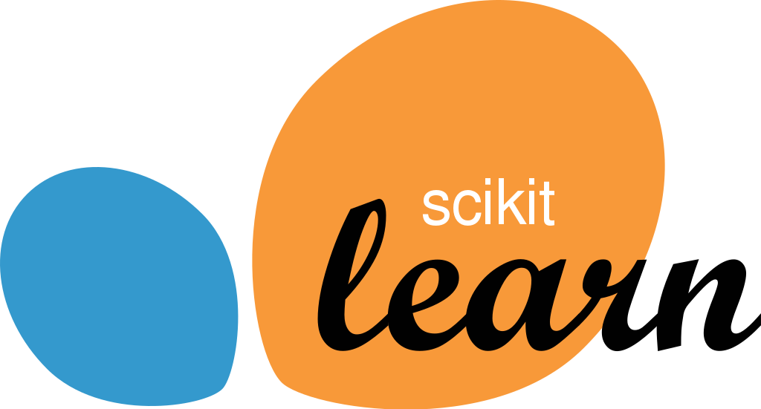


Appendix: Tooling and Technology
Primary language: Python 3.7.0 (+ some bash)
Python Libraries:
Data Structures: pandas/numpy/native
Parallel Processing: Dask
NLP Algorithms: Explosion AI’s spaCy (sentence parsing, POS tagging, similarity scoring)
Baseline Classifier Algorithms: scikit-learn
Clustering Algorithms: scikit-learn
Deep Neural Networks: Tensorflow/Keras
Transfer Learning: BERT
VC: git

