Slide 1
WE6 – Data Mining
Zach Cooper &
Kellyn Elaine Wolden

Slide 2
The Story
Google Play Store data
Number of installs for hundred thousand apps
Broken down by category, genre, name, date published, etc.
Interesting patterns including most ratings above 4

Slide 3
Data Mining: Business Question
What is a good app category to develop in to reach the highest number of consumers based on the categories or genres consumers are more likely to install from the Google Play Store today?

Slide 4
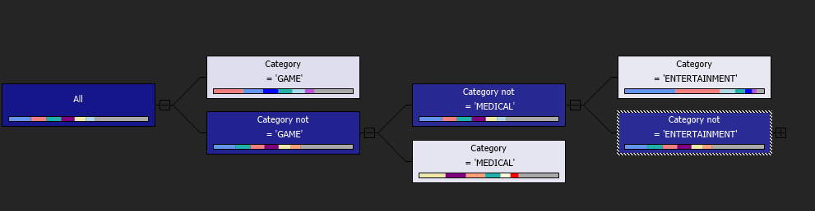
Data Mining: Decision Tree
Used decision tree to find most likely categories to be skipped or installed
Found that non-entertainment and non-games along with non-medical apps more likely to be installed
More games/entertainment leads to worse chances for installation

Slide 5
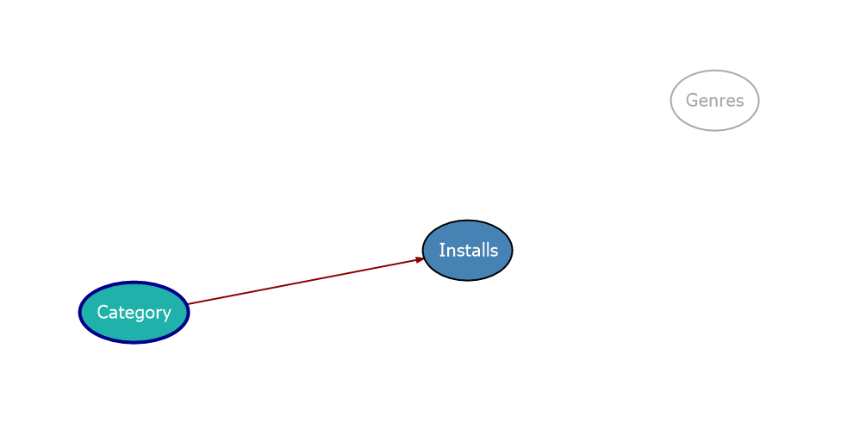
Data Mining: Naïve Bayes
Naïve Bayes showed which category had the strongest impact
Once rating was removed as a "missing" outlier, category shown as the biggest impactor
Naïve Bayes model more able to predict than the Decision Tree model

Slide 6
Data Mining: Conclusions
Category has a large impact on which apps are installed or not
Avoid continuing to oversaturate the games and entertainment market – much more likely to be skipped over
If possibly developing a medical app, determine the limits of population need in – avoid unnecessary development toward low populations
Family, finance, and education are highest categories for likely installations

