Slide 1
Impact Evaluator Grant
Milestone 2
What’s Cookin` Team
Impact Evaluator Git Repository

Slide 2
Impact Evaluator Components
Impact Evaluator Console
POC is implemented using Taiga as the source
The goal is to support a pluggable source for Claims.
The console enables a workflow flow of:
Approve Tasks – (”Approved” tasks result in creation of “Approved” claims in composeDB
Distribute Funds for the completed task to the award recipient (”Earned” tasks result in creation of “Earned” claim in composeDB)
Submit for Payment:
Retrieves “Approved” and “Distributed” claims from composeDB
Pin claims to web3.storage
Initiate Bacalhau Calc using web3.storage CID.
Bacalhau Server
Provides method for a user interface to initiate a Bacalhau program. It allows for information such as parameters and IPFS CIDs to be passed down to the Bacalhau program and any returned files to be passed back to the front end
Bacalhau Calc
Receives the CID for the claims pinned to web3.storage
Calculates the rewards and balances them to the amount in the Approved Reward.
Returns a Merkle tree of rewards.
Wrapper Contract
Receives a Merkle tree of rewards
Sets a one-day challenge
Host the token airdrop address

Slide 3
Reusability
Each of the components within this solution offers opportunities for reusability. The following outlines each component's current level of reusability and opportunities for improving future reusability.
IE Console – the sources for the data fed into the evaluator for each round can be a pluggable component. The POC is implemented with Taiga as the source of the data, but additional sources can be added. The pluggable component would simply be an extract of the source data and a mapping to the standard claim model.
Bacalhau – The compute component can be made a pluggable component allowing the implementor to customize the rules of the calculation.
Wrapper Contract – The wrapper can support any ERC20 token.

Slide 4
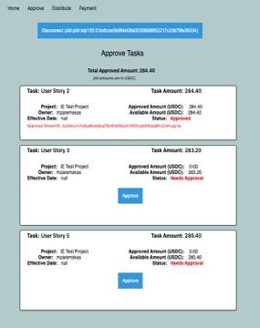
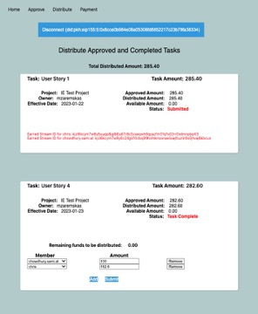
IE Console Screenshots

Slide 5
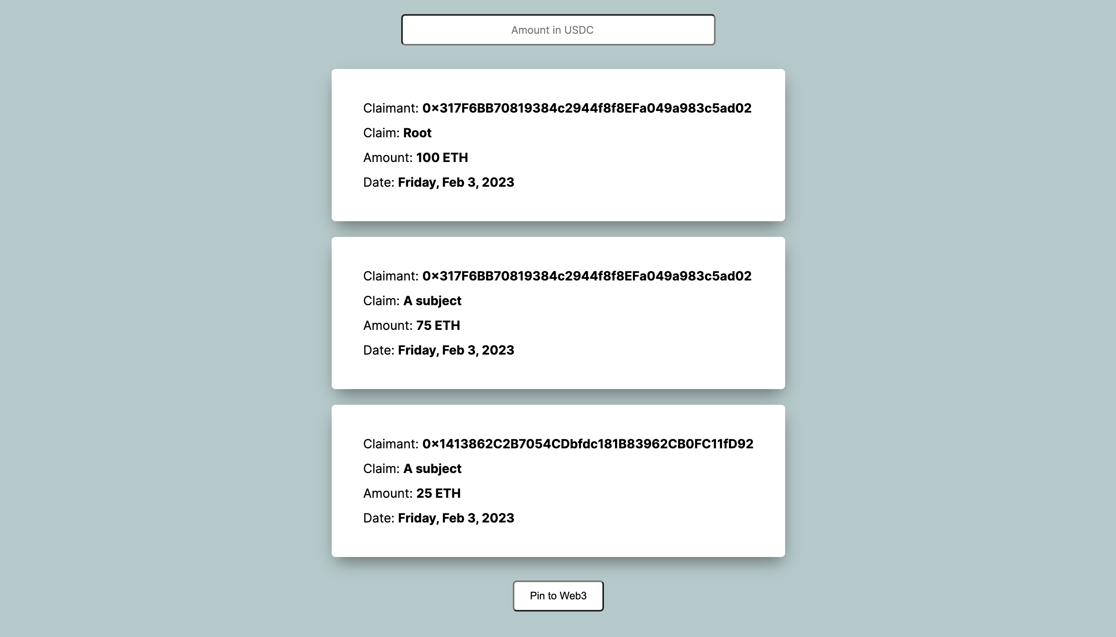
IE Console Screenshots

Slide 6
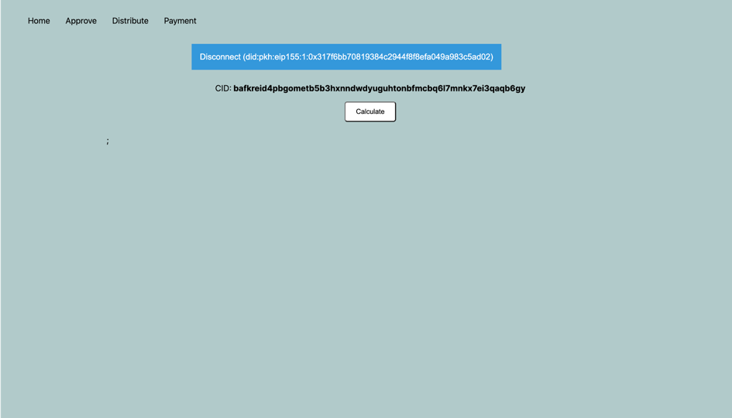
IE Console Screenshots

Slide 7
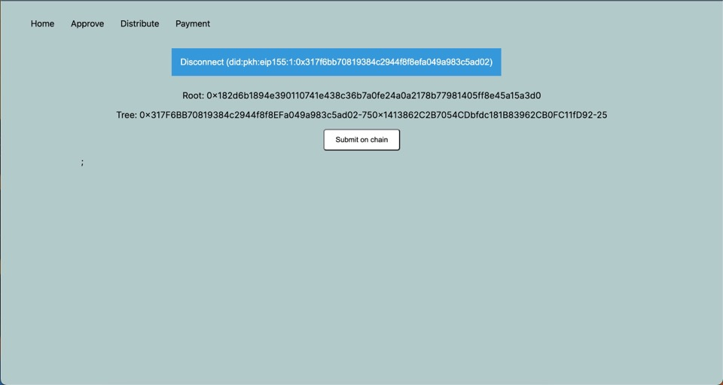
IE Console Screenshots

Slide 8

Flow Diagram
Admin
Impact Evaluator Console
Bacalhau Impact Eval Calc
1
2
3
4
Receives an array of CID’s.
Calculates rewards and balances them to the total reward amount in the root.
Returns a Merkle tree of rewards.
Taiga
Extract and Present Taiga Tasks to Review/Approve
Create ‘Approved’ Claim in ComposeDB
Create one or more ‘Earned’ Claims in ComposeDB (not to exceed approved amount)
Sum the total Approved Claims
Approved?
5
Initiate Bacalhau Calc (retrieve all approved Claims from ComposeDB. Persist to web3 storage. Invoke Calc interface passing a single web3 storage CID. Response is Merkle Tree of rewards.
Wrapper Contract
Confirm token balance in Gnosis (manual)
6
2
State
Stream:[ id:1, id:2, id:3, id:4, id:5]
1
Publish accepted answer.
Wrapper submits the question “is the Merkle root for effective-date x’” to reality.eth contract.
Sets Merkle root is the answer.
Sets a one-day challenge.
challenge period ended?
3
11
10
7
Use Merkle tree root to host the token airdrop where user can claim their token reward.
Tag Taiga Task as ‘Processed’
Retrieve the Users Claim Link
(Use a Wrapper Contract inquiry API to retrieve a link the user can use to retrieve their award.)
Initiate Wrapper Contract (Submits Merkle tree (received from Bacalhau) to the Wrapper Contract using ether.js)
8
1
Confirm and Initiate Airdrop (Confirms accepted answer and initiate airdrop. Update claim in ComposeDB setting isSatisfied=true)
Claim Reward
ComposeDB
User Wallets
Gnosis Safe
{id:1,claim:task1,subject:wallet1,rootClaimId:””,effective_date:01-31-2023,amount:100,unit:ETH,isSatisfied:false}
{id:2,claim:task1,subject:wallet2,rootClaimId:1,effective_date:01-31-2023,amount:75,unit: ETH, isSatisfied:false}
{id:3,claim :task1, subject: wallet3,rootClaimId:1,effective_date:01-31-2023, amount: 25, unit: ETH, isSatisfied:false}
{id:4,claim :task2, subject: wallet4,rootClaimId: “”,effective_date:01-31-2023, amount: 200, unit:ETH ,isSatisfied:false}
{id:5,claim :task2, subject: wallet2,rootClaimId:4, effective_date:01-31-2023, amount: 200, unit: ETH, isSatisfied_false}
User

Slide 9
Claim Model
Resources
type IEClaim
@createModel(
accountRelation: LIST
description: "Claim or attestation, possibly from 3rd party sources"
) {
subject: String @string(minLength: 1, maxLength: 256)
claim: String @string(minLength: 1, maxLength: 1024)
root_claim_id: String @string(minLength: 1, maxLength: 1024)
round: String @string(minLength: xx, maxLength: xx)
amount: Int
amountUnits: String @string(minLength: 1, maxLength: 16)
isSatisfied: Boolean @boolean
effective_date: String! @string(minLength: 1, maxLength: 10)
statement: String @string(minLength: 1, maxLength: 16384)
source: String @string(minLength: 1, maxLength: 1024)
digestMultibase: String @string(minLength: 1, maxLength: 256)
aspect: String @string(minLength: 1, maxLength: 256)
object: String @string(minLength: 1, maxLength: 1024)
confidence: Float @float(min: 0, max: 1)
rating: Float @float(min: -1, max: 1)
intendedAudience: String @string(minLength: 1, maxLength: 256)
respondAt: String @string(minLength: 1, maxLength: 1024)
}
Impact Evaluator Git repository
Approved Claims will not have a root_claim_id value. Earned claims will have the stream id of the Approved claim.

