Slide 1
Project
Synoptic
Louis Cooper, Matthew Chinnery, Kaleb Suter, Dumebi Onyebuchi, Edward Ward

Slide 2
Table of contents
01
02
03
04
Research
Design
Implementation
Researching Govan and the problems they face
Making designs based on these problems
Implementing these ideas
Testing
Making sure the software works

Slide 3
01
Research
Researching Govan

Slide 4
Problems Govan face
The current situation in Govan shows that access to fair food for refugees and people seeking asylum is an ongoing emergency.
Lack of variety and quality of food in foodbanks which can impact mental health, fairness, and dignity.
Fresh food being limited means those who require halal food often must travel into Glasgow City Centre.
Struggle to provide variety and culturally accessible food as donations and surplus is mainly long-lasting tinned foods or frozen food.
Impacts food banks and community food members who rely on surplus stock

Slide 5
Mission statement
The mission of our system is to connect each part of Govan and ensure everyone can easily get access to food. Our purpose encourages both normal people and businesses to help each other by providing food to everyone.

Slide 6

Share-a-Plate
Empowering Communities, One Meal at a Time

Slide 7
What we will do
Create a web app to…
Allow businesses to operate as food banks
Allow users to check stock of local foodbanks
Allow users to donate to any of the businesses to help them manage stock
Include accessibility features and a food filter to help as many people as possible

Slide 8
Why a web app?
Simple to use
Familiarity
People can access it on a wide range of devices
Only a simple browser required – no extra software needed to be downloaded
Planned restoration of Elder Park library with IT facilities

Slide 9
Requirements
Must have:
User Registration
Business Registration
Inventory Management
Stock Availability Display
Donation System
Geolocation and Mapping
Responsive Design
Internet Connectivity
Should have:
Accessibility Features
Food Filter
Notifications
Security
Cross-Browser Compatibility
Mobile Optimization
Won’t Have Requirements:
Over filling on pages
Offline functionality
Too intrusive inputs for personal info
Could-Have Requirements:
Translation
Data Storage and Backup
Performance Optimization
Error Handling and Logging

Slide 10
02
Design
Finding solutions to the problems Govan faces

Slide 11
Agile Methodology
SCRUM:
Scrum is an agile project management framework that provides a structured approach to managing and delivering projects in an iterative manner.
PROCESS SUMMARY:
The product owner compiles a list of all the tasks necessary to complete the project.
The group then determines how to implement it and builds a sprint backlog.
For the period of a sprint, the team typically meets daily, providing an update and the manager assessing the progress.
REASON FOR CHOOSING
Scrum allows teams respond to changes and deliver quickly.
Scrum ensures effective use of time and money.
Short sprints enable changes based on feedback a lot more easily

Slide 12
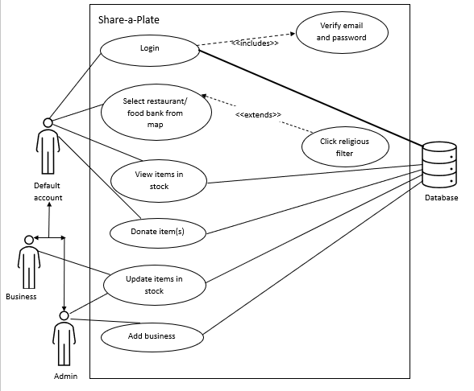
UML diagram

Slide 13
Personas
Humza Bashir
Community volunteer, Food Bank User
Humza volunteers at the Govan Community Project this helps to keep him busy, and the other volunteers feel like a Family to him. This has also helped him combat the loneliness of leaving his family behind and improved his mental health.
Humza moved to Govan as an asylum seeker 3 years ago. Due to his asylum seeker status, he currently cannot work, to cover expenses such as travel, food, clothing etc. he receives £35-£40 a week. This can make obtaining certain foods such as halal hard, as the main source is located within the city centre. Humza makes use of the Food bank in Govan but often finds that they are not holding items that he requires which can sometimes lead to a wasted trip due to travel expenses.

Slide 14
Personas
Martin Holmes
Food Bank Manager
Martin has lived in Govan most of his life and has helped in multiple projects including the ‘Govan Community Project’.
Martin helped create establish the Govan food bank back in 2020 with the start of the pandemic. Which has helped many families in the community by providing food and sundries to them. However, he is aware that there are occasions where members of the community have arrived, but they no longer have certain items in stock leading to a ‘wasted’ journey.

Slide 15
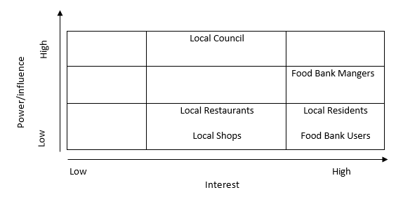
Stakeholder
The identified Stakeholders
Residents
Food Bank Management
Local Shops and Restaurants
Local Council
Food Bank Users

Slide 16
Wireframes
Desktop version
Phone version

Slide 17
03
Implementation
Implementing the designs to real software

Slide 18
Low resources
Phone CSS is prioritised to be easy to use
Internet access is required for the website, however…
All content are in dropdowns so things like the map won’t be initially requested on the network unless needed
Animations are translations, and use CSS so require only initial network request and rest is handled by browser
All data on the food page is loaded at the start to avoid multiple calls to the database – so if connection is lost, users can still view stock

Slide 19
Accessibility
Cursor changes over clickable buttons
Dyslexic, high contrast and language filter allows higher accessibility
Alt text and role attributes used to explain layout and images to aid screen readers
Maintenance is easy with an entire page dedicated to admins and their ability to manage businesses

Slide 20
Scaling
It scales well, just would need to switch the selection dropdown to a search for local foodbank businesses instead and to allow businesses in locations outside of Govan to use the service
The large focus on accessibility means a higher amount of people would be able to use it
All inputs have formatting conditions to ensure no errors, max character count could be increased for parts to give businesses more freedom

Slide 21
Demo
Business signup
Admin approves business (have admin account already setup)
Business adds/removes stock
Show stock on food page
Food filter
Show user donating to business (have a test user already registered)

Slide 22
04
Testing

Slide 23
Testing
We used…
Black-box testing – to test whether our prototype meets our specification
User testing - to get a third party opinion

Slide 24
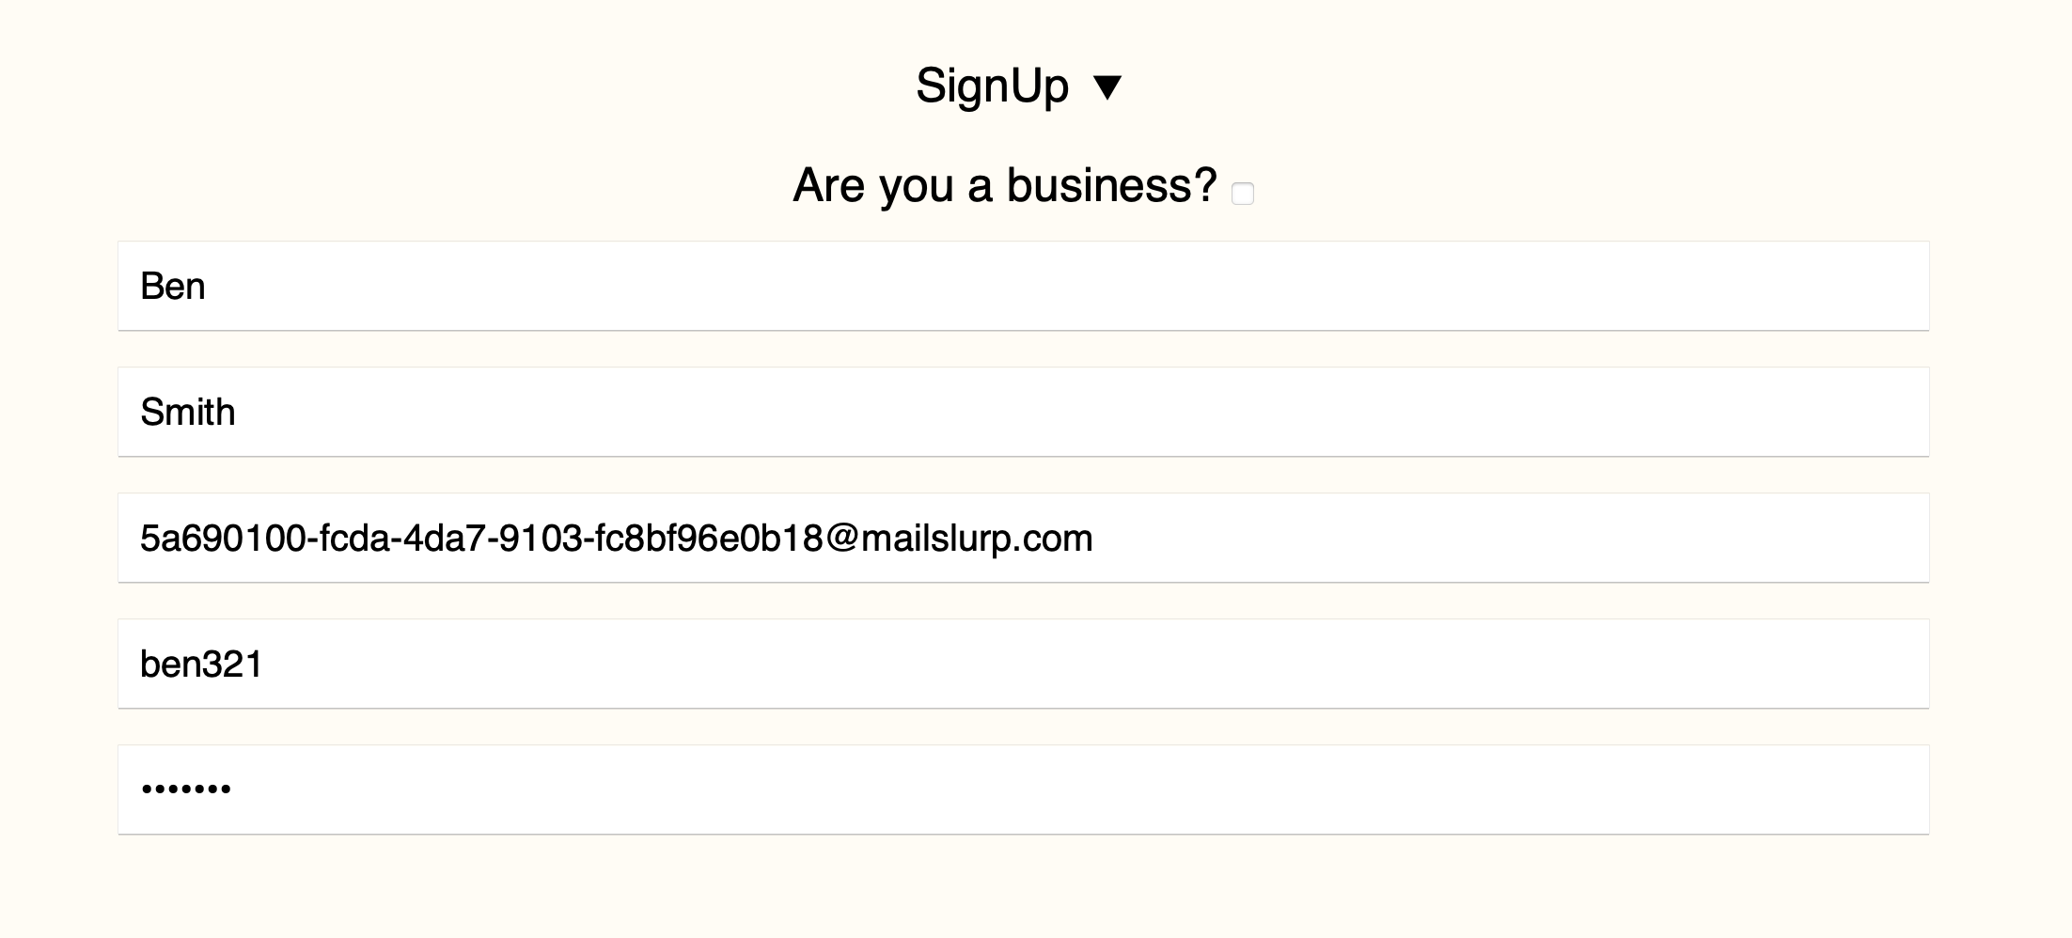
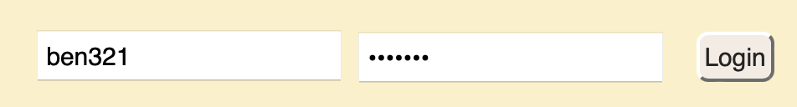
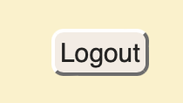
Testing
 | Feature | Input Operations | Expected outcome | Pass/Fail
1 | User signup: a user enters valid details and signs up | Scroll to the bottom of the home page Enter “Ben” ”Smith” “[test email]” “ben321” “123abc!” | The user’s account should be created | Pass
Evidence of Testing
Logging in
Logged in / account create

Slide 25
Testing
 | Feature | Input Operations | Expected outcome | Pass/Fail
2 | Business signup: a business enters valid details and signs up | Scroll to the bottom of the home page Select business account Enter “John” ”Smith” “[test email]” “john321” “123abc!” “John’s Shop” “My business helps by giving out damaged stock that can’t be sold” “581 Govan Rd Govan Glasgow” “GS1 2AS" | The account should be create as a user and added to the pending table for admin’s to view the request | Pass

Slide 26
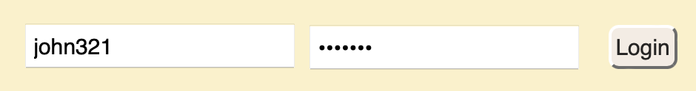
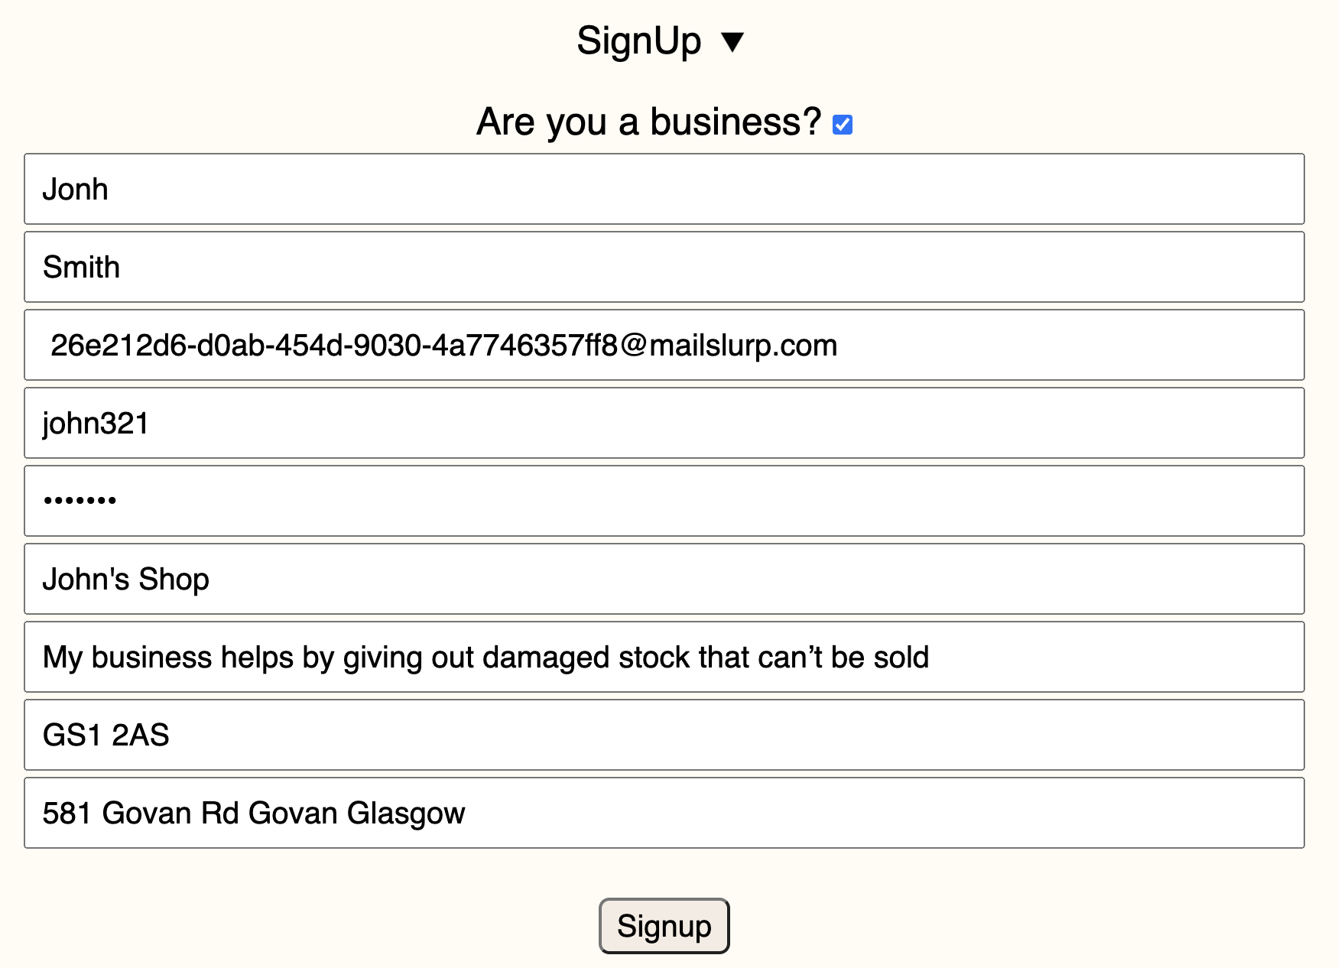

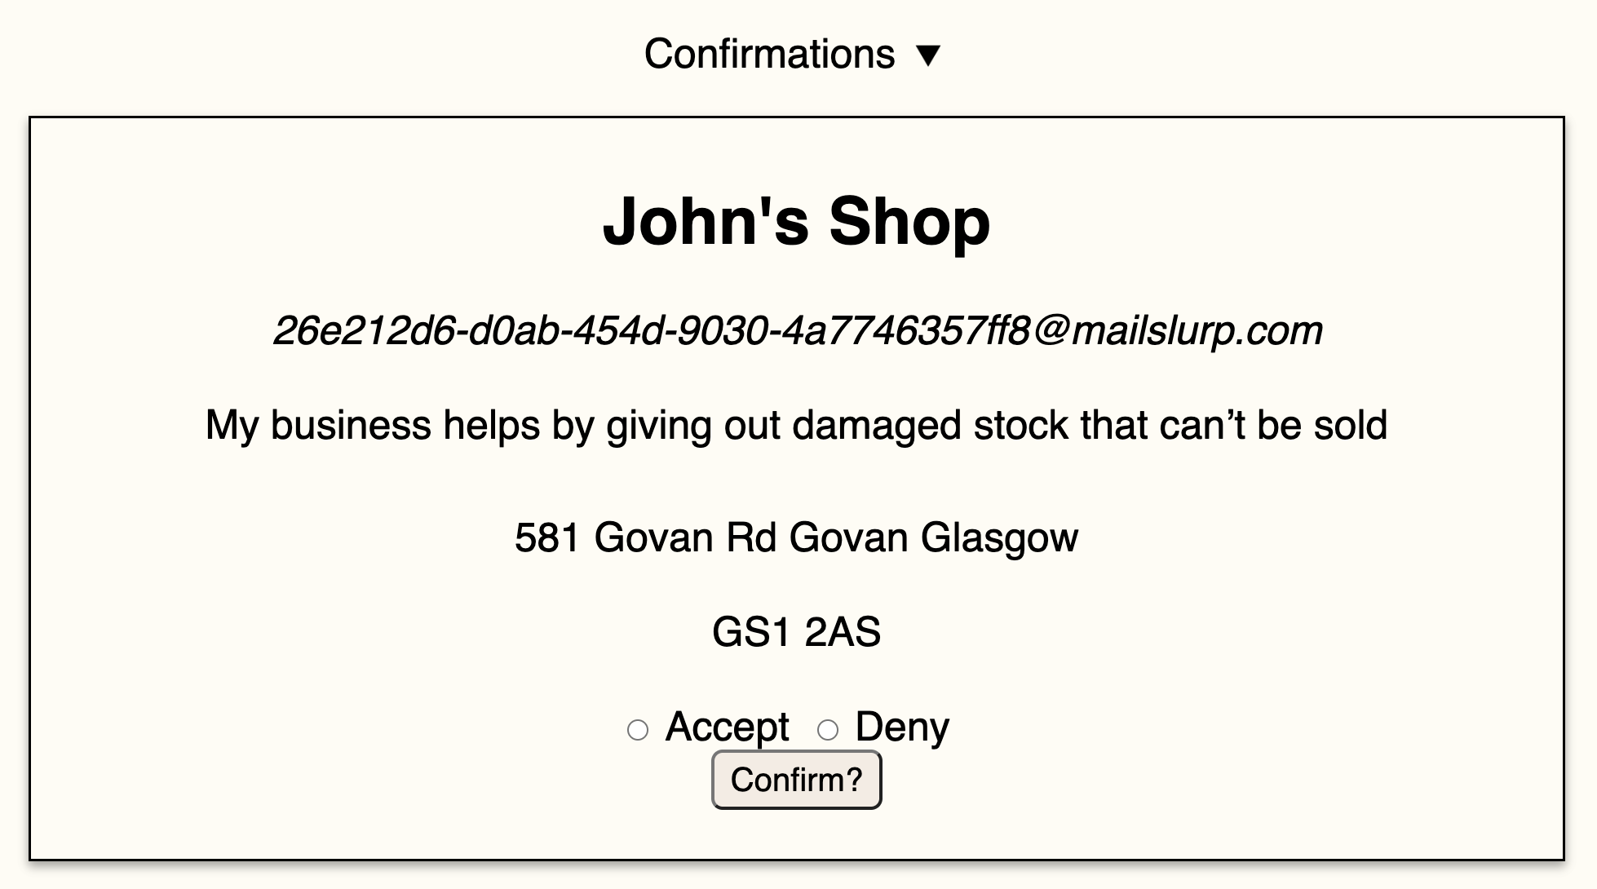
Testing
Logging in
Logged in / account created
Request sent to admins

Slide 27
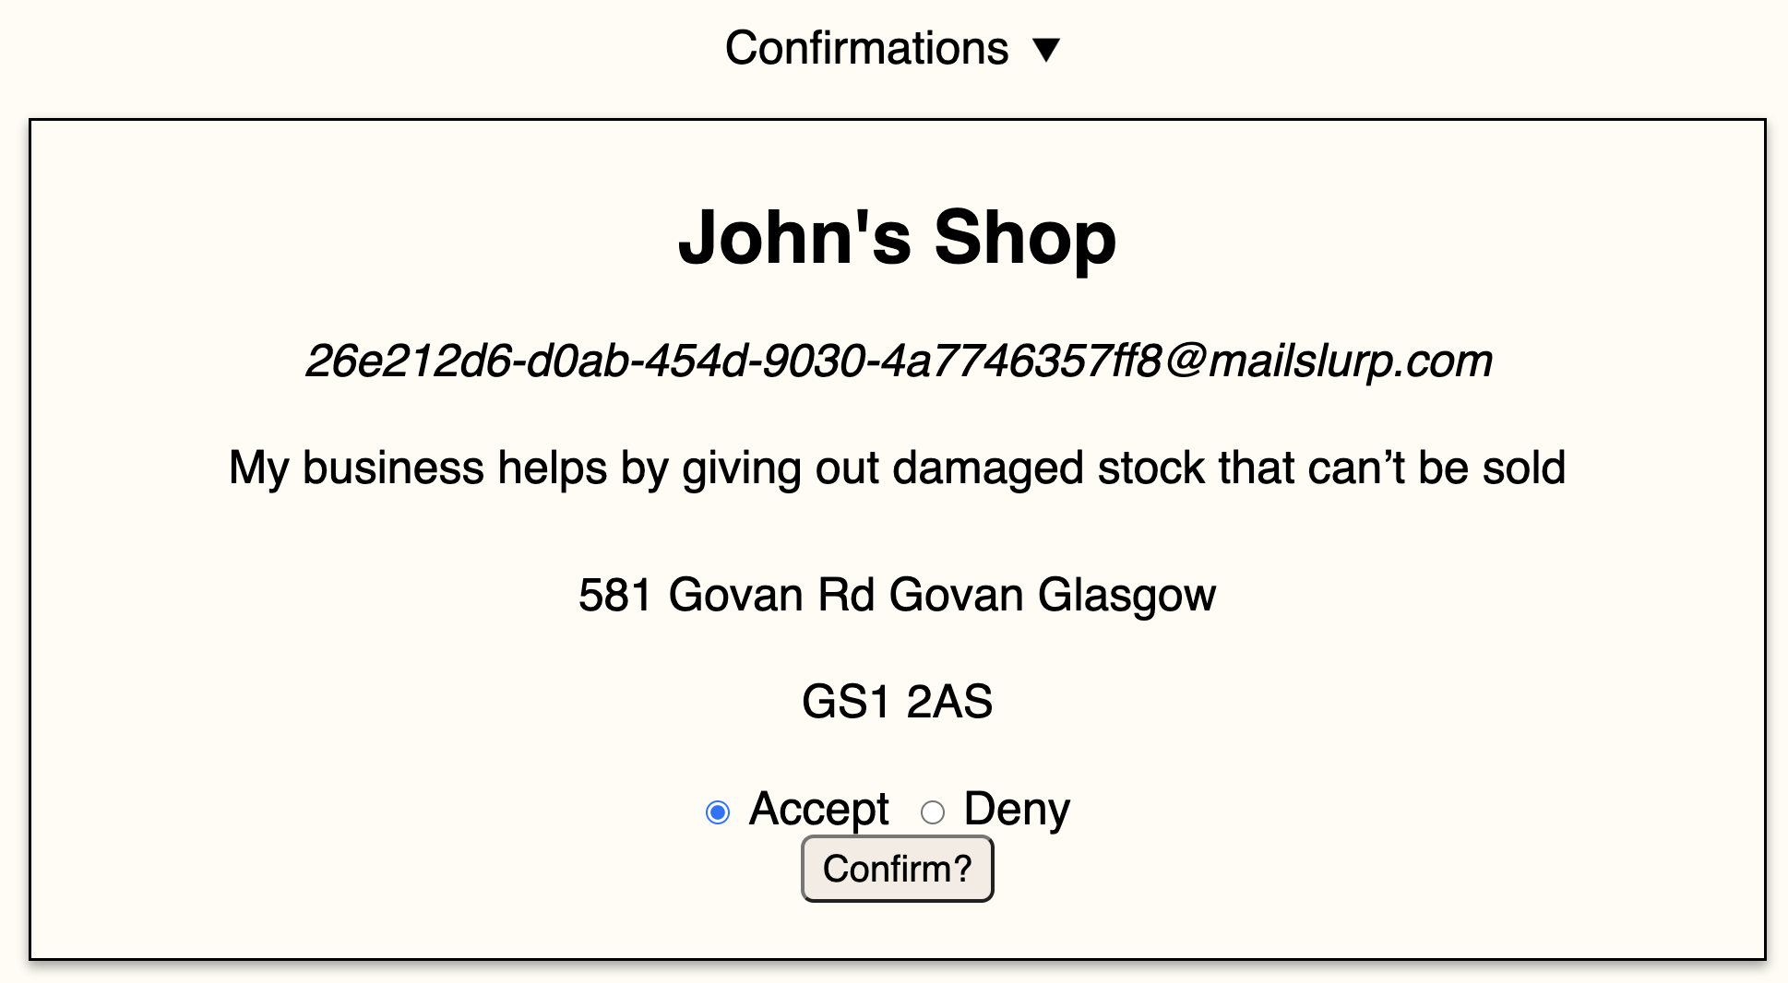
Testing
 | Feature | Input Operations | Expected outcome | Pass/Fail
3 | Admin approves/denies business: admin sees businesses that have applied and can accept or deny them | Navigate to the admin page Click the accept button next to the request from the previous signup test | The account type should be updated to a business account | Pass
Evidence of Testing
Before account accepted
After account accepted

Slide 28
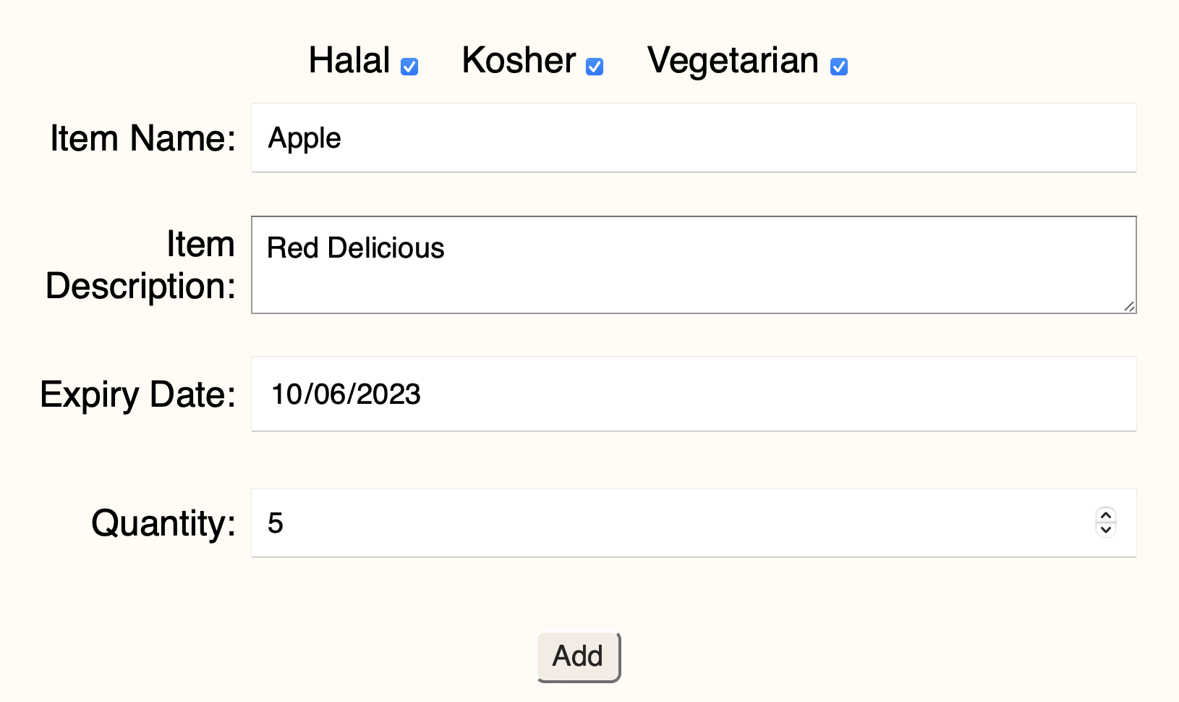
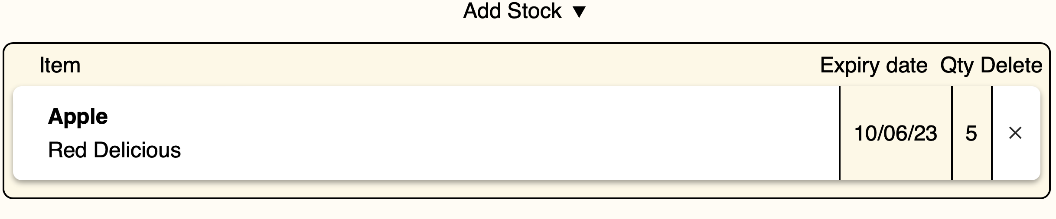
Testing
 | Feature | Input Operations | Expected outcome | Pass/Fail
4 | Add stock: the user enters valid data and the item is added to the business's stock | Navigate to the my business page Enter “Apple” ”Red Delicious” “10/06/23” “5” Click “Add Stock” | The item should be added to the business’s stock | Pass
Evidence of Testing
Stock after “Add” pressed

Slide 29
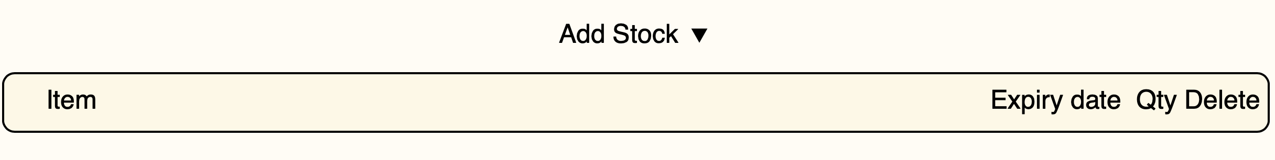
Testing
 | Feature | Input Operations | Expected outcome | Pass/Fail
5 | Remove stock: the user selects an item to remove and the item is deleted from the business’s stock | Navigate to the my business page Click the remove button next to the item from the previous test in the business’s stock | The item should be removed from the business’s stock | Pass
Evidence of Testing
Stock before
Stock after “X” pressed

Slide 30
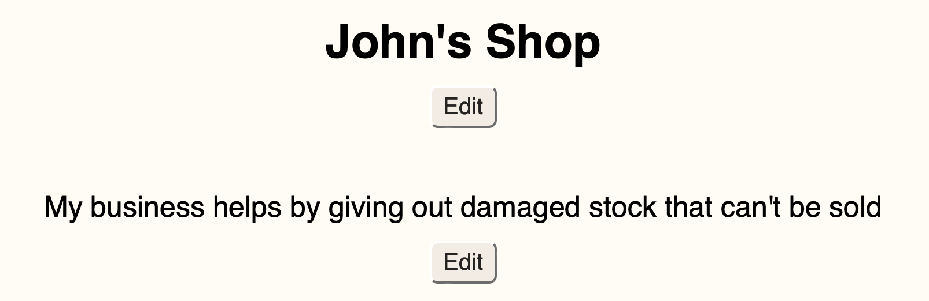
Testing
 | Feature | Input Operations | Expected outcome | Pass/Fail
6 | Edit business information: a business updates their name and information | Navigate to the my business page Select edit under their name/info Enter new name/info e.g. “John’s Corner Shop” Click “Save” | The business’s name/info should be updated | Pass
Evidence of Testing
Before editing

Slide 31
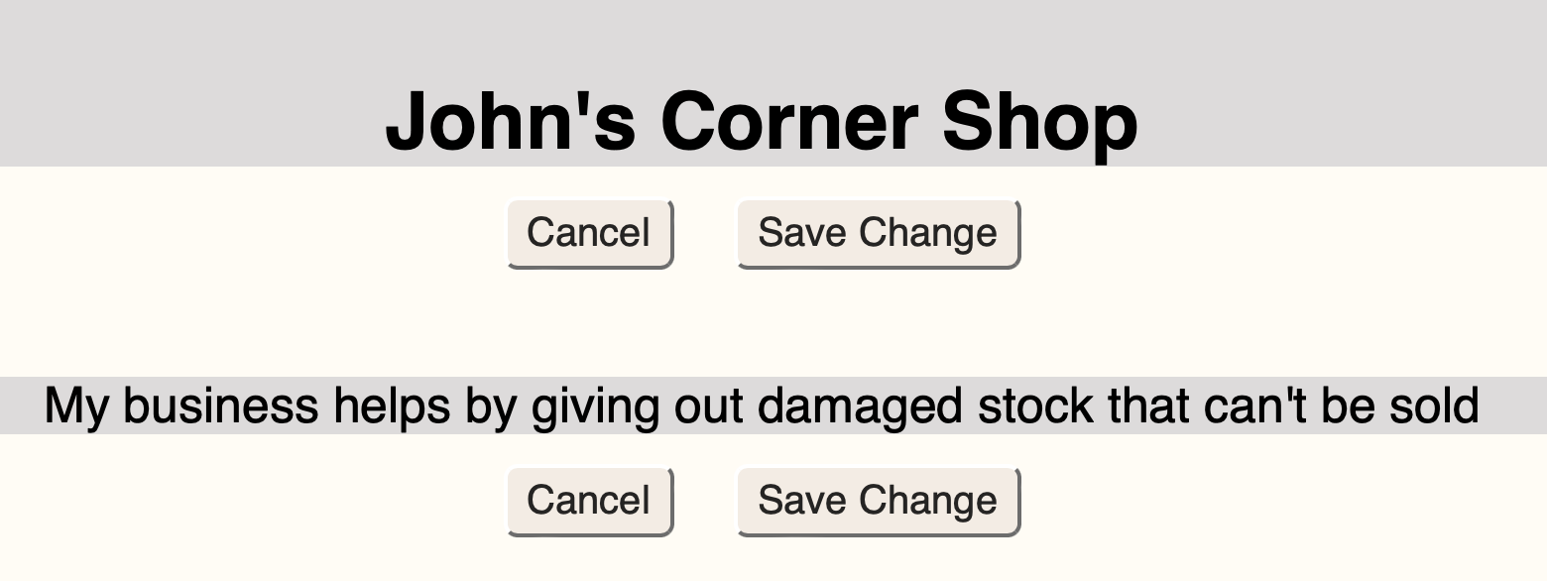
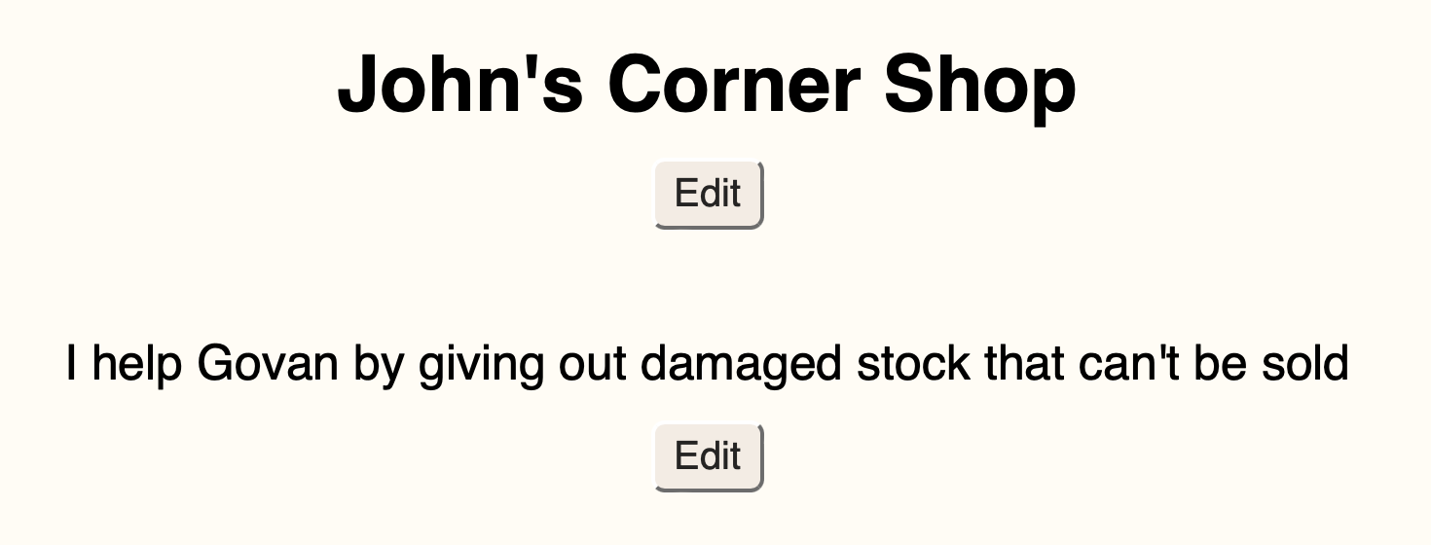
Testing
During editing
After editing

Slide 32
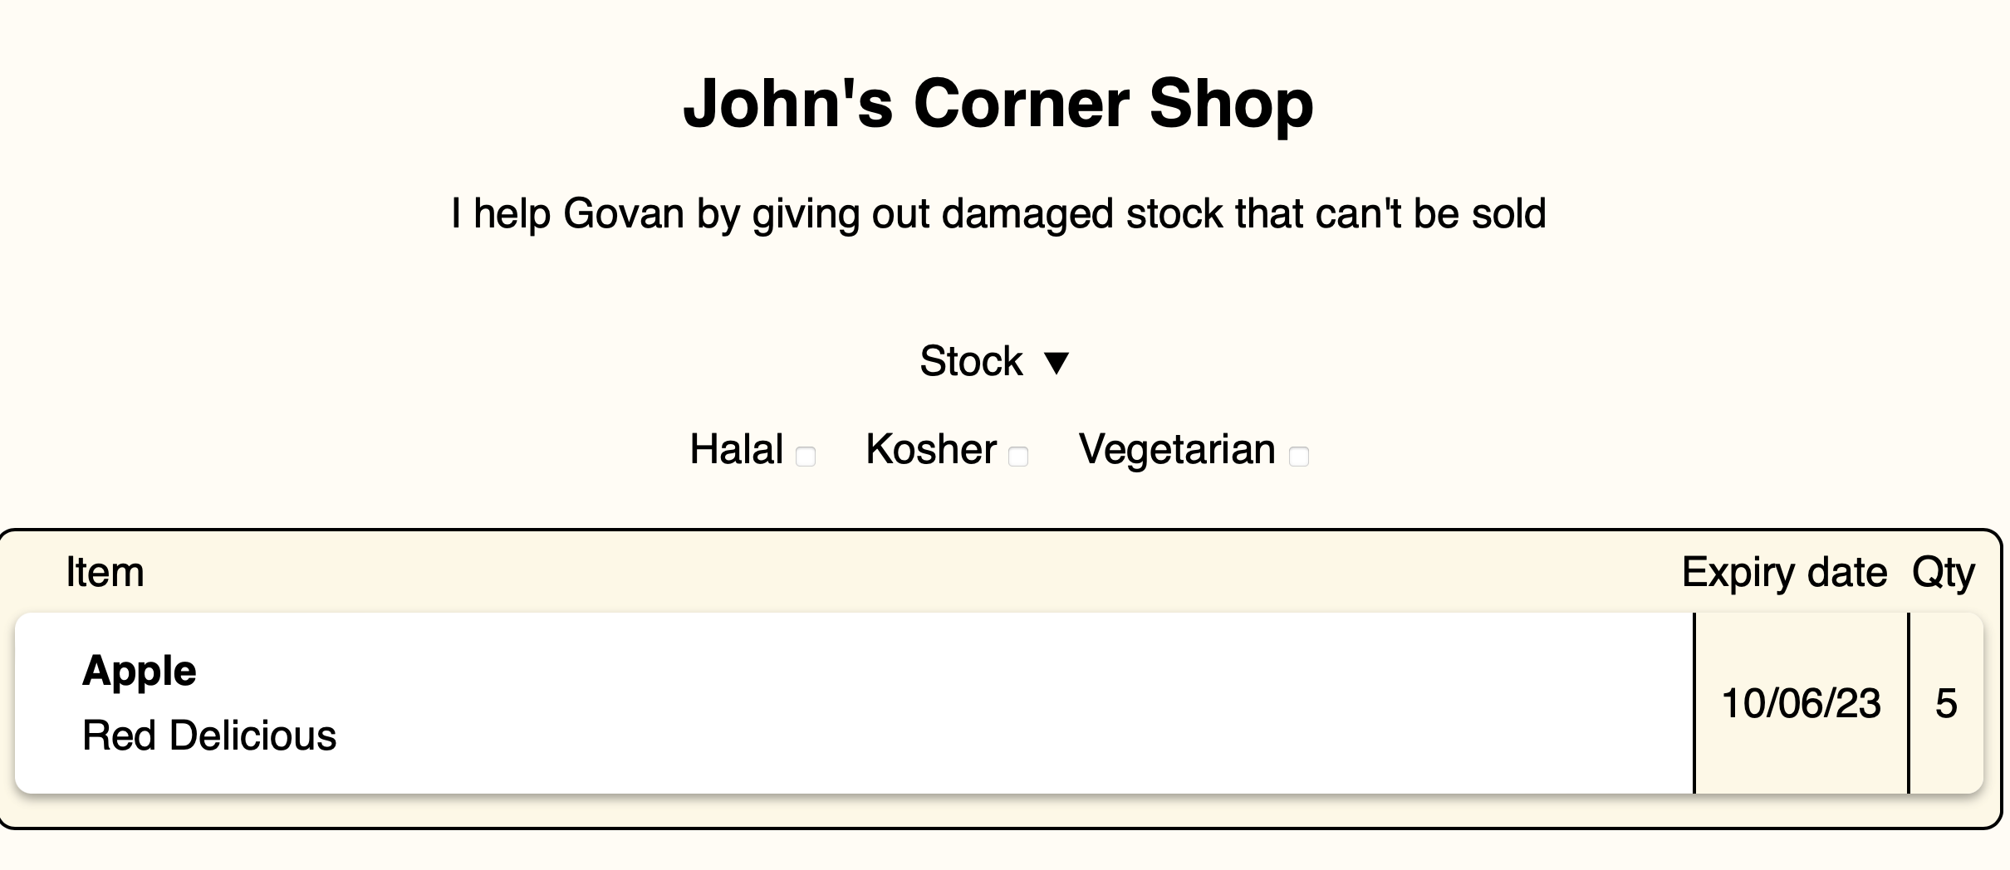
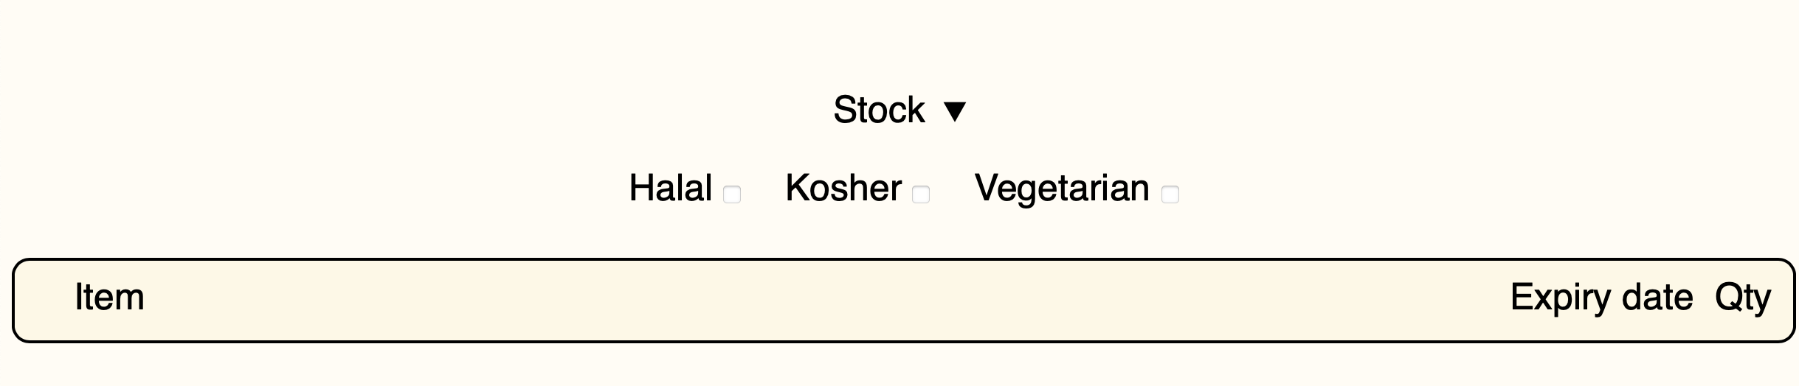
Testing
 | Feature | Input Operations | Expected outcome | Pass/Fail
7 | View stock: a user wants to view the stock of a business | Navigate to the food page Select “John’s Corner Shop” Go to the bottom of the page to view the stock | The stock of the selected business to be displayed | Pass
Evidence of Testing
Selected business
No business selected

Slide 33
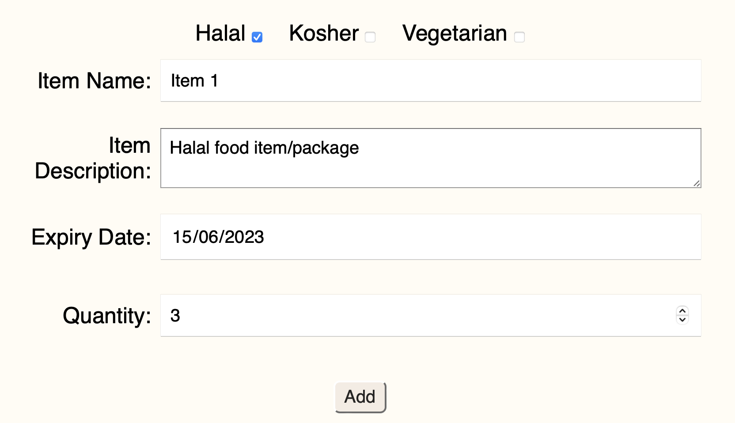
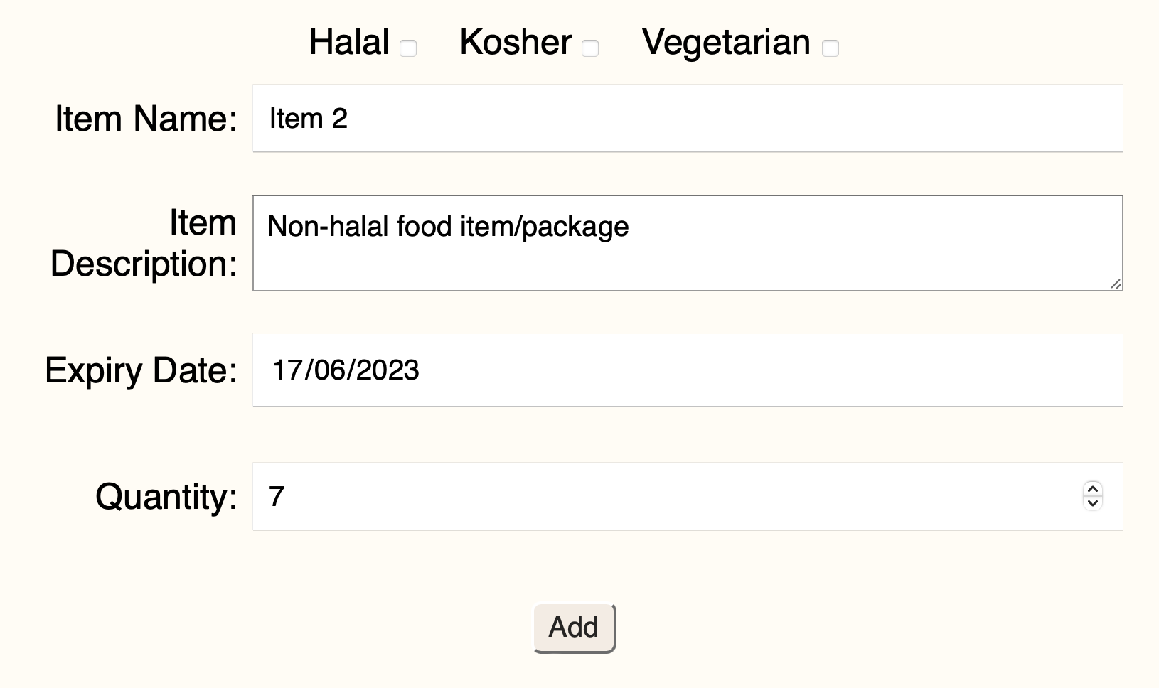
Testing
 | Feature | Input Operations | Expected outcome | Pass/Fail
8 | Food Filter: the user selects a filter and the stock table is updated | Add two new items to the stock of a business, selecting “Halal” for one and nothing for the other Select that business from the list on the food page Select “Halal” on the filter | Both items should be displayed when no filter is selected and only the halal item should be displayed when the filter is selected | Pass
Evidence of Testing
Both items are added

Slide 34
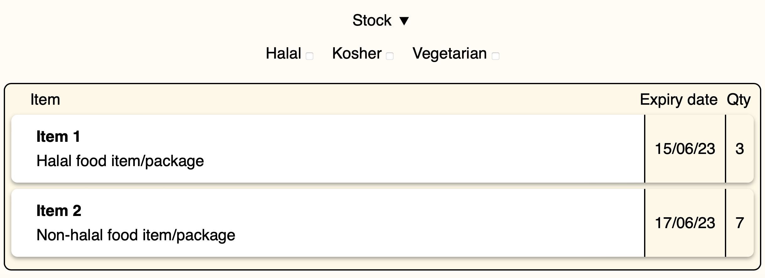
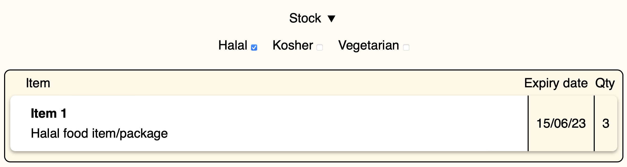
Testing
No filter selected
Halal filter selected

Slide 35


Testing
 | Feature | Input Operations | Expected outcome | Pass/Fail
9 | Donation: a user tries to submit a donation without being signed into an account | Logout (if signed in) Navigate to the donate page Try to submit a donation | A message should be displayed telling the user to login | Pass
Evidence of Testing
When the user is not logged in
When the user is logged in

Slide 36
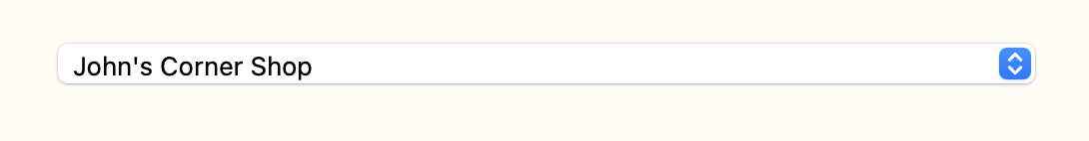
Testing
 | Feature | Input Operations | Expected outcome | Pass/Fail
10 | Donation: a user wants to donate to a business | Navigate to the donate page Select a business to donate to Enter “Bread” “White sliced bread” “12/06/23” “1” and click “Add” Enter “Beans” “Tinned Heinz beans” “17/05/24” “2” and click “Add” Click “Submit” | The donation should be added to the “expected donations” of the business | Pass
Evidence of Testing
Business selected

Slide 37
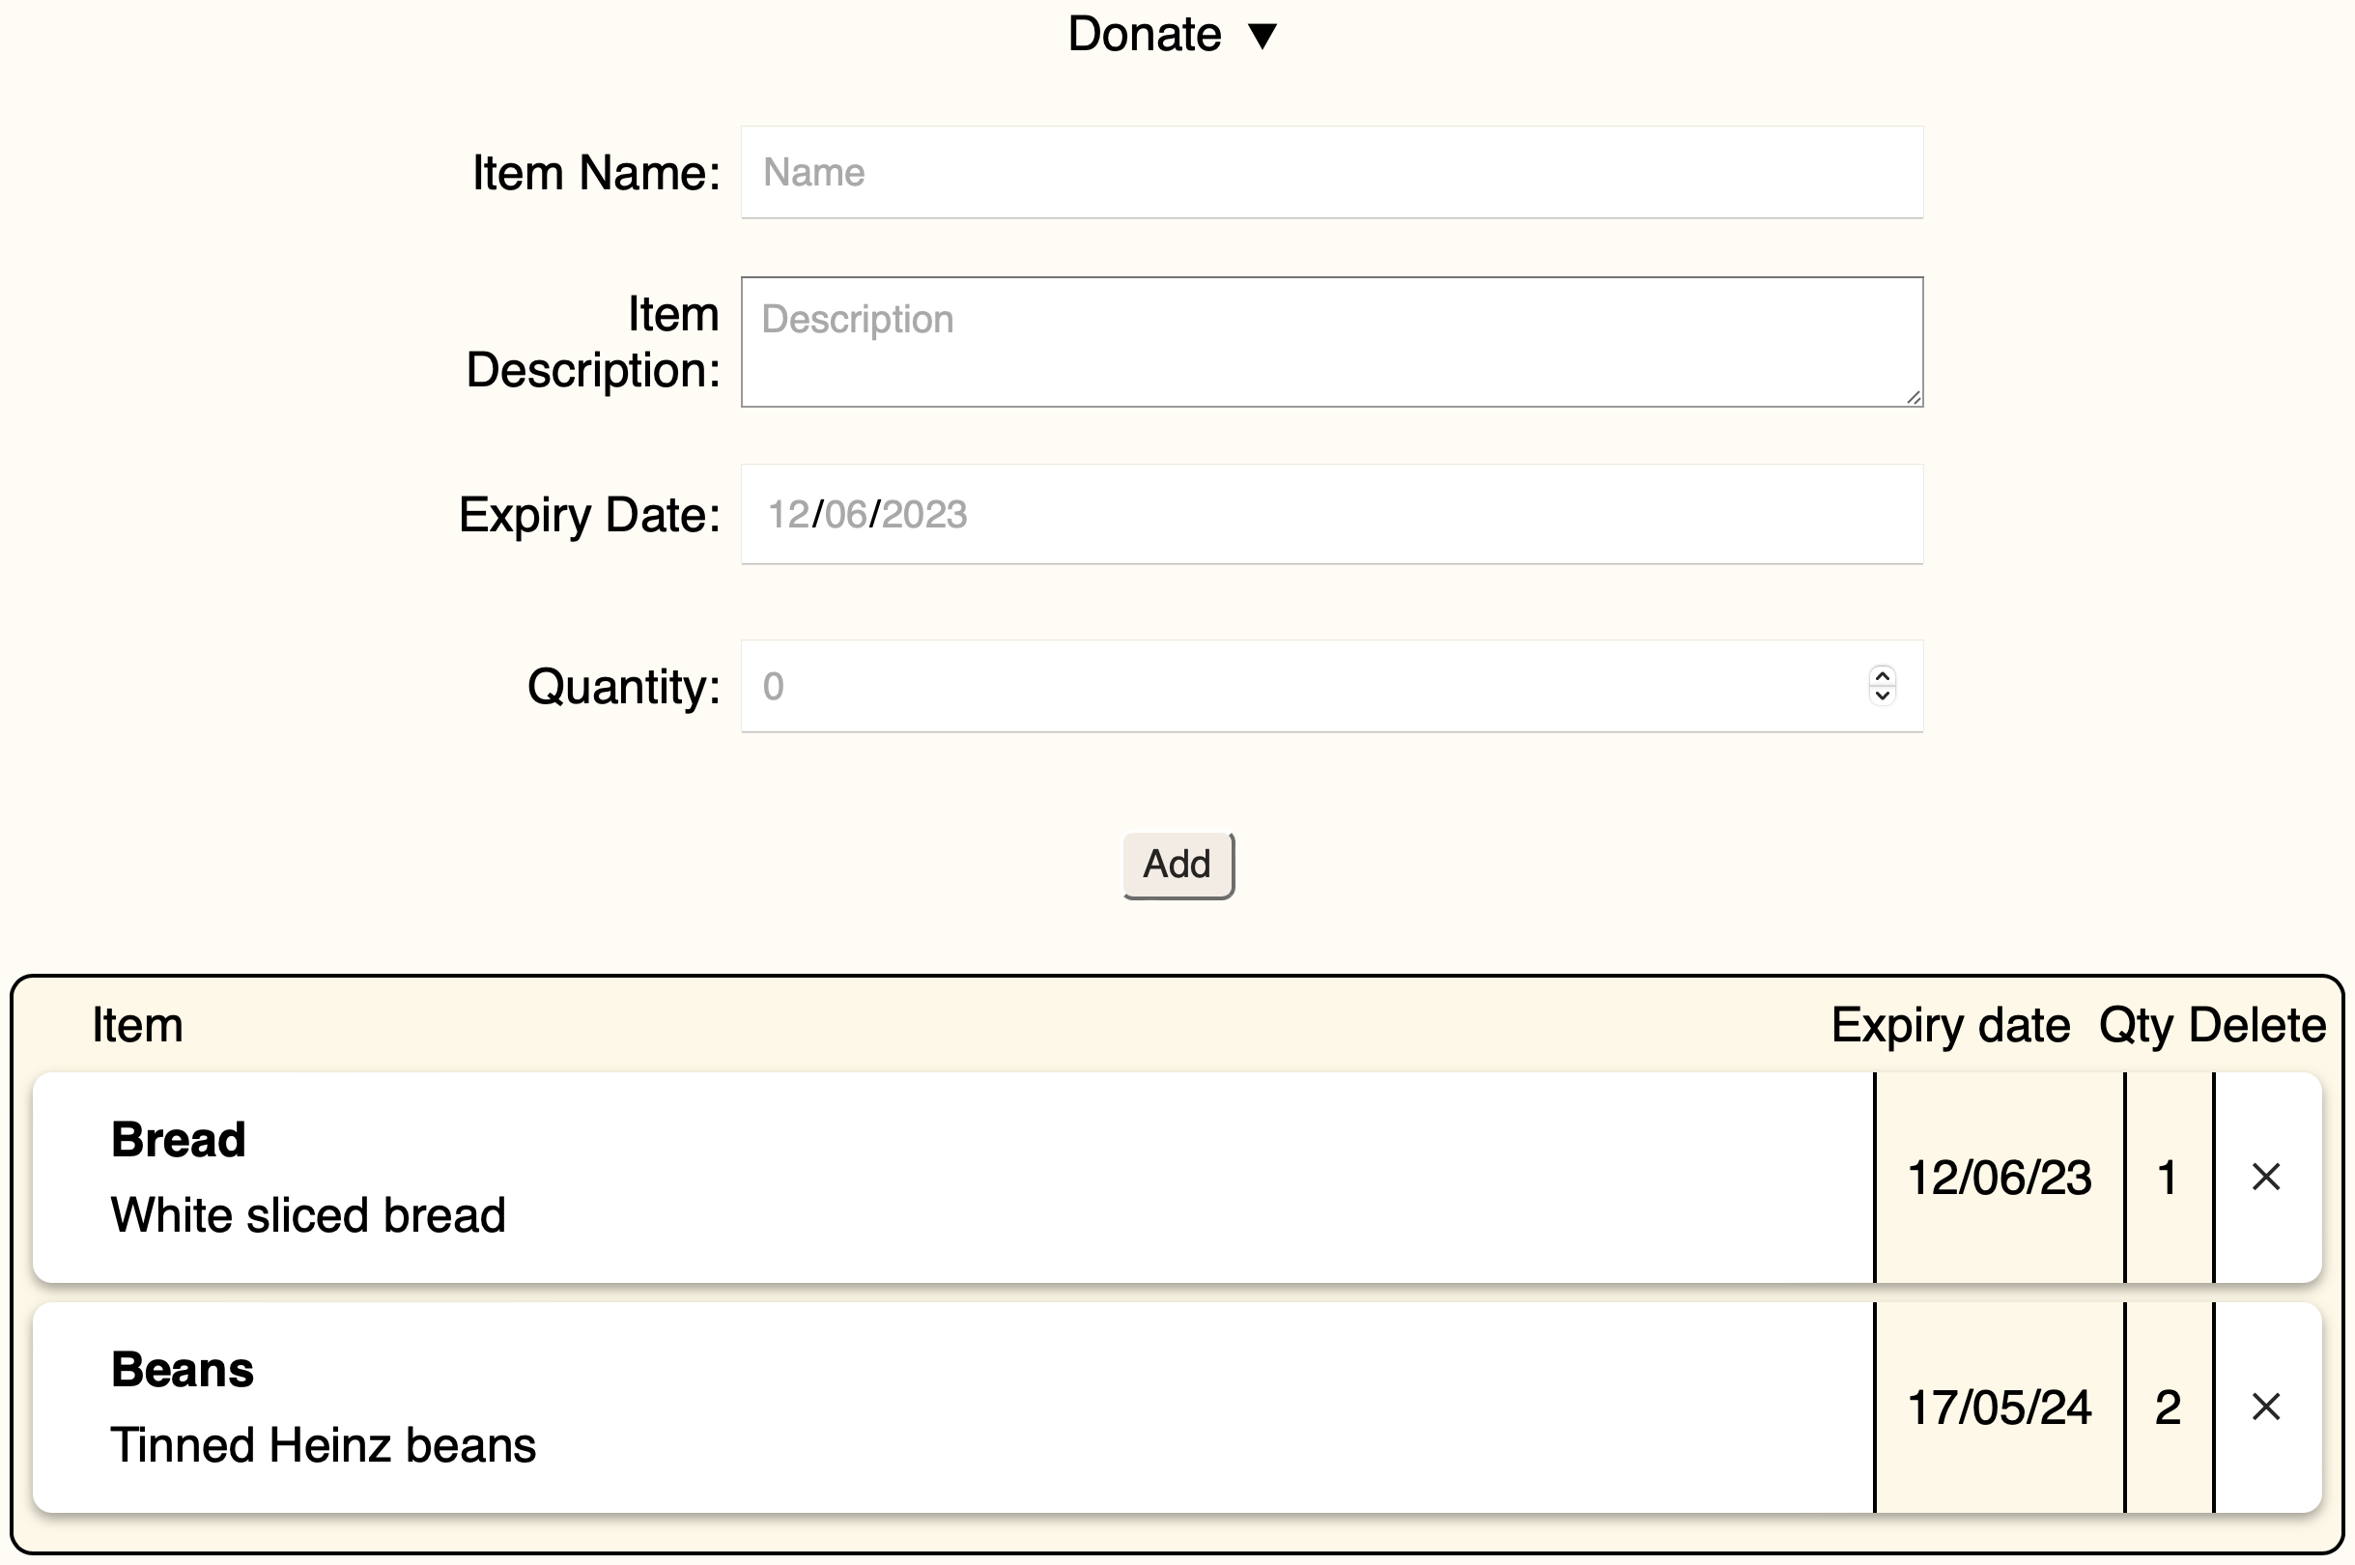
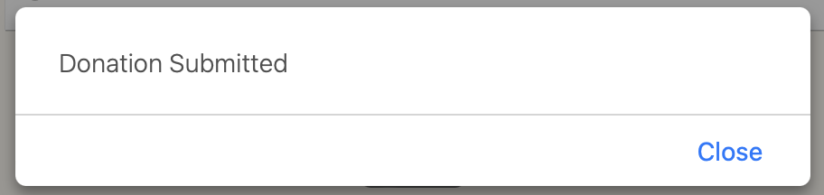
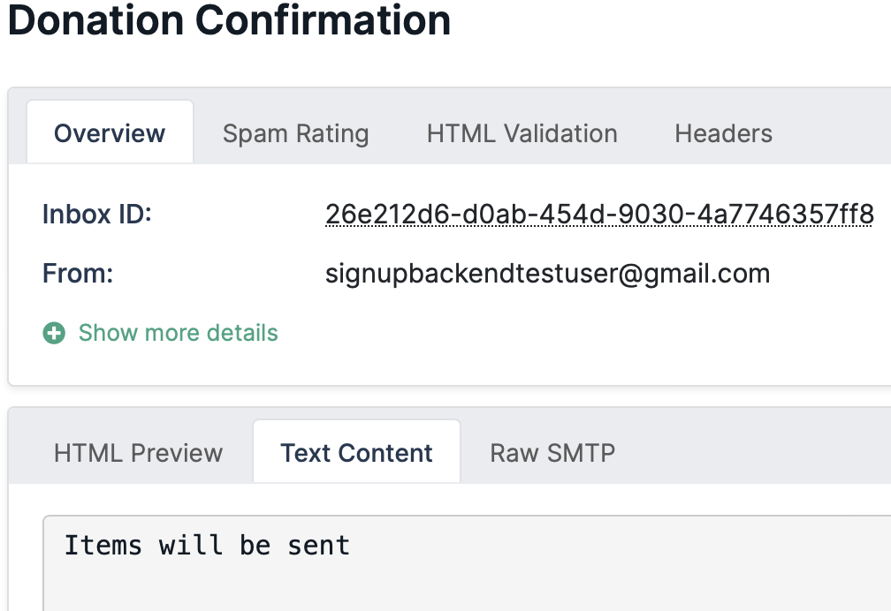
Testing
Items added to donation
Donation submitted

Slide 38
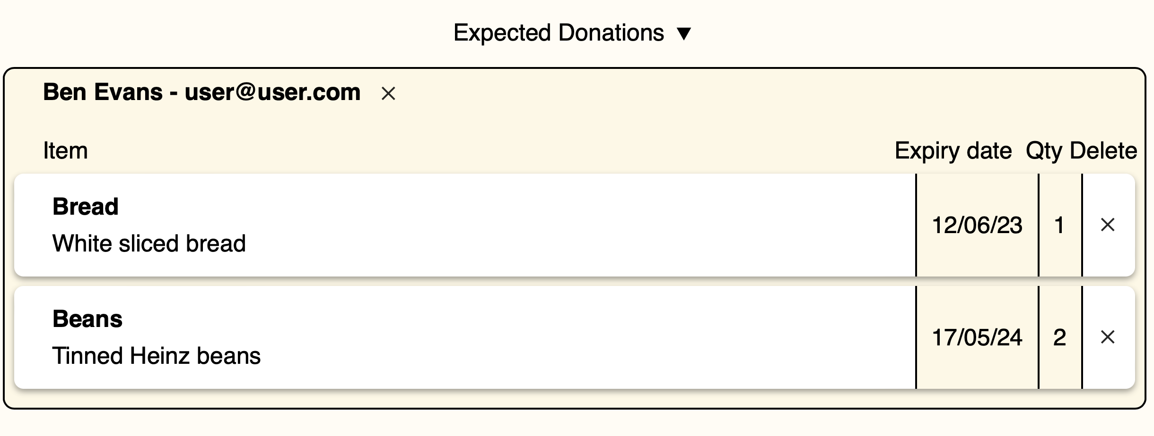
Testing
 | Feature | Input Operations | Expected outcome | Pass/Fail
11 | Expected donations: a business wants to view items that people intend on donating | Navigate to the my business page Scroll down to “expected donations” | All donations should be displayed | Pass
Evidence of Testing

Slide 39
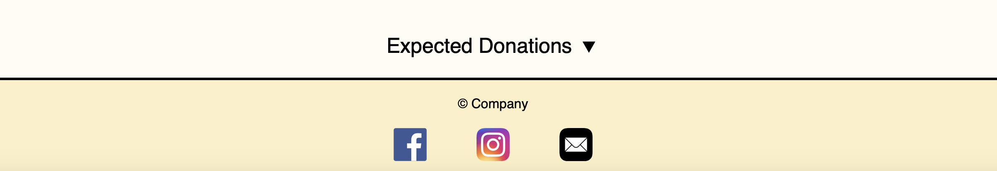
Testing
 | Feature | Input Operations | Expected outcome | Pass/Fail
12 | Business removes donation: a business can delete an expected donation from it’s page | Navigate to the my business page Scroll down to “expected donations” Click on the remove button | The donation should be deleted | Pass
Evidence of Testing
Before pressing “X”
After pressing “X” at top – entire donation removed

Slide 40
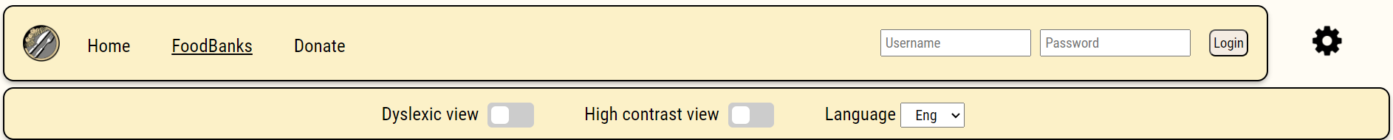
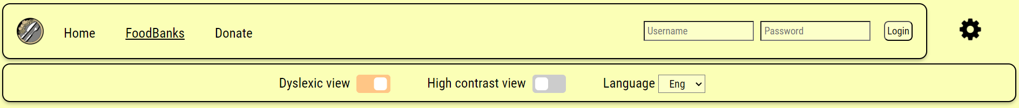
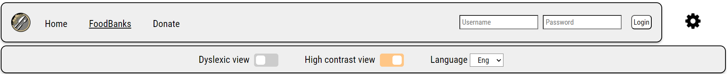
Testing
 | Feature | Input Operations | Expected outcome | Pass/Fail
12 | Accessibility: the user changes the view from normal to dyslexic or high contrast | Click the settings cog Click the “Dyslexic view” button Click the “High contrast view” button | The dyslexic view should be enabled and then the high contrast view should be enabled | Pass
Evidence of Testing

Slide 41
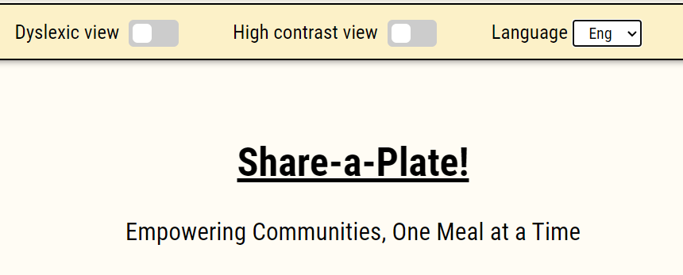
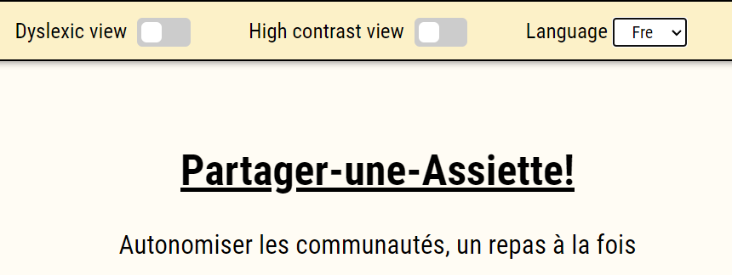
Testing
 | Feature | Input Operations | Expected outcome | Pass/Fail
12 | Translation: the user translates the website into a different language | Click the settings cog Click the language dropdown Select “French” | The website should be translated into the selected language | Fail – only first paragraph translated, implemented as proof of concept
Evidence of Testing
Default language “English”
“French” language selected

Slide 42
User feedback
Emily Parker
Logan Hughes
Friend from another course, 21 years old
Housemate, 20 years old
Liked
Disliked
Liked
Disliked
Good navigation
Pretty colour scheme
Not a modern design, buttons seemed boring
Vast accessibility options
Nice animations
Slightly cramped layout of table on donate page

Slide 43
User testing
Emily Parker
Logan Hughes
As a business owner
As an admin
 | What is being tested | Pass/ Fail
1 | Register business X | Pass
3 | Change the title of business X | Pass
5 | Update Stock X | Pass
 | What is being tested | Pass/ Fail
2 | Accept business X signup | Pass
4 | Donate stock to business X | Pass
6 | Remove stock from business X | Pass
Liked

Slide 44
Improvements
Allow users to change their details
Automate approving businesses - so an admin is not required
Fully implement translation feature
Improve email message

