Slide 1
CMEMS IBI User & Training Workshop

Slide 2
In Situ TAC

Slide 3
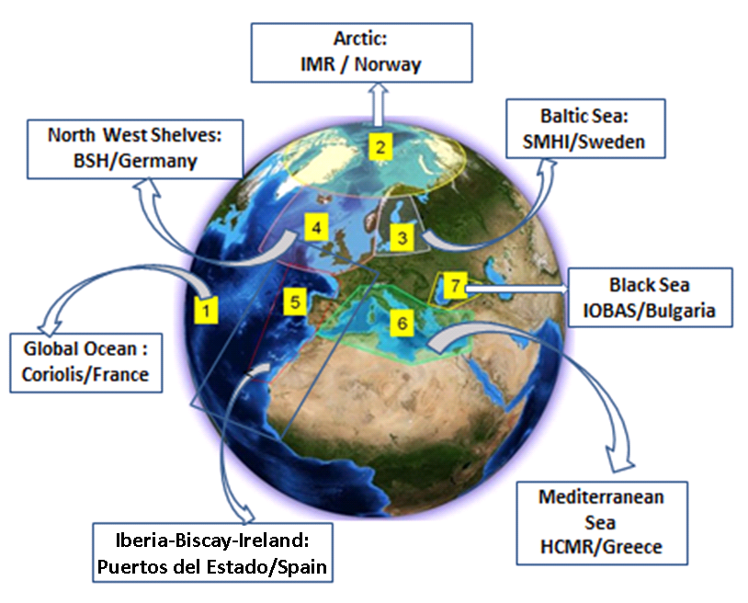
In Situ TAC: Organization

Slide 4
In Situ TAC: Organization
In Situ TAC:
7 Components: Global + 6 regions (Arctic, Baltic, NWS, IBI, MED and BlackSea).
Same data format (NetCDF - OceanSites 1.2)
Same FTP structure
Same RTQC & quality indexes

Slide 5
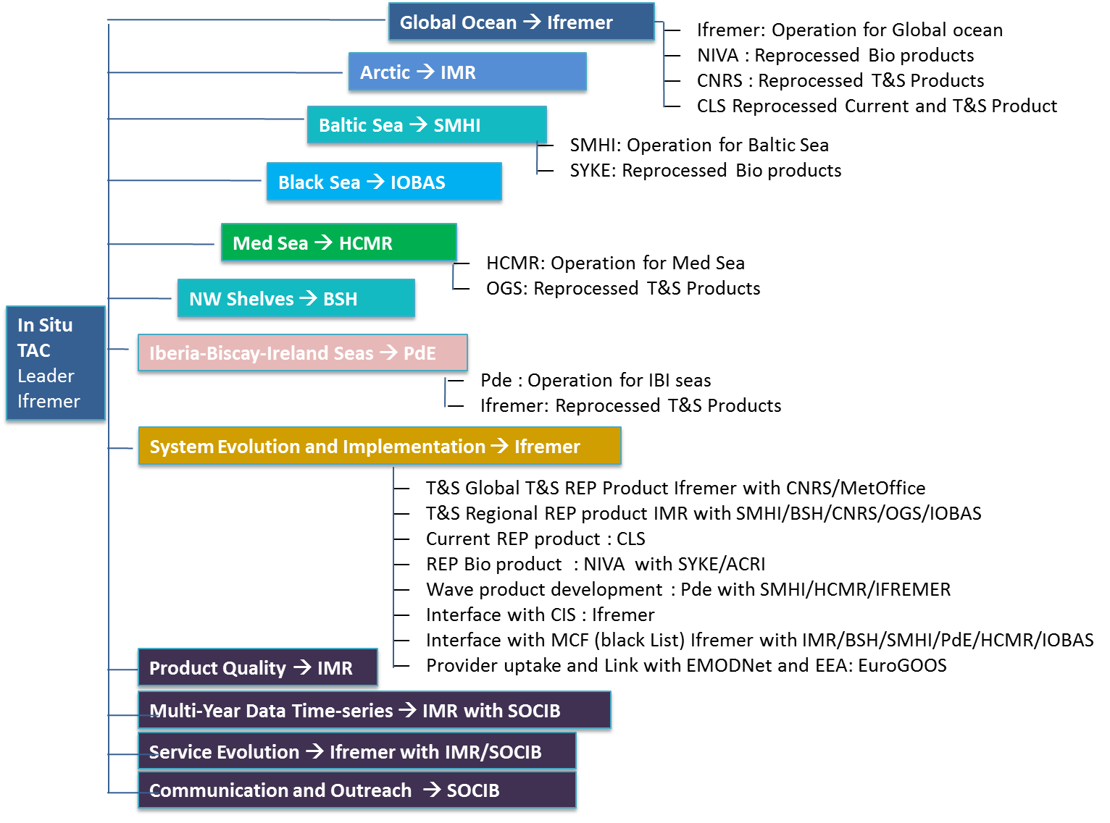
In Situ TAC: Work breakdown structure

Slide 6
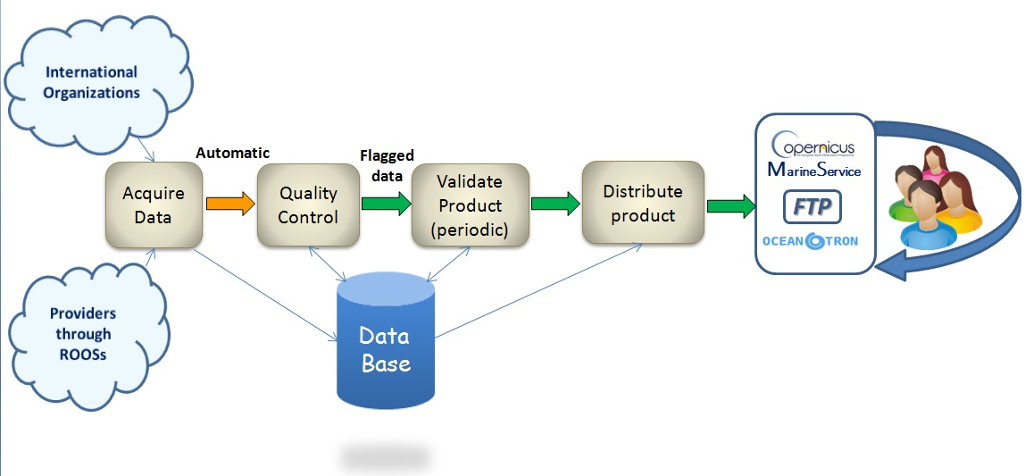
In Situ TAC: Implemented functions

Slide 7
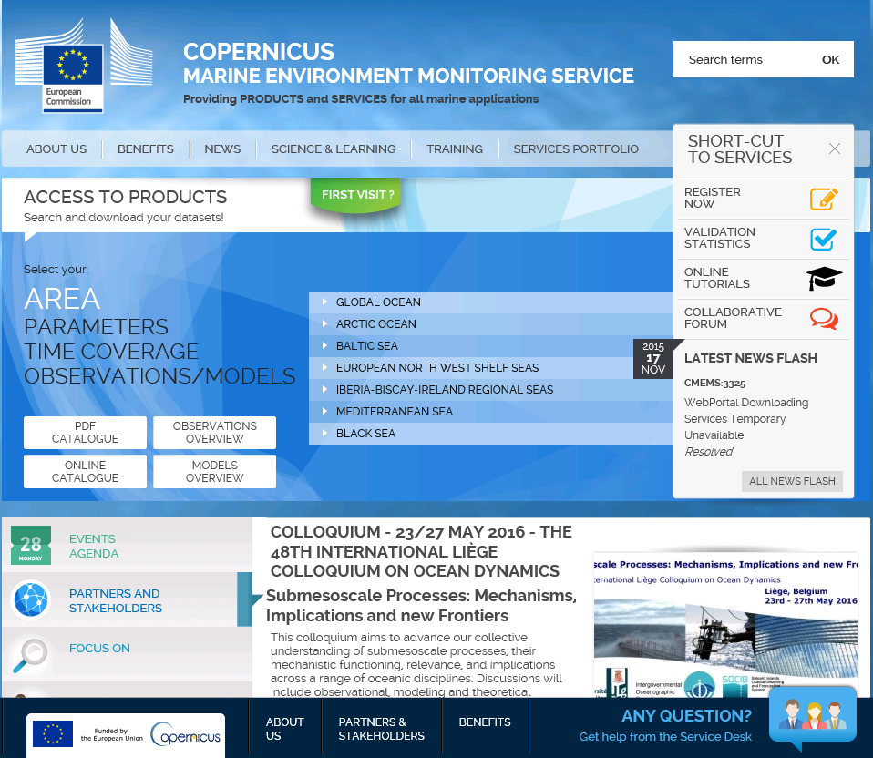
In Situ TAC: Data Access
Copernicus catalogue: http://marine.copernicus.eu/

Slide 8
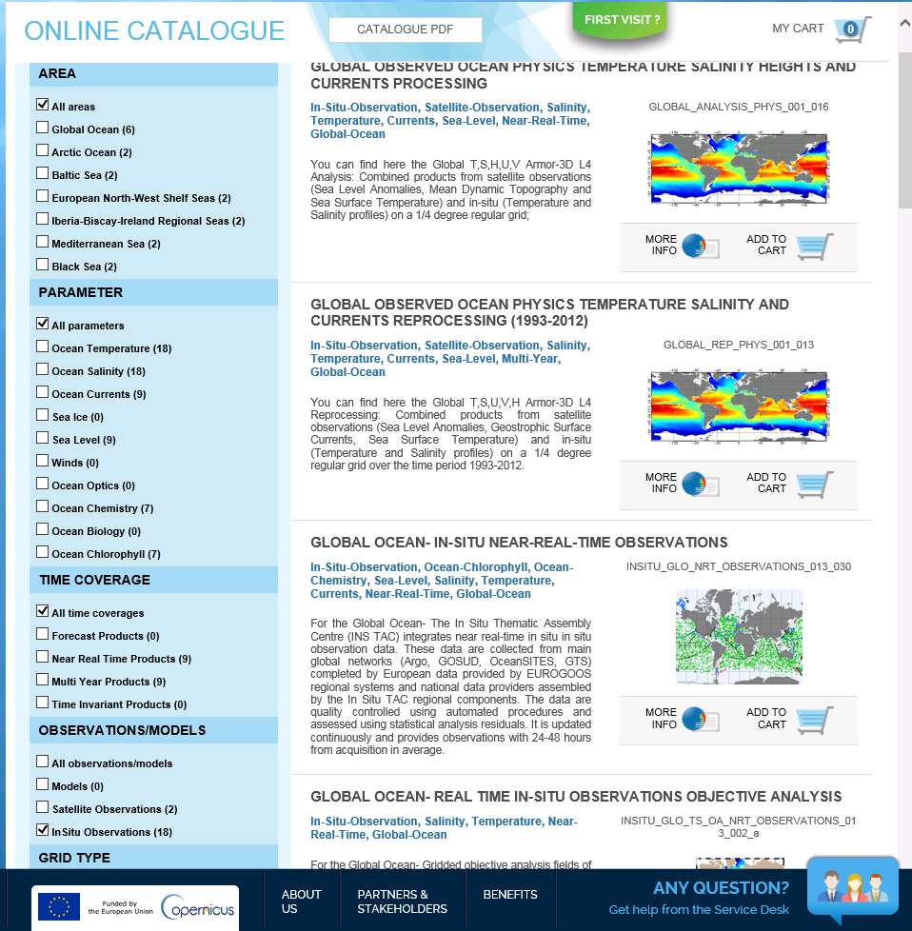
In Situ TAC: Data Access

Slide 9
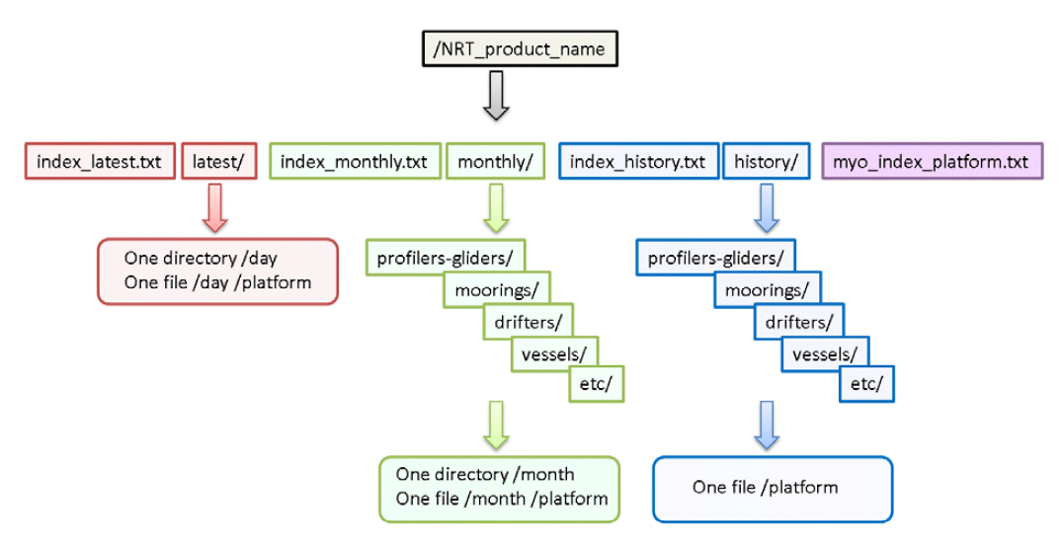
In Situ TAC: FTP structure
MyOcean – Copernicus user & passwd

Slide 10
In Situ TAC: index files
index_latest.txt
# Title : in-situ observations catalog
# Description : catalog of available IBI in-situ observations per platform.
# Project : MyOcean (generated by Puertos del Estado-SPAIN).
# Format version : 1.1.
# Date of update : 20151120072253
# product_id,file_name,geospatial_lat_min,geospatial_lat_max,geospatial_lon_min,geospatial_lon_max,time_coverage_start,time_coverage_end, provider,date_update,data_mode,parameters
MYO_IBIROOS_01,ftp://arcas.puertos.es/Core/INSITU_IBI_NRT_OBSERVATIONS_013_033/latest/20151109/GL_LATEST_PR_GL_58970_20151109.nc,43.3013,43.38,7.91735,8.03727,2015-11-09T01:19:34Z,2015-11-09T22:43:07Z,INSU Institut National des Sciences
de l'Univers,2015-11-17T08:12:15Z,R,DC_REFERENCE PRES CNDC TEMP_DOXY CDOM TEMP PSAL
MYO_IBIROOS_01,ftp://arcas.puertos.es/Core/INSITU_IBI_NRT_OBSERVATIONS_013_033/latest/20151110/GL_LATEST_PR_GL_58970_20151110.nc,43.2865,43.3531,7.91254,8.0125,2015-11-10T01:02:48Z,2015-11-10T23:49:14Z,INSU Institut National des Sciences de l'Univers,2015-11-17T08:13:24Z,R,DC_REFERENCE PRES CNDC TEMP_DOXY CDOM TEMP PSAL
MYO_IBIROOS_01,ftp://arcas.puertos.es/Core/INSITU_IBI_NRT_OBSERVATIONS_013_033/latest/20151022/IR_LATEST_TS_MO_13130_20151022.nc,28.19336,28.19824,-15.79834,-15.79102,2015-10-22T00:00:00Z,2015-10-22T23:00:00Z,Puertos del Estado (Spain), 2015-10-24T18:10:03Z,R,DEPH VTDH VTZA VDIR ATMS DRYT WSPD WDIR HCSP HCDT TEMP PSAL
MYO_IBIROOS_01,ftp://arcas.puertos.es/Core/INSITU_IBI_NRT_OBSERVATIONS_013_033/latest/20151023/IR_LATEST_TS_MO_13130_20151023.nc,28.18848,28.19824,-15.80078,-15.79102,2015-10-23T00:00:00Z,2015-10-23T23:00:00Z,Puertos del Estado (Spain),2015-10-25T18:10:02Z,R,DEPH VTDH VTZA VDIR ATMS DRYT WSPD WDIR HCSP HCDT TEMP PSAL
myo_index_platform.txt
# Title : in-situ platforms catalog
# Description : catalog of available IBI in-situ platforms.
# Project : MyOcean (generated by Puertos del Estado-SPAIN).
# Format version : 1.0.
# Date of update : 20151120074057
# platform_code,creation_date,update_date,wmo_platform_code,data_source,institution,institution_edmo_code,parameter,last_latitude_observation, last_longitude_observation,last_date_observation
1900602,2010-01-01T00:00:00Z,2014-12-13T20:56:01Z,1900602,GL_LATEST_TS_PF_1900602 GL_XXXXXX_TS_PF_1900602,IFREMER,1054,DC_REFERENCE POSITIONING_SYSTEM PRES TEMP PSAL,9.96921E36,9.96921E36,2013-04-23T21:36:58Z
1900616,2010-01-01T00:00:00Z,2013-04-06T11:39:35Z,1900616,GL_LATEST_TS_PF_1900616 GL_XXXXXX_TS_PF_1900616,SHOM,540,DC_REFERENCE POSITIONING_SYSTEM PRES PRES_ADJUSTED TEMP PSAL,48.857,-10.431,2010-09-07T12:35:27Z
62024,2010-01-01T00:00:00Z,2015-11-20T06:10:03Z,62024,IR_LATEST_TS_MO_62024 IR_XXXXXX_TS_MO_62024,Puertos del Estado (Spain),2751,DEPH VTDH VTZA VDIR ATMS DRYT WSPD WDIR HCSP HCDT TEMP PSAL,43.645,-3.04443,2015-11-20T05:00:00Z
62092,2010-01-01T00:00:00Z,2015-11-20T06:10:03Z,62092,IR_LATEST_TS_MO_62092 IR_XXXXXX_TS_MO_62092,Marine Institute (Ireland),396,DEPH VTDH VTZA WSPD WDIR,51.2162,-10.5506,2015-11-20T04:00:00Z

Slide 11
In Situ TAC: File naming
Data types
• BA data from Bathy messages on GTS
• CT CTD profiles
• DB Drifting buoys
• FB FerryBox
• GL Gliders
• MO Fixed buoys or mooring time series
• PF Profiling floats vertical profiles
• RE Recopesca
• RF River flows
• TE data from TESAC messages on GTS
• TS Thermosalinographs
• XB XBT or XCTD profiles
File naming convention in the latest directory:
• RR_LATEST_XX_YY_CODE_YYYYMMDD.nc
• RR: region bigram
• LATEST: fixed name
• XX: TS (timeserie) or PR (profile)
• YY: data type
• CODE: platform code
• YYYYMMDD: year month day of observations
• .nc: NetCDF file name suffix
Example: GL_LATEST_PR_GL_58970_20151112.nc
File naming convention in the monthly directory:
• RR_YYYYMM_XX_YY_CODE.nc
• RR: region bigram (see table 2)
• YYYYMM : measurement date (YearMonth : 200901)
• XX: TS (timeserie) or PR (profile)
• YY: data type
• CODE: platform code
• .nc : NetCDF file name suffix
Example: IR_201510_TS_MO_62024.nc
Region bigram
• GL Global
• AR Arctic
• BO Baltic
• NO North West Shelf
• IR IBI (Iberia-Biscay-Ireland)
• MO Mediterranean
• BS Black Sea

Slide 12
In Situ TAC: IBI component

Slide 13
IBI INSTAC ORGANIZATION
Operations. Roles & responsibilities:
Puertos del Estado: Coordination. NRT production and validation (fixed stations). Waves REP development and assessment (Task 3.3).
Ifremer: Contribution to the NRT production and validation for Lagrangian and underway platforms. T&S REP product assessment.
Institute | Coordination | Dissemination Unit DU | Production Unit PU | Product Quality NRT Assessment | Product Quality multi-year assessment (REP)
Puertos del Estado (PdE) | IBI | IBI | IBI MED | IBI | IBI (Waves)
Ifremer |  |  | IBI | IBI | IBI (T&S)

Slide 14
IBI INSTAC: Providers
Fixed stations (Moorings)
Buoys
Tide Gauges,
Platforms,
Lightships,
River flow stations
Providers
Spain:
Puertos del Estado, IEO, Euskalmet, Xunta Galicia
Portugal:
Instituto Hidrografico, University of Azores
France:
SHOM, Meteofrance, Ifremer, CETMEF, CEREMA
Ireland:
Marine Institute
UK:
UKMO, POL, CEFAS
Lagrangian and underway stations:
Profilers-gliders:
ARGO, CTD, Gliders, XBT and other profiles
Drifters
Vessels
Providers
EuroARGO (BSH, IEO, Ifremer, RNMI, UKMO, MI, SHOM, LOV,…)
Data from GTS (Global Telecommunication System)
SeaDataNet (Historical)
Non European: NOAA, WOODS HOLE O.I., Univ. Washington, US Navy, Inst. Ocean Sciences Victoria,…
PLOCAN, Univ. College, SOCIB, IRD Brest, IRISH SHIPPING LTD, SBR, INSU,…

Slide 15
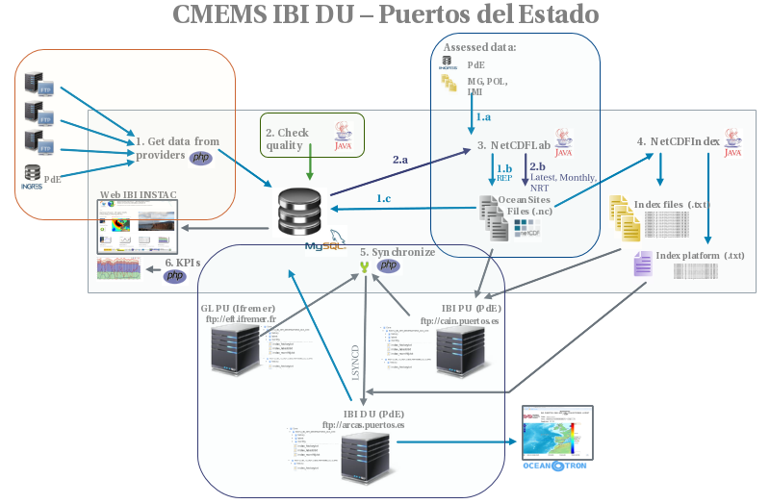
IBI INSTAC: Data flow
Updates every 3 hours

