Slide 1
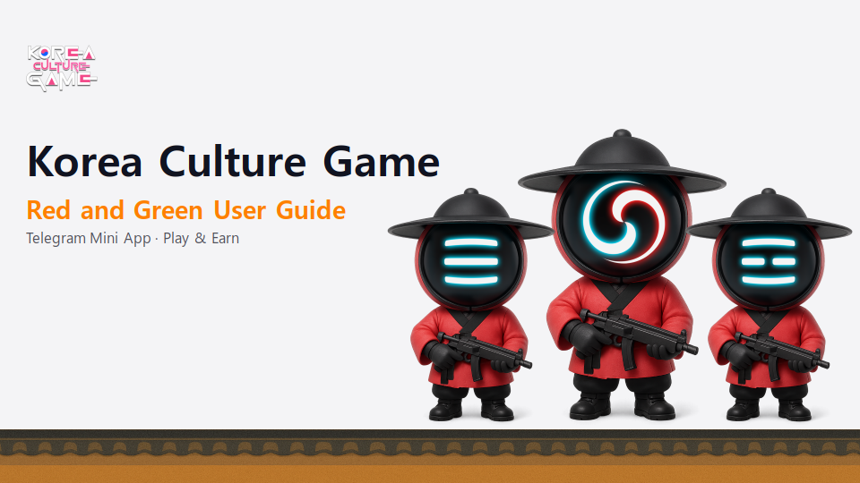

Slide 2
Index
Korea Culture Game Play
Creating a Wallet
Connecting Wallet (Game to Wallet)

Slide 3
1. Korea Culture Game Play – Earn
Ruby: Current 'Ruby' holdings.
Point: Current 'Point' holdings.
HP: Current maximum 'HP' holdings.
TOUCH: Tap to move characters (multi-finger support).
AUTO OFF/ON: Tap to toggle 'Auto' game mode.
earn: Game Screen.
exchange: Exchanging points or tokens.
boost: Upgrading a character's abilities.
point: Earning points.
help: Get answers to your questions on our homepage.

Slide 4
1. Korea Culture Game Play – Exchange
Exchange your points for KCG.
When entering points, you will see KCG available for redemption.
Enter wallet address and click Confirm button to send KCG.
Exchange your KCG holdings for points.
When entering KCG, you will see the points available for redemption.
If the wallet created through the user guide does not have KCG, it will not be displayed.
If you don't have KCG, you can transfer KCG to a wallet created through the user guide (try sending KCG using a different wallet address).

Slide 5
1. Korea Culture Game Play – Boost
HP: Options to increase HP.
Multi tap: Options to increase points with a single tap.
Assist: Option to increase your character's speed by up to 4x.

Slide 6
1. Korea Culture Game Play – Point
Mission: Earn 10,000 points for watching ads.
Referral: Earn 50,000 points for inviting friends.
Buying Ruby: Buy Ruby with TON coin.
Ruby is used to level up at levels 50, 55, 60, 65, 70, 75, 80, 85, 90, 95, 100 (intermediate laps are leveled with points).

Slide 7
2. Creating a Wallet – Step 1
Search for @wallet and click START.
Click the Open Wallet button.
Agree and move on to the next step.

Slide 8
2. Creating a Wallet – Step 2
Click the Let's go button.
Select TON Space and click Create New Wallet button.
Click Back Up via Email button.
Input your email and click Continue button.

Slide 9
2. Creating a Wallet – Step 3
Check your email and enter your email code.
Click View TON Space button.
Check the created wallet.

Slide 10
3. Connecting Wallet (Game to Wallet)
Click Connect Wallet button in the Buying Ruby category.
Click Connect Wallet in Telegram button.
Click Connect button.
Wallet is connected.

