Slide 1



A Do-it-Yourself
High-Assurance Compiler
Lee Pike Nis Wegmann Sebastian Niller Alwyn Goodloe | Galois, Inc. <leepike@galois.com> Technical University of Coppenhagen Unaffiliated NASA Langley Research Center

Slide 2


Do-It-Yourself

Slide 3

Do-It-Yourself

Slide 4
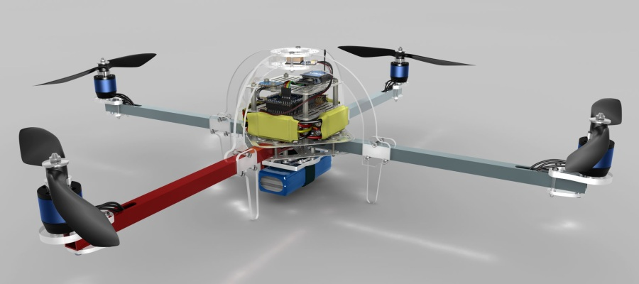

Do-It-Yourself

Slide 5

Do-It-Yourself

Slide 6
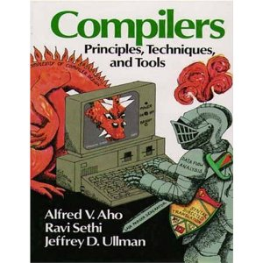
High-Assurance
????
????
????

Slide 7
National Aeronautics
and Space Administration
??

Slide 8
National Aeronautics
and Space Administration

Slide 9
Monitoring constraints
Goal: run-time monitors for software-intensive embedded systems
Runtime monitoring for real-time embedded systems should satisfy the FaCTS:
False-positives: don’t change the target’s behavior
Certifiability: make software re-certification easy
Don't go changing sources
Timing: don’t interfere with the target’s timing
SWaP: don’t exhaust size, weight, power reserves

Slide 10



Software reliability is still a problem
(even in ultra-critical systems)
2005-2008:
Malaysia Airlines Flight 124 (Boeing 777)
  “Software anomaly”
Qantas Airlines Flight 72 (Airbus A330)
  Transient fault in the inertial reference unit
Space Shuttle STS-124 aborted launch
  Bad assumptions about distributed fault-tolerance
Notes:
Flight 124
2005 From Perth to Kula Lampur. Pitched violently up from 38k to 41k. the pilots disengaged the autopilot, and returned to Perth. They reengaged the autopilot briefly, but had to shut it off again due to the same issues. The problem turned out to be failed accelerometers , and a bug that prevented an accelerometer that had been in need of service for months not to be noted for replacement.
Flight 72
2008 Singapore to Perth---pitch down for 200m in 20s. 14 people went to the hospital. Transient fault in the ADIRU system.
Space Shuttle
2008 a fissure in a hardware connection in a distributed system is an unexpected fault in the system design. The fault manifests itself as a Byzantine fault. In the distributed system, there are four fault-tolerant computers. In series, the computers are voted out of the “good clique” in series, until a single computer remained, and a pre-launch abort was required.

Slide 11
Our answer: Copilot
Synthesize monitors
  EDSL
  From high-level specs, generate C99
  Lustre-like stream language → Purely functional Misra-like C
  Constant time: easy to compute WCET
    Scheduler to give fine-grained timing control
    No RTOS needed
Time-triggered monitoring:
  Sample program variables periodically
  Keep histories as needed
  Not addressing control-flow

Slide 12
Sample Copilot specification
fib :: [Word32]
fib = [0, 1] ++ zipWith (+) fib (drop 1 fib)
Haskell
fib :: [Word32]
fib = [0, 1] ++ zipWith (+) fib (drop 1 fib)
Copilot
fib :: Stream Word32
fib = [0, 1] ++ (fib + drop 1 fib)
Special constructs for input (sampling) and output (triggers)

Slide 13
Copilot Architecture
LTL
ptLTL
Regular expressions
clocks
fault-tolerance
etc.
Libraries
Copilot specification
language
Type-checking,
causality analysis,
etc.
Interpreter
Core language
Atom back-end
(C)
SBV back-end
(C)

Slide 14
Copilot: a Run-Time Monitoring DSL
But who watches the watchmen? Copilot has to be correct
No time for “professional” formal methods
Do-it-yourself compiler assurance?

Slide 15
Lessons in DIY Assurance
Turing incomplete languages, Turing complete macros
Multi-level type-checking
Cheap front-end/back-end testing
Unified host language

Slide 16
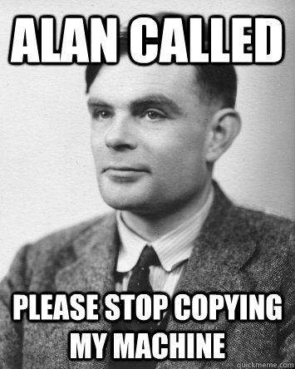
Lesson #1: Turing-Incompleteness
Turing incompleteness means:
  Compiler writing is simplified
  Compiler reasoning is easier (e.g., termination analysis)
  Security is improved
  Formal methods have a chance of working!
Have your cake and eat it, too:
In an embedded DSL, the host
language is Turing-complete!
majority :: [Stream a] -> Stream a
-> Stream Word32 -> Stream a

Slide 17
Lesson #2: Multi-Level Type-Checking
Lean on Haskell's type system as much as possible
  Already powerful: Polymorphism, GADTs, type-safe dynamic typing, etc.
  But ensure you aren't abusing it: Safe Haskell
Then go beyond it, e.g.:
  Productiveness:
  Inputs are consistently typed (e.g., external functional calls)
x :: Stream Word64
x = [0] ++ drop 1 x

Slide 18
Lesson #3: Cheap, High-Quality Testing
Interpreter
Interpreter is the up-to-date semantics
So make sure the back-ends agree
Random program generation (keep the core constructs small)
Test ~1.5M programs/day
QuickCheck
testing
Core language
Atom back-end
(C)
SBV back-end
(C)
CBMC: (C bounded
model-checker)

Slide 19
Lesson #4: Safe, Unified Host Language
Embedded DSLs are a gestalt-shift for safety-critical languages
Few front-end bugs: (no parser, lexer, etc.)
Type-safe translation between DSLs in the same language
  E.g., seemless union of verification languages and programming languages
The macro language is a build system, too!
compile program node
(setCode (Just header)) baseOpts
distCompile program node headers =
compile (program node) node
(setCode (Just (headers node))) baseOpts

Slide 20
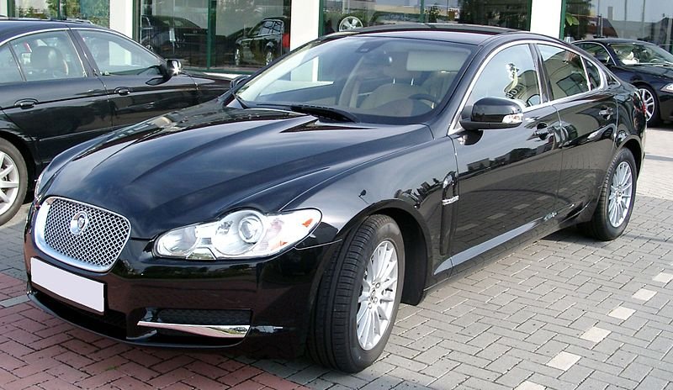
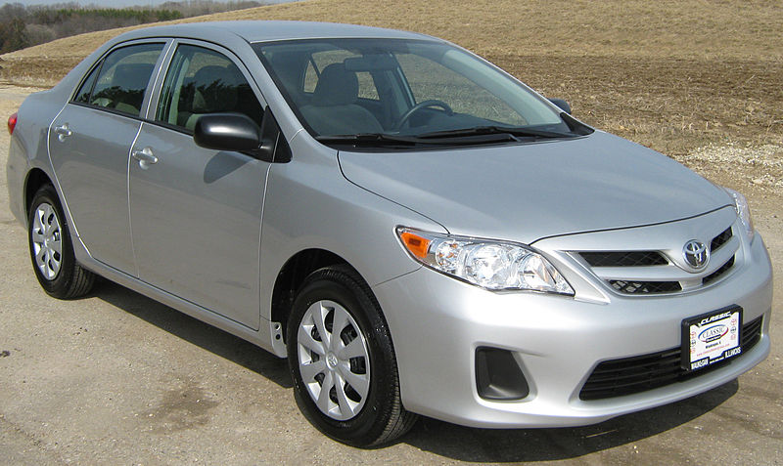
Conclusions
Compiler formal verification
  Expensive
  Specialized
  Hard to make changes
  But flawless when it works
Embedded DSLs
  Quick to prototype
  Easy to change
  Rely on existing infrastructure
  Can still be a bumpy ride...

Slide 22
3 themes and a case-study
RV for ultra-critical systems
  Distributed systems
  Hard real-time systems
  Monitor hardware and software faults
Using functional languages for monitor generation
  embedded domain-specific languages (eDSL)
Low-cost, high assurance
Case-study: aircraft guidance systems

Slide 23
Runtime verification is needed!
How do you know your embedded software won’t fail?
Certification (e.g., DO-178B) is largely process-oriented
Testing exercises a small fraction of the state-space
It's probably not formally verified
  Even if so, just a small subsystem
  And making simplifying assumptions
I'll argue: need the ability to detect/respond at runtime

Slide 24
Copilot Interpreter
evalExpr_ e0 exts locs strms = case e0 of
Const _ x -> x `seq` repeat x
Drop t i id -> strictList $
let Just xs = lookup id strms >>= fromDynF t
in P.drop (fromIntegral i) xs
Local t1 _ name e1 e2 -> strictList $
let xs = evalExpr_ e1 exts locs strms
locs' = (name, toDynF t1 xs) : locs
in evalExpr_ e2 exts locs' strms
Var t name -> strictList $
let Just xs = lookup name locs >>= fromDynF t in xs
ExternVar t name -> strictList $ evalExtern t name exts
Op1 op e1 -> strictList $ repeat (evalOp1 op)
<*> evalExpr_ e1 exts locs strms
Op2 op e1 e2 -> strictList $ repeat (evalOp2 op)
<*> evalExpr_ e1 exts locs strms
<*> evalExpr_ e2 exts locs strms
Op3 op e1 e2 e3 -> strictList $ repeat (evalOp3 op)
<*> evalExpr_ e1 exts locs strms
<*> evalExpr_ e2 exts locs strms
<*> evalExpr_ e3 exts locs strms

Slide 25
Flight Tests

Slide 26
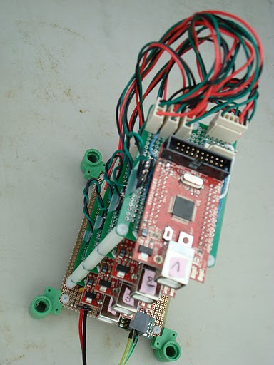
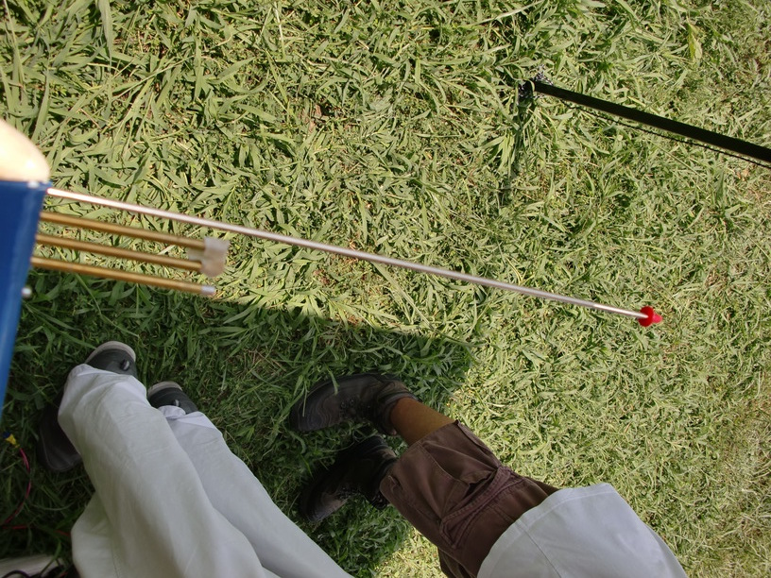
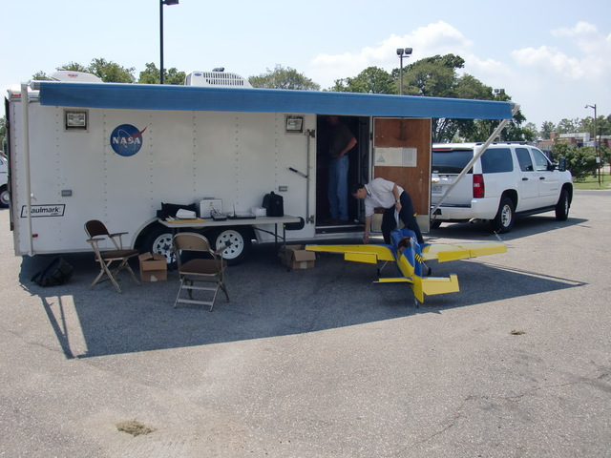
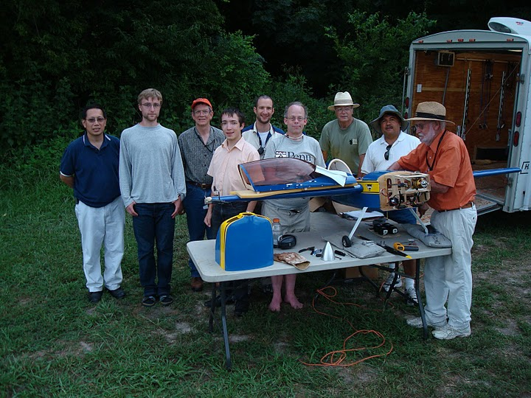
Experiment goals
Monitors to check a distributed airspeed system
Monitors also distributed & real-time
“Bolt-on” fault-tolerance
While satisfy timing, certifiability, SWaP goals
Inject both physical and software faults

Slide 27
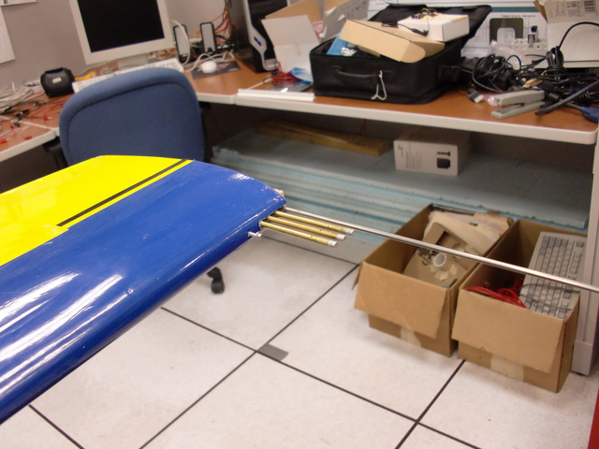
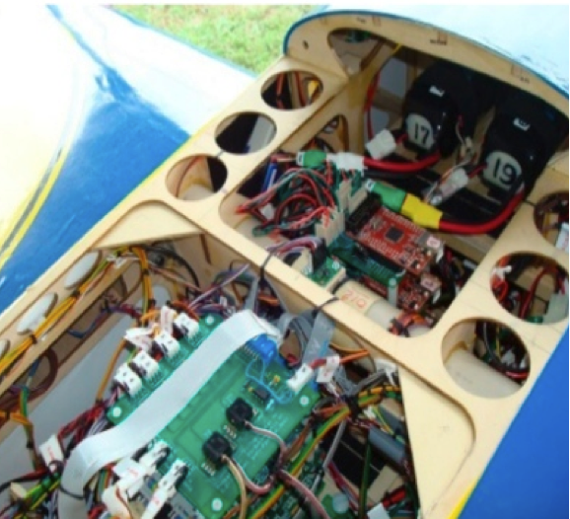
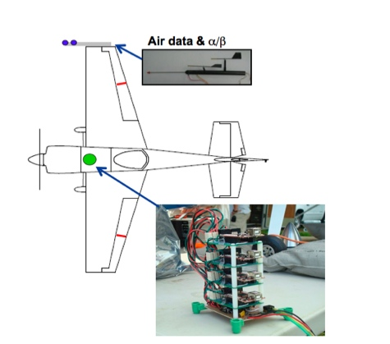
Aircraft configuration
Edge 540T

Slide 28
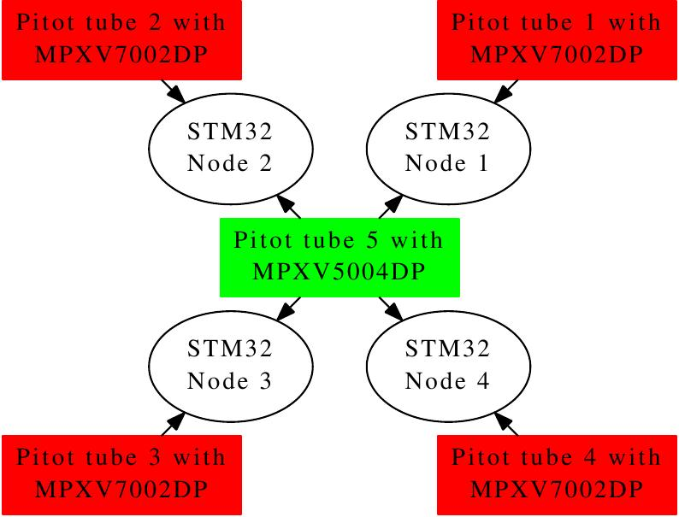
Monitoring experiments
Monitors communicate with one another over dedicated serial lines in real-time
Properties
  Agreement: return a fault-tolerant average of sensor values
    Used to diagnose local faults
    Diagnoses faults in the monitors
    or the sensor systems
  Unrealistic sensor data
  Senors values change “too fast”
Upshot: decomposable
fault-tolerance

Slide 29
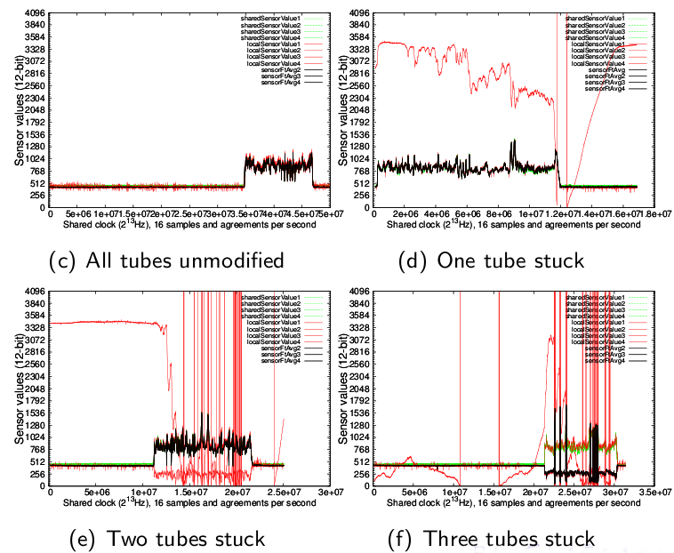
Monitoring results
One Byzantine-faulty processor, plus

Slide 30
Future work
Another case-study on autopilot communication system
Tools for scheduling monitors
  Used timer interrupts
  And scheduler to decompose monitor's tasks (variable sampling, computation, etc.)
Efficient compilation for eDSLs
Automated mapping from real-time history to value history
E.g., state in monitor that the Δ in v over 1sec. → monitor maintains a history buffer of x values.

Slide 31
Summary
RV works and is needed for ultra-critical systems!
  Distributed systems
  Real-time systems
Using functional languages for monitor generation
  eDSLs: “the benefits of functional languages applied to real-time embedded systems”
Low-cost, high assurance

Slide 32
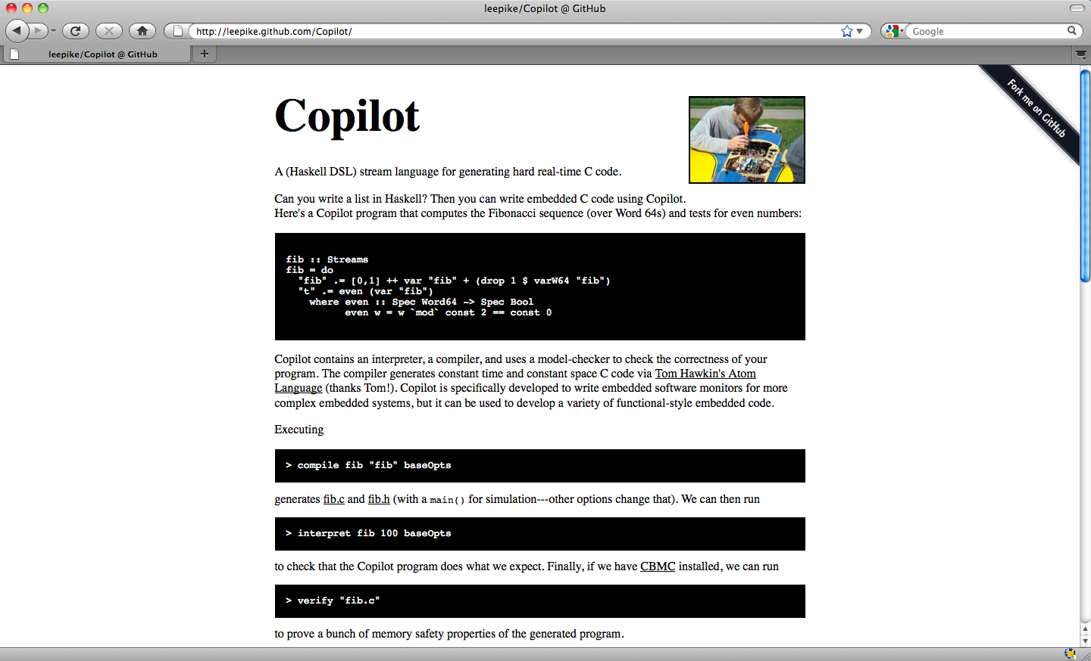
http://leepike.github.com/Copilot/

Slide 33
Differences From Lustre
eDSL approach
Polymorphic (embedded in Haskell)
Simpler clock calculus—no projection operator
BSD3
V&V tools

Slide 34
Cheap assurance
Who watches the watchmen?
Types are free proofs—use a typed language
Reuse existing compiler infrastructure
Automated random testing
  Ensure interpreter == compiler, millions of times
Test coverage (line, branch, functional call) using gcov
Automated back-end equivalence proofs (CBMC)
And it's all cheap & easy.

Slide 35
Air Data Inertial Reference Units
35+ years of failures
Failures cited in
Northwest Orient Airlines Flight 6231 (1974)---3 killed
  Increased climb/speed until uncontrollable stall
Birgenair Flight 301, Boeing 757 (1996)---189 killed
  One of three pitot tubes blocked; faulty air speed indicator
Aeroperú Flight 603, Boeing 757 (1996)---70 killed
  Tape left on the static port(!) gave erratic data
Líneas Aèreas Flight 2553, Douglas DC-9 (1997)---74 killed
  Freezing caused spurious low reading, compounded with a failed alarm system
  Speed increased beyond the plane’s capabilities
Qantas Flight 72 , Airbus A330---115 injuries
  ADIRU failure, software “limitation”
Air France Flight 447, Airbus A330 (2009)---228 killed
  Airspeed “unclear” to pilots
  Still under investigation

Slide 36
The power of eDSLs
Some problems for conventional compilers go away
  New language features are host-language macros
  Don't need scripting languages
E.g., compiling distributed monitors is just another host-language function:
compile program node
(setCode (Just header)) baseOpts
distCompile program node headers =
compile (program node) node
(setCode (Just (headers node))) baseOpts

