Slide 1
Monitoring Dynamic Systems with a Copilot Monitor
Ryan Spring
Mentor: Alwyn Goodloe
Thanks TO Stanley Bak, Taylor Johnson, et Al.
Notes:
The goal of my project was to lay the groundwork for creating a Copilot monitor for dynamic systems. I implemented a real-time reachability algorithm from a paper published by Stanley Bak at AFRL and Taylor Johnson at UT-Arlington. In my presentation, I'm going to be talking about the algorithm’s background, walking you through a visualization of the algorithm, and ending with the experiments I used to test the monitor.

Slide 2
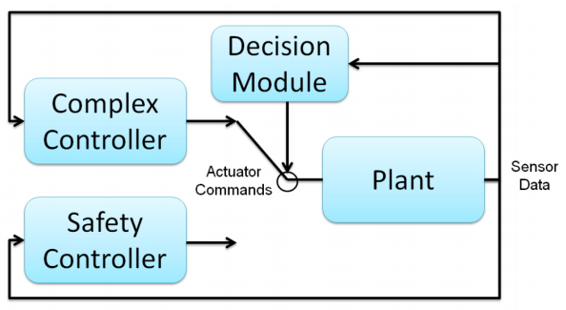
Simplex Architecture
Notes:
The algorithm I implemented is a part of the Simplex Architecture. The architecture is composed of a complex controller, a safety controller, and a decision module. The complex controller is capable of high performance but you cannot formally verify its behavior. The safety controller is formally verified to return the system to a safe state but does not provide high performance. The goal of the decision module is to switch from the complex controller to the safety controller to maintain safety but also to utilize the complex controller as much as possible to maximize performance. The decision module is the part of the architecture is what we're using as the basis for the Copilot monitor.

Slide 3
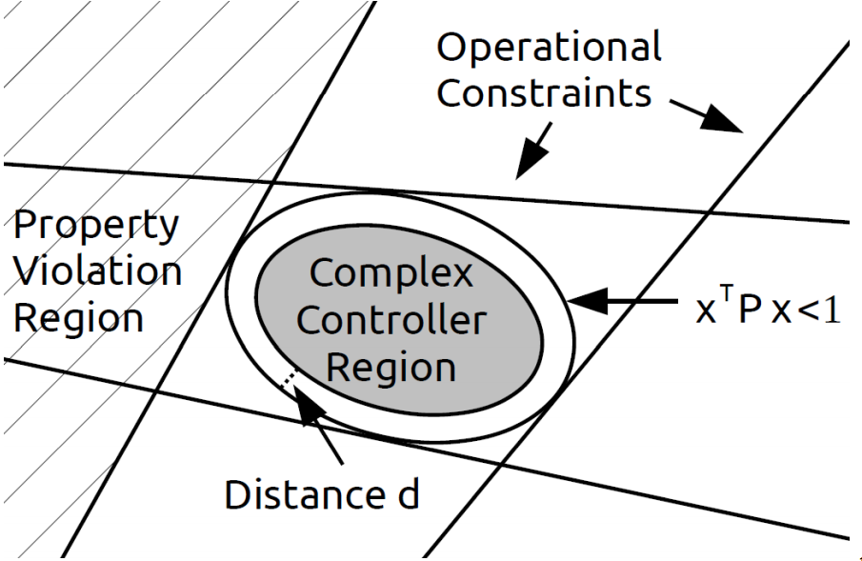
Simplex LMI Architecture
Notes:
So here is an example of a Simplex architecture that uses Linear Matrix Inequalities to generate a safety controller and decision module from the operational constraints and actuator limits of the system. The output of the LMI convex optimization is this matrix P that defines an ellipsoid where the linear controller can recover the system. The ellipsoid is inside of the operation constraints and does not violate any safety properties. The complex controller is allowed to operate inside the ellipsoid region but there is a buffer distance d where the safety controller activates to return the system to the center of the ellipsoid .

Slide 4
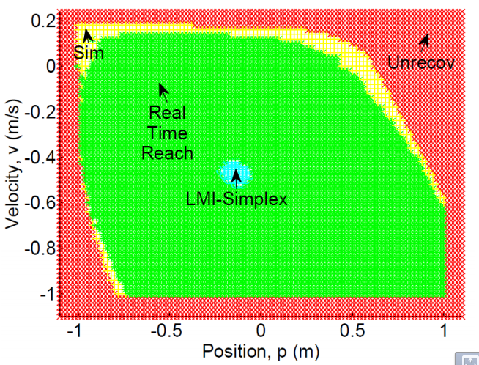
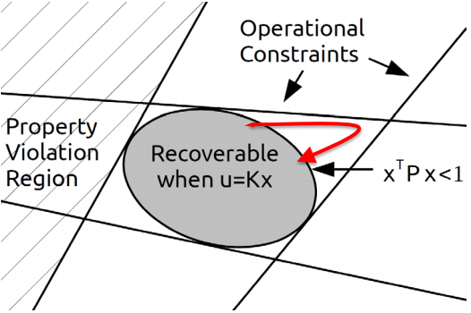
Unified LMI + Reachability Simplex Architecture
Notes:
A downside of the LMI simplex approach is the size of ellipsoid safety region. You can see on the left picture that the blue LMI safety region is much smaller than the area recoverable with the safety controller. The real-time reachability algorithm expands the safety region as shown by the green area in the picture. You can see with the right picture that we are allowing the complex controller to leave the ellipsoid as long as the safety controller can return the system to a safe state. Since the complex controller is allowed to operate more often, this approach has greater performance but with the same safety properties.

Slide 5
Algorithm Requirements
Fast computation for short reachability time calculations
No dynamic data structures or recursion
Monitor the safety conditions of the system
The Complex Controller (CC) does not intersect with the inadmissible states
The Safety Controller (SC) does not intersect with the inadmissible set, given the REACH set for the complex controller
The safety controller is inside the recoverable region, given the REACH set of the complex controller at time
Notes:
So here are the requirements for the real-time reachability algorithm. We want to ensure fast computation for short reachability time calculations, to support real-time embedded systems by not allowing any dynamic data structures or recursion, and to monitor the safety condition of the system. The safety condition of the system are broken down into three components. First, we don't want the complex controller to violate the operational constraints. Second, we don't want the safety controller to violate the operation constraints after being activated by the decision module. The REACH set in this definition is the range of possible states caused by the complex controller. Finally, the safety controller returns the system to the recoverable region after being activated by the decision module.

Slide 6

Algorithm - Initial State
Notes:
So I will now begin a visual walkthrough of the real-time reachability algorithm. Here is the initial set of states for a system. It is represented by a hyper-rectangle.

Slide 7
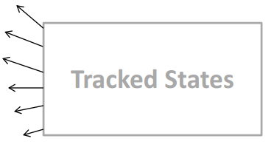
Algorithm - Derivative
Notes:
For the second step, we take the derivative along each face of the hyper-rectangle.

Slide 8
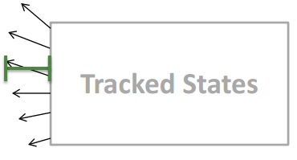
Algorithm - Maximum Advancement
Maximum advancement of the face of the hyper-rectangle after the desired reachTimeStep
Notes:
Next, we take the maximum change along the face of hyper-rectangle.

Slide 9
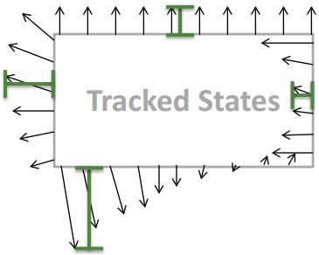
Algorithm - Maximum Advancement
Calculate maximum advancement for all of the hyper-rectangle's faces
Notes:
We repeat this process for every face of the hyper-rectangle

Slide 10
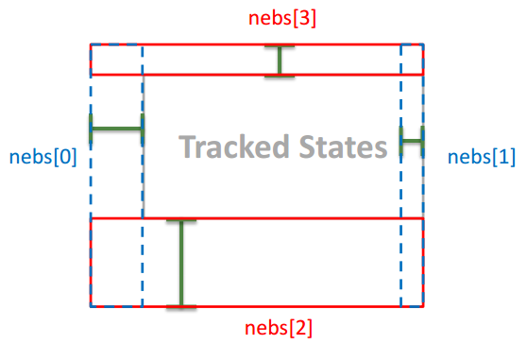
Algorithm - Construct Neighborhoods
Construct overlapping neighborhoods using the maximum advancement for each face
Notes:
Then, we construct overlapping neighborhoods using the maximum change for each face.

Slide 11
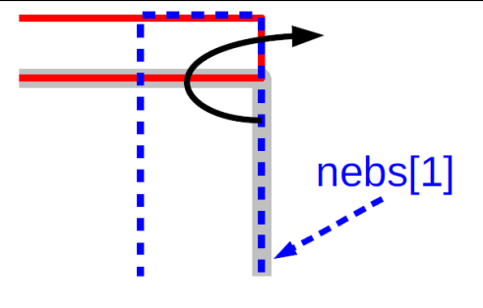
Algorithm - Resample Derivatives
Reconstruct Neighborhoods if (1) the inward-facing neighborhood flips to an outward-facing neighborhood or (2) the neighborhood width doubles in size
Notes:
Now, we resample the derivatives for each neighborhood of the hyper-rectangle. We reconstruct the neighborhoods if an inward facing neighborhood flips to become an outward facing neighborhood or if the width of a neighborhood doubles in size. So the first condition is described with the picture on the right. An inward facing neighborhood is where the neighborhood extends inside of the tracked states. The second condition ensures that the algorithm makes sufficient progress during each iteration.

Slide 12
Algorithm - Calculate Advancement Time
Compute the minimum time for any face to leave its neighborhood
Notes:
Now, we calculate the minimum time step for any face to leave its neighborhood.

Slide 13
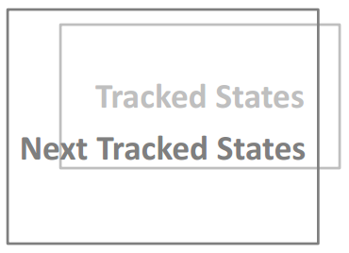
Algorithm - Update Hyper-Rectangle
Notes:
Finally, we advance each face of the hyper-rectangle using the maximum derivative and the minimum reach time step.

Slide 14
Algorithm Summary
HyperRect state = initialState
while reachTimeRemaining >= 0:
HyperRect[] nebs = constructNebs(state, reachTimeStep)
crossTime = minCrossReachTime(nebs)
advanceReachTime = min(crossTime, reachTimeRemaining)
state = advanceState(nebs, advanceReachTime)
reachTimeRemaining -= advanceTime
end while
Notes:
Each iteration of the while loop advances the reachability calculation by the minimum time step of the constructed neighborhoods.

Slide 15
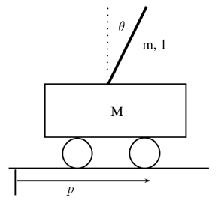
Experiments - Inverted Pendulum
Notes:
I verified the algorithm by using an inverted pendulum dynamic system.

Slide 16
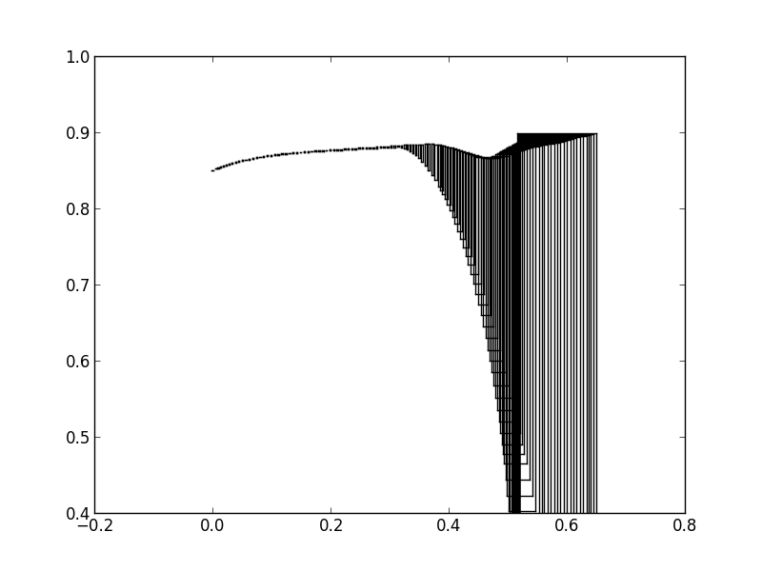
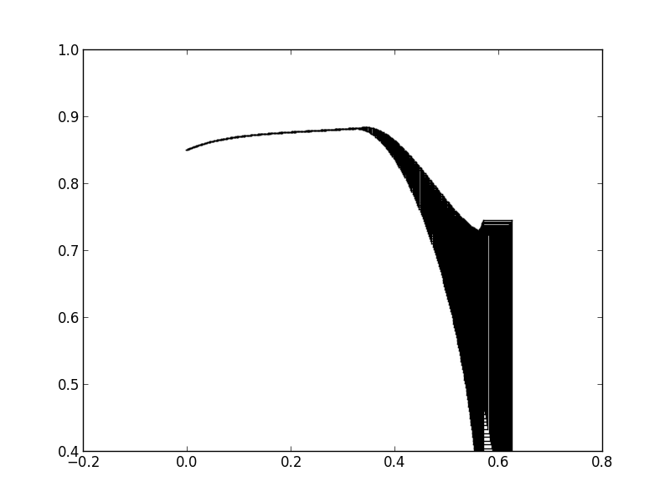
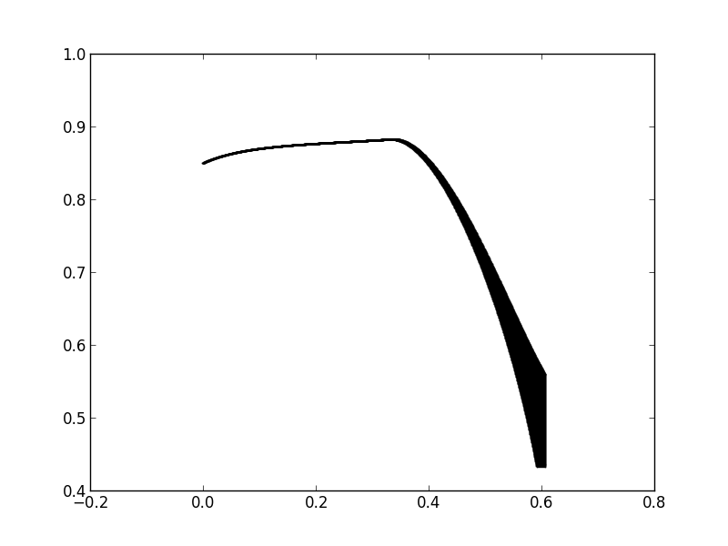
ReachTimeStep Parameter - 0.75 Reach Time
0.0075 - 100 Iterations
0.0025 - 300 Iterations
0.0006 - 1250 Iterations
Notes:
These pictures are reproductions of the ones from the paper using my implementation. They show how the ReachTimeStep parameter affects the reachability calculation. ReachTimeStep parameter controls the speed and accuracy of the reachability analysis. It controls the width of the neighborhoods and so the advancement time during each iteration

Slide 17
RTR Monitor - Uncontrolled
Unsafe Inverted Pendulum Demonstration
Notes:
I implemented a numerical simulation of the inverted pendulum model. The simulation uses the real-time reachability algorithm to predict the state of the pendulum. This video show the system when it is not controlled and so violates the safety conditions.

Slide 18
RTR Monitor - PID Controller
Safe Inverted Pendulum Demonstration
Notes:
This video shows the system when it is balanced by a PID controller. It does not violate its safety conditions.

Slide 19
Summary
Implemented Decision Module of Unified LMI+Reachability Simplex Architecture
Reproduced the results from the paper and implemented a basic test simulation
Implemented the algorithm in Haskell to start the groundwork of adding support to the Copilot language

Slide 20
Questions?

