Slide 1
Runtime Verification of Hard Realtime Systems with Copilot: A Tutorial
Ivan Perez
KBR @ NASA Ames Research Center
Alwyn E. Goodloe
NASA Langley Research Center
Frank Dedden
System F Computing

Slide 2
RV Motivation
Mission-critical and safety-critical systems often require a high degree of assurance
Formal verification proves a correctness property holds for every execution of a program correct
Most software is too large and requires very specialized workforce
Testing demonstrates correctness property holds on specific test cases
Runtime verification (RV) detects if a correctness property is violated during execution and invokes procedures to steer the system into a safe state
A form of dynamic system verification

Slide 3
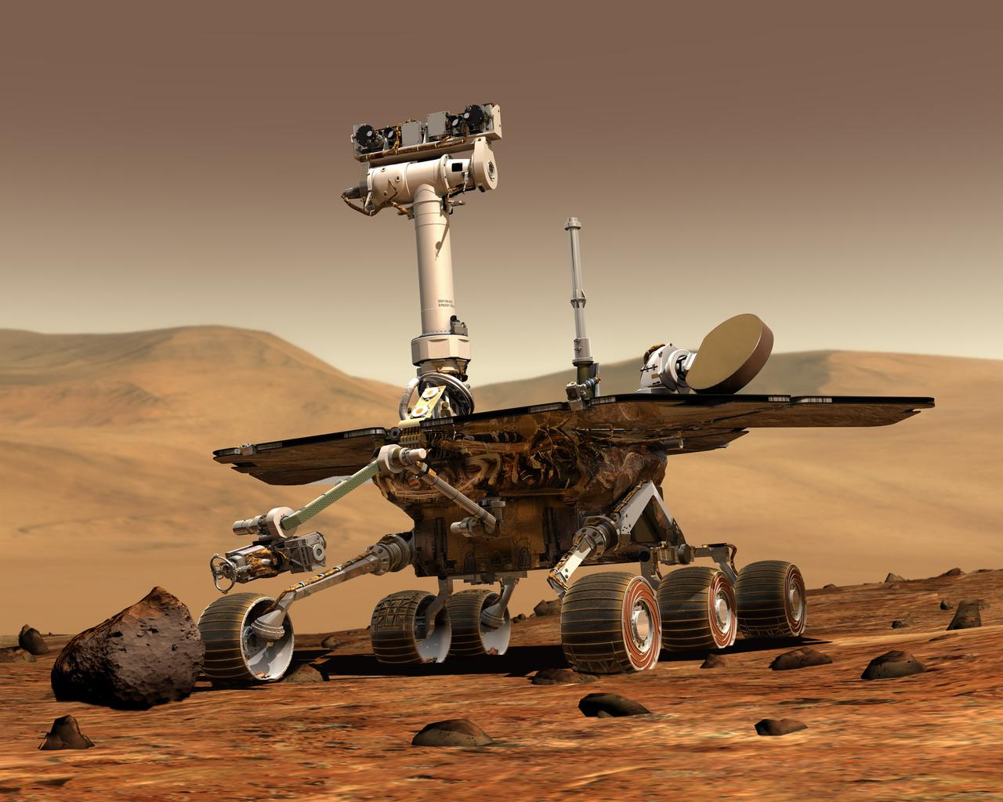
RV in Practice
Monitors
System
Environment
https://photojournal.jpl.nasa.gov/catalog/PIA04413

Slide 4
Foundations of RV
Given a specification φ of the property we want to check
Specification logics: linear temporal logics (LTL), regular expressions, …
A trace τ of the execution capturing information about the state of a system under observation (SUO)
System must be instrumented to capture the trace
An RV monitor checks for language inclusion τ ∊ 𝔏(φ)
Accept all traces admitting φ
We do this online, but offline analysis is possible
RV frameworks synthesize monitors from specifications

Slide 5
RV Engineer Checklist
Specify the property to be checked
Identify the trace to be captured
Synthesize a monitor that checks the property using an RV framework
Create handler that steers the system to a safe state when the property is violated
Install monitor and handler

Slide 6
Copilot
Copilot is a language and runtime verification framework targeting hard real-time safety-critical systems
Stream based specification language similar to Lustre and LOLA
Employs sampling rather than extensive code instrumentation
Appropriate for monitoring safety of CPS systems
Copilot specifications are translated into MISRA C99 monitors or to BlueSpec and Verilog for implementation in FPGAs
Effort started in 2008 as a research program
Galois and the National Institute of Aerospace (NIA)
Copilot has evolved into a NASA software engineering tool
Adapted NASA Software Engineering development processes
Open source
Monitors classified as “Mission Support Software” and flown on NASA flights

Slide 7
Copilot Language
Copilot language implemented as a Haskell Embedded Domain Specific Language (EDSL)
Users can be productive in Copilot without having to learn Haskell
Users can write many useful specifications/programs using only a small set of Copilot combinators
There is an expanding library of predefined combinators to aid in the writing concise specifications
The Copilot language has been used for general purpose programming of embedded systems
Not just for RV

Slide 8
Where to Find More Information
Copilot website : https://copilot-language.github.io
The Copilot manual
Links to source code
Copilot 3 Technical Report: https://ntrs.nasa.gov/citations/20200003164
Questions / Contributions: https://github.com/Copilot-Language

Slide 9
Questions?
Contact Information:
Ivan Perez.
ivan.perezdominguez@nasa.gov
Alwyn Goodloe.
a.goodloe@nasa.gov
Frank Dedden.
frank@systemf.dev

