Slide 1
Going Deeper with Convolution

Slide 2
Author(s)
Szegedy, C., Liu, W., Jia, Y., Sermanet, P., Reed, S., Anguelov, D., Erhan, D., Vanhoucke, V. and Rabinovich, A., 2015. Going deeper with convolutions. In Proceedings of the IEEE conference on computer vision and pattern recognition (pp. 1-9).
Presentation by: S M Rafiuddin Rifat

Slide 3
Outline
Introduction
Motivations
Model Architectures
Result Analysis
Conclusion

Slide 4
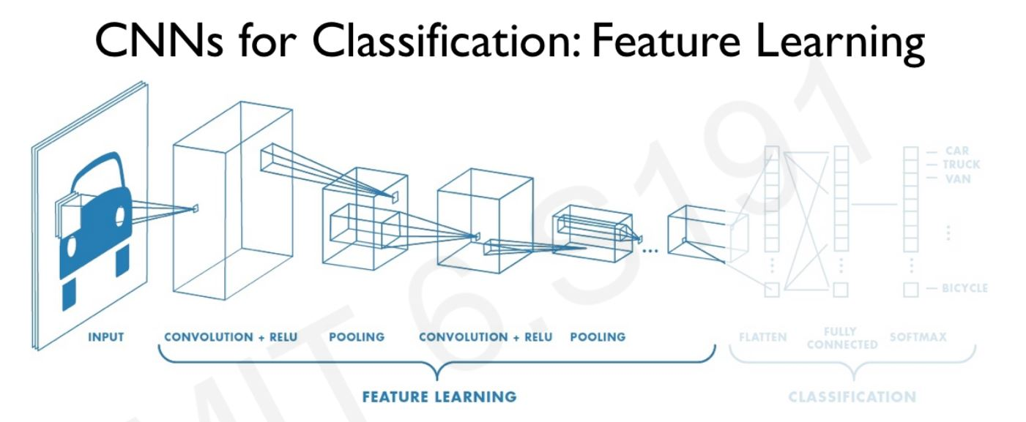
Introduction
Image Courtesy: MIT 6.S191

Slide 5
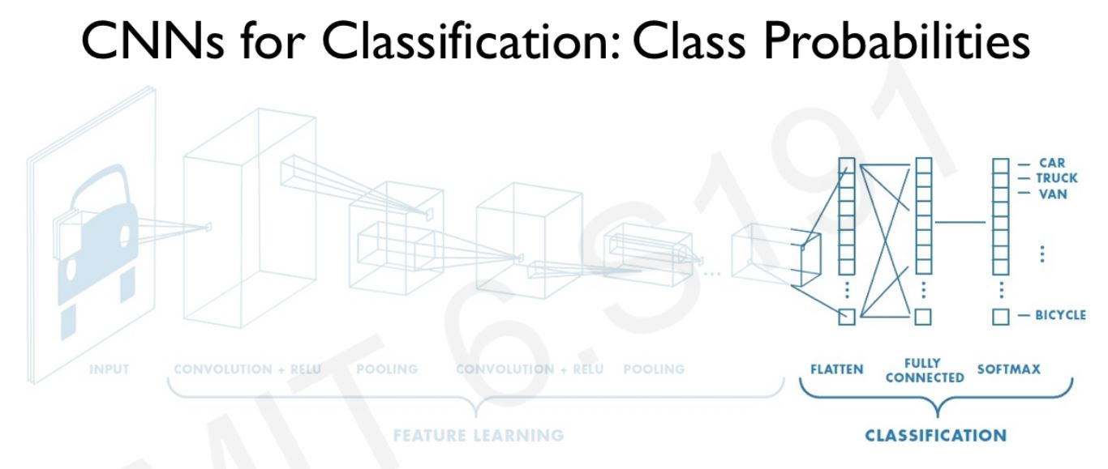
Introduction (Cont’d)
Image Courtesy: MIT 6.S191

Slide 6
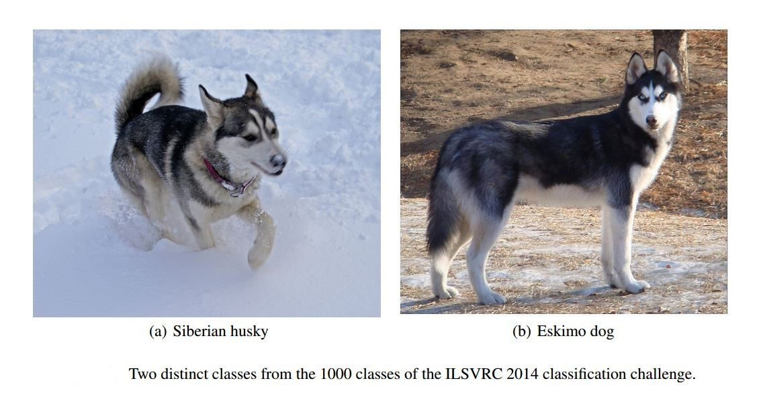
Motivation
1. Different classes with very closely related images.

Slide 7
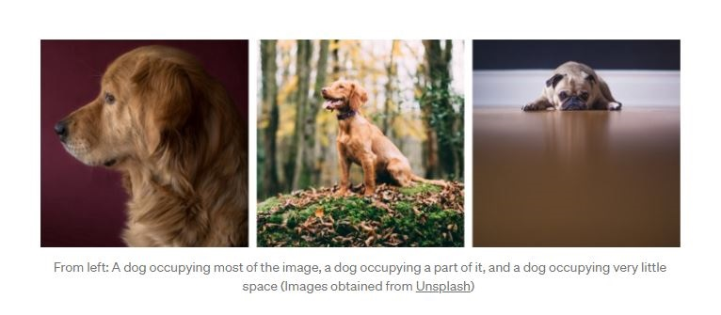
Motivation (Cont’d)
2. Salient parts in the image can have extremely large variation in size.

Slide 8
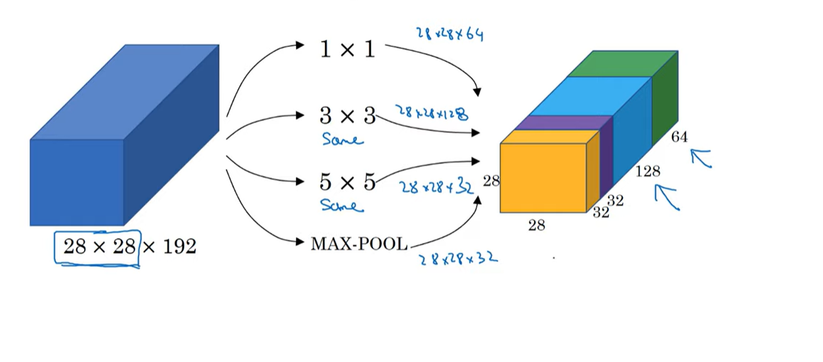
Motivation (Cont’d)
3. Same convolution.

Slide 9
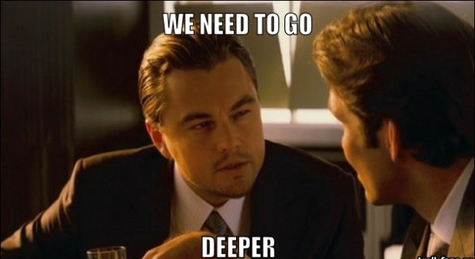
Motivation (Cont’d)
Image Courtesy: https://knowyourmeme.com/memes/we-need-to-go-deeper

Slide 10
Model Architecture
Going deeper means both ways, i.e. in length and width.
Any uniform increase in the number of deep vision filters results in a quadratic increase of computation.
Consider sparse ConvNet rather than dense.

Slide 11
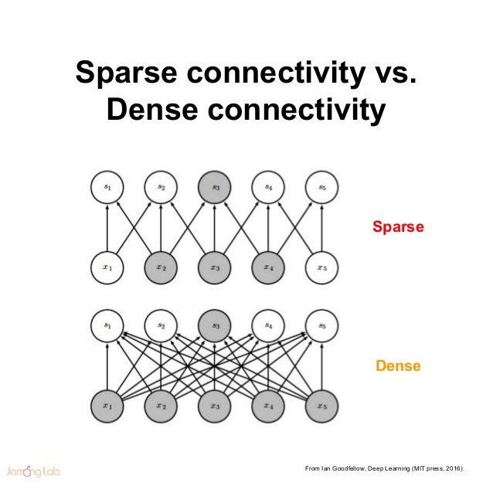
Model Architecture (Cont’d)

Slide 12
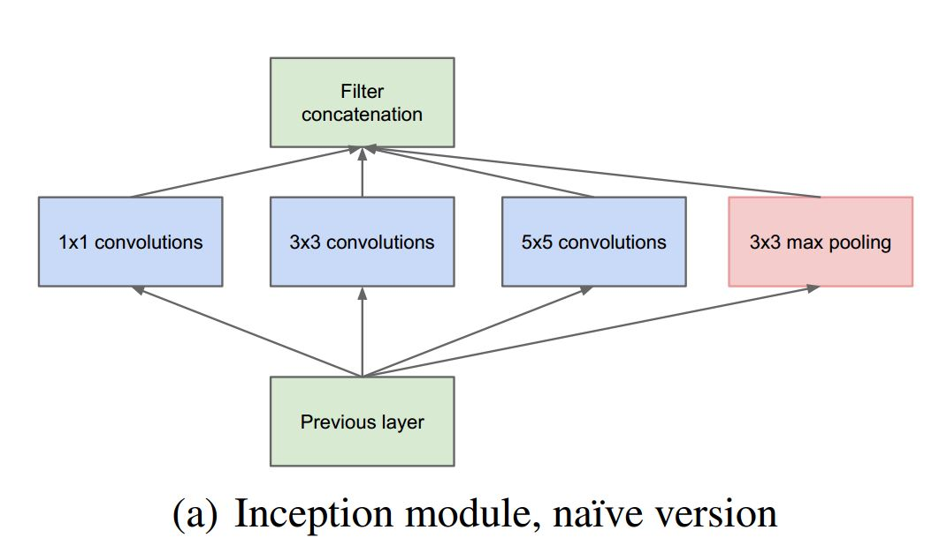
Model Architecture (Cont’d)

Slide 13
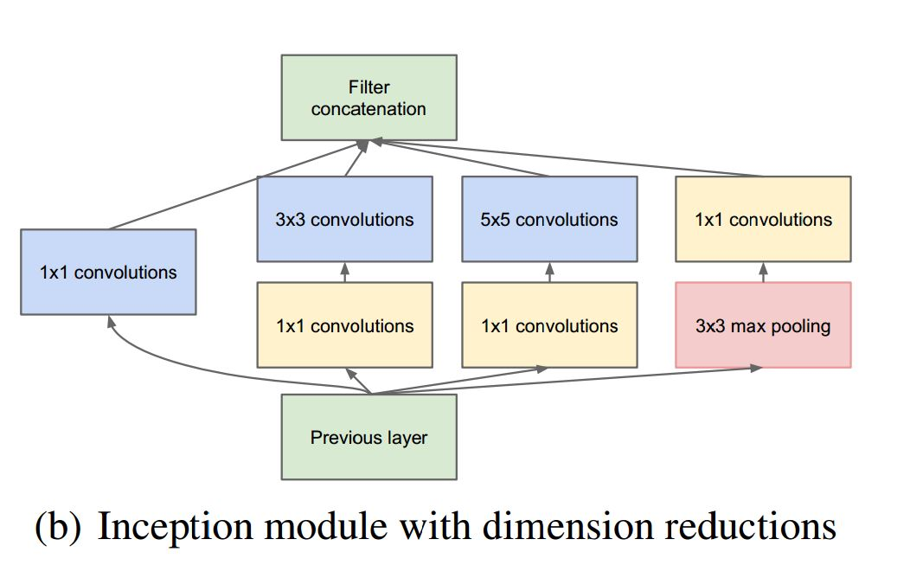
Model Architecture (Cont’d)

Slide 14
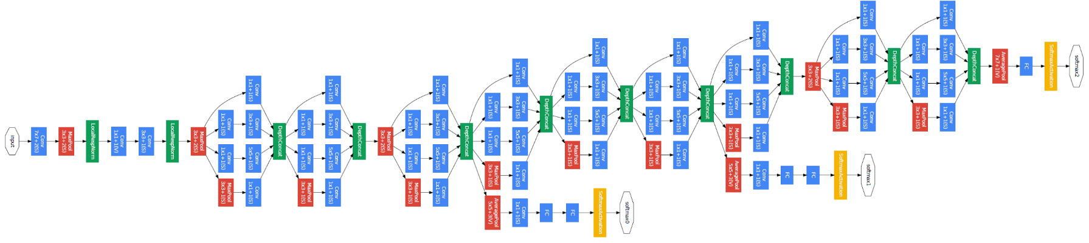
Model Architecture (Cont’d)

Slide 15
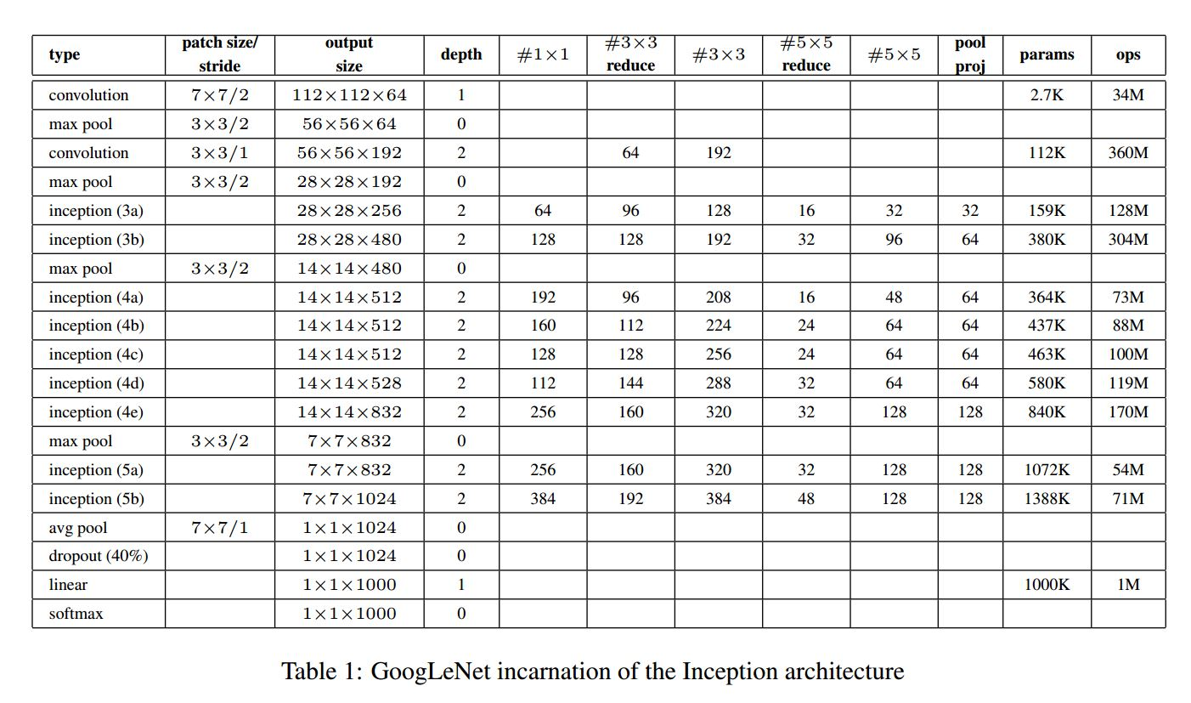
Model Architecture (Cont’d)

Slide 16
Result Analysis
total_loss = real_loss + 0.3 * aux_loss_1 + 0.3 * aux_loss_2

Slide 17
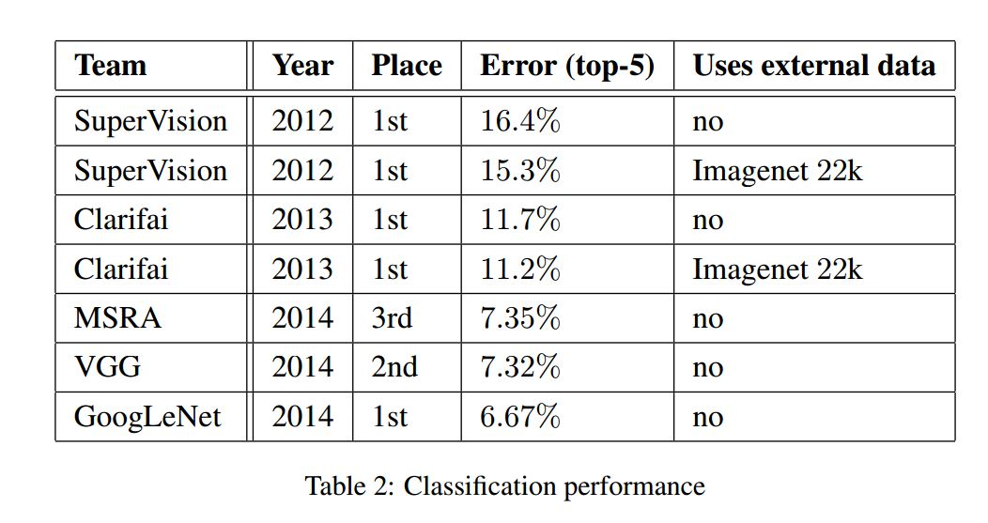
Result Analysis (Cont’d)

Slide 18
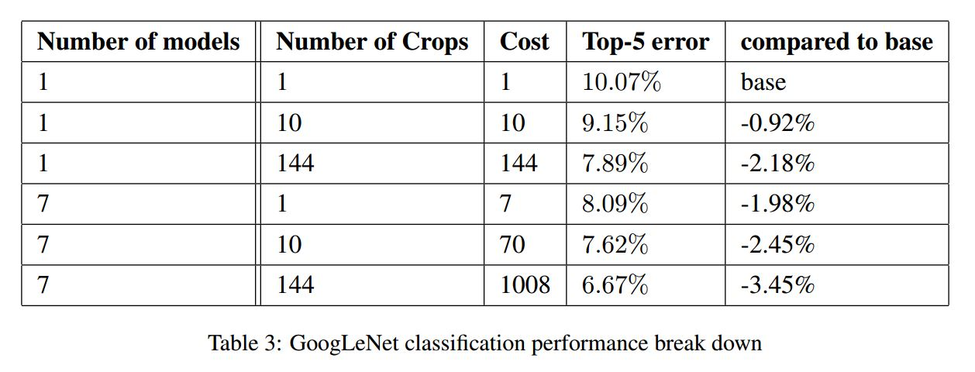
Result Analysis (Cont’d)

Slide 19
Conclusion
Further Improvement towards Inception Model.
InceptionV2 and InceptionV3.
InceptionV4 and Inception-ResNet.

Slide 20
Thank You! ☺

