Slide 1
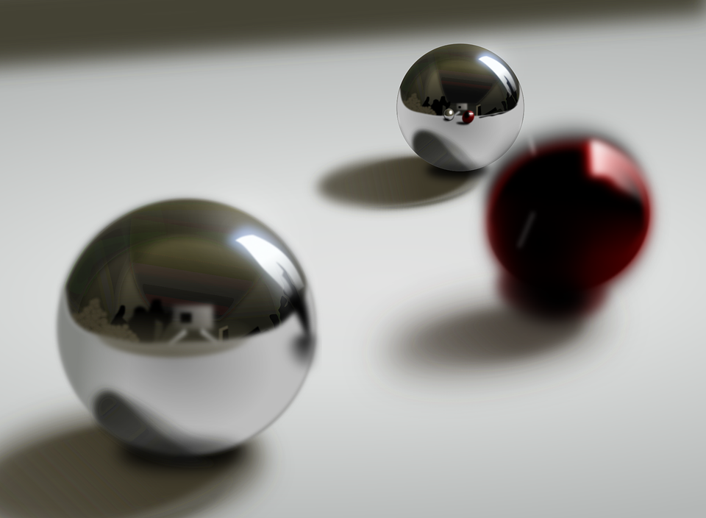
Pinballs - Final Presentation
Simon & Dario

Slide 2
Milestones revisited
Create the flipper structure (Box, Wall, Paddles)
Add balls and collision detection
Able to push flippers and exert force on balls
Add obstructions & (Bonus: Special obstructions)
(Bonus: Add scoring system & High Score list)
(Bonus: Add Sound)

Slide 3
Obstacles
A wrapper for multiple RigidObjects.
Position and Angle relative to parent rigid object (local to world transform.)
Reads mesh from “obj_1”, “obj_2” ,...
Obstacle (
std::shared_ptr<Table> table, std::string name,
int count,
Eigen::Vector3d pos, Eigen::Vector3d color,
double angle,
bool mirror)

Slide 4
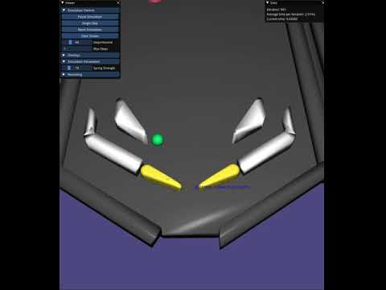
Paddles
Same as last time except..
Added sound
Like obstacles placed relative to table surface

Slide 5
Effects
Encapsulates stuff that happens to an object.
Gets executed before integration
Cooldown timer
The available effects:
Score effect
Sound effect
Gravity effect
Force effect
Color effect
Effect(PinballSim *sim, double cooldown)
void apply(std::shared_ptr<RigidObject> other)
virtual void updateEffect()
virtual void objectInit();
Let's look at some of the effects...

Slide 6
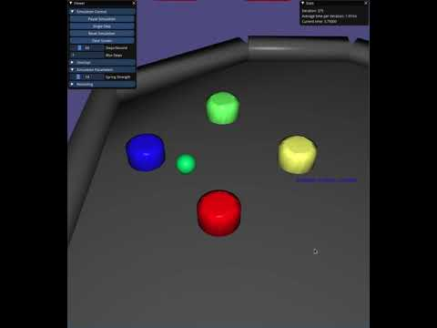
The new effects
Color effect can have two fade types, linear or constant and a fade duration.
Force effect used to implement launch mechanic. Has a control slider in the GUI.
Sound effects are using a random pitch shift to create a slightly different sound.

Slide 7
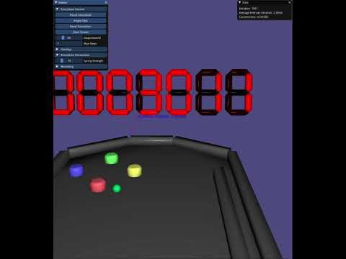
Scoring system
The large 7 segment display shows your current score.
Ball can be reset at most three times per game.
Number consists of seven RigidBody segments.
Is updated via the score effect._
Chosen to be intangible to reduce cost of broad phase collision detection.

Slide 8
Collision Detection
Last time: GJK + EPA , AABB(framework + sphere bounding box)
GJK for collision detection and EPA for Penetration and collision normal
Use GJK only if no other method is available!!!! (Numerical issues, Hard to debug, hard to imagine )
Split up mesh into known objects (Cube, Plane, Sphere etc)
Then use simple math: Point to Plane, Sphere vs Sphere
We used Sphere vs Sphere and Point to Plane

Slide 9
Continuous Collision Detection
Balls can get fast especially when the flipper also rotates
So we test the whole trajectory with a binary search
If we do collide still test previous collision possibilities
v
-v/2
+v/4

Slide 10
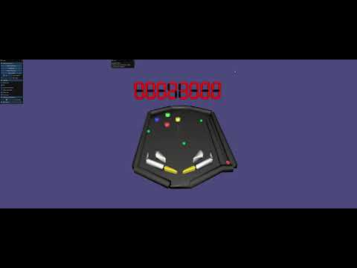
Multiple balls (+-2ms per iteration)

Slide 11
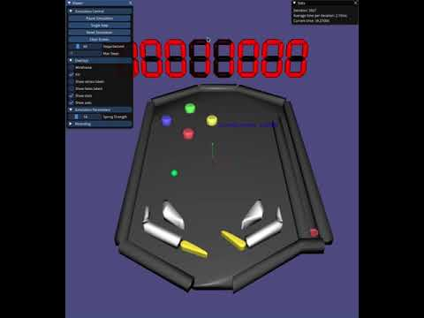
Thank you for your attention!

