Slide 1
PBS Project Plan
Pinballs

Slide 2
Game Scenario
Balls
Balls

Slide 3
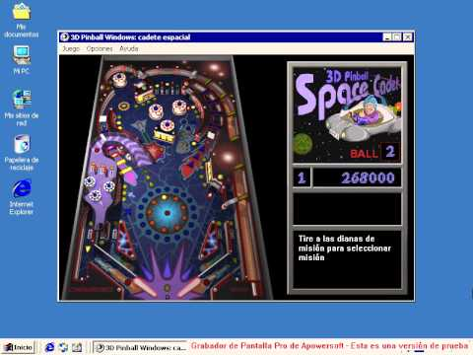
Inspiration (Remember Windows 2000?)

Slide 4
Methods used
Collision detection & handling
Rigid body simulation
Numerical integration

Slide 5
Minimal Target
Simple box with 2 flippers that can manually be pushed and multiple balls that can be shot around in the box.
Basic scene set up

Slide 6
Desired Target
Fully functioning game that allows to interchange multiple parts of the flipper box.
Cool obstructions with springs, back-pushing buttons, walls & balls with different materialistic properties.
Score counter

Slide 7
Bonus Target
Sound effects
High score list

Slide 8
Milestones
Create the flipper structure (Box, Wall, Flippers)
Add balls and collision detection
Able to push flippers and exert force on balls
Add obstructions
(Bonus: Add point system & Highscore list)
(Bonus: Add Sound)

Slide 9



Timeline
more obstacles
more level design
07.11
14.11
28.11
05.12
12.12
19.12

