Slide 1
Pinballs - Current state

Slide 2
Milestones according to Project Plan
Create the flipper structure (Box, Wall, Paddles)
Add balls and collision detection
  (Bug:) Collision detection fails with complex meshes
Able to push flippers and exert force on balls
Add obstructions
(Bonus: Add scoring system & High Score list)
(Bonus: Add Sound)

Slide 3
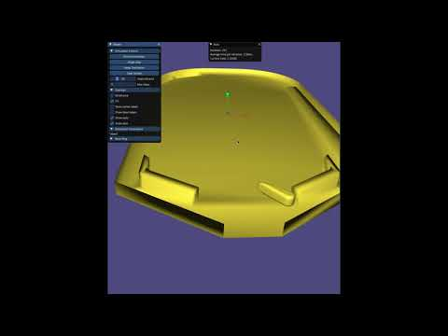
The Paddle
Controlled by the player
Moves between fixed angles
Has the following properties:
COM on the rotation axis
Movement by manipulation
of angular momentum
Inverse mass is 0
Cannot be moved

Slide 4
Collision Detection
First tried SAT. Was way to slow (20 seconds per iteration).
Changed to GJK + EAP. (Few milliseconds)

Slide 5
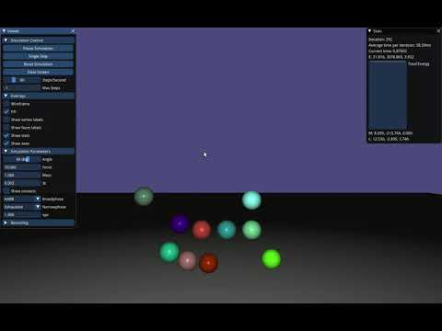
Collision detection - exhaustive
Exhaustive:
  Avg: 150 ms
  Max: 250 ms

Slide 6
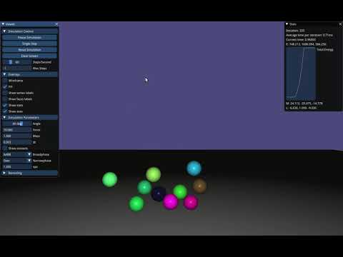
Collision detection - GJK + EAP
Exhaustive:
  Avg: 150 ms
  Max: 250 ms
GJK + EAP:
  Avg: <1 ms
  Max: 1.3 ms

Slide 7
Effects
Effects are triggered when an object collides.
A set of effects can be attached to objects.
These effects consists of:
Adding a number to the total score
Playing a sound effect
Change the gravity or add external
forces…
Can implement both bonus milestones with the Effect interface
For all effects e in contact.a->getEffects():
e.apply()

Slide 8
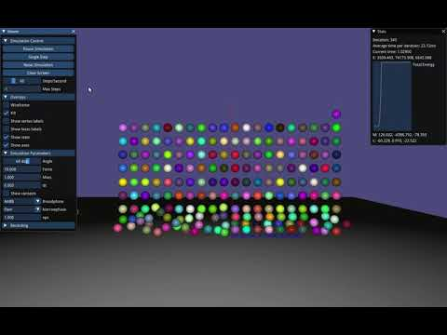
Any questions?

