Slide 1

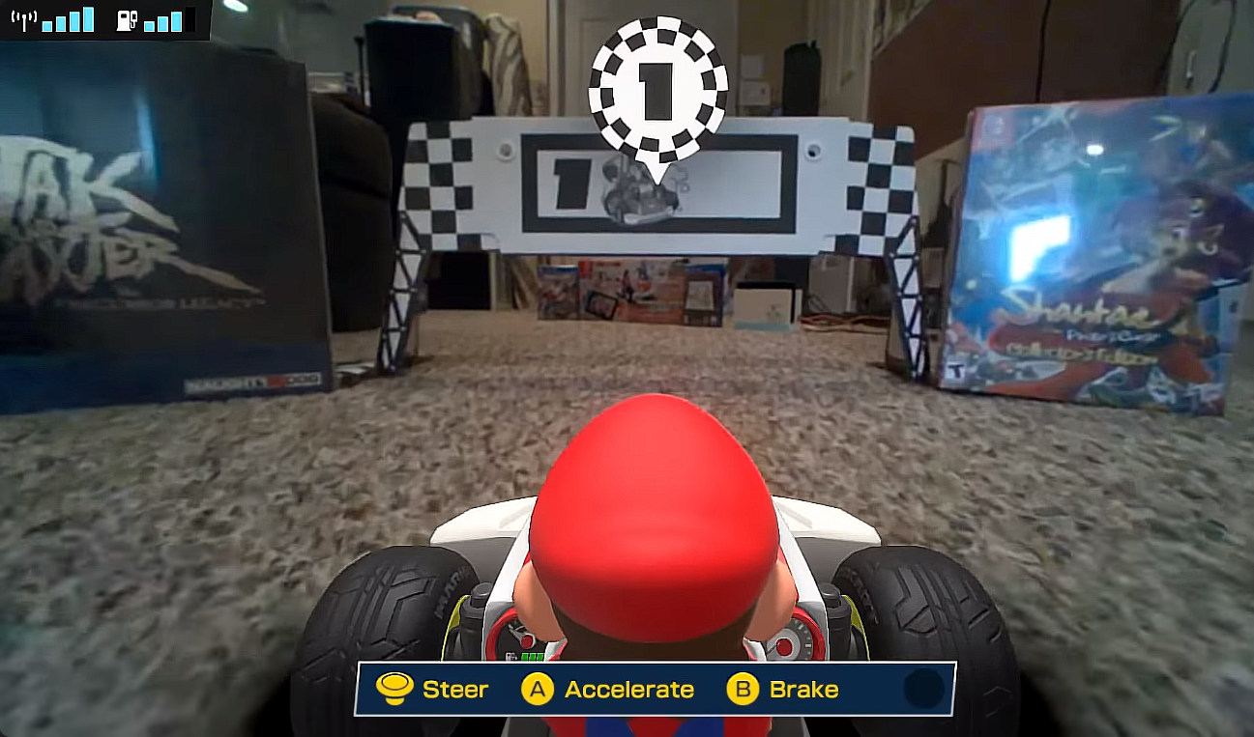
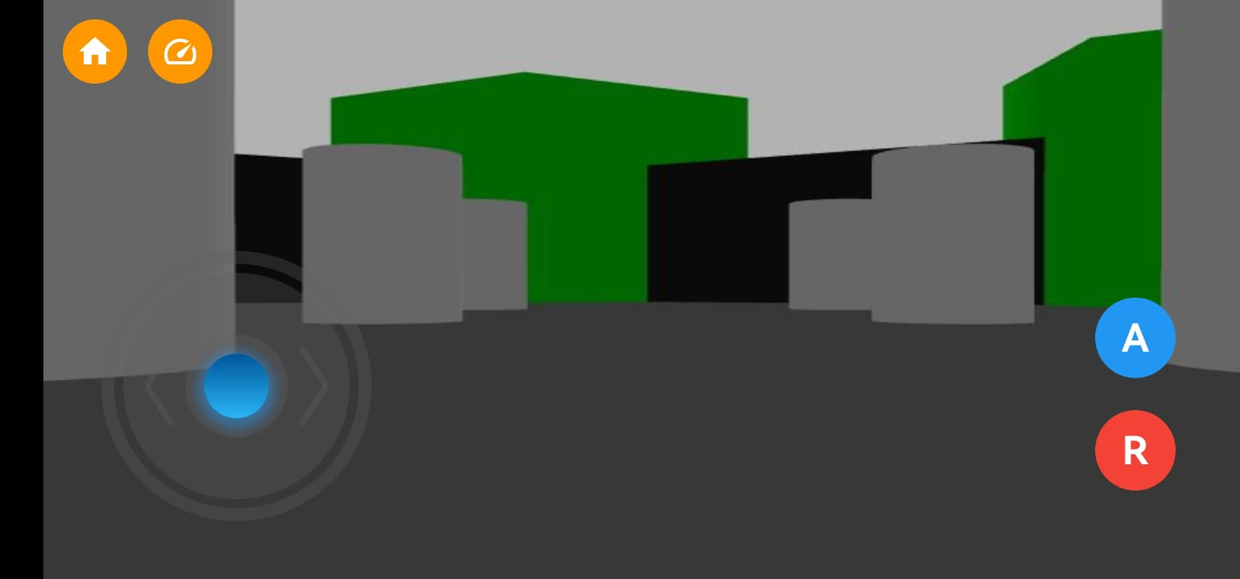

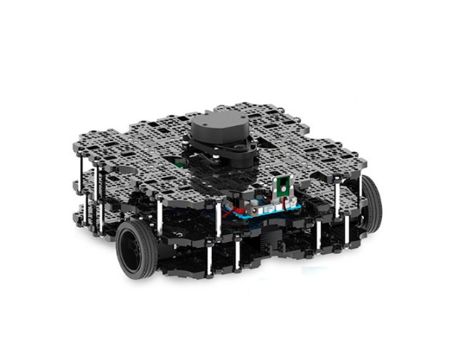
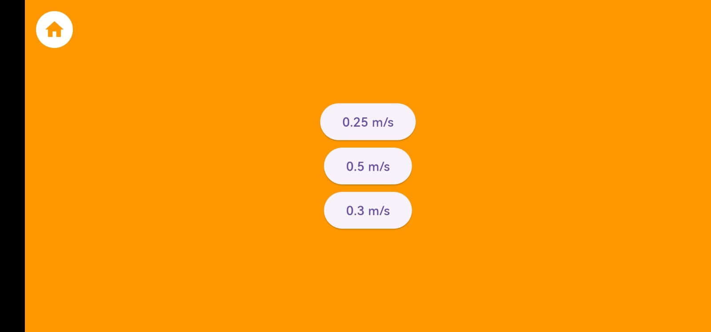
ROBOKART HOME LIVE
YILDIZ TECHNICAL UNIVERSITY
FACULTY OF ELECTRICAL AND ELECTRONICS
DEPARTMENT OF COMPUTER ENGINEERING
Muhammed KASAP, Asst. Prof. Dr. Furkan ÇAKMAK
muhammed.kasap@std.yildiz.edu.tr, fcakmak@yildiz.edu.tr
Özet
RoboKart Home Live projesi, yarış oyunlarına yeni bir soluk getirerek telefon ekranında aracı hareket ettirmeyi ve haritayı gerçek dünyada görebilmeyi mümkün hale getiriyor. Elimizdeki uygulamadan bir robota bağlanarak, robotu oyunumuzun aracı haline getiren bu oyun, ROS işletim sistemi vasıtasıyla gerçek dünya üzerinde hareket eden robota gerekli mesajları yolluyor. Flutter ve Firebase ile yapılan mobil uygulama sayesinde robotu hareket ettiren kullanıcılar, harita oluşturma, harita seçme ve zamana karşı yaptıkları yarış sonunda diğer kullanıcıların skorlarını görüyor ve kendi skorlarıyla karşılaştırma imkânı buluyor.
III. Experimental/Application Results
Abstract
The RoboKart Home Live project offers a new way to play racing games. You can control the vehicle on your phone and see the game map in the real world. Our game connects to a robot through our app, turning the robot into the game’s vehicle. Using the ROS operating system, we send messages to the robot to move in real life. With our mobile app made with Flutter and Firebase, you can control the robot, make and choose maps, and compare your scores with others after time-based races.
Figure III.I: MarioKart Live Home Circuit
Figure III.II: RoboKart Home Live
Features | Mario Kart Live: Home Circuit | RoboKart Home Live
Game Mechanics and Controls | Figure III.I | Figure III.II
Track Creation | Allowed | Allowed
Race Strategies and Obstacles | against other AR characters, dealing with in-game obstacles | against time
Physical Size and Flexibility of Gameplay | AR cards, Nintendo Switch, enough room to race | Robot, enough room to race
I. Introduction
The fast evolution of technology is bringing up new perceptions regarding robotics and mobile gaming. This project works on the development of an innovative system, Robokart Homelive, using Robot Operating System (ROS) and Flutter. The system integrates robot control with a racing game that can be enjoyed by the user on their phone.
Table III.I Mario Kart Live: Home Circuit v RoboKart Home Live
The comparison focuses on various features such as game mechanics and controls, track creation, race strategies, obstacles, and the physical size and flexibility of gameplay. Mario Kart Live: Home Circuit utilizes AR cards and the Nintendo Switch for gameplay, allowing players to race against other AR characters with in-game obstacles. In contrast, RoboKart Home Live involves racing against time with a robot, emphasizing sufficient room for racing. Both games provide unique AR experiences, highlighting different aspects of AR technology and gameplay mechanics.
II. System Design
The system design enables easily clear communication between robots and mobile devices through the use of ROS and Flutter. WebSocket technology allows for the free exchange of data and control commands in real time. This allows users to monitor and control robots remotely from the Flutter app, making it easier to access and more flexible. It also incorporates a module in which ROS messages are turned into images, so the users can also view what the robot is seeing through the Flutter app. With communication, message conversion, and robot connectivity already set, the system will now be ripe for more features and different uses.
Figure III.III: Login Screen
Figure II.I Turtlebot3 WafflePi Model Robot Used in the Simulation Environment.
Figure III.IV: Speed Select Screen
In addition to the features mentioned above, RoboKart Home Live includes:
A map saving and selection screen.
A post-race scoreboard screen.
The game interface shown in Figure III.II.
These pages generally consist of:
A button that allows us to enter the offline game without requiring a username and password (Figure III.III: Login Screen).
Two screens for drawing the map we want to race on or selecting one from pre-drawn maps.
A speed selection screen based on the size, difficulty of the map, and driving skill after map selection (Figure III.IV: Speed Select Screen).
The racing screen.
Scoreboard screens where we see our race results and the scores of other users.
Algorithm II.I -Communication between ROS and Flutter -Connecting Robot (WebSocket)
1 | Necessary library imports -roslibdart/core/topic -roslibdart/core/ros
2 | Variable definitions -late Ros ros; -late Topic selected_topic;
3 | Function to connect to the robot -ros = Ros(url: ‘ws://ipaddress:portaddress’);
4 | Procedures for sending messages to the robot and listening for messages, connecting to selected messages -topicname =Topic( ros: ros, name: ‘topicname’, type:’sensortype’, );
5 | Establishing a connection to the robot and performing subscribe and advertise operations on messages -Future<void> connect()/disconnect() async { ros.connect(); await topic.subscribe(subscribehandler); await topic. advertise(); }
Conclusion
The RoboKart Home Live project offers a new gaming experience by using a remotely controlled robot. The racing game map is shown through the camera of the robot.The mobile app was made in Flutter and Firebase. It uses WebSockets to send the speed commands of the robot. Users can select three different modes depending on the size of their environment.For racing, the user could first drive the robot over the map to set it up. When the race begins, the user can view his rank in the leaderboard along with other users on the same map.
References
[1] Çakmak F., Dilaver M.B. , A.E. Kırlı, (2017) “Mobile robot control with Android device sensors by using ros”, Mugla Journal of Science and Technology, vol. 3,no. 1, pp. 31–34
[2]Gupta B. and Vani M.,(2018) “An overview of web sockets: The future of real-time communication,” Int. Res. J. Eng. Technol. IRJET, vol. 5, no. 12.
[3] Ersahin G. and Sedef H. ,(2015) “Wireless mobile robot control with tablet computer,”
Procedia-Social and Behavioral Sciences, vol. 195, pp. 2874–2882.

