Slide 1
MapReduce: Simplified Data Processing on Large Clusters - Jeffrey Dean and Sanjay Ghemawat
Yinghang Ma coppelia@yorku.ca

Slide 2
Agenda
Problem Statement
MapReduce Programming Model & Examples
An implementation of MapReduce at Google
Execution Overview
Fault Tolerance
Refinements
Results and Conclusion

Slide 3
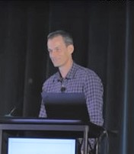

Authors
Jeffrey Adgate "Jeff" Dean(1968) is an American computer scientist and software engineer. He was appointed Google’s chief scientist in 2023 after a reorganization of Google’s AI focused groups.
Programs: Spanner, Bigtable, MapReduce, LevelDB, TensorFlow…
Sanjay Ghemawat(1966) is an Indian American computer scientist and software engineer. He is currently a Senior Fellow at Google in the Systems Infrastructure Group.
Programs: same as Jeffery
Pictures from Wikipedia.

Slide 4
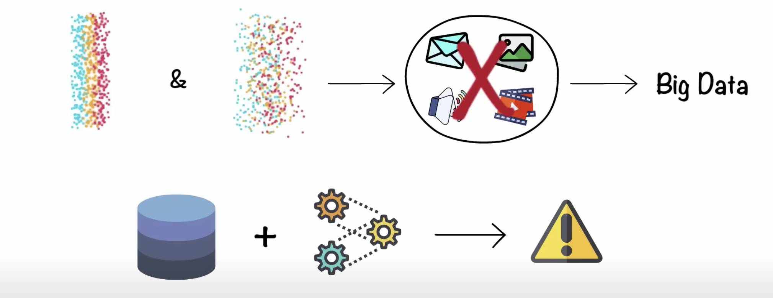
Large-scale Computing Problems
Traditional Single Node Architecture
The Google Index has 40-60 billion active web pages, it's over 100 billion gigabytes in size on May 26, 2023.
SSD reads 500MB/sec from disk
Time to read the web: 200 billion secs = 2 million days = 6342 Years?
Not sufficient for large-scale data

Slide 5



Large-scale Computing Problems
Previous solutions: crawled documents, web request logs, etc.
How to distribute data and parallelize computation?
How can we make it easy to write distributed programs? (parallelization, fault-tolerance, data distribution and load balancing)
What if machine failed? (e.g., Node failure, Unable to recover, Fire in a server room…)
Time consummation to copy data over networks?

Slide 6

MapReduce: A solution for processing Big Data
Large scale data processing
Using hundreds or thousands of machines but without the hassle of management
MapReduce benefits
Automatic parallelization & distribution
Fault tolerance
I/O scheduling
Monitoring & status updates

Slide 7
Section 2: Programming Model
Input & Output: each a set of key/value pairs
Programmer specifies two functions:
map(k, v) -> list(k’, v’)
Processes each input key/value pair
Produces set of intermediate pairs
reduce(k’, list(v’, …)) -> list(k’, v’’)
Combines all intermediate values for designated particular keys
Produces a set of merged output values
Inspired by similar primitives in LISP and other languages

Slide 8
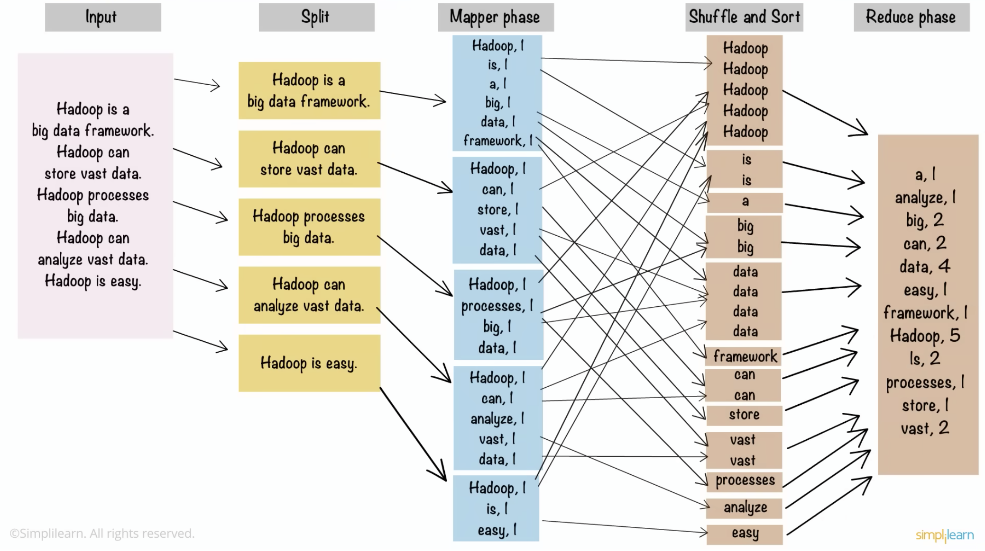
MapReduce: Word Count Examples
map(key= fileName, value = fileContent)
output = <key = word, value = count>
reduce = (key = word, value = [count_1, count_2, …])
output = <key = word, value = count_all>

Slide 9
MapReduce: More Examples
Distributed Grep:
Utilize a Hadoop cluster to find log messages hidden within terabytes of log data.
Input consists of (url+offset, single line)
Count of URL Access Frequency:
Analyzing logs of webpage request history and provide frequency analysis
Input contains logs of web page requests and output counts of total requests
Reverse Web-Link Graph:
For each url, analyzing the content and link source to the url.
Input consists of url and page content
Output consists of <target, list (source)> pairs
Term-Vector per Host:
A term vector summarizes the most important words that occur in a document or a set of documents as a list of <hword, frequency> pairs
Output <hostname, term vector>

Slide 10
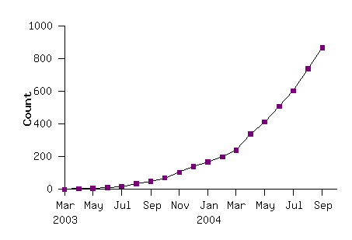
MapReduce: More Examples
MapReduce programs in Google source tree (2003-04)
Examples:
Distributed Grep
Count of URL Access Frequency
Reverse Web-Link Graph
Term-Vector per Host
Inverted Index
Distributed Sort
…

Slide 11
Implementation Overview
Typical Google cluster:
Dual-CPU x86 machines, 2-4 GB of memory
Limited bisection bandwidth
Storage is on local IDE disks
Hundreds or thousands of machines: random failure (GFS)
Job scheduling system: jobs made up of tasks, scheduler assigns tasks to machines (workers)
Implementation as C++ library linked into user programs

Slide 12
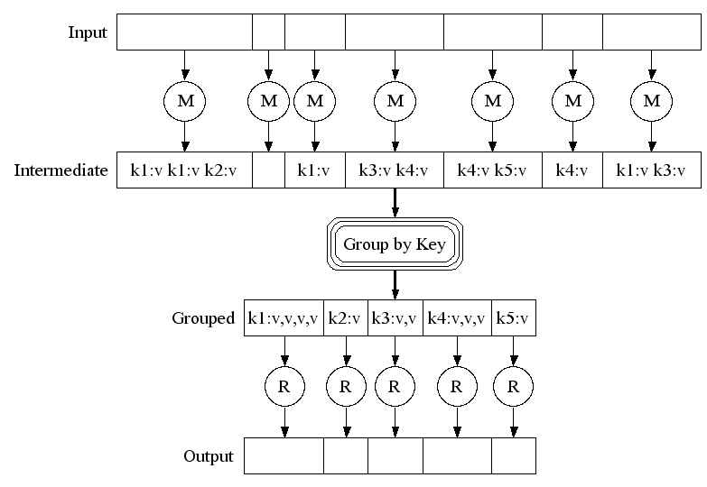
MapReduce: Execution

Slide 13
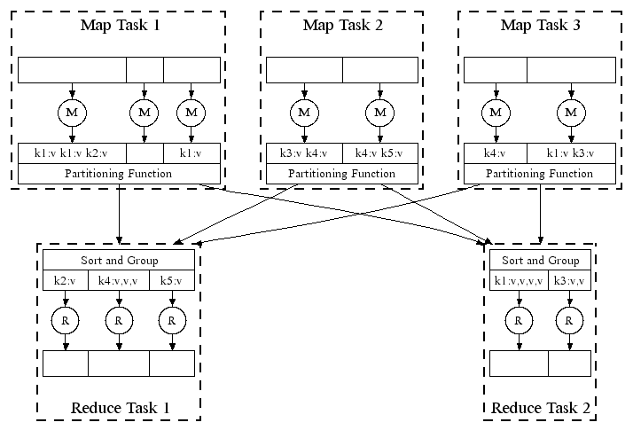
MapReduce: Parallel Execution

Slide 14
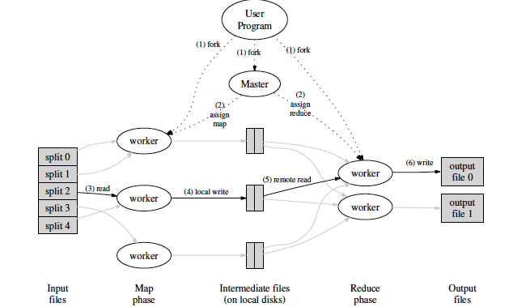
Overall execution workflow

Slide 15
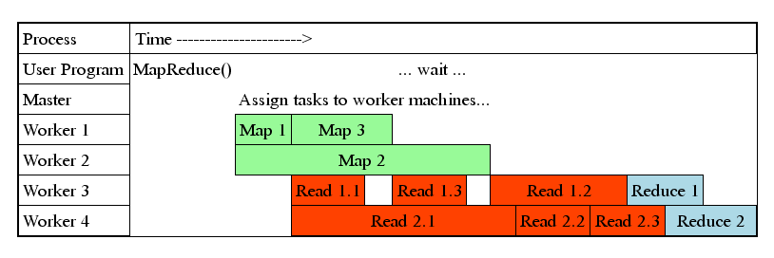
Task Granularity & Pipelining

Slide 16
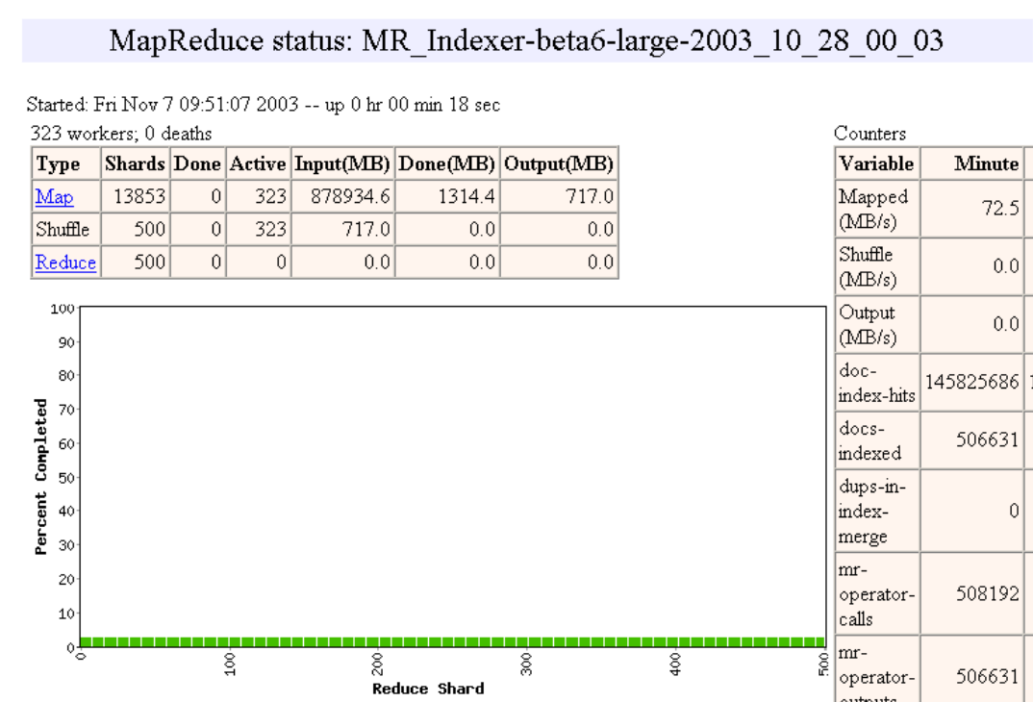
Execution progress illustration

Slide 17
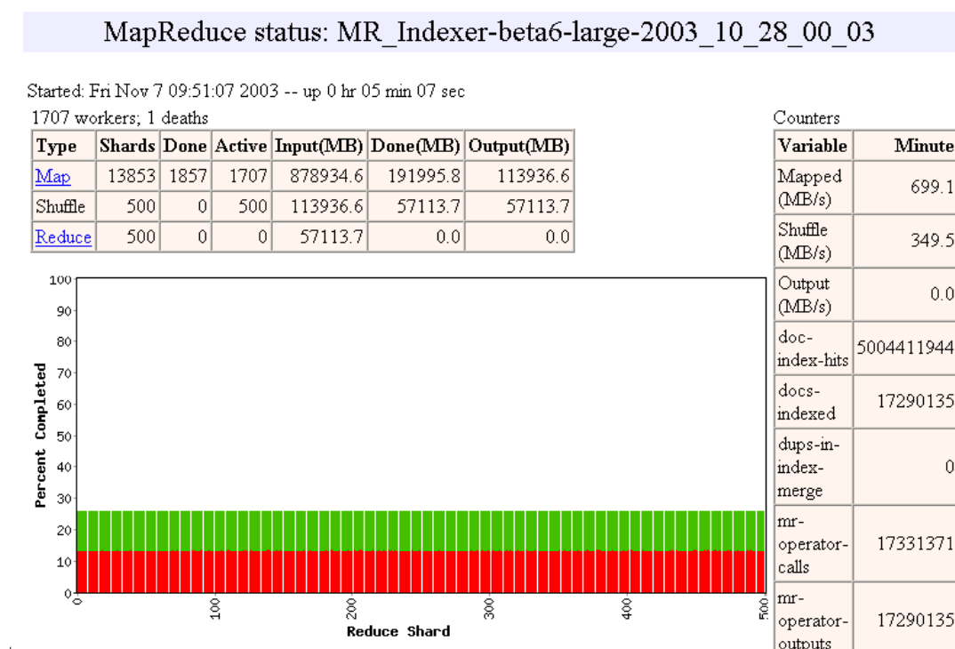

Slide 18
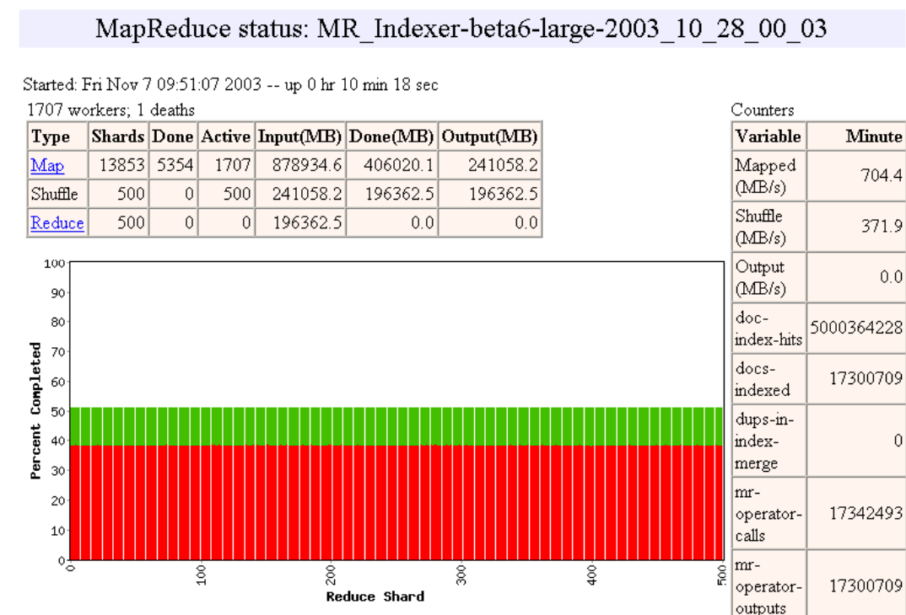

Slide 19
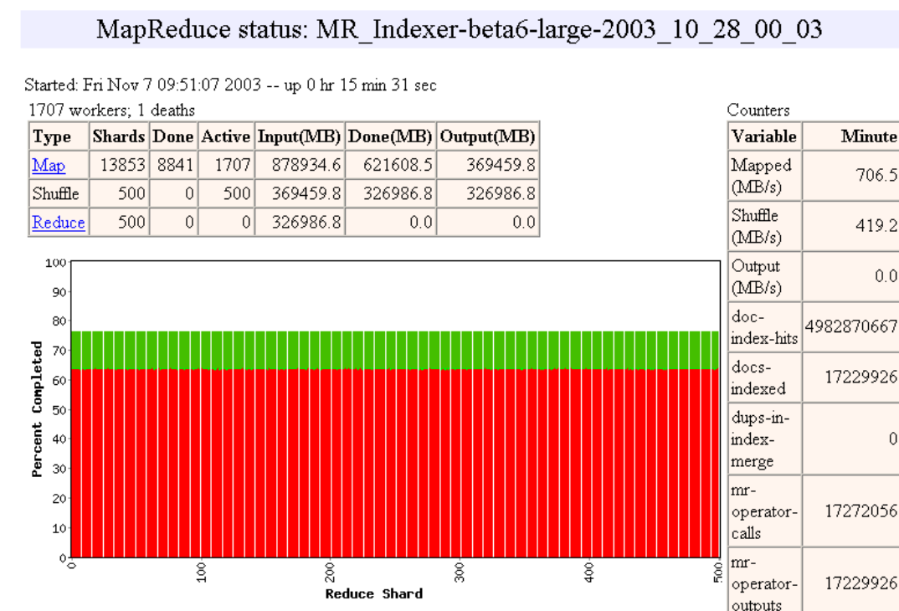

Slide 20
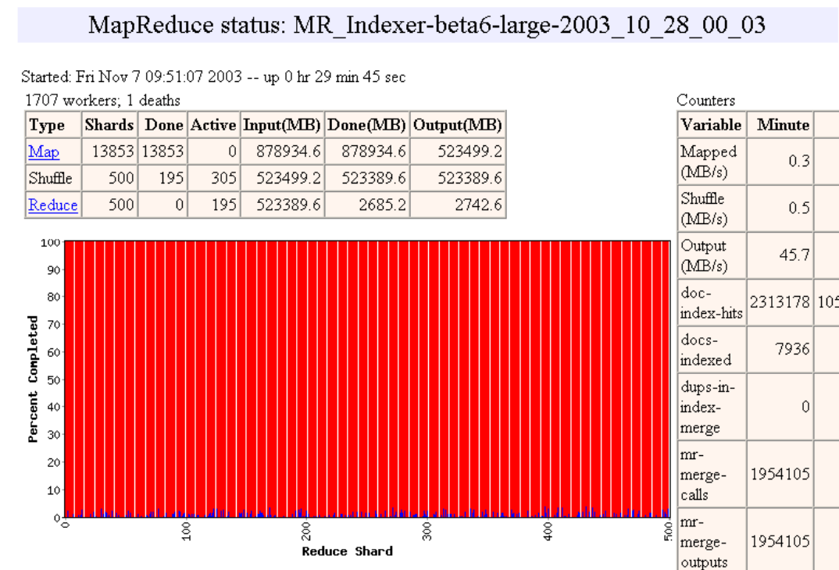
How many Map and Reduce tasks?

Slide 21
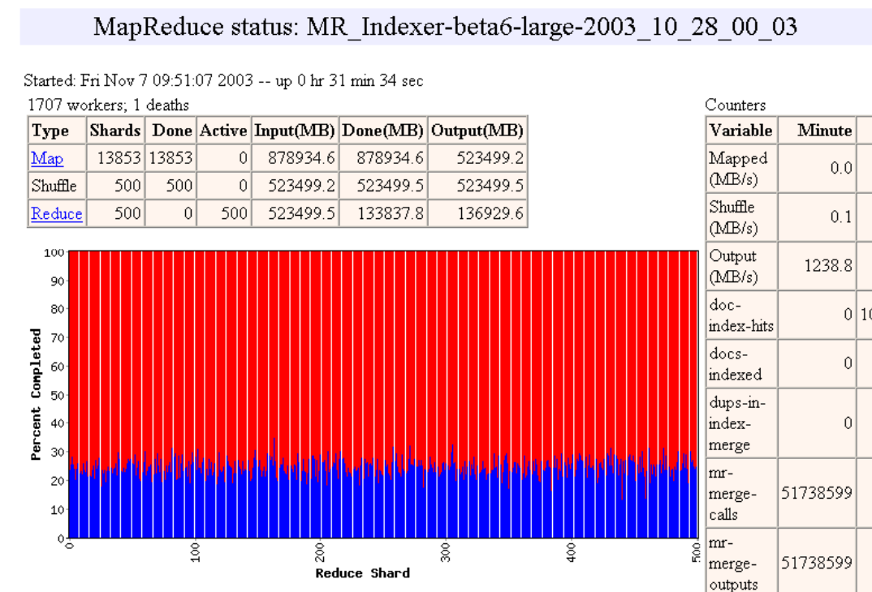

Slide 22
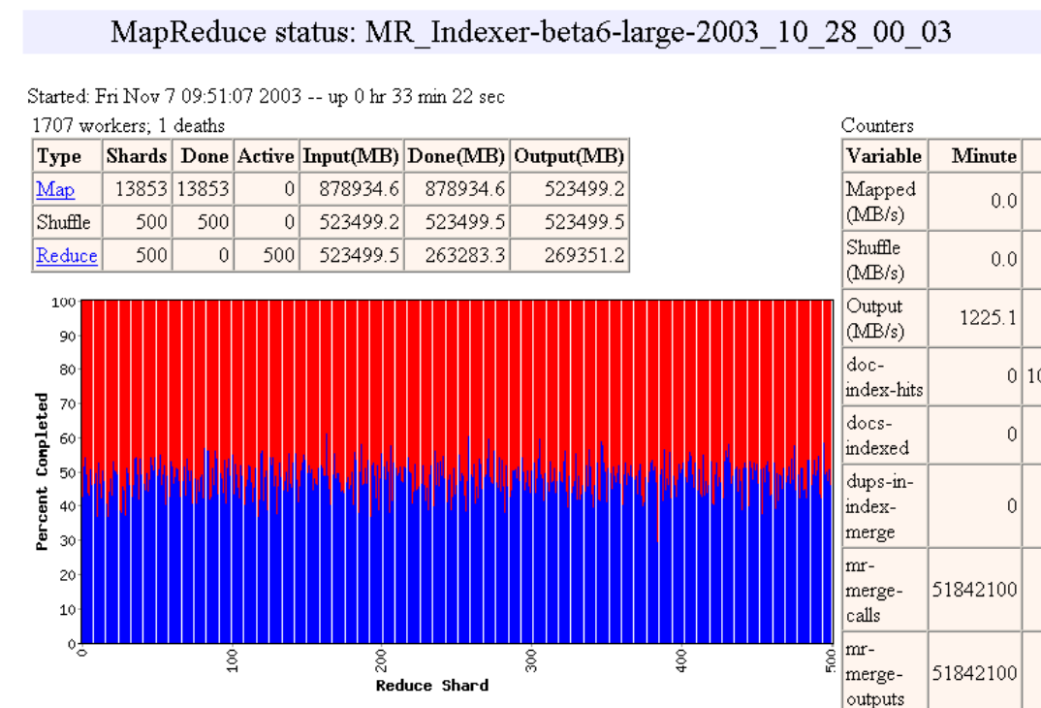
How many Map and Reduce tasks?

Slide 23
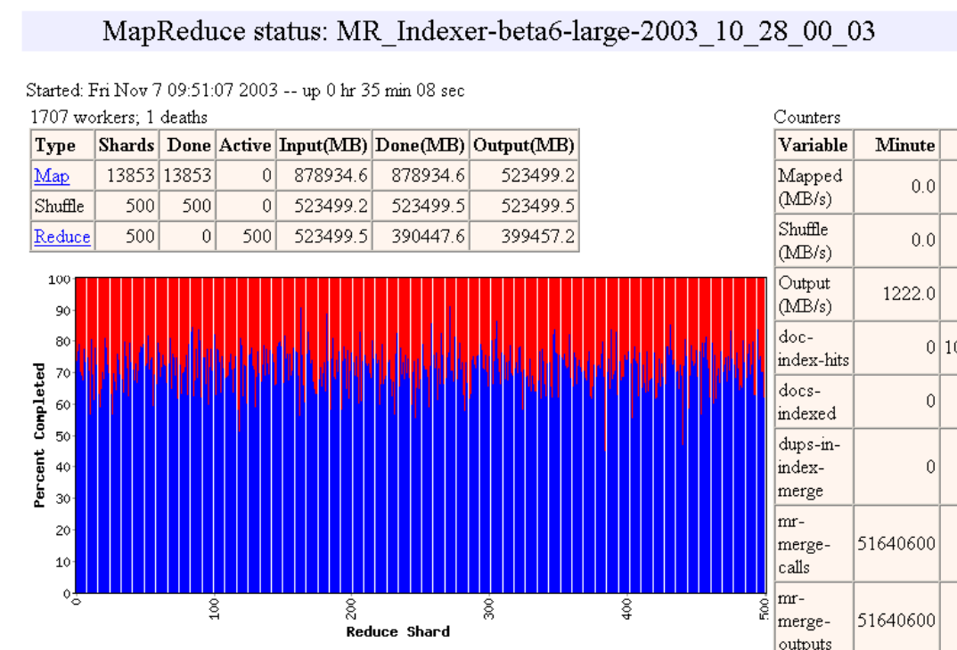

Slide 24
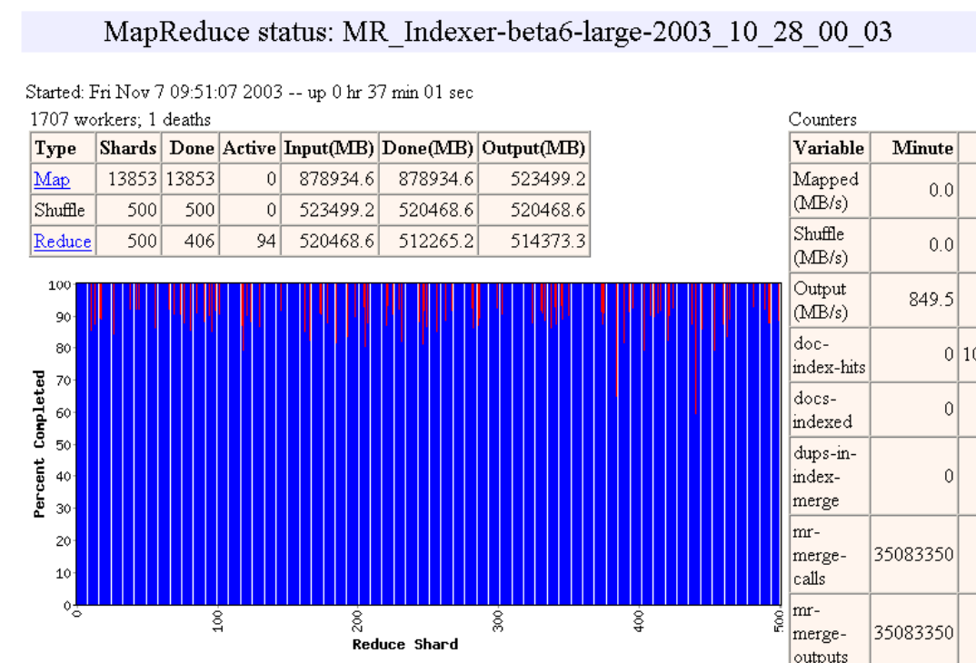

Slide 25


Slide 26


Slide 27
Fault Tolerance
On worker failure:
Detect failure via periodic heartbeats (how?)
Re-execute completed and in-progress map tasks (why?)
Re-execute in progress reduce tasks
Task completion committed through master
Master failure:
Left unhandled as considered unlikely
Users are required to restart computation (Any other ways?)
Robust: lost 1600 of 1800 machines, but finished fine

Slide 28
Locality Optimization
How does master node scheduling tasks:
Asks GFS for locations of replicas of input file blocks
Map tasks typically split into 64MB (== GFS block size)
Map tasks scheduled so GFS input block replica are on same machine or same rack
Benefits:
machines read input at local disk speed
Without this, rack switches limit read rate

Slide 29

Task Granularity
Fine granularity tasks: map tasks >> machines
Minimizes time for fault recovery
Can pipeline shuffling with map execution
Better dynamic load balancing
Often use 200K map and 5000 reduce tasks running on 2000 machines

Slide 30
Backup Tasks
Problem: Slow workers(stragglers) significantly lengthen completion time
Other jobs consuming resources on machine
Bad disks with soft errors transfer data very slowly
Weird things: processor caches disabled
Solution: Near end of phase, spawn backup task copies
Whichever one finishes first "wins"
Benefit: Dramatically shortens job completion time

Slide 31
Refinement
Partitioning Function: hash(key) mod R
Ordering Guarantees: Sorting guarantees within each reduce partition
Combiner: useful for saving network bandwidth
Input and Output Types: reading input data in several different formats
Side-effects
Skipping Bad Records
Local Execution

Slide 32
Performance evaluation
Tests run on cluster of 1800 machines:
4 GB of memory
Dual-processor 2 GHz Xeons with Hyperthreading
Dual 160 GB IDE disks
Gigabit Ethernet per machine
Bisection bandwidth approximately 100 Gbps
Two benchmarks:
MR_Grep: Scan 10¹⁰ 100-byte records to extract records matching a rare pattern (92K matching records)
MR_Sort: Sort 10¹⁰ 100-byte records (modeled after TeraSort benchmark)

Slide 33
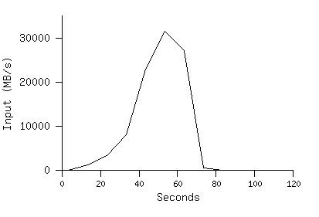
MR_Grep
M =15000 R=1
Locality optimization helps:
1800 machines read 1 TB at peak ~31 GB/s
W/out this, rack switches would limit to 10 GB/s
Startup overhead is significant for short jobs

Slide 34
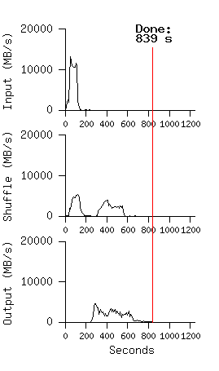
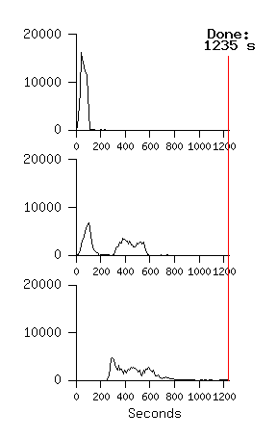
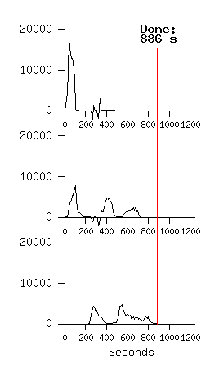
MR_Sort M=15000 R=4000
Normal No backup tasks 200 processes killed

Slide 35
Conclusions
MapReduce has proven to be a useful abstraction
Libary hide horrible details
Provide solutions for previous problems
Greatly simplifies large-scale computations at Google with efficiency
With GFS: local processing saves time for r/w from/to local disks

Slide 36
Discussions & Questions
Any better ways of solving master node failure?
Any other partitioning functions rather than hash(map) mod R?
What is the Integration Architecture between blockchain and MapReduce?

Slide 37
References and Resources
[1] MapReduce: Simplified Data Processing on Large Clusters Jeffrey Dean and Sanjay Ghemawat
[2] https://research.google.com/archive/mapreduce-osdi04-slides/index.html Slides for MapReduce: Simplified Data Processing on Large Clusters
[3] https://www.youtube.com/watch?v=plOXvbXw8qw EECS582 F20 -- MapReduce: Simplified Data Processing on Large Clusters
[4] https://www.youtube.com/watch?v=bcjSe0xCHbE Learn MapReduce with Playing Cards
[5] https://www.youtube.com/watch?v=aReuLtY0YMI Hadoop In 5 Minutes | What Is Hadoop? | Introduction To Hadoop | Hadoop Explained |Simplilearn
[6] https://github.com/arnesund/distributed-grep Distributed Grip

