Slide 1
MapReduce: Simplified Data Processing on Large Clusters
Jeff Dean, Sanjay Ghemawat, Google, OSDI 2004
Slides based on those by authors and other online sources

Slide 2
Motivation
Large scale data processing
Using hundreds or thousands of machines but without the hassle of management
MapReduce benefits
Automatic parallelization & distribution
Fault tolerance
I/O scheduling
Monitoring & status updates

Slide 3
Programming model
Input & Output: each a set of key/value pairs
Programmer specifies two functions:
map(in_key, in_value) -> list(out_key, intermediate_value)
Processes each input key/value pair
Produces set of intermediate pairs
reduce(out_key, list(intermediate_value)) -> list(out_value)
Combines all intermediate values for a particular key
Produces a set of merged output values (usually just one)
Inspired by similar primitives in LISP and other languages

Slide 4
Example: Count word occurrences
Input: (URL, content) pairs
map(key=URL, value=content):
for each word w in content, output (w, 1)
reduce(key=word, values=uniq_counts_list)
sum all 1’s in uniq_counts_list
output(word, sum)

Slide 5
Word count example illustrated
map(key=url, val=content):
For each word w in contents, emit (w, “1”)
reduce(key=word, values=uniq_counts_list):
Sum all “1”s in values list
Emit result “(word, sum)”
see 1
bob 1
run 1
see 1
spot 1
throw 1
bob 1
run 1
see 2
spot 1
throw 1
see bob throw
see spot run

Slide 6
Grep
Input consists of (url+offset, single line)
map(key=url+offset, val=line):
if line matches regexp, emit (line, “1”)
reduce(key=line, values=uniq_counts_list):
Just emit line as-is

Slide 7
Reverse web-link graph
Map
For each URL linking to target, …
Output <target, source> pairs
Reduce
Concatenate list of all source URLs
Outputs: <target, list (source)> pairs

Slide 8
Inverted index
Map ?
Reduce ?

Slide 9
Other example problems
Multiplying a large matrix with
a large vector
a large matrix
Find paths of length two in a web link or social network graph
How to translate relational database style operations like selections, projections, union, intersection, difference, joins etc. given a set of tuples to MapReduce operations?

Slide 10
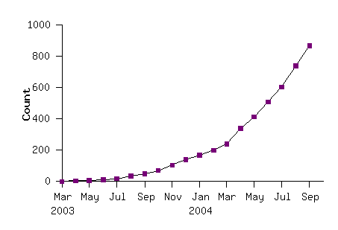
MapReduce model widely applicable
MapReduce programs in Google source tree (2003-04)
Examples
distributed grep |  | distributed sort |  | web link-graph reversal
term-vector / host |  | web access log stats |  | inverted index construction
document clustering |  | machine learning |  | statistical machine translation
... |  | ... |  | ...

Slide 11
Implementation overview
Typical cluster:
100s/1000s of 2-CPU x86 machines, 2-4 GB of memory
Limited bisection bandwidth
Storage is on local IDE disks
GFS: distributed file system manages data (SOSP'03)
Job scheduling system: jobs made up of tasks, scheduler assigns tasks to machines
Implementation as C++ library linked into user programs

Slide 12
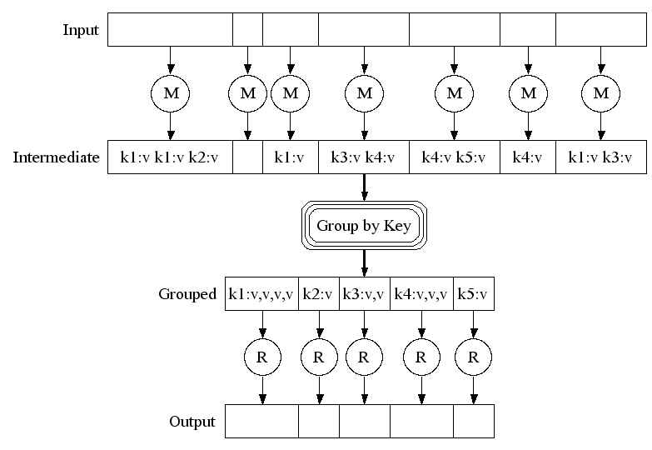
Execution

Slide 13
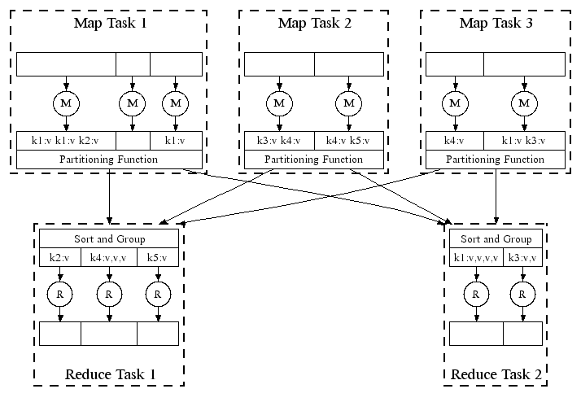
Parellel execution

Slide 14
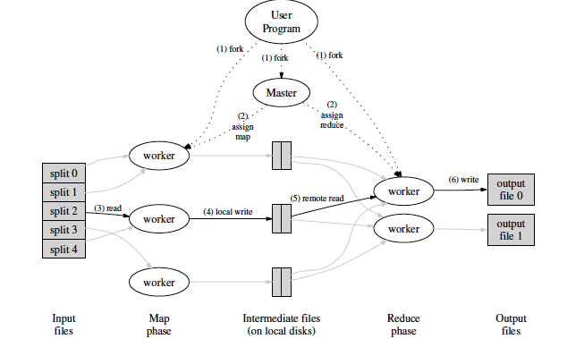
Overall execution workflow

Slide 15
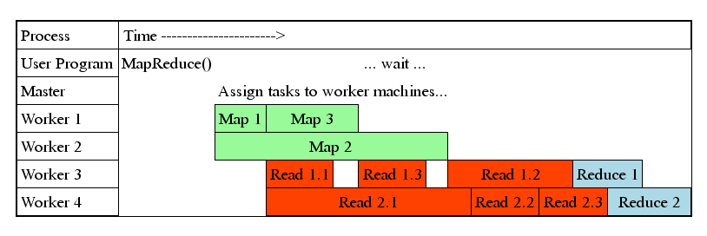
Task Granularity & Pipelining
Fine granularity tasks: map tasks >> machines
Minimizes time for fault recovery
Can pipeline shuffling with map execution
Better dynamic load balancing
Often use 200K map and 5000 reduce tasks running on 2000 machines

Slide 16
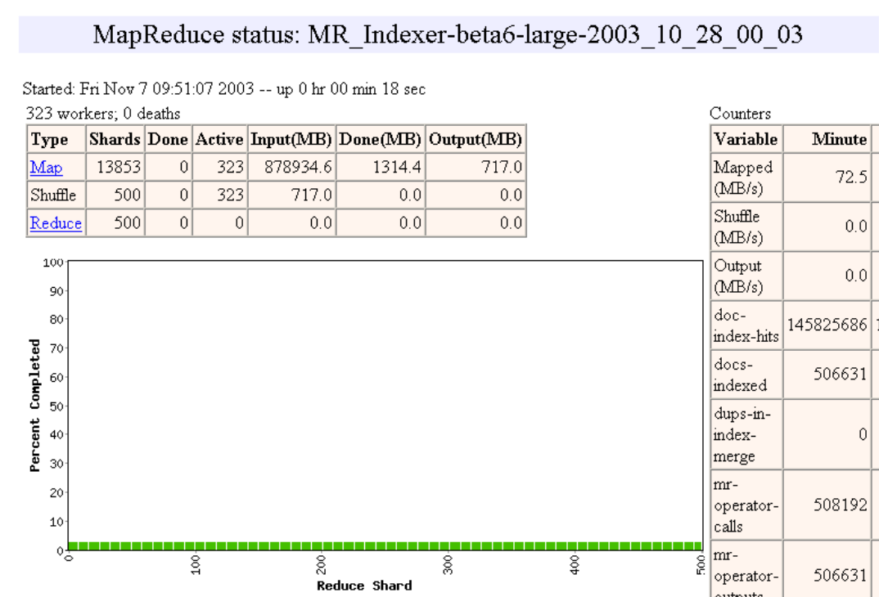
Execution progress illustration

Slide 17
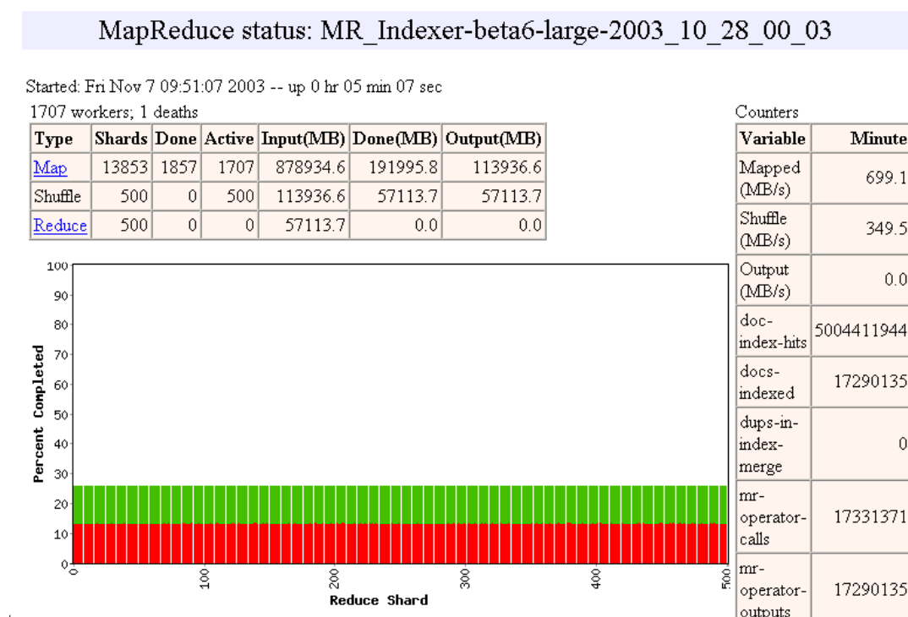

Slide 18
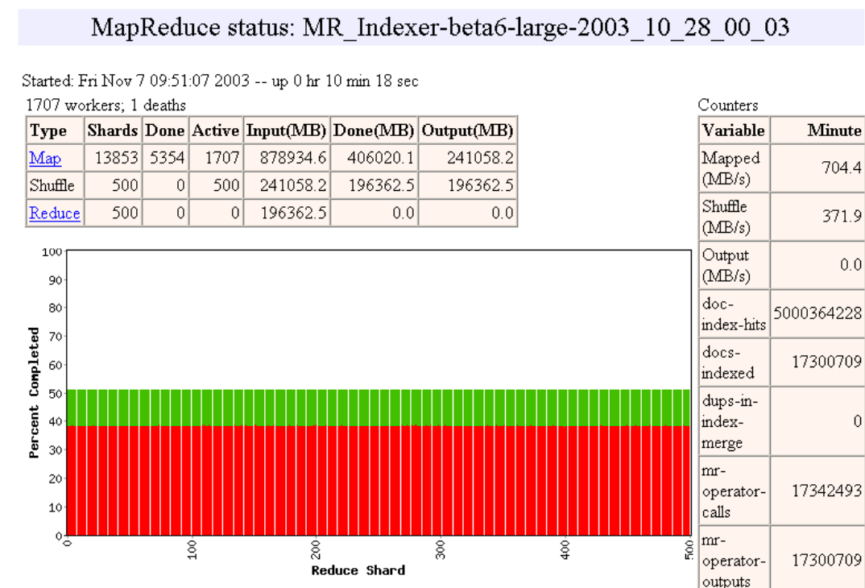

Slide 19
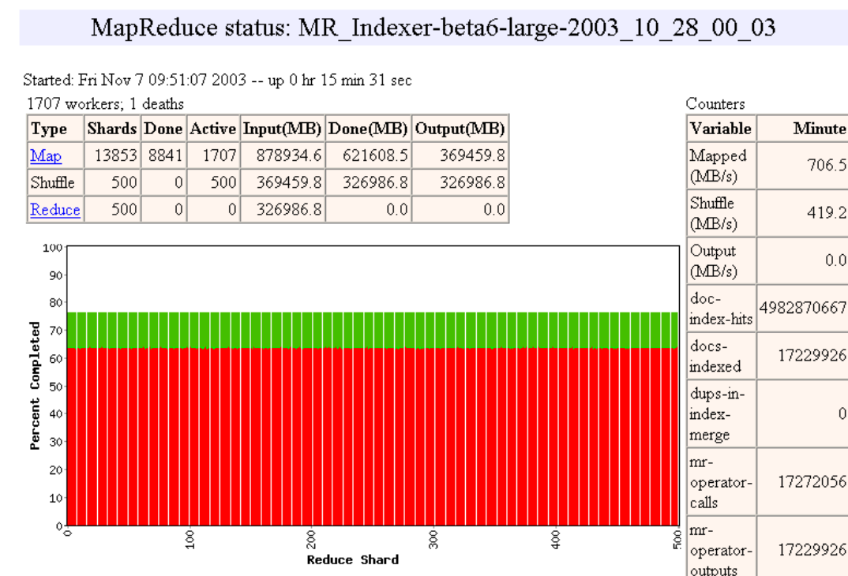

Slide 20
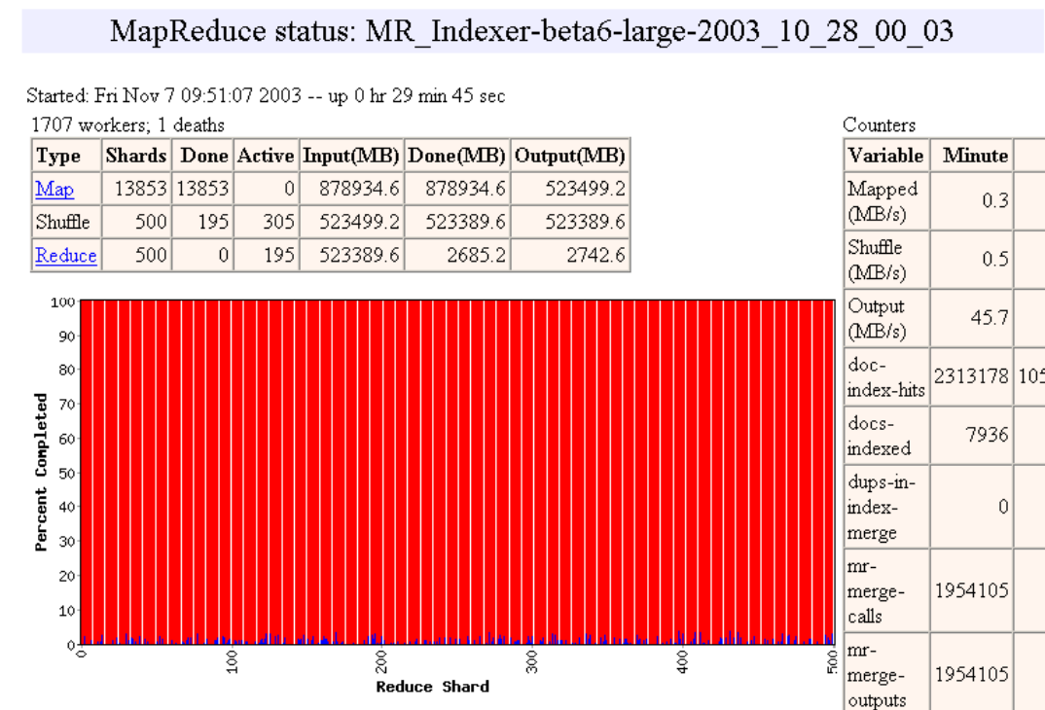

Slide 21
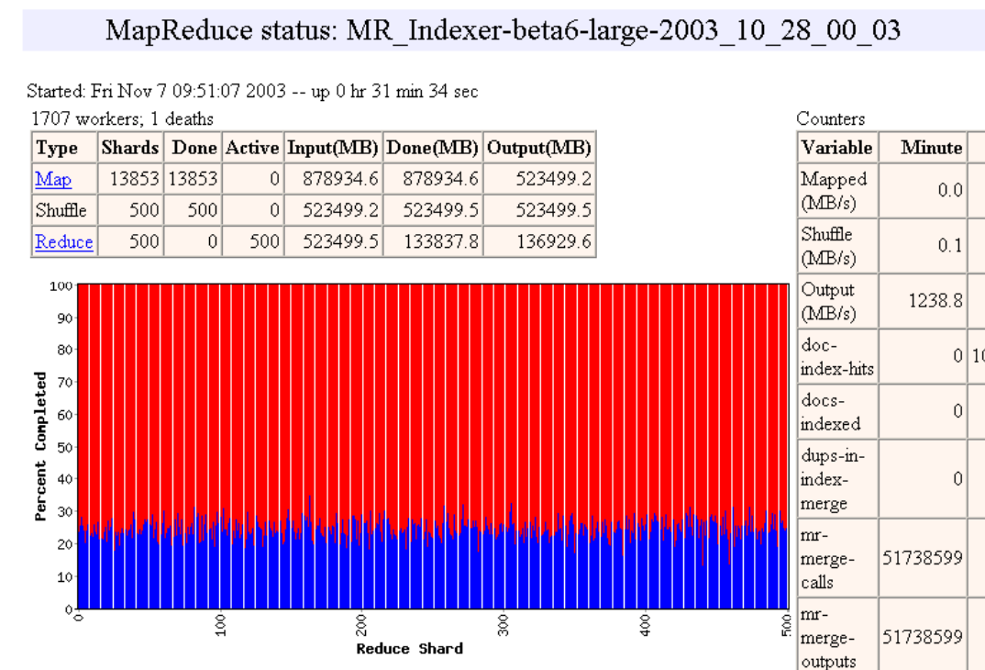

Slide 22
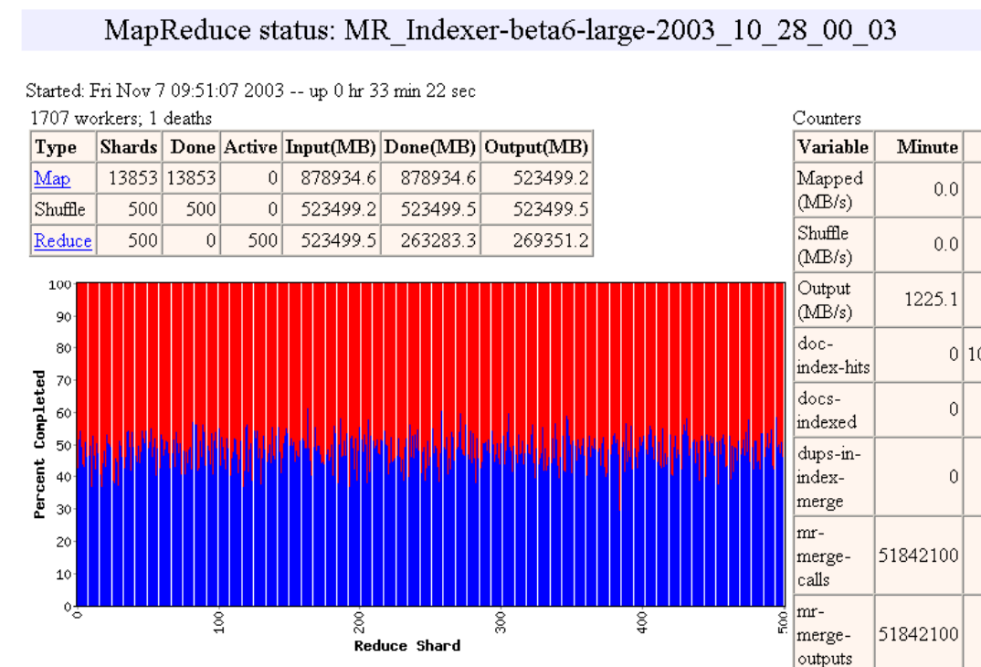

Slide 23
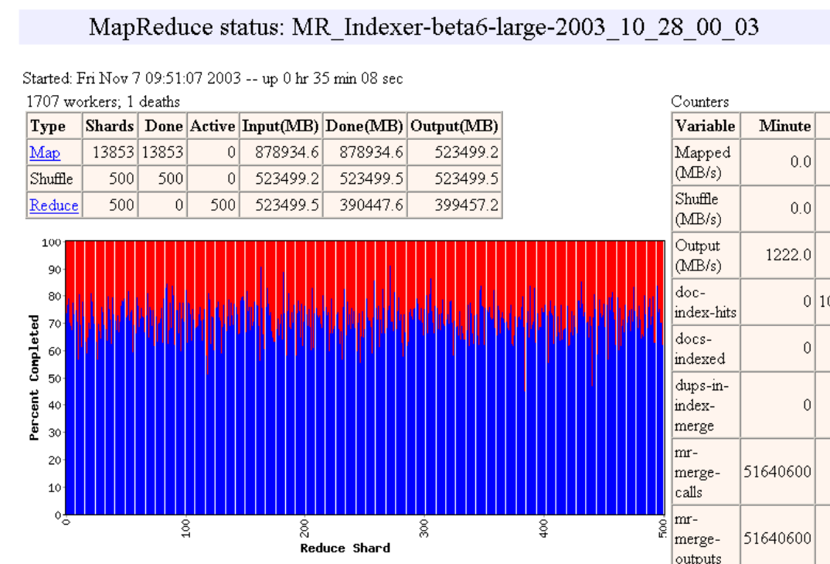

Slide 24
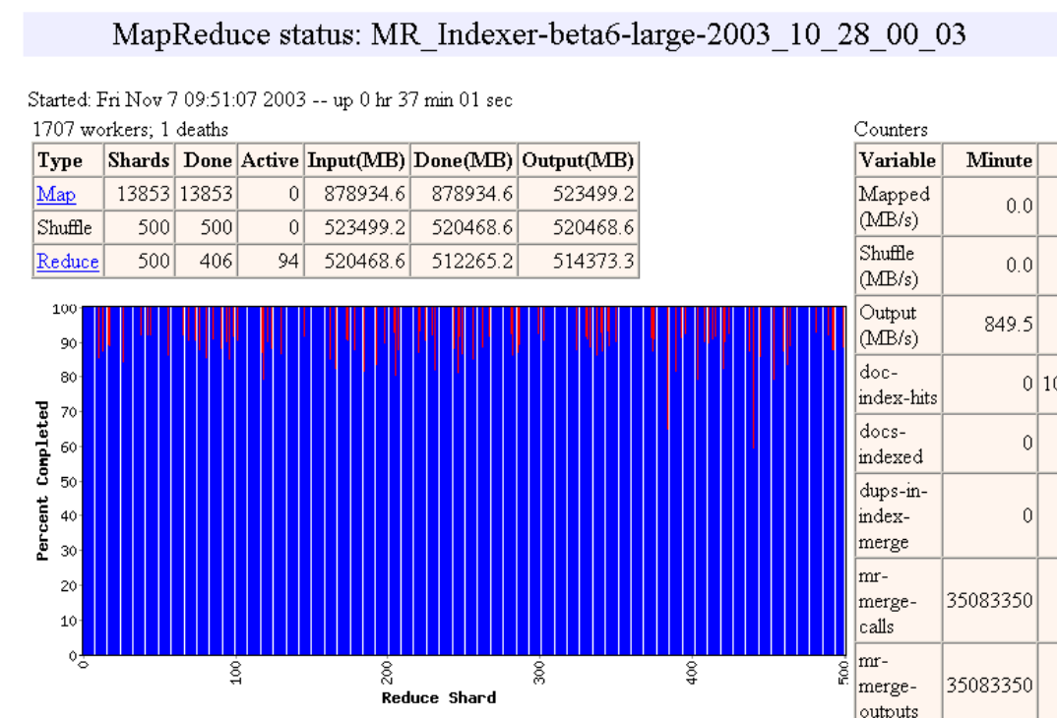

Slide 25


Slide 26


Slide 27
Fault-tolerance via re-execution
On worker failure:
Detect failure via periodic heartbeats
Re-execute completed and in-progress map tasks (why?)
Re-execute in progress reduce tasks
Task completion committed through master
Master failure:
Left unhandled as considered unlikely
Onus on users to restart computation
Robust: lost 1600 of 1800 machines, but finished fine

Slide 28
Refinement: Redundant Execution
Slow workers significantly lengthen completion time
Other jobs consuming resources on machine
Bad disks with soft errors transfer data very slowly
Weird things: processor caches disabled (!!)
Solution: Near end of phase, spawn backup task copies
Whichever one finishes first "wins"
Benefit: Dramatically shortens job completion time

Slide 29
Refinement: Locality Optimization
Master scheduling policy:
Asks GFS for locations of replicas of input file blocks
Map tasks typically split into 64MB (== GFS block size)
Map tasks scheduled so GFS input block replica are on same machine or same rack
Effect: Thousands of machines read input at local disk speed
Without this, rack switches limit read rate

Slide 30
Refinement: Skipping Bad Records
Map/Reduce functions sometimes fail for particular inputs
Best solution is to debug & fix, but not always possible
On seg fault:
Send UDP packet to master from signal handler
Include sequence number of record being processed
If master sees two failures for same record:
Next worker is told to skip the record
Effect: Can work around bugs in third-party libraries

Slide 31
Other Refinements
Sorting guarantees within each reduce partition
Compression of intermediate data
Combiner: useful for saving network bandwidth
Local execution for debugging/testing
User-defined counters

Slide 32
Performance evaluation
Tests run on cluster of 1800 machines:
4 GB of memory
Dual-processor 2 GHz Xeons with Hyperthreading
Dual 160 GB IDE disks
Gigabit Ethernet per machine
Bisection bandwidth approximately 100 Gbps
Two benchmarks:
MR_GrepScan 10¹⁰ 100-byte records to extract records matching a rare pattern (92K matching records)
MR_SortSort 10¹⁰ 100-byte records (modeled after TeraSort benchmark)

Slide 33
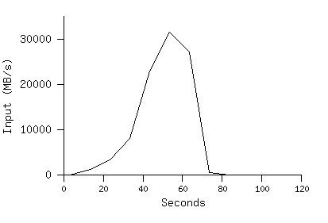
MR_Grep
Locality optimization helps:
1800 machines read 1 TB at peak ~31 GB/s
W/out this, rack switches would limit to 10 GB/s
Startup overhead is significant for short jobs

Slide 34
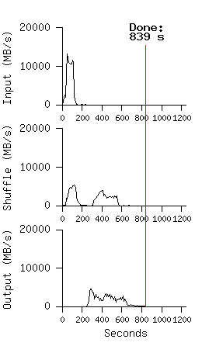
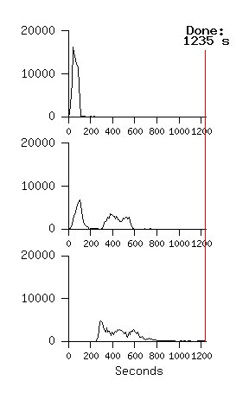
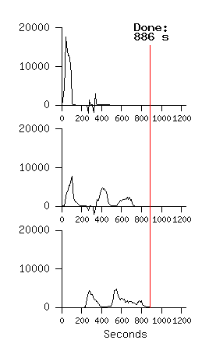
MR_Sort
Normal No backup tasks 200 processes killed
Backup tasks reduce job completion time a lot!
System deals well with failures

Slide 35
Google Experience: Rewrite of Production Indexing System
Rewrote Google's production indexing system using MapReduce
Set of 10, 14, 17, 21, 24 MapReduce operations
New code is simpler, easier to understand
MapReduce takes care of failures, slow machines
Easy to make indexing faster by adding more machines

Slide 36
Google usage: MapReduce jobs in Aug’04
Number of jobs 29,423
Average job completion time 634 secs
Machine days used 79,186 days
Input data read 3,288 TB
Intermediate data produced 758 TB
Output data written 193 TB
Average worker machines per job 157
Average worker deaths per job 1.2
Average map tasks per job 3,351
Average reduce tasks per job 55
Unique map implementations 395
Unique reduce implementations 269
Unique map/reduce combinations 426

Slide 37
Related Work
Programming model inspired by functional language primitives Partitioning/shuffling similar to many large-scale sorting systems
NOW-Sort ['97]
Re-execution for fault tolerance
BAD-FS ['04] and TACC ['97]
Locality optimization has parallels with Active Disks/Diamond work
Active Disks ['01], Diamond ['04]
Backup tasks similar to Eager Scheduling in Charlotte system
Charlotte ['96]
Dynamic load balancing solves similar problem as River's distributed queues
River ['99]

Slide 38
Conclusions
MapReduce has proven to be a useful abstraction
Greatly simplifies large-scale computations at Google
Fun to use: focus on problem, let library deal w/ messy details

