Slide 1
Manuscript Figures

Slide 2
Sketch of transport

Slide 3
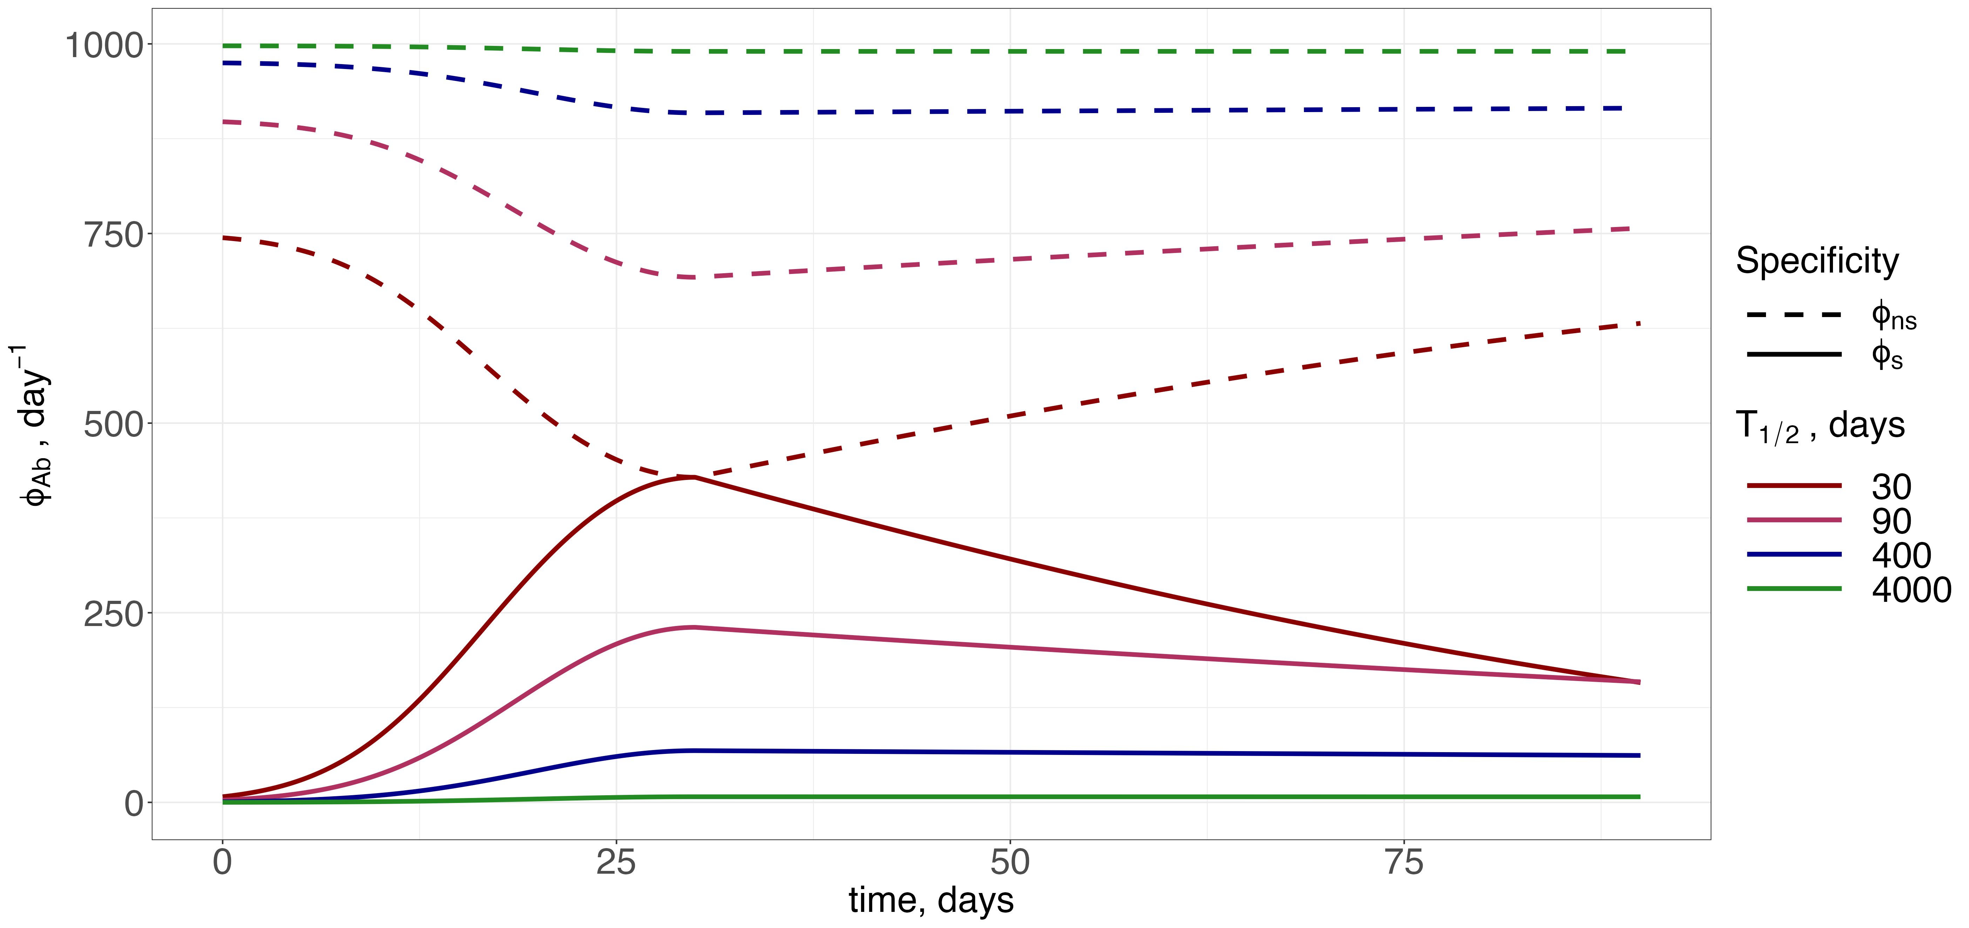

Slide 4
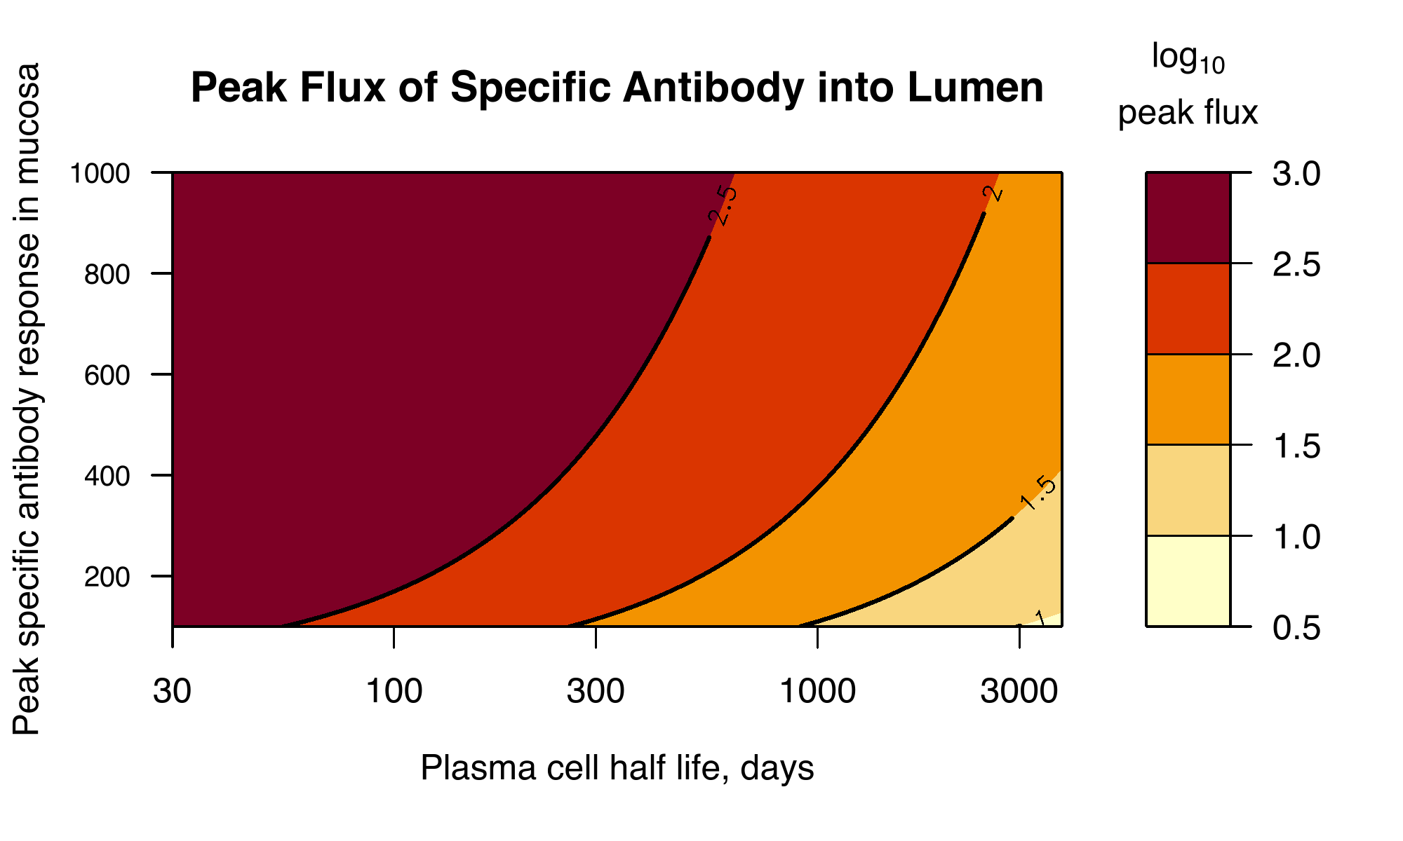
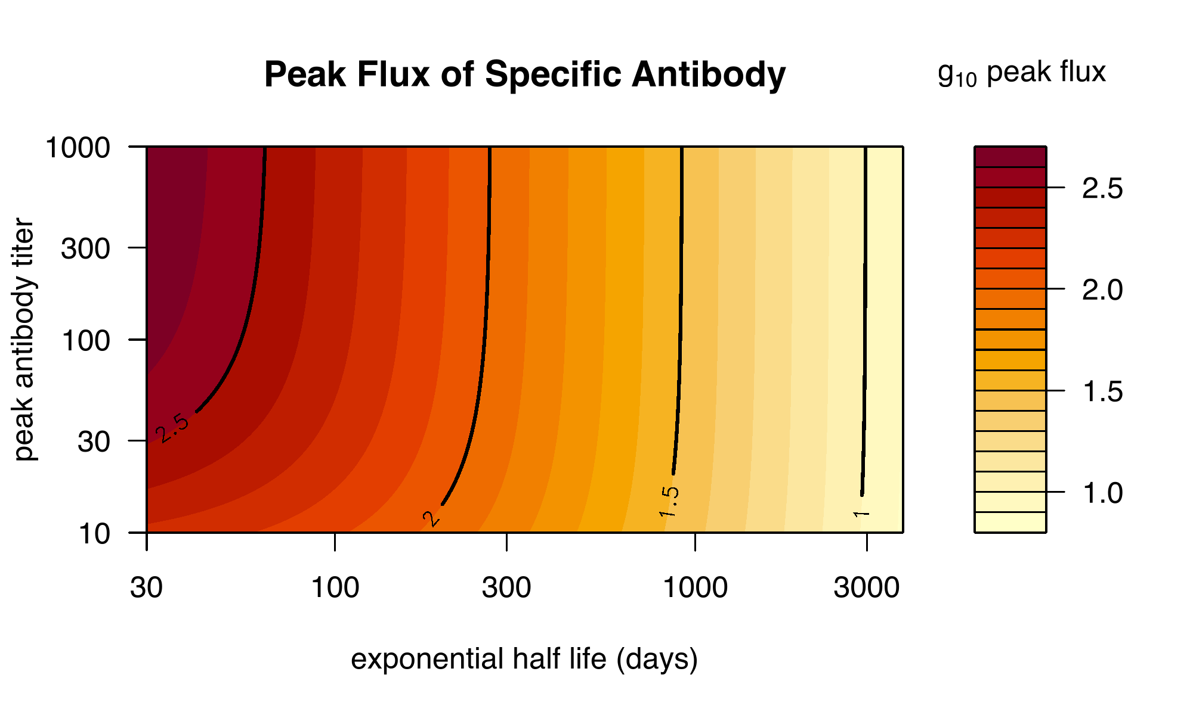

Slide 5
