Slide 1
Ag
Ag
Ag
Ag
Antigen-binding
v_{H}
v_{H}
v_{L}
v_{L}
light chain
C_{H}
C_{H}
C_{L}
C_{L}
Constant region for IgA
Constant region for IgG1
components for dimerization & secretion
heavy
chains
IgA (dimer)
IgG1 (monomer of
2H and 2L chains)

Slide 2
antigen
Long-lived plasma cells
B cells
Antibody
(short T_{1/2} ~ 21 days)
Antibody concentration reflects secretion from plasma cells

Slide 3
IgG1: tradeoff for space in bone marrow
IgA: competition for transport into lumen
lumen
(infection site)
Adding new PC
pIgR
antibody to new infections
competes for transport with
removal of PC to old infections
antibodies to earlier infections
polymeric IgA transport receptor

Slide 5
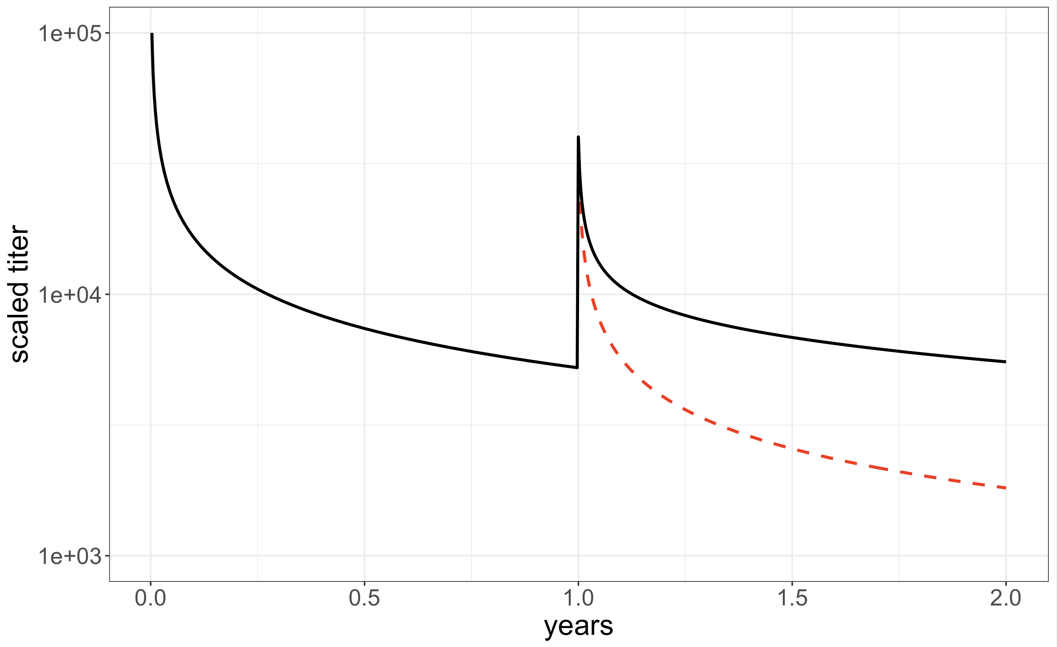
Short lived Effector
Long-lived PC
Secreted antibody
(T_{1/2}~21d)
Naïve
T cell
Prolif. / Effector
death
Naïve
B cell
Prolif. GC
death follows Power-Law
death
death
Long-lived
TCM cell
Long lived MBC
A
B
10⁵
Long-lived PC
Secreted antibody
(T_{1/2}~21d)
simulations from eqn 4
10⁴
Naïve
B cell
Prolif. GC
death follows Power Law m_{p} (prime) and m_{b} (boost)
Scaled antibody titer
simple power law decay (m)
Long lived MBC
simple power law decay (m)
10³
0 1.0 2.0
death
years

Slide 6
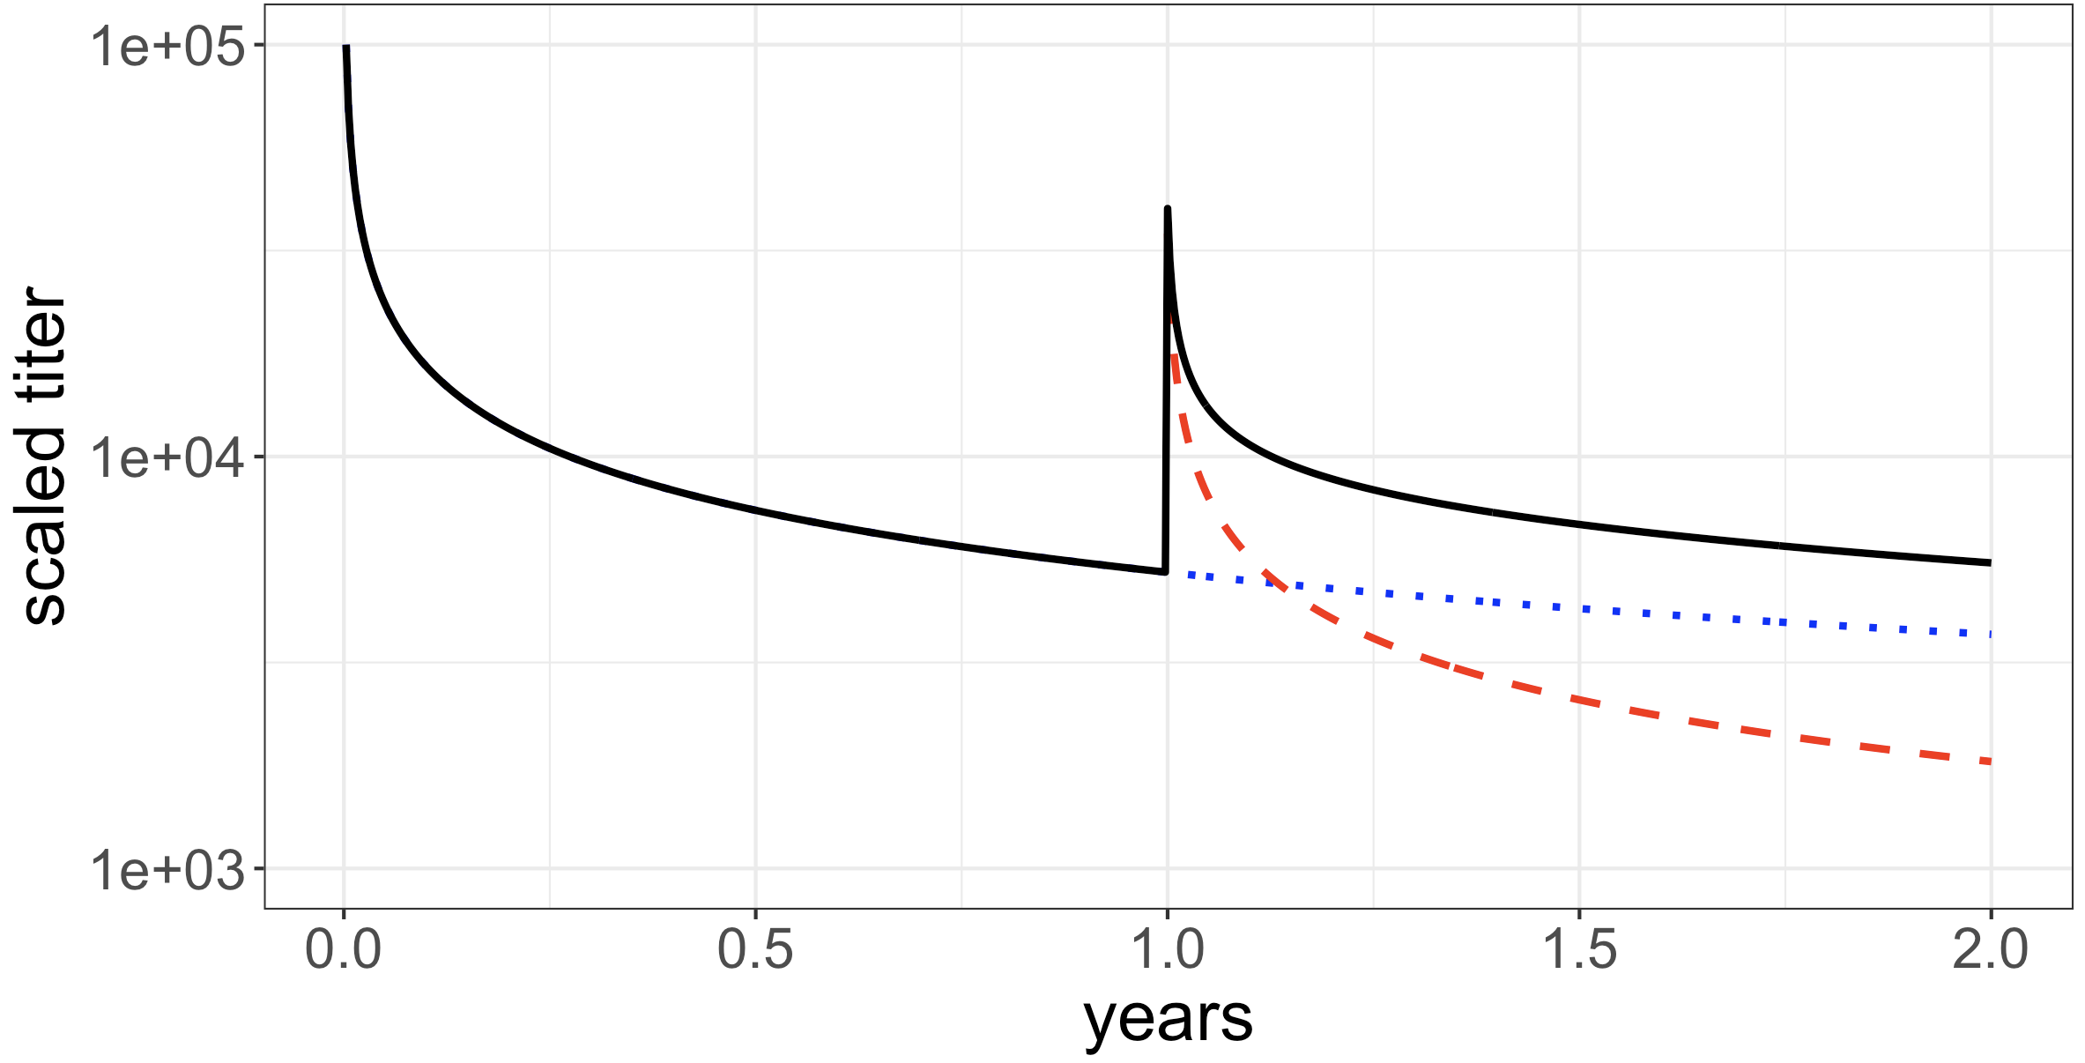
5
log₁₀ scaled titer
4
observed (total) titer
from primary
from boost
primary response
4x boost
3
0
1
2
time (years)

Slide 7
Primary vaccination First boost Second boost
SARS-CoV-2 spike antibody titter
natural
threshold
March 2020 March 2021 March 2022 March 2023

Slide 8
Influx after immunization or infection
Homeostasis:
d_{i} = h_{i}(x_{1, …} x_{n})
Antibody
dA/dt = p Σx_{i} – d_{A}A
Death rates
d₁>d₂>…>d_{n}
extrinsic model
a
intrinsic model
a₁
a₂
a_{n}
f₁
f_{n-1}
X₁
X₂
…..
X_{n}
b₁
b_{n-1}
d₁
d₂
d_{n}

Slide 9
pIgR
Respiratory
mucosal tissue
(production site)
lumen
(infection site)
polymeric IgA transport receptor

Slide 10
Blood
Respiratory Mucosa
Lumen URT
Secreted antibody
(T_{1/2}~21d)
Secreted antibody
(T_{1/2}~21d)
Long-lived PC
Long-lived PC
death follows Power-Law
death
Naïve
B cell
Prolif. GC
Naïve
B cell
Prolif. GC
death
death
Transported antibody
(T_{1/2}~3d)
Long lived MBC
Long lived MBC
Secreted antibody
(T_{1/2}~21d)
Secreted antibody
(T_{1/2}~21d)
Long-lived PC
Long-lived PC
death follows Power-Law
death follows Power-Law
Naïve
B cell
Prolif. GC
Naïve
B cell
Prolif. GC
death
death
Long lived MBC
Long lived MBC

