Slide 1
Manuscript

Slide 2
Endemic circulation in
animal reservoir
Stuttering transmission in humans
R_{e} < 1
Sustainable transmission in humans
R_{e} > 1
†
†
†
Adaptation in stuttering chains of transmission, R₀ increasing
Further evolution to high
transmissibility, R₀ increasing
Introduction
(from reservoir)
Incipient epidemic (R_{e} > 1)
(R_{e} >> 1)
Extinction
Emergence
Continued evolution

Slide 3
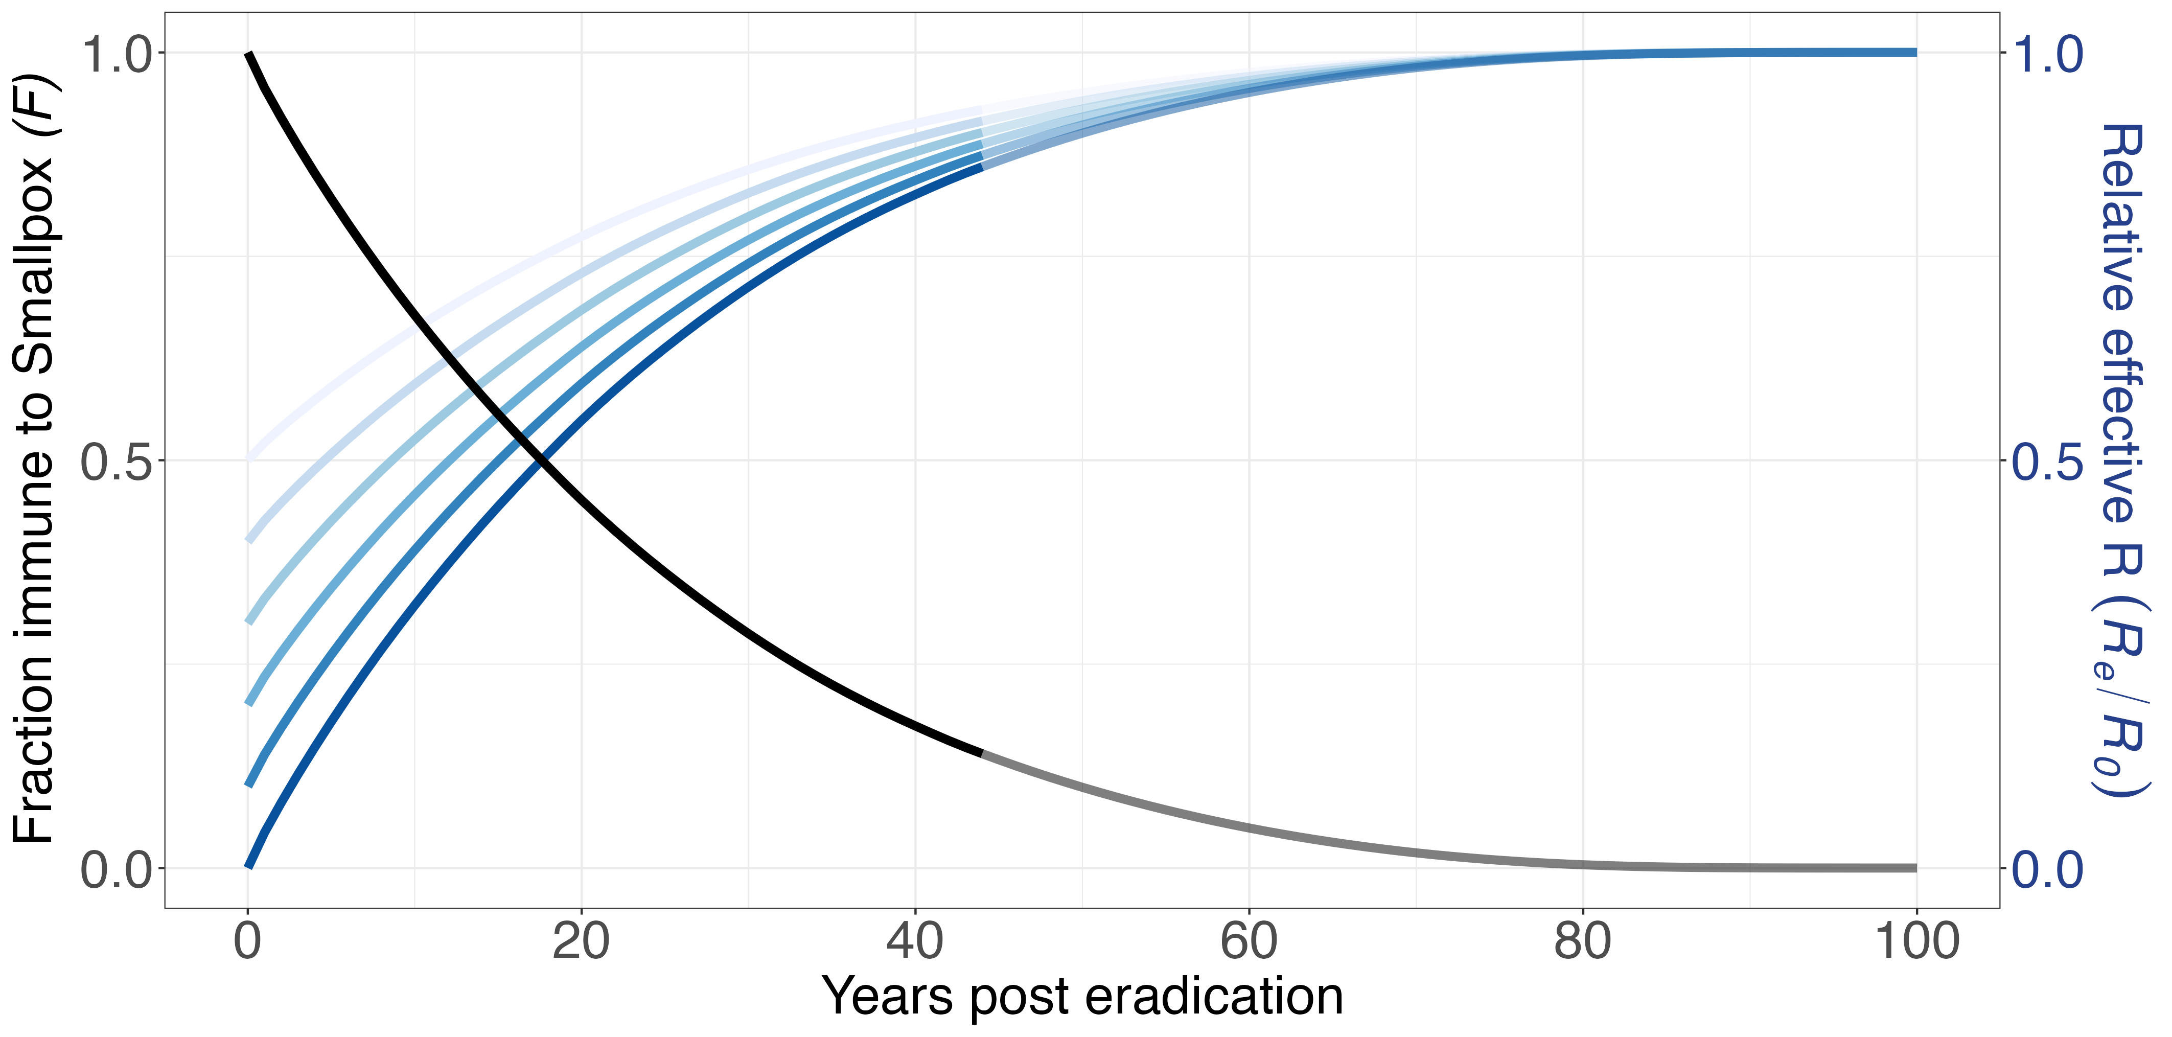
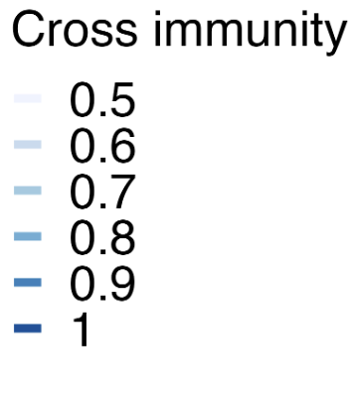

Slide 4
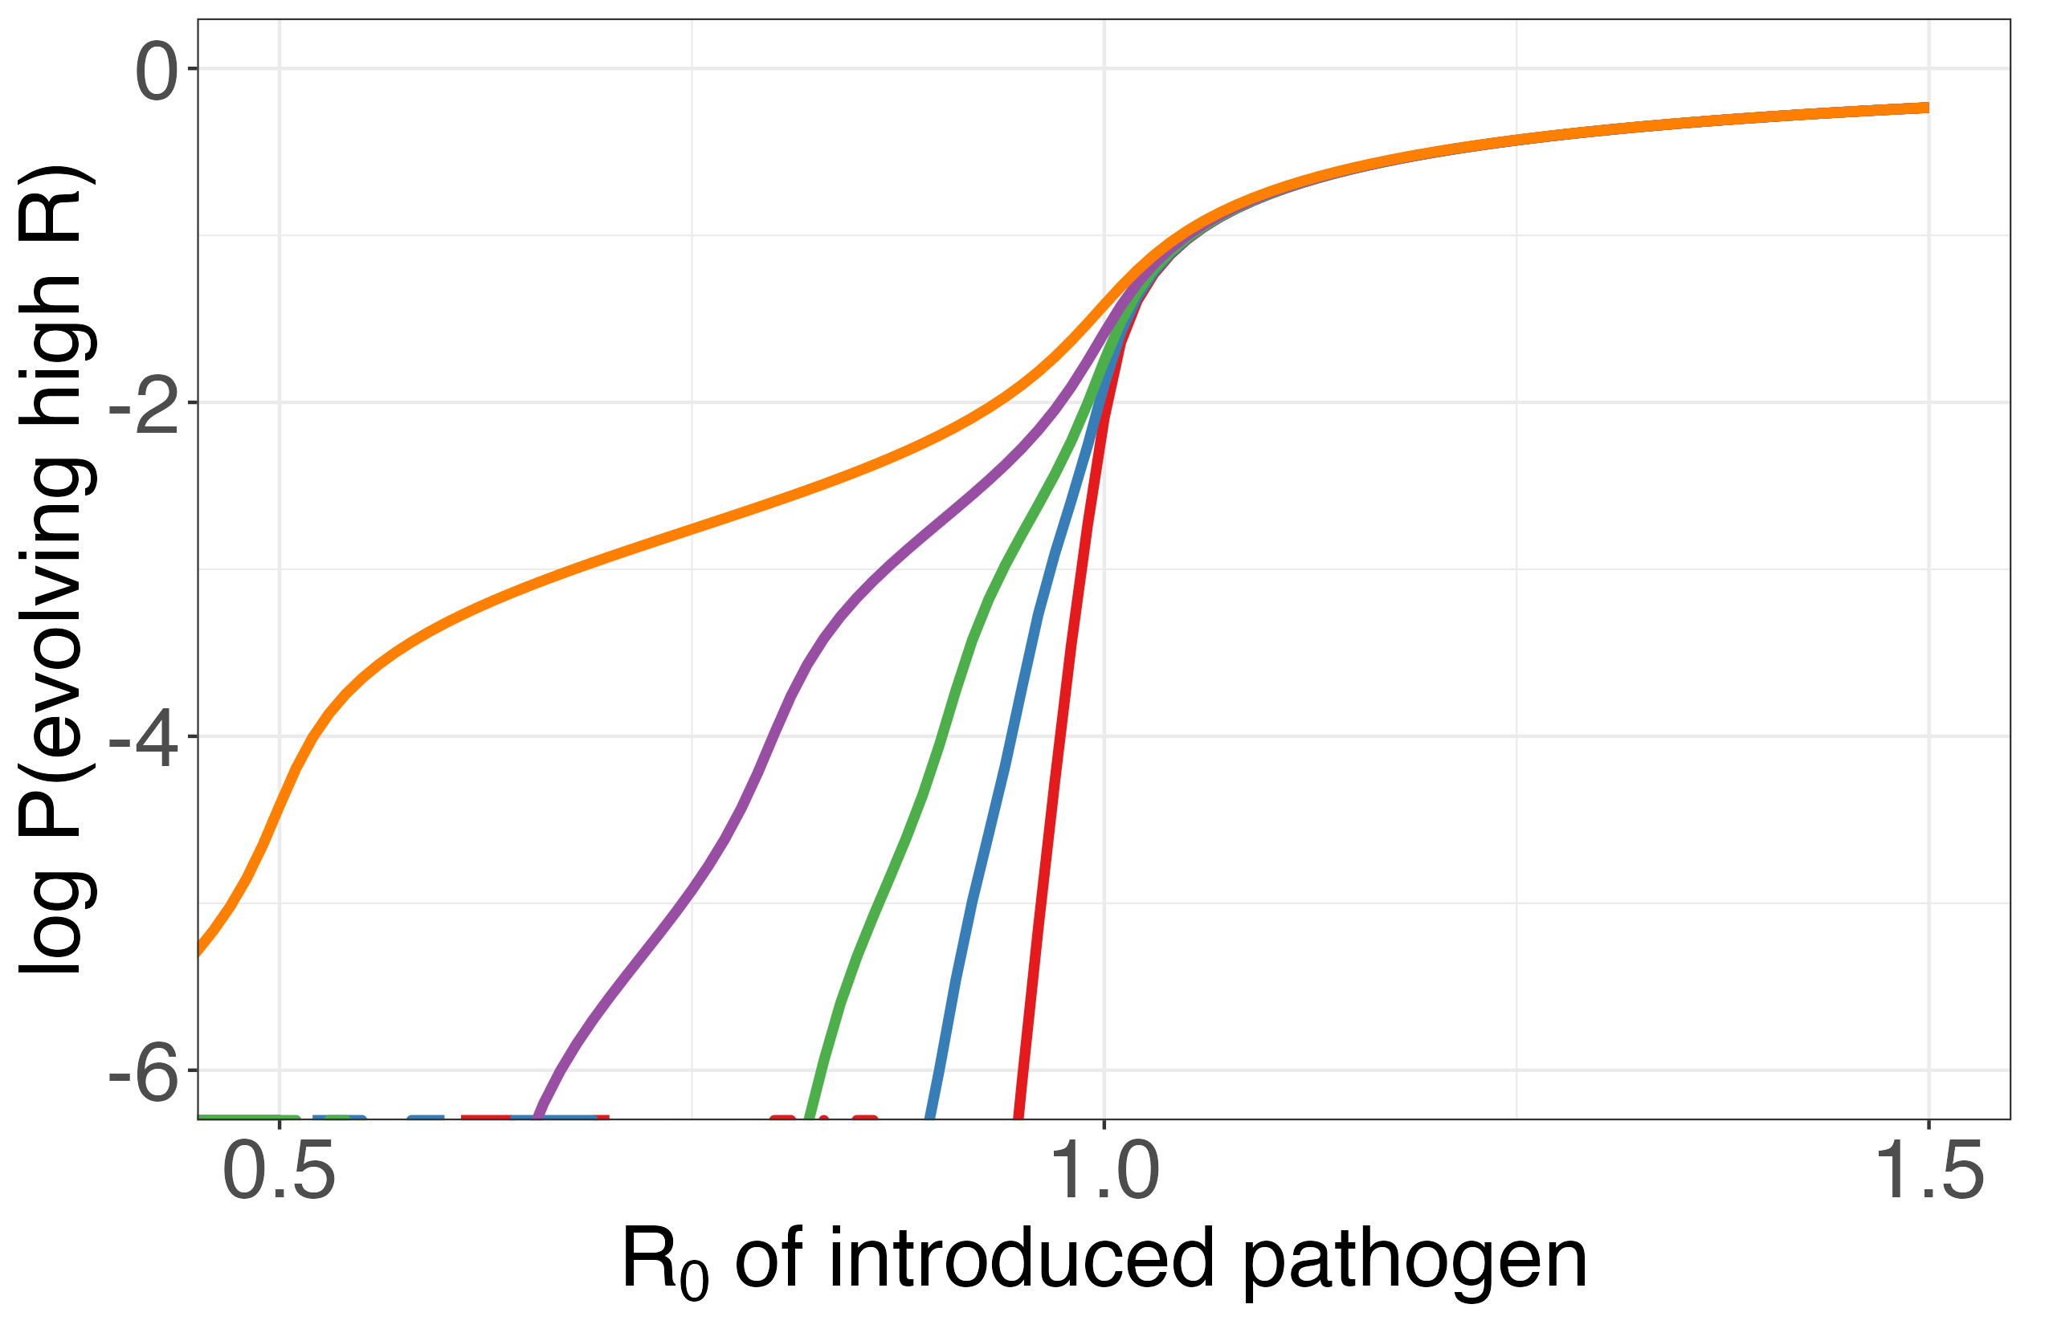
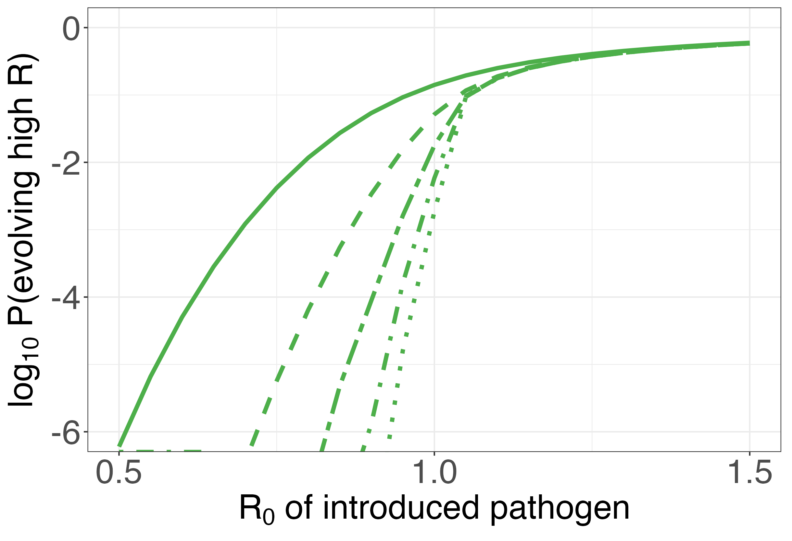

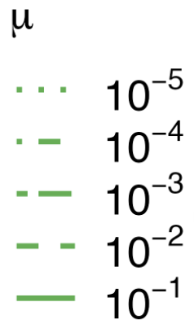
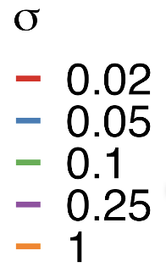
A
B

Slide 5
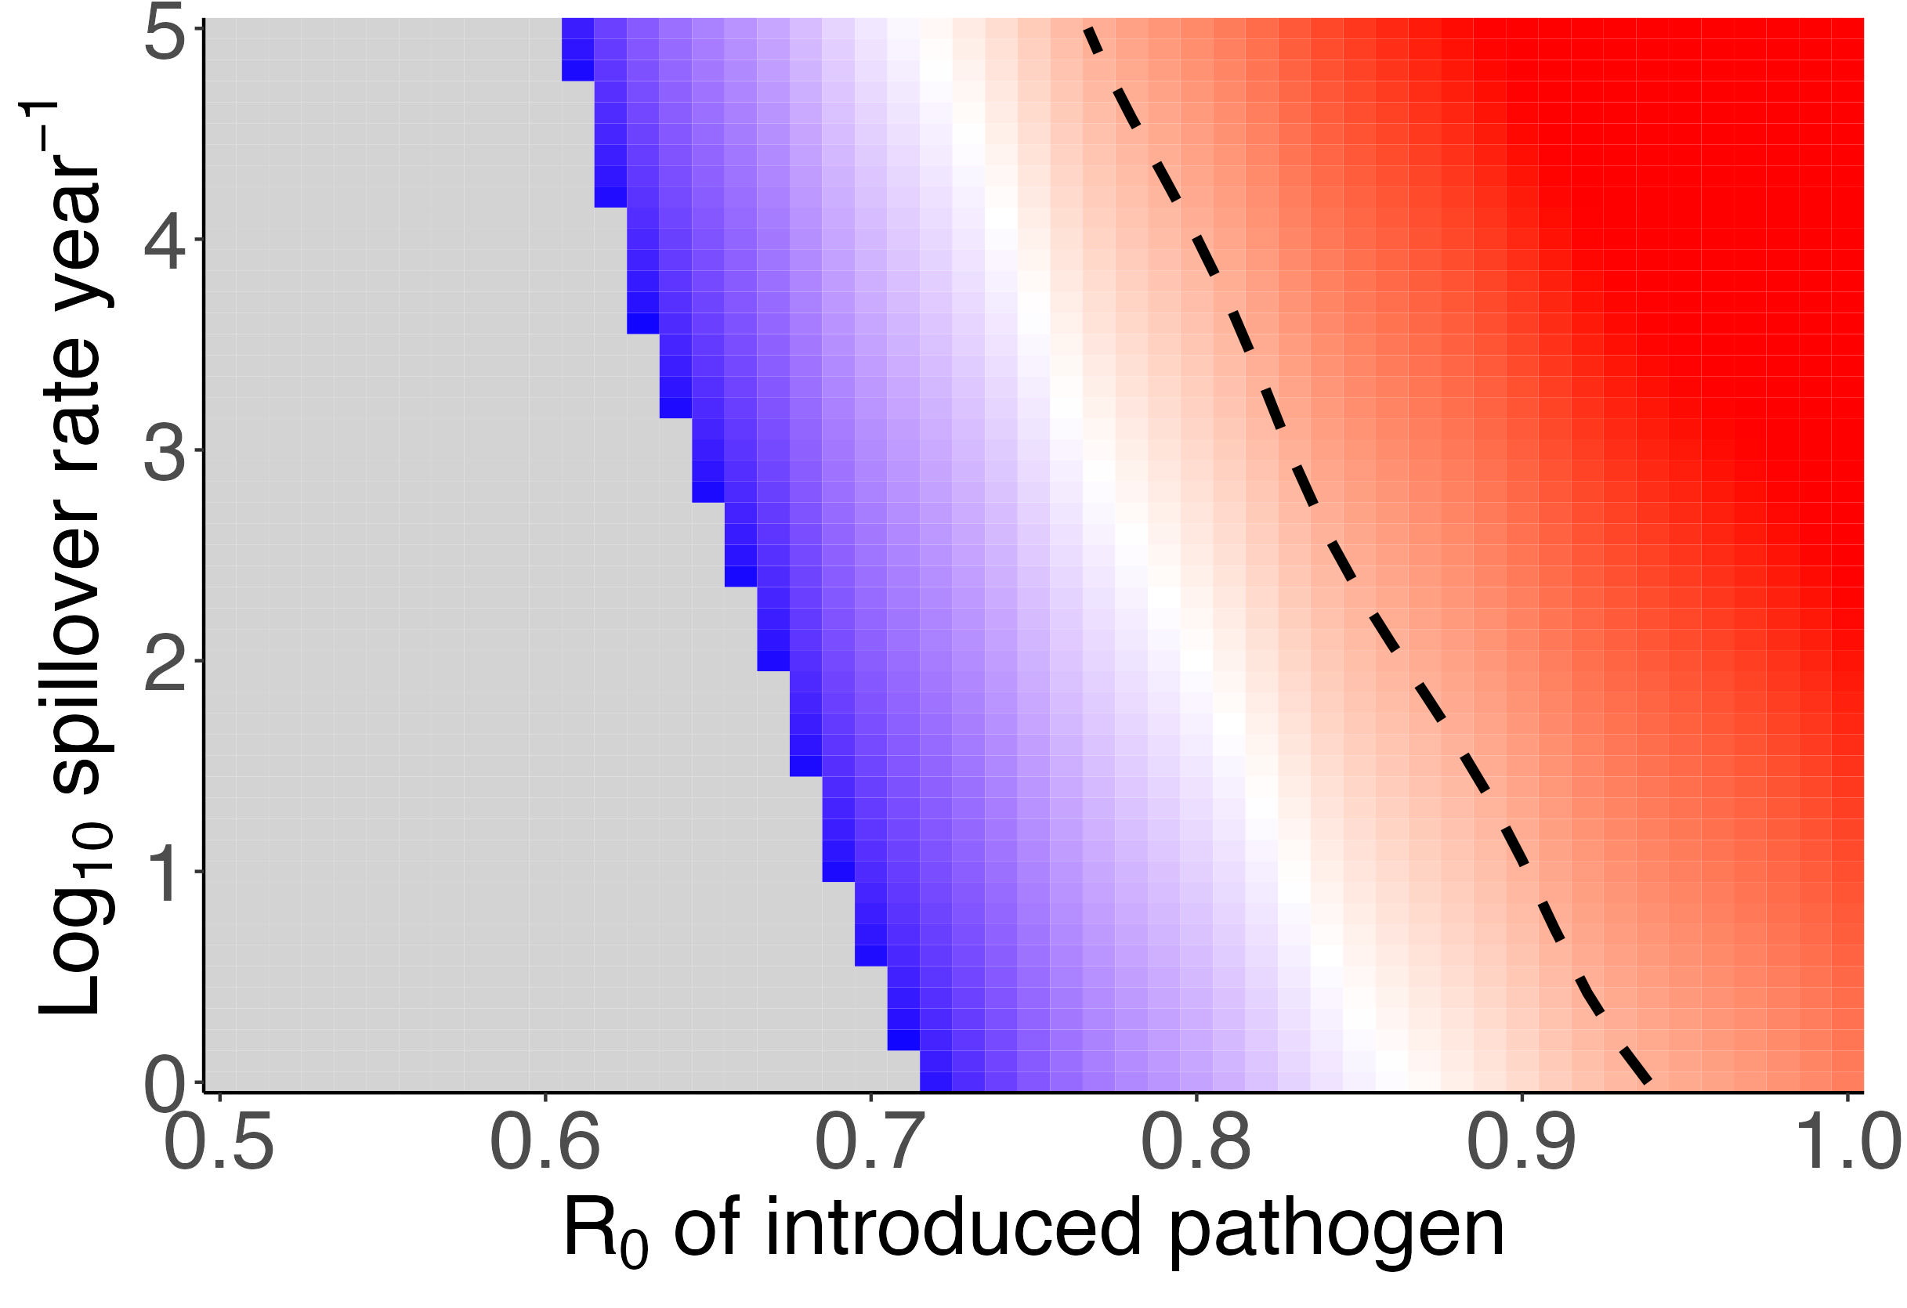
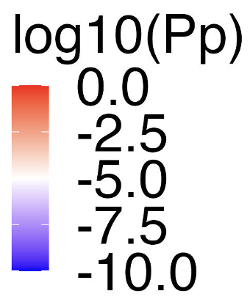

Slide 6
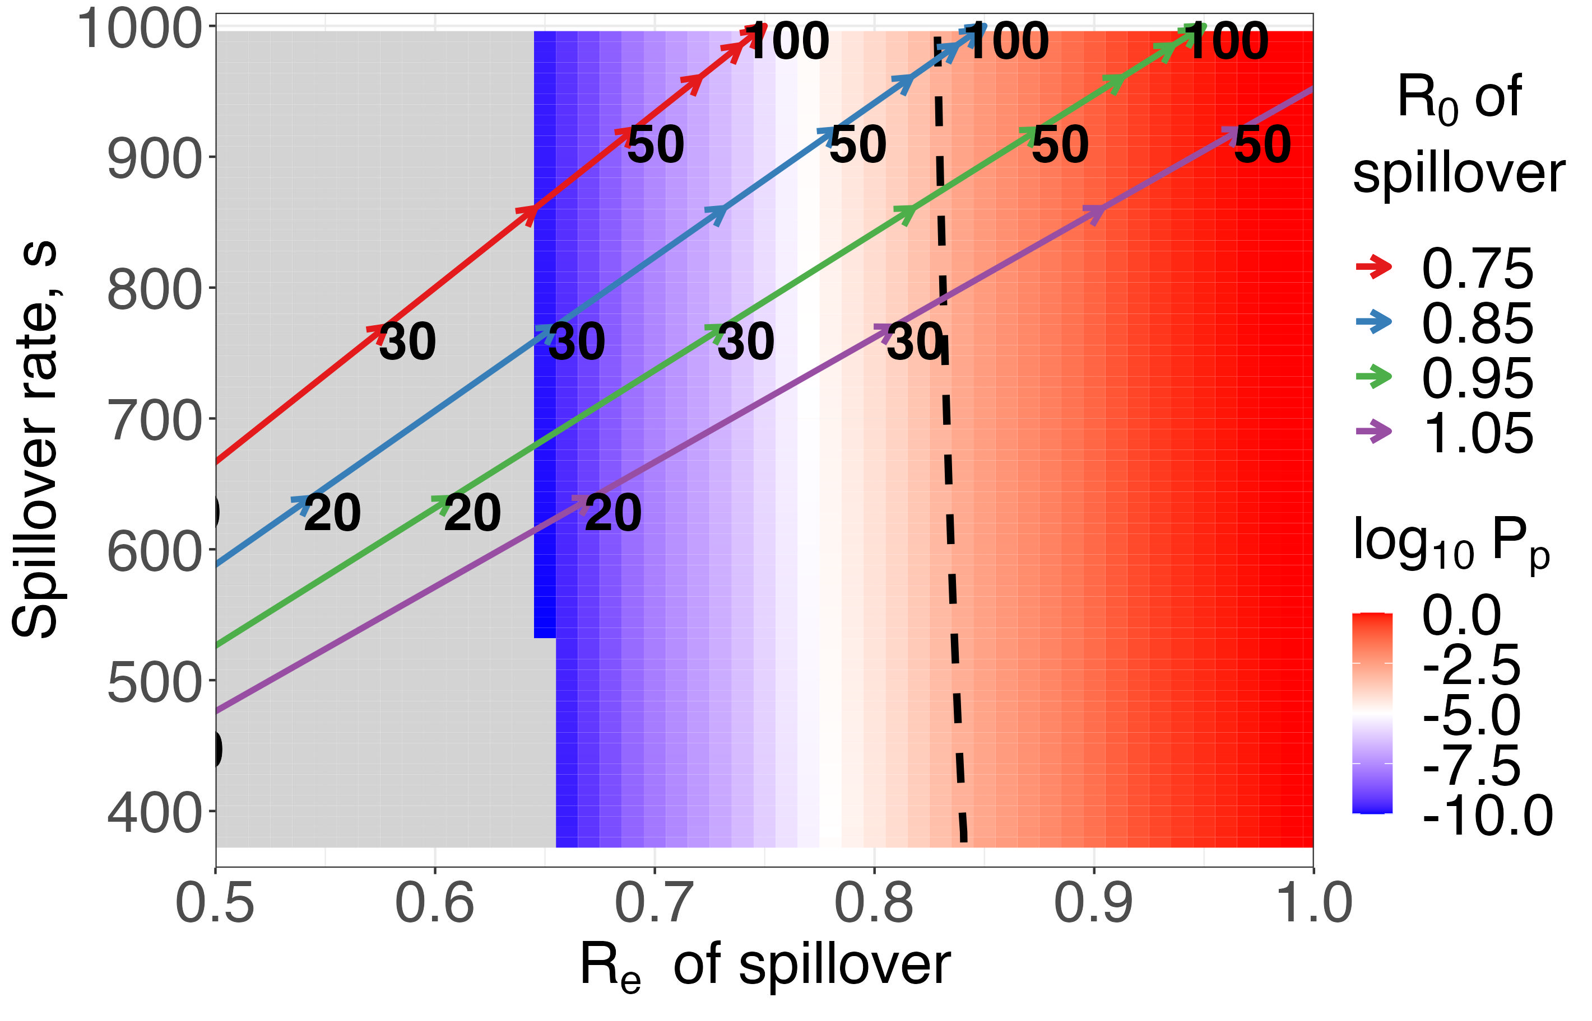
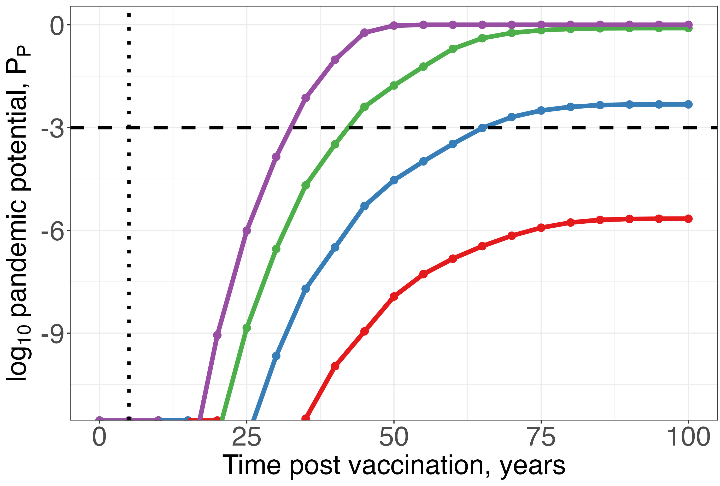
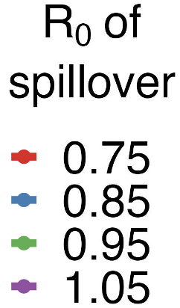
A
B

Slide 7
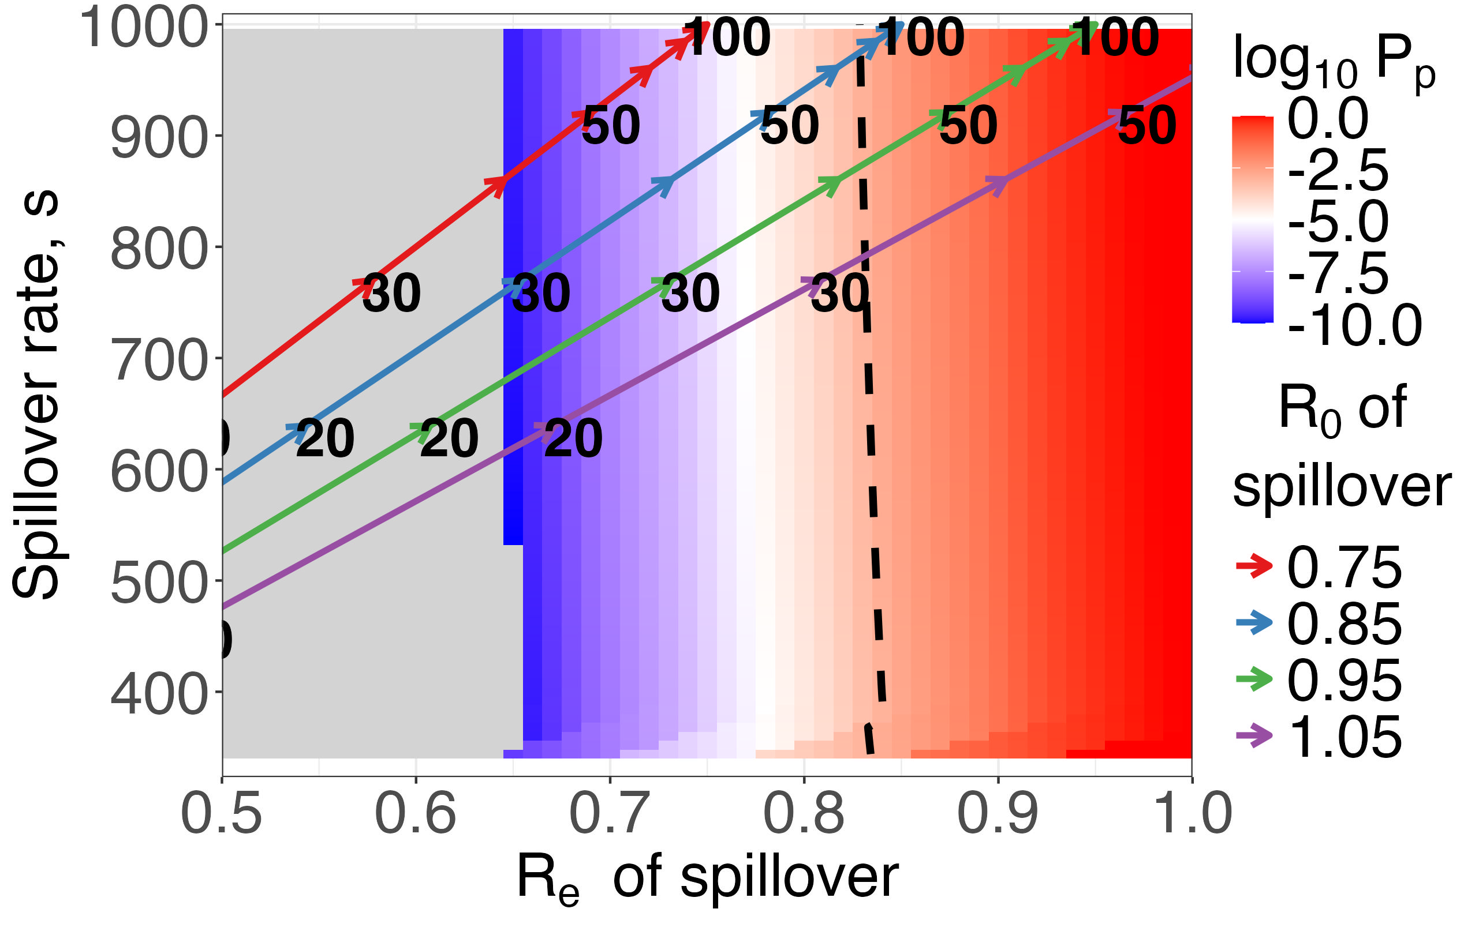
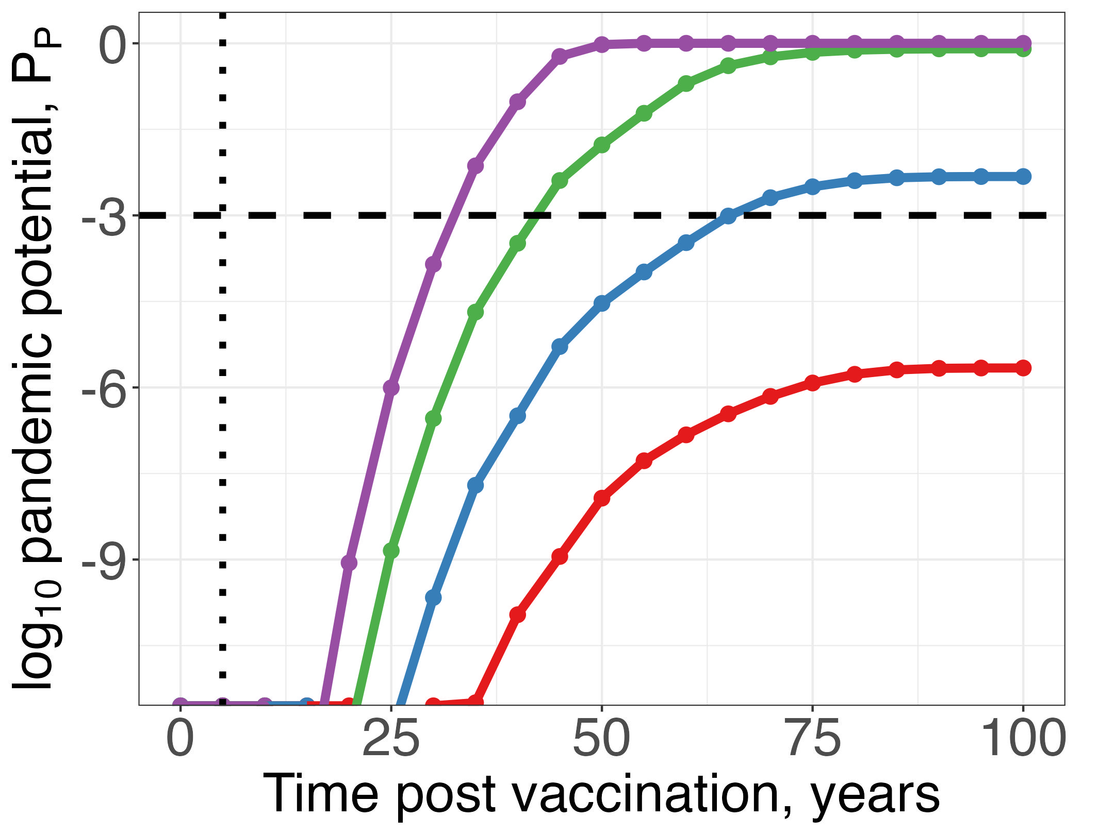
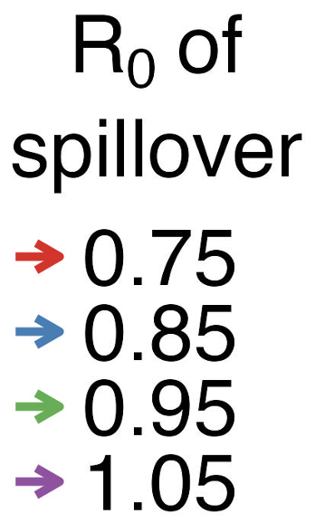
A
B

Slide 8
Eradication
Prevention
Reproductive Number, R
Small
Small
Large
R_{T}
R_{0,Spillover}
1
R_{0,Evolved}
Waning immunity:
R_{e} increases
toward R₀
Evolution after spillover:
Adaptation continues to increase R₀
Effort required for control

Slide 9
Supplement

Slide 10
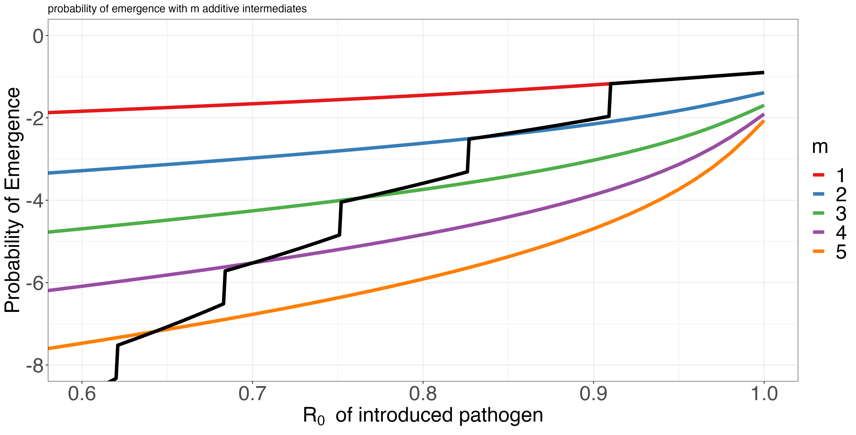
Supercritical
1 mutations away
2 mutations away
Number of mutations required, additive model (Antia et al 2003)
Probability of becoming supercritical before extinction
3 mutations away
4 mutations away
5 mutations away
R₀ of introduced pathogen

Slide 11
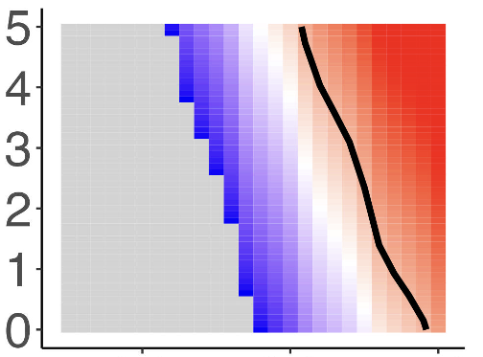
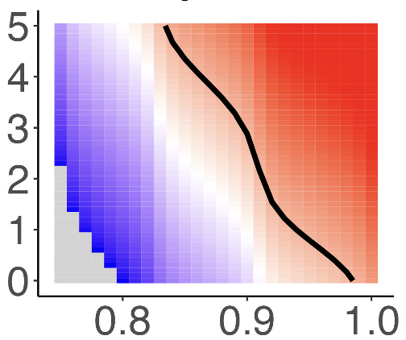
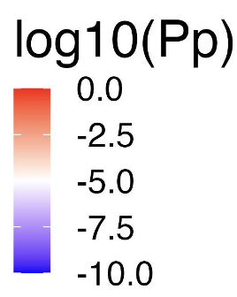
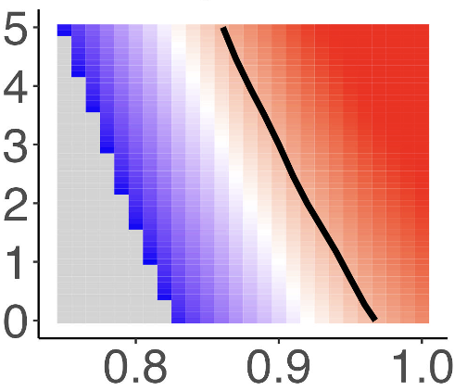
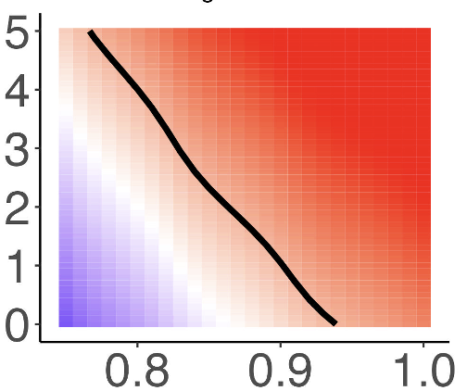
Increase in fitness with mutation, 𝛔
0.05 0.1
10⁻⁴
Beneficial mutation rate (infection⁻¹), 𝝁
Log10 Spillover rate year⁻¹
10⁻³
R₀ of introduced pathogen

Slide 12
