Slide 1
The effect of population immunity on the emergence probability of zoonotic infections

Slide 2
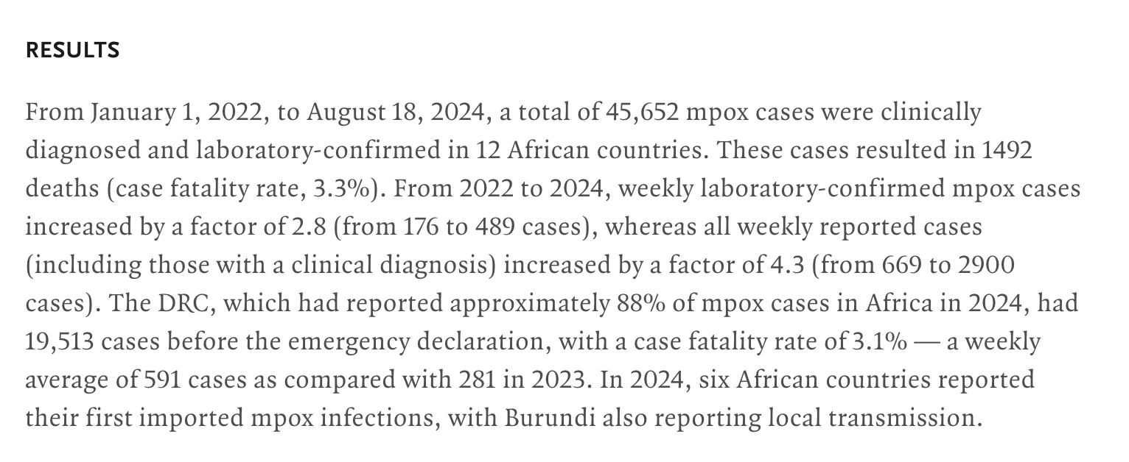
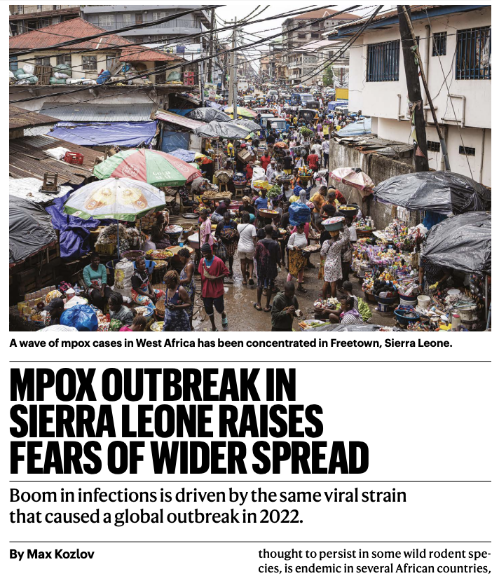
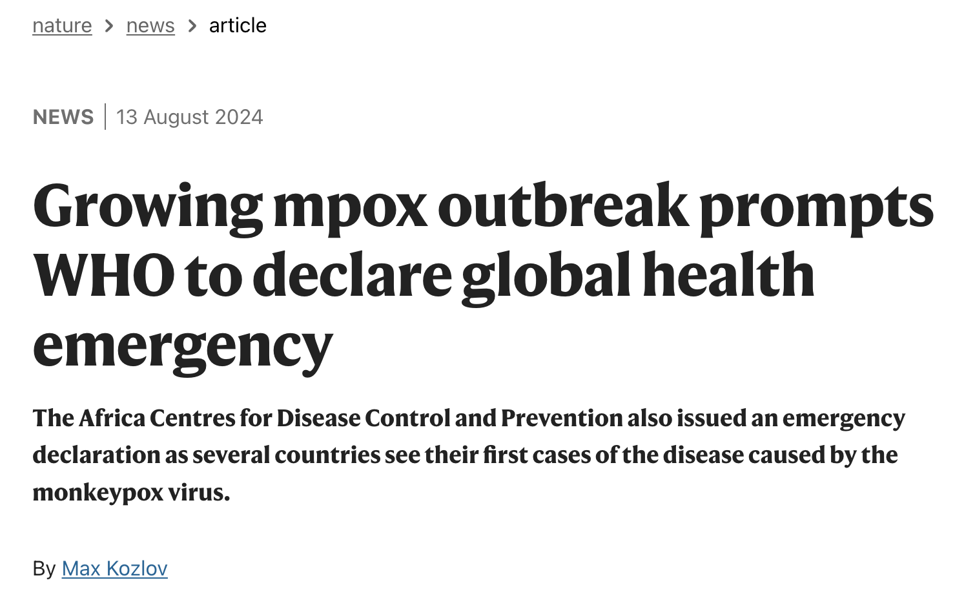

Slide 3















How can Mpox cause an epidemic?
Bites, scratches, bushmeat hunting
Close contact with lesions, large droplets
Epidemic
Highly transmissible in humans
“Tailor-made”: virus acquires mutations during stuttering human-human transmission after spillover
Notes:
Through broken skin or mucous membranes

Slide 4
R0 > 1 Theory
Deterministic simulation
Stochastic Simulation

Slide 5
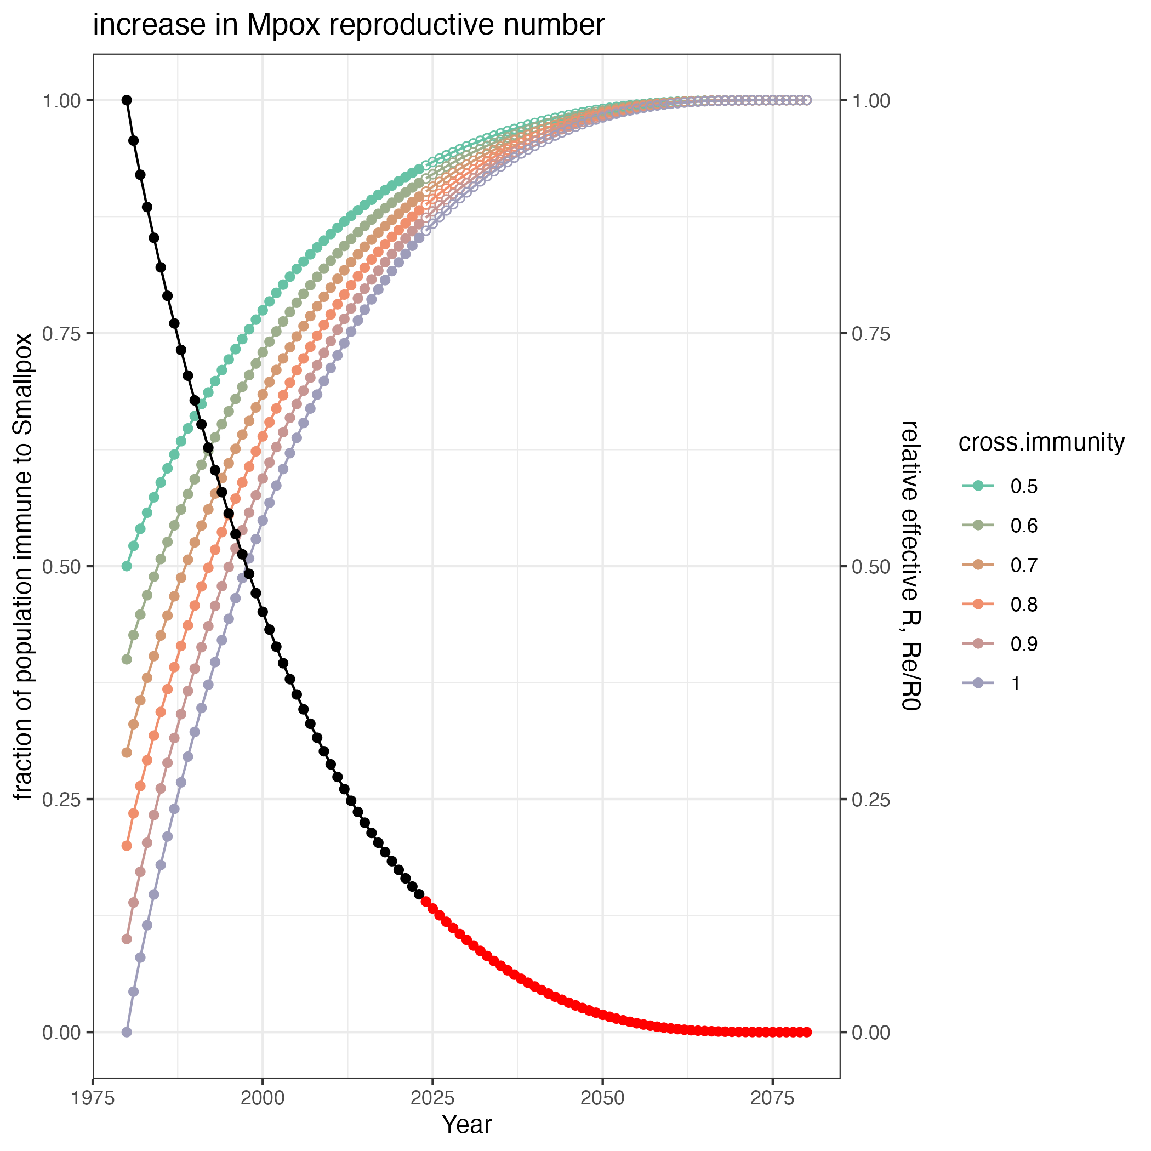

Slide 6
How does the emergence of highly infectious disease depend on:
The rate of acquiring beneficial mutations
R0 of the first infection
Number of mutations required to adapt
(pre-adaptation, R0 > 1)
“Off-the-shelf”
Number of mutations to adaptation
†
“Tailor-made”
Adaptive evolution during stuttering chains of transmission in humans
Introduction
(from reservoir)
Incipient epidemic
R0 increasing
R0 = 1
Extinction
Emergence

Slide 7
Introduction
(from reservoir)
Transmission in
human population
†
†
†
†
†
†
†
Infections by:
†
4 mutations away from R0 > 1
3 mutations away from R0 > 1
2 mutations away from R0 > 1
1 mutations away from R0 > 1
R0 > 1
†
†
Emergence

Slide 8
Branching process
Calculate the probability that a lineage starting with some R evolves a variant with R > 1 (or 3, for Smallpox) before going extinct

