Slide 1
Modeling Disease Re-emergence Post-Eradication: application to mpox
2 mutations away
4 mutations away
†
Cora Hirst
Emergence
Population Biology, Ecology, and Evolution, Emory University
EEID 2026
†
Acknowledgements: Rustom Antia, Daniel Weissman
Emergence
NIH Funding
Notes:
I’ll be talking about some work I’m finishing up regarding the potential for evolution of subcritical diseases during stuttering chains of transmission

Slide 2

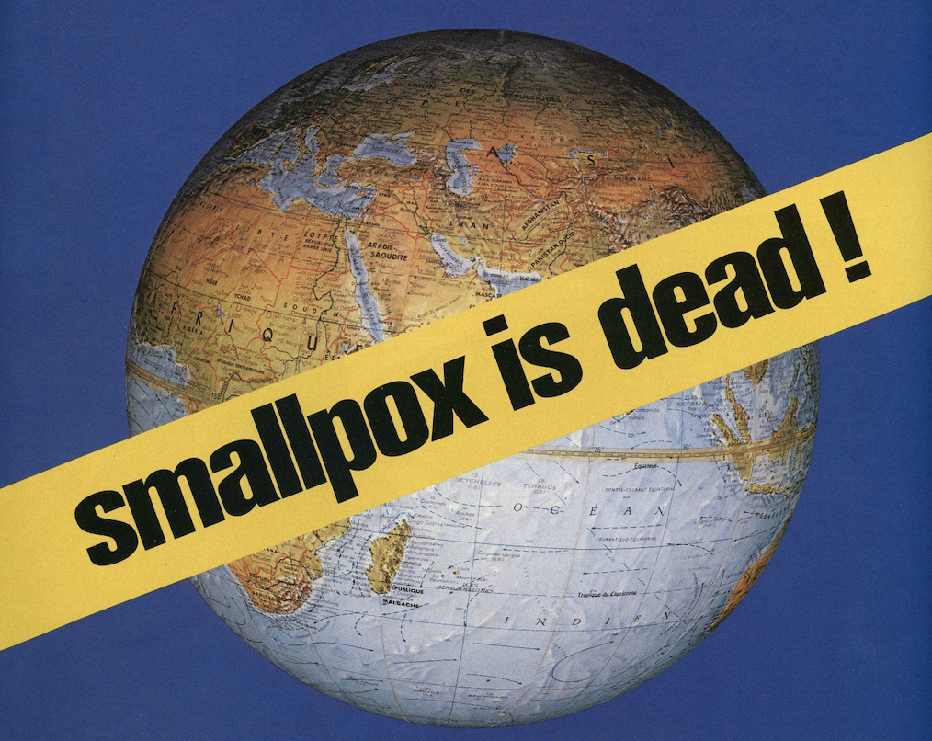
How will waning immunity facilitate mpox emergence?
R_{e} of mpox
Population Immunity
Time post eradication

Slide 3
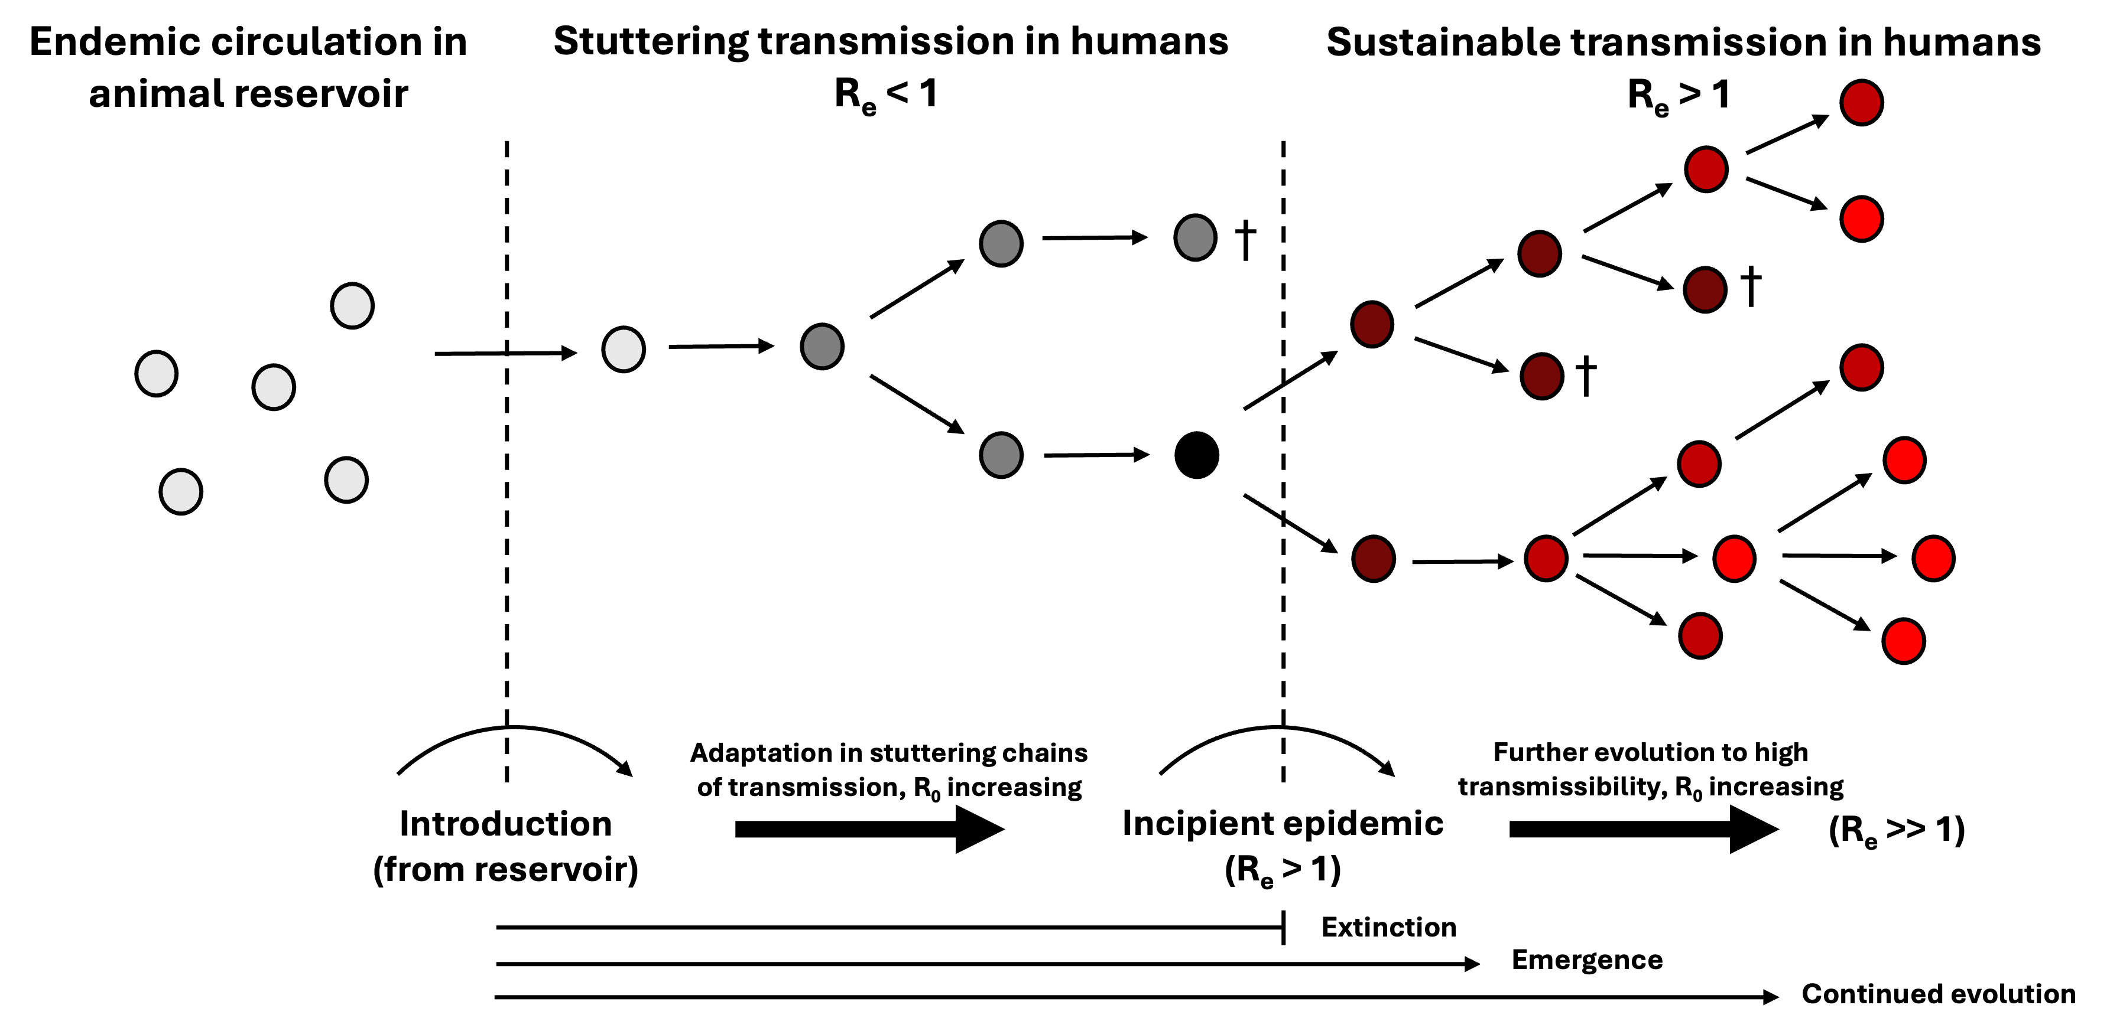
We use a stochastic framework for emergence.

Slide 4
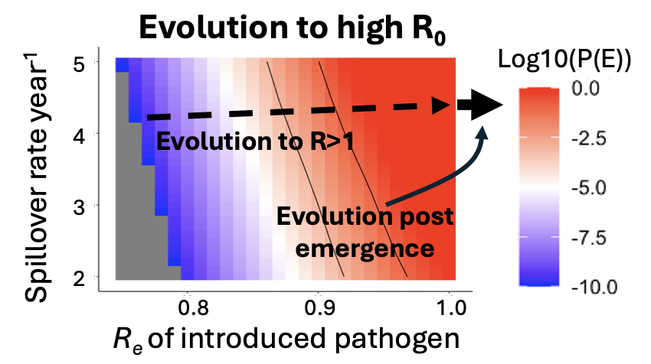
Emergence depends more on transmission than spillover rate.
Notes:
Small changes in R_{e} lead to large changes in large changes in R

Slide 5
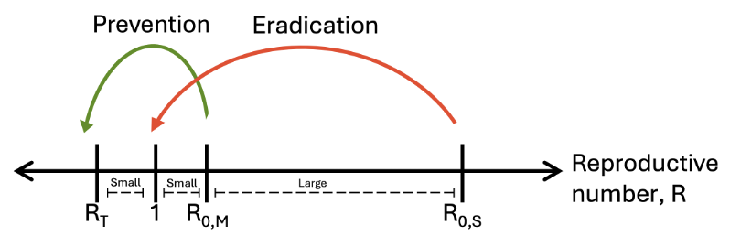
Prevention is much easier than eradication.
1
Preprint: Hirst et al, BioRxiv 2026

