Slide 1
Endemic circulation in
animal reservoir
Stuttering transmission in humans
R < 1
Sustainable transmission in humans
R > 1
†
†
†
Adaptation in stuttering chains of transmission, R₀ increasing
Further evolution to high
transmissibility, R₀ increasing
Introduction
(from reservoir)
Incipient epidemic (R > 1)
(R >> 1)
Extinction
Emergence
Continued evolution

Slide 2
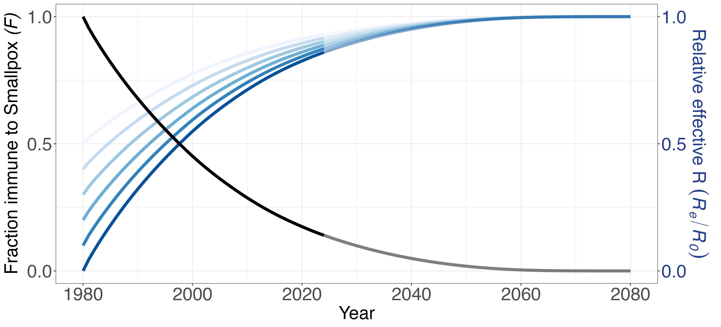
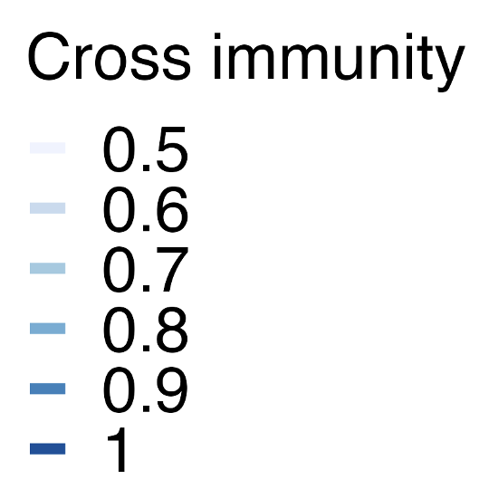

Slide 3
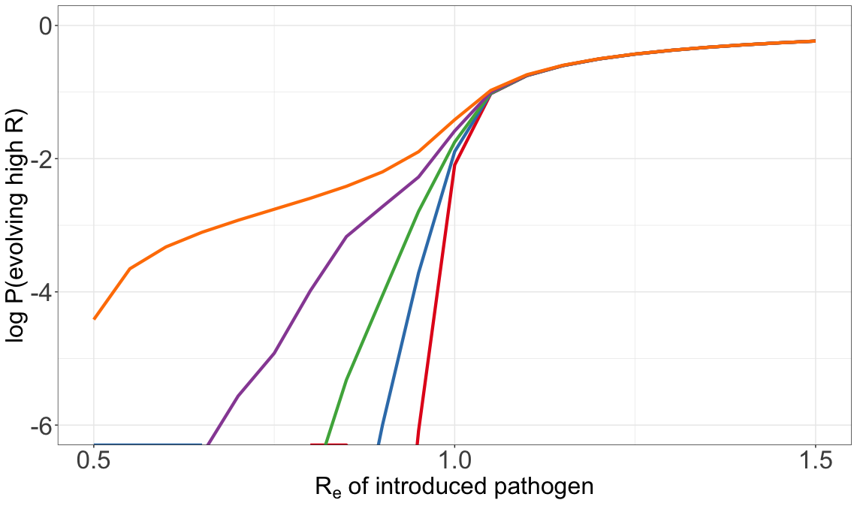
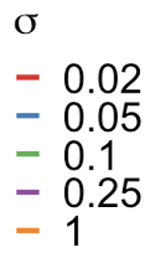
Notes:
Selective advantage after sigma
Aspect ratio – golden ratio
P(evolving high R0)

Slide 4
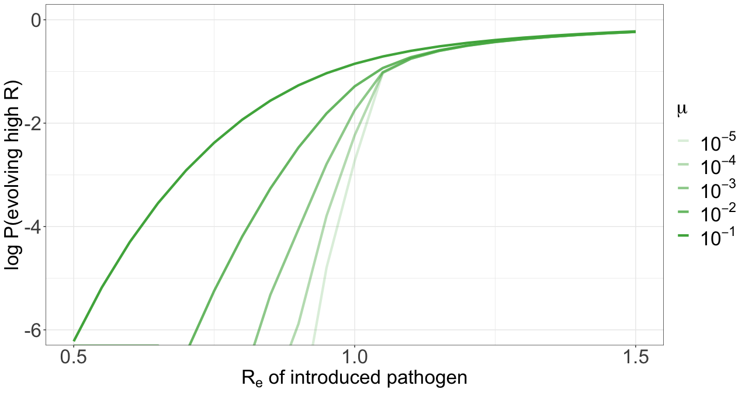
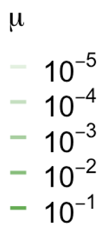
Notes:
Mu – beneficial mutation rate infection-1
P(evolving high transmissibility)
Take out 10^-1

Slide 5
A.
B.

Slide 6
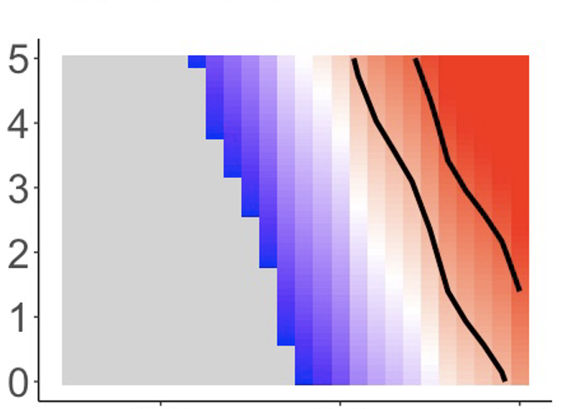
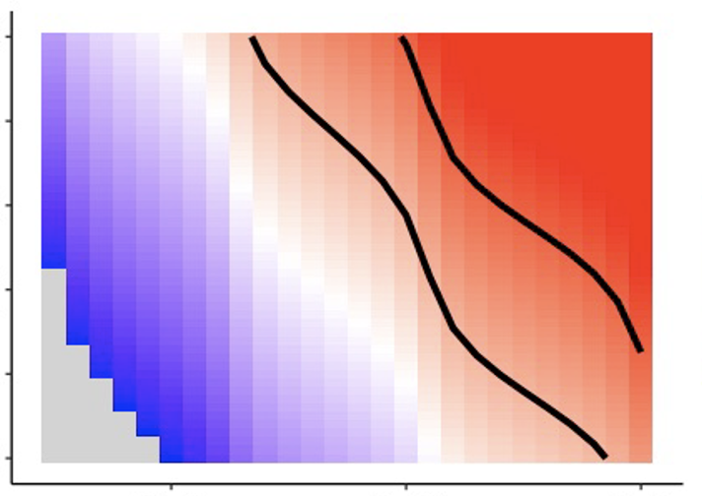
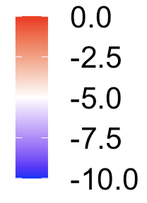
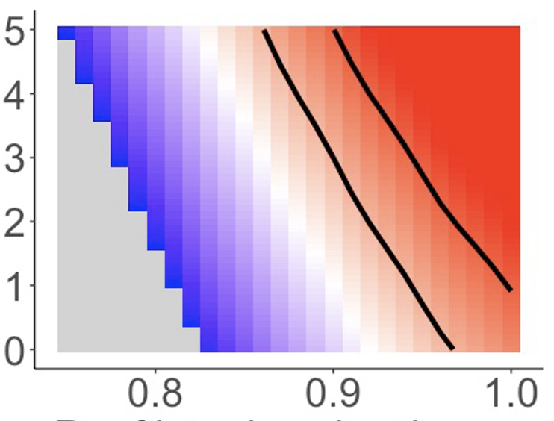
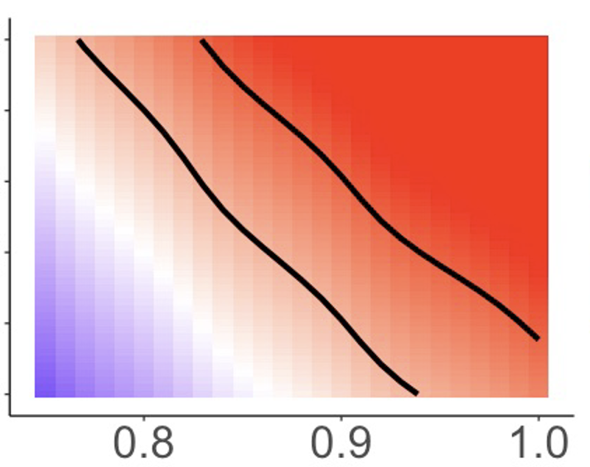
Increase in fitness with mutation, 𝛔
0.05 0.1
10⁻⁴
Log P(Emergence)
Beneficial mutation rate (infection⁻¹), 𝝁
Log spillover rate, year⁻¹
10⁻³
R_{e} of introduced pathogen
Notes:
Mutation^-1

Slide 7
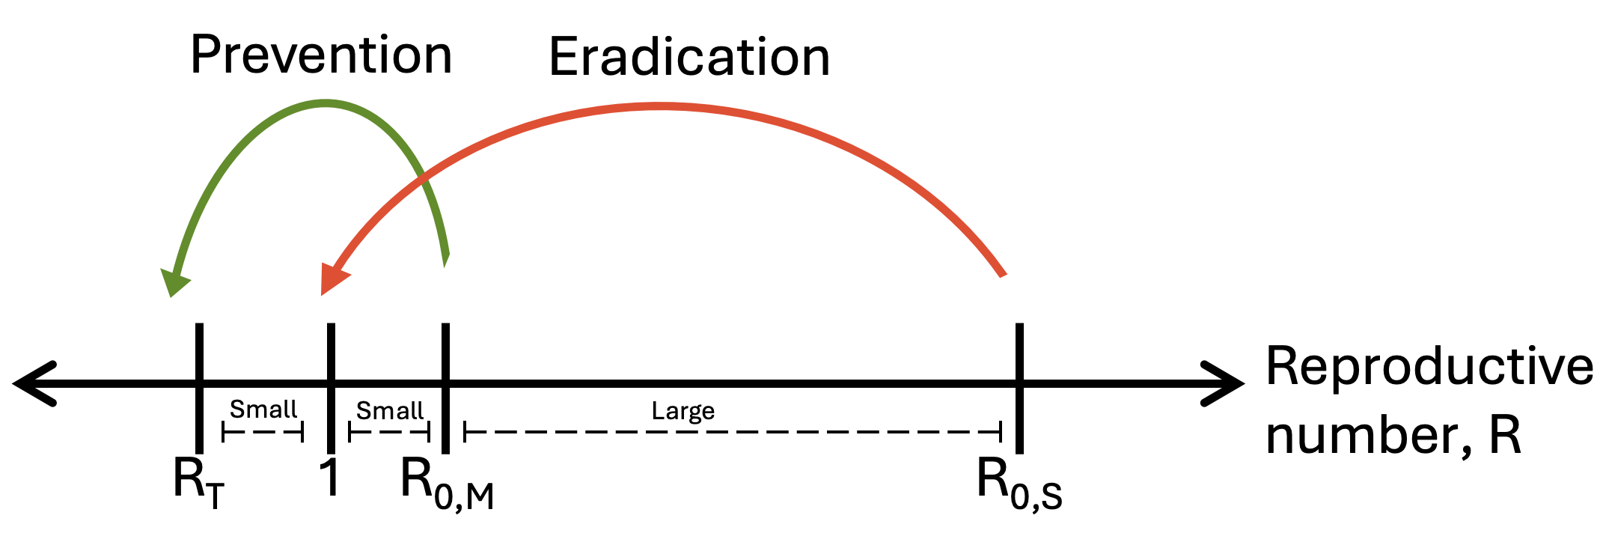
0

Slide 8
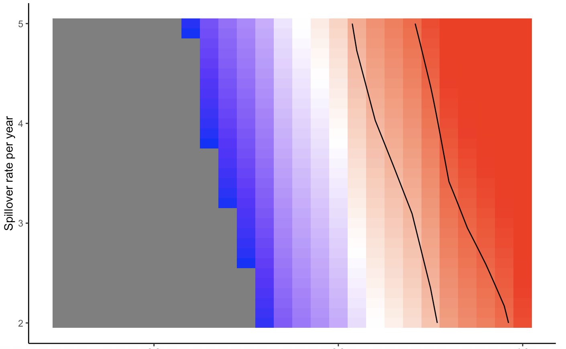
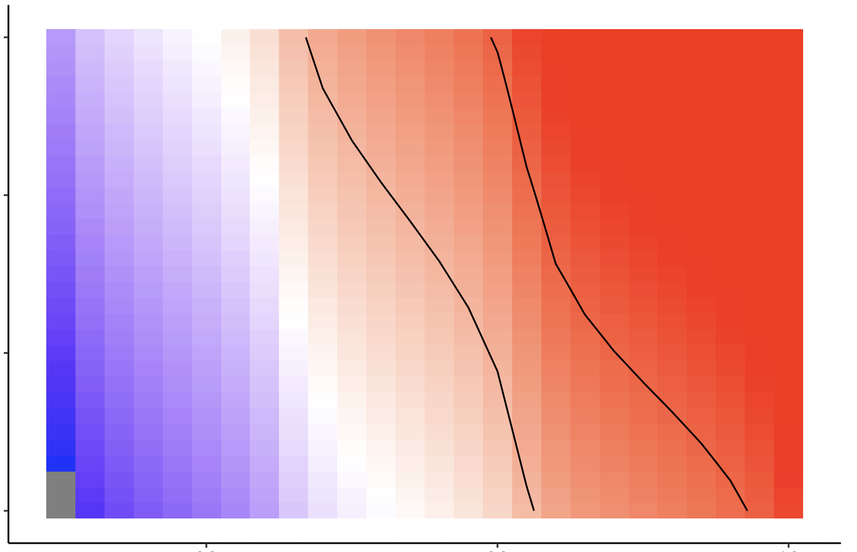
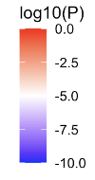
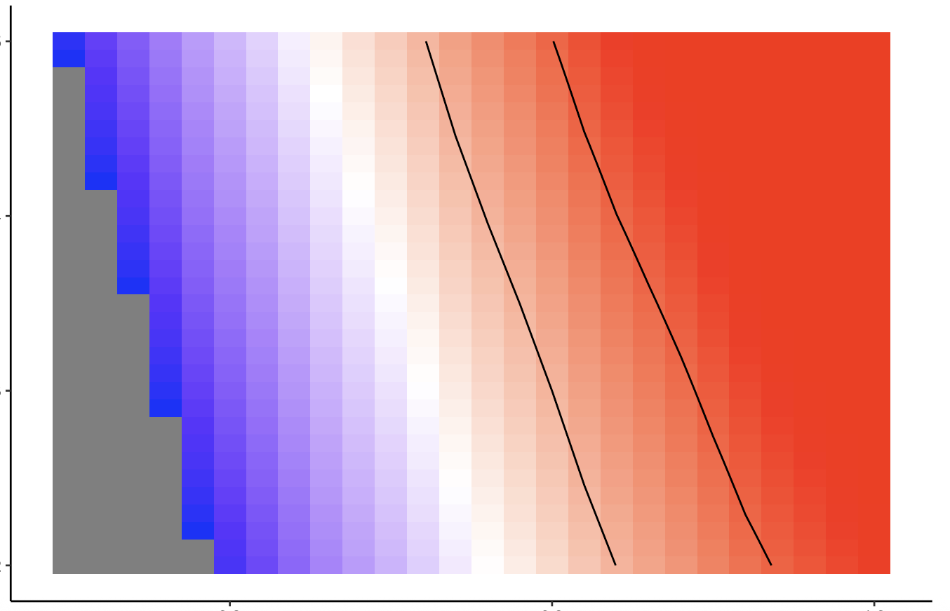
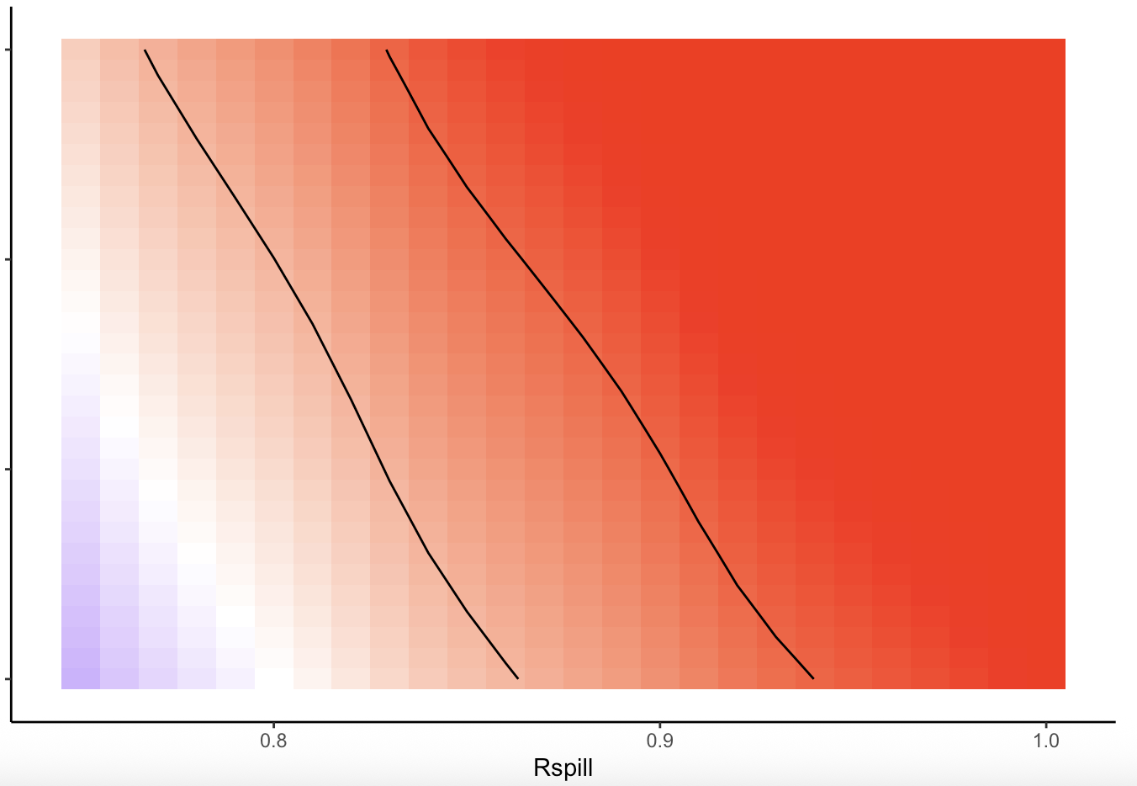
Reducing Re can be a more effective prevention strategy.
Increase in fitness with mutation
0.05 0.1
5
4
3
2
10⁻⁴
Beneficial mutation rate (per infection)
Log10 Spillover rate year⁻¹
5
4
3
2
10⁻³
0.8 0.9 1.0
0.8 0.9 1.0
R_{e} of introduced pathogen
Notes:
P(Emergence) changes more sharply with Re than S . Black contours show when probability of emergence per year is between 1 in 10 and 1 in 1000 years
And note that changing Re can be effective to reduce the probability of evolving high transmissibility after spillover (during outbreaks), while reducing spillovers will only reduce the probability of emergence before spillover.

