Slide 1
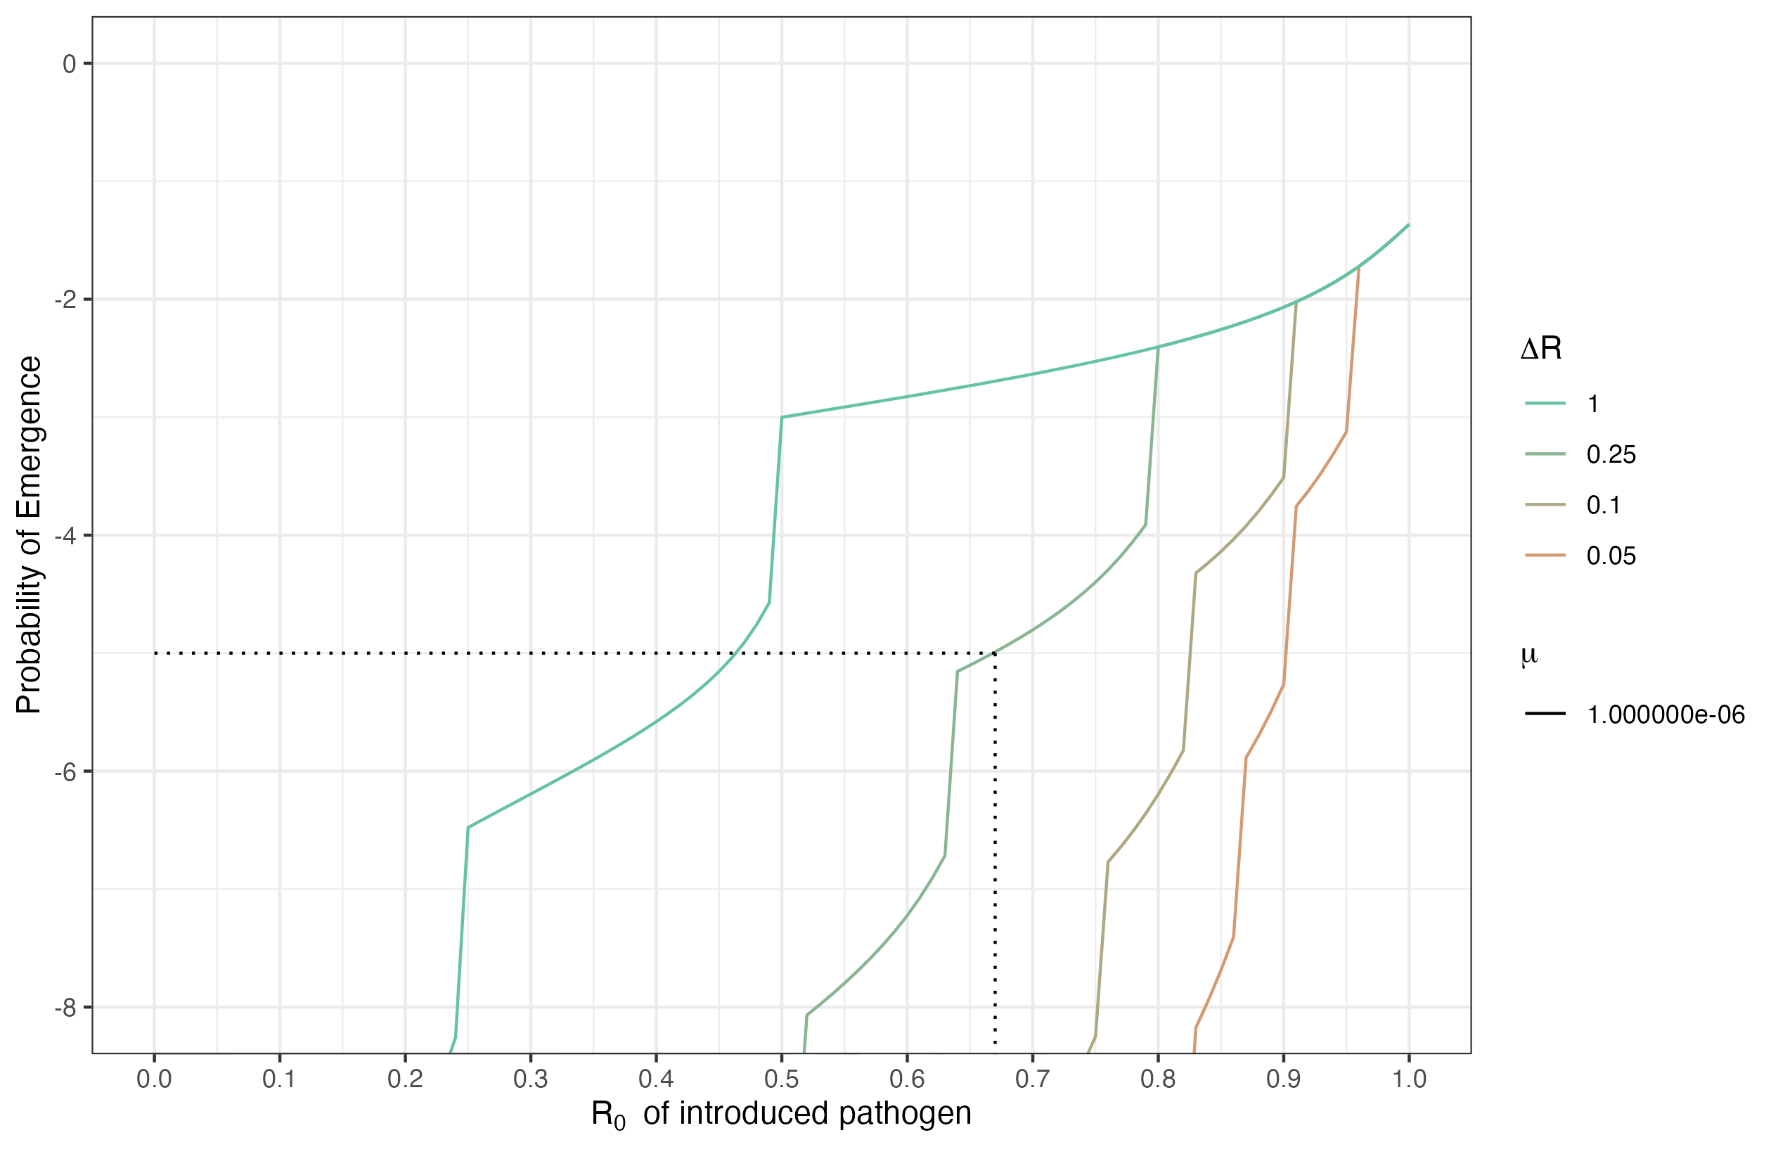
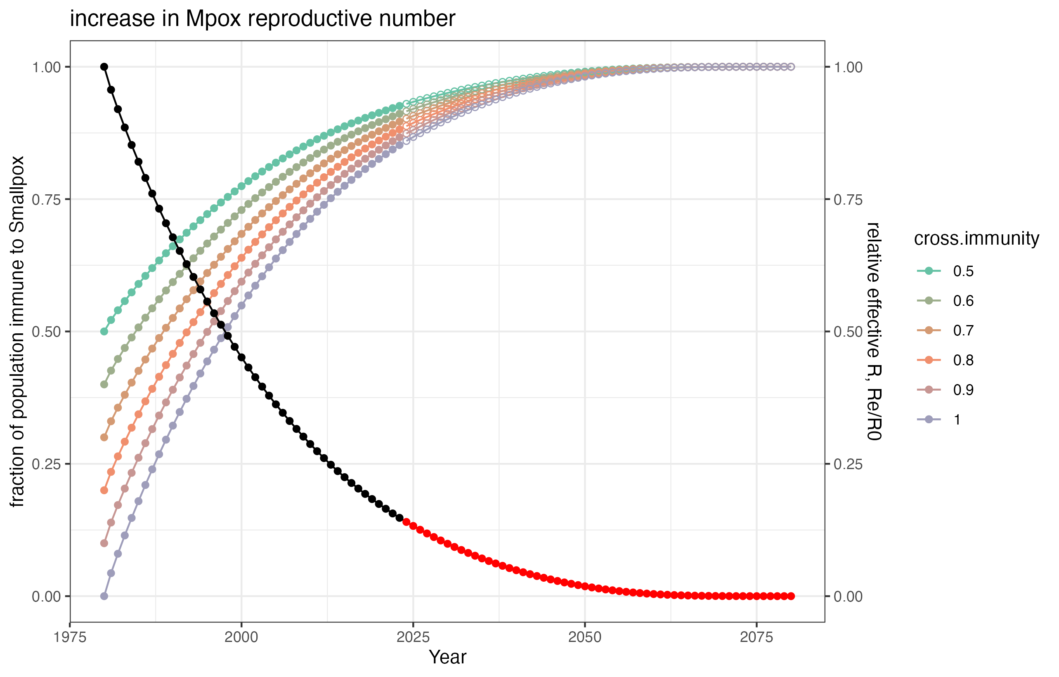
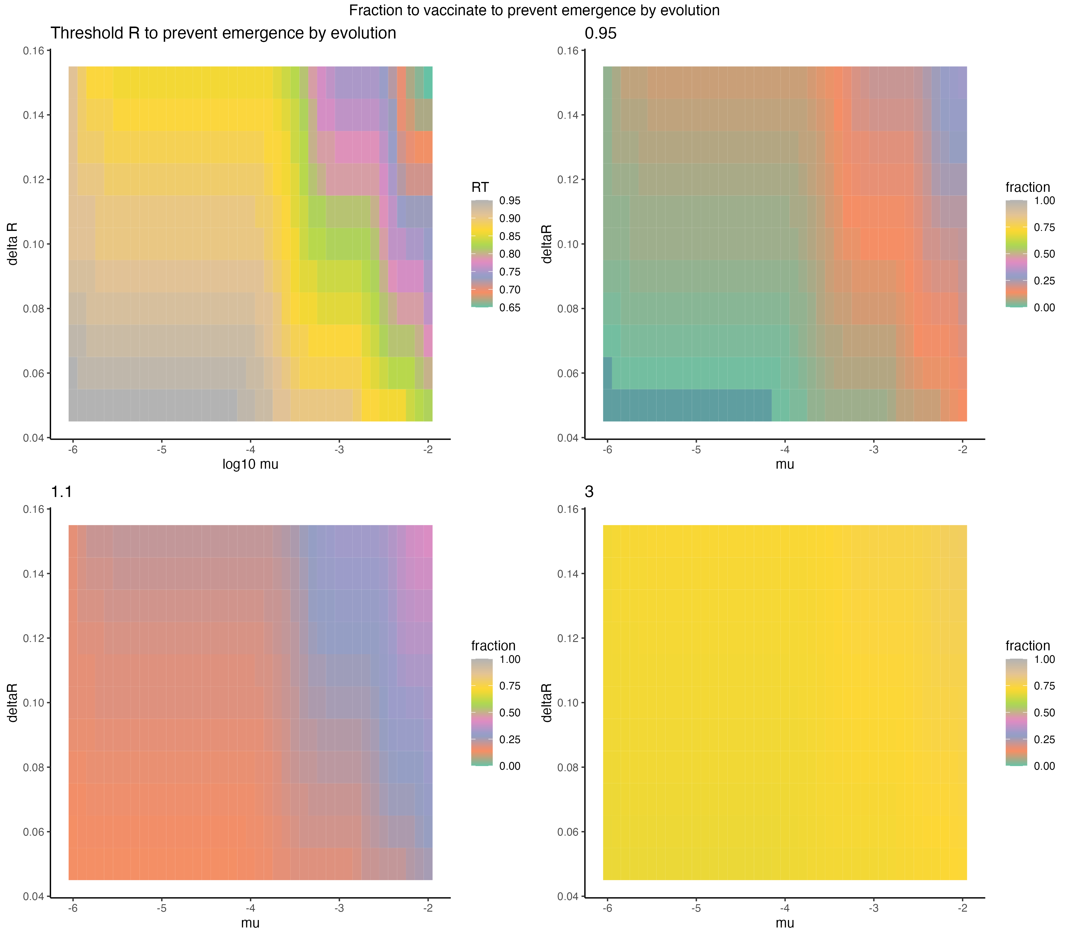
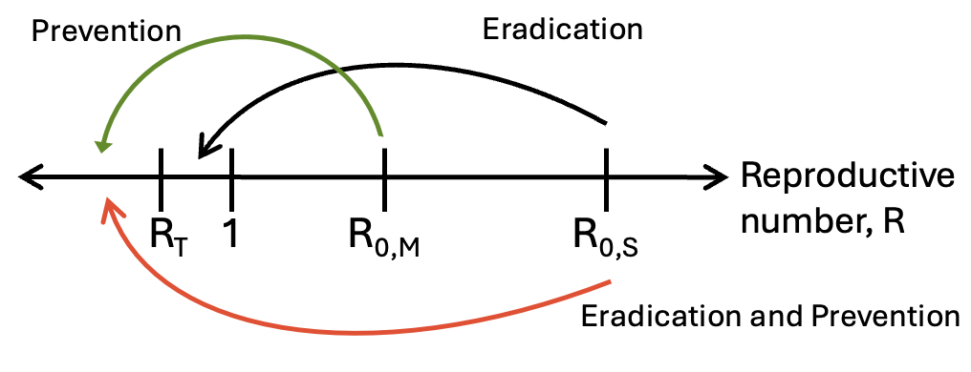
Vaccination to Prevent Disease Emergence
Can we stop vaccinating against
pox viruses?
Cora Hirst¹, Julia Deichmann², Rustom Antia¹
(1) Emory University Department of Biology (2) Harvard T. Chan School of Public Health
†
Decaying immunity at the population level increases the evolutionary potential of zoonotic pathogens.
Modeling adaptive evolution during stochastic chains of transmission
Cross-immunity arising from either natural infection or vaccine-induced immunity to Smallpox largely prevented zoonotic spillovers and human-human transmission of Mpox. Since the eradication of Smallpox in 1980, the dilution of the population with this cross-immunity over time has led to an increase in both the number of zoonotic cases and the transmission of Mpox in humans.
As a consequence, the threat of emergence of Mpox as a highly transmissible human pathogen is increasing.
†
P_{Emergence}(R_{T}) = 10⁻⁵
We used branching process models to explore the interplay between waning population immunity, evolutionary adaptation during outbreak, and the emergence of an evolved and highly transmissible Mpox virus.
Probability of evolving a subcritical R. Multi-type branching process model to describe the process of adaptive evolution of a zoonotic disease after spillover. Delta R: proportional increase in transmissibility with mutation; mu: rate (per infection) of adaptation.
Zoonotic disease transmission after spillover becomes more likely as cross-protection to eradicated relative decays at the population level.
Calculating
We develop an analogous framework to f = 1 − 1/R0
to explore how vaccination
can prevent th evolution
and emergence of Mpox
into humans.
A modest level of vaccination can prevent the emergence of a zoonosis with near-critical R.
Preventing the emergence of zoonotic disease requires significantly less vaccination than eradicating once endemic.

Slide 2
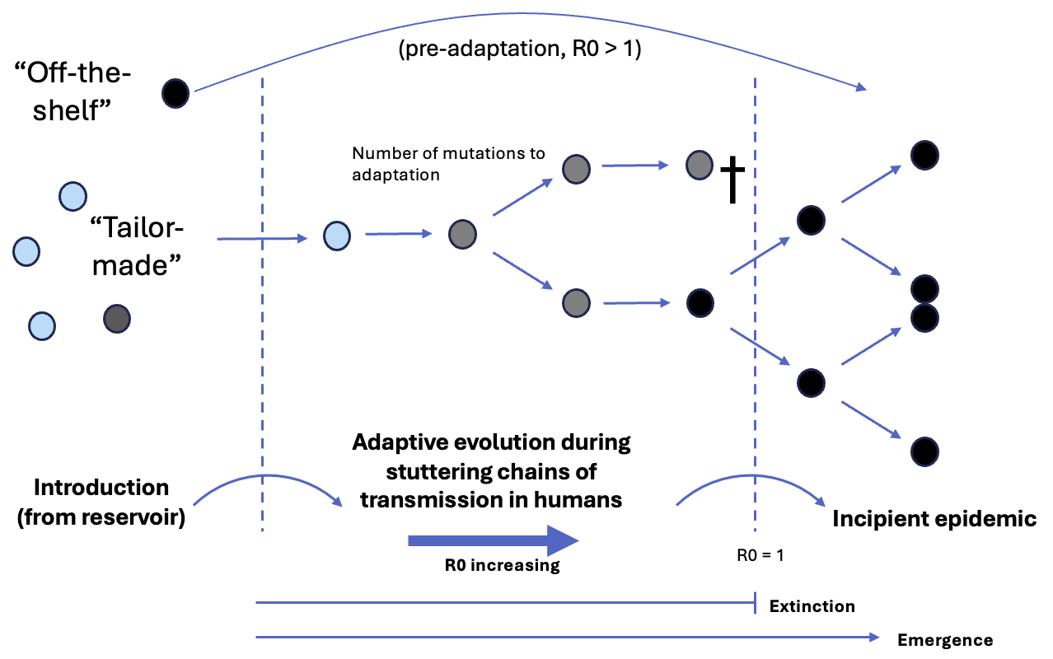
Vaccination to Prevent Disease Emergence
Can we stop vaccinating against
pox viruses?
Cora Hirst¹, Julia Deichmann², Rustom Antia¹
(1) Emory University Department of Biology (2) Harvard T. Chan School of Public Health
†
Decaying immunity at the population level increases the evolutionary potential of zoonotic pathogens.
Evolution during stochastic chains of transmission can facilitate the emergence of pandemic zoonoses.
Zoonotic disease transmission after spillover becomes more likely as cross-protection to eradicated relative decays at the population level.
Even if the number of secondary cases expected from a single case is less than 1 (R < 1) , mutations accumulated during stochastic chains of transmission after spillover may facilitate emergence of a supercritical (R > 1) variant with sustained human-human transmission.
†
P_{Emergence}(R_{T}) = 10⁻⁵
Cross-immunity arising from either natural infection or vaccine-induced immunity to Smallpox largely prevented zoonotic spillovers and human-human transmission of Mpox. Since the eradication of Smallpox in 1980, the dilution of the population with this cross-immunity over time has led to an increase in both the number of zoonotic cases and the transmission of Mpox in humans.
Probability of evolving sustained transmission (R > 1). We developed a multi-type branching process model to describe the process of adaptive evolution of a zoonotic disease during stochastic transmission after spillover. Delta R: proportional increase in transmissibility with mutation; mu: rate (per infection) of adaptation.
Calculating
As a consequence, the threat of emergence of Mpox as a highly transmissible human pathogen is increasing.
We explored the effect of vaccination on preventing the adaptive evolution of zoonotic disease toward sustained human-human transmission.
analogous framework to f = 1 − 1/R0 to explore how vaccination can prevent th evolution and emergence of Mpox into humans.
A modest level of vaccination can prevent the emergence of a zoonosis with near-critical R.
Preventing the emergence of zoonotic disease requires significantly less vaccination than eradicating once endemic.

Slide 3
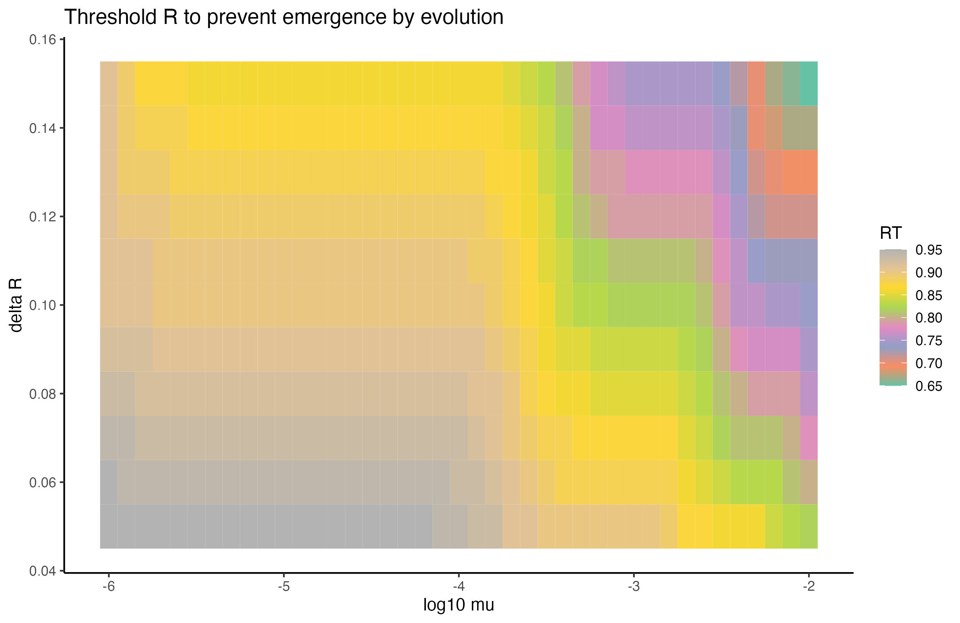
Vaccination to Prevent Disease Emergence
Can we stop vaccinating against
pox viruses?
Cora Hirst¹, Julia Deichmann², Rustom Antia¹
(1) Emory University Department of Biology (2) Harvard T. Chan School of Public Health
†
Motivation
Results
Decaying immunity at the population level increases the evolutionary potential of zoonotic pathogens.
The probability of
emergence of a subcritical variant by adaptation during transmission increases sharply with R_e.
Zoonotic disease transmission after spillover becomes more likely as cross-protection to eradicated relative decays
at the population level.
Even if the number of secondary cases expected from a single case is less than 1
(R < 1) , mutations accumulated during stochastic chains of transmission after spillover may facilitate emergence of a supercritical (R > 1) variant with sustained human-human transmission.
P_{Emergence}(R_{T}) = 10⁻⁵
†
Probability of evolving sustained transmission (R > 1). As R_e increases, fewer mutations are required to evolve R > 1, introducing sharp increases in emergence probability. Delta R: proportional increase in transmissibility with mutation; mu: rate (per infection) of adaptation.
Cross-immunity arising from either natural infection or vaccine-induced immunity to Smallpox largely prevented zoonotic spillovers and human-human transmission of Mpox. Since the eradication of Smallpox in 1980, the dilution of the population with this cross-immunity over time has led to an increase in both the number of zoonotic cases and the transmission of Mpox in humans.
There exists some R < 1, R_T, above which evolution of sustained transmission during an outbreak may occur in the absence of intervention.
As a consequence, the threat of emergence of Mpox as a highly transmissible human pathogen is increasing.
Methods
We explored the effect of vaccination on preventing the adaptive evolution of zoonotic disease toward sustained human-human transmission.
A modest amount of vaccination can reduce the effective reproductive number below the threshold for adaptive evolution of a zoonotic disease with a near critical R.
If circulation in the human population continues and the virus evolves high (Smallpox, R=3) transmissibility, a much larger fraction of the population must be vaccinated to first eradicate the disease.
Preventing the emergence of zoonotic disease requires significantly less vaccination than eradicating once endemic.

Slide 4
Vaccination to Prevent Disease Emergence
Can we stop vaccinating against
pox viruses?
Cora Hirst¹, Julia Deichmann², Rustom Antia¹
(1) Emory University Department of Biology (2) Harvard T. Chan School of Public Health
†
Motivation
Results
Decaying cross-protective immunity at the population level increases the evolutionary potential of zoonotic pathogens related to eradicated pathogens.
Zoonotic disease transmission after spillover becomes more likely as cross-protection to eradicated relative decays
at the population level.
Even if the number of secondary cases expected from a single case is less than 1
(R < 1) , mutations accumulated during stochastic chains of transmission after spillover may facilitate emergence of a supercritical (R > 1) variant with sustained human-human transmission.
P_{Emergence}(R_{T}) = 10⁻⁵
†
Probability of evolving sustained transmission (R > 1). As R_e increases, fewer mutations are required to evolve R > 1, introducing sharp increases in emergence probability. Delta R: proportional increase in transmissibility with mutation; mu: rate (per infection) of adaptation.
Cross-immunity arising from either natural infection or vaccine-induced immunity to Smallpox largely prevented zoonotic spillovers and human-human transmission of Mpox. Since the eradication of Smallpox in 1980, the dilution of the population with this cross-immunity over time has led to an increase in both the number of zoonotic cases and the transmission of Mpox in humans.
There exists some R < 1, R_T, above which evolution of sustained transmission during an outbreak may occur in the absence of intervention.
As a consequence, the threat of emergence of Mpox as a highly transmissible human pathogen is increasing.
Take Aways
We explored the effect of vaccination on preventing the adaptive evolution of zoonotic disease toward sustained human-human transmission.
We identified a threshold effective reproductive number , R_T, above which the evolution of a subcritical variant to supercriticality is highly likely.
We use this R_T to define a framework analogous to 1-1/R0 to inform vaccination strategies to prevent disease emergence. This is given as 1-R_T_R0.
A modest amount of vaccination can reduce the effective reproductive number below the threshold for adaptive evolution of a zoonotic disease with a near critical R.
We find that models levels of vaccination can dramatically reduce the probability of disease emergence by adaptive evolution in transmission chains.
Preventing the emergence of zoonotic disease requires significantly less vaccination than eradicating once endemic.

Slide 5
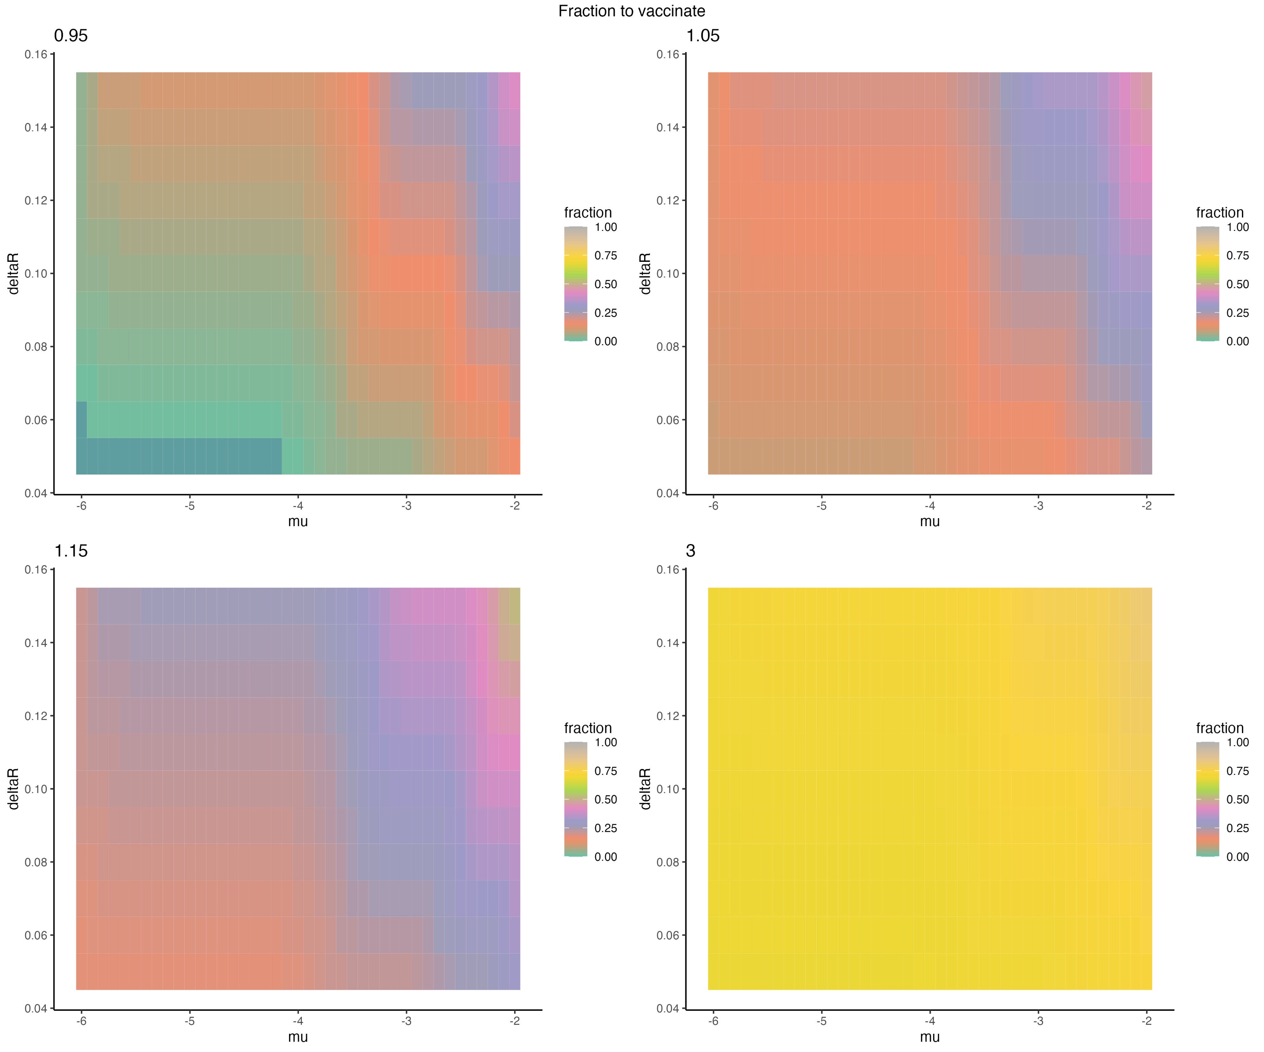
Vaccination to Prevent Disease Emergence
Can we stop vaccinating against
pox viruses?
Cora Hirst¹, Julia Deichmann², Rustom Antia¹
(1) Emory University Department of Biology (2) Harvard T. Chan School of Public Health
†
Motivation
Methods
†
Results
P_{Emergence}(R_{T}) = 10⁻⁵
Take-Aways
Preventing the emergence of zoonotic disease requires significantly less vaccination than eradicating once endemic.

