Slide 1
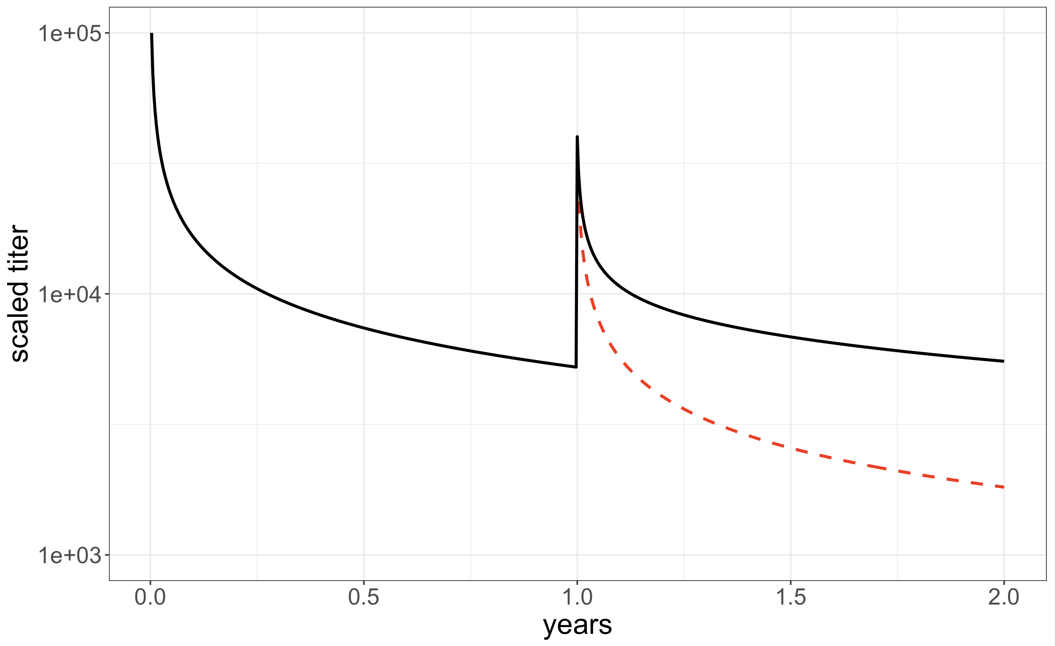
Short lived Effector
Long-lived PC
Secreted antibody
(T_{1/2}~21d)
Naïve
T cell
Prolif. / Effector
death
Naïve
B cell
Prolif. GC
death follows Power-Law
death
death
Long-lived
TCM cell
Long lived MBC
A
B
10⁵
Long-lived PC
Secreted antibody
(T_{1/2}~21d)
simulations from eqn 4
10⁴
Naïve
B cell
Prolif. GC
death follows Power Law m_{p} (prime) and m_{b} (boost)
Scaled antibody titer
simple power law decay (m)
Long lived MBC
simple power law decay (m)
10³
0 1.0 2.0
death
years

Slide 2
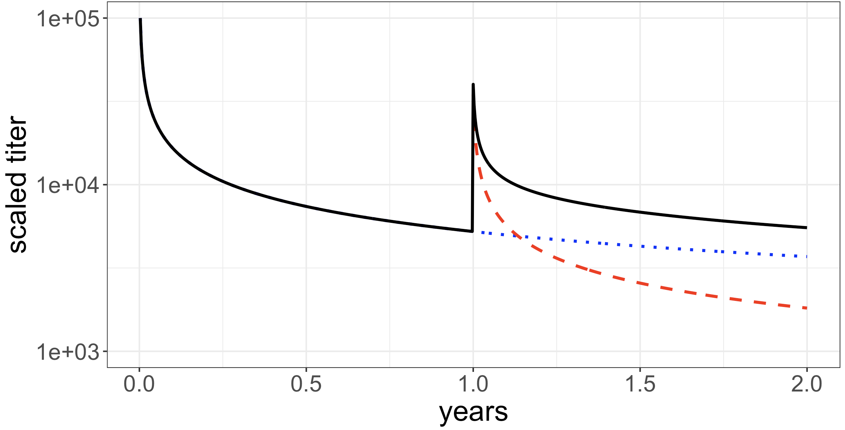
5
log₁₀ scaled titer
4
observed (total) titer
from primary
from boost
primary response
4x boost
3
0
1
2
time (years)

Slide 3
Primary vaccination First boost Second boost
SARS-CoV-2 spike antibody titter
natural
threshold
March 2020 March 2021 March 2022 March 2023

Slide 4
Influx after immunization or infection
Homeostasis:
d_{i} = h_{i}(x_{1, …} x_{n})
Antibody
dA/dt = p Σx_{i} – d_{A}A
Death rates
d₁>d₂>…>d_{n}
extrinsic model
a
intrinsic model
a₁
a₂
a_{n}
f₁
f_{n-1}
X₁
X₂
…..
X_{n}
b₁
b_{n-1}
d₁
d₂
d_{n}

Slide 5
Secreted antibody
(T_{1/2}~21d)
Secreted antibody
(T_{1/2}~21d)
Long-lived PC from 1°
A
death follows
Power Law m_{p} (prime)
Long-lived PC from 2°
Naïve
B cell
Prolif. GC
death follows
Power Law m_{b} (boost)
Long lived MBC
Prolif. GC
1° infection
Long lived MBC
death
2° infection
death

Slide 6
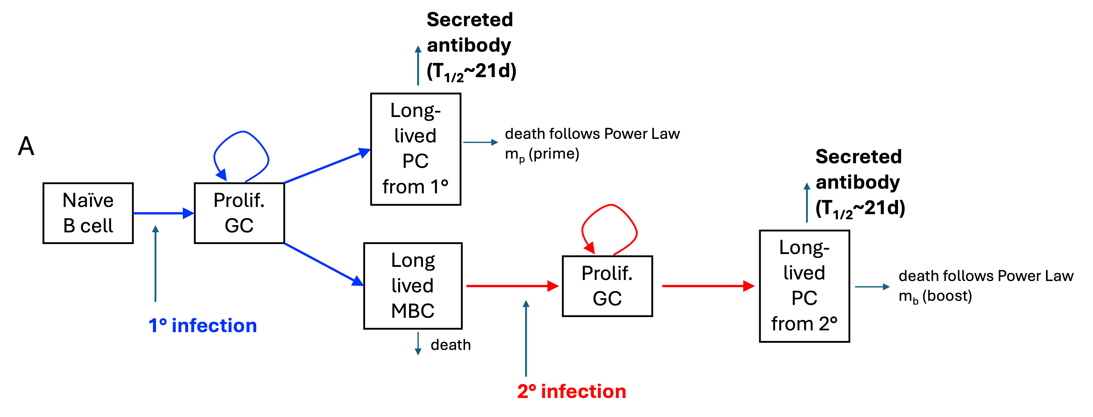
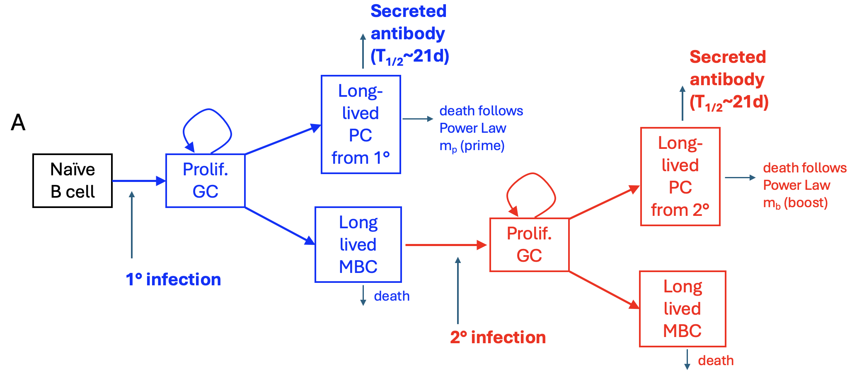
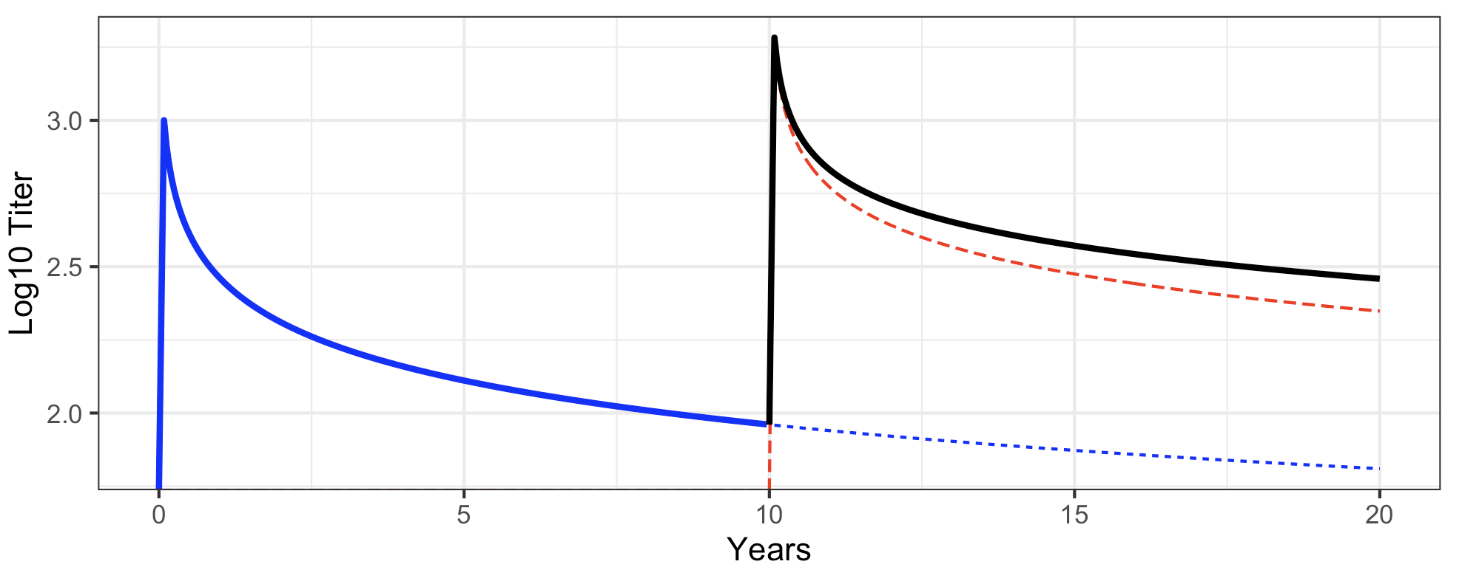
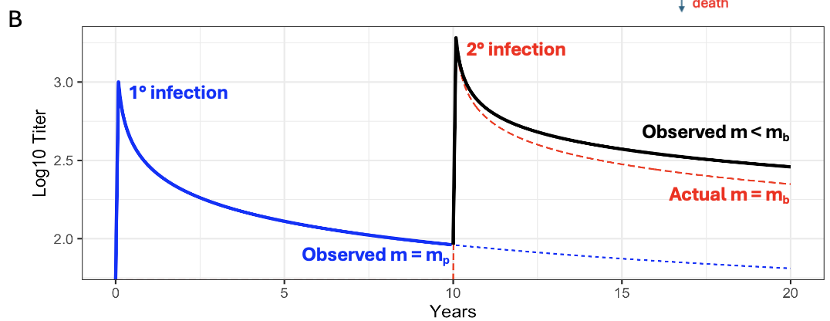
B
2° infection
1° infection
Observed m < m_{b}
Actual m = m_{b}
Observed m = m_{p}

Slide 7
