Slide 1
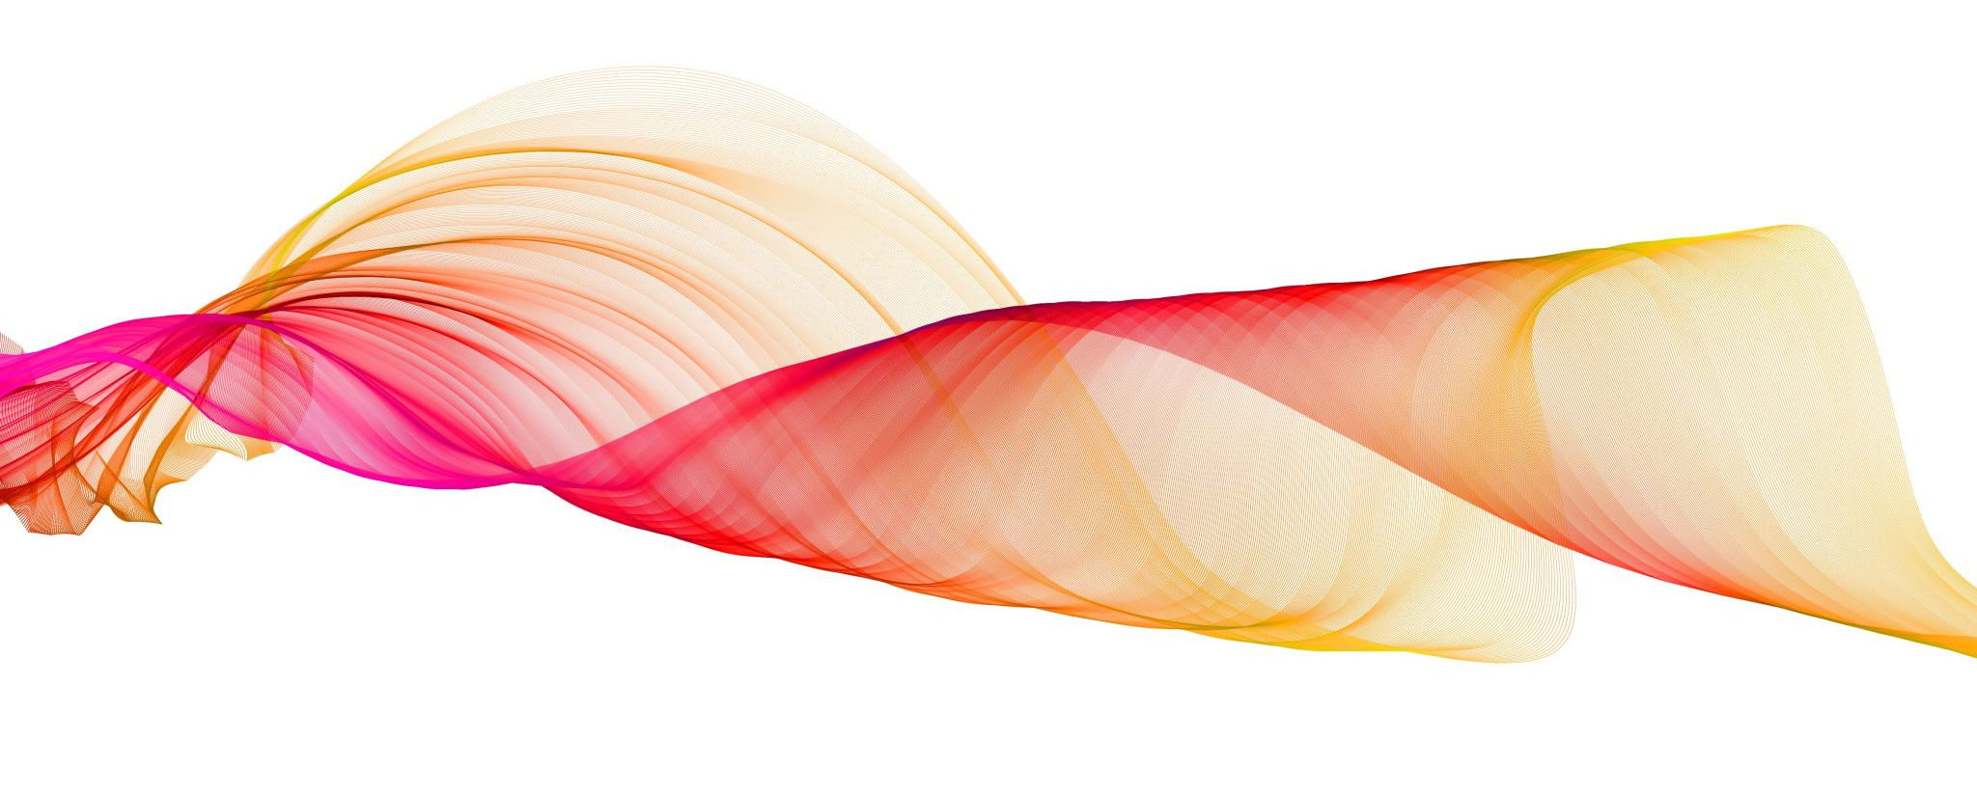
Long time, no see!
Consequences of Waning Immunity Between

