Slide 1
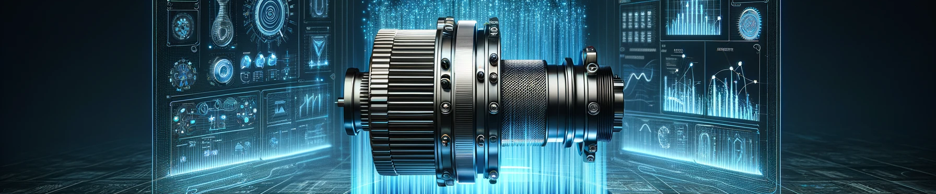
EV Range Simulation
Enabling Efficient EV Battery Development Through Digital Twin Simulation
Džejlan Ždralović, Laurin Lack, Silke Redecker

Slide 2
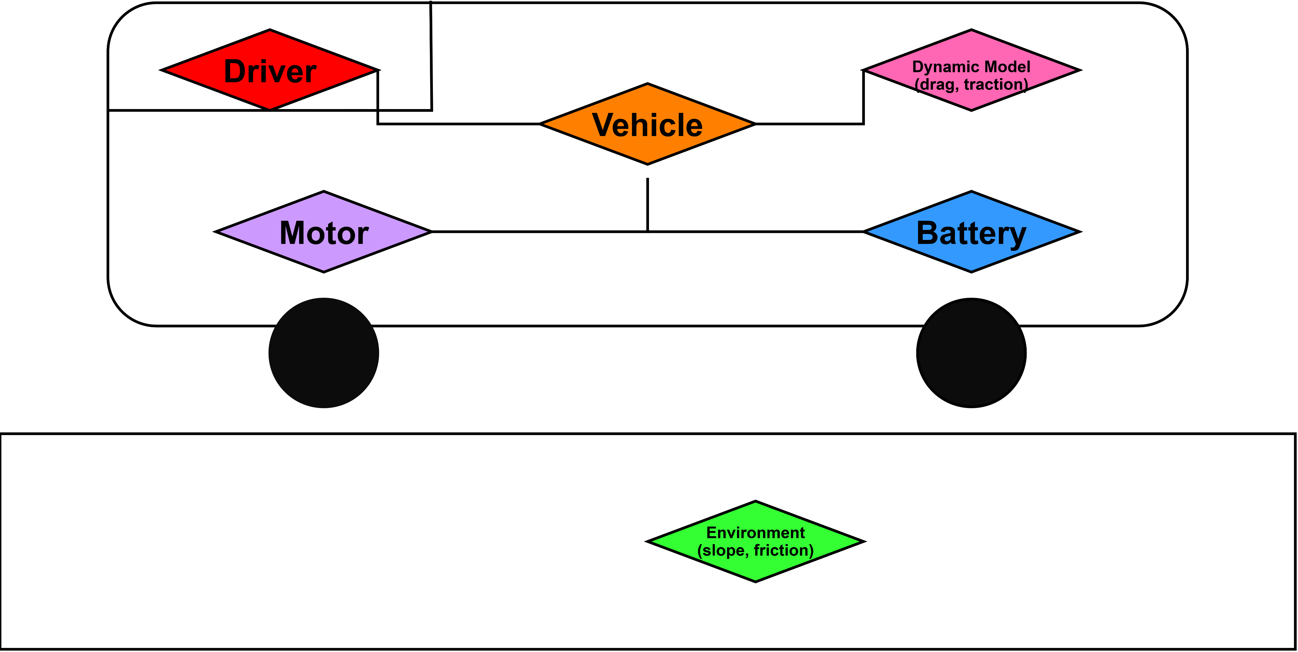
System Overview

Slide 3
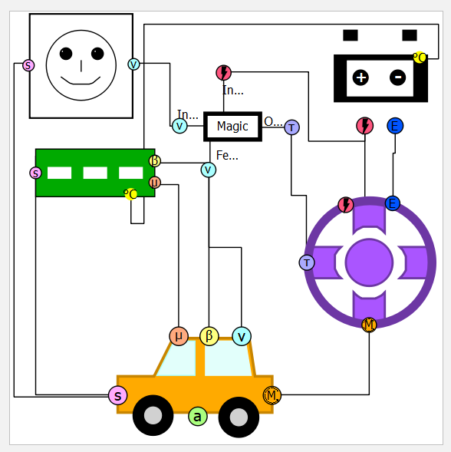

Example
Library Components
  Battery
    3 default parametrisations
      NMC, Solid State, LFP
  Controller
    Constrained P-Controller
  Driver
    Normal, Speeding
  Environment
    Slope, Friction, Temperature
  Motor
    Brushless Lynch Type DC Motor
  Vehicle
    Longitudinal Dynamics

