Slide 1


Chapter
1
Introduction to Statistics

Slide 2
Chapter Outline
1.1 An Overview of Statistics
1.2 Data Classification
1.3 Data Collection and Experimental Design

Slide 3
Section 1.1
An Overview of Statistics

Slide 4
Section 1.1 Objectives
A definition of statistics
How to distinguish between a population and a sample and between a parameter and a statistic
How to distinguish between descriptive statistics and inferential statistics

Slide 5
What is Data?
Data
Consist of information coming from observations, counts, measurements, or responses.
“7 in 10 Americans believe the arts unify their communities, and 2 in 5 Americans have changed an opinion or perception based on an arts experience.” (Source: Americans for the Arts)
“Notably, 21% of 8 –11 year-olds have a social media profile.” (Source: Smart Insights, Ltd)

Slide 6
What is Statistics?
Statistics
The science of collecting, organizing, analyzing, and interpreting data to make decisions.

Slide 7
Data Sets
Population
The collection of all outcomes, responses, measurements, or counts that are of interest.
Sample
A subset, or part, of the population.

Slide 8
Example: Identifying Data Sets
In a recent survey, 834 employees in the United States were asked if they thought there jobs were highly stressful. Of the 834 respondents, 517 said yes. Identify the population and the sample. Describe the sample data set. (Source: CareerCast Job Stress Report)

Slide 9
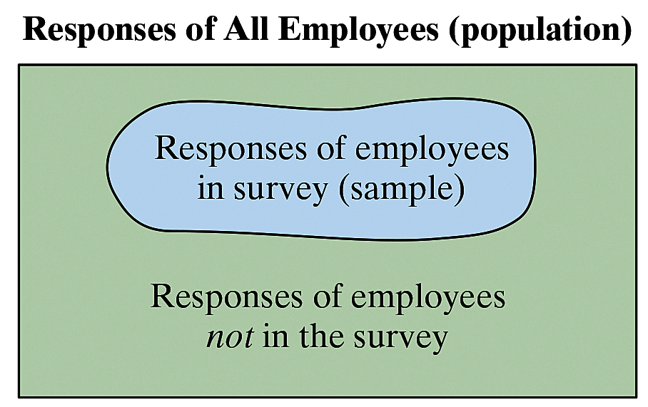
Solution: Identifying Data Sets
The population consists of the responses of all employees in the U.S.
The sample consists of the responses of the 834 employees in the survey.
The sample is a subset of the responses of all employees in the U.S.
The data set consists of 517 yes’s and 317 no’s.

Slide 10
Parameter and Statistic
Parameter
A numerical description of a population characteristic.
Average age of all people in the United States
Statistic
A numerical description of a sample characteristic.
Average age of people from a sample of three states

Slide 11
Example: Distinguish Parameter and Statistic
Decide whether each number describes a population parameter or a sample statistic.
In the United States, a survey of about 9400 individuals aged 15 and over found that such individuals spent an average of 5.19 hours per day engaged in leisure and sports activities. (Source: U.S. Bureau of Labor Statistics)
Solution:
Because the average of 5.19 hours per day is based on a subset of the population, it is a sample statistic.

Slide 12
Example: Distinguish Parameter and Statistic
Decide whether the numerical value describes a population parameter or a sample statistic.
The freshman class at a university has an average SAT math score of 514.
Solution:
Because the average SAT math score of 514 is based on the entire freshman class, it is a population parameter.

Slide 13
Example: Distinguish Parameter and Statistic
Decide whether the numerical value describes a population parameter or a sample statistic.
In a random check of several hundred retail stores, the Food and Drug Administration found that 34% of the stores were not storing fish at the proper temperature.
Solution:
Because 34% is based on a subset of the population, it is a sample statistic.

Slide 14

Branches of Statistics
Descriptive Statistics Involves the organization,
summarization, and display of data.
e.g. Tables, charts, averages
Inferential Statistics Involves using sample data to draw conclusions about a population.

Slide 15
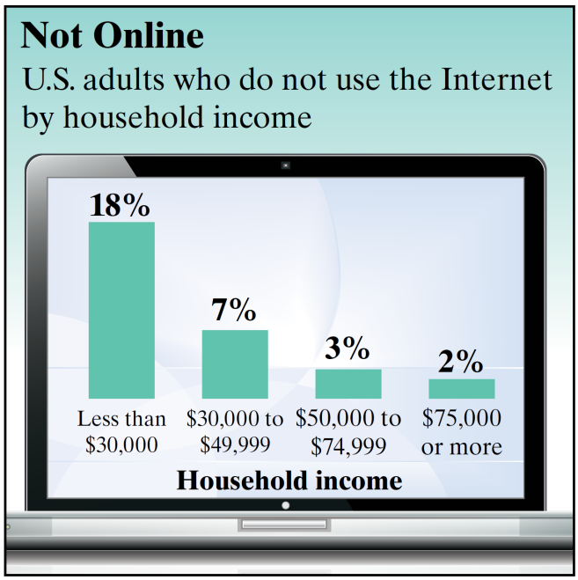
Example: Descriptive and Inferential Statistics
For each study, identify the population and the sample. Then determine which part of the study represents the descriptive branch of statistics. What conclusions might be drawn from the study using inferential statistics?
A study of 1502 U.S. adults found that 18% of adults from households earning less than $30,000 annually do not use the Internet, as shown in the figure. (Source: Pew Research Center)

Slide 16
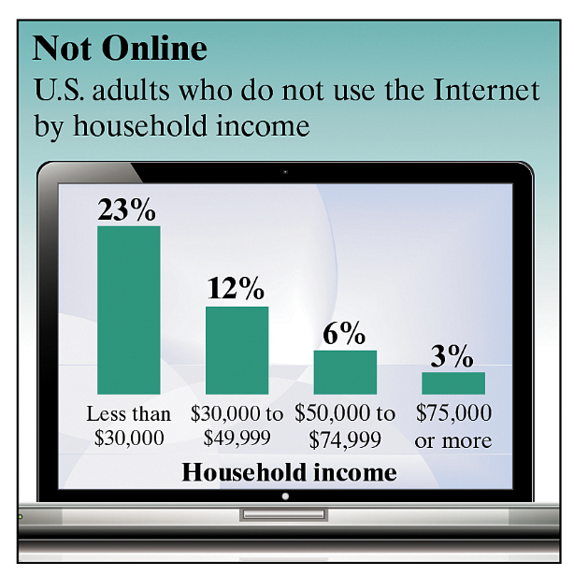
Solution: Descriptive and Inferential Statistics
Solution:
The population consists of the responses of all U.S. adults, and the sample consists of the responses of the 1502 U.S. adults in the study. The descriptive branch of statistics involves the statement “18% of adults from households earning less than $30,000 annually do not use the Internet.” A possible inference drawn from the study is that the Internet has been made inaccessible to lower- income households.

Slide 17
Example: Descriptive and Inferential Statistics
For each study, identify the population and the sample. Then determine which part of the study represents the descriptive branch of statistics. What conclusions might be drawn from the study using inferential statistics?
A study of 1000 U.S. 401(k) retirement plan participants found that the percentage who do not know how many years their retirement savings might last is 32%%. (Charles Schwab & Co., Inc.)

Slide 18
Solution: Descriptive and Inferential Statistics
Solution:
The population consists of the responses of all U.S. 401(k) retirement plan participants, and the sample consists of the responses of the 1000 U.S. 401(k) retirement plan participants in the study. The part of this study that represents the descriptive branch of statistics involves the statement “the percentage [of U.S. 401(k) retirement plan participants] who do not know how many years their retirement savings might last is 32%..” A possible inference drawn from the study is that the amount of money a person needs for retirement is difficult to determine.

Slide 19
Exercise 1
In a recent survey, 1708 adults in the United States were asked if they think global warming is a problem that requires immediate government action. Nine hundred thirty-nine of the adults said yes. Identify the population and the sample. Describe the data set. (Adapted from: Pew Research Center)

Slide 20
Solution 1

Slide 21
Exercise 2
Decide whether the numerical value describes a population parameter or a sample statistics. Explain your reasoning.
A recent survey of a sample of MBAs reported that the average salary for an MBA is more than $82,000. (Source: The Wall Street Journal)
Starting salaries for the 667 MBA graduates from the University of Chicago Graduated School of Business increased 8.5% from the previous year.
In a random check of a sample of retail stores, the Food and Drug Administration found that 34% of the stores were not storing fish at the proper temperature.

Slide 22
Solution 2

Slide 23
Exercise 3
Decide which part of the study represents the descriptive branch of statistics. What conclusions might be drawn from the study using inferential statistics?
A large sample of men, aged 48, was studied
for 18 years. For unmarried men,
approximately 70% were alive at age 65.
For married men, 90% were alive at age 65.
(Source: The Journal of Family Issues)
In sample of Wall Street analyst, the percentage who incorrect forecasted high-tech earnings in a recent year was 44%. (Source: Bloomberg News)

Slide 24
Solution 3

Slide 25
Try It Yourself 1
The U.S Department of Energy conducts weekly surveys of approximately 800 gasoline stations to determine the average price per gallon of regular gasoline. On February 12, 2007, the average price was $2.24 per gallon. (Source: Energy Information Administration)
Identify the population.
Identify the sample.
What does the data set consist of?

Slide 26
Answer - Try it Yourself 1

Slide 27
Try It Yourself 2
In 2006, major league baseball teams spent a total of $2,326,706,685 on players’ salaries. Does this numerical value describe a population parameter or a sample statistics? Source: USA Today)
Decide whether the numerical value is from a population or a sample.
Specify whether the numerical value is a parameter or a statistic.

Slide 28
Answer - Try it Yourself 2

Slide 29
Try It Yourself 3
A survey conducted among 1017 men and women by Opinion Research Corporation International found that 76% of women and 60% of men had a physical examination within the previous year. (Source: Men’s Health)
Identify the descriptive aspect of the survey.
What inference could be drawn from this survey?

Slide 30
Answer - Try it Yourself 3

