Slide 1


Chapter
1
Introduction to Statistics

Slide 2
Chapter Outline
1.1 An Overview of Statistics
1.2 Data Classification
1.3 Data Collection and Experimental Design

Slide 3
Section 1.2
Data Classification

Slide 4
Section 1.2 Objectives
How to distinguish between qualitative data and quantitative data
How to classify data with respect to the four levels of measurement: nominal, ordinal, interval, and ratio

Slide 5
Types of Data
Qualitative Data
Consists of attributes, labels, or nonnumerical entries.
Major
Place of birth
Eye color

Slide 6
Types of Data
Quantitative data
Numerical measurements or counts.
Age
Weight of a letter
Temperature

Slide 7
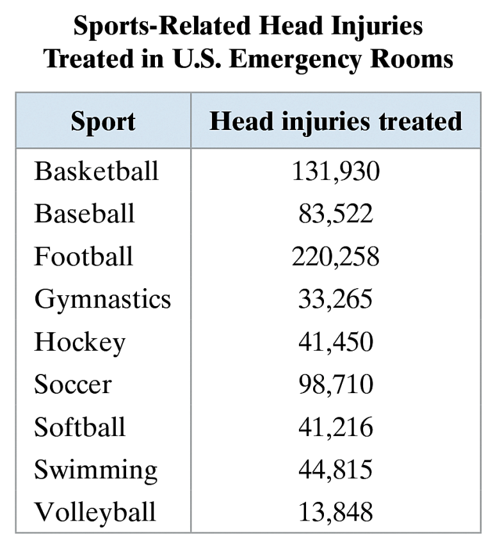
Example: Classifying Data by Type
The table shows sports-related head injuries treated in U.S. emergency rooms during a recent five-year span for several sports. Which data are qualitative data and which are quantitative data? (Source: BMC Emergency Medicine)

Slide 8
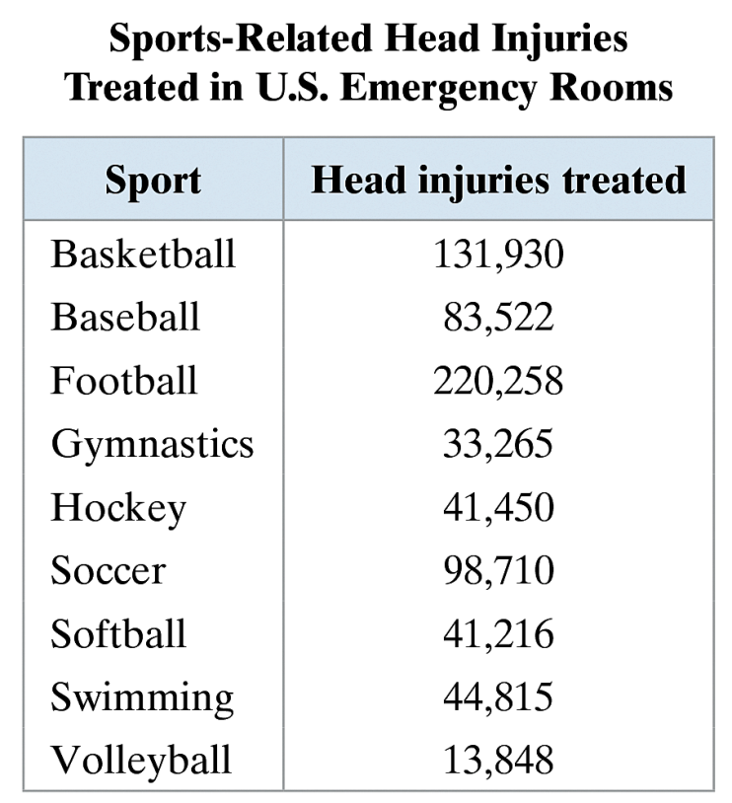
Solution: Classifying Data by Type
Qualitative Data (Types of sports are nonnumerical entries.)
Quantitative Data (Head injuries treated are numerical entries.)

Slide 9
Levels of Measurement
Nominal level of measurement
Qualitative data only
Categorized using names, labels, or qualities
No mathematical computations can be made
Ordinal level of measurement
Qualitative or quantitative data
Data can be arranged in order, or ranked
Differences between data entries is not meaningful

Slide 10
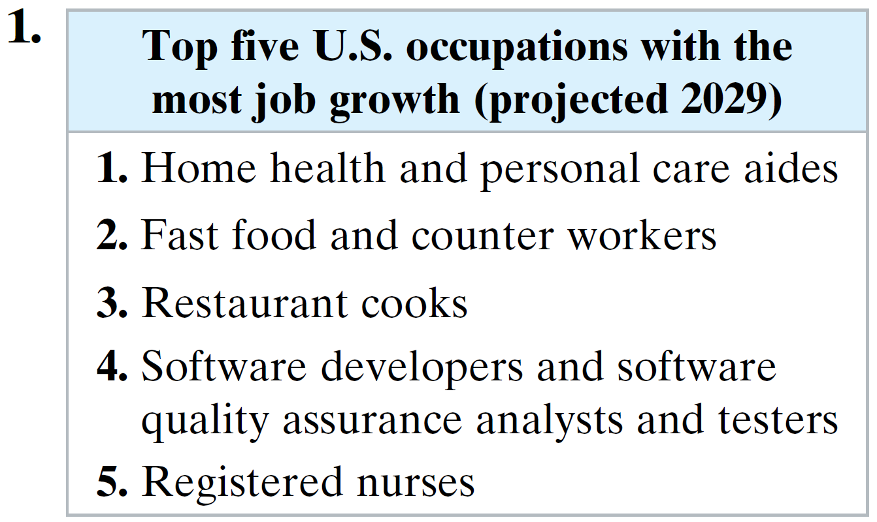
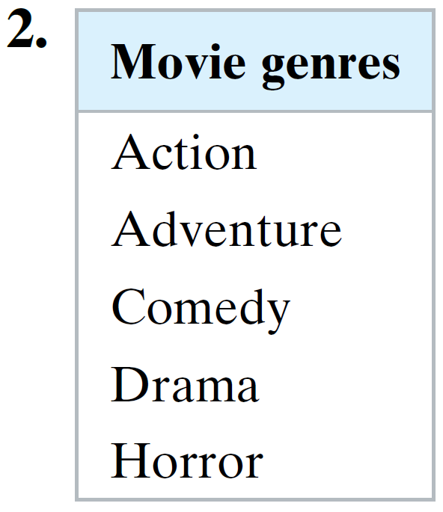
Example: Classifying Data by Level
For each data set, determine whether the data are at the nominal level or at the ordinal level. Explain your reasoning. (Source: U.S. Bureau of Labor Statistics)

Slide 11

Solution: Classifying Data by Level
Ordinal level (lists the rank of five largest job growth occupations. Data can be ordered. Difference between ranks is not meaningful.)
Nominal level (lists movie genres). No mathematical computations can be made and cannot be ranked.

Slide 12
Levels of Measurement
Interval level of measurement
Quantitative data
Data can ordered
Differences between data entries is meaningful
Zero represents a position on a scale (not an inherent zero – zero does not imply “none”)

Slide 13
Levels of Measurement
Ratio level of measurement
Similar to interval level
Zero entry is an inherent zero (implies “none”)
A ratio of two data values can be formed
One data value can be expressed as a multiple of another

Slide 14
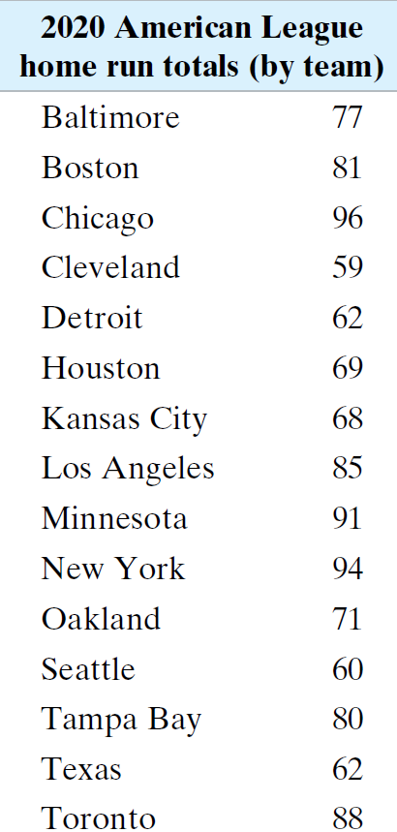
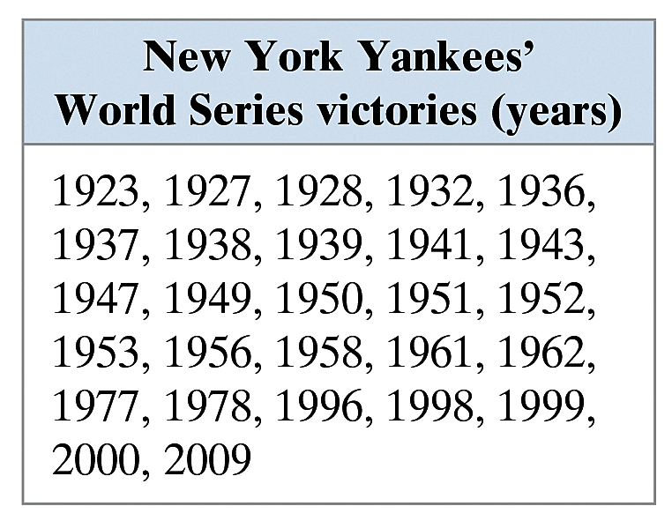
Example: Classifying Data by Level
Two data sets are shown. Which data set consists of data at the interval level? Which data set consists of data at the ratio level? (Source: Major League Baseball)

Slide 15
Solution: Classifying Data by Level
Interval level (Quantitative data. Can find a difference between two dates, but a ratio does not make sense.)
Ratio level (Can find differences and write ratios.)

Slide 16
Solution: Classifying Data by Level
Both of these data sets contain quantitative data. Consider the dates of the Yankees’ World Series Victories. It makes sense to find differences between specific dates. For instance, the time between the Yankees’ first and last World Series victories is
2009 − 1923 = 86 years.
But it does not make sense to say that one year is a multiple of another. So, these data are the interval level.

Slide 17
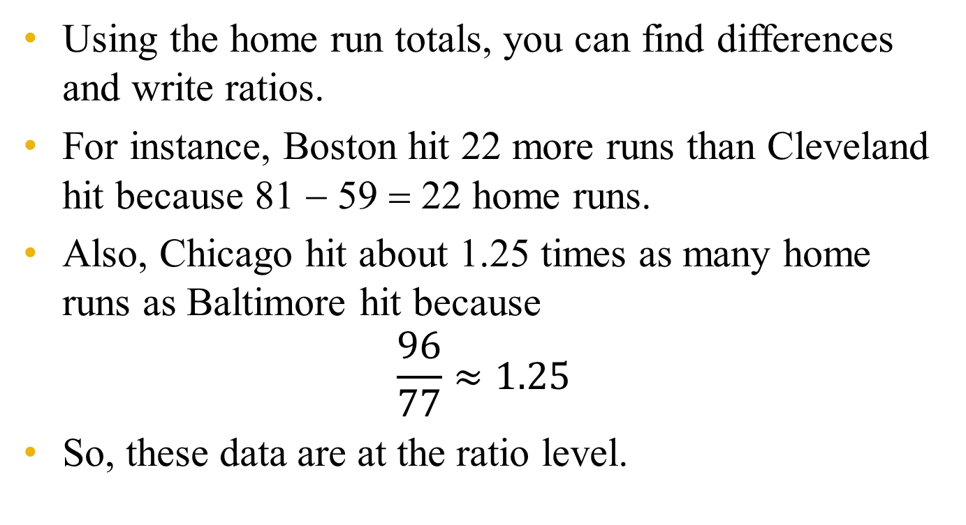
Solution: Classifying Data by Level
Using the home run totals, you can find differences and write ratios.
For instance, Boston hit 22 more runs than Cleveland hit because 81 − 59 = 22 home runs.
Also, Chicago hit about 1.25 times as many home runs as Baltimore hit because
$$\frac{96}{77}≈1.25$$
So, these data are at the ratio level.

Slide 18
Summary of Four Levels of Measurement
Level of Measurement | Put data in categories | Arrange data in order | Subtract data values | Determine if one data value is a multiple of another
Nominal | Yes | No | No | No
Ordinal | Yes | Yes | No | No
Interval | Yes | Yes | Yes | No
Ratio | Yes | Yes | Yes | Yes

Slide 19
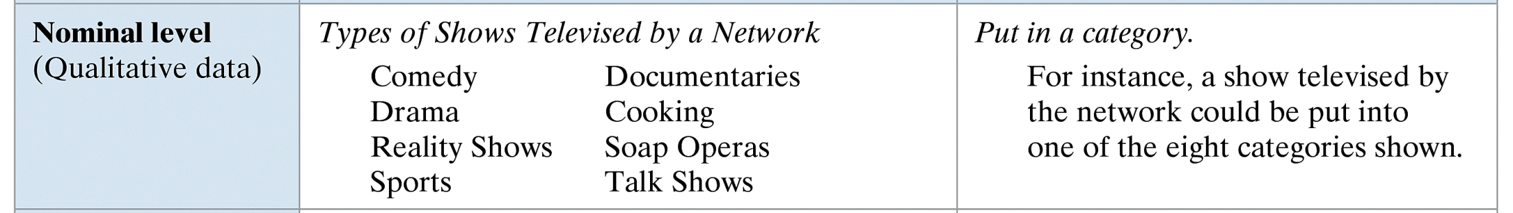
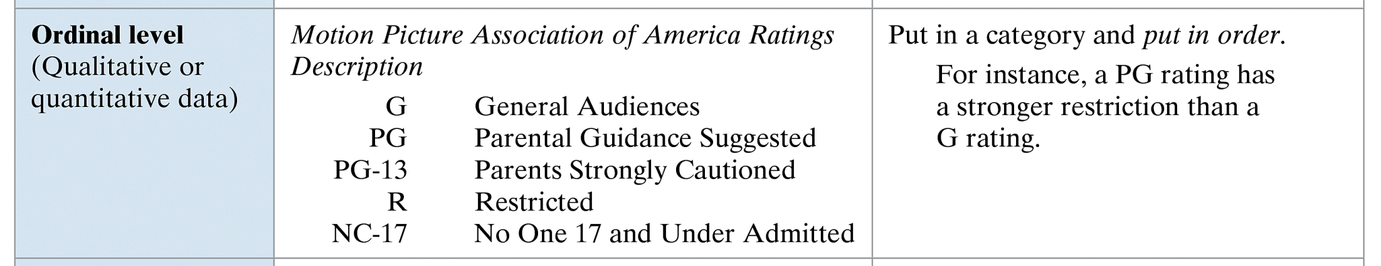
Summary of Four Levels of Measurement

Slide 20
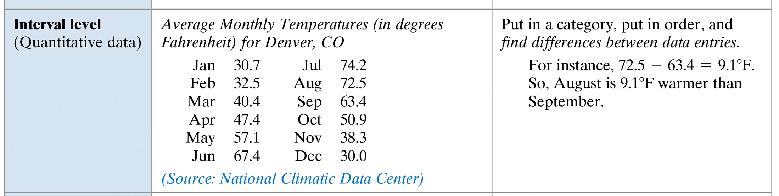
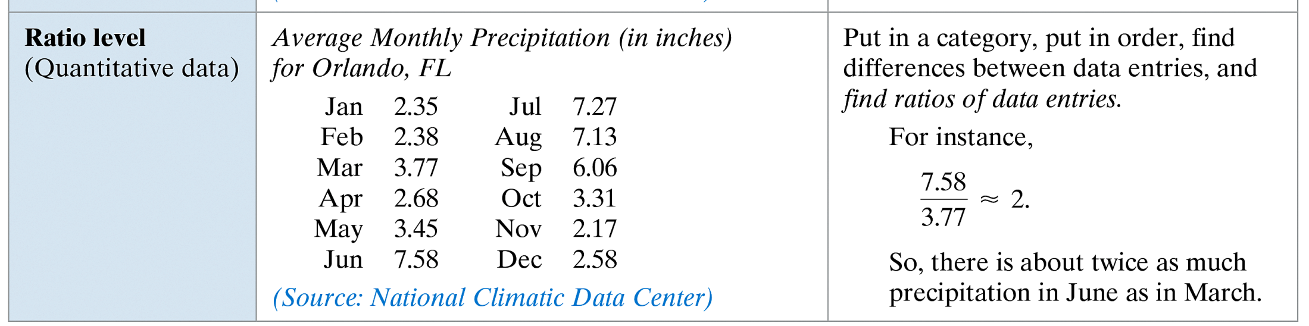
Summary of Four Levels of Measurement

Slide 21
Exercise 1
The populations of several U.S cities are shown in the table. Which data are qualitative data and which are quantitative data?
Identify the contents of each data set.
Decide whether each data set consists of numerical or nonnumerical entries.
Specify the qualitative data and the quantitative data.
City | Population
Cleveland, OH | 452,208
Detroit, MI | 886,671
Houston, TX | 2,016,582
Las Vegas, NV | 545,147
Portland, OR | 533,427
Tropeka, KS | 121,946

Slide 22
Solution 1

Slide 23
Exercise 2
Consider the following data sets. For each data set, decide whether the data are at the nominal level or at the ordinal level.
The final standings for the Pacific Division of the National Basketball Association.
A collection of phone numbers.

Slide 24
Solution 2

Slide 25
Exercise 3
Decide whether the data are at the interval level or at the ratio level.
The body temperature (in degrees Fahrenheit) of an athlete during an exercise session.
The heart rates (in beats per minute) of an athlete during an exercise session.

Slide 26
Solution 3

Slide 27
Exercise 4
Determine whether the data are qualitative or quantitative and identify the data set’s level of measurement. Explain your reasoning.
Football. The top five teams in the final college football poll released in January 2024 are listed.
1. Florida 2. Ohio State 3. LSU 4. USC 5. Boise State
Politics. The three political parties in the 110th Congress are listed below.
Republican Democrat Independent

Slide 28
Exercise 4
Determine whether the data are qualitative or quantitative and identify the data set’s level of measurement. Explain your reasoning.
Bell Schedule. The times from a high school bell schedule are listed.
8:00 A.M. 8:52 A.M. 8:56 A.M. 9:48 A.M. 9:52 A.M.
10:44 A.M. 10:48 A.M. 11:40 A.M. 11:44 A.M. 1:08 P.M.
1:12 P.M. 2:04 P.M. 2:08 P.M. 3:00 P.M.
Fish Lengths. The region (in inches) of a sample of striped bass caught in Maryland water are listed.
16 17.25 19 18.75 21 20.3 19.8 24 21.82

Slide 29
Solution 4

Slide 30
Solution 4

Slide 31
Solution 4

