Slide 1


Chapter
1
Introduction to Statistics

Slide 2
Chapter Outline
1.1 An Overview of Statistics
1.2 Data Classification
1.3 Data Collection and Experimental Design

Slide 3
Section 1.3
Data Collection and
Experimental Design
3 of 61

Slide 4
Section 1.3 Objectives
How to design a statistical study and how to distinguish between an observational study and an experiment
How to collect data by using a survey or a simulation
How to design an experiment
How to create a sample using random sampling, simple random sampling, stratified sampling, cluster sampling, and systematic sampling and how to identify a biased sample

Slide 5
Designing a Statistical Study
Identify the variable(s) of interest (the focus) and the population of the study.
Develop a detailed plan for collecting data. If you use a sample, make sure the sample is representative of the population.
Collect the data.
Describe the data using descriptive statistics techniques.
Interpret the data and make decisions about the population using inferential statistics.
Identify any possible errors.

Slide 6
Data Collection
Observational study
A researcher observes and measures characteristics of interest of part of a population.
Researchers measured the amount of time people spent doing various activities, such as paid work, childcare, and socializing. (Source: U.S. Bureau of Labor Statistics)

Slide 7
Data Collection
Experiment
A treatment is applied to part of a population, called a treatment group, and responses are observed.
Another part of the population may be used as a control group, in which no treatment is applied. (The subjects in both groups are called experimental units.) In many cases, subjects in the control group are given a placebo, which is a harmless, fake treatment that is made to look like the real treatment.

Slide 8
Data Collection
Experiment
An experiment was performed in which overweight subjects were given the artificial sweetener sucralose to drink while a control group drank water. After performing a glucose test, researchers concluded that “sucralose affects the glycemic and insulin responses” in overweight people who do not normally consume artificial sweeteners. (Source: Diabetes Care)

Slide 9
Example: Observational Study or an Experiment
Determine whether each study is an observational study or an experiment.
Researchers study the effect of vitamin D₃ supplementation among patients with antibody deficiency or frequent respiratory tract infections. 70 patients receive 4000 IU of vitamin D₃ daily for a year. Another group of 70 patients receive a placebo daily for one year. (Source: British Medical Journal)
Solution:
The study applies a treatment (vitamin D₃) to the subjects. The study is an experiment.

Slide 10
Example: Observational Study or an Experiment
Determine whether each study is an observational study or an experiment.
Researchers conduct a study to determine how confident Americans are in the economy. Researchers call 3040 U.S. adults and ask them to rate current U.S. economic conditions and whether the economy is getting better or worse. (Source: Gallup)
Solution:
The study does not attempt to influence the responses of the subjects, the study is an observational study.

Slide 11
Data Collection
Simulation
Uses a mathematical or physical model to reproduce the conditions of a situation or process.
Often involves the use of computers.
Allow you to study situations that are impractical or even dangerous to create in real life.
Often save time and money.
For instance, automobile manufacturers use simulations with dummies to study the effects of crashes on humans.

Slide 12
Data Collection
Survey
An investigation of one or more characteristics of a population.
Surveys are carried out on people by asking them questions.
Commonly done by interview, Internet, phone, or mail.
In designing a survey, it is important to word the questions so that they do not lead to biased results, which are not representative of a population.

Slide 13
Data Collection
Survey
For instance, a survey is conducted on a sample of physicians to determine whether the primary reason for their career choice is financial stability.
In designing the survey, it would be acceptable to make a list of reasons and ask each individual in the sample to select their first choice.

Slide 14
Exercise 1
Decide which method of data collection you would use to collect data for study. Explain.
A study of the effect on the human digestive system of potato chips made with a fat substitute.
A study of the effect of a product’s warning label to determine whether consumers still buy the product.
A study of how fast a virus would spread in a metropolitan area.

Slide 15
Solution 1

Slide 16
Solution 1

Slide 17
Experimental Design
Three key elements of a well-designed experiment are control, randomization, and replication.

Slide 18
Experimental Design
Confounding variables
Occurs when an experimenter cannot tell the difference between the effects of different factors on a variable.
For instance, a coffee shop owner remodels her shop at the same time a nearby mall has its grand opening. If business at the coffee shop increases, it cannot be determined whether it is because of the remodeling or the new mall.

Slide 19
Experimental Design
Confounding Variable (continued)
The placebo effect occurs when a subject reacts favorably to a placebo when in fact the subject has been given a fake treatment.
To help control or minimize the placebo effect, a technique called blinding can be used.

Slide 20
Experimental Design
Blinding
Blinding is a technique in which the subjects do not know whether they are receiving a treatment or a placebo.
Double-blind experiment neither the subject nor the experimenter knows if the subject is receiving a treatment or a placebo.

Slide 21
Experimental Design
Randomization
A process of randomly assigning subjects to different treatment groups.
Completely randomized design
Subjects are assigned to different treatment groups through random selection.
Randomized block design
Divide subjects with similar characteristics into blocks, and then within each block, randomly assign subjects to treatment groups.

Slide 22
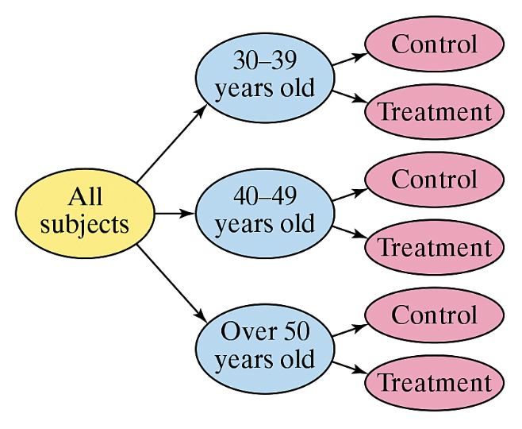
Key Elements of Experimental Design: Randomization
Randomized block design
An experimenter testing the effects of a new weight loss drink may first divide the subjects into age categories. Then within each age group, randomly assign subjects to either the treatment group or control group.

Slide 23
Experimental Design
Matched-Pairs Design
Subjects are paired up according to a similarity. One subject in the pair is randomly selected to receive one treatment while the other subject receives a different treatment.

Slide 24
Experimental Design
Sample Size
The number of subjects in a study is very important to experimental design.

Slide 25
Experimental Design
Replication
The repetition of an experiment using a large group of subjects.
For instance, to test a vaccine against a strain of influenza, 10,000 people are given the vaccine and another 10,000 people are given a placebo. Because of the sample size, the effectiveness of the vaccine would most likely be observed.

Slide 26
Example: Experimental Design
A company wants to test the effectiveness of a new gum developed to help people quit smoking. Identify a potential problem with the given experimental design and suggest a way to improve it.
The company identifies ten adults who are heavy smokers. Five of the subjects are given the new gum and the other five subjects are given a placebo. After two months, the subjects are evaluated and it is found that the five subjects using the new gum have quit smoking.

Slide 27
Solution: Experimental Design
Problem:
The sample size being used is not large enough to validate the results of the experiment.
Correction:
The experiment must be replicated to improve the validity.

Slide 28
Example: Experimental Design
A company wants to test the effectiveness of a new gum developed to help people quit smoking. Identify a potential problem with the given experimental design and suggest a way to improve it.
The company identifies one thousand adults who are heavy smokers. The subjects are divided into blocks according to gender. After two months, the female group has a significant number of subjects who have quit smoking.

Slide 29
Solution: Experimental Design
Problem:
The groups are not similar. The new gum may have a greater effect on women than men, or vice versa.
Correction:
The subjects can be divided into blocks according to gender, but then within each block, they must be randomly assigned to be in the treatment group or the control group.

Slide 30
Sampling Techniques
A census is a count or measure of an entire population.
A sampling is a count or measure of part of a population and is more commonly used in statistical studies.
Even with the best methods of sampling, a sampling error may occur. A sampling error is the difference between the results of a sample and those of the population.

Slide 31
Sampling Techniques
Random Sample
Every member of the population has an equal chance of being selected.
Simple Random Sample
Every possible sample of the same size has the same chance of being selected.
x
x
x
x
x
x
x
x
x
x
x
x
x
x
x
x
x
x
x
x
x
x
x
x
x
x
x
x
x
x
x
x
x
x
x
x
x
x
x
x
x
x
x
x
x
x
x
x
x
x
x
x
x
x
x
x
x
x
x
x
x
x
x
x
x
x
x
x
x
x
x
x
x
x
x
x
x
x
x
x
x
x
x
x
x
x
x
x
x
x
x
x
x
x
x
x
x
x
x
x
x
x
x
x
x
x
x
x
x

Slide 32
Simple Random Sample
Random numbers can be generated by a random number table, a software program or a calculator.
Assign a number to each member of the population.
Members of the population that correspond to these numbers become members of the sample.

Slide 33
Example: Using a Simple Random Sample
There are 731 students currently enrolled in statistics at your school. You wish to form a sample of eight students to answer some survey questions. Select the students who will belong to the simple random sample.
Assign numbers 1 to 731 to each student taking statistics.
On the table of random numbers, choose a starting place at random (suppose you start in the third row, second column.)

Slide 34
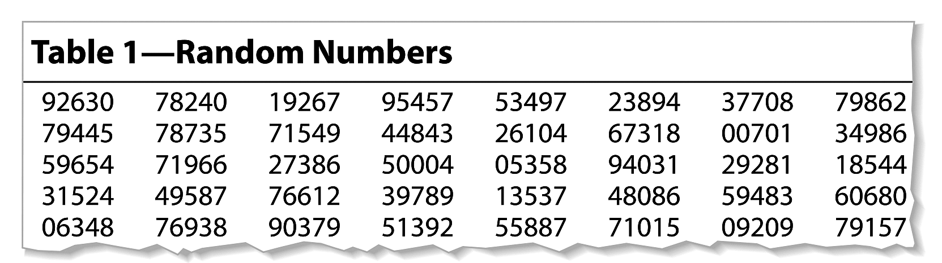
Solution: Simple Random Sample
Read the digits in groups of three
Ignore numbers greater than 731
The students assigned numbers 719, 662, 650, 4, 53, 589, 403, and 129 would make up the sample.

Slide 35
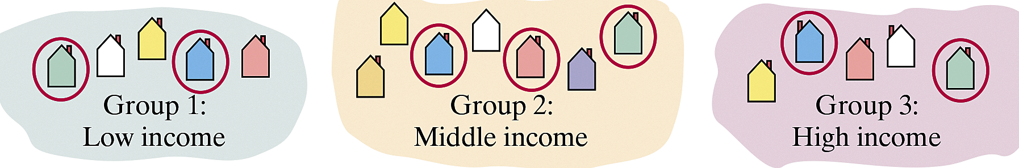
Other Sampling Techniques
Stratified Sample
Divide a population into groups (strata) and select a random sample from each group.
To collect a stratified sample of the number of people who live in West Ridge County households, you could divide the households into socioeconomic levels and then randomly select households from each level.

Slide 36
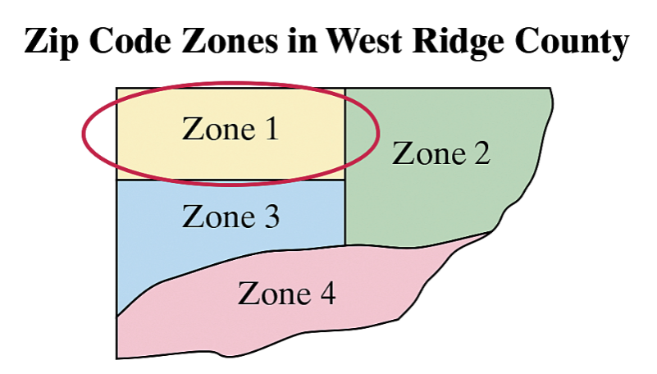
Other Sampling Techniques
Cluster Sample
Divide the population into groups (clusters) and select all of the members in one or more, but not all, of the clusters.
In the West Ridge County example you could divide the households into clusters according to zip codes, then select all the households in one or more, but not all, zip codes.

Slide 37
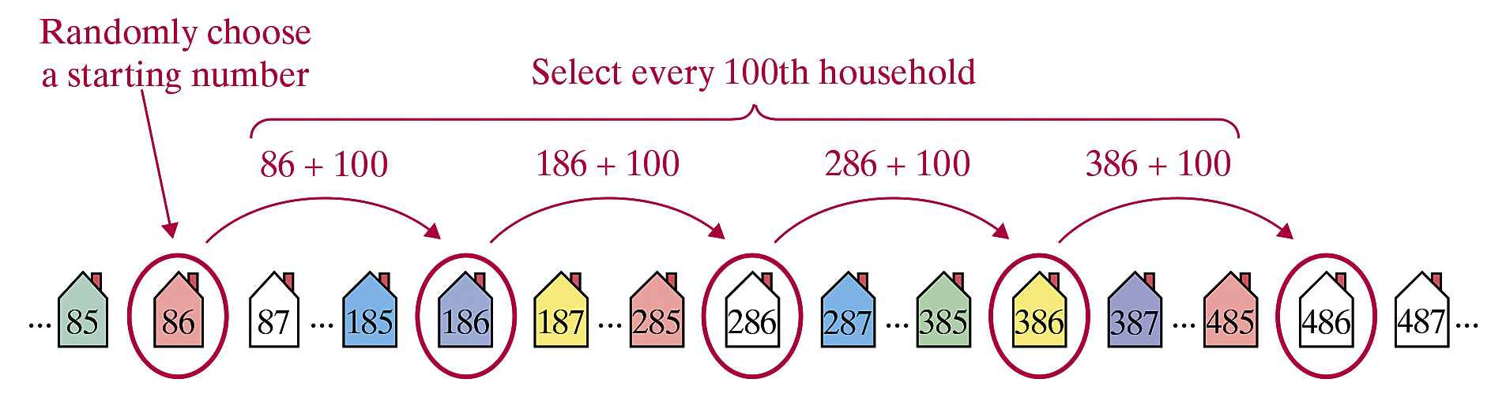
Other Sampling Techniques
Systematic Sample
Choose a starting value at random. Then choose every k^{th} member of the population.
In the West Ridge County example you could assign a different number to each household, randomly choose a starting number, then select every 100th household.

Slide 38
Other Sampling Techniques
Convenience Sample
Choose only members of the population that are easy to get.
Often leads to biased studies (not recommended).

Slide 39
Example: Identifying Sampling Techniques
You are doing a study to determine the opinion of students at your school regarding stem cell research. Identify the sampling technique used.
You divide the student population with respect to majors and randomly select and question some students in each major.
Solution:
Stratified sampling (the students are divided into strata (majors) and a sample is selected from each major)

Slide 40
Example: Identifying Sampling Techniques
You assign each student a number and generate random numbers. You then question each student whose number is randomly selected.
Solution:
Simple random sample (each sample of the same size has an equal chance of being selected and each student has an equal chance of being selected.)

Slide 41
Example: Identifying Sampling Techniques
You select students who are in your biology class.
Solution:
Because the sample is taken from students that are readily available, this is a convenience sample. The sample may be biased because biology students may be more familiar with stem cell research than other students and may have stronger opinions.

Slide 42
Exercise 2
Identify the sampling technique used.
Using random digit dialing, researcher called 1599 people and asked what obstacles (such as childcare) kept them from exercising.
Chosen at random, 500 rural and 500 urban age 65 or older were asked about their health and experience with perception drugs.
Chosen at random, 1210 hospital outpatients were contacted and asked their opinion of the care they received.

Slide 43
Exercise 2
Identify the sampling technique used.
Soybeans are planted on a 48-acre field. The field is divided into one-acre subplots. A sample of plant is taken from each subplot to estimate the harvest.
A list of managers is compiled and ordered. After a starting number is randomly chosen, every ninth name is selected until 1000 managers are selected. The managers are questioned about the use of digital media.

Slide 44
Solution 2

Slide 45
Solution 2

Slide 46
Solution 2

Slide 47
Solution 2

Slide 48
Solution 2

