Slide 1




Global temperature and terror attacks
Can we find the next location of terror attack based on temperature?
By Coral Tsarfati & Moshe Iftach

Slide 2
Why we choose this topic?
Following the recent “Shomer Ha’Homot” operation and due to the fact that for centuries terrorism is one of the most topical subject around the world, we decided to research this subject in order to try predicting where will be the next terror attack and hopefully help prevent it. We decided to choose temperature as our indicator for the next terror attack based on the question if there is a real connection between the two?
Terrorism is a type of violent struggle that is produced and turned into deliberate use of violence against civilians, in order to achieve political goals (national, socio-economic, ideological, religious, etc.)

Slide 3

Progress
Obtaining data
1
Cleaning and organizing data
2
3
EDA
4
ML & Conclusions

Slide 4
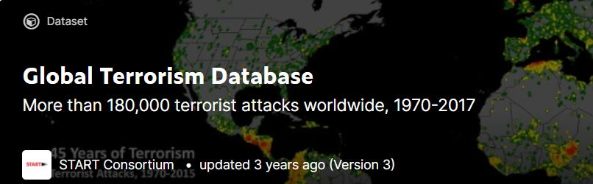

Data source
1
Terrorisms data - https://www.kaggle.com/START-UMD/gtd
This data contains a breakdown of global terrorist attacks by days
from 1917 to 2017.
Temperature data - https://www.kaggle.com/hansukyang/temperature-history-of-1000-cities-1980-to-2020
This data contains a breakdown of global temperature by days from 1980 to 2020.
The data brought from Kaggle.com

Slide 5
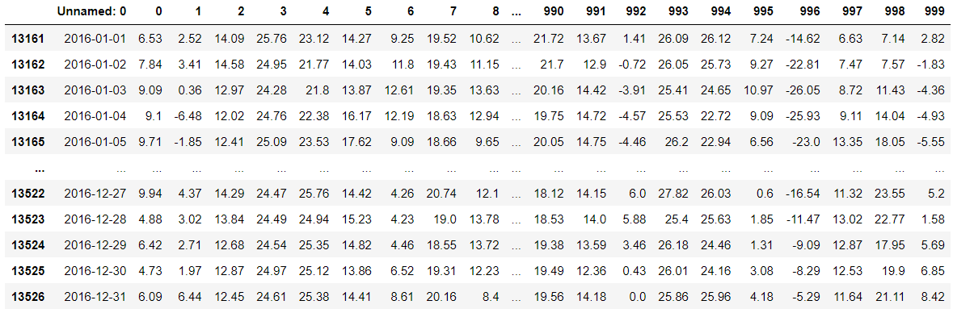
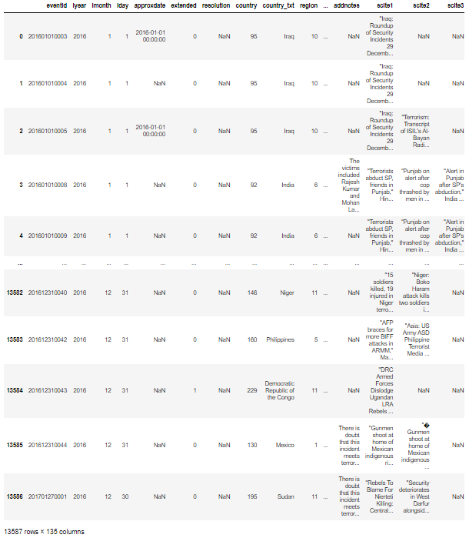
Cleaning and organizing data
2
First we noticed that the temperature data is too heavy to work with, therefore we decided to focus only on a single year and we choose 2016 considering the fact that we are not extending lower data frame less then 50,000 data.
Temperature data
Terrorism data

Slide 6
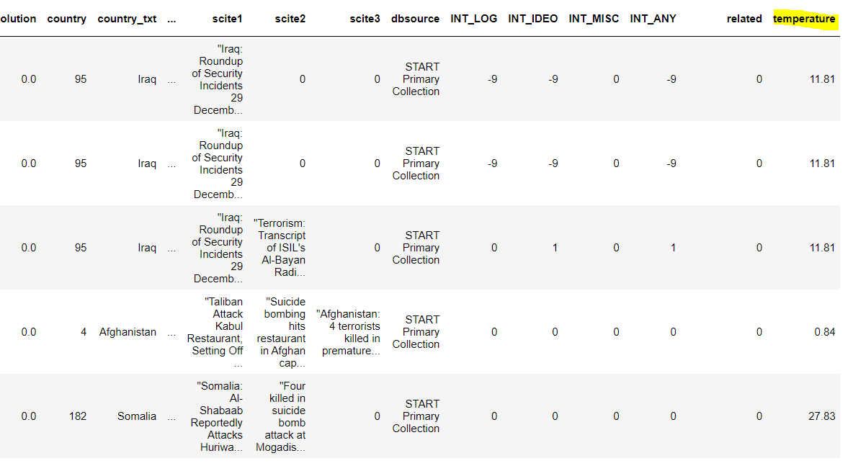
Cleaning and organizing data
2
Finding the common cities in both data frames and cleaning NA values.
Adding the temperature values to the terrorism data frame by building base data for the ML.
Terrorism data

Slide 7
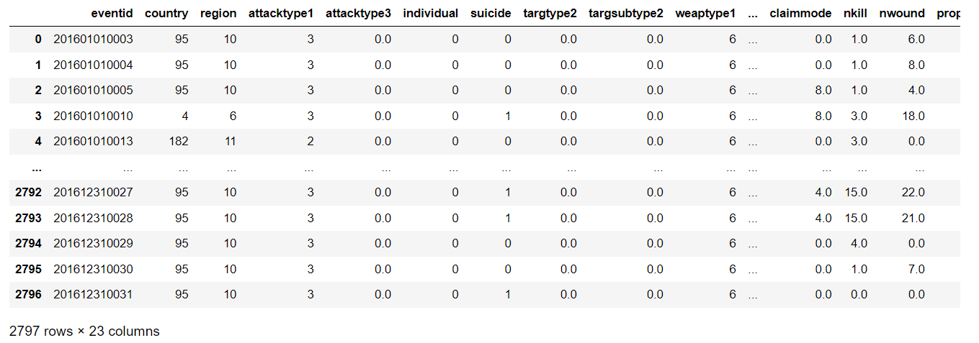
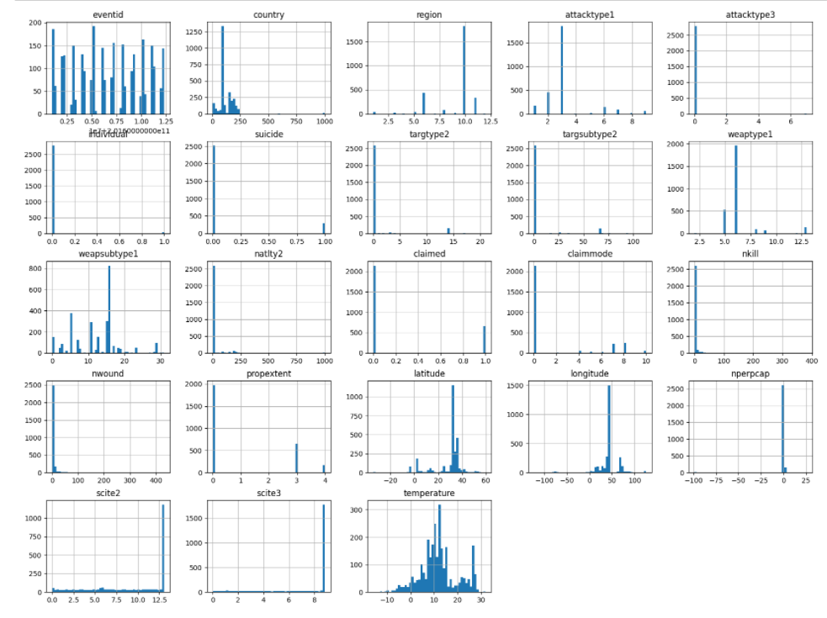
EDA
3
Finding correlation between critical variables, wounded & temperature in order that the data will be relevant for the ML prediction model. We made another dataset by only taking the values that have positive correlation greater than 0.1 and negative correlation smaller than 0.1.
Histogram of all columns of the dataset which was used in the Machine learning process
Data frame after correlation

Slide 8
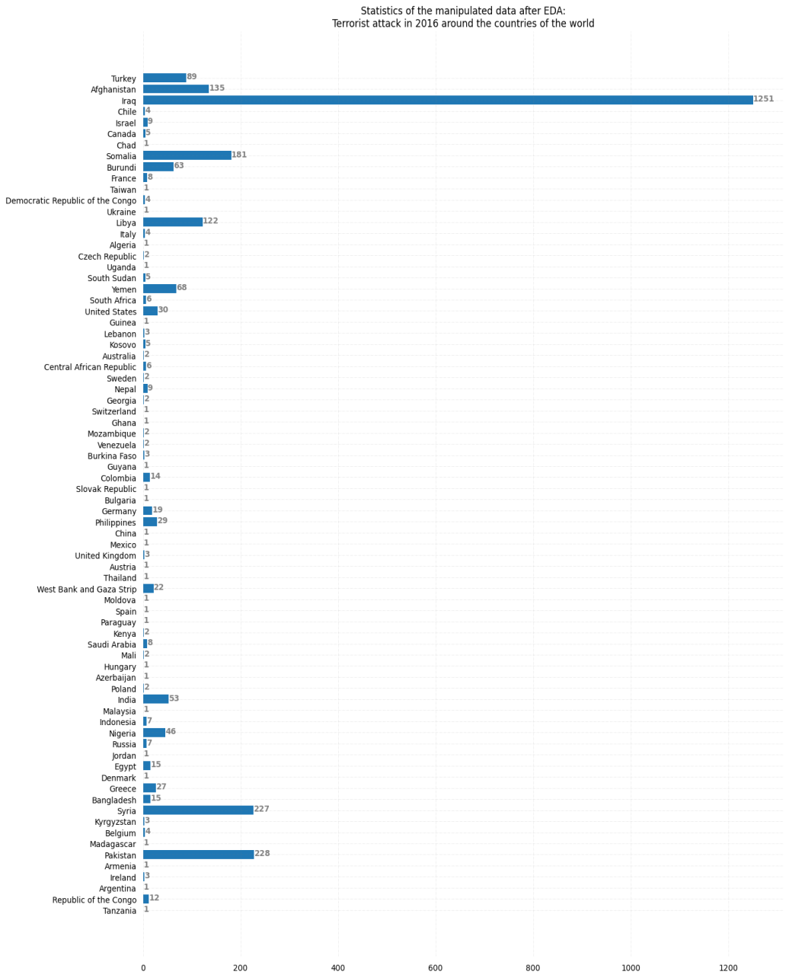
EDA
3
This statistic represent the number of total terror attacks from the list of countries we researched, we got a sort of indication where was accrued the most terror attacks.

Slide 9
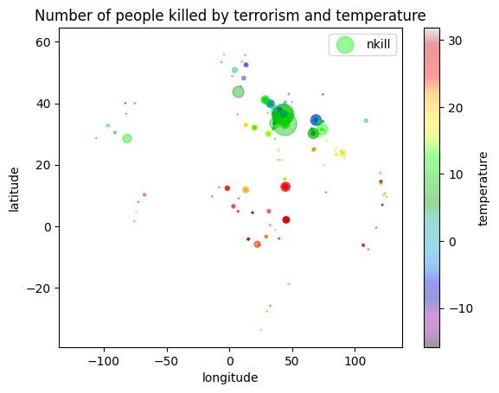
EDA
3
Finding correlation between number of kills based on temperature, we can see that most critical numbers of kill are in the range of green to red which corresponded with mid to high temperature.

Slide 10
ML & Conclusions
4
In order to get best accuracy we used Random forest regressor, decision tree regressor and SVM (kernel =linear/ rbf).
We got the maximum accuracy for Random forest regressor after Cross value score of ~79%.

Slide 11
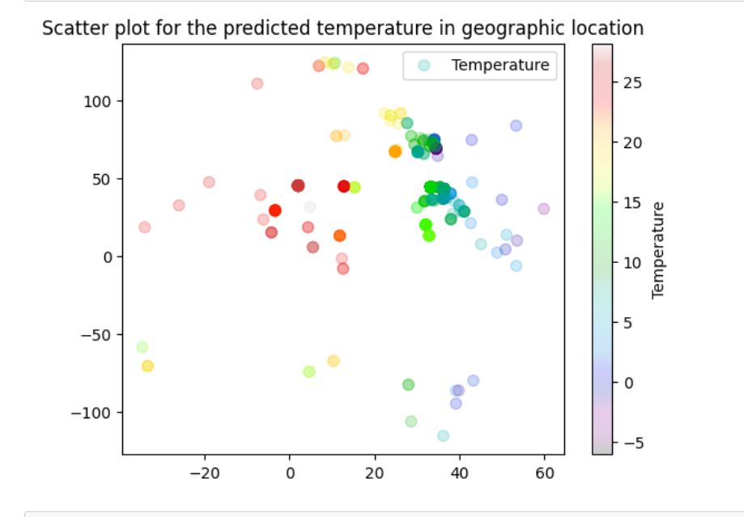
ML & Conclusions
4
Based on the Kmeans we got the plot with the predicted temperature geographic wise.

Slide 12
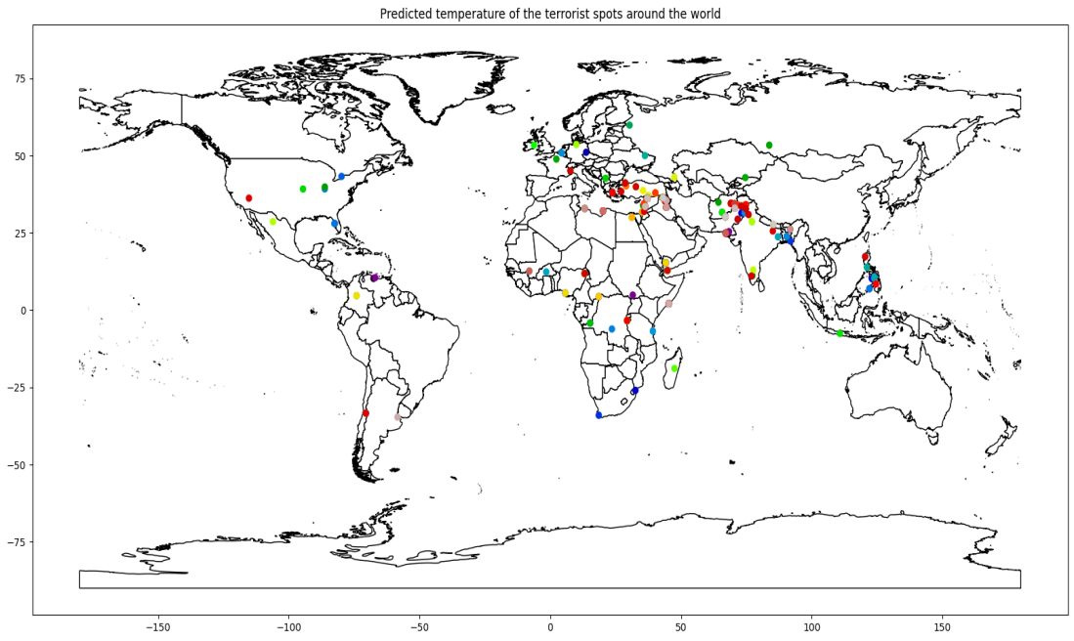
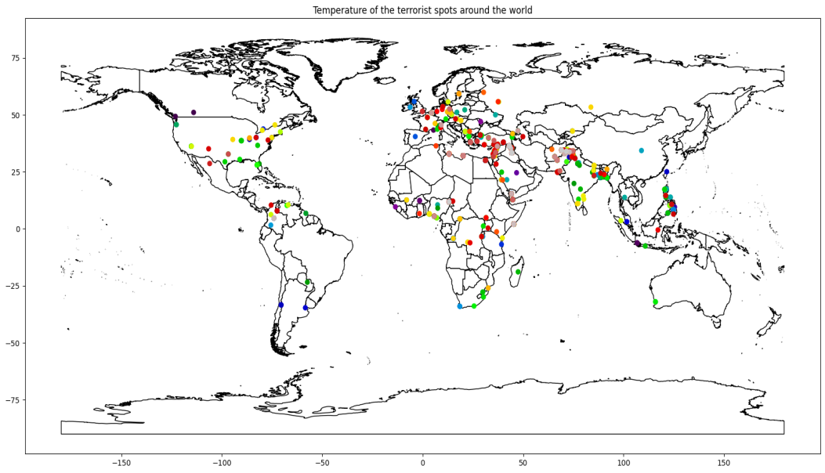
ML & Conclusions
4
Plot 1: Predicted temperature based on ML.
Plot 2: Predicted temperature vs actual temperature (2016).
Plot 1
Plot 2

