Slide 1

Understanding the Factors that Modulate the Biomedical Research Workforce
NIH Mentors:
Jake Basson, Lisa Hechtman, Anna Calcagno
Team Members:
Jingning Li, Xin Yuan
Xinyi Wang, Yunning Zhu

Slide 2
Introduction
Organization
NIGMS -The National Institution of General Medical Sciences
Exit
Background and Goals
Gap
Getting funded is never easy for members of the biomedical research workforce
NIH has found that when researchers experience time without funding, the longer researchers stay unfunded, the less likely they are to return to the NIH workforce pool
By digging deeper into NIH grants records, we aim to find key factors to better explain and predict when investigators lose or gain funding
The findings will help NIGMS efficiently allocate biomedical funds for long-term planning purposes as well as identify better ways to preserve and support researchers
NIGMS:
R01/R37
Entry
Renew
Graph: NIGMS R01/R37 grantees’ flow.

Slide 3
Problem Identification
Important Concept - Gap
A situation where a project is temporarily or permanently not funded.
Reason for Studying Gaps
When investigators experience funding gaps, they encounter financial challenges.
If an investigator is not able to continue research, NIH also loses their investment.
Other Potential Factors
· Stability of funding
· The number of concurrent projects/funding
· Number of support years
...
Notes:
Explain the graph:
1 NIH entry- threshold.
2 R01/R37 grants distributed.
3 maybe a gap (a cutoff of funds, temporarily or permanently).

Slide 4
Project Workflow, Methods & Tools
Workflow:
Methods:
Logistic Regression (Primary), Multilevel Logistic Regression & Stepwise Model Selection (Complementary)
Tools:
R, Python, JMP, Fuzzy Match/Excel
Detect Gaps
Model Construction
Validation
& Conclusion
Generate Target & Predictors
Analysis
&
Visualization
Notes:
Primary regression
Secondary and exploratory analysis

Slide 5
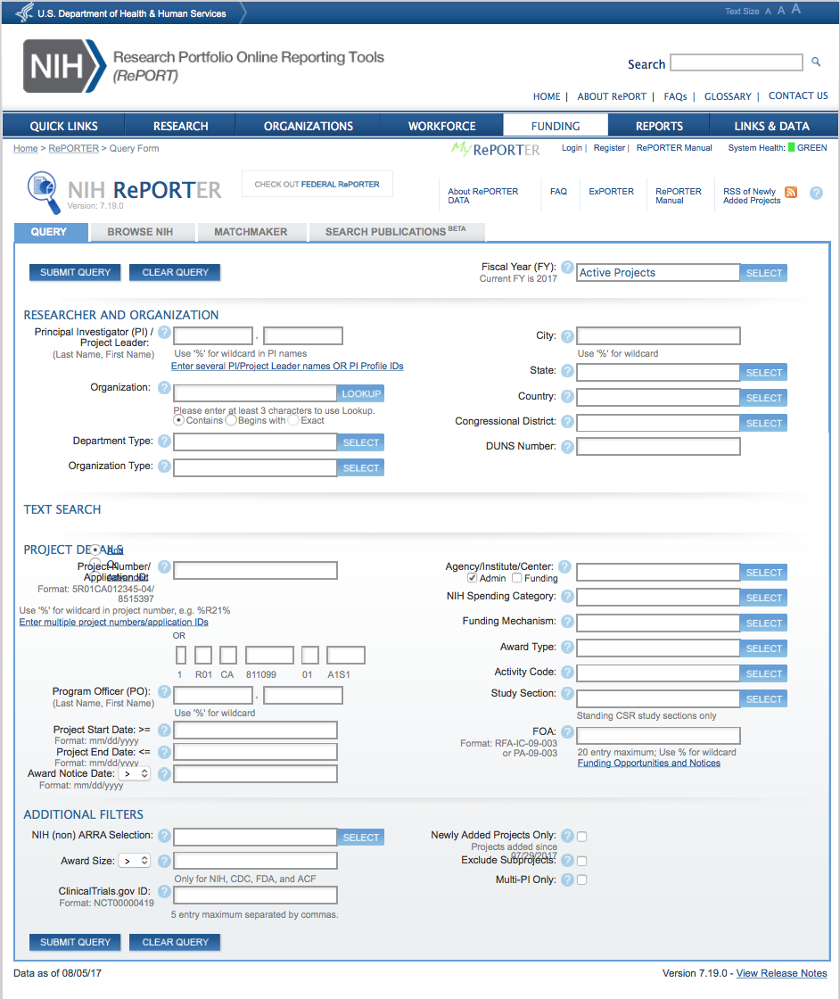
Data Overview
Main Data Source: Public Grants Database (NIH/ Federal RePORTER), containing annual records of funded projects
Time Span: From 1993 to 2015
Notes:
Application type:
· 1 = New
· 2 = Renewal
· 3 = Supplement
· 4 = extension
· 5 = non-competing continuation
· 6 = change of IC (new, training programs)
· 7 = change of grantee or training institution
· 8 = change of IC (non-competing continuation)
· 9 = change of IC (competing continuation)
Research Grants:

Slide 6
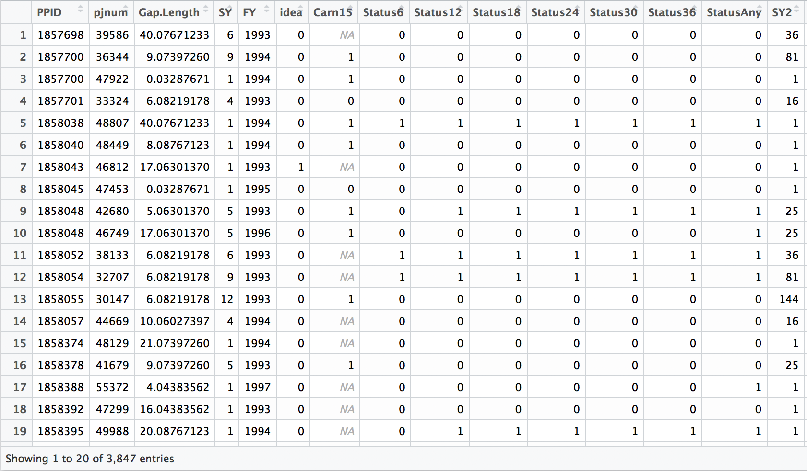
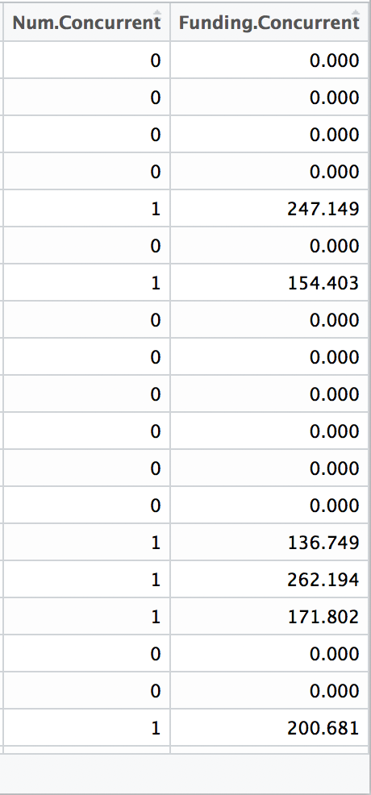
Data Overview

Slide 7
Key Concepts
Principal Investigator
(PI 1)
Let’s take
an example
Gap for Project 1
1998/1/1 is in gap
Project 1
Project 1
Gap Length: 14
Timeline
1996/9/1
1998/1/1
Principal Investigator (PI) | Project (PJ) | Gap Length
PI 1 | PJ 1 | 14
Most gaps last no longer than 4 years
Judge if one project is in gap on four specific dates:
Model Construction: 1998/1/1; 2002/1/1; 2006/1/1
Model Validation: 2010/1/1
Notes:
Gaps and gap length for key concepts
Why those the predictors important: Gap Length; Concurrent Project

Slide 8
Key Concepts
One principal investigator (PI) can have several ongoing projects at the same time
Principal Investigator
(PI 1)
Funding for Project 2: 100k Funding for Project 3: 200k
Gap for Project 1
PIs with more concurrent projects tend to have more motivation to apply for more fundings
1998/1/1 is in gap
Project 1
Project 1
Gap Length: 14
Timeline
1996/9/1
1998/1/1
Principal Investigator (PI) | Project (PJ) | Gap Length | Concurrent Projects | Concurrent Funding
PI 1 | PJ 1 | 14 | 2 | 100k + 200k
Project 2
Concurrent
Projects for Project 1
in Gap
Project 3
Notes:
Gaps and gap length for key concepts
Why those the predictors important: Gap Length; Concurrent Project

Slide 9
Key Concepts
Targets
Status 6/12/.../36:
1 ---- Re-entered within
next 6/12/.../36 months
0 ---- Hasn’t re-entered within
next 6/12/.../36 months
Status Any:
1 ---- Re-entered after gap
0 ---- Still in gap
Principal Investigator
(PI 1)
Gap for Project 1
1998/1/1 is in gap
Project 1
Project 1
Gap Length: 14
Re-entered
within 12 month
Timeline
1996/9/1
1998/7/1
1999/1/1
1998/1/1
Project 2
Principal Investigator (PI) | Project (PJ) | Gap Length | Concurrent Projects | Concurrent Funding | Status6 | Status 12 | ... | Status 36 | Status Any
PI 1 | PJ 1 | 14 | 2 | 100k + 200k | 0 | 1 |  | 1 | 1
Concurrent
Projects for Project 1
in Gap
Project 3
Notes:
Gaps and gap length for key concepts
Why those the predictors important: Gap Length; Concurrent Project

Slide 10
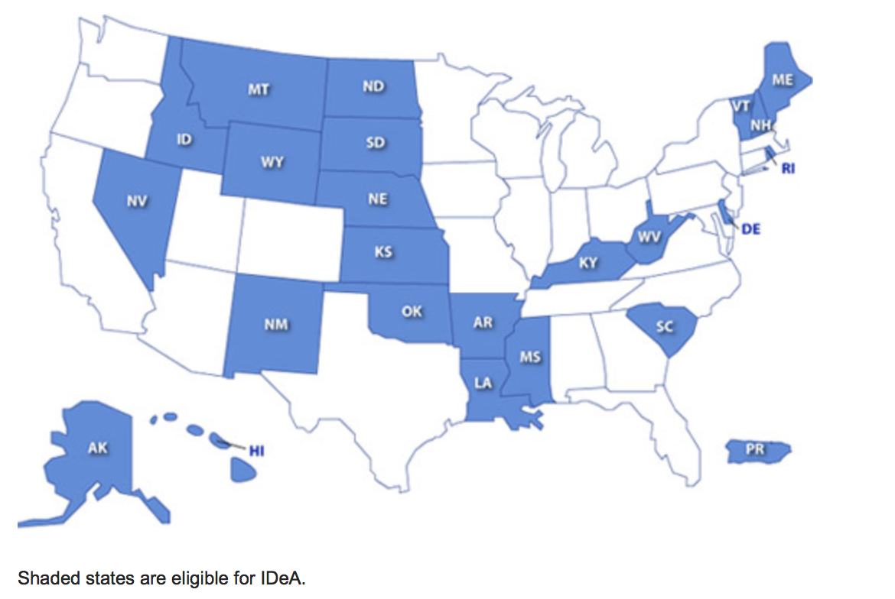
Potential Predictors
Institutional Development Award (IDeA)
“To ...enhance the competitiveness of investigators at institutions located in states in which the aggregate success rate for applications to NIH has historically been low”
IDeA: 1/0 (IDeA State/ not IDeA State)

Slide 11
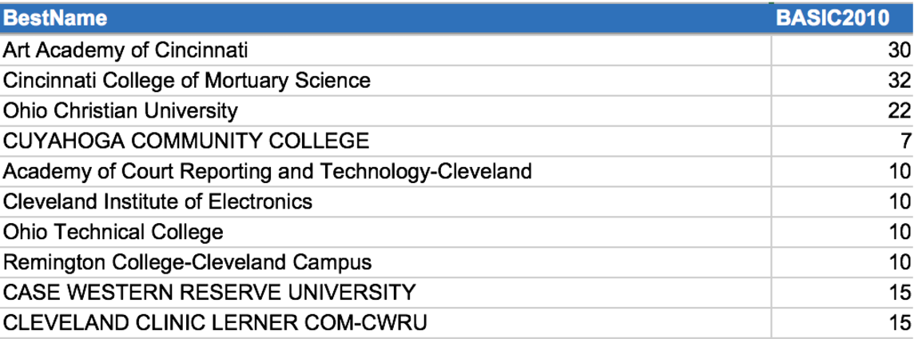
Potential Predictors
Carnegie Classification of Institutions of Higher Education
A classification system describing research activity at an institution:
Very high research activity; High research activity; Medical focus
Support Year:
Fiscal Year:
The funding year number that the project is on:
New project: support year 1
Ongoing project: support year 2, 3, etc.
Government funding year

Slide 12
Model Construction - logistic regression
Target
· Re-entry - Binary variable. Value 1 means the project re-enter the funding pool
and 0 means otherwise.
Predictors
· Support Year - Years the project has lasted.
· Gap Length - Months the project has been unfunded.
· Concurrent Funding - The amount of total funding an investigator has on
other projects while the current project is in a gap.
· Concurrent Project - The number of total concurrent projects a project has during its gap.
· IF is IDeA State - Binary variable, value 1 means the research institute is
located in an IDeA state, 0 means otherwise.
· IF Carnegie 15 - Binary variable, value 1 means institute Carnegie
code equals to 15, 0 means otherwise.
· Fiscal Year - A numeric value represents the fiscal year of project.

Slide 13
Model Construction
Preliminary Predictors
Support Year
Gap Length
Concurrent Funding
# of Concurrent Projects
If is IDeA State
If Carnegie 15
Fiscal Year
Improvement
Final Predictors
Support Year
(Support Year)²
Gap Length
Fiscal Year
# of Concurrent Projects
· Num.Concurrent and
Funding.Concurrent
have strong positive
correlation: 0.92
· SY has a quadratic,
rather than linear,
effect on Gap.Status

Slide 14
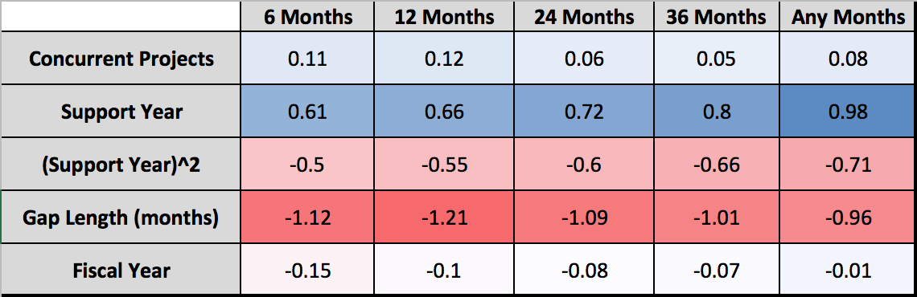
Final Model
Probability of Re-Entry ~ Support Year + Support Year² + Gap Length + Number of Concurrent Projects + Fiscal Year
Coefficients of Standardized Predictors
Notes:
Coefficients of the standardized predictors
Make point the most two important predictors and the positive and negative effect

Slide 15
Model Interpretation
In order of the importance to probability of re-entry, controlling for other variables:
· One-unit increase in Gap Length will lead to 8.556% of decrease in the relative
probability of re-entry within the next 12 months;
Reason: Longer gap means weaker projects that are more difficult to be funded again.
· One-unit increase in Fiscal Year will lead to 3.422% of decrease in the relative
probability of re-entry within the next 12 months;
Reason: NIH are more strict to applicants in recent years than before.
· One-unit increase in Number of Concurrent Project will lead to 23.759% of
increase in the relative probability of re-entry within the next 12 months;
Reason: Investigators with other work going on have a financial buffer which could help
them keep running their lab while applying to renew the project that’s in a gap.

Slide 16
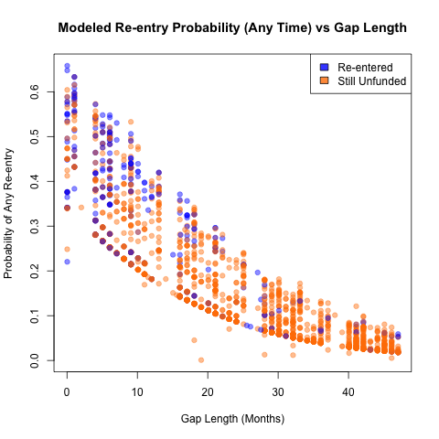
Model Interpretation
A closer look at the effect of Gap Length:
- Blue points: projects that really returned after gap
- Yellow points: projects that really didn’t come back
X-lab: Gap length in number of months
Y-lab: Re-entry probability model predicted
we could conclude:
· For those projects that did re-enter after gap, our
model gave a higher estimate of re-entry probability
· Majority of returned projects have a gap length no
longer than 15 months

Slide 17
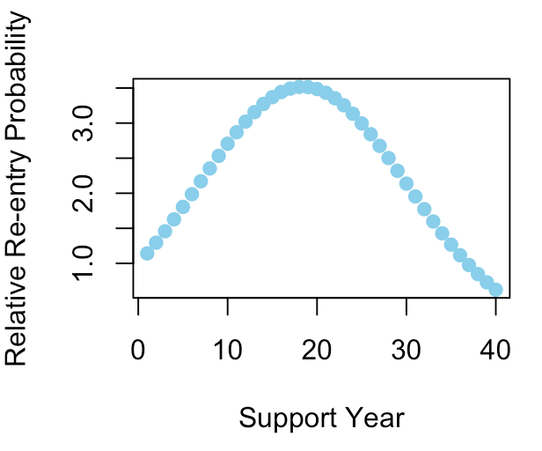
Model Interpretation
· Support Year : SY , SY²
Support Year has a quadratic effect on the Odds of Gap.status.
Turning point - about 20 years :
· Before: positive effect
Reasons: - Unsuccessful projects will end
earlier, while more successful
projects (longer ones) are
more likely to be funded again
· After: negative effect
Reasons: - Researcher’s age
- New research topics identified
About 36
Graph: effect of SY on Relative re-entry probability
Notes:
Support year and support year squared into one sentence: show the different percentage change before and after turning point

Slide 18
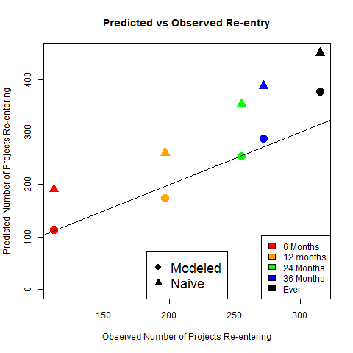
Model Validation - 2010 Dataset
Value of Naive Points = Real Returning Fraction in 1998-2006 * Number of Records in 2010 Dataset
Value of Modeled Points = Predicted Returning Fraction in 2010 * Number of Records in 2010 Dataset
Best-Estimation Line (slope = 1)
Notes:
2053 gaps in 2010
Even Using validation dataset

Slide 19
Model Validation - 2010 Dataset
Large Distances between Modeled Points and Naive Points
Modeled-points are scattering around the Best-Estimation Line
Best-Estimation Line (slope = 1)
Notes:
2053 gaps in 2010
Even Using validation dataset

Slide 20
Summary & Recommendations
Gap Length, Support Year, Number of Concurrent Projects and Fiscal Year are key factors, which significantly predict the likelihood that a project will be funded again.
The Larger the Gap Length is, the harder it would be for NIH to sustain projects that have had gaps
The relationship between Support Year and re-entry probability depends on the number of Support Years. Up until about support year 20, the relationship is positive; otherwise, it’s negative
The larger the number of Fiscal Year is, the less probability that a project would re-enter the funding pool
The More Concurrent Projects there are, the higher probability there would be for projects that have had gaps to get re-funded
Using these predictors...
NIH can detect which investigators may be at higher risk of losing funding for their projects as well as design interventions to keep investigators funded, for example, providing supporting funds during gaps.
Notes:
In order of the importance, gap length >

Slide 21
Future Directions
Estimating application volume in the future, based on current funded projects and the percentage of the all those expired projects that returned historically.
Identifying a reasonable time range for inspection. Of those projects that successfully get funded, how many may drop off in different periods of time and how far to look forward.
Providing insights for generating new predictors with complementary data that only NIH have access to, e.g. trial-and-fail funding application data.
Tagging “High-Risk Group” with more private data about investigators to better classify them. Features such as gender, race, age...

Slide 22
Thanks!
&
Questions?

Slide 23
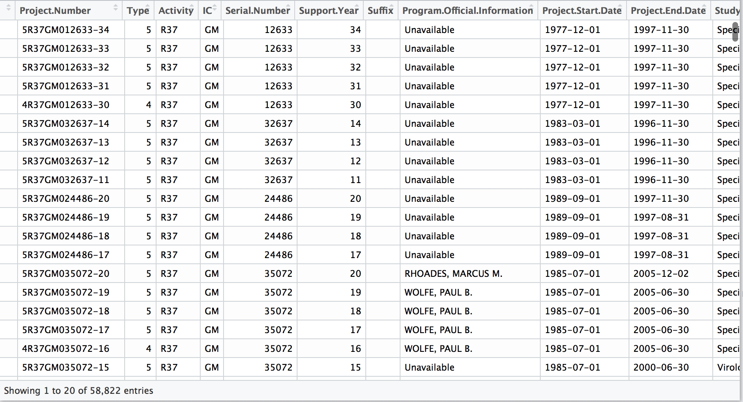
Appendix
Metadata:
NIGMS_R01_R37_93_08 : 58822 x 47
Notes:
Loglikelihood
Stepwise Table

Slide 24
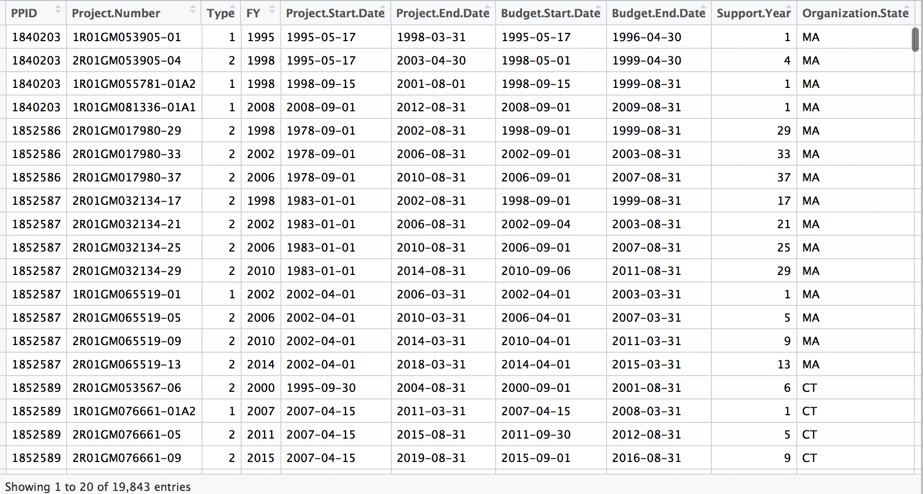
Appendix
Metadata:
IGMS_R01_R37_09_15 : 19843 x 47

Slide 25
Model Construction
· Model Selection: Multilevel Logistic Model Logistic Model
Upper Level: PPID
Reasons for using logistic regression finally:
Logistic regression model is more stable and doesn’t have to adjust its parameters according to new sample before making predictions.
Since very few investigators have more than one projects, so the effect of their characteristic can be ignored.
Records: Gaps

Slide 26
Appendix
Within different months, when controlling for other predictors, 1unit increase in predictors will lead the odds of re-entry:
Predictors | % of change in Odds of re-entry (months)
 | 6 | 12 | 24 | 36 | Any
Gap Length | -7.937 | -8.556 | -7.754 | -7.179 | -6.837
# of Concurrent Project | 21.593 | 23.759 | 11.902 | 10.063 | 16.442
Fiscal Year | -5.148 | -3.422 | -2.709 | -2.360 | -0.248
Support Year | 8.829 | 9.615 | 10.447 | 11.761 | 14.643
(Support Year)² | -0.261 | -0.288 | -0.313 | -0.345 | -0.370
Notes:
Focus on one column
English language and sentence: gap length; fiscal year and # of concurrent projects ; explain the importance of the variables and its practical meaning
Eg: NIH becomes harder on providing funding in most recently years than before
Just mention support year is complicated, mention later

Slide 27
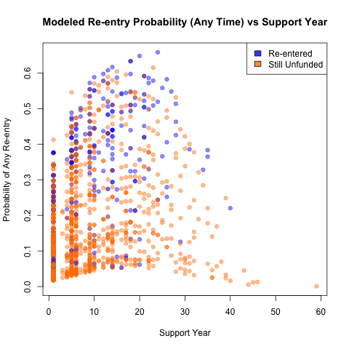
Appendix
Notes:
Significant variables to be emphasized

Slide 28
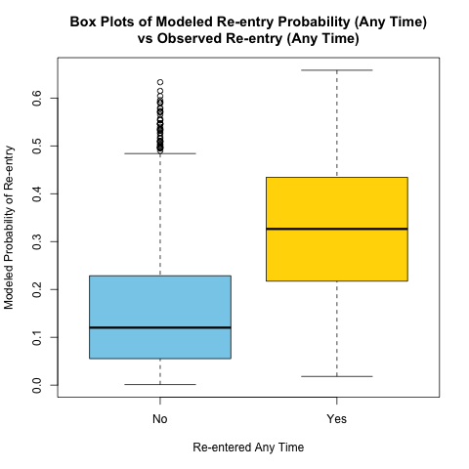
Appendix
Model Validation - Using 2010 data
The probability model predicted for project actually re-entered is higher than those for project didn’t re-entered

Slide 29
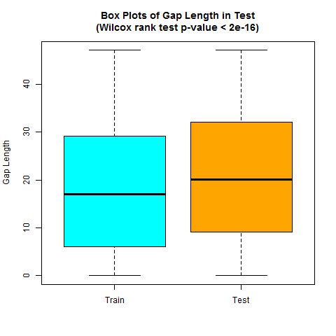
Appendix
Model Validation - Using 2010 data
General Gap Length in the training dataset (1998,2002, 2006) is different from in test dataset (2010).
Gap Length has increased from 1998 to 2010.

